Slide 1
Human Performance Improvement:
Minimizing the Impact from Errors We All Make
Brian C Legg, Ed.S.
System Operations Training
OTS 2018

Slide 2
Overall Learning Objectives
Recognize organizational, cultural factors associated with human performance error
Identify tools that minimize risk related to human performance error
Identify management’s role in reducing human performance errors
Notes:
https://youtu.be/w4jI97DiHF8
Kevin Spills Chili

Slide 3
What is Human Performance… and Why do we need to Improve it?
An individual…
working within organizational systems…
to meet expectations set by leaders.

Slide 4
HPI Principles
People are fallible
Error-likely situations are predictable
Individual behaviors can be influenced
Operational upsets can be avoided
People achieve high levels of performance based on encouragement and reinforcement

Slide 5
Two Types of Errors
Active Errors change equipment, system or processes that trigger immediate undesired consequences.
Latent Errors result in undetected organization-related weaknesses or equipment flaws that lie dormant.

Slide 6
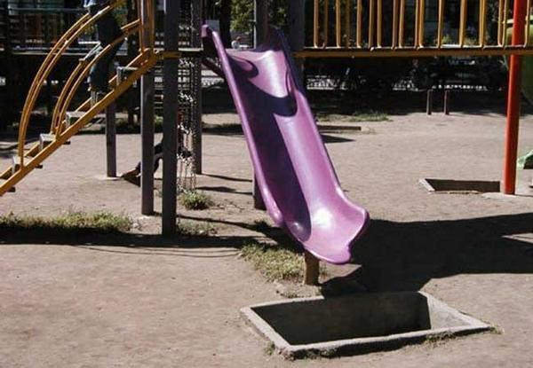
Notes:
Example of Latent Error

Slide 7
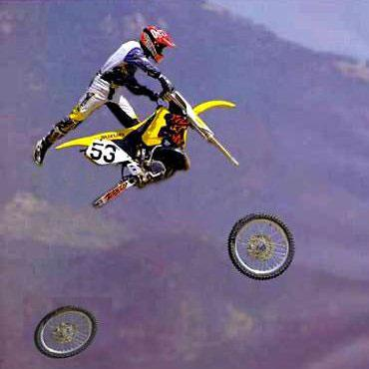

Slide 8
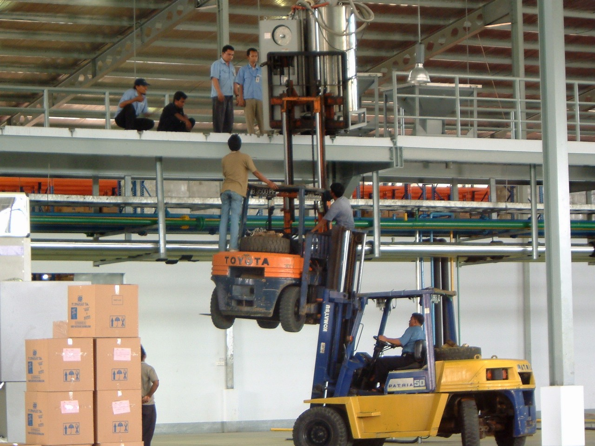
Notes:
Ask:
What is wrong with this picture?
Why do you think they are doing it this way?
Do you suppose their could be a culture of “get ‘er done” going on with this organization?
Is it “good enough” if nobody gets hurt?
Recognize organizational, cultural factors associated with human performance error

Slide 9
How good is good enough?
Is 99.9% good enough?
1 hour of unsafe drinking water per month
2 unsafe landings per day in Atlanta, GA
50 dropped babies per day
116,000 lost pieces of mail per hour
20,000 incorrect drug prescriptions per year
22,000 checks deposited in wrong accounts per hour

Slide 10
Origins of Human Error
Human Errors
Operational Upsets
30%
Slip, Trip or Lapse
Equipment Failures
70%
System Induced Error
10%
90%
Human Error
Notes:
90% of workplace accidents or Operational Upsets are attributed to Human Errors. But of those human errors, only 30% were actually the person’s fault. The Lion’s share of accidents are actually caused by the organizational setup or culture.
Recognize organizational, cultural factors associated with human performance error

Slide 11
Limitations of Human Nature
Stress
Avoidance of mental strain
Inaccurate mental models
Limited working memory
Limited attention resources
Mind set
Difficulty seeing own errors
Limited perspective
Susceptible to emotion
Focus on the goal
Fatigue
Notes:
Recognize organizational, cultural factors associated with human performance error

Slide 12
Hazardous Attitudes
Pride: “Don’t insult my intelligence.”
Heroic: “I’ll get it done, by hook or by crook.”
Invulnerable: “That can’t happen to me.”
Fatalistic: “What’s the use?”
Bald Tire: “Gone 60K miles without a flat yet.”
Summit Fever: “We’re almost done.”
Pollyanna: “Nothing bad will happen.”

Slide 13
Error Prevention Tools
Self-checking
Peer-checking
Concurrent verification
Independent verification
Three-part communication
STAR (Stop-Think-Act-Review)
Pre-job briefing
Post-job briefing
Procedure use & adherence
Problem-solving
Questioning attitude
Conservative decision making
Stop & collaborate
Notes:
Identify tools that minimize risk related to human performance error

Slide 14
Communicating is Easy!
Notes:
https://youtu.be/QJq_yFjKyRE
Before Video Ask:
Look for the error-likely precursors in this video!
After Video Ask:
What did you see that set up this poor Groot employee for failure?
What could have helped?

Slide 15
Old View of Human Error vs. New View
Old View
New View
Human error is a cause of accidents
To explain failure, investigations must seek failure
They must find people’s inaccurate assessments, wrong decisions and bad judgments
Human error is a symptom of trouble deeper inside a system…
To explain failure, do not try to find where people went wrong.
Instead, find how people’s assessments and actions made sense at the time, given the circumstances that surrounded them.
Notes:
Recognize organizational, cultural factors associated with human performance error
Identify tools that minimize risk related to human performance error

Slide 16
Human Error vs. System
Notes:
https://youtu.be/7C-vYY3SBDE
Before Video Ask:
Look for the error-likely precursors in this video!
After Video Ask:
What did you see that set up this poor German Coast Guard employee for failure?
What could have helped?

Slide 17
Understanding Events
Incentives are the cornerstone of human behavior
Dramatic events often have distant even subtle causes
Conventional wisdom is often wrong
Knowing what to measure and how to measure it makes a complex world much less complicated
Notes:
Recognize organizational, cultural factors associated with human performance error

Slide 18
Organizational Processes
Workplaces and organizations are easier to manage than the minds of individual workers.
You cannot change the human condition, but you can change the conditions under which people work.
— Dr. James Reason
Notes:
Recognize organizational, cultural factors associated with human performance error

Slide 19
How We Typically View Human Error
Number of errors is relative to the severity of consequences
For every major accident there are many errors
Leads us to assume that driving down errors will eliminate major accidents
Notes:
Identify management’s role in reducing human performance errors

Slide 20
Another Way to View Human Error
The consequence of error has no relationship to the number of errors
It is related to the number and integrity of defenses
Any error can lead to a major accident if defenses fail
Notes:
Identify management’s role in reducing human performance errors

Slide 21
The Managers Role in Reducing Human Error
Operational upsets can be avoided by understanding the reasons mistakes occur and applying the lessons learned from past events.
Notes:
Identify management’s role in reducing human performance errors

Slide 22
Blame Cycle
Human Error
Individual counseled and/or disciplined
Reduced trust
Less communication
Management
less aware
Latent organizational weaknesses persist
More flawed defenses and error precursors

Slide 23
Accountability vs Culpability
Accountability
Culpability
The power to accomplish performance objectives
vs.
The blame for failure
A starting point for improvements
vs.
A dead end that discourages reporting
Arises from empowerment and partnership
vs.
Is disempowering and divisive
Notes:
Identify management’s role in reducing human performance errors

Slide 24
Managers Can Encourage a Performance Culture
Encourage Reporting: Value errors as leading safety data
Create a Just Work Environment: Don’t try and punish errors out of the system
Flexibility: Prepare workers to adapt effectively to changing demands
Learning: Create opportunities for observation, reflection, and feedback
Notes:
Identify management’s role in reducing human performance errors

Slide 25
Leaders Influence Protection vs Production
What they pay attention to, measure, and control
Their reactions to critical incidents or crises
The allocation of resources
Their criteria for allocation of rewards and punishment
Their criteria for selection, advancement, and termination
Their deliberate attempts to coach or model behaviors

Slide 26
Implementing HPI
HPI is not just training
It is a way of doing business that includes:
Behavioral observation and walk-arounds
Conduct of operations and work management
Systems development and re-engineering
Issues reporting, management and corrective actions
Event investigation and lessons learned
Performance management and assurance
Simulations and training
Notes:
Identify management’s role in reducing human performance errors

Slide 27
Overall Learning Objectives
Recognize organizational, cultural factors associated with human performance error
Identify tools that minimize risk related to human performance error
Identify management’s role in reducing human performance errors
27

