Slide 1
Extreme Natural Events
Kristi Hobbs
ERCOT Director, Enterprise Risk Management & Strategic Analysis
2018

Slide 2
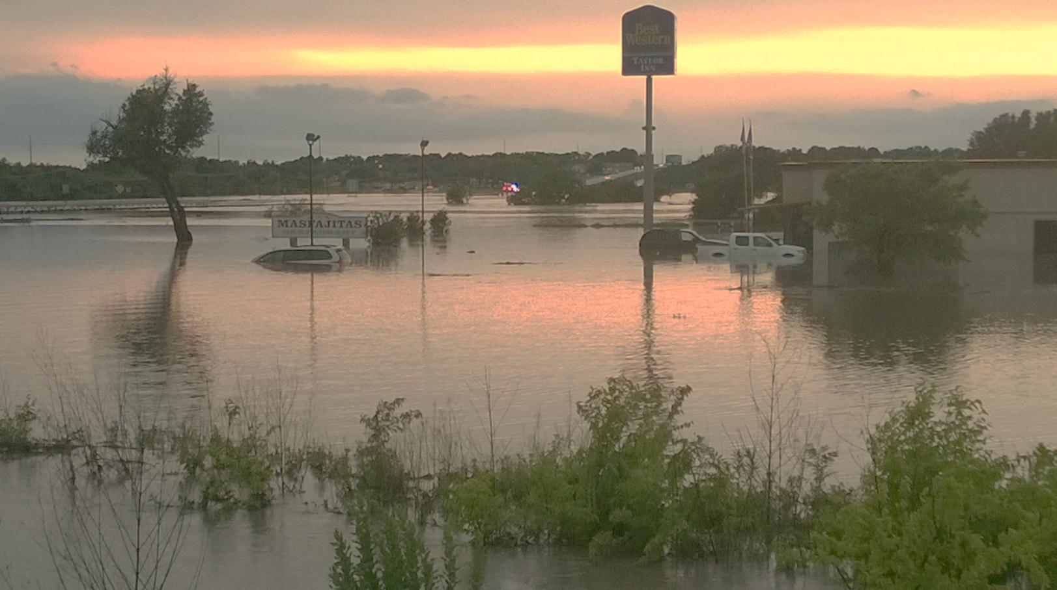
It’s NOT a matter of IF…
Notes:
Memorial Day Floods – May 2013

Slide 3
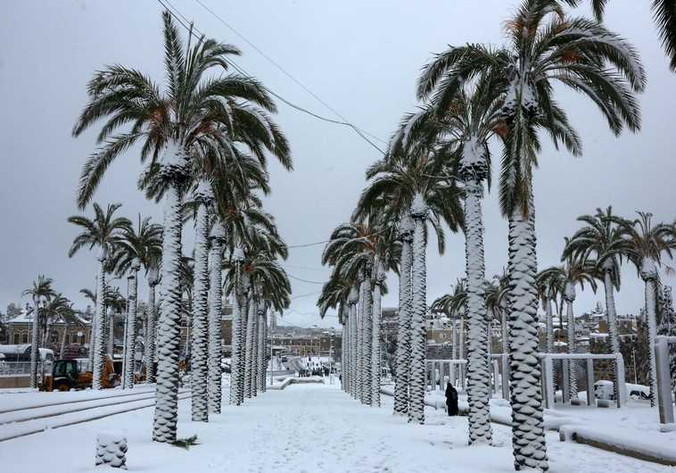
It’s a matter of WHEN.
Notes:
Texas Coastal Snow – Christmas 2004

Slide 4
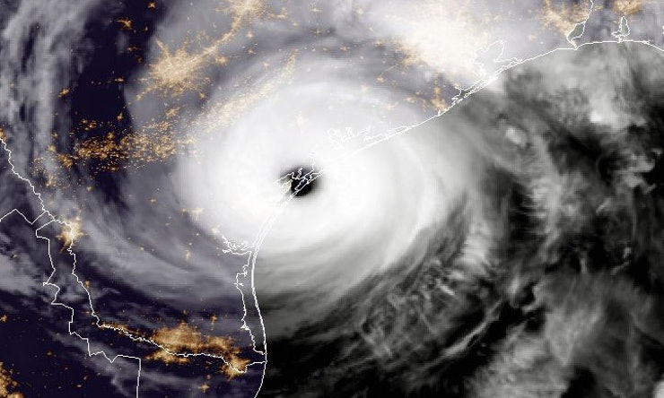
It’s not a matter of IF a disaster will strike…
Notes:
Hurricane Harvey – satellite image from NASA

Slide 5
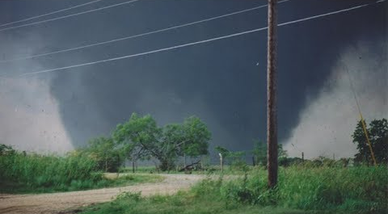
It’s a matter of WHEN a disaster will strike.
Notes:
Jarrell – F5 tornado May 27, 1997

Slide 6
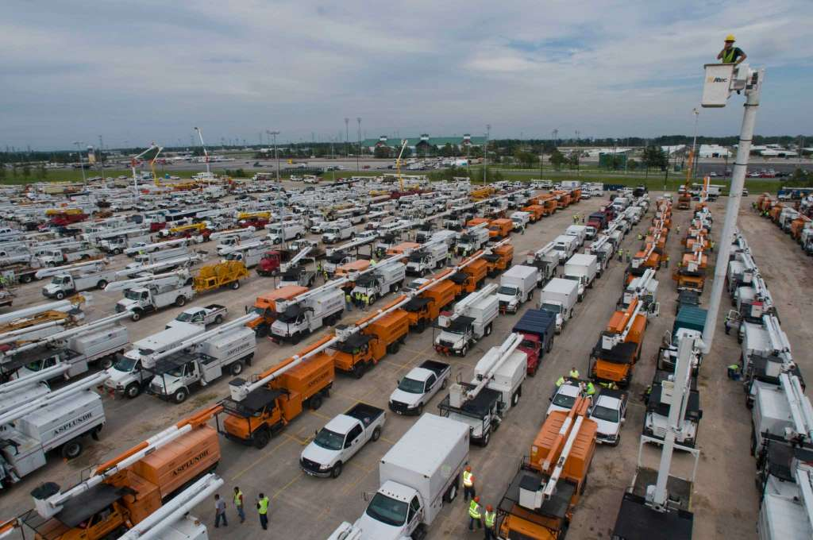
And will we be prepared?
Notes:
Thousands of linemen and tree service workers arrive and are dispatched from Sam Houston Race Park – Harvey 2017

Slide 7
Objectives
Identify extreme natural events threatening the ERCOT region.
Identify what actions the Transmission Operator, Qualified Scheduling Entity (QSE) and ERCOT should take to ensure reliability during an extreme natural event.
Identify critical relationships for coordinated disaster recovery.
Recognize types of information required by outside agencies in an extreme natural event.

Slide 8
Potential Threats to the ERCOT Region
Identify extreme natural events threatening the ERCOT region.
Notes:
Everything is bigger in Texas and with a geography this size, the number of potential extreme natural events we must prepare for are just as large. If you don’t like the weather, just give it a few minutes…it will change.
Every Texan lives in a county that was affected by at least one federally-declared weather disaster since 2010.
(hurricane, flood, tornado, extreme cold (ice and snow), extreme heat (temp & drought), wind, fire, earthquakes and geomagnetic disturbances).

Slide 9
Hurricane
Since 1900, 48 hurricanes have made landfall in Texas.
Notes:
48 hurricanes to make landfall in TX since 1900
2 category 4 hurricanes on record that have made landfall in Texas (Carla 1961 and Harvey 2017)
2.4 avg # years b/t landfall; largest gap was 10 yrs (1989-1999); 9 years b/t Ike and Harvey
June 8; July 5; August 17; Sept 15; Oct 3

Slide 10
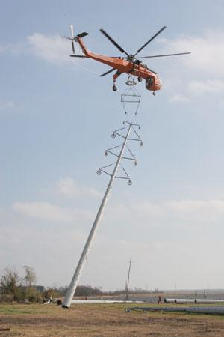
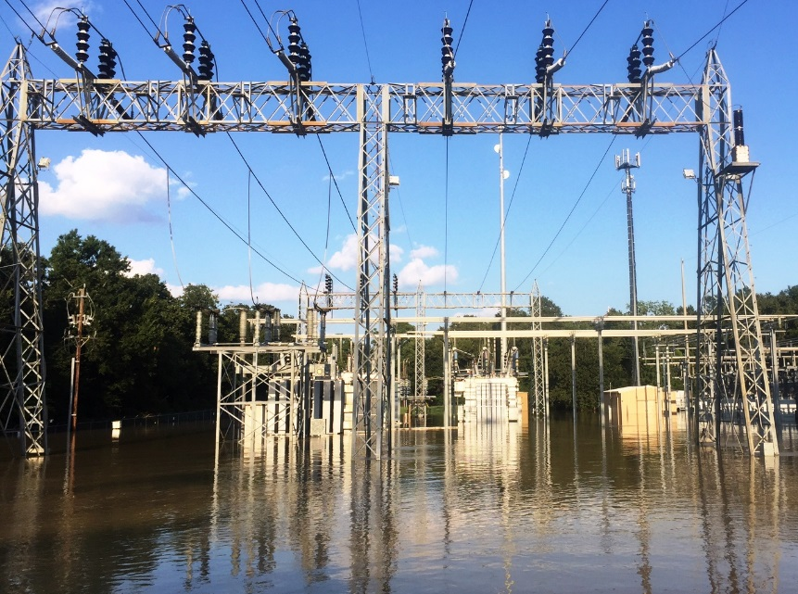
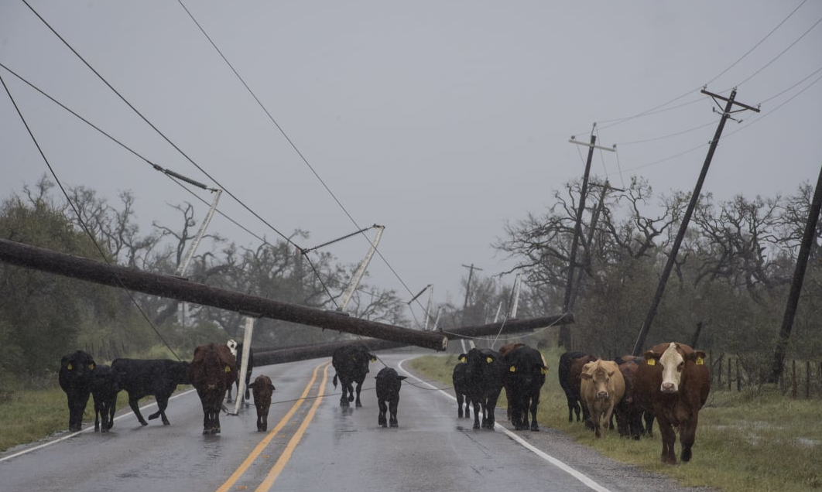
Hurricane
Average 2.4 years between landfalls
Largest gap: 10 years (1989-1999)
Notes:
2.4 avg # years b/t landfall; largest gap was 10 yrs (1989-1999); 9 years b/t Ike and Harvey
Pics: Rita – 2 top; Harvey – 2 bottom

Slide 11
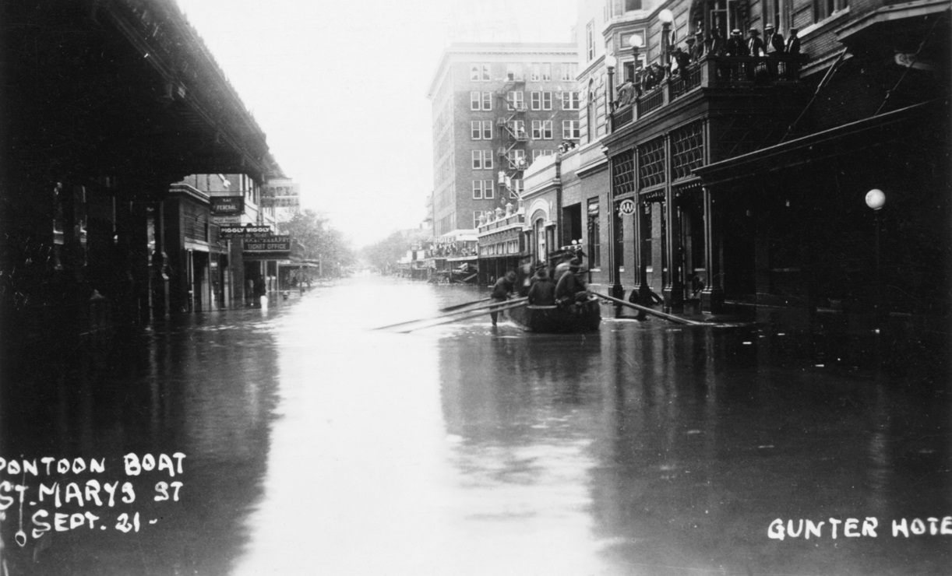
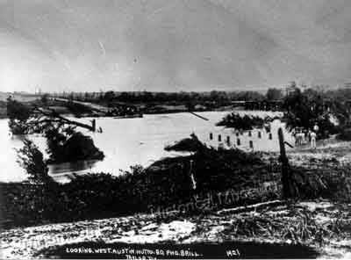
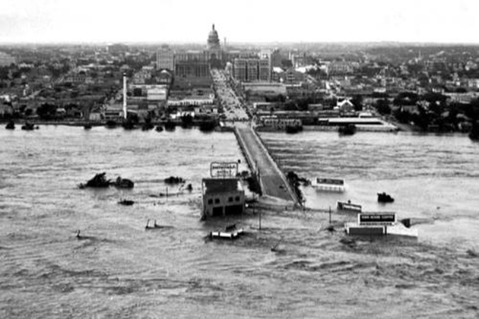
Flood
September 1921:
Thrall, TX received 38.2 inches within 24 hours
215 recorded deaths
1935 – South Congress
Notes:
On September 9 and 10, 1921, the remnants of a hurricane moved over Williamson County. The center of the storm became stationary over Thrall, dropping a storm total of 39.7 inches (1,010 mm) of rain in 36 hours. This storm caused the most deadly floods in Texas, with a total of 215 fatalities.
Left – Taylor 1921
Right top – SA 1921
Right bottom – Austin 1935

Slide 12
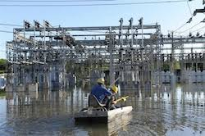
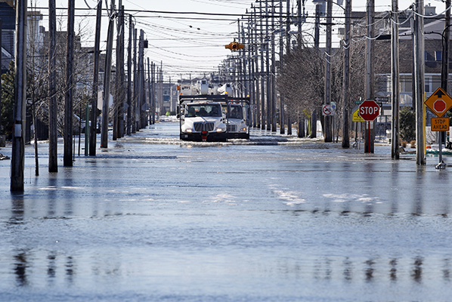
Flood
August 2017:
Cedar Bayou – 51.88 inches (new record for hurricane in lower 48)
Average yearly rainfall at IAH is 49.76 inches
Estimated 15-20 trillion gallons of water
Notes:
Victoria electric coop truck in water – Harvey
August 2017 – Hurricane Harvey: NOAA reported that Cedar Bayou, Texas received 51.88 inches of rain. This marks a new rainfall record for any tropical storm or hurricane in the lower 48 states. ... largest economic U.S. natural disaster (certainly the costliest hurricane).“Forecasters estimate Harvey dumped about 15 to 20 trillion gallons of water across Texas. For comparison – average yearly rainfall at Houston Intercontinental is 49.76 inches.

Slide 13
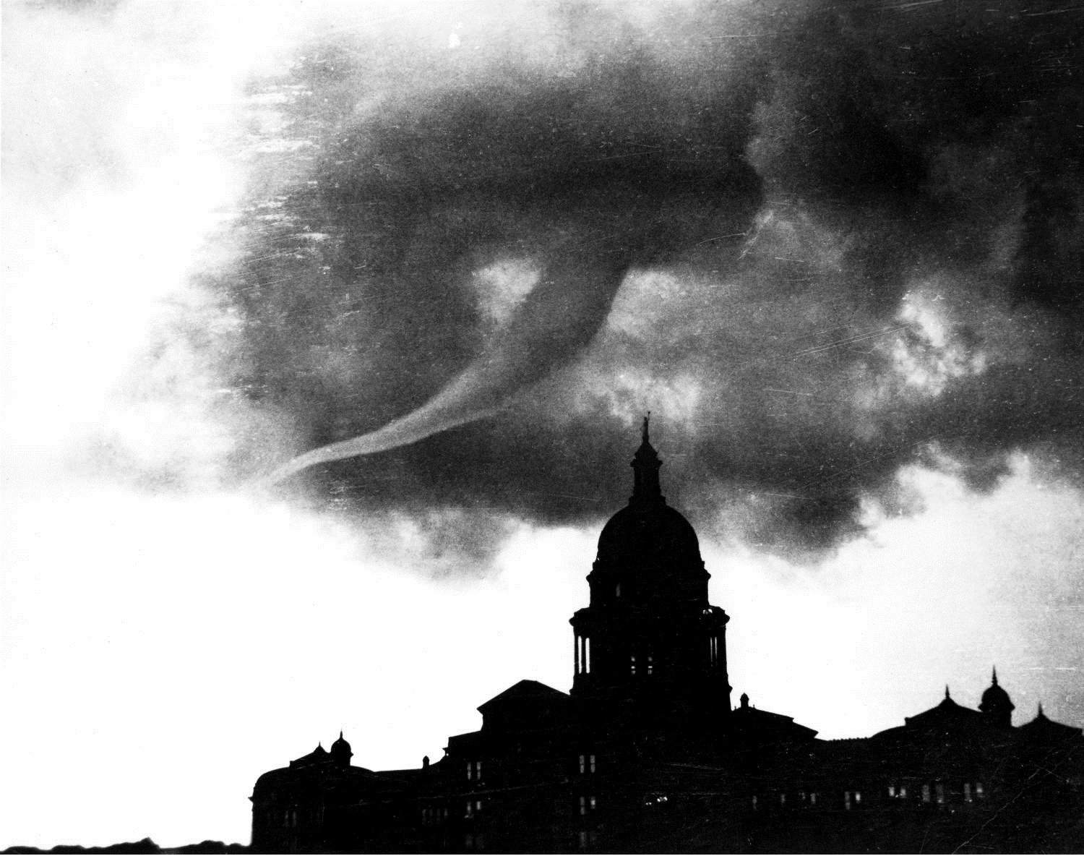
Tornado
More tornadoes have been recorded in Texas than in any other state
8,599 funnel clouds between 1951-2016
May 4, 1922
Notes:
Between 1951–2016, 8,599 funnel clouds are known to have reached the ground, thus becoming tornadoes.

Slide 14
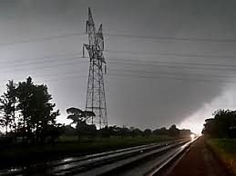
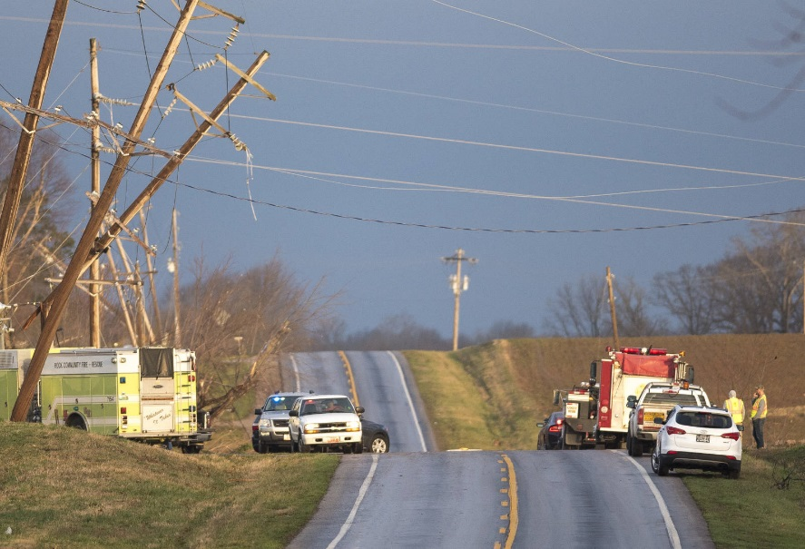
Tornado
Texas records:
Average – 130 per year
2015 was record breaking year:
248 total
130 in month of May
Six F5 tornadoes since 1950
Notes:
An average of 130 tornadoes touch Texas soil each year.
In May 2015, there were 130 tornadoes, which is a Texas record for a single month. The greatest number of tornadoes in Texas in a single year was 248, which was also in 2015.
Since 1950, there have been six tornadoes recorded of the F5 category, that is, with winds between 261-318 mph. They were:
Waco May 11, 1953
Wichita Falls April 3, 1964
Lubbock May 11, 1970
Valley Mills (McLennan Co.) May 6, 1973
Brownwood April 19, 1976
Jarrell (Williamson Co.) May 27, 1997

Slide 15
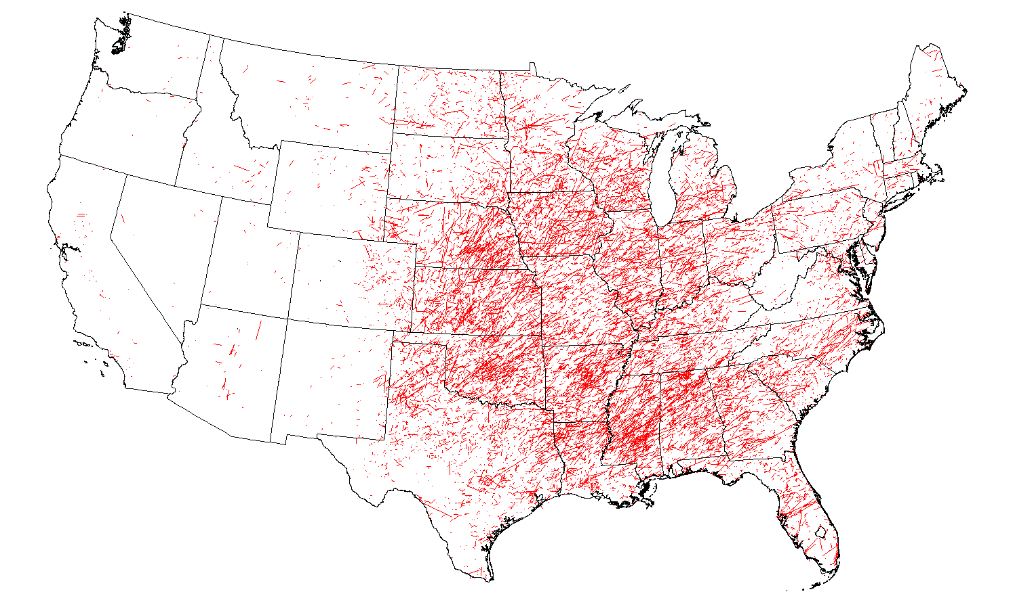
Tornado Tracks, 1950-2015
Greatest outbreak in Texas:
Hurricane Beulah – Sept. 1967
115 known within 5 days
67 on one day (record)
Notes:
Tornadoes occur with greatest frequency in the Red River Valley.
Tornadoes may occur in any month and at any hour of the day, but they occur with greatest frequency during the late spring and early summer months.
The greatest outbreak of tornadoes on record in Texas was associated with Hurricane Beulah in September 1967. Within a five-day period — Sept. 19–23 — 115 known tornadoes, all in Texas, were spawned by this great hurricane. Sixty-seven occurred on Sept. 20, a Texas record for a single day.

Slide 16
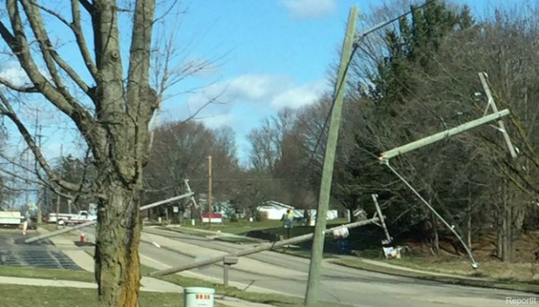
Wind
Texas Sustained Winds:
September 1961
Hurricane Carla
Matagorda & Port Lavaca - 145 mph (record)
August 2017
Hurricane Harvey
Rockport – 130 mph
Notes:
Highest sustained wind 145mph: Matagorda - Sept. 11, 1961 SE, 145 mph
Port Lavaca - Sept. 11, 1961 NE, 145 mph (Hurricane Carla ranks as the most intense U.S. tropical cyclone landfall on the Hurricane Severity Index Cat 5)
With Harvey – max sustained winds were 130 mph near Rockport.
Highest peak gust: Aransas Pass - Aug. 3, 1970 SW, 180 mph
Robstown - Aug. 3, 1970 WSW, 180 mph (Hurricane Celia made landfall near Port Aransas as a major Hurricane (category 3)

Slide 17
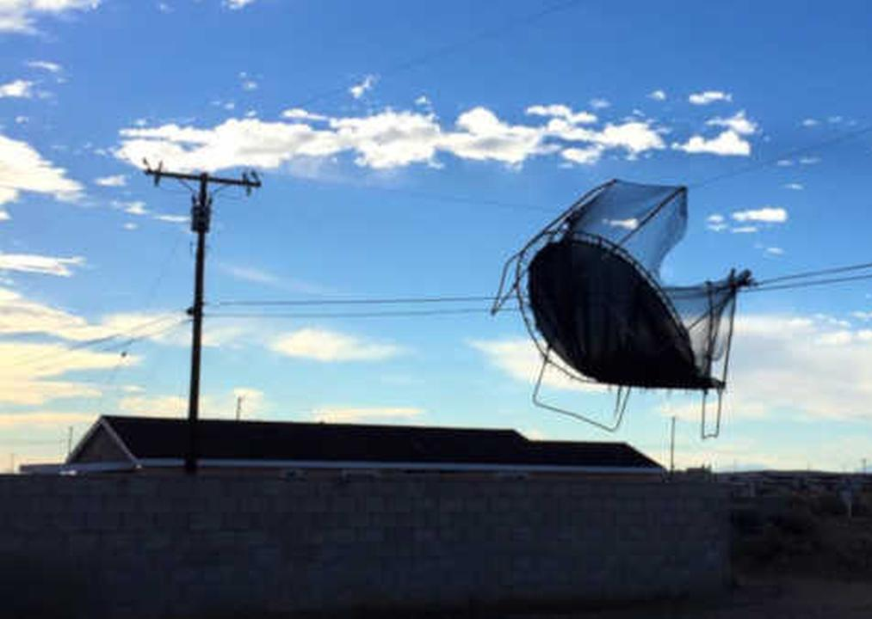
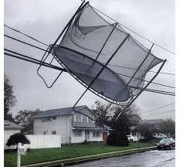
Wind
Texas Peak Gusts:
August 1970
Hurricane Celia
Aransas Pass & Robstown
180 mph

Slide 18
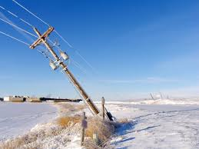
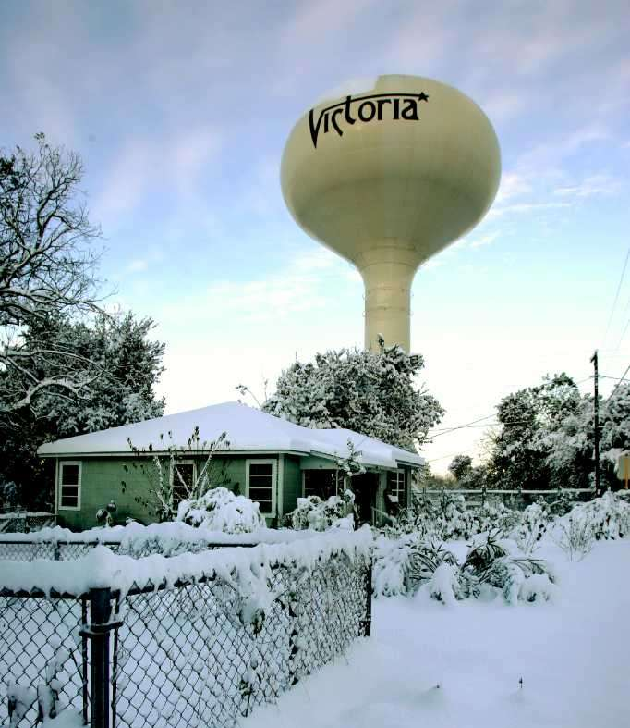
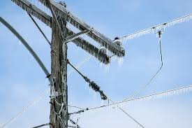
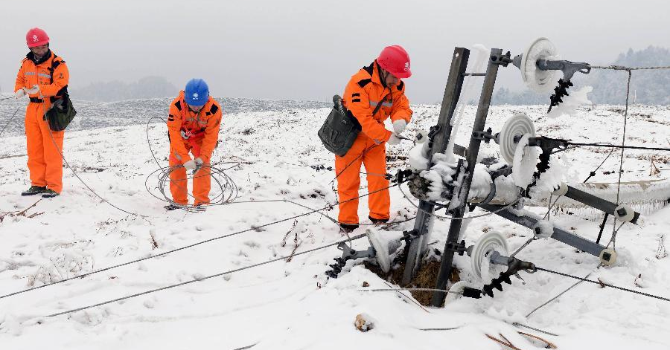
Extreme Cold
Lowest temperatures:
-23 degrees February 1899 – Tulia February 1933 - Seminole
Greatest single snowstorm:
33 inches
Hale Center
4 days in February 1956
Notes:
Snow, ice
Lowest temps recorded in Texas: Tulia, Feb. 12, 1899 -23°F; Seminole, Feb. 8, 1933 -23°F
Snowfall:
Greatest seasonal - Romero³ (Hartley Co.), 1923-1924 65.0 in.
Greatest monthly - Hale Center, Feb. 1956 36.0 in.
Greatest single storm - Hale Center, Feb. 2-5, 1956 33.0 in.
Greatest in 24 Hours - Follett, March 28, 2009 25.0 in.
Maximum depth on ground - Hale Center, Feb. 5, 1956 33.0 in.

Slide 19
Extreme Heat
Highest temperatures:
120 degrees August 1936 – Seymour June 1994 - Monahans
Driest year:
1917 with 14-15 inches of recorded rainfall statewide
Notes:
High temperatures & drought
Highest temps recorded in TX 120°F: Seymour, Aug. 12, 1936 & Monahans, June 28, 1994
Driest year statewide -- 1917 (FNEP)¹ 14.38 in. 1917 (NCDC)² 14.99 in.

Slide 20
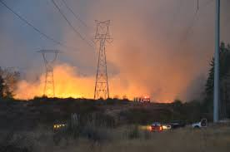
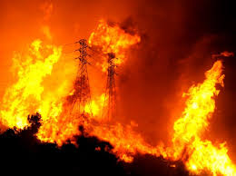
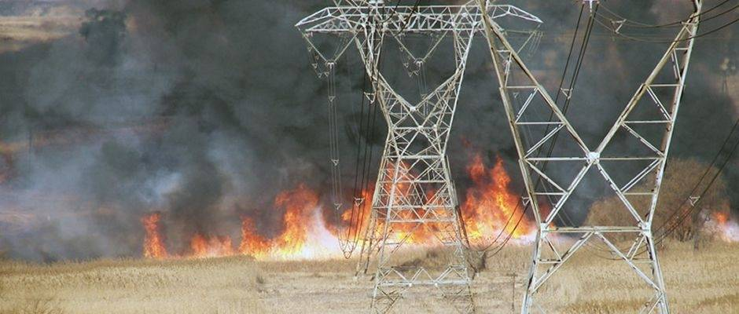
Fire
Most catastrophic wildfire in Texas:
Bastrop County Complex Fire
September 2011
Destroyed 1645 homes
Burned over 34,000 acres
Killed two
Notes:
On Sunday, September 4, 2011, a firestorm known as the Bastrop County ComplexFire engulfed Bastrop, Texas and by September 30 had destroyed 1,645 homes, burned 34,068 acres, and killed two people. This fire is now regarded as the most catastrophic wildfire in Texas history.

Slide 21
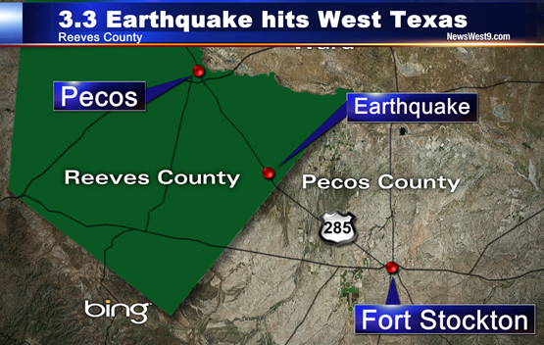
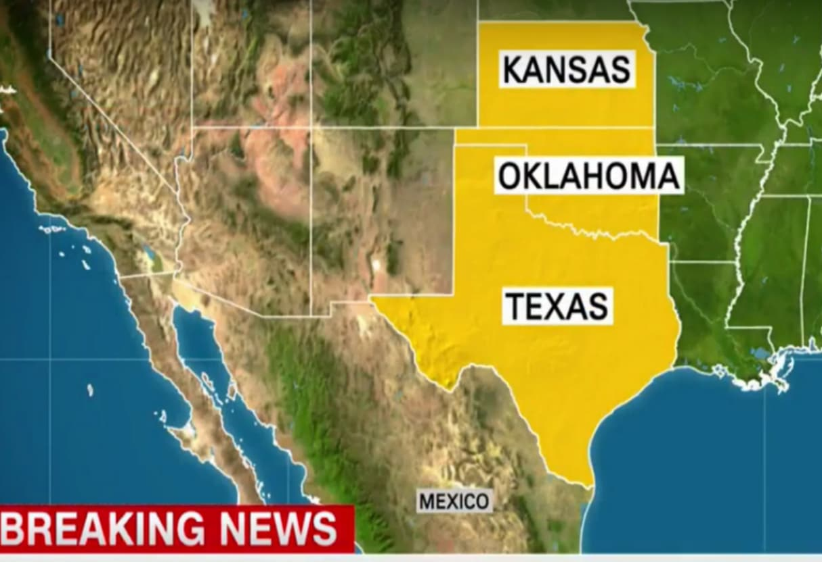
Earthquake
Since 1847, Texas has experienced more than 100 earthquakes of magnitude 3 or greater.
Notes:
Texas has experienced more than 100 earthquakes of magnitude 3 or greater since 1847. However, because the density of both seismographs and people has been very low in Texas, knowledge of the state’s seismicity is undoubtedly incomplete.

Slide 22
Earthquake
Notes:
As the map shows, except for the Trans-Pecos, most of the state has a relatively small probability of experiencing an earthquake.
The largest known earthquake in Texas occurred on Aug. 16, 1931, near the town of Valentine in Jeff Davis County.

Slide 23
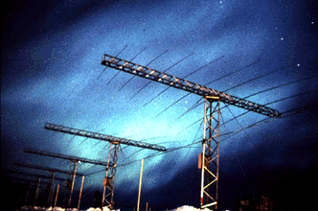
Geomagnetic Disturbance (GMD)
Major disturbance of Earth’s magnetosphere
Exchange of energy from solar wind into the space environment surrounding Earth
Potential adverse impacts to operation of interconnected transmission systems
Notes:
NERC Reliability Standard, EOP-010-1, Geomagnetic Disturbance Operations
ERCOT Nodal Op Guide Section 4
A geomagnetic storm is a major disturbance of Earth's magnetosphere that occurs when there is a very efficient exchange of energy from the solar wind into the space environment surrounding Earth. These storms result from variations in the solar wind that produces major changes in the currents, plasmas, and fields in Earth’s magnetosphere. The solar wind conditions that are effective for creating geomagnetic storms are sustained (for several to many hours) periods of high-speed solar wind, and most importantly, a southward directed solar wind magnetic field (opposite the direction of Earth’s field) at the dayside of the magnetosphere. This condition is effective for transferring energy from the solar wind into Earth’s magnetosphere.
Geomagnetic disturbance (GMD) events have the potential to adversely impact the reliable operation of interconnected transmission systems. During a GMD event, geomagnetically-induced currents (GIC) may cause transformer hot-spot heating or damage, loss of Reactive Power sources, increased Reactive Power demand, and Protection System Misoperation, the combination of which may result in voltage collapse and blackout.

Slide 24
Will we be prepared?
2. Identify what actions the Transmission Operator, QSE and ERCOT should take to ensure reliability during an extreme natural event
Taking steps to ensure continuity of your business
Governing rules in place
Notes:
Info on ERCOT’s internal plan
Governing rules in place
Not just ERCOT asking you for items
Requirements in place from the federal to state to ERCOT level

Slide 25
Taking steps to ensure continuity of your business
Business impact assessment
Succession plans
Training
Alternate communications
Partnerships
Regular tests
Notes:
Business continuity is a proactive plan to avoid and mitigate risks associated with a disruption of operations. It details steps to be taken before, during and after an event to maintain the viability of an organization.
Tips to make sure you are ready:
Start with a Business Impact Assessment. This will identify the business’s most crucial systems and processes and the effect an outage would have on the business. The greater the potential impact, the more money a company should spend to restore a system or process quickly.
Succession plan – develop and practice a contingency plan that includes a succession plan for your top leaders.
Training – train back up employees to perform emergency tasks. The employees you count on to lead in an emergency will not always be available.
Crisis meeting places – determine offsite crisis meeting places and crisis communication plans for top execs. Practice crisis communication with employees, customers and the outside world.
Alternate Communication - invest in an alternate means of communications in case the phone networks go down.
Partnerships – form partnerships with local emergency response groups – firefighters, police and EMTs – to establish a good working relationship. Let them become familiar with your company and site.
Test regularly –
Test your continuity plan regularly to reveal and accommodate changes.
The testing environment should be safe - Continuity exercises should reveal weaknesses.
Make sure all employees – as well as execs – are involved in the exercises so that that get practice in to responding to an emergency.
Make it real - continuity exercises should be realistic enough to tap into employees’ emotions so that you can see how they will react when the situation gets stressful.

Slide 26
ERCOT’s Business Continuity Plan
Required by the Public Utility Commission of Texas Substantive Rules
Procedures to recover major ERCOT business operations and resources in the event of an extended interruption of operations
Includes mobilization procedures for:
Loss of ERCOT Inc. facilities
Black start event
ERCOT Cyber or IT disaster
Pandemic
Documents recovery objectives and facility requirements for major ERCOT business processes
Notes:
What is priority
Who is needed
How we will communicate
Alternatives, options

Slide 27
Governing Rules in Place
Federal & State
PUCT Substantive Rule 25.53, Electric Service Emergency Operations Plans
PUCT Substantive Rule 25.503, Oversight of Wholesale Market Participants
ERCOT Protocols & Guides
Protocol Section 6.5.9, Emergency Operations
Protocol Section 3.21, Submission of Emergency Operations Plans, Weatherization Plans, and Declarations of Summer and Winter Weather Preparedness
ERCOT Operating Procedures
Transmission & Security Desk Section 8, Weather Events
Real Time Desk Section 6, Weather Events
Operating Guide Section 4, Emergency Operations
NERC Standard EOP-011-1, Emergency Operations
Notes:
Not just ERCOT asking you for items
Requirements in place from the federal to state to ERCOT level

Slide 28
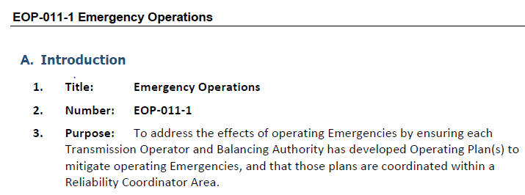
Governing Rules in Place – NERC Standard
Requires Transmission Operator and Balancing Authority have an Operating plan that identifies roles and responsibilities for activating the plan and has processes to prepare for and mitigate Emergencies which include reliability impacts of extreme weather.

Slide 29
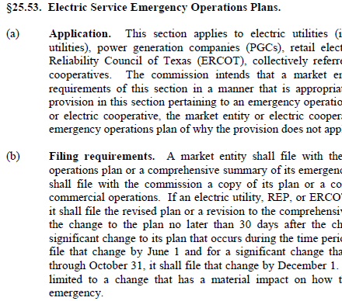
Governing Rules in Place – PUCT Rules
PUCT Subst. R. 25.53 defines requirements to:
File emergency operations plans
Conduct drills
Provide status reports in an event

Slide 30
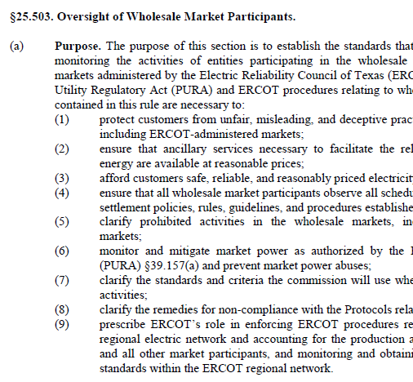
Governing Rules in Place – PUCT Rules
PUCT Subst. R. 25.503 ensures market oversight

Slide 31
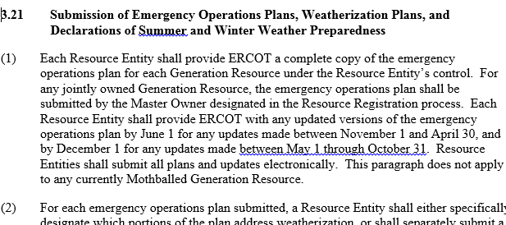
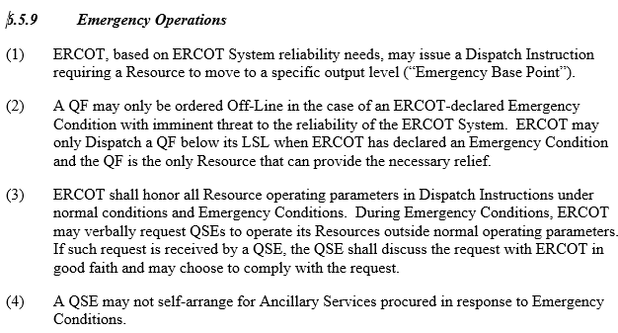
Governing Rules in Place – ERCOT Rules
Protocols prescribe:
Operations and communication in an emergency
Plans that must be submitted
Notes:
ERCOT, based on ERCOT System reliability needs, may issue a Dispatch Instruction requiring a Resource to move to a specific output level (“Emergency Base Point”).
(1) Effective, accurate, and timely communication between ERCOT, TSPs, and QSEs is essential. Each QSE must be provided adequate information to make informed decisions and must receive the information with sufficient advance notice to facilitate Resource and Load responses.
(2) The type of communication ERCOT issues is determined primarily on the basis of the time available for the market to respond before an Emergency Condition occurs. The timing of these communications could range from days in advance to immediate. If there is insufficient time to allow the market to react, ERCOT may bypass one or more of the communication steps.
(3) ERCOT shall consider the severity of the potential Emergency Condition as it determines which of the communications set forth in Section 6.5.9.1, Emergency and Short Supply Operation, to use. The severity of the Emergency Condition could be limited to an isolated local area, or the condition might cover large areas affecting several entities, or the condition might be an ERCOT-wide condition potentially affecting the entire ERCOT System.

Slide 32
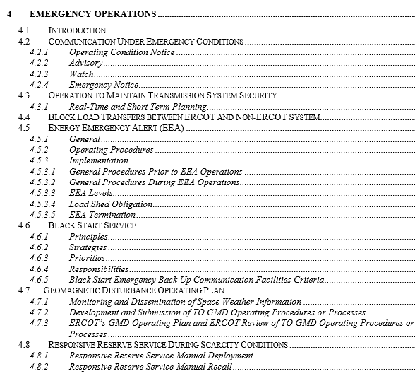
Governing Rules in Place – ERCOT Rules
ERCOT Nodal Operating Guide, Section 4 provides additional detail related to operations and communication in an emergency.

Slide 33
Governing Rules in Place – ERCOT Rules
ERCOT Operating Procedure Manuals for the Transmission and Security Desk and the Real Time Desk provide additional detail to prepare for hurricanes, extreme heat and cold or other significant weather events.

Slide 34
All in this together
Identify critical relationships for coordinated disaster recovery
Notes:
We already know that we are all in this together, but want to highlight additional helpful contacts/partnerships outside of regular ERCOT-MP relationships.

Slide 35
Texas Response
Division of Emergency Management
Emergency Management Council
Disaster District Chairmen (Highway Patrol Commander)
Mayors & County Judges
Governor

Slide 36
Texas Governor
Responsibilities include:
Directing homeland security in the State
Developing a statewide homeland security strategy
Dealing with dangers to Texans presented by disasters and disruptions

Slide 37
Texas Division of Emergency Management (TDEM)
Division of the Department of Public Safety (DPS)
Maintains the Energy Annex of the State of Texas Emergency Management Plan
Charged with deploying state resources to respond to major emergencies and disasters
Notes:
TDEM has specific responsibilities for carrying out a comprehensive all-hazard emergency management program for the State and assisting cities, counties and state agencies in implementing their own emergency management programs. Among the specific responsibilities of TDEM are:
Emergency Planning: TDEM maintains the State of Texas Emergency Management Plan and other specialized state plans. It also adopts standards for local emergency management plans, reviews those plans, and maintains a database of planning accomplishments.
Training: TDEM conducts an extensive emergency management-training program for local and state officials and emergency responders.
Public Education & Information: TDEM provides threat awareness and preparedness educational materials for the public, and also provides emergency public information during disasters.
Hazard Mitigation: TDEM administers a number of pre and post-disaster programs to eliminate or reduce the impact of known hazards.
Response: TDEM coordinates mobilization and deployment of state resources to respond to major emergencies and disasters
Disaster Recovery: TDEM administers disaster recovery programs for individuals and for local governments, state agencies, schools, hospitals, and other public entities.

Slide 38
Texas Emergency Management Council
Composed of 32 state agencies, the American Red Cross & the Salvation Army.
Assists the Governor in all matters relating to disaster mitigation, emergency preparedness, disaster response, and recovery.
During major emergencies, Council representatives convene at the State Operations Center (SOC) to provide assistance with response operations and coordinate state resources.
Notes:
Generally, state resources are deployed to assist local governments that have requested assistance because their own resources are inadequate to deal with an emergency. The Council is organized by emergency support function (ESF) -- groupings of agencies that have legal responsibility, expertise, or resources needed for a specific emergency response function.

Slide 39
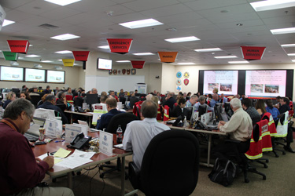
State Operations Center (SOC)
Operated by TDEM 24x7, communicating critical info to partner organizations at all levels of government.
Coordinates state assistance to local governments that are dealing with emergencies.
Notes:
The SOC coordinates 3,000 to 4,000 incidents per year.
Representatives from the PUCT and the Railroad Commission staff the SOC during periods of activation.
If the SOC is not able to provide resources, TDEM may submit mutual aid requests to other states or request federal assistance from the Federal Emergency Management Agency (FEMA), which coordinates federal resources during disasters.

Slide 40
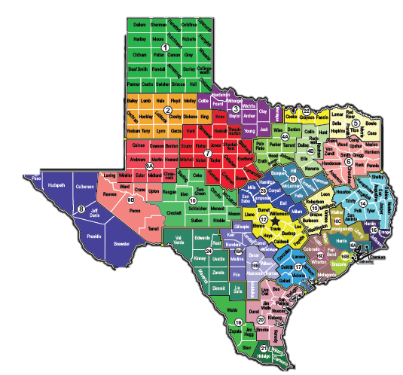
Disaster Districts
31 Disaster Districts
Initial source of state emergency assistance for local governments
Led by a Chairman (i.e., local Texas Highway Patrol commander)
If local resources are not available, the Disaster Chairman sends request to SOC

Slide 41
Local Emergency Officials & Organizations
Mayors & County Judges have responsibility for local emergency preparedness and response.
May appoint an Emergency Management Coordinator to manage day-to-day program.
Can request additional assistance from the District Chairman when they exhaust or identify a gap in resources.
Notes:
Mayors and County Judges have responsibility for emergency preparedness and response within their jurisdictions. These officials may appoint an Emergency Management Coordinator (EMC) to manage day-to-day program activities. Local emergency management and homeland security programs include threat identification and prevention activities, emergency planning, providing or arranging training for local officials and emergency responders, planning and conducting drills and exercises, carrying out public education relating to known hazards, designing and implementing hazard mitigation programs, coordinating emergency response operations during incidents and disasters, and carrying out recovery activities in the aftermath of a disaster.

Slide 42
Other Critical Relationships
Mutual Aid
Agreements with neighboring jurisdictions may allow local jurisdictions to manage incidents without state assistance.
Interstate Emergency Response Support Plan Collective agreement between the five FEMA Region VI states to provide immediate response and support using a unified command structure.

Slide 43
Reporting Out
Recognize types of information required by outside agencies in an extreme natural event

Slide 44
Reporting Out
Info
Local Officials
NERC
Media
PUCT
DOE
Texas RE
ERCOT
FERC

Slide 45
Reporting Out - PUCT
PUCT Subst. R. 25.53(f) specifies reporting requirements
ERCOT provides the PUCT updates with every Operating Condition Notice (OCN), Advisory, Watch, and Emergency.

Slide 46
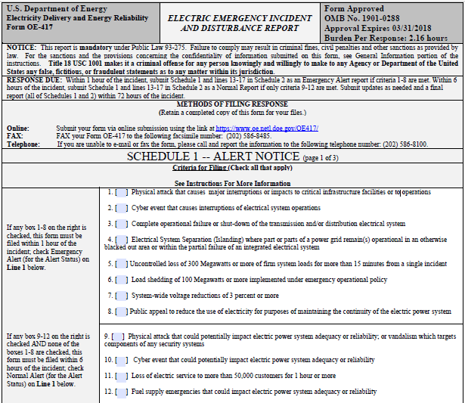
Reporting Out – DOE
U.S. Department of Energy (DOE) Electric Emergency Incident and Disturbance Report (Form OE-417)
Collects information on electric incidents and emergencies
Assists DOE fulfill overall national security and other energy emergency management responsibilities
Initial submission deadlines of one and six hours of incident.
Final report within 72 hours.
Notes:
3 page form – The OE-417 from ERCOT is submitted to DOE, NERC and TexasRE .
Classify type of event
Disturbance data
Cause of incident
Action taken
Narrative
Assets impacted

Slide 47
Reporting Out – DOE OE-417
Scenarios requiring reporting within one hour of incident:
Physical attack that causes major interruptions or impacts to critical infrastructure facilities or to operations
Cyber event that causes interruptions of electrical system operations
Complete operational failure or shut-down of the transmission and/or distribution electrical system
Electrical System Separation (Islanding) where part or parts of a power grid remain(s) operational in an otherwise blacked out area or within the partial failure of an integrated electrical system
Uncontrolled loss of 300 MW or more of firm system loads for more than 15 minutes from a single incident
Load shedding of 100 MW or more implemented under emergency operational policy
System-wide voltage reductions of 3% or more
Public appeal to reduce the use of electricity for purposes of maintaining the continuity of the electric power system
Notes:
3 page form – The OE-417 from ERCOT is submitted to DOE, NERC and TexasRE .

Slide 48
Reporting Out – DOE OE-417
Scenarios requiring reporting within six hours of incident:
Physical attack that could potentially impact electric power system adequacy or reliability; or vandalism which targets components of any security systems
Cyber event that could potentially impact electric power system adequacy or reliability
Loss of electric service to more than 50,000 customers for one hour or more
Fuel supply emergencies that could impact electric power system adequacy or reliability
Notes:
3 page form – The OE-417 from ERCOT is submitted to DOE, NERC and TexasRE .

Slide 49
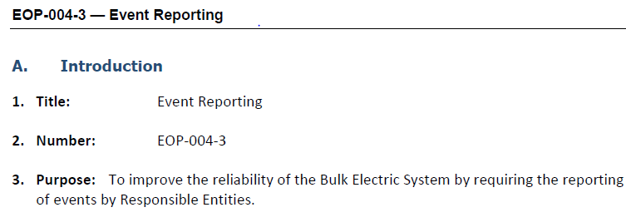
Reporting Out – NERC
NERC Standard EOP-004-3 Event Reporting requires:
An event reporting Operating Plan in accordance with EOP-004 Attachment 1
Reporting events within 24 hours of recognition of meeting an event type threshold for reporting (or by the end of next business day if event occurs on a weekend)
Notes:
ERCOT Operations will have daily conference calls in preparation for and during the extreme weather event. (FEMA, Homeland Security, NRC, Regional Entities are invited to the calls)

Slide 50
Reporting Out – NERC EOP-004-Attachment 1
NERC Standard EOP-004 – Attachment 1: Reportable Events
Damage or destruction of a Facility
Physical threats to a Facility or BES control center
BES Emergency requiring public appeal for load reduction, system-wide voltage reduction, or manual firm load shedding
BES Emergency resulting in automatic firm load shedding
Voltage deviation on a Facility
IROL Violation
Loss of firm load
System separation (islanding)
Generation or Transmission loss
Complete loss of off-site power to a nuclear generating plant
Unplanned BES control center evacuation
Complete loss of voice communication capability
Complete loss of monitoring capability
Notes:
EOP-004-2-3 Attachment 1 (event types, responsible reporting entity and threshold for reporting)

Slide 51
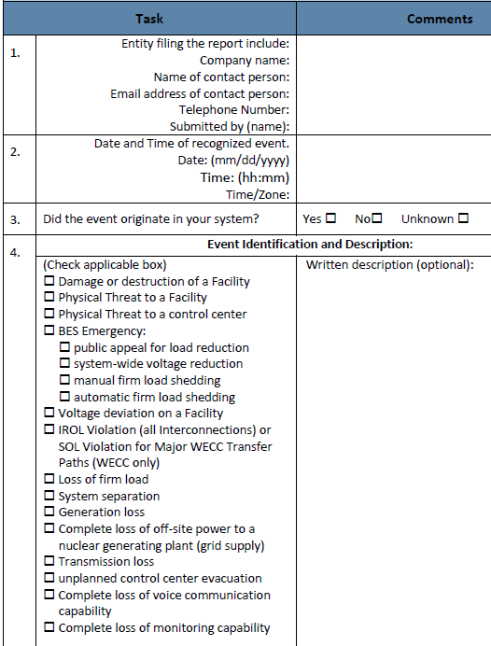
Reporting Out – NERC EOP-004-Attachment 2
NERC Standard EOP-004 – Attachment 2: Event Reporting Form
For events that are also DOE reportable, use OE-417.
For other events, use the EOP-004 Attachment 2 Event Reporting Form.
Under certain adverse conditions it may not be possible to issue a written Event Report within the timing standard. Responsible Entity must notify appropriate parties and provide as much information as available.

Slide 52
Reporting Out – NERC
NERC Electricity Information Sharing and Analysis Center (E-ISAC)
ERCOT Operations will have daily conference calls in preparation for and during an extreme weather event.
Participants could include:
FEMA
Homeland Security
Nuclear Regulatory Commission
Regional Entities
Notes:
ERCOT Operations will have daily conference calls in preparation for and during the extreme weather event. (FEMA, Homeland Security, NRC, Regional Entities are invited to the calls)

Slide 53
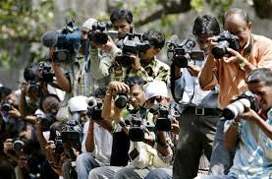
Reporting Out – Media
News and social media outlets will seek information as well.

Slide 54
Objective Summary
Identify extreme natural events threatening the ERCOT region.
Identify what actions the Transmission Operator, QSE and ERCOT should take to ensure reliability during an extreme natural event.
Identify critical relationships for coordinated disaster recovery.
Recognize types of information required by outside agencies in an extreme natural event.

Slide 55
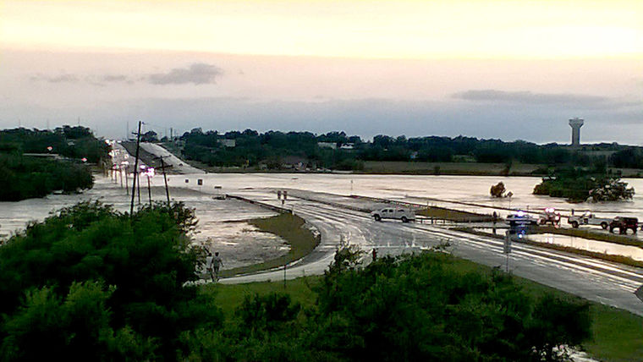
It’s NOT a matter of IF. It’s a matter of WHEN…
We must prepare now.

