Slide 1
Distributed Energy Resources (DER) including Demand Side Management
Clayton Stice and Shane Thomas
OTS 2018

Slide 2
Objectives
DERs in ERCOT
Recognize Drivers behind DER adoption
  Environmental; backup power; $$; etc
  List benefits and challenges associated with utility scale vs. DERs
Identify Types of DERs being used in ERCOT
Recognize Reporting mechanisms and gaps
  Recall ERCOT DER interconnection requirements
  Recognize how Mapping large DERs improve situational awareness
Trend toward fossil rather than renewable
Reliability Whitepaper
Identify reliability considerations for DER reliability
  Characteristics of inverter-based DER
    Identify Impacts of DERs on the ERCOT nodal market
Identify IEEE 1547-2018 status and impacts
Demand side management
    Identify resources available for ERCOT Dispatch

Slide 3
DER Definition
Distributed generation (also known as distributed energy resources or DER) typically refers to power generation at the point of consumption. Generating power on-site, rather than centrally, eliminates the cost, complexity, interdependencies, and inefficiencies associated with transmission and distribution.
DER systems typically use renewable energy sources, including biogas, solar power, wind power, and geothermal power.
Source: Wikipedia

Slide 4
DER Drivers
Behind the meter generation allows DER owners to lower their utility bills, by reducing their load.
  Incentives (local, state, federal), utility rates, utility policies (net metering), etc have affected adoption rates around the US.
Many Utilities in ERCOT offer incentives for solar PV (Oncor, CPS, Austin Energy, etc)
Reduced costs have led to increased adoption rates.
Source: Wikipedia

Slide 5

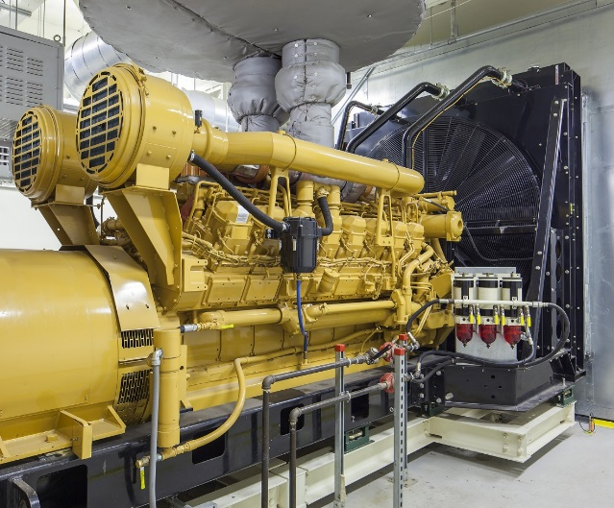
Variety of DERs are coming
Inverter-based generation
  Typically Solar PV
Fuel-based generation (typically synchronous)
  Gas turbines, Internal Combustion Engines, Biogas
Energy Storage
  Batteries, pumped hydro, compressed air
Small wind turbines
Small hydro turbines
Geothermal
Some DERs will be capable of providing fast-acting, flexible services to the grid

Slide 6
Existing DER Visibility Issues
DER >1 MW
  Visible to ERCOT -- If it injects to the grid; and is not registered with PUC as Self-Generation then it must register with ERCOT.
  Not Visible – If it is behind the meter and does not inject to the grid, then it is not required to register.
DER <1 MW
  Investor Owned TDSPs
    TDSPs submit Annual DER Interconnection reports to PUC
  Visible to ERCOT – 50 kW –> 1 MW Annual report by premise*
  Visible to ERCOT -- <50 kW Annual report by premise*
      *all units by profile code including those that never inject to the grid
  Muni’s and Co-ops (NOIEs) report:
  Limited visibility - aggregate summary 50 kW->1 MW that inject energy to the grid**
  Delayed visibility <50kW Reported to EIA—data posted by Oct the following year.
    **may not include units that don’t export to the grid

Slide 7


Estimates of DER Penetration in ERCOT 2016
Based on reports filed with PUCT, EIA, etc., we estimate:
  Units <1 MW:
    ~ 30,000 units (mainly rooftop solar)
    ~ 250 MW
  Units >1 MW:
    ~140 units (~80% diesel or natural gas)
    More than 750 MW
This is a different picture from what you’ll find in other regions.
  Example: California reports more than 5,000 MW of rooftop solar, not including LADWP

Slide 8
Common Misconceptions
“Once customers install a DER (PV) system, they are off-grid.”
  The overwhelming majority of PV systems are Grid-Tied and *require* the grid connection to operate and balance the customer load with their generation.
  Average solar radiance in Texas averages ~5 hours per day over the year. Therefore, the customer relies on the grid the other 19 hours/day.
  Installing a large enough solar PV system with enough batteries to handle the customer load that the grid provides would be very expensive.
“If the DER system over-generates early in the day, customers will just use the grid to ‘store’ it, and then use it later in the day.”
  The grid must be balanced and does not *store* electricity. When there is over-generation during the day, some generators shut off to balance supply with demand. Similarly, when the sun goes down, some generators start up to provide generation needed at that time.

Slide 9
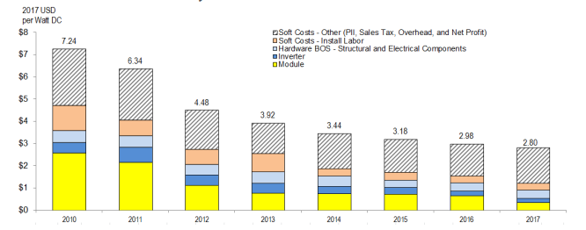
Price Drops Enabling Solar PV Growth
Solar PV Pricing Trends
Future pricing only slightly impacted by Suniva 201C Trade petition which implements tariffs on approx. 80% of imports at ~11 cents/watt or ~4% increase to the total installation.
Source: NREL, https://www.nrel.gov/docs/fy17osti/68925.pdf
Notes:
Price drops for Solar PV has enabled exponential growth. Note that the Suniva Trade petition would implement a tariff on the PANELS only. Since total cost includes inverters, installation, sales, etc, the tariff would essentially make pricing look like 2016, which was a good year. Although there will be some impact, it wont be the end of the world for DG. This is contrasted with Utility scale where costs are only about $1/watt. A 11 cent tariff has a bigger impact there.

Slide 10
Key Solar PV Price Point for Texas
Texas
Arizona
Oklahoma
California
Colorado
New Mexico
Breakeven value ($/W)
Break-even point for Texas commercial customers ~$1.00-$1.25/W.
Source: NREL, http://www.nrel.gov/docs/fy16osti/64793.pdf

Slide 11
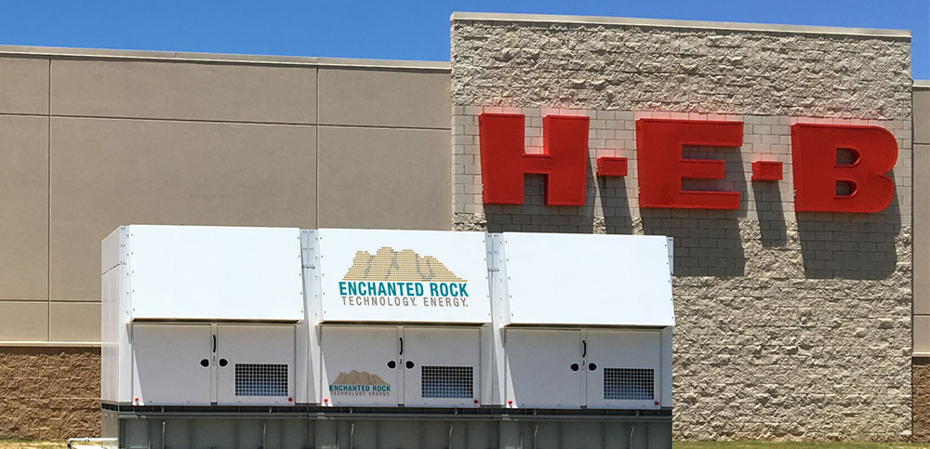
Fossil (Natural gas) co-located with Load
~ 90% of Registered DG units for ERCOT in the last year have been Fossil based.
Resiliency during extended outages
  Hurricane Ike impacts to Houston area 2008
  Hurricane Harvey 2017
Peak load/4CP charges
  Businesses pay peak demand charges
Photo courtesy of Enchanted Rock
Notes:
Note that Fossil-powered DG that is getting more common in ERCOT (Houston and Corpus Christi area) is currently relatively “unique” to Texas. Other ISO’s have not seen this category of DG.

Slide 12
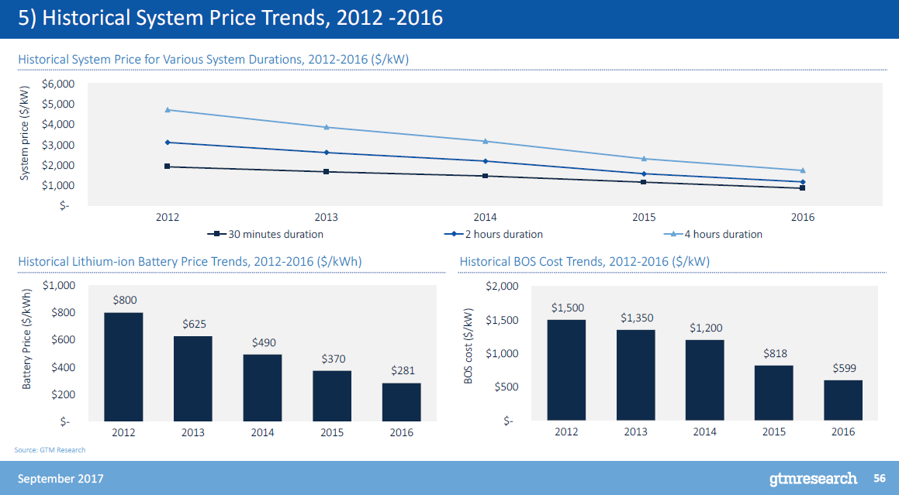
Energy Storage Pricing
Notes:
Although there has been a lot of media print about Energy Storage across the US, the reality is that the pricing environment in ERCOT is quite challenging. California retail pricing of electricity around 28 cents/kWh make a lot of things possible that are financially not viable at 8-9 cents/kWh. (Powertochoose website..)

Slide 13
Energy Storage in ERCOT
Owners want to maximize “value proposition”
  Participate in multiple market functions to optimize revenue and payback
    DOE identified 17+ separate markets
  Can be a key player in ancillary services but need to work out an energy market strategy that balances regulated and competitive requirements.
  Current regulatory requirements for Competitive Choice areas prevent ownership by “Wires” companies.
  Economic Environment is challenging compared to rest of country, but still occurring
    “Stand alone” system growth occurring in “NOIEs”
      Municipalities and Coops.
        Federal and state grants (ex: TCEQ)
    “Behind the meter” growth for large commercial/industrial applications.
      Enables peak load reductions for customer

Slide 14
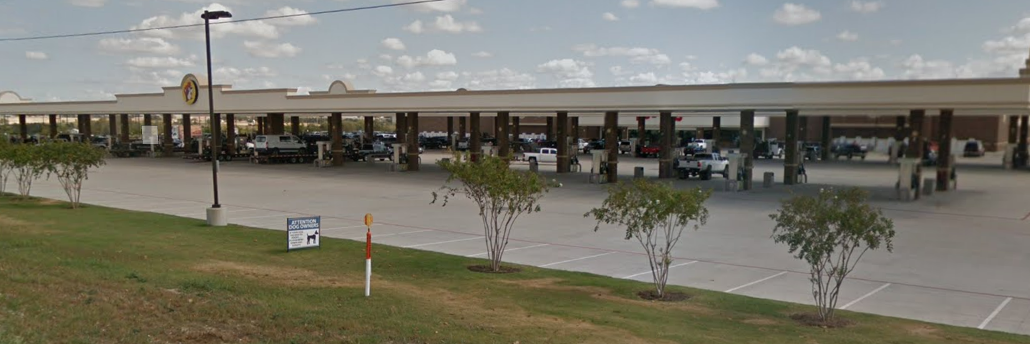
Future Energy Storage in ERCOT
EV Future Scenarios being evaluated.
  Understand how DC fast charge can impact the grid
    2017 DC fast charge deployment in Europe is 150kW.
  Larger “gas” stations have >100 “pumps”.
    At what level are EVs an issue for ERCOT?

Slide 15
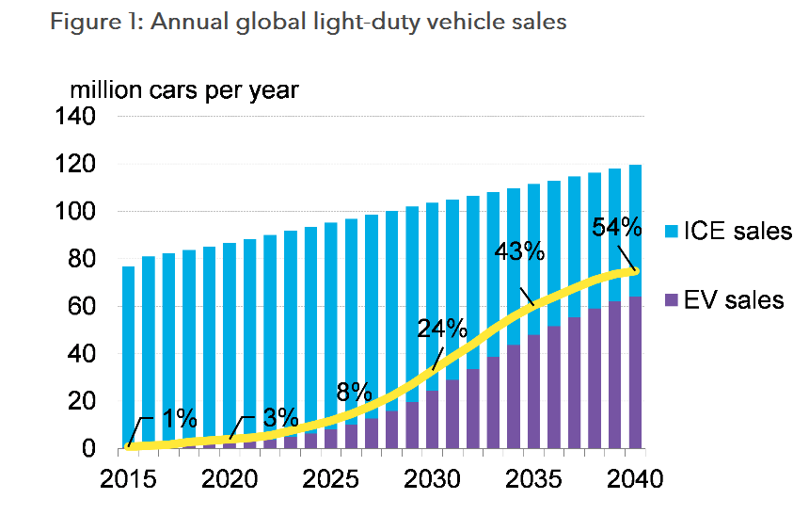
Future EV Growth Projections
EV’s to reach 54% of global sales by 2040
Note--Each EV projection is more aggressive than the previous years.
https://about.bnef.com/blog/electric-vehicles-accelerate-54-new-car-sales-2040/

Slide 16
Groundwork for DERs
Emerging Technologies Working Group (WMS)
DREAM TF
  DER Concept Paper
  DER Reliability Paper
Ongoing Actions
Notes:
ERCOT started writing the DER reliability whitepaper after the DREAMTF concluded their work in 1st qtr 2016.

Slide 17
DER Concept Paper
Whitepaper Issued Aug 19, 2015
  www.ercot.com/content/wcm/key_documents_lists/72724/ERCOT_DER_Whitepaper_082015.doc
  Addressed market issues with DERS
  Introduced the concepts:
    DER Minimal—intended for unregistered DER
    DER Light—intended for intermittent registered DER
    DER Heavy—intended for self-dispatched DER
  Nodal Pricing
  Dual Metering
Notes:
DER Whitepapers --ERCOT started writing the DER Concept as part of the DREAM TaskForce.

Slide 18
DER Reliability Paper
Reliability White Paper Issued March 22, 2017
  http://www.ercot.com/content/wcm/lists/121384/DERs_Reliability_Impacts_FINAL.pdf
  Follow on to first DER Concept paper addressing markets
  Requested by TDSP’s in response to ERCOT’s request for additional information
  ERCOT started writing the DER reliability whitepaper after the DREAMTF concluded its work in 1st qtr 2016.
  Very Similar in scope to NERC whitepaper issued Feb 2017
“Based on installed capacity and current rates of growth, these resources do not pose an immediate or near-term reliability concern for the transmission grid.”
Notes:
As a followup to questions from the first concept paper, ERCOT started writing the DER reliability whitepaper after the DREAMTF concluded their work in 1st qtr 2016.

Slide 19
Reliability Impacts
Power Flow and State Estimation (SE)
  Incorrect handling of energy injection data from distribution circuits may lead to invalid SE results, inaccurate Load Adaptation and hence incorrect Load Distribution Factors (LDFs) in Operational Studies.
Load Forecast
  Inaccuracies Short-Term and Mid-Term Load Forecast may lead to excessive dependance on reserves.
  Inaccuracies in forecasting DERs used Long-Term Load Forecast may lead to less than optimal transmission planning decisions.
Limited reactive power, voltage control, and lacking dynamic response to faults may affect grid reliability during abnormal system disturbances.
Lack of coordination during system restoration of DER energization following a system blackout may cause power quality issues.
Notes:
Key Reliability Impacts

Slide 20
Goals for DERs
Improved reporting and visibility
Mapping of Registered DERs to the transmission grid
  Requires cooperation among TSPs, DSPs and the ISO
  Will improve situational awareness
  Underway now
Nodal pricing for larger DERs
  Registered DGs (>1 MW)
  currently are paid Load Zone
  price
  Local price signals would
  enhance reliability and would
  align DER behavior with overall
  market design
Notes:
Actions needed by ERCOT in response to the Reliability whitepaper challenges.

Slide 21
Which DGs require mapping?
NPRR 866 submitted by ERCOT (Feb 2018) proposes to map Registered Distributed Generation (Registered DGs) to their appropriate CIM Loads
  Registration with ERCOT is required for DG >1 MW
  There are 120 such DG units on the system as of Nov. 2017
  A small percentage of registered DG are less than 1 MW.
  Approximately 40 DGs have registered in the last 12 months.
*Note In the ERCOT reliability whitepaper ERCOT discusses the concept of accumulations or clusters of smaller (unregistered) Registered DGs.
In local areas these accumulations may start to resemble larger (registered) Registered DGs
  This is a potential long-term issue and is not yet resolved.

Slide 22
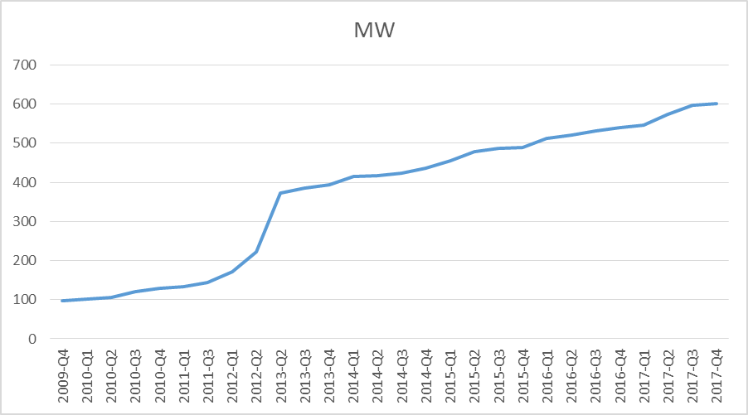
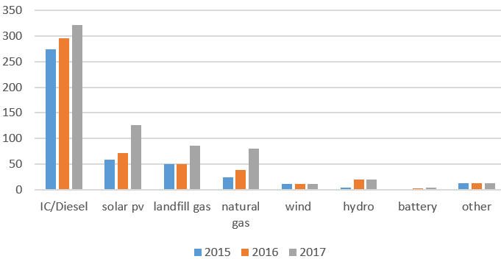
Trends for Registered DG (4Q09-4Q17)
600 MW of Registered DG now on the system
Notes:
Although there has been growth in Solar PV in the last few years, most of the registered DG is either IC/Diesel, Landfill Gas or Natural Gas.

Slide 23
What’s involved in Registered DG Mapping
Mapping is not the same as Modeling
  Distribution system modeling is the responsibility of the Distribution Service Providers (DSPs)
  Modeling involves gathering, generating and maintaining distribution system information (impedances, switches, etc.) – a compilation of TSP, DSP and Resource data
Mapping is associating registered DG with its appropriate Common Information Model Load (CIM Load) in the Network Operations Model
  CIM Loads are modeling constructs developed by Transmission Service Providers (TSPs)
Note* Since Nodal launch, distribution-connected Load Resources have been mapped to the transmission system in a similar way

Slide 24
“Mapping” Process
Transmission model for NOIEs and Competitive choice areas.
CIM Load is the telemetered value that is typically brought in from the high side of the substation transformer
Mapping associates Registered DG under a CIM load that consists of:
Loads
Registered DG
Controllable Load Resources
Non-Controllable Load Resources
This approach mirrors the Load Resource process which is manageable for lower volumes of mapping

Slide 25
IEEE1547-2018 revision to address DER Enables
“smart inverters”—approved Feb 15, 2018
Requirements have not substantially changed for:
Added New Capabilities:
Anti-islanding detection
Low- and high-frequency trip settings
Low- and high-voltage trip settings
General need to verify a DER’s compliance through type, production and commissioning tests
Reactive power capability
Voltage and Frequency Ride-Through
Voltage and frequency regulation
  ie: volt/Var, watt/Var
Open-phase detection
Standardized communication interface
Reduced Overvoltage limits
Varying reconnection after outages
Intentional Islanding
Etc.
Additional information available in this EPRI fact sheet: http://www3.dps.ny.gov/W/PSCWeb.nsf/96f0fec0b45a3c6485257688006a701a/def2bf0a236b946f85257f71006ac98e/$FILE/EPRI%20Fact%20Sheet.pdf

Slide 26
Load Resources and ERS

Slide 27



Load and ERS Services
Load Resources
  Non-Controllable (NCLR)
  Controllable (CLR)
Emergency Response Service
  10-Minute ERS
  30-Minute ERS
  Weather-Sensitive ERS
TDSP Load Management Programs
Retail Demand Response Products offered through Reps, Munis, and Coops
4CP (Transmission Costs)
www.ercot.com/services/programs/load
Notes:
Multiple different Load Programs

Slide 28
Non-Controllable Load Resources
Responsive Reserve Service (Spinning Reserves)
  Load Resources Controlled by High-Set UFRs
  Currently have about 340 Individual LRs
  Aggregated Maximum Interruptible Capacity of about 4600 MW capable of participating
  Procured as part of Day Ahead Market
  Compete with Generation Resources
  Hourly RRS Responsibility ranges from 2300 to 2800 MW
  LR can provide up to 50% of the total
  Provide telemetry updated every 2 seconds - Load in MW, Resource Status, Responsibility and Schedule, Breaker and UFR Status
  Load Resources are primarily industrial and large commercial facilities

Slide 29
Non-Controllable Load Resources
Responsive Reserve Service (Spinning Reserves) Deployments
  Manually by Operators during an Emergency using XML followed by VDI
    System Capacity Issues
    Interconnection Reliability Operating Limit (IROL) Violations – e.g. North to Houston IROL
    As a last resort before firm Load Shedding
    Need to deploy within 10 minutes of instruction being issued
    Need to remain deployed until recalled
  Automatic Response to Underfrequency Event
    UFR set-points are 59.7 hz with 20 cycle delay
    Need to remain deployed until recalled
Testing
  Qualification done initially to start providing service
  Annual Interruption Test unless deployed for operational needs and perform adequately
  UFR is tested every two years
  Telemetry is tested annually

Slide 30
Current Operating Plans
Resource Name – e.g. MDTXI_LD1
Resource Status
  ONRGL—Regulation including FRRS
  ONCLR—Available for Dispatch by SCED as a CLR
  ONRL—NCLRs providing RRS
  OUTL—Not available
HSL (Maximum Power Consumption)
LSL (Low Power Consumption)
Emergency Limits
AS Resource Responsibility

Slide 31
Load Resource Participation in RRS
Typical Manual Deployments – 1/6/2014

Slide 32
Load Resource Participation in RRS
Typical UFR Deployment – 1/18/2014

Slide 33
DR available for ERCOT dispatch
Service | MWs | Notes
Load Resources providing Responsive Reserves | ≤1400 | Non-Controllable Load Resources -- procured on an hourly basis in the Day-Ahead Market for next Operating Day Deployed via 10-minute instruction or instantaneously based on grid frequency Since 4/2012 capped at half of total hourly RRS procurement (2800 MW) Starting 6/2015 quantities determined in 4 hour blocks, LRs may still provide up to 50% of the requirement
Emergency Response Service (ERS) | ~891 | DR and DG assets with 10- or 30-minute ramp periods Also open to weather-sensitive loads such as residential AC aggregations Procured three times per year (4-month strips), with 4 Time Periods within each contract term
TDSP Load Management Programs | ~223 | C&I and Residential Loads procured for summer peak hours only Dispatched concurrently with ERS through agreements between ERCOT and TDSPs
2,500+ MW of dispatchable DR: ~ 3.5% of ERCOT summer peak

Slide 34
Emergency Response Service (ERS)
ERS is procured for 4-month Contract Periods
  February thru May
  June thru September
  October thru January
There are 6 time periods which ERS Resources may participate in during each Contract Period
ERCOT assigns a risk value to each time period (values between 1 and 10). These risk values are used to allocate a portion of the $50 million spend limit to each time period
Time Period | Hours (HE) | June-September |  |  | October-January
 |  | Risk Factor | MW Procured* | Clearing Price | Risk Factor | MW Procured* | Clearing Price
1 | 0600-0800 | 1 | 238 [644] | $2.05 | 8 | 204 [632] (5) | $17.57
2 | 0900-1300 | 1 | 239 [701] | $1.95 | 3 | 215 [676] | $6.34
3 | 1400-1600 | 10 | 226 [632] (9) | $21.06 | 1 | 213 [660] (4) | $2.20
4 | 1700-1900 | 10 | 221 [607] (9) | $21.68 | 8 | 208 [653] (5) | $17.18
5 | 2000-2200 | 1 | 235 [659] | $2.06 | 8 | 204 [629] | $18.29
6 | All others | 1 | 229 [567] | $2.30 | 1 | 194 [561] | $2.53
MW Procured* = ERS-10 [ERS-30] (WS-ERS-30)
Notes:
ERS-30 deployed in EEA1 & ERS-10 in EEA2 both via All QSE Call

Slide 35
August 4, 2011 ERS Deployment Event
Deployment Instruction
Recall
Baseline Load
Actual Load
Load Reduction
Three real-time deployments of ERS:
February 2, 2011
August 4, 2011
January 6, 2014
Obligation

Slide 36
Retail Demand Response Programs
Used during EEA
  only available during peak hours (13:00-19:00) M-F
Survey REPs for ESIIDs enrolled in Load Management Programs
Product type | ESIIDs Participating | Estimated MW Deployed | Events | ESIIDs Responding
Block & Index | 14,371 | 85 – 145 | 2 | 13,117
Other Load control | 8,726 | 2 - 4 | 10 | 1,780
Other Voluntary DR | 34,214 | 0 – 15 | 23 | 33,922
Peak Rebate | 513,612 | 1 – 28 | 22 | 78,506
Real-time Price | 9,804 | 4 - 5 | 2 | 9,576
Time of Use | 336,052 | n/a | n/a | n/a
NOIE Price Response | 16 | 0 - 84 | 4 | n/a
Price Response Total | 882,582 | 95 - 292 |  | 337,000

Slide 37
4CP
June, July, August & September
Profile type of BUSIDRRQ
  typically meaning that the customer is either served at transmission voltage or has had a peak demand greater than or equal to 700 kW
Customer type | Estimated MW response | ESIIDs responding
IDR transmission-connected | 206 - 419 | 60 of 371
IDR distribution-connected NWS | 184 - 265 | 1,445 of 9,727
IDR distribution-connected WS | 5 - 24 | 308 of 1,181
NOIE | 440 - 783 | 18 of 154
4CP Total | 835 – 1,491 | 1,831 of 11,433

Slide 38
Objectives
DERs in ERCOT
Recognize Drivers behind DER adoption
  Environmental; backup power; $$; etc
  List benefits and challenges associated with utility scale vs. DERs
Identify Types of DERs being used in ERCOT
Recognize Reporting mechanisms and gaps
  Recall ERCOT DER interconnection requirements
  Recognize how Mapping large DERs improve situational awareness
Trend toward fossil rather than renewable
Reliability Whitepaper
Identify reliability considerations for DER reliability
  Characteristics of inverter-based DER
    Identify Impacts of DERs on the ERCOT nodal market
Identify IEEE 1547 status and impacts
Demand side management
    Identify resources available for ERCOT Dispatch

Slide 39
Questions?

