Slide 1
Physical and Cyber Security
Josh Aldridge
System Operations Training
2018 Operator Training Seminar

Slide 2
Objectives
Identify the scope of BES Physical Security Standards
Identify the purposes of CIP-006-6 and CIP-014-2
Identify the problems associated with human error in Cybersecurity
List the three areas of concern associated with power grid hacking
Identify four elements of the four-pronged approach to protecting the power grid
Identify specific concerns associated with physical security of the transmission system
Notes:
Open the class with a

Slide 3
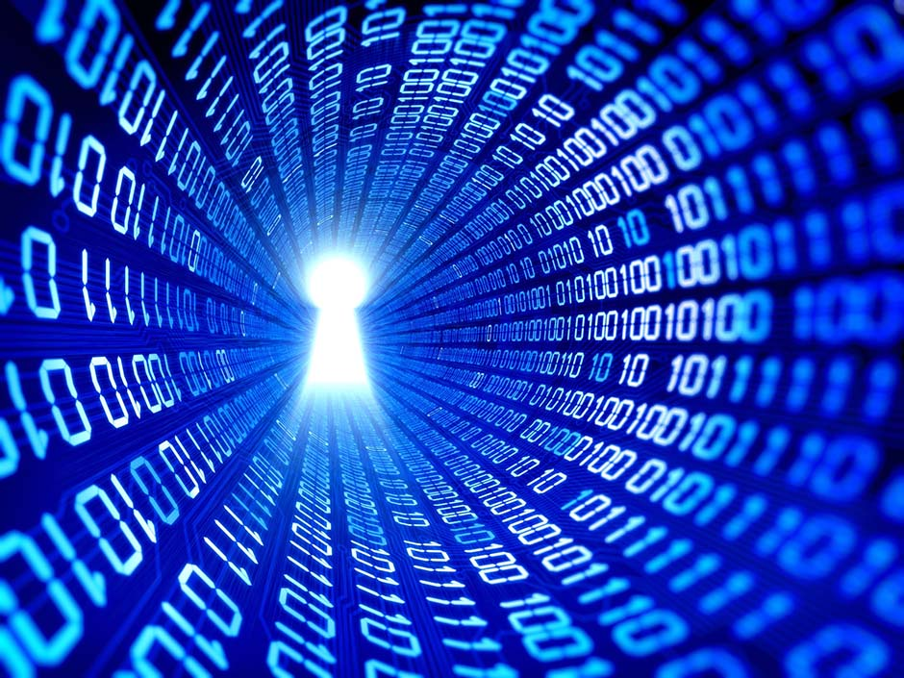
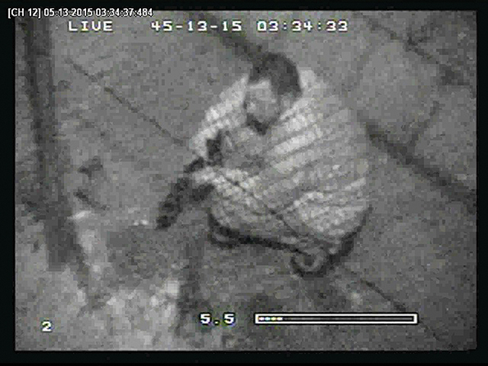
Scope of Standards
Two standards discussed:
CIP-006-6
Physical Access to Cyber Systems
CIP-014-2
Physical Security of Transmission Systems

Slide 4
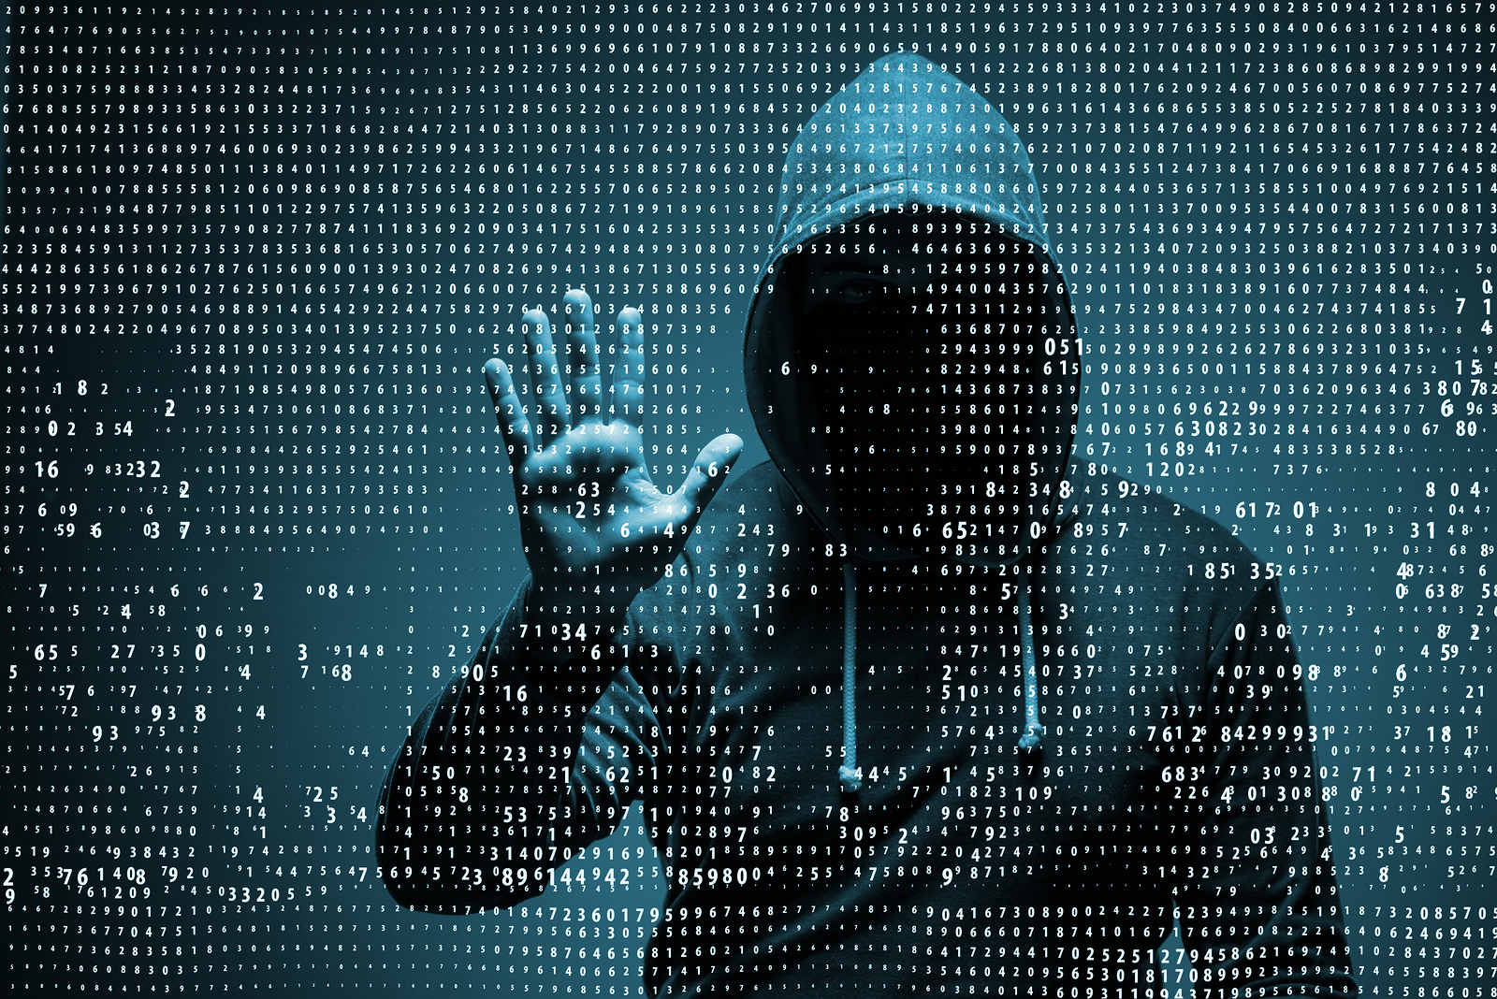
Purpose of Standards
CIP-006-6
To manage physical access to BES Cyber System by specifying a physical security plan in support of protecting BES Cyber Systems against compromise that could lead to misoperation or instability in the BES.

Slide 5
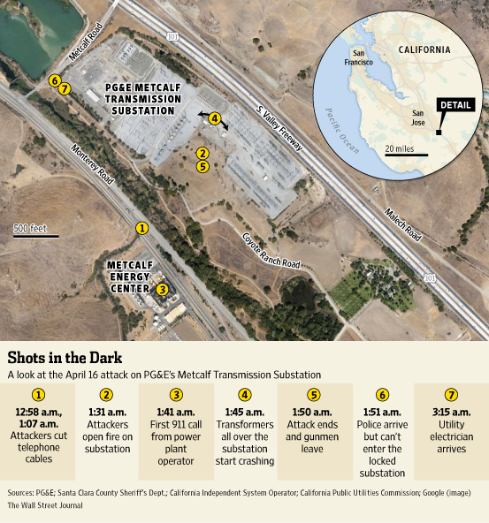
Purpose of Standards
CIP-014-2
To identify and protect Transmission stations and Transmission substations, and their associated primary control centers, that if rendered inoperable or damaged as a result of a physical attack could result in instability, uncontrolled separation, or Cascading within an Interconnection.

Slide 6
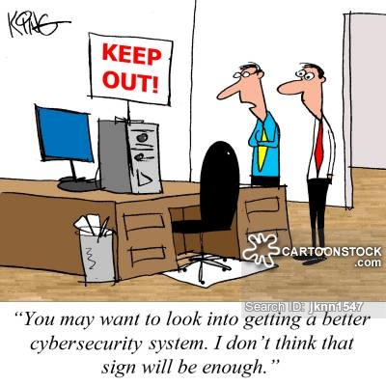
Exploiting The Human Factor
“One of the foundational precepts of Stratfor’s security analysis is that as security measures become more effective, people increasingly become the weakest link in a security system.”
- Scott Stewart, Stratfor 2017

Slide 7
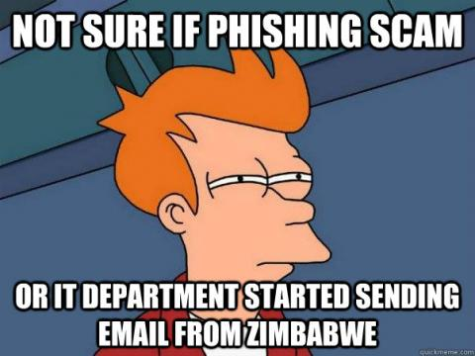
Exploiting The Human Factor
Are we negating improved technical barriers?
Problems continue to arise from:
Unlocked workstations
Unsecure network connections
Social engineering tactics
Opinion Poll…what has more effect:
Combining charm, psychology and sociology?
Technical ability to hack a system?

Slide 8
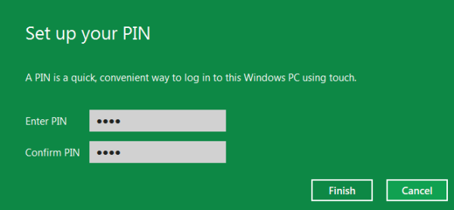
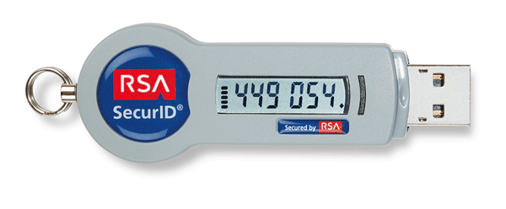
Exploiting The Human Factor
Why are attackers changing their tactics?
Because our physical access controls are now broken into three categories:
Something you know
Something you are
Something you have

Slide 9
Exploiting The Human Factor
More attackers are relying on charisma!
Username and Password scamming for users
Administrators convinced to reset user credentials
Popular Strategies:
Fake President Fraud
IRS Agent Fraud
Nigerian Prince/Doctor/Family

Slide 10
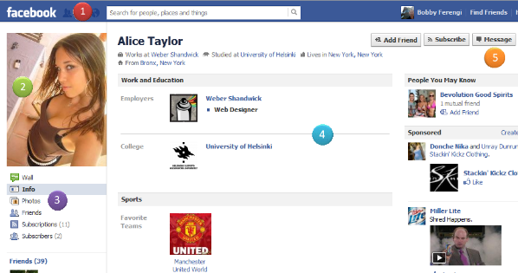
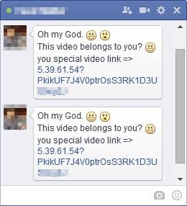
Exploiting The Human Factor
Why are more companies blocking access to social media sites such as Facebook and Instagram?
SpearPhishing!
Notes:
Through the fake account, the hackers persuaded the employee to set up a website for the woman's business. When the hackers, in the guise of the female "friend," sent a file to his work email account, he opened the attachment. The malware within infected his company's network, allowing the hackers to gather sensitive information on at least six of the firm's clients. This "virtual honey-trap" operation demonstrates the variety of social engineering approaches that can be used to trick people into unwittingly compromising cybersecurity.

Slide 11
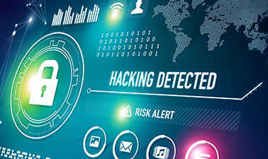
Hacking The Power Grid
“Of the hundreds of well-funded hacker groups that Dragos Inc. tracks globally, roughly 50 have targeted companies with industrial control systems. Of those, Dragos Inc. has found only six or seven groups that have reached into companies' so-called "operations" network—the actual controls of physical infrastructure. And even among those cases, only two such groups have been known to actually trigger real physical disruption.” – Greenberg & Lee, 2017, Wired.com

Slide 12
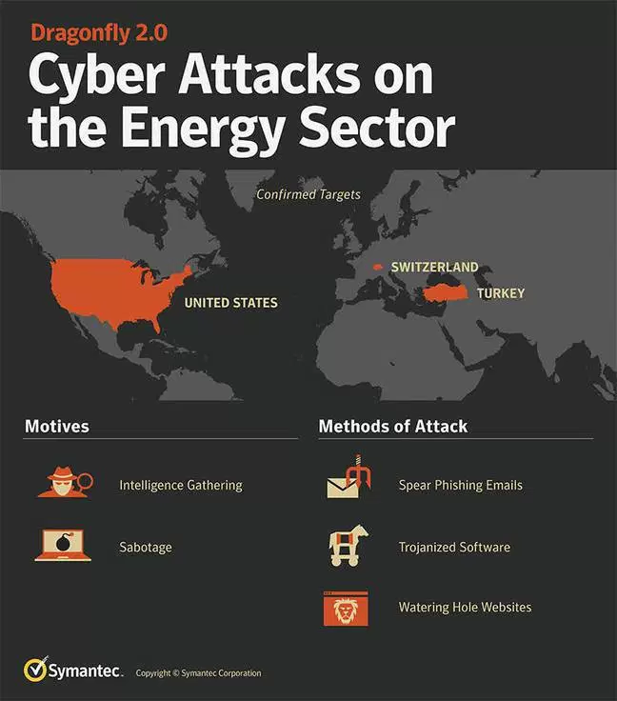
Hacking The Power Grid
Dragonfly 2.0 (Symantec Corp., 2017)
Campaign of attacks on energy companies in spring and summer of 2017
Hackers are focusing on three steps:
Network Breach
Operational Access
Coordinated Attack
Notes:
The hackers used a range of techniques to reach their intended targets, according to DHS. They often began with a "spearphishing" email, a customized message to lure users into clicking and downloading malware or giving up their login credentials.
Many of the hackers' emails included a resume purporting to come from an engineer with experience managing industrial control systems. Others were sent from accounts hijacked from within a target organization, making them seem more trustworthy, and included a subject line marked "AGREEMENT & Confidential."

Slide 13
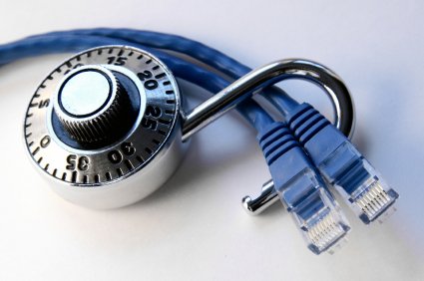
Hacking The Power Grid
Network Break
“When government agencies or the press warn that hackers have compromised a power utility, in the vast majority of cases those intruders haven't penetrated the systems that control the flow of actual power, like circuit breakers, generators, and transformers. They're instead hacking into far more prosaic targets: corporate email accounts, browsers, and web servers.” – Andy Greenberg, 2017
Network Breaks focus on three areas:
Corporate email accounts
Browsers
Web servers
Notes:
Those penetrations, which typically start with spearphishing emails, or "watering hole" attacks that infect target users by hijacking a website they commonly visit, don't necessarily differ from traditional criminal or espionage-focused hacking. Most importantly, they don't generate the means of causing any physical damage or disruption. In some cases, the hackers may be performing reconnaissance for future attacks, but nonetheless don't get anywhere near the actual control systems that can tamper with electricity generation or transmission.

Slide 14
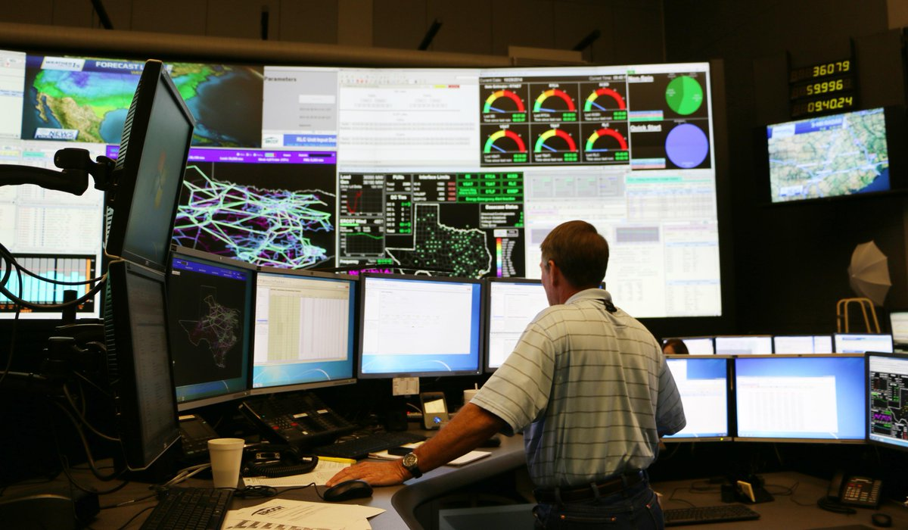
Hacking The Power Grid
Operational Access
“When hackers penetrate OT, or gain so-called operational access, they've moved from the computer systems that exist in practically every modern corporation to the far more specialized and customized control systems for power equipment, a major step towards manipulating physical infrastructure.” – Andy Greenberg, 2017
Operational Access activities focus on:
Familiarity with user interfaces
Operating Procedures
Desktop Guides

Slide 15
Hacking The Power Grid
Coordinated Attack
“In the Ukrainian blackout of late 2015, the first-ever confirmed case of hackers causing a power outage, the intruders manually opened dozens of circuit breakers at three different facilities across the country, using remote access to electric distribution stations' control systems—in many cases by literally hijacking the mouse controls of the stations' operators. Analysts who responded to the attack believe it likely required months of planning and a team of dozens working in coordination.” – Andy Greenberg, 2017
Notes:
Scope and Duration - "If they wanted to do the full Eastern Interconnect, that’s exponentially more resources," he says, referring to the grid that covers nearly the full eastern half of the US. "And if they want to take it down for a full week, that’s an exponential of an exponential.“
The second Ukrainian blackout attack used a piece of malware known as Crash Override, or Industroyer, capable of automating the process of sending sabotage commands to grid equipment, and built to be adapted to different countries' setups so that it could be deployed broadly across multiple targets.

Slide 16
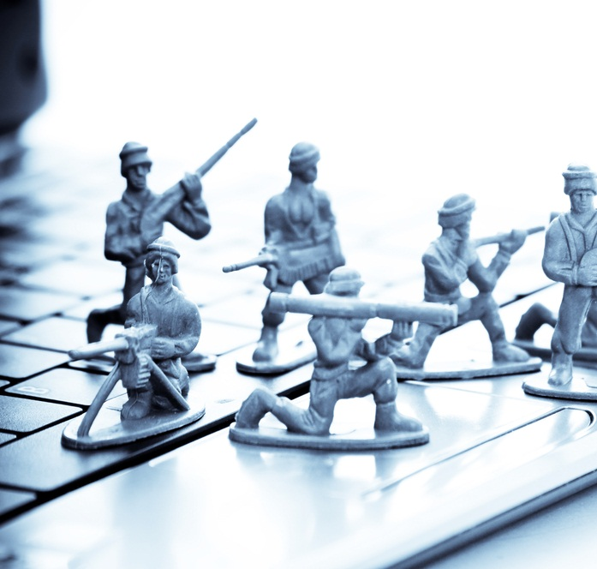
Hacking The Power Grid
In 2015 and 2016 Ukraine was subject to TWO cyber attacks
2015 = Distribution, 2016 = Transmission
In both cases attackers were VERY patient
Coordinated Attacks focus on:
Making the choice between scope and duration
Malware complexity
Notes:
Scope and Duration - "If they wanted to do the full Eastern Interconnect, that’s exponentially more resources," he says, referring to the grid that covers nearly the full eastern half of the US. "And if they want to take it down for a full week, that’s an exponential of an exponential.“
The second Ukrainian blackout attack used a piece of malware known as Crash Override, or Industroyer, capable of automating the process of sending sabotage commands to grid equipment, and built to be adapted to different countries' setups so that it could be deployed broadly across multiple targets.

Slide 17
Protecting The Power Grid
“Because the energy grid is so complex and interconnected, managing it requires constant diligence, planning and coordination. Complicating matters, cyber threats to the grid are not static. They evolve — and so must the industry’s efforts to prepare.” – Scott Aaronson, 2017
The Four-Pronged Approach
NERC Reliability Standards
Electricity Subsector Coordinating Council
Sharing CIP Responsibilities
“Defense-In-Depth”
Notes:
(1) NERC is an independent, government-certified, standards-setting body that develops and enforces critical infrastructure protection standards for the grid, all under the oversight of the Federal Energy Regulatory Commission.
(2) The electric power industry, through the Electricity Subsector Coordinating Council (ESCC), coordinates closely with the government to prepare and respond to national-level incidents affecting critical infrastructure.
(3) Involves enhancing resiliency, redundancy and the ability to recover should an extraordinary event occur.
(4) Working with the ESCC, the Edison Electric Institute developed the cyber mutual assistance program.

Slide 18
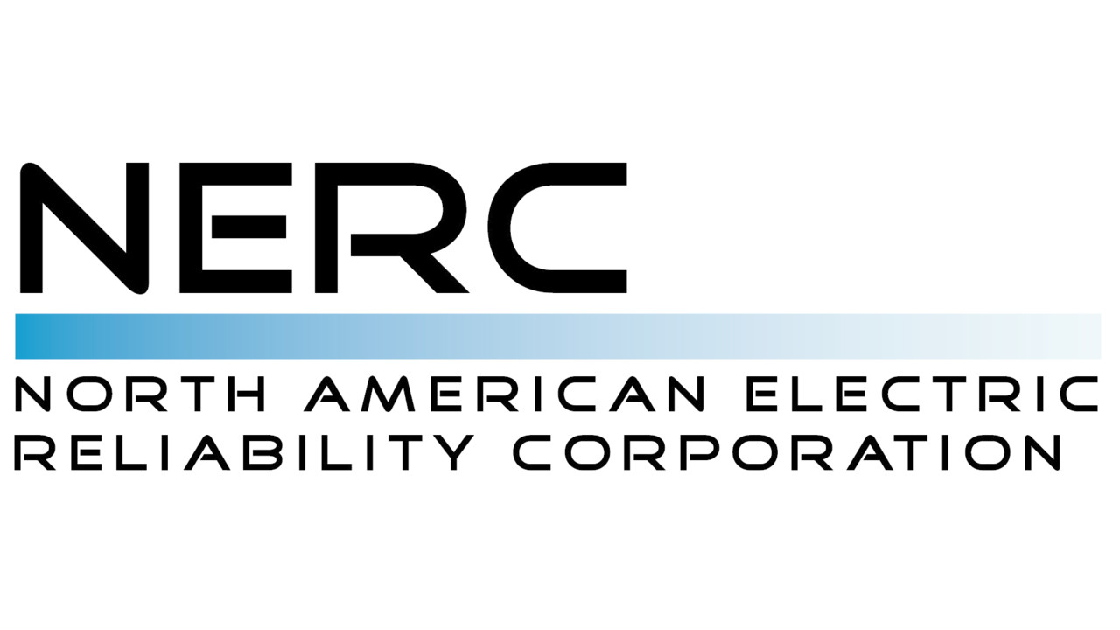
Protecting The Power Grid
NERC Reliability Standards
Evolved threats required evolved standards
Ensures reliable operations across all segments of industry
Unique to the power industry
Drive training, site-specific security, planning
Notes:
As threats to the grid evolve, so do the standards. This ensures that the energy grid operates reliably across all segments of the industry, including the grid facilities of investor-owned electric companies, electric cooperatives and public power utilities. The electric power industry is the only critical infrastructure industry subject to mandatory and enforceable cyber and physical security standards. To comply with these standards, users, owners and operators of the nation’s energy grid implement risk and security training, background checks, and site-specific security and incident-response plans to protect against an attack.

Slide 19
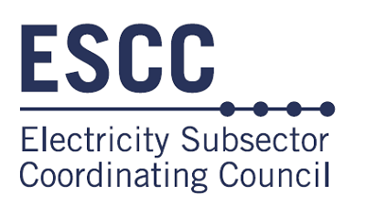
Protecting The Power Grid
Electricity Subsector Coordinating Council
Plan and exercise responses to grid attacks
Communicate threat information to government and stakeholders
Deploying government-developed advanced technologies
Coordinate with interdependent critical industries
Notes:
The ESCC focuses on several key areas, including planning and exercising coordinated responses to any attacks on the energy grid; making sure that information about threats is communicated quickly among government and industry stakeholders; deploying government-developed advanced technologies on energy systems that improve situational awareness of threats to the grid; and working closely with other interdependent critical industries (communications, financial services, transportation, water and downstream natural gas) to prepare for major incidents. This helps all parties better understand threats, protect mutual dependencies, and share information.
The industry also works closely with the Electric Power Research Institute, NERC, and the government, including the National Laboratories, to enhance resiliency and to mitigate threats from geomagnetic disturbances and electromagnetic pulses.

Slide 20
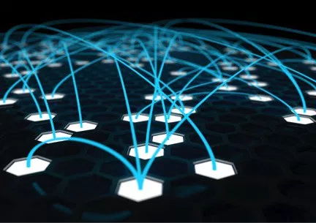
Protecting The Power Grid
Sharing CIP Responsibilities
Cyber Mutual Assistance Program
Conducting national-level exercises (GridEx)
Electricity Information Sharing and Analysis Center (E-ISAC)
Notes:
Industry cybersecurity experts from more than 120 companies are part of the program and can be deployed in the event of a regional or national cyber incident.
The level of coordination among regulators, electric companies, the government, and the ESCC is unprecedented. It has been cited as a model for other critical infrastructure industries by the National Infrastructure Advisory Council, a group created after 9/11 to inform the president on critical infrastructure issues.

Slide 21
Protecting The Power Grid
“Defense-In-Depth” Strategies
Aims to enhance resilience, redundancy and recovery against attacks
Focuses on physical and cyber security of transmission facilities
Routinely exercise incident-response plans (simulations)

Slide 22
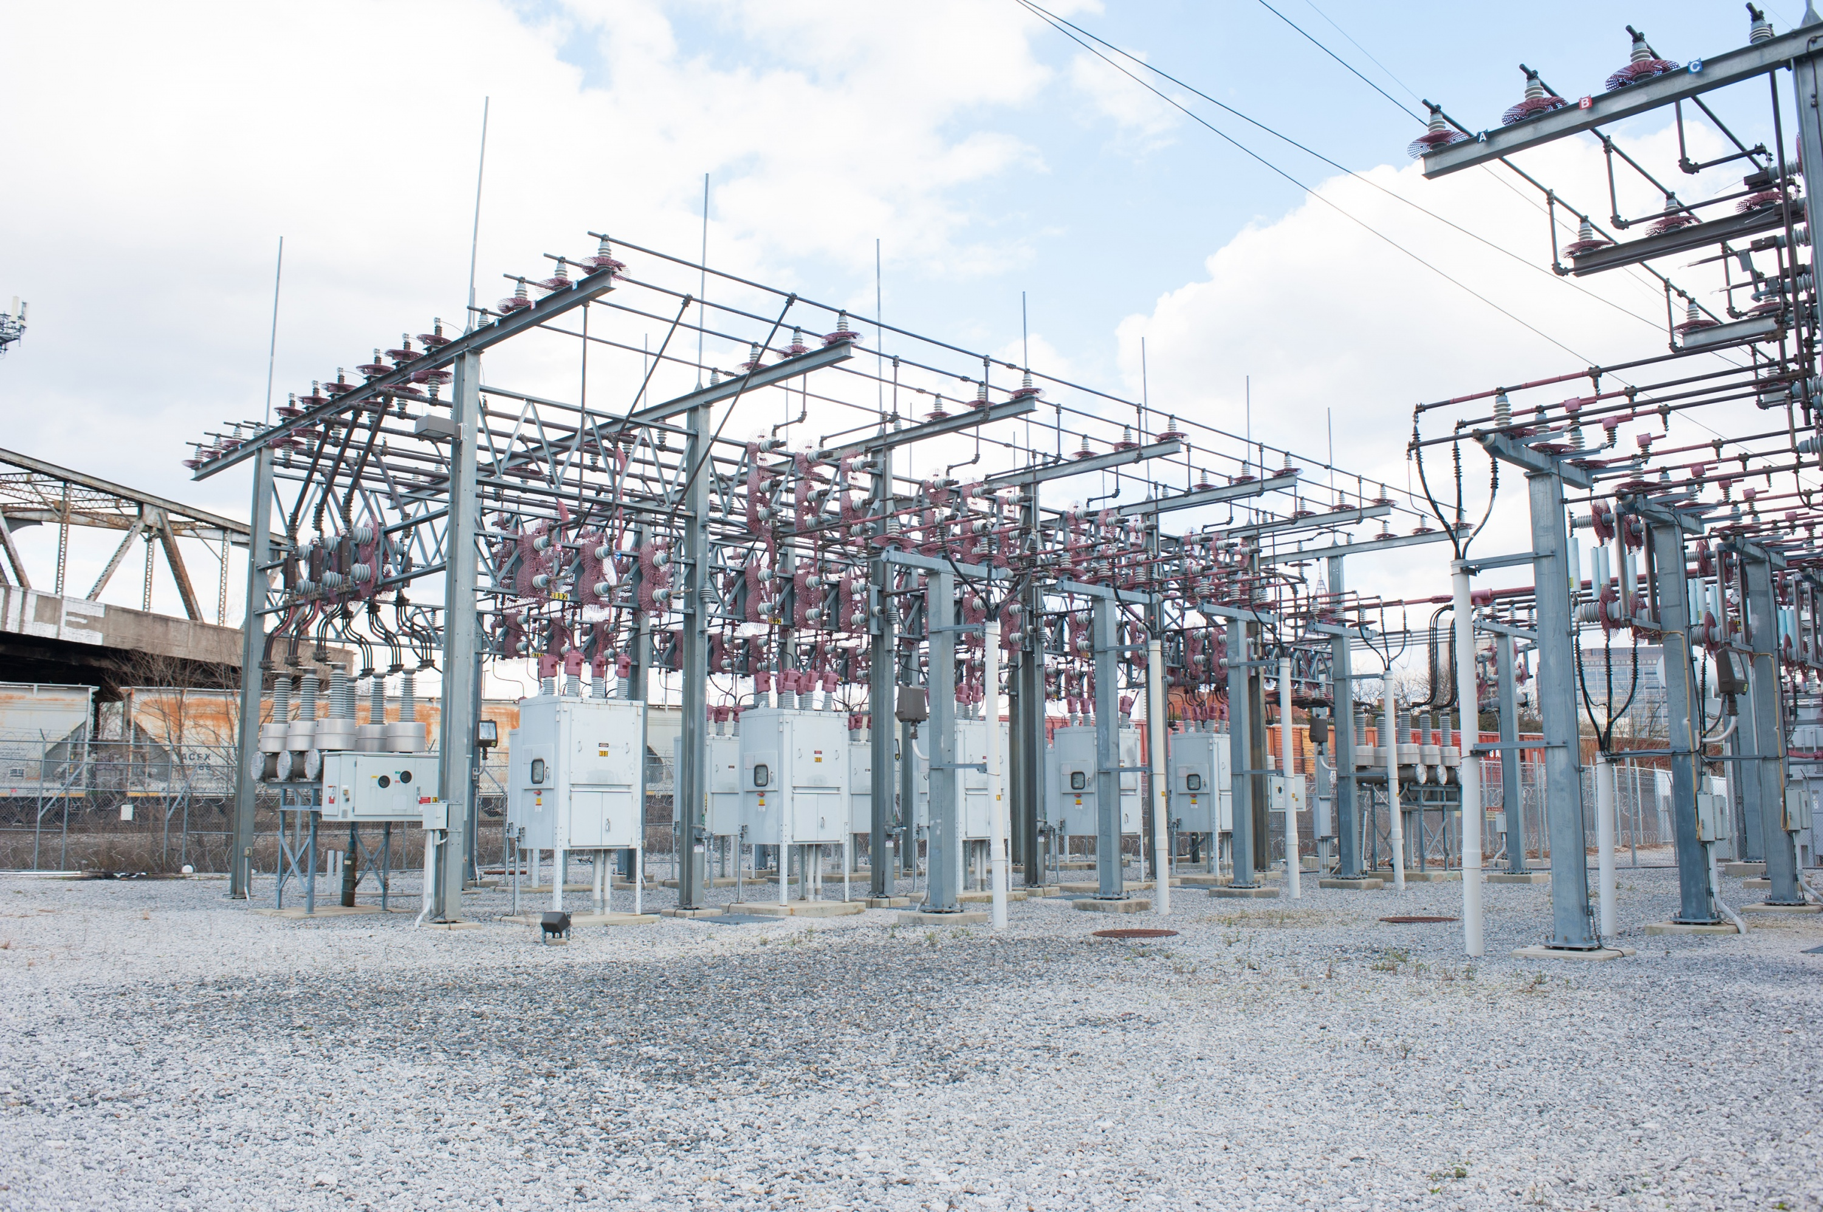
Physical Security of the Transmission System
Equal threat of a Cyber Attack!
2013 began years of increased activity
Substations and Transmission lines are particularly vulnerable
National and International Incidents spurred CIP-014
Notes:
2013 Metcalf Substation, 2016 repeated attacks throughout Eastern Europe and Southeast Asia
The unfortunate truth is that substations and power lines on the electric transmission system are particularly vulnerable to physical attacks, where large, high-voltage transformers are typically located in exposed outdoor conditions, and transmission towers can be seen stretching to the horizon

Slide 23
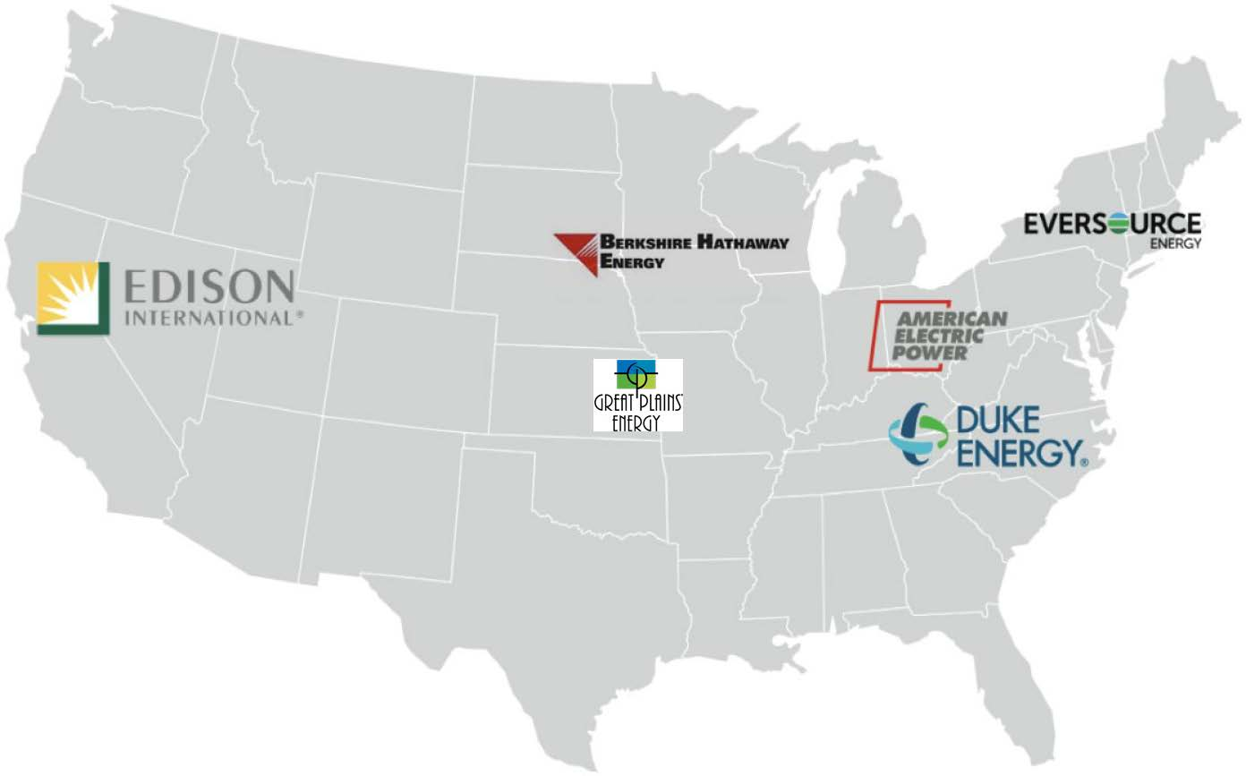
Physical Security of the Transmission System
How can equipment availability play a role?
“In 2015, a group of eight U.S. transmission system operators (TSOs) announced a new initiative to speed their response to major physical attacks or other equipment failures on the transmission grid by establishing regional warehouses and inventories to long lead-time critical replacement technologies.” – James McCray, 2016
Grid Assurance
LLC that stockpiles critical equipment
Aims to prevent prolonged transmission outages
What’s the biggest problem here?
Notes:
Participants include American Electric Power, Berkshire Hathaway Energy, Duke Energy, Edison International, Eversource Energy, Exelon, Great Plains Energy, and Southern Company. These companies have committed to a memorandum of understanding to develop Grid Assurance
These companies have committed to a memorandum of understanding to develop Grid Assurance, a limited liability company that will stockpile the critical equipment necessary to shield utility customers from prolonged transmission outages in multiple locations across the nation.
Grid Assurance will own and provide participants and subscribers with timely access to an inventory of emergency spare transmission equipment that could otherwise take months to acquire.

Slide 24
Physical Security of the Transmission System
What impact has CIP-014 had on the industry?
Awareness and Acknowledgment of threats and vulnerabilities such as:
Aging Infrastructure
Natural Disasters
Coordinated Attacks
What problems still exist?
Can a single major attack have long term regional and national effects?
A study in 2015 revealed some shocking findings:
49% of utilities have identified threats and vulnerabilities to critical assets, though 28% haven’t taken further action
42% of utilities surveyed have already developed physical security plans to address potential threats
40% have not taken any hardening measures to limit or prevent damage to critical assets in the last 2 years
Notes:
Since the release of the NERC CIP-014 regulations in 2014, utilities are significantly more aware of potential threats and vulnerabilities in the grid. Aging infrastructure, natural disasters, and coordinated attacks on key substations are all major issues.
Unfortunately, on the transmission grid, a single major attack or breakdown can have long-term regional or national effects on the United States. A recent 2015 industry survey looked at initiatives that over 200 TSOs have taken since the NERC ruling. Findings included:
49% of utilities have identified threats and vulnerabilities to critical assets, though 28% haven’t taken further action
42% of utilities surveyed have already developed physical security plans to address potential threats
40% have not taken any hardening measures to limit or prevent damage to critical assets in the last 2 years

Slide 25
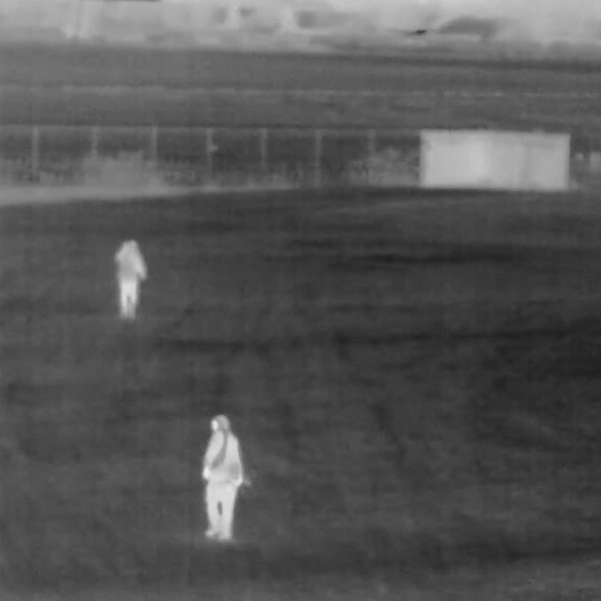
Physical Security of the Transmission System
How is Vulnerability Determined?
Threat and Vulnerability Evaluation
Unique Characteristics of the facility
Detailed history of attacks on similar facilities
Intelligence regarding threats from various sources
This is a continuous process!!!
Notes:
Detailed history of attacks should include frequency of attack, geographic proximity of similar facilities, and severity of past attacks and security related events.
Image courtesy of the Wall Street Journal, 2016)

Slide 26
Physical Security of the Transmission System
Specific Points of Vulnerability (National Research Council, 2012)
Transmission Substations
Soft Targets (Stand-off and Penetration Attacks)
Difficult to protect
Difficult to obtain specialized repair parts
Transmission Lines
Ease of disabling lines
Towers easy to damage
Potential for domino effect
Notes:
Bulk Transmission Substations have unique security concerns in that they are relatively soft targets; they are vulnerable to stand-off attack as well as penetration attacks by adversaries compromising the substation’s perimeter fences. There is general agreement among security planners that key high-voltage substations are the most worrisome terrorist targets within the power transmission system.
Transmission lines are often very long and in sparsely populated areas. They make easy targets and cannot be well protected. However, they can also be repaired quickly unless there is a coordinated widespread attack. Even then, the transmission lines can be repaired almost as soon as replacement towers can be delivered. Thus transmission lines are of less concern than substations.

Slide 27
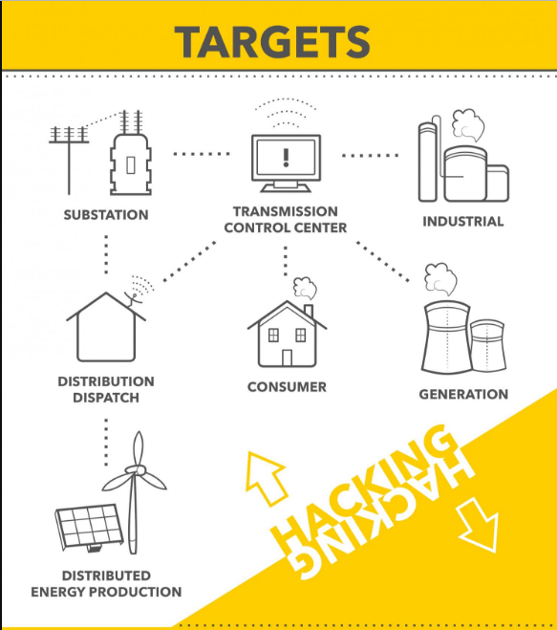
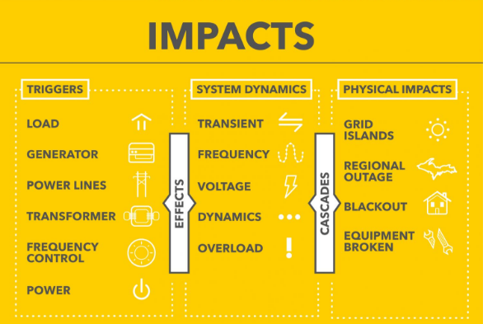
Physical Security of the Transmission System
Countermeasures
Security Engineering Techniques
Calculating blast effects
Using hardened construction
Calculating minimum standoff ranges
Improved surveillance Equipment
Point vibration sensors
Leaky coaxial cable sensors
Seismic and electrostatic field disturbance sensors
Microphonic cable
What about underground systems?
Remote locking devices for manhole covers
Access point monitoring
Notes:
Physical Security Countermeasures
Property Protection – doors, locks, lightening
Structural hardening – physical construction of barriers
Physical access control – authorized users
Intrusion detection – guards and surveillance
Physical security procedures – escorting visitors, badge tracking, logs
Contingency planning – backup generators, off-site storage
Training – training people to spot suspicious activities

Slide 28
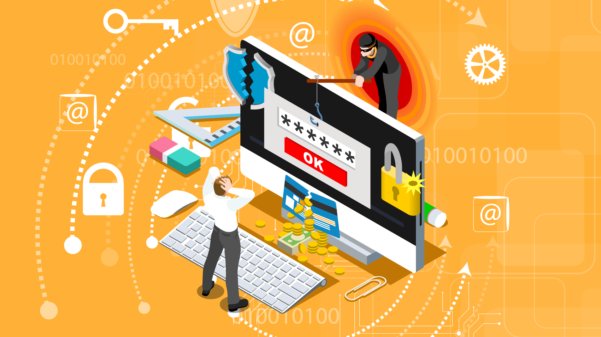
Recognition and Response
NERC and Electricity Information Sharing and Analysis Center (E-ISAC)
Created the “Cyber Intrusion Guide”
Written for System Operators but applicable to everyone
Focus on Recognizing and Responding to a Cyber Attack in progress

Slide 29
Recognition – are we under attack?
Why are System Operators the first and last defense?
System Operators possess a combination of direct access to both Cyber Assets and Field Personnel…as such we may be the first to recognize threats in real-time
As threats evolve, listing anomalies becomes more difficult
Greatest Tools
Operator Awareness
Questioning Attitude
If you see something…say something!
What are we looking for?

Slide 30
Response– we under attack!
Internal Actions and Notifications
Communicate with other operators and Shift Supervisor
Supervisor notifies Cyber Security Team ASAP
Give specific details on impact of attack
Critical for resolution, containment and preservation
Operator actions
Internal
Contact EMS, IT and CySec
Notify other operators
Disconnect workstation
DO NOT POWER DOWN
External
Notify neighbors
CySec takes over
Law enforcement confiscates equipment

Slide 31
References
“Hacking a Power Grid in Three (Not-So-Easy) Steps”. (2017). WIRED
“Hackers Gain Direct Access to US Power Grid”. (2017). WIRED
“How America Could Go Dark”. (2017). The Wall Street Journal
“Physical Security Threats to the Transmission and Distribution Grid, Part 1”. (2016). Navigant Research
“Protecting the Energy Grid From Today’s Cyber Threats”. (2017). Insider Sources
“The Weakest Link in the Cybersecurity Chain Is Sitting at the Keyboard”. (2017). Worldview.stratfor.com
“Terrorism and the Electric Power Delivery System”. (2012). The National Academic Press
“Reliability Guideline: Cyber Intrusion Guide for System Operators” . (2017) NERC

Slide 32
Objectives
Identify the scope of BES Physical Security Standards
Identify the purposes of CIP-006-6 and CIP-014-2
Identify the problems associated with human error in Cybersecurity
List the three areas of concern associated with power grid hacking
Identify four elements of the four-pronged approach to protecting the power grid
Identify specific concerns associated with physical security of the transmission system

Slide 33
Physical and Cyber Security
Josh Aldridge
2018 Operator Training Seminar

