Slide 1
Australian Blackout Event
On Sep 28th 2016
Alex Lee
Operations Planning Engineer
3/29/2018

Slide 2
Objectives
Identify factors that contributed to the cause of the Australian Blackout Event
Identify steps of restoration that were used during this event
Recognize market impacts associated with the blackout event
Identify lessons learned from the event

Slide 3
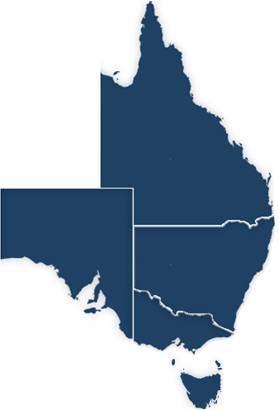


Australian Energy Market Operator (AEMO)
AEMO was established on July 2009
Electricity Markets
  National Electricity Market (NEM) since Dec. 1998
  Wholesale Electricity Market (WEM) since Sep. 2006
Gas Markets
  Victorian Declared Wholesale Gas Market (DWGM)
  Short Term Trading Market (STTM)
  National Gas Market
  Western Australia Gas
Wholesale Electricity Market
Non-AEMO
National Electricity Market
Northern
Territory
Western
Australia
Queensland
South
Australia
New South
Wales
Victoria
Tasmania
Notes:
AEMO: 50 Hz. Two 24/7 control rooms in different states (either one could control entire system).
AEMO is currently delegating Western Power to operate the system until AEMO setup systems to operate it.
WEM: 5,798 MW gen capacity. 4,013 W peak demand. 7,800 km transmission line. 18 TWh of electricity usage/year. 1 mil customers. Bilateral contracts, Short Term Energy Market (STEM) = DAM, Balancing Market. Reserve Capacity Mechanism.

Slide 4
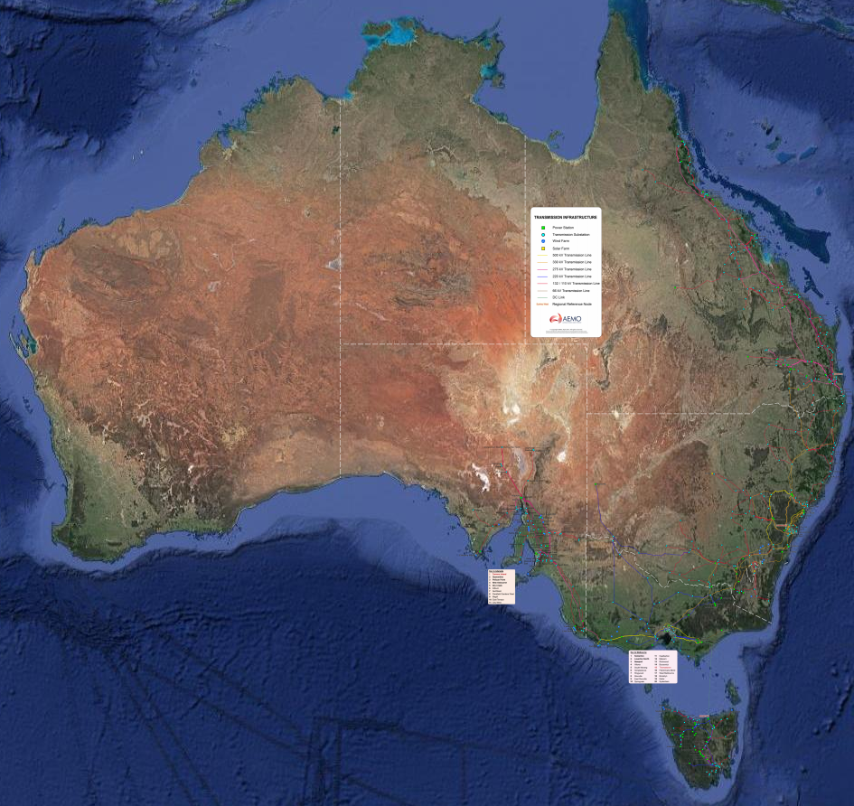
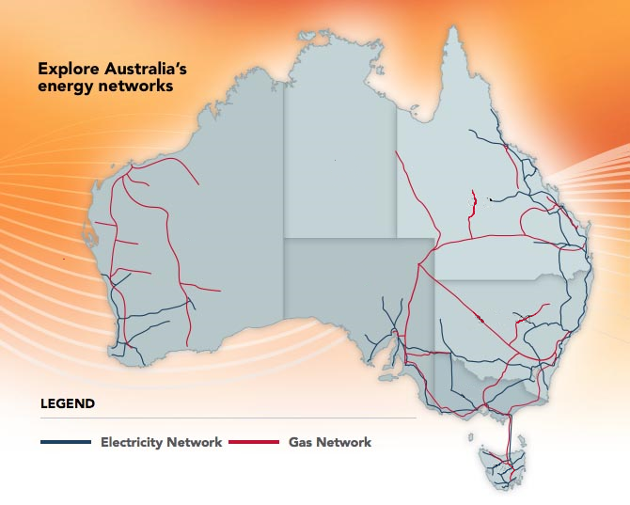
Challenging Terrain in Australia
Mainland is 70% desert
Weak Long Transmission Network with
numerous radial systems
source: AEMO website, www.aemo.com.au
Notes:
Australia: 85% of US land size, but less than 8% of US population (89% of 28 mil. Texas population).
Tasmania joined NEM in 2005 when the under water cable, Basslink HVDC with 500/600 MW limit to Tasmania/Victoria, was built in 2005.
Tasmania DC Tie was unavailable for 6 months Dec 2015 – June 2016.

Slide 5

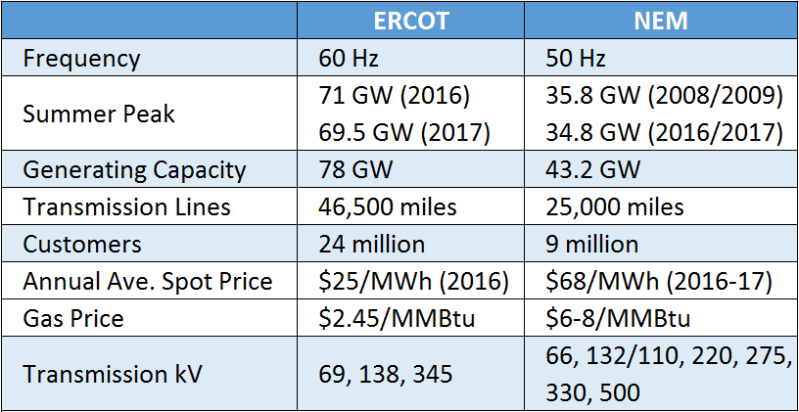
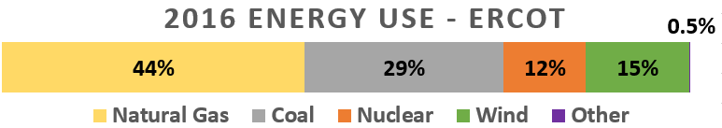
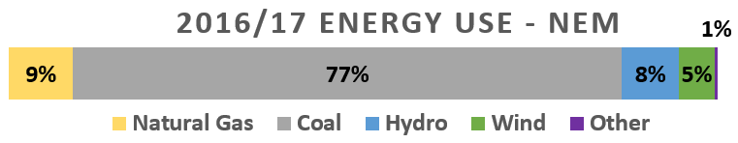
ERCOT vs. NEM High Level Overview
Queensland
9,508 MW (2016/17)
$78/MWh
TX
South Australia
3,397 MW (2010/11)
$93/MWh
New South Wales
14,764 (2010/11)
$67/MWh
Victoria
10,490 (2008/09)
$53/MWh
Tasmania
1,884 MW (2008)
$56/MWh
77% Coal back in 2003 as well.
Notes:
NEM: 34.8 GW in 2016/17 which is third highest load after 35.8 GW in 2008/09 and 35.6 GW in 2010/11.
Financial year is July-June. Summer is Dec-Feb. 200 TWh of electricity usage/year.
2016-17 prices are $103(QLD), 88$/MWH (NSW), $70(VIC), $123(SA), $76(TAS) – all in AUD not USD.
$16.6 bil AUD traded in 2016-17. Price cap/floor of $13,800/-1,000 AUD per MWh, 10,500/-764 USD.
Tasmania Ave price for 15/16 increased to $74(USD) from $28.28(USD) in 2014-15.

Slide 6
Blackout Event – Sep. 28th 2016 @ 16:18
Sequence of event (16:16:46 – 16:18:15)
  Extreme weather caused transmission faults.
  Significant voltage dips caused Wind Generators to reduce output.
  Heywood Interconnector (AC Tie) exceeded its limit and automatic power system protection operated.
  System imbalance resulted in the state-wide blackout (1,895 MW of demand) in South Australia.

Slide 7
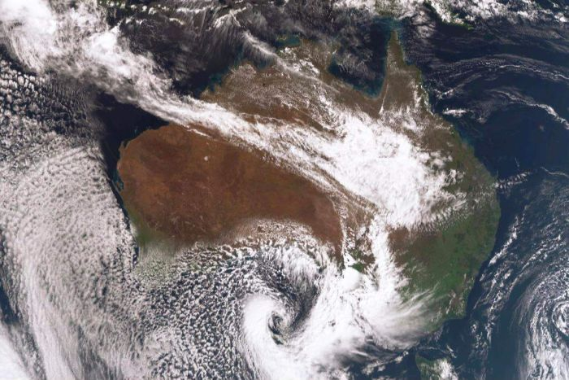
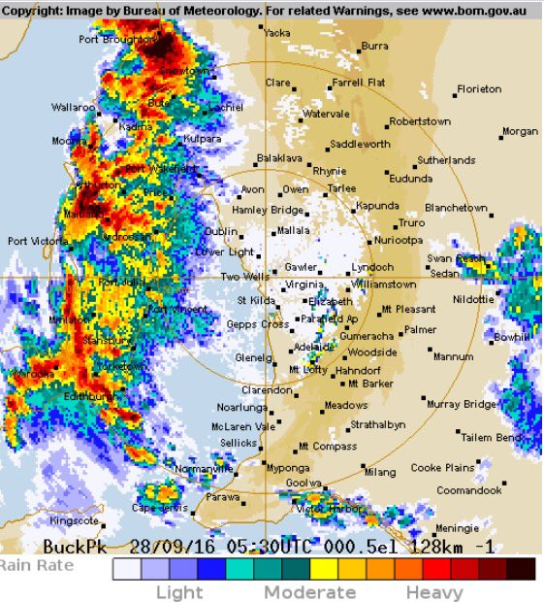
South Australia Cyclone: Sep. 28th-30th 2016
Wind speed: 40-60 mph with gusts up to 70 mph common (similar intensity to a weak tropical storm). Reports of isolated 85 mph gusts.
  Ike in 2008 was Category 2 hurricane with highest wind speed of 145 mph.
Two weeks prior, Adelaide experienced flooding. This acted to loosen the soil, resulting in greater ease in trees, power lines, and towers coming down.
Widespread thunderstorms, cloud to ground lightning strikes (20,000+), damaging hail, and heavy rainfall (flooding).
Strongest storm to hit South Australia in 50 years.
Adelaide
Notes:
Hurricane Dolly in July 23rd 2008 with 85 mph winds was Category 1 in Texas.
Hurricane Katrina (175 mph) in 2005 was Category 5 (157+ mph)

Slide 8
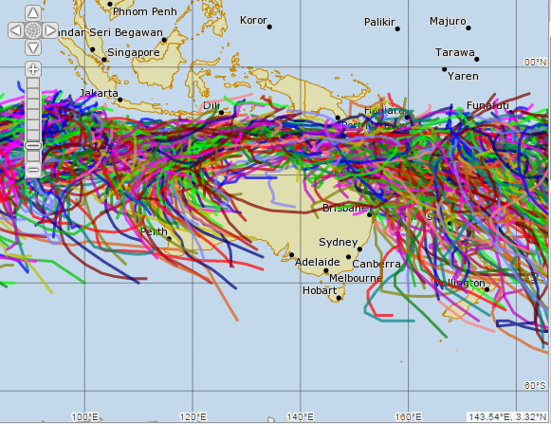
Historical Cyclone Path since 1969.
South Australia never experience a cyclone
Infrastructures may have weak resistance to weather events.

Slide 9
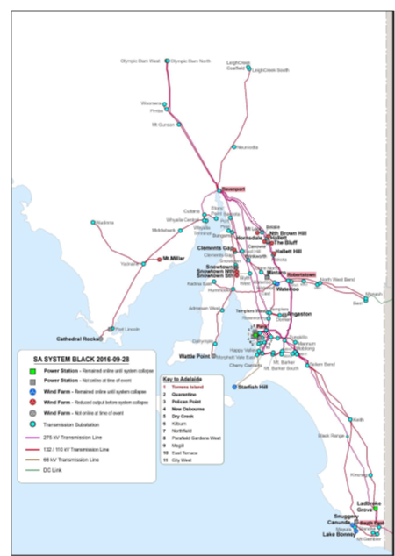
Pre-Event
System Configuration
  Load: 1,895 MW (850,000 customers)
DC Tie
Limit 220
AC = 525
AC Tie
Limit 600
source: AEMO, Final Report SA Black System 28 September 2016.

Slide 10
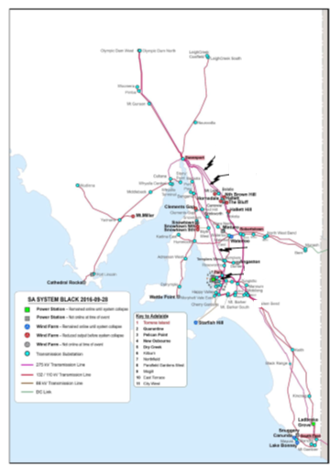
Transmission Line Faults
Six system faults on four lines, three ultimately lost.
Fault # | Time | kV | Line | Voltage Dip @ Davenport
1 | 16:16:46 | 66 | Northfield – Harrow | 85%
2 | 16:17:33 | 275 | Brinkworth – Templers | 60%
3 | 16:17:59 | 275 | Davenport – Belalie | 40%
4 | 16:18:08 | 275 | Davenport – Belalie | 40%
5 | 16:18:13 | 275 | Davenport – Mt Lock | 40%
6 | 16:18:14 | 275 | Davenport – Mt Lock | 40%
Davenport
3-4
5-6
2
1
*note: RED indicates that line remained out of service after the fault.
source: AEMO, Final Report SA Black System 28 September 2016.
Notes:
F1: No detail on fault. Successful auto-reclose.
F2: two-phase-to-ground. No reclose attempt. Damaged towers bypassed.
F3/4: single-phase-to-ground. Successful auto-reclose. Second fault occurred within 30 seconds and remained opened. Damaged towers bypassed. Restored on 10/10
F5/6: single-phase-to-ground. Auto-reclose failed and all three phases locked out. Damaged towers bypassed. Restored on 10/12

Slide 11
Six Voltage Disturbances
100 seconds data
41 sec
15 sec
1
Davenport
3-4
5-6
2
2
1
3
4
5
6
source: AEMO, Update Report – Black System Event in South Australia on 28 September 2016

Slide 12
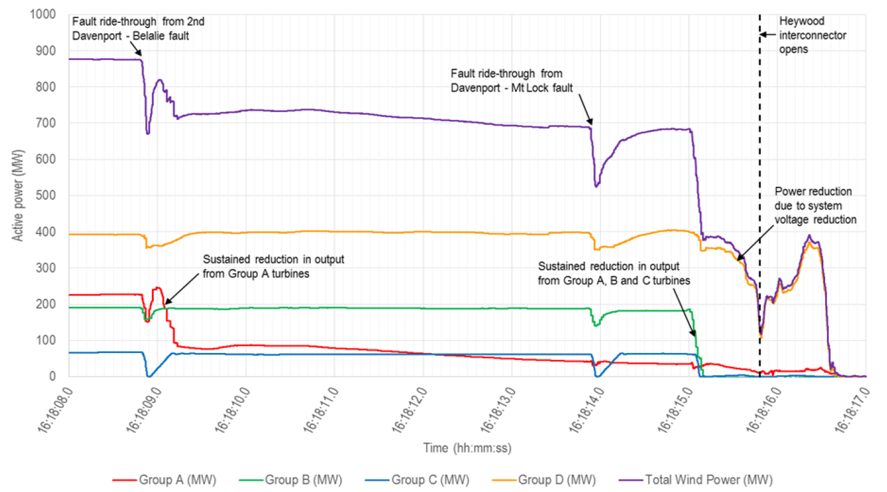
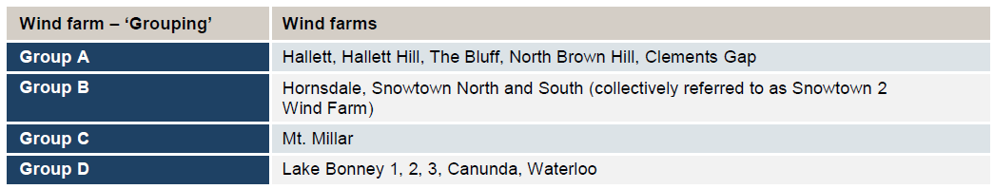
Wind Generation Reduction
10 seconds data
4
5
6
source: AEMO, Final Report SA Black System 28 September 2016.
Notes:
Showing voltage disturbances 4, 5, and 6.
Group A: Hallett, Hallett Hill, The Bluff, North Brown Hill, Clements Gap
Group B: Hornsdale, Snowtown North and South 2
Group C: Lake Bonney 1, 2, 3, Canunda, Waterloo
Group D: Mt. Miller
5 thermal units responded to voltage disturbance through physical characteristics (size, mass, inertia) and AVR. Operated till black out.
DC Tie: fast response time of < 20 ms during which the current is increased up to 150%.

Slide 13
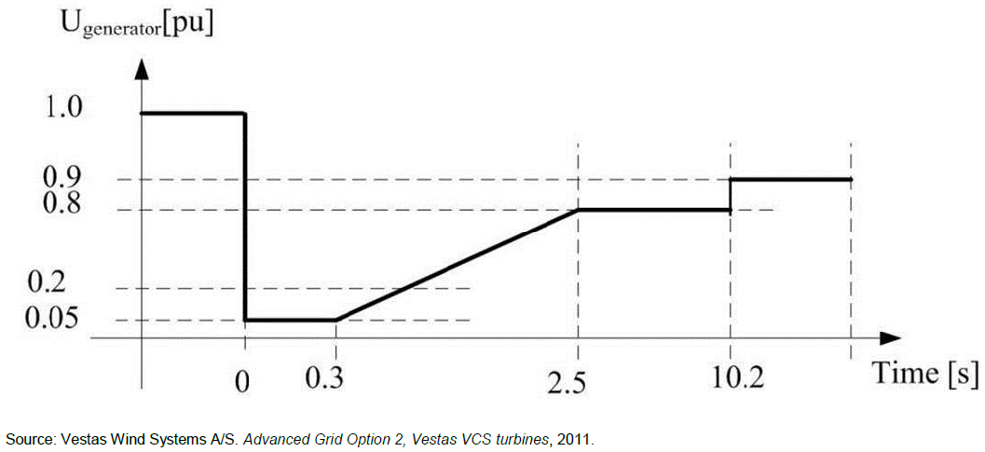
Low-Voltage Ride-Through (LVRT)
Purpose: remain connected and provide voltage recovery support.
Threshold: typically 80 – 90 % of normal voltage.
LVRT Withstand Capability
Notes:
Fault Ride-Through Mode applies to other power electronic technologies as well - inverters, HVDC, STATCOMs, etc.
Normal ride-through duration is up to 0.2sec.

Slide 14
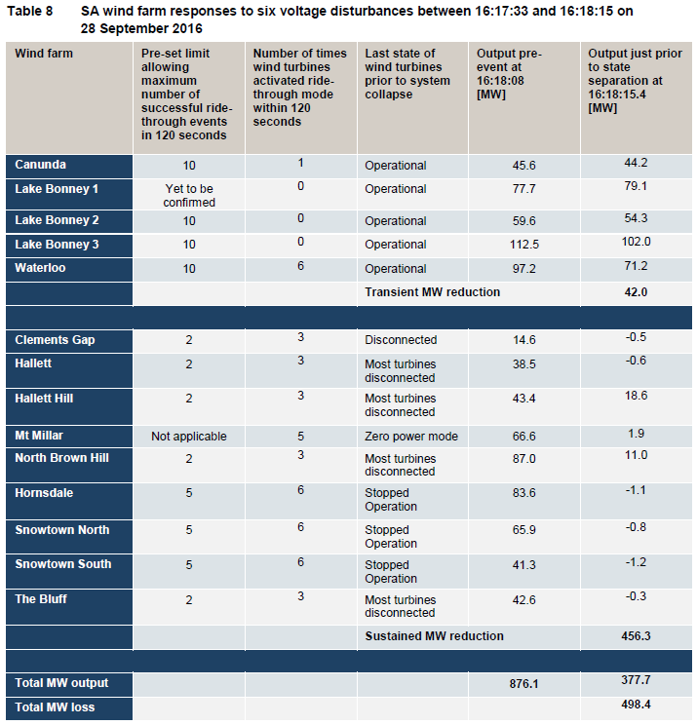
Wind Generation Reduction (Continued)
LVRT
  42 MW of expected reduction through normal transient ride-through response
  456 MW of unexpected sustained wind reduction
20 MW Over-Speed Trip
  Typically 55mph or more
source: AEMO, Final Report SA Black System 28 September 2016.

Slide 15
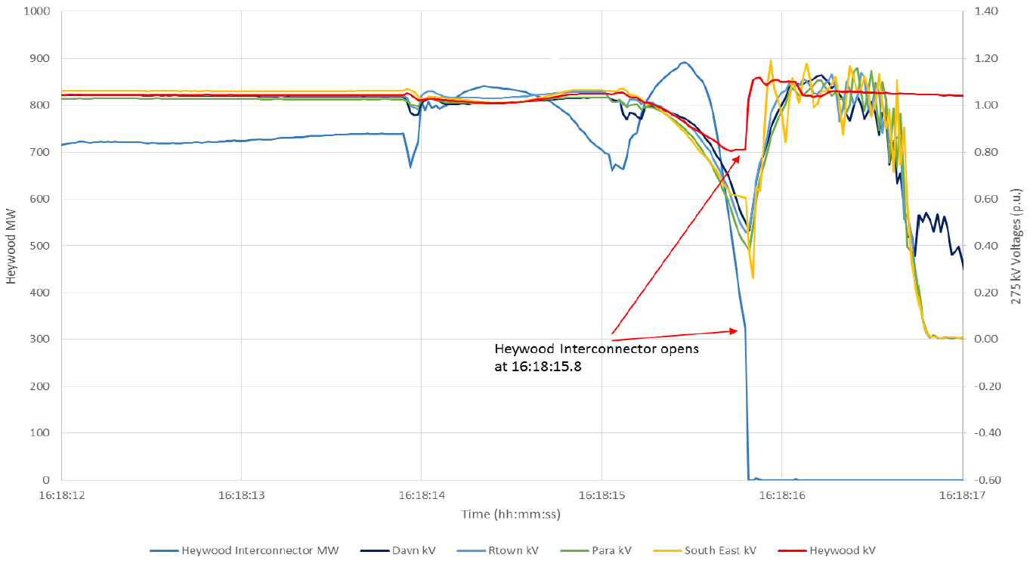
Heywood Interconnector (AC Tie) Trip
Flow increased from 525 MW to approximately 900 MW
  Limit = 600 MW
Tripped on Automatic Loss of Synchronism Protection Mechanism
5 seconds data
5
6
source: AEMO, Final Report SA Black System 28 September 2016.
Notes:
Showing voltage disturbances 5 and 6.

Slide 16
Frequency Collapse
2 seconds data
Immediate loss of ~900 MW caused rapid Rate of Change of Frequency (RoCoF), 6-7 Hz/sec.
Under-Frequency Load Shedding (UFLS), which is triggered at 49 Hz, is capable of arresting RoCoF up to 3 Hz/sec.
6
49 Hz
source: AEMO, Preliminary Report – Black Start System Event in South Australia on 28 September 2016
Notes:
RoCoF increases as size of the disturbance increases and ability to resist the disturbance (inertia) decreases.
Critical Inertia at ERCOT for loss of two STP trip is 0.8 Hz/sec.
Showing voltage disturbance 6 only.

Slide 17
Restoration Process: AEMO
Identify state of the power system
Secure any islands and devise restoration plan
Provide auxiliary supply to power stations
Restore load
Prepare transmission network
Continue 3-5.

Slide 18
Restoration Plans
Initiate two parallel plans at 16:30 (T+12min) :
    Use System Restart Ancillary Service (SRAS) #1.
    Use AC Tie.
Damaged Transmission
SRAS #2
DC Tie
SRAS #1
AC Tie

Slide 19
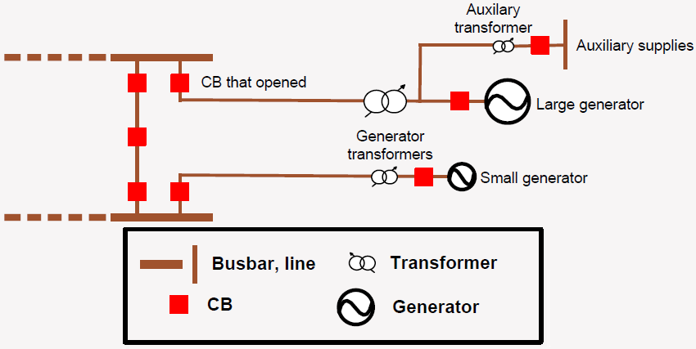
System Restart Ancillary Service (SRAS) #1
SRAS #1 – requested to start at 16:37 (T+19min)
  1 small unit (24 MW) & 1 large unit (128 MW)
  Successful test on May 21st 2016
  Small unit is not capable of energizing the transformer required to energize the 275 kV transmission network
  Circuit breaker for the large unit was closed but subsequently tripped five times due to in-rush current on the large generator side
Soft-Started during test vs. Hard-started during real blackout
source: AEMO, Final Report SA Black System 28 September 2016.
Notes:
SRAS = Black Start Generators in ERCOT
Soft-Start: start with three busbar CBs opened. When the last/third CB is closed, large in-rush current on the generator transformer and auxiliary transformer caused the large unit to trip -> instantaneous surge in in-rush current. Manages risk by opening an isolator.
Hard-Start: start with three busbar CBs closed -> gradual in-rush current. Manages the risk by opening CBs.

Slide 20
System Restart Ancillary Service (SRAS) #2
SRAS #2 – started automatically
  Successful test on Apr 19th 2016
  Pre-defined path required energizing damaged transmission lines and AEMO did not send instruction to start
  Emergency diesel generator which is used to start the unit tripped after 15 seconds of operations due to a stator earth fault which severely damaged the diesel generator
  Highly suggestive of lightning being the cause of the fault
source: AEMO, Final Report SA Black System 28 September 2016.
Notes:
SRAS 2 is still unavailable.
Stator earth fault: due to lack of isolation between the stator winding and its iron core.

Slide 21
Restoration from AC Tie
# | Time | Energization Event
1 | 17:23 (T+1h 5min) | AC Tie (Heywood – South East #2 275 kV)
2 | 17:33 (T+1h 15min) | South East – Tailem Ben 275 kV
3 | 18:06 (T+1h 48min) | Tailem Bend – Tungkillo 275 kV
4 | 18:09 (T+1h 51min) | Tungkillo – Para 275 kV
5 | 18:28 (T+2h 10min) | Para – Torrens Island 275 kV
6 | 18:42 (T+2h 24min) | AC Tie (Heywood – South East #1 275 kV)
 | … | Numerous other events
7 | 23:52 (T+7h 34min) | Tungkillo – Robertstown 275 kV
 | … | Numerous other events
8 | 09/29 12:15 (T+19h 57min) | Davenport – Bungama 275 kV
8
7
5
4
3
2
1,6

Slide 22
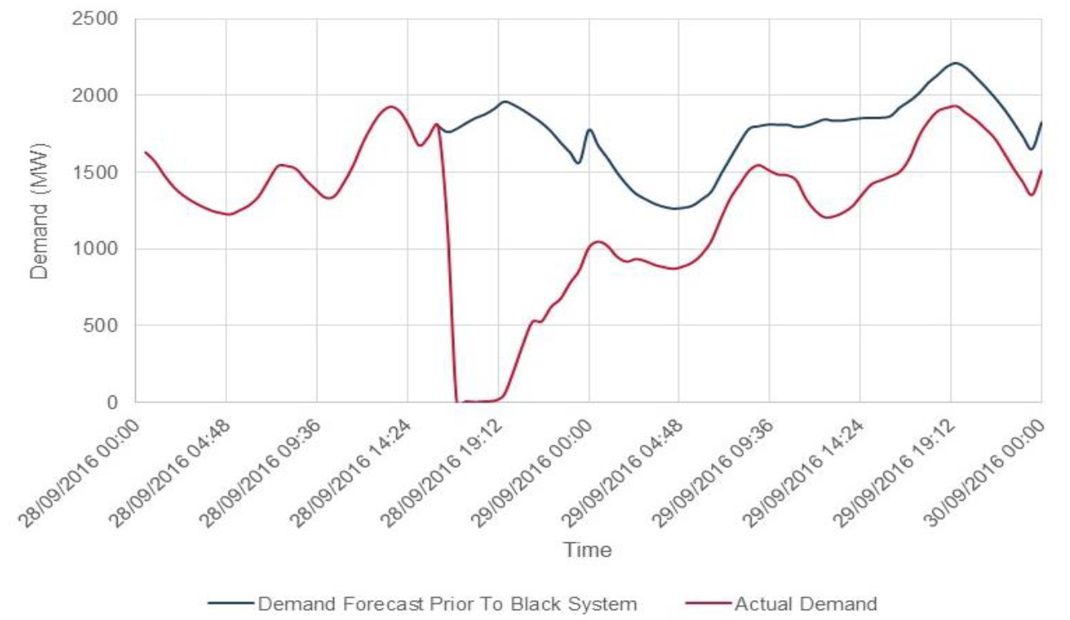
Load Restoration
Sept 29th 18:25 (T + 1d 2h 7min): Blackout condition terminated
source: AEMO, Final Report SA Black System 28 September 2016.
Notes:
Black System condition termination means grid can supply to all customers, subject to completion of repairs on damaged equipment.

Slide 23
Market Suspension
From Sept. 28th 16:25 to Oct. 11th 22:30 (13 Days)
Market suspension occurs under three conditions:
  Blackout in the region
  Directed by the participating jurisdiction
  Provisions of the National Electricity Rule (NER) has become impossible to meet
Termination of Market Suspension occurs when none of the above three conditions exists AND AEMO evaluates that another market suspension is unlikely to occur within 24 hours.
Notes:
9/29/16 20:39 Ministerial direction to suspend the market
10/6/16 15:05 Ministerial direction to maintain suspension is extended by a further seven days
10/11/16 17:48 Ministerial direction to maintain suspension had been revoked.

Slide 24
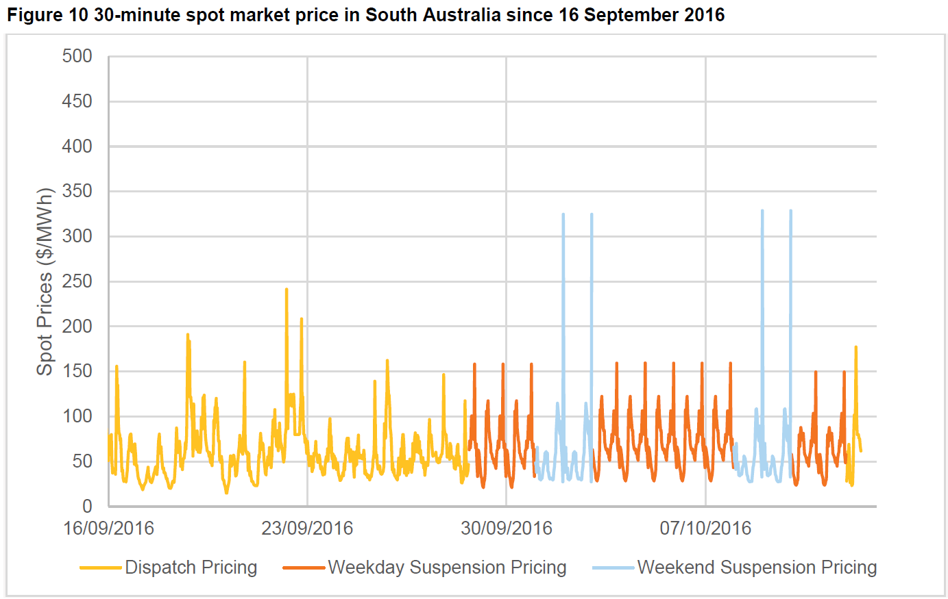
Market Suspension – Market Prices
Spot Energy and Ancillary Service Prices are based on a published schedule of average prices for the region
Suspension pricing schedule = Ave. of previous four billing weeks.
  Determined on weekly rolling basis and published for following 14 days where possible
  Separates weekdays and weekends
source: AEMO, Update Report – Black System Event in South Australia on 28 September 2016

Slide 25
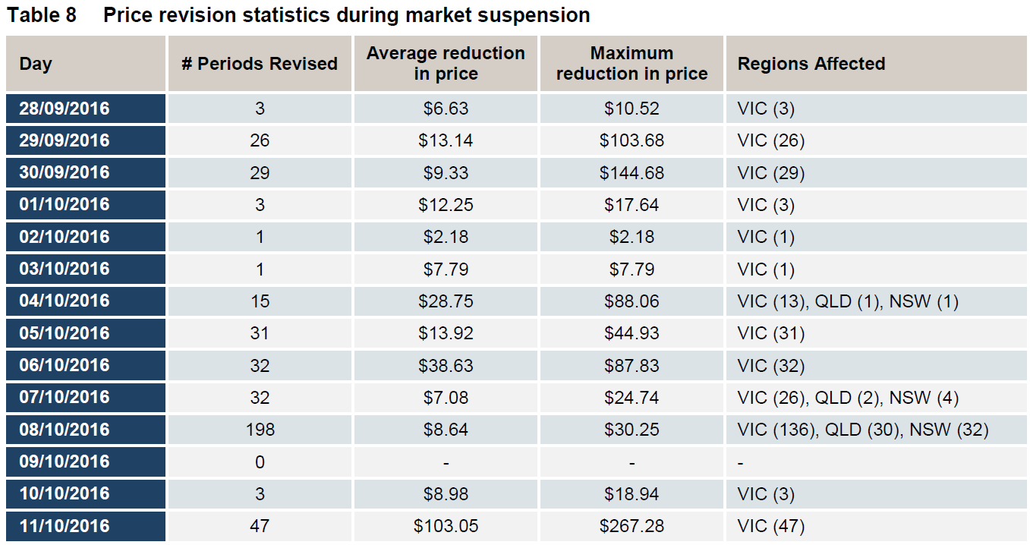
Market Suspension – Market Prices (Continued)
Prices in neighboring regions must be adjusted to ensure no negative settlement residues accrue (price capping)
source: AEMO, Update Report – Black System Event in South Australia on 28 September 2016
Notes:
Negative settlement residues = cost differential that AEMO must recover when generation is sourced in a more expensive region and consumed in a less expensive region.
Market Price Cap: $13,800(AUD)/MWh = $10,546.86(USD)/MWh
Market Price Floor: $-1,000(AUD)/MWh = -$764.26(USD)/MWh

Slide 26
Market Suspension – Congestion Management
Oct 1st: AEMO requested generators to continue submitting bids
AEMO manually dispatched generators as close as possible to economic merit order.
  Manually dispatched generators may be entitled to compensation amount

Slide 27
Lessons Learned
Optimize the ride-through settings on wind resources
  AEMO worked with wind generators and changed the setting from 3-6 faults to 9-20 faults within 2 minutes.
Evaluate severe contingencies (N-X) during projected extreme weather
  AEMO created contingencies for multiple wind trips/reductions
Control flow to the region during extreme weather
  South Australian Government directed AEMO to limit flow on AC Tie, RoCoF < 3 Hz/sec
Ensure proper operation of Black Start Resources
Review the Market Suspension process and pricing methodology

Slide 28
Lessons Learned
Lessons | AEMO | ERCOT
Optimize the ride-through settings on wind resources | AEMO worked with wind generators and changed the setting from 3-6 faults to 9-20 faults within 2 minutes. | Sent out RFI for VRT. Actual past event of 475 MW of wind reduction dropped 92 MW of firm load on UVLS relays.
Evaluate severe N-X contingencies during projected extreme weather | Created contingencies for multiple wind trips/reductions. | Already doing.
Control flow to the region during extreme weather | South Australian Government directed AEMO to limit flow on AC Tie, RoCoF < 3 Hz/sec. | Already doing.
Ensure proper operation of Black Start Resources | Align real and test procedures. | N/A.
Review the Market Suspension process and pricing methodology | Improve procedures for long market suspension. | NPRR 850, Market Suspension and Restart.

Slide 29
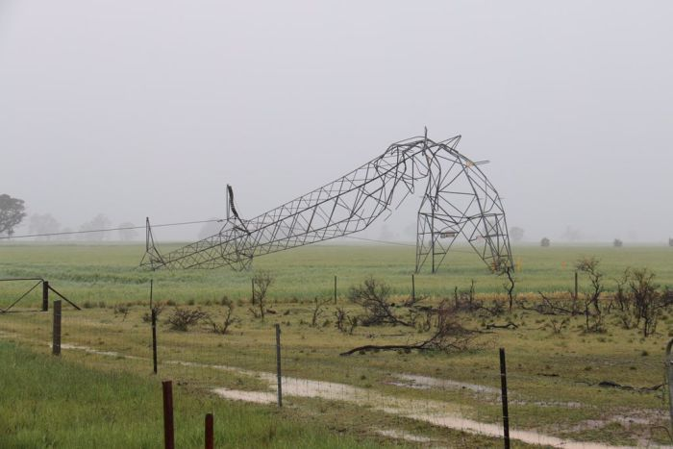
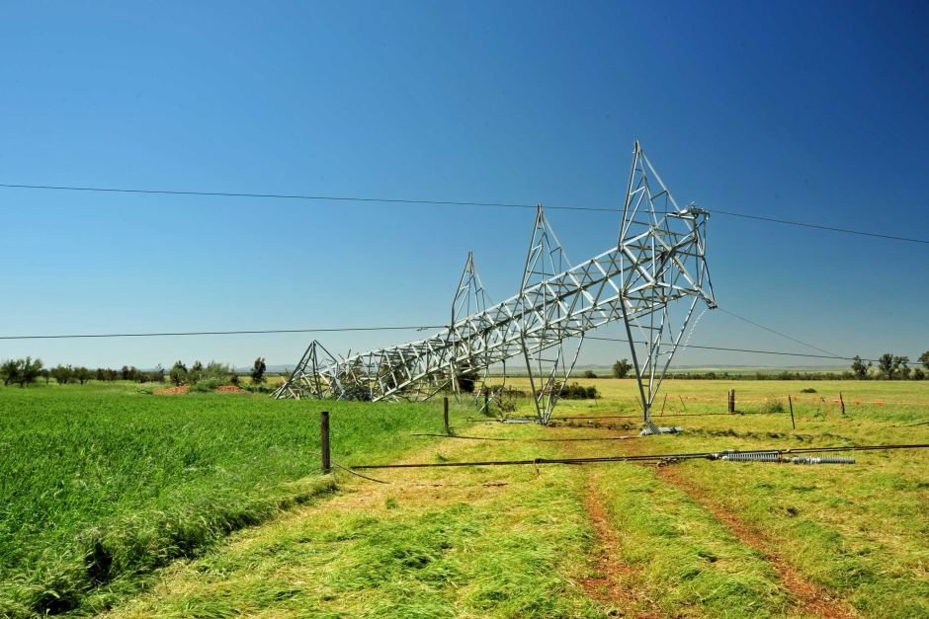
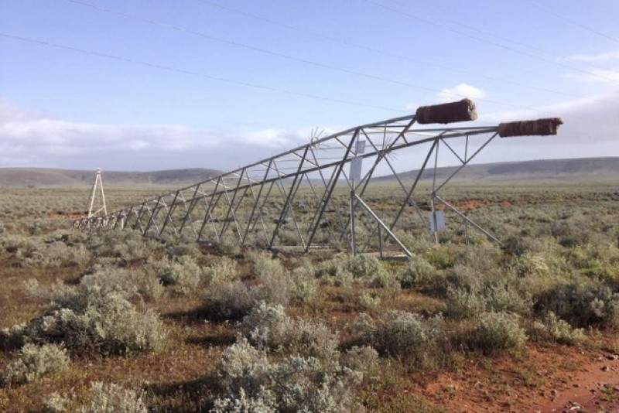
Questions?

