Slide 1
“Informal” Distributed Generation Review
Includes Registered DG as well as unregistered DG.
June 15 , 2018

Slide 2
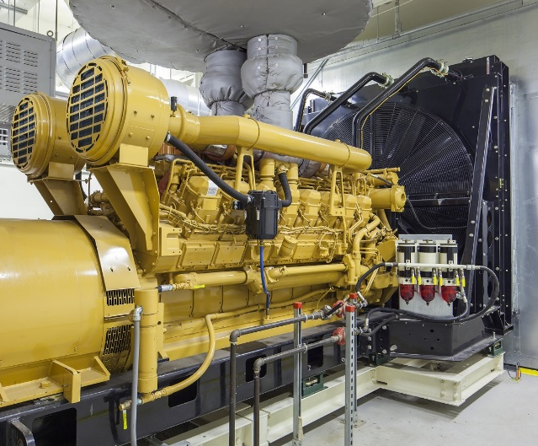
Existing DER Awareness Issues in ERCOT
DER >1 MW
Visible to ERCOT -- If it injects to the grid; and is not registered with PUC as Self-Generation then it must register with ERCOT.
Not Visible – If it is behind the meter and does not inject to the grid, then it is not required to register.

Slide 3
Existing DER Awareness Issues in ERCOT
DER <1 MW
Investor Owned TDSPs
TDSPs submit updated ESI ID Profile Codes to ERCOT as DG is installed
TDSPs submit Annual Interconnection reports to PUC including fuel type.
Visible to ERCOT 50 kW –> 1 MW Annual report by premise*
Visible to ERCOT <50 kW Annual report by premise*
*all units by profile code including those that either never inject, or are not capable of injecting to the grid
Muni’s and Co-ops (NOIEs) report:
Limited visibility - Quarterly reports with aggregated capacity by Load Zone 50 kW->1 MW
Delayed visibility <50kW EIA annual reports with aggregate data for units, 50kW -posted by Oct the following year.

Slide 4
ERCOT Estimated DG Growth 2015-2017 (MW)
181%
26%
31%
Note: This estimate includes informal data reporting by many NOIE’s as well as excludes generation data informally reported by investor owned utilities for generation that would typically be considered backup or emergency generation.

Slide 5
ERCOT Estimated DG Growth by category 2015-2017 (MW)
Note: This estimate includes informal data reporting by many NOIE’s as well as excludes generation data informally reported by investor owned utilities for generation that would typically be considered backup or emergency generation.

Slide 6
ERCOT Estimated DG Growth by category 2015-2017 (# units)
Note: This estimate includes informal data reporting by many NOIE’s as well as excludes generation data informally reported by investor owned utilities for generation that would typically be considered backup or emergency generation.

