Slide 1
TX SET Interactive

Slide 2
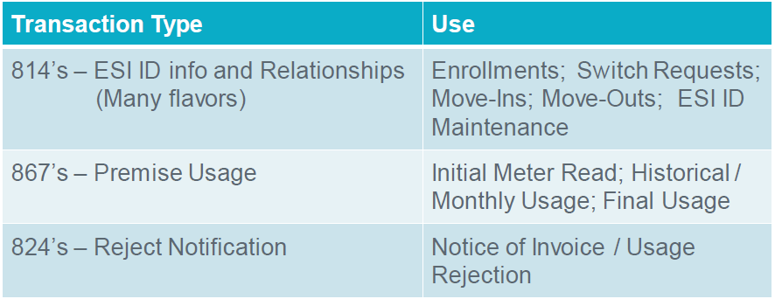
Texas Standard Electronic Transactions (TX SET) – Interactive
Many transactions involve ERCOT
These transactions flow through the ERCOT clearinghouse as the registration agent.

Slide 3
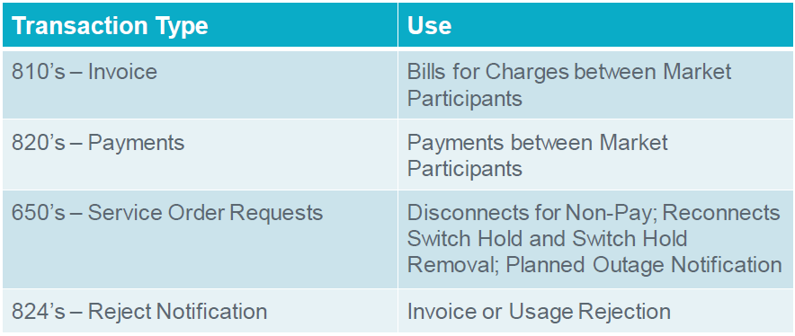
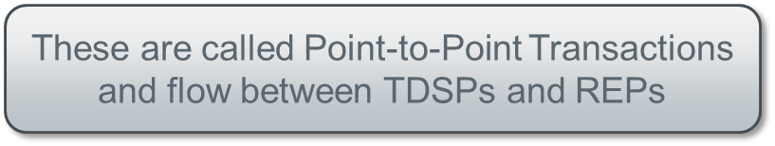
Texas Standard Electronic Transactions (TX SET) – Interactive
Some transactions do not involve ERCOT

Slide 4
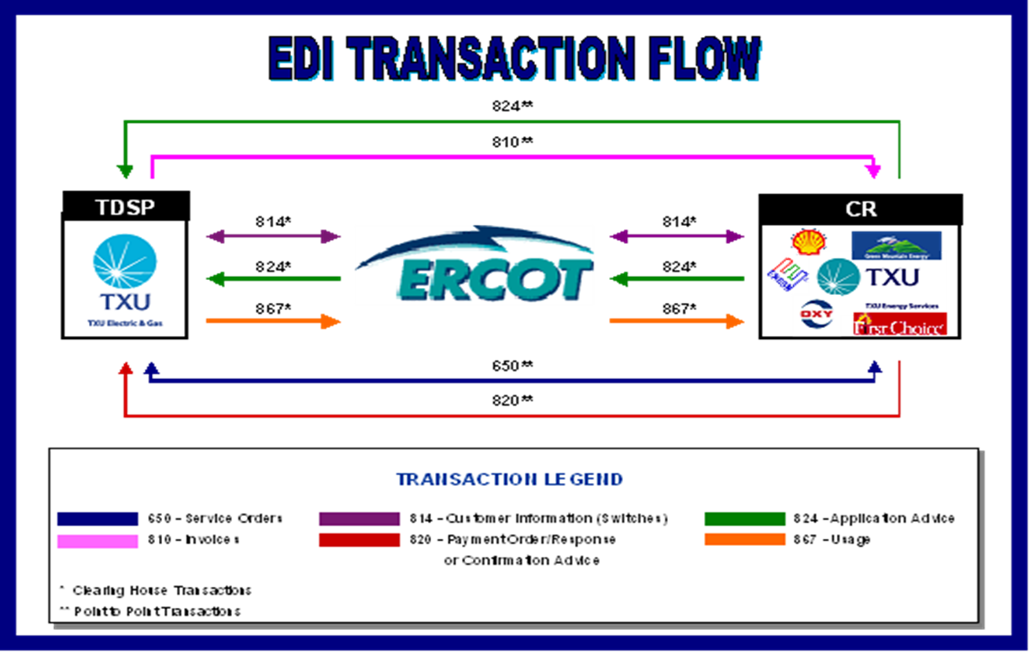
Texas Standard Electronic Transactions (TX SET) – Interactive
Overview of transaction flow

Slide 5
Transaction Names
TX SET Version 4.0 – Transaction Names Inventory

Slide 6
Transaction Names
TX SET Version 4.0 – Transaction Names Inventory

Slide 7
Transaction Names
TX SET Version 4.0 – Transaction Names Inventory

Slide 8
Checkpoint Questions – Exercise #1
Which transactions are customer initiated transactions? Select all that apply.
  814_16 ____________
  814_01 ____________
  814_08 ____________
  814_24 ____________
Response transactions can only be Rejects (True/False) _____________________
A point-to-point transaction is sent only to ERCOT. (True/False) ___________________

Slide 9
Checkpoint Questions – Exercise #1 – continued
Historical Usage (867_02) is associated to what? Select only one.
  Meter _____________
  Permit _____________
  Date Change _____________
  CSA _____________
What transaction is used to determine the actual start date for a customer? Select only one.
  814_04 ______________
  814_16 ______________
  867_04 ______________
  814_01 ______________

Slide 10


Transaction Flows
Switch – Accept
New CR
Current CR

Slide 11
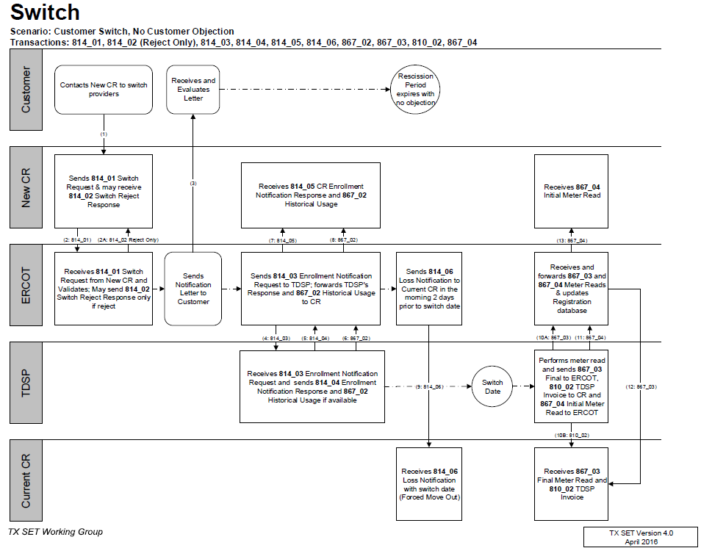
TX SET Swimlanes
Switch – Reject & Accept

Slide 12
Transaction Flows
Switch Hold – Add – Deferred Payment Plan (DPP)
Current CR
Switch Hold – Remove – DPP / Tampering

Slide 13
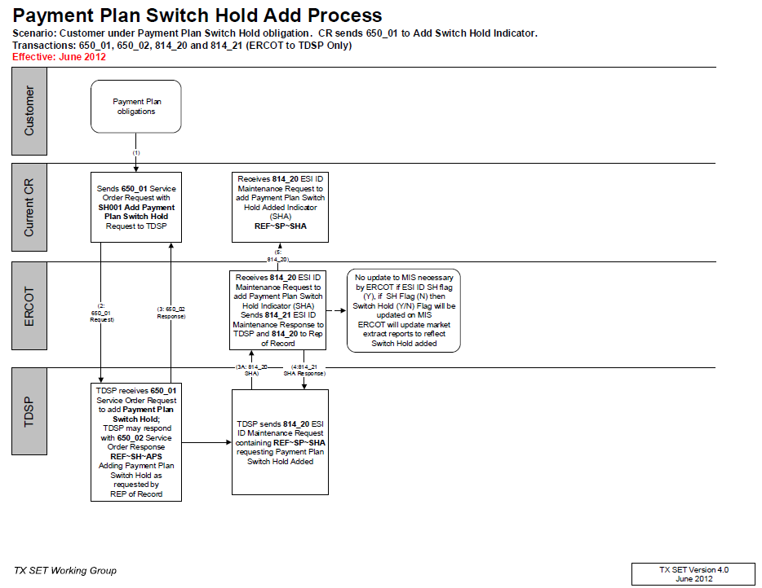
TX SET Swimlanes
Switch Hold – Add DPP

Slide 14
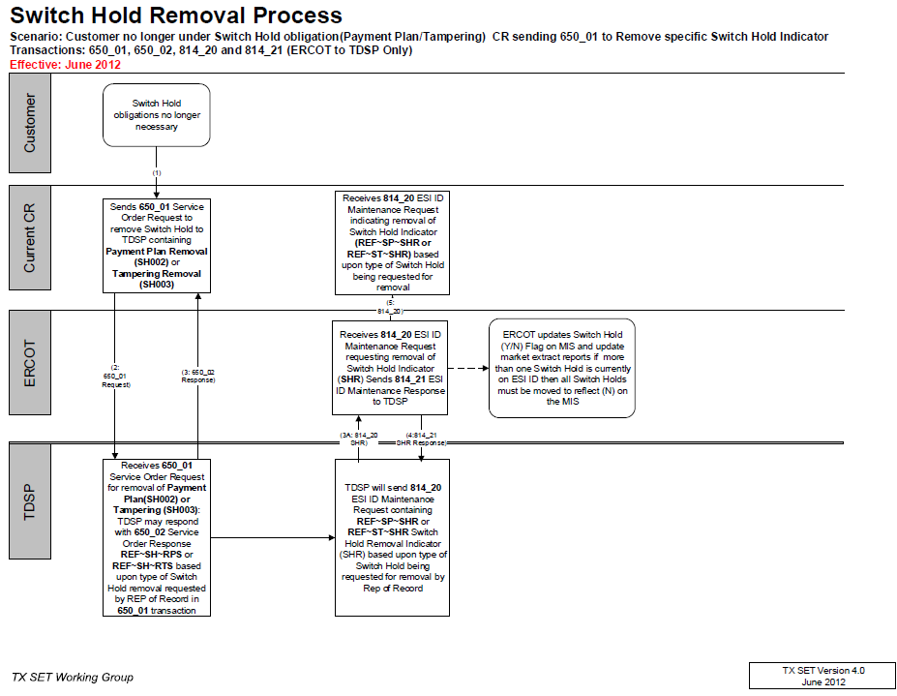
TX SET Swimlanes
Switch Hold – Remove - DPPs

Slide 15
Transaction Flows
Switch Hold – Add - Tampering
Current CR

Slide 16
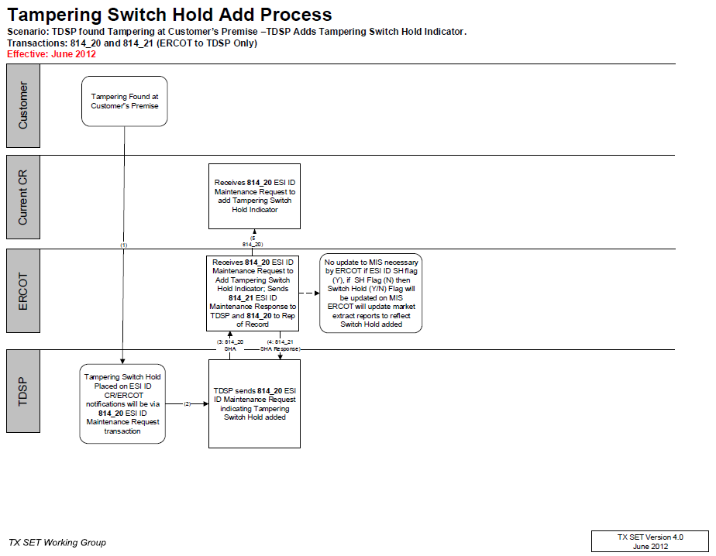
TX SET Swimlanes
Switch Hold – Add - Tampering

Slide 17
Transaction Flows
Switch w/ Switch Hold
New CR
Current CR

Slide 18
Checkpoint Questions – Exercise #2
A Customer Loss (814_06) transaction is sent to which entity? Select only one.
  Current Rep of Record _______________
  TDSP _______________
  ERCOT _______________
  New CR _______________
The 814_04 / 814_05 provides meter details and scheduling. (True/False) _________________
If a Switch Hold exists on an ESI, a MVO transaction (814_24) will automatically reject (True/False) ________

Slide 19
Transaction Flows
Move In – Accept
New CR
Current CR

Slide 20
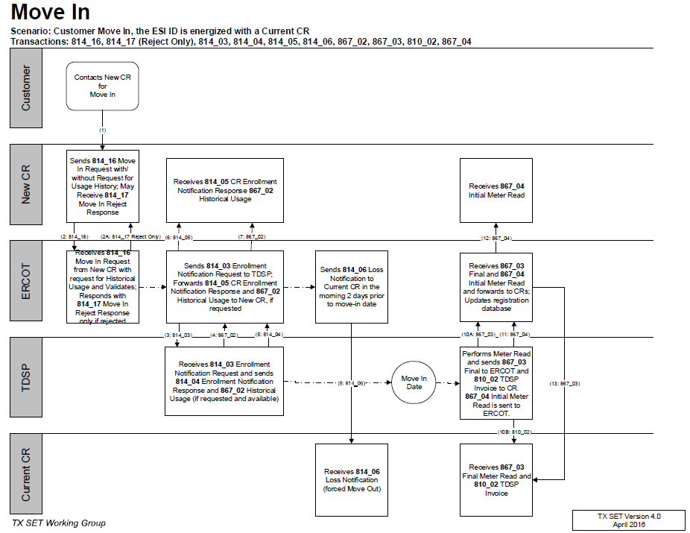
TX SET Swimlanes
Move In w/ Accept/Reject

Slide 21
Transaction Flows
Move In w/ Permit Required
New CR

Slide 22
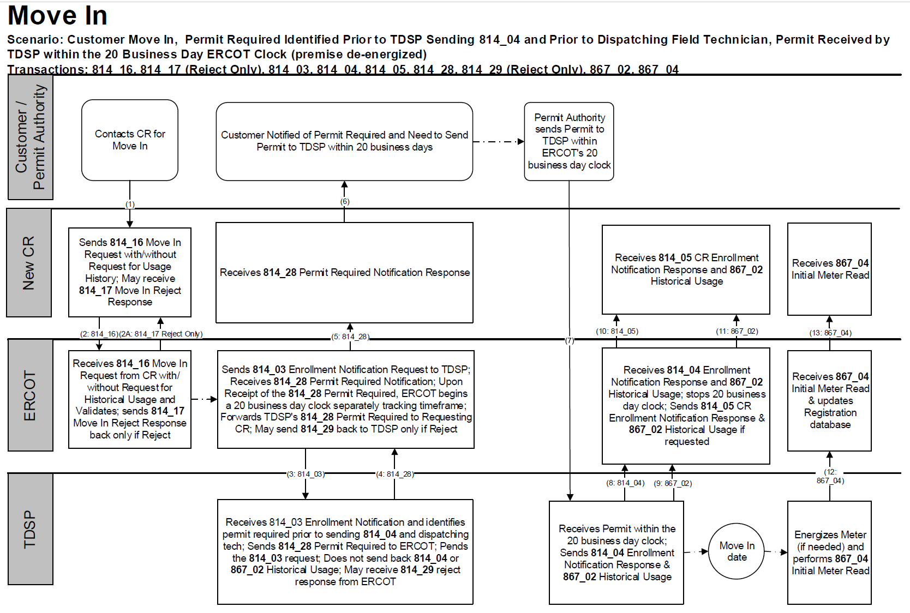
TX SET Swimlanes
Move In w/ Permit Required

Slide 23
Transaction Flows
Move In w/ Date Change followed by Cancel
New CR
Current CR

Slide 24
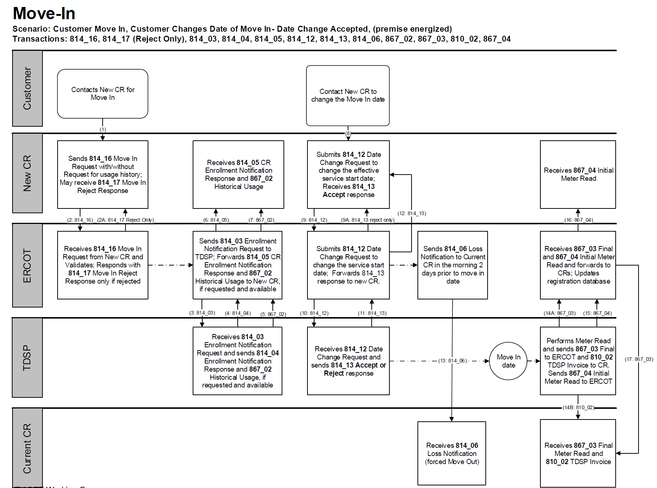
TX SET Swimlanes
Move In w/ Date Change & Cancel

Slide 25
Checkpoint Exercise #3
A date change transaction (814_12) is sent to change the date for which transactions? Select all that apply.
  814_08 __________ d) 867_03F ______________
  814_24 __________ e) 814_05 ______________
  814_18 __________ f) 814_16 ______________
What transaction does the TDSP receive when an 814_01 or 814_16 is initiated? Select only one.
  867_04 _____________
  814_03 _____________
  867_03 _____________
  814_04 _____________

Slide 26
Checkpoint Exercise #3 - continued
A Customer Loss (814_06) transaction can “force out” or “switch out” an existing customer. (True/False) ___________________
If a MVI order is submitted and an 814_28 PR is received, does it cancel the original MVI order? (Yes/No) ____________________
If a MVI order is submitted and an 814_28 PR is received and then later an 814_08 is received should we receive an 867_04? (Yes/No) ______________________
Based on the scenario in item 13, should we expect this customer to be with the submitting CR? (Yes/No) ____________________

Slide 27
Checkpoint Exercise #3 - continued
Which entity would receive an 814_17 Not First In (NFI) reject after a same day MVI is submitted in the morning by CR “A” and then another same day MVI is submitted in the afternoon by CR “B”?
  TDSP ______________
  ERCOT ______________
  CR A ______________
  CR B ______________

Slide 28
Transaction Flows
Move Out – Accept
Current CR

Slide 29
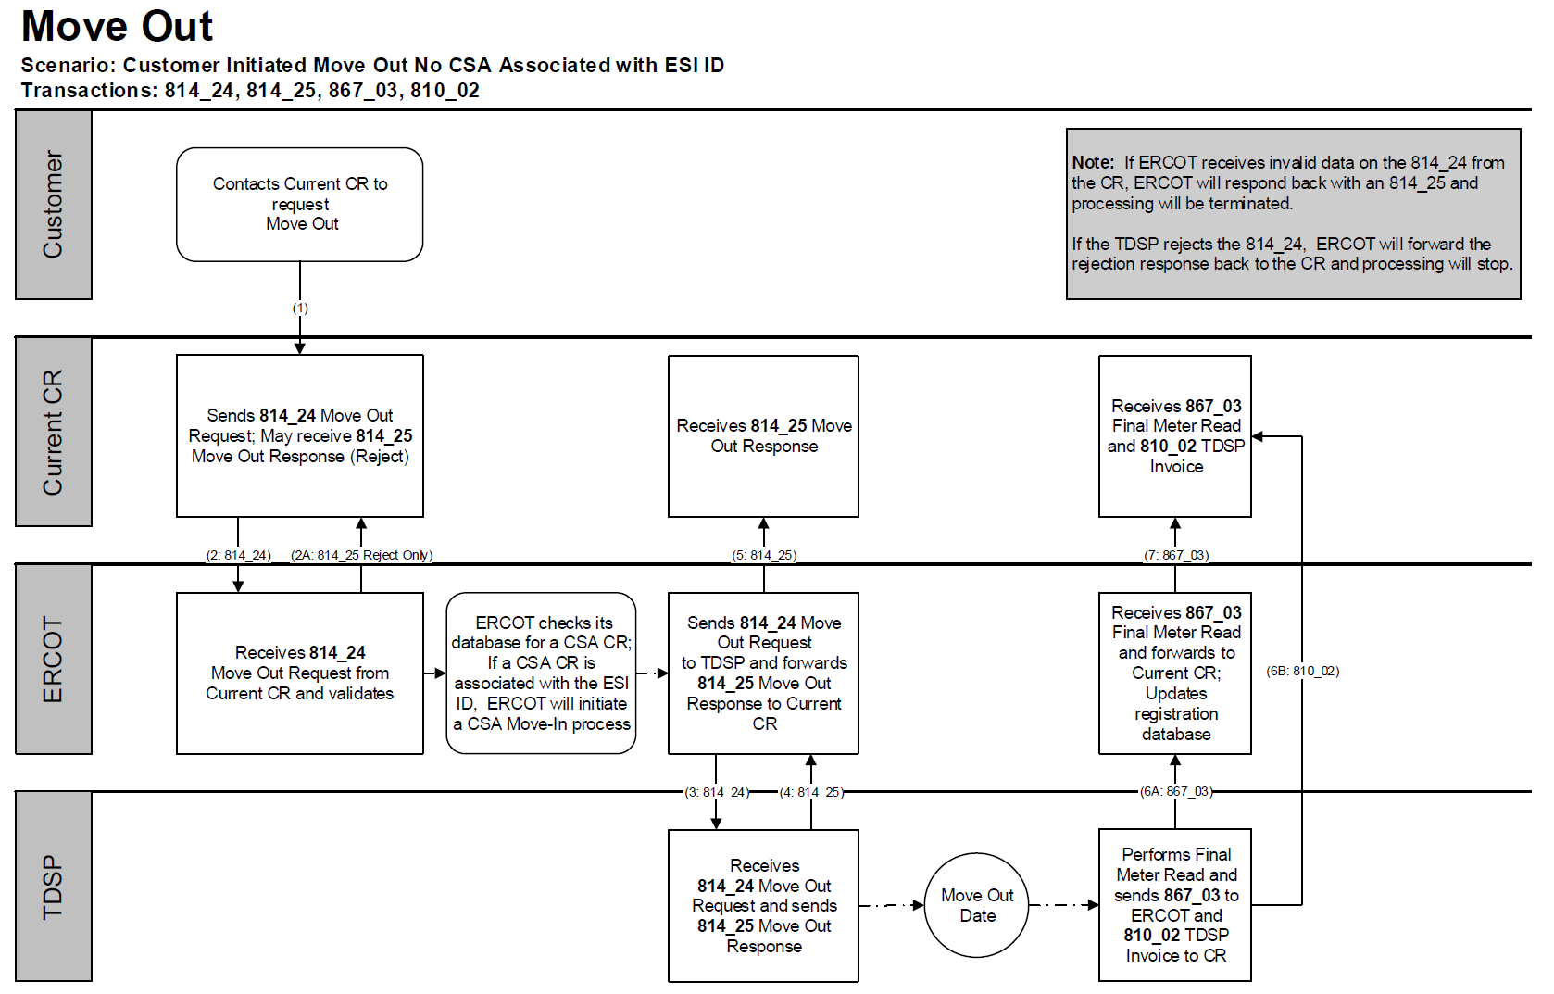
TX SET Swimlanes
Move Out – Reject & Accept (ERCOT)

Slide 30
Transaction Solution to Stacking
MVO Trumps SWI
ERCOT will reject a Switch Request if the ESI ID is scheduled to be De-energized at ERCOT on the Requested Date.
12/1 MVO CR A
12/2
12/4 SWI CR B
12/3
CR B will need to submit a MVI (814_16) in order to enroll their customer.

Slide 31
Transaction Solution to Stacking
11.4.1 REP Operating Rule 1: Cancel Move Out
REPs who have a Pending move out and submit a move in (same REP) with an earlier Requested Date are responsible for canceling the Pending move out if that is what the Customer requires (REP manages Customer expectations). If the REP does not cancel the move out, the move out will be allowed to effectuate.
MVI Customer A REP A
MVI Customer B REP A
MVO Customer A REP A
MVO transaction from Customer A has left Customer B in the dark.
If Customer A issues a MVI and a future dated MVO, and REP A enrolls Customer B at the same premise, if the REP A fails to cancel the future dated MVO, the MVO will be executed leaving Customer B in the dark.

Slide 32
Transaction Flows
Move Out w/ Future dated Switch
New CR
Current CR

Slide 33
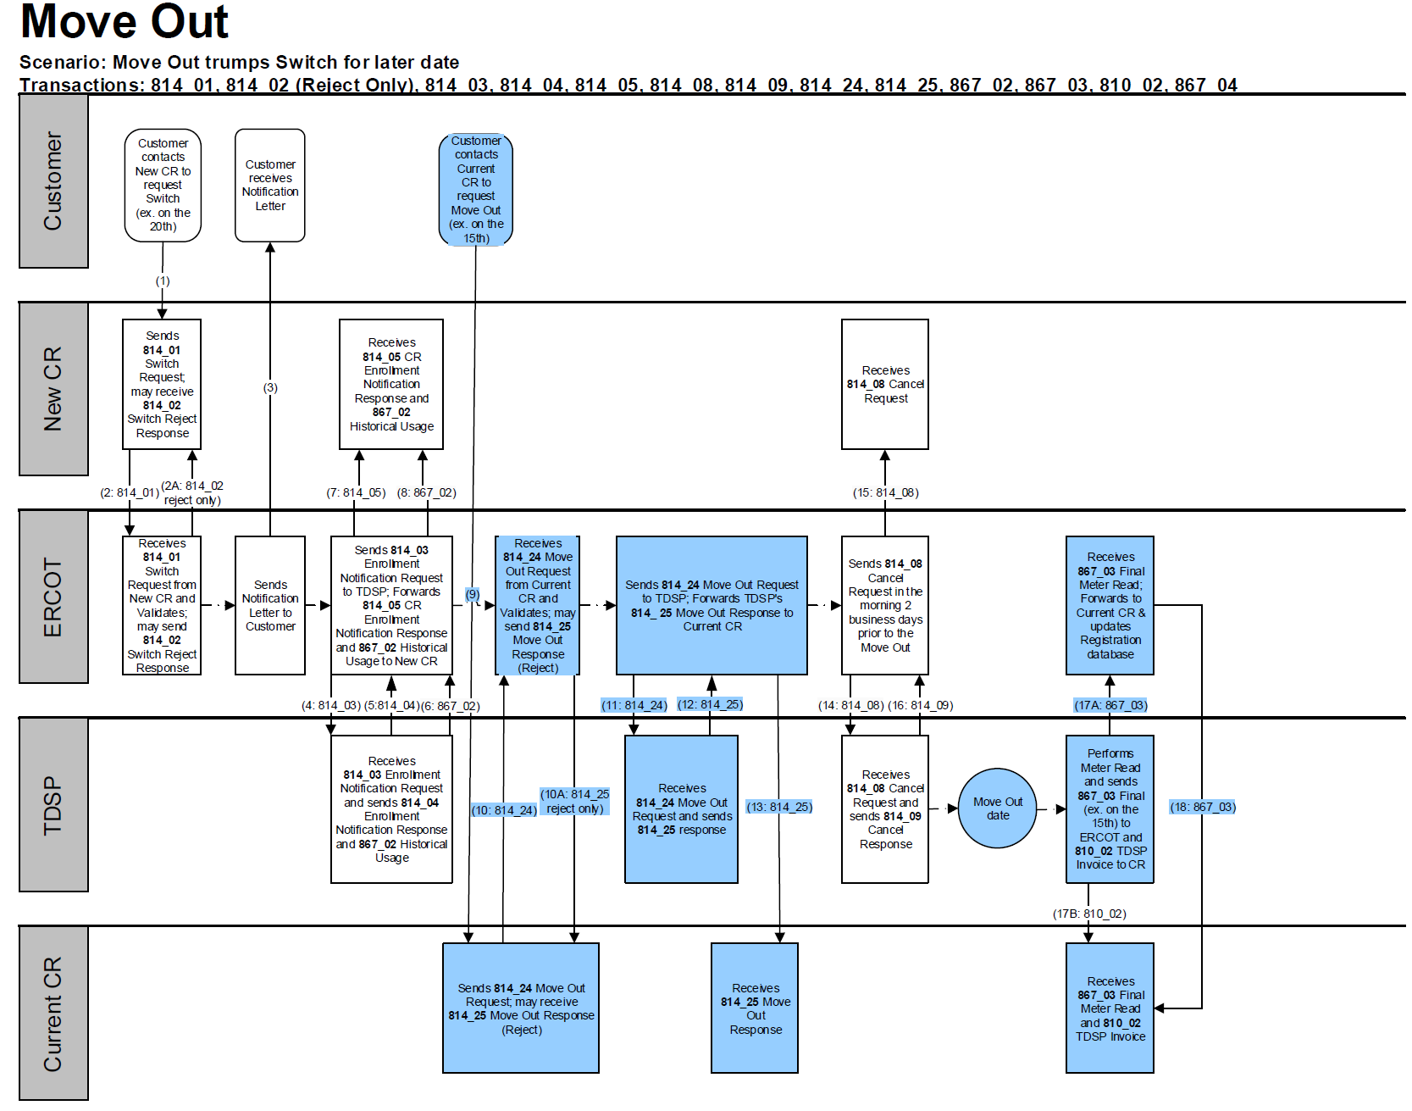
TX SET Swimlanes
Move Out w/ Future dated Switch

Slide 34
Checkpoint Exercise #4
If a MVO order is submitted and an 814_28 CU is received from the TDSP, does the customer receive a final bill? (Yes/No) ____________________
An 814_16 MVI trumps an 814_24 MVO for the same day when they are from two different REPs. (True/False) _______________________________
An 814_16 MVI trumps an 814_24 MVO for the same day when they are from the same REP. (True/False) _______________________________
An 814_24 MVO trumps an 814_01 Switch. (True/False) ___________________

Slide 35
Checkpoint Exercise #4 - continued
Which entity is responsible for sending an 814_08 cancel when there is a MVO for customer “A” pending for 5/5 and a MVI for customer “B” pending for 5/1, both with the current REP? Select only one.
  TDSP ______________
  ERCOT ______________
  Current REP ______________
  Another REP __________

Slide 36
Checkpoint Exercise #4 - continued
Which entity is responsible for sending an 814_08 cancel when there is a MVO for customer “A” pending for 5/5 and a MVI for customer “B” pending for 5/5 both with different REPs? Select only one.
  TDSP ______________
  ERCOT ______________
  Current REP ___________
  Another REP __________

Slide 37
Checkpoint Exercise #4 - continued
What transaction is used to determine the actual end date of a customer? Select only one.
  814_24 ______________
  814_01 ______________
  867_03F ______________
  814_22 ______________

Slide 38
Transaction Flows
Continuous Service Agreement (CSA) – Add & Delete
New CSA CR
Current CSA CR

Slide 39
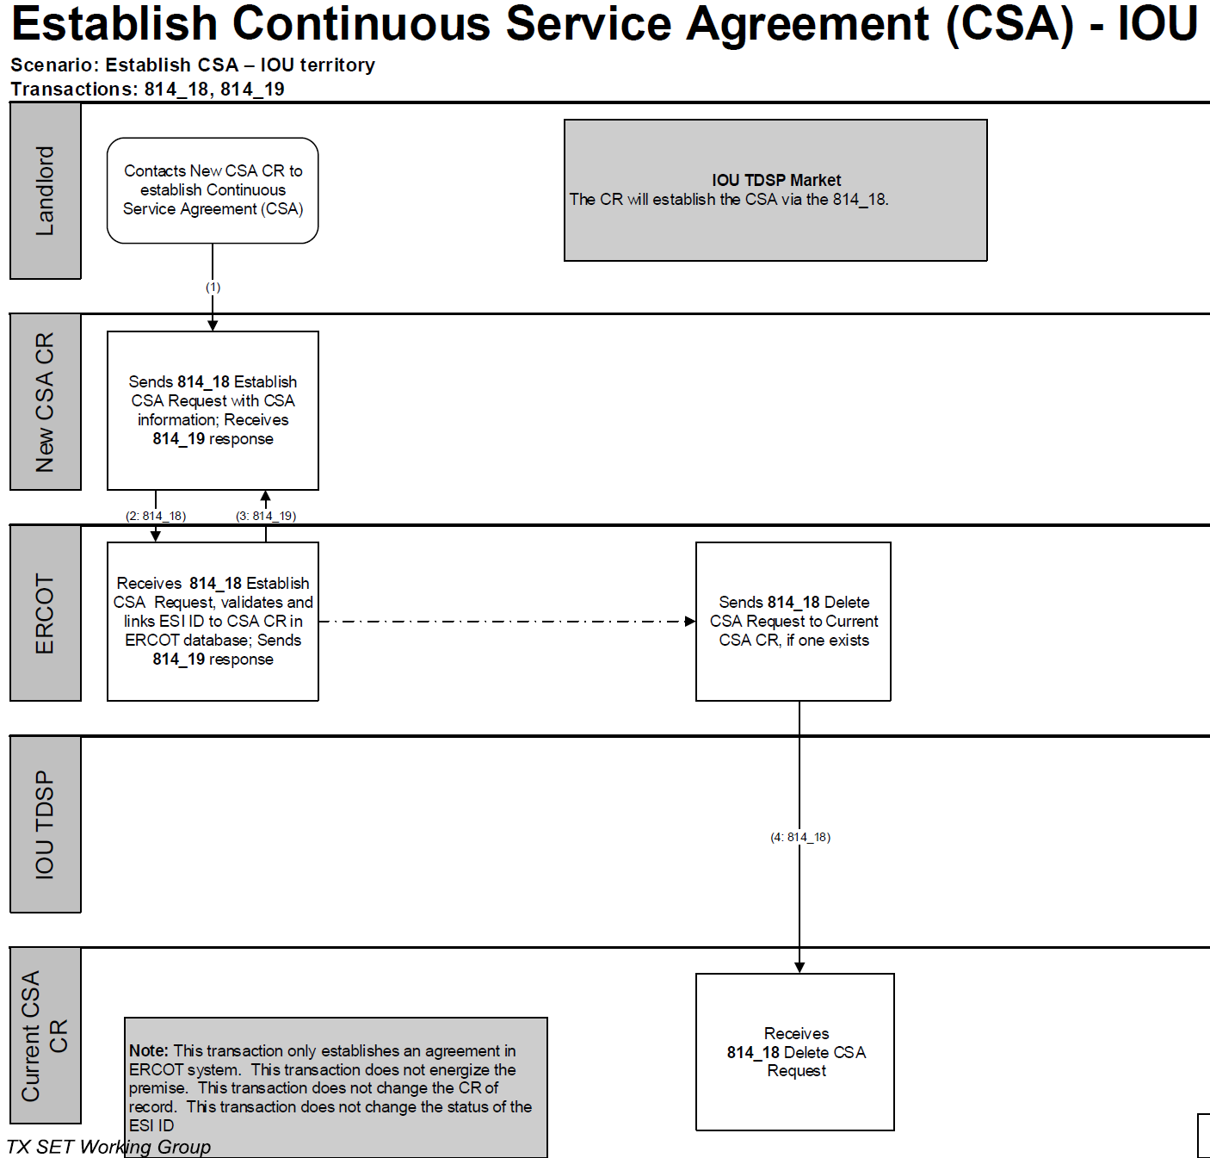
TX SET Swimlanes
Continuous Service Agreement (CSA) – Add & Delete

Slide 40
Transaction Flows
Move Out to CSA
CSA CR
Current CR

Slide 41
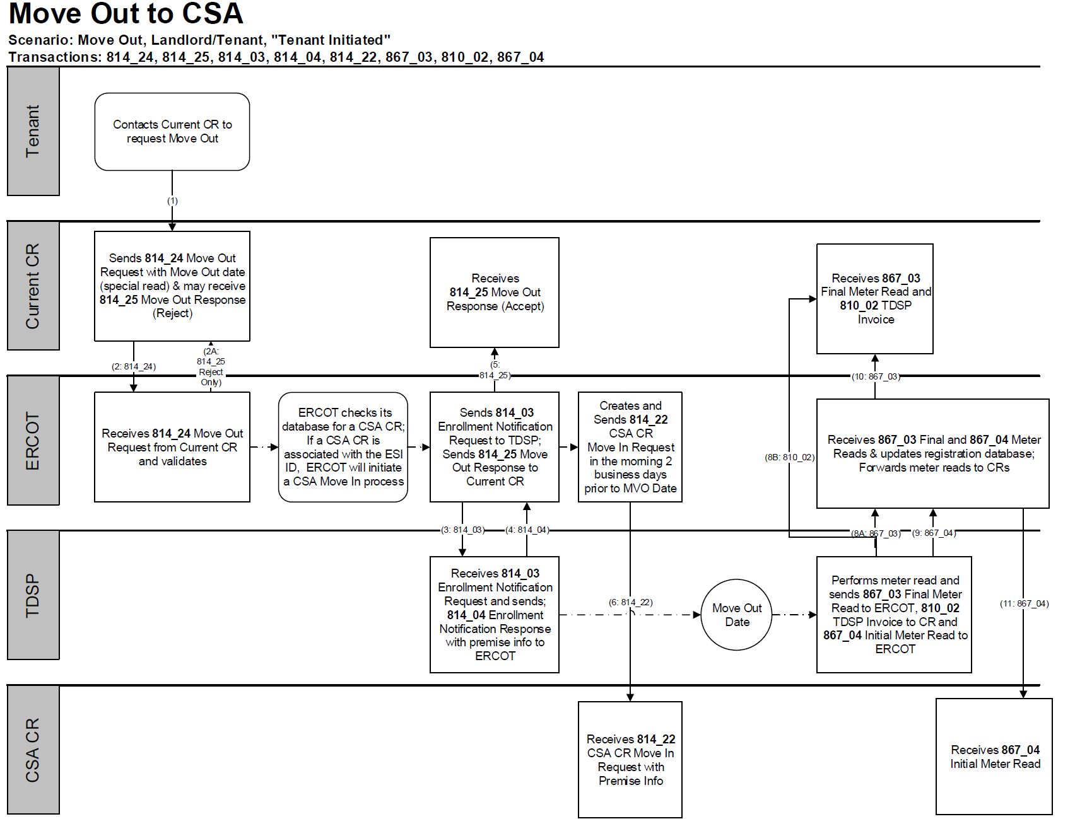
TX SET Swimlanes
Move Out to CSA

Slide 42
Checkpoint Exercise #5
What does CSA mean? Select only one.
  Continuous Service Arrangement ____________
  Continued Service Arrangement ____________
  Continuous Service Agreement ____________
  Country Served Agreement ____________
When a tenant moves out what transaction places the service back in the apartment’s name, if there is a CSA active at ERCOT? Select only one.
  867_04 ______________
  814_18 _______________
  814_01 _______________
  814_22 _______________

Slide 43
Checkpoint Exercise #5 - continued
What is the business process called that uses the 814_22 transaction, as it is seen in ERCOT MIS Portal? Select only one.
  Move-Out _______________
  Move-In _______________
  CSA _______________
  Move-out to CSA _______________

Slide 44
Transaction Flows
Disconnect for Non-Pay (DNP)
Current CR
Reconnect after DNP
Current CR

Slide 45
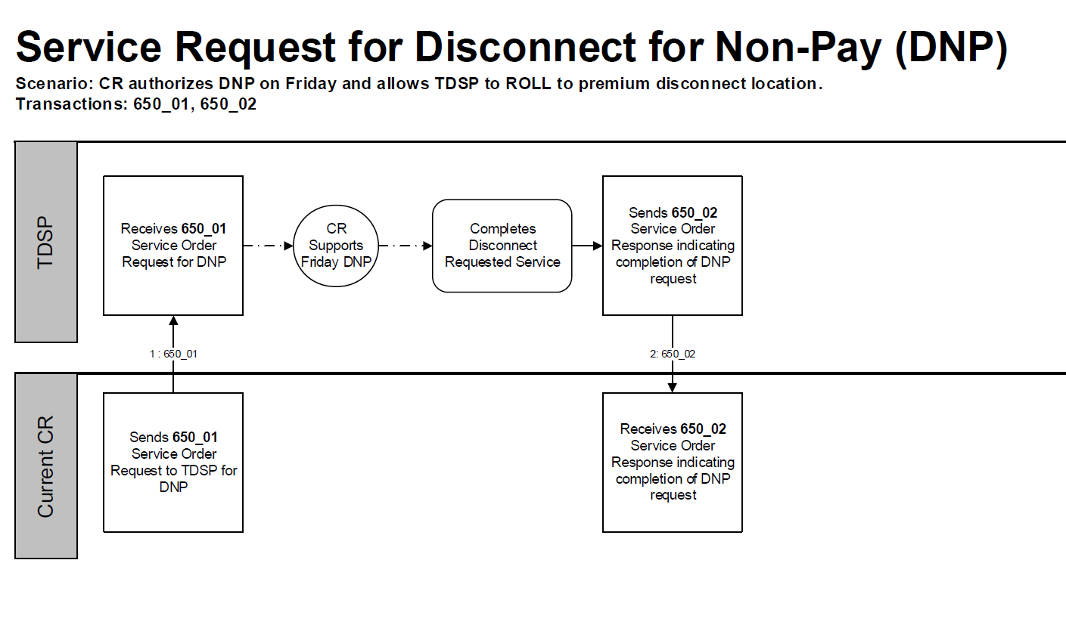
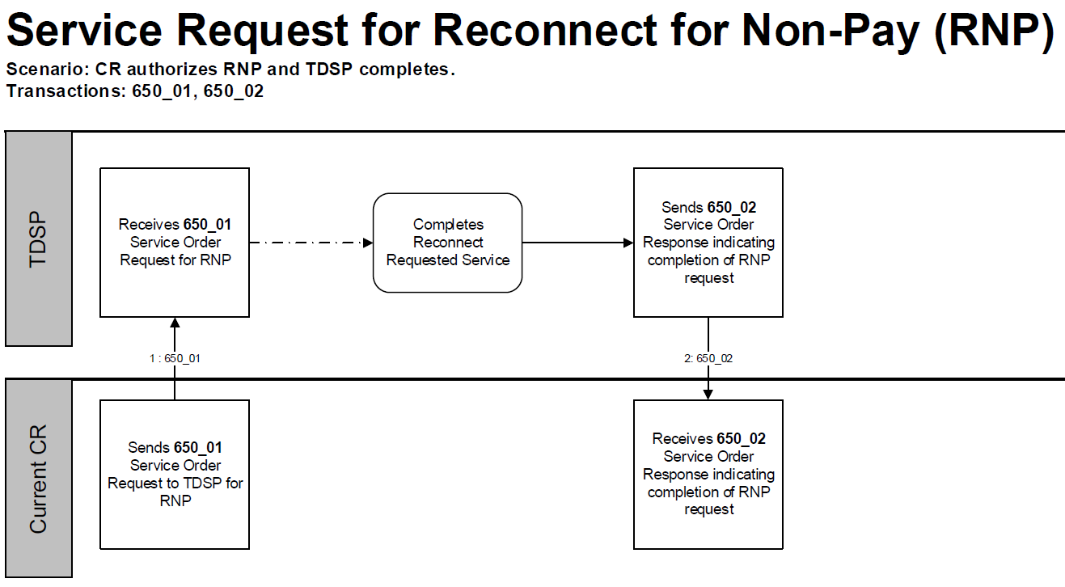
TX SET Swimlanes
Disconnect for Non-Pay (DNP)
Reconnect after DNP

Slide 46
Checkpoint Exercise #6
Which transactions are point-to-point? Select all that apply.
  820 ________________
  814 ________________
  650 ________________
  810 ________________

Slide 47
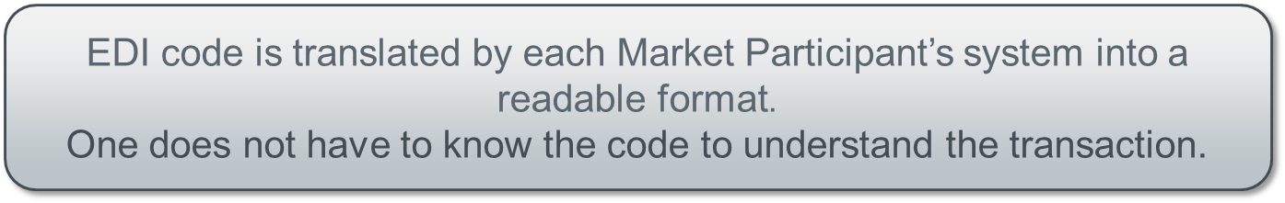
Electronic Data Interface (EDI) Transactions
Example of an 814_20 EDI transaction

Slide 48
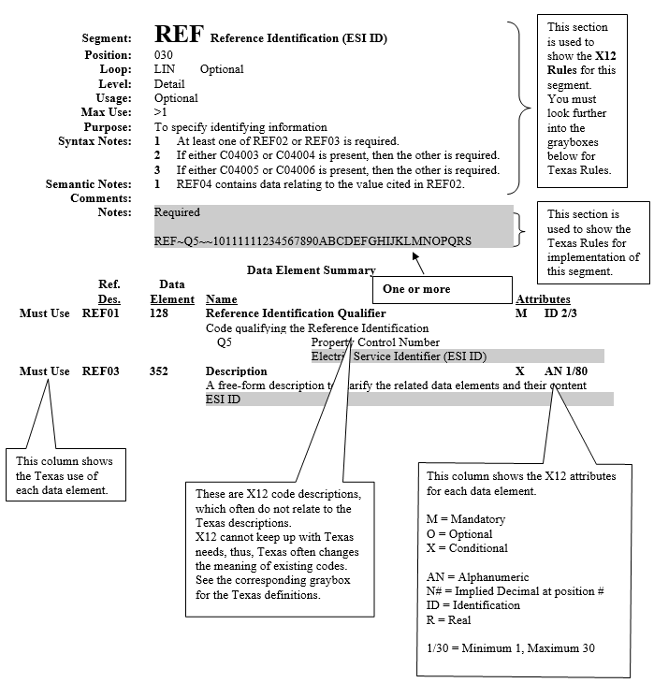
TX SET Implementation Guides w/ Examples
814_20 EDI transaction guide

Slide 49
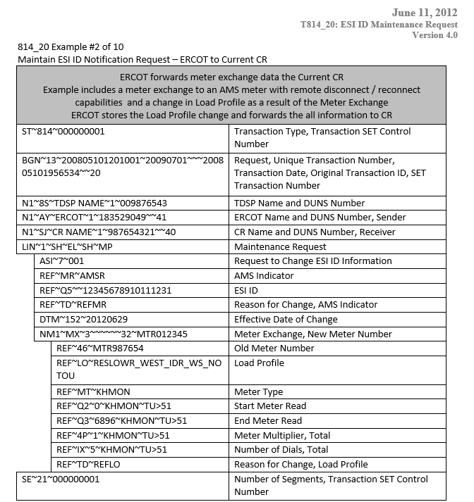
TX SET Implementation Guides w/ Examples
814_20 EDI transaction example – meter exchange

Slide 50
Checkpoint Exercise #7
Which transaction changes the meter and/or meter information? Select only one.
  814_09 _______________
  814_18 _______________
  814_26 _______________
  814_20 _______________

Slide 51
ERCOT’s Market Information System (MIS)
Find ESI ID
Point out key attributes-
status, premise type, Switch Hold, AMS Indicator, metered flag, MRU, dates
Link to “View Transactions” for past 7 months

Slide 52
ERCOT’s Market Information System (MIS)
Find Transactions
Learning “how to read ERCOT”
Key points:
Transaction status, key dates
Review some examples of ESIs with the following:
MVI, no CSA
MVI on retired ESI ID
MVI with permit pending
MVI with permit required
Switch and customer loss
MVO to CSA, with date change
MVI energized, no other CR, metered premise - MVO trumped by MVI - MVI with another CR - CSA Addition - MVO to CSA - MVI with another CR > customer loss for TXUE on CSA

Slide 53
Checkpoint Exercise #7 – FINAL EXAM
Provide each transaction name, who the transaction is from and who it is going to, and at the ends who the REP of Record is from the scenario flow listed below.
Customer calls REP B to enroll for service and REP A is the current REP of Record at that premise:
814_01
814_03
814_04
814_05
867_02
814_06
814_08 from submitting CR on same day as MVI requested date
814_09
867_03F
867_04
Switch Request
Enrollment Notification Request
Enrollment Notification Response
CR Enrollment Notification Response
Historical Usage
Loss Notification
Cancel Request
Cancel Response
Final Usage
Initial Meter Read
ERCOT
CR/REP A
TDSP
CR/REP B

Slide 54
Checkpoint Exercise #7 – FINAL EXAM - continued
From the transaction flow, who is the REP of Record?
_________________________________________________
What is the situation described?
_________________________________________________

