Slide 1
Texas SET Working Group

Slide 2
Texas SET Working Group

Slide 3
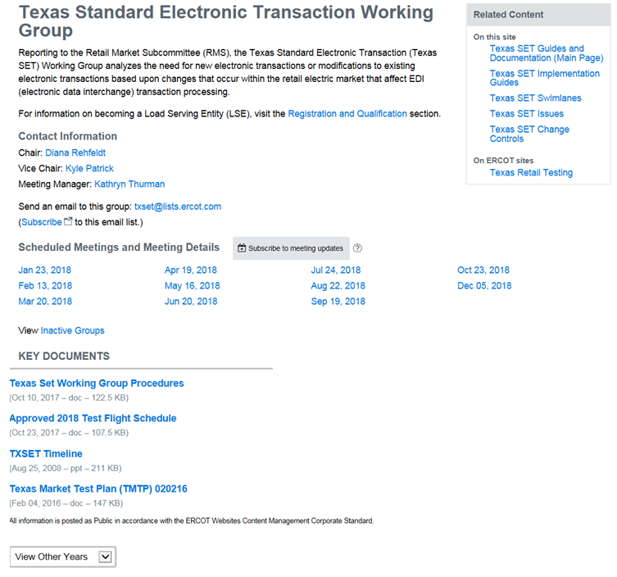
What is the Texas SET Working Group?
TX SET is an ERCOT Working group comprised of stakeholders participating in the development and maintenance of TX SET EDI transactions .
Texas Standard Electronic Transaction (Texas SET) Working Group, reporting to the Retail Market Subcommittee (RMS), analyzes the need for new or modifications to existing electronic transactions, recommends changes to retail market processes, works with the ERCOT Flight Administrator to ensure that testing processes and procedures are defined and administered, maintains the Texas SET Implementation Guides and the Texas Market Test Plan Guide, and collaborates with other working groups and task forces as directed by RMS.
http://www.ercot.com/committee/txset

Slide 4
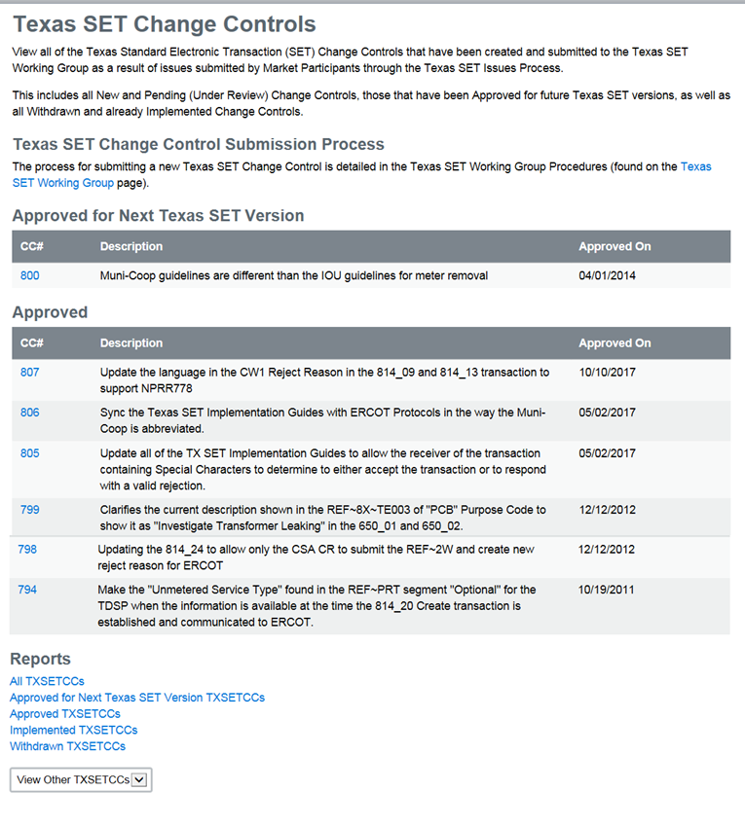
What is Tx SET Working Group?
Change Controls
http://www.ercot.com/mktrules/issues/txsetcc

Slide 5
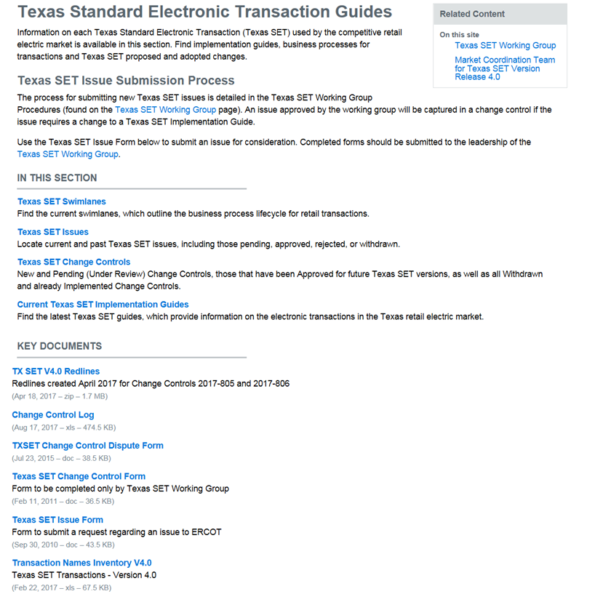
What is Tx SET Working Group?
Other Information
Texas SET Swimlanes
Texas SET Issues
Current Texas SET IGs
http://www.ercot.com/mktrules/guides/txset

