Slide 1
Tools Necessary to
Operate
in the Texas Market

Slide 2
Hierarchy of Rules
Public Utility Regulatory Act (PURA)
PUCT Substantive Rules
ERCOT Protocols

Slide 3
ERCOT Protocols

Slide 4
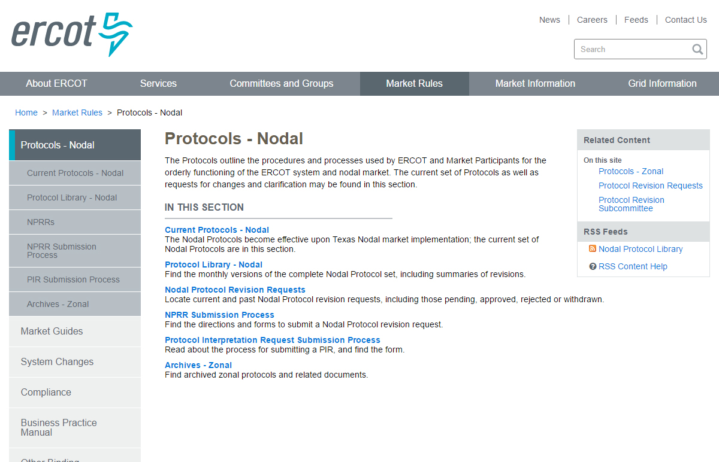
ERCOT Protocols
Notes:
Instructor should point out that current protocols are housed under the top link. However, all previous versions are also available under the “Protocol Library” link.
Instructor should also point out the “Other Binding Documents” link in the navigation bar and briefly mention that these other documents supplement the Protocols.

Slide 5
What Are ERCOT Protocols?
The Electric Reliability Council of Texas (ERCOT) Protocols, created through the collaborative efforts of representatives of all segments of Market Participants, as amended from time to time, that contains the scheduling, operating, planning, reliability, and Settlement (including Customer registration) policies, rules, guidelines, procedures, standards, and criteria of ERCOT.
These Protocols outline the procedures and processes used by ERCOT and Market Participants for the orderly functioning of the ERCOT system and nodal market.
Market Participants, the Independent Market Monitor (IMM), and ERCOT shall abide by these Protocols.

Slide 6
Protocol Sections of Interest
Section 2: Definitions and Acronyms
Section 9: Settlement and Billing
Section 10: Metering
Section 12: Market Information System
Section 15: Customer Registration
Section 18: Load Profiling
Section 19: Texas Standard Electronic Transaction
Section 21: Revision Request Process
Section 24: Retail Point to Point Communications
http://ercot.com/mktrules/nprotocols/current

Slide 7
ERCOT Protocol Section 15
Customer Registration
This section provides Market Participants and ERCOT with the market rules and transactional timing when operating in ERCOT’s Retail Electric Market and providing Customer Choice, for example:
ERCOT shall maintain a registration database of all metered and unmetered Electric Service Identifiers (ESI IDs) in Texas for Customer Choice.
All Customer registration processes will be conducted using the appropriate Texas Standard Electronic Transactions (TX SETs). Definitions of all TX SET codes referenced in this Section can be found in Section 19, Texas Standard Electronic Transaction.
All CRs with Customers in Texas, whether operating inside the ERCOT Region or not, shall be required to register their Customers in accordance with this Section.

Slide 8
ERCOT Protocol Section 15
Section 15.1.1 Customer Switch of Competitive Retailer
Section 15.1.2 Response Transaction from ERCOT
Section 15.1.3 Transition Process, includes Mass Transition and Acquisition(s)
Section 15.1.4 Move-In (No Construction)
Section 15.1.5 Service Termination aka “Move-Out”
Section 15.1.6 Concurrent Processing aka Solution to Staking Logic
Section 15.1.7 Move-In or Move-Out Date Change
Section 15.1.8 Cancellation of Registration Transaction
Section 15.1.9 Continuous Service Agreement (CSA CR) Processing
Section 15.1.10 CSA CR Processing in MOU or EC Service Territory
Section 15.2 Database Queries
Section 15.3 Monthly Meter Reads
Section 15.4 Electric Service Identifier (ESI ID) and ESI ID Formatting

Slide 9
ERCOT Protocol Section 19
Texas Standard Electronic Transactions (TX SETs)
Provides the mechanism that enables and facilitates the retail business processes in the deregulated Texas electric market. The Texas SET Implementation Guides shall serve as the standard for the applicable TX SETs among all Market Participants and ERCOT.
This Section shall cover:
Transactions between Transmission and/or Distribution Service Providers (TDSPs) (refers to all TDSPs unless otherwise specified), Competitive Retailers (CRs) and ERCOT;
Technical Advisory Committee (TAC) subcommittee and ERCOT responsibilities; and
Texas SET Change Control process.

Slide 10
ERCOT Protocol Section 19
Section 19.1 Overview
Section 19.2 Methodology
Section 19.3 Texas Standard Electronic Transaction Definitions
Section 19.3.1 Defined Texas Standard Electronic Transactions
Section 19.4 Texas Standard Electronic Transaction Change Control Process
Section 19.5 Texas Standard Electronic Transaction Acceptable Character Set
Section 19.5.1 Alphanumeric Field(s)
Section 19.6 Texas Standard Electronic Transaction Envelop Standards
Section 19.6.1 ERCOT Validation
Section 19.7 Advanced Meter Interval Data Format and Submission
Section 19.8 Retail Market Testing

Slide 11
ERCOT Protocol Section 24
Retail Point to Point Communications
Point to point communications include transactions flowing directly between Competitive Retailers (CRs), and Transmission and/or Distribution Service Providers (TDSPs) and do not flow through ERCOT. These point to point transactions may be Customer requested service orders and CR/TDSP invoicing and remittance advise transactions.

Slide 12
ERCOT Protocol Section 24
Section 24.1 Maintenance Service Order Request
Section 24.1.1 Disconnect/Reconnect
Section 24.1.2 Suspension of Delivery Service
Section 24.1.3 Switch Hold Indicator
Section 24.1.3.1 Tampering Switch Hold
Section 24.1.3.2 Bill Payment Switch Hold
Section 24.2 TDSP to Competitive Retailer Invoice
Section 24.3 Remittance Advice
Section 24.4 MOU/EC TDSP to CR Remittance Advice
Section 24.5 Maintain Customer Information Request
Section 24.6 MOU/EC TDSP to CR Maintain Customer Information Request

Slide 13
Hierarchy of Rules
ERCOT Protocols
ERCOT
Market Guides
Other Binding Documents (OBDs)

Slide 14
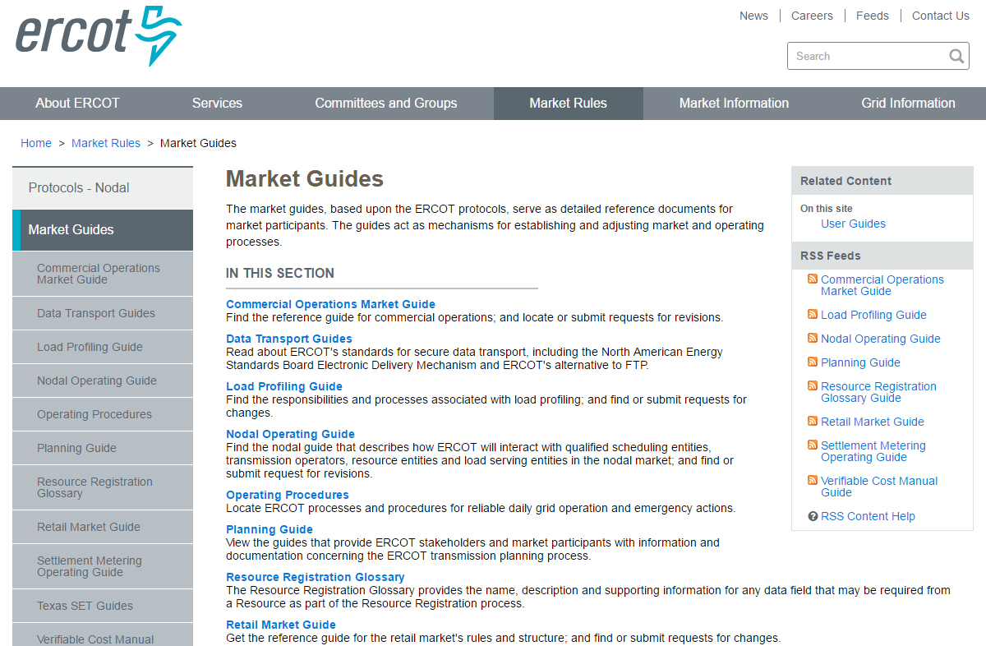
ERCOT Market Guides

Slide 15
ERCOT Retail Market Guide
Retail Market Guide Overview
Sections | Description
1-2 | Purpose; Definitions; Acronyms
3 | Retail Market Guide Revision Process
4-5 | PUCT & ERCOT
6 | RMS Working Groups
7 | **Market Processes**
8 | Municipally Owned Utilities & Co-ops
9 | **Appendices**
10 | Competitive Metering
11 | **Solution to Stacking**

Slide 16
ERCOT Retail Market Guide
Other Binding Documents List
Name | Description
Commercial Operations Market Guide | Supplements the ERCOT protocols and describes the process through which ERCOT market data is translated into financial settlements in the ERCOT market.
Load Profiling Guide | A reference document used by market participants and ERCOT, expands upon and details the responsibilities and processes listed in the ERCOT protocols.
Retail Market Guide | A reference document for rules affecting the competitive retail electric market in Texas.
Texas Data Transport Guides | Provides information on secure data transport utilized by the Retail Electric Market and enabled by the North American Energy Standards Board (NAESB) Electronic Delivery Mechanism (EDM), ebXML and digital certificates.
Texas Market Test Plan | Defines the market plan for testing retail commercial operations systems and business processes to support the Texas Electric Choice Market.
Texas SET Implementation Guides | Provides details of information contained within the electronic transactions used in the competitive retail electric market in Texas.

