Slide 1
Unregistered Distributed Generation Report:
2018.Q1 Update
Resource Adequacy
6/6/2018

Slide 2
2018 Q1 Unregistered Distributed Generation Report
Load Zone | 2018 Q1 Aggregate MW by Primary Fuel Type
 | SOLAR | WIND | OTHER RENEWABLE | OTHER NON-RENEWABLE | TOTAL
LZ_AEN | 16.68 | - | - | - | 16.68
LZ_CPS | 13.01 | - | 0.23 | - | 13.24
LZ_HOUSTON | 9.79 | 0.36 | 0.11 | 4.34 | 14.61
LZ_LCRA | 12.41 | - | 0.60 | - | 13.01
LZ_NORTH | 93.62 | 2.59 | - | 0.71 | 96.91
LZ_RAYBN | 0.90 | - | - | - | 0.90
LZ_SOUTH | 16.25 | 0.86 | - | - | 17.11
LZ_WEST | 8.55 | 0.78 | - | 0.34 | 9.67
TOTAL | 171.21 | 4.59 | 0.94 | 5.39 | 182.13
Load Zone | 2017 Q4 → 2018 Q1 Change in Aggregate MW by Primary Fuel Type
 | SOLAR | WIND | OTHER RENEWABLE | OTHER NON-RENEWABLE | TOTAL
LZ_AEN | +0.61 | - | - | - | +0.61
LZ_CPS | +2.43 | - | - | - | +2.43
LZ_HOUSTON | +0.14 | - | - | - | +0.14
LZ_LCRA | +9.90 | - | - | - | +9.90
LZ_NORTH | -0.96 | - | - | - | -0.96
LZ_RAYBN | +0.05 | - | - | - | +0.05
LZ_SOUTH | +0.85 | +0.01 | - | - | +0.86
LZ_WEST | +1.17 | -0.06 | - | - | +1.11
TOTAL | +14.19 | -0.05 | - | - | +14.13

Slide 3
Unregistered DG Growth: 2016-Q2* to 2018-Q1
* 2016-Q2 was the first report published after implementation of report changes per NPRR794/COPMGR044

Slide 4
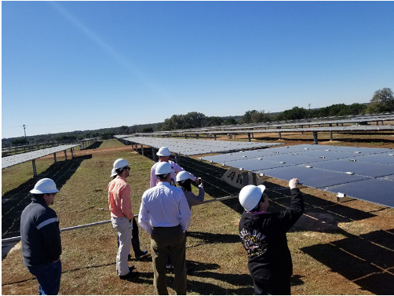
Unregistered DG Spotlight
Pedernales Electric Cooperative (PEC) reported over 11 MW of new unregistered distributed solar generation in 2018 Q1
ERCOT employees visited PEC’s Bertram Solar Farm in March (pictured)

