Slide 1
2018 LTSA Update
Regional Planning Group Meeting
May 22, 2018

Slide 2
Agenda
Results of completed scenarios
High Renewable Cost
Emerging Technologies
Next Step

Slide 3
High Renewable Cost
Included 30% tariff for PV panels
Reserve margin in final year:6.2%
Built 9,500 MW gas generation
Built 11,500 MW solar
Built 4,200 MW wind
Total retirement was 6,271 MW
Unserved energy in 2023 and 2033. Shortages mainly occur hours 15 through 17 in 2023 and hours 20 thru 21 in 2033. Maximum magnitude is over 3,000 MW in both years

Slide 4
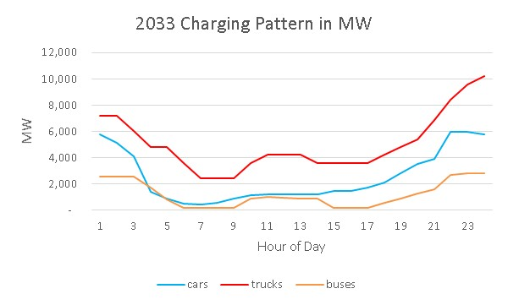
Emerging Technology
Gas price – 2018 AEO HOG case.
Scenario included by 2033:
Charging patterns for all three still occurs mostly at night.
Total MW increase over 18,500
Occurs at Midnight
5,000 to 6,000 MW during peak hours
Notes:
Total MW increase in co-incident value
Austin Energy
ONCOR
CapMetro
American Trucking Assoc
Owner-operator Independent Drivers Assoc.
North Central Texas Council of Goverments
TxDot.gov
FERC
Love’s Truck Stops
Flying J Truck stops

Slide 5
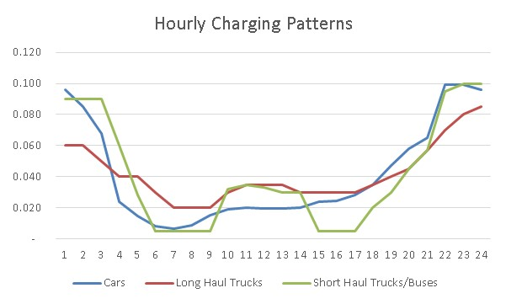
Emerging Technology
Hourly charging patterns
Assumes some control during the day
Values are percent of charge in each hour

Slide 6
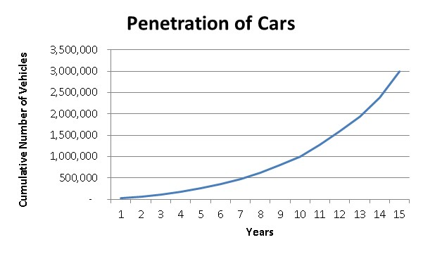
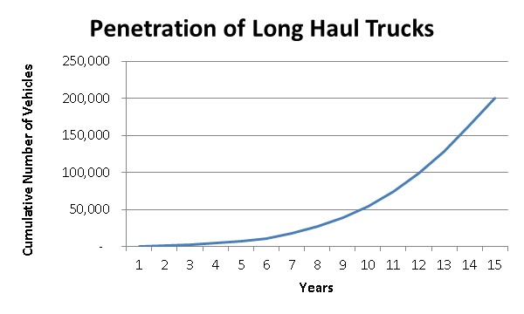
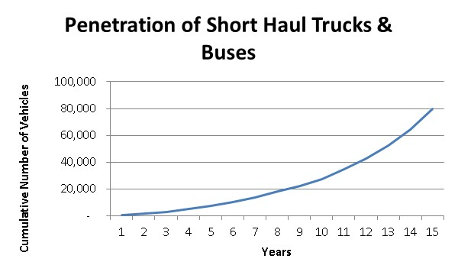
Emerging Technology
Penetration rates

Slide 7
Emerging Technology
Reserve margin in final year: 9.9%
Built 15,000 MW gas generation
Built 10,400 MW solar
Built 2,200 MW wind
Built 550 MW batteries
Total retirement was 1,723 MW
Unserved energy in 2033 Shortages occur hours 21 thru 23. Maximum magnitude is over 5,000 MW

Slide 8
Next Step
Sensitivity cases

Slide 9
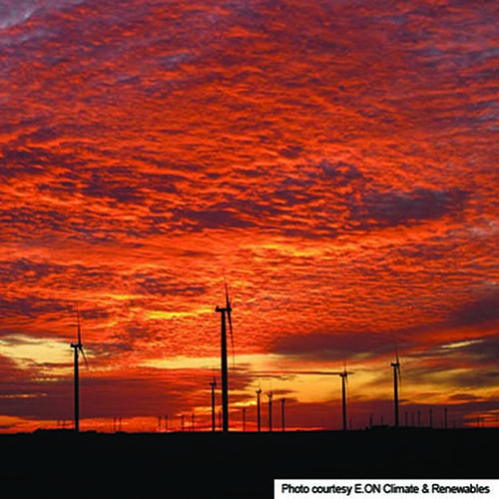
Questions
Contact info:
Julie Jin Doug Murray
julie.jin@ercot.com douglas.murray@ercot.com
512.248.3982 512.248.6908
Sandeep Borkar
sandeep.borkar@ercot.com
512.248.6642

