Slide 1
Commercial Operations Subcommittee (COPS)
Update to TAC
05/24/2018

Slide 2
COPS Meeting 5/24/2018
TAC Subcommittee Restructuring Discussion
  3 Strike Rule
    CONSECUTIVE?
    Proxy vs. Alternate
COPMGRR 47 - Approved
    Changes Ownership of Commercial Operations Guide from COPS to WMS
    Moves Retail section to the Retail Market Guide.

Slide 3
COPS Meeting 5/24/2018
ERCOT Updates
  IT Report (Included in Appendix A)
  Met all SLA Targets
PWG
  Annual Validation Progress (Appendix B)
  Possible Change in Default Profile
    Current BUSIMEDLF
    Possible BUSLO

Slide 4
Questions?

Slide 5
Incident Report Highlights
Appendix A
ERCOT IT Incident Report Highlights
Service Availability – April 2018
  Market Data Transparency IT systems met all SLA targets
Incidents & Maintenance – April 2018
  04/02/18 – Planned Maintenance (Site Failover – External Web Services)
  04/02/18 – Planned Maintenance (Site Failover – MPIM, Retail API)
  04/03/18 – Planned Maintenance (Site Failover – MIS)

Slide 6
Appendix B
Annual Validation Process
Current Annual Validation Process & Timeline
March 30th
ERCOT provides list of ESIs to TDSPs
April 10th
TDSPs to provide finalized list of ESIs to ERCOT
April 15th
Market notice announcing lists are available to ROR
April 15th – September 30th
TDSPs submit 814_20s
October 1st
ERCOT completes review of expected changes
Proposed Annual Validation Process & Timeline
March 30th
ERCOT provides list of ESIs to TDSPs
April 10th
TDSPs to provide finalized list of ESIs to ERCOT
April 15th
Market notice announcing lists are available to ROR
TDSPs submit flat file of revisions via MarkeTrak to ERCOT
April 15th - TBD
TBD
ERCOT completes revisions as scheduled
The current pain point is the coordination of the submittal of over ~150,000 transactions for profile changes which can occur over a period of 5 months. Streamlining the process for changes to be made is an overall market efficiency.

Slide 7
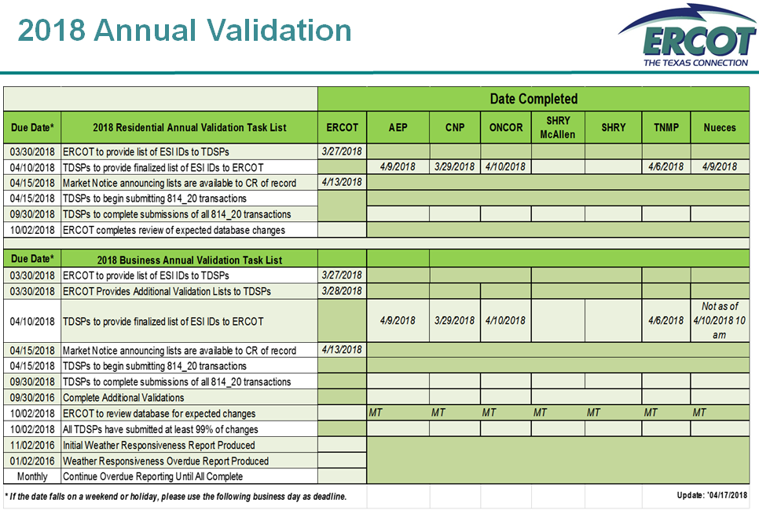
Appendix B

