Slide 1
Synchronous Inertial Response (SIR) Workshop #02
ERCOT Staff
May 18, 2018

Slide 2
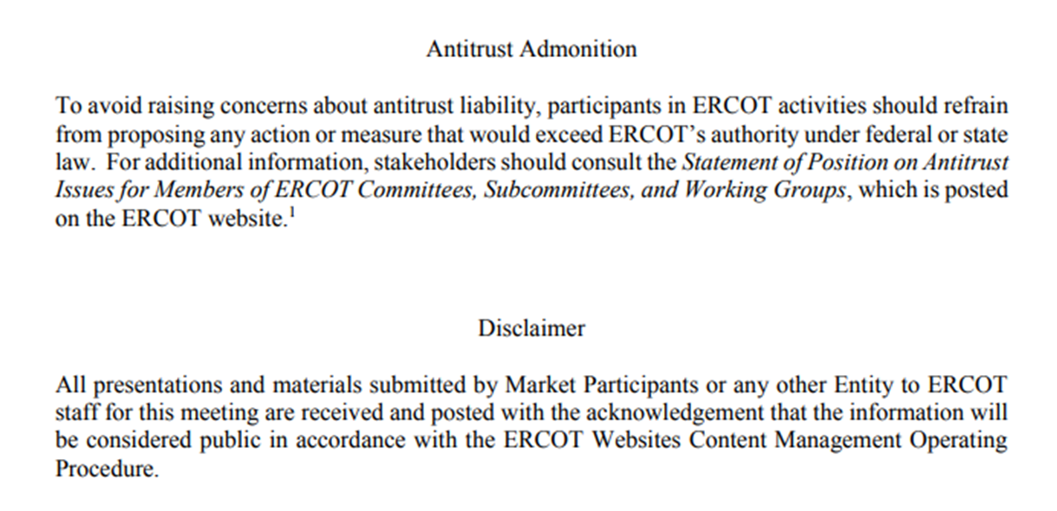
Antitrust Admonition

Slide 3
Introduction
Dan Woodfin
Sr. Director, System Operations
ERCOT
Synchronous Inertial Response (SIR) Workshop
May 18, 2018

Slide 4
Inertia Background
Only synchronous machines provide inertia to the system
Everything else provides a response, but does not provide system inertia
The level of Inertia on the system is solely a function of the synchronously-connected machines online on the System and their characteristics
However, because the synchronously-connected machines that are online at a particular point in time are related to the load and wind generation on the system at that point in time, the system inertia may be correlated with the load and wind generation

Slide 5
Inertial Effect
Initial rate of change of frequency (RoCoF) prior to any resource response is solely a function of inertia

Slide 6
Inertial Effect
Slope of the RoCoF line changes due to resources’ response

Slide 7
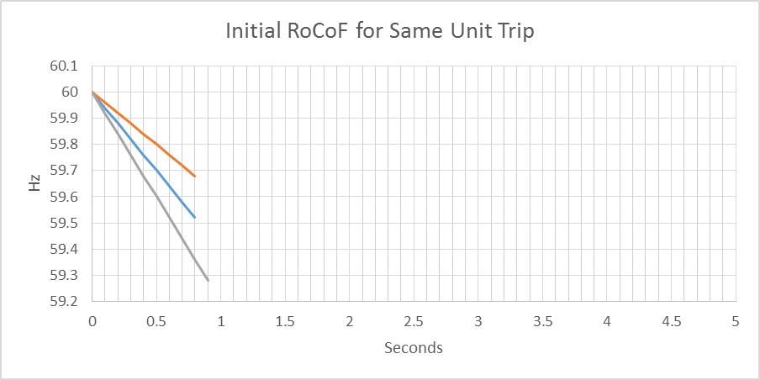
Inertial Effect
Higher Inertia
Lower Inertia

Slide 8
Critical Inertia Concept
The level of inertia which causes the frequency to drop below the UFLS trigger before the “fastest” resources can provide sufficient frequency response (for the two STP trip) is the “Critical Inertia”
0.4 Hz
0.5 s

Slide 9
Critical Inertia
Currently, the Critical Inertia Level for ERCOT appears to be around 100 GW-s (based on current operations and response characteristics of current resources)
  Simulation results have shown that below this level RoCoF is high enough that frequency would drop below 59.3 Hz for the two STP trip
  Simulation results have also shown wide-area voltage oscillations at inertia below this level; this is a separate but somewhat related issue as identified in the Panhandle region as weak grid

Slide 10
Topics Discussed at Workshop #01
Trends in Inertia – where are we currently & where are we headed.
Introduction to Long Term Stability Assessment Study’s high penetration scenario.
Current Practice for Monitoring & Maintaining Critical Inertia in Real Time.
RRS Study & other parameter changes and there impact on Critical Inertia.
How are other regions mitigating the critical inertia problem.
Brief discussion on potential solutions & next steps.

Slide 11
Whitepaper on Inertia
A paper titled Inertia: Basic Concepts and Impacts on the ERCOT Grid was published on Apr 4, 2018.
This paper document’s the initiatives ERCOT has undertaken
  to track the trends of historical inertia on the ERCOT system
  to develop tools and methods to mitigate negative impacts of low inertia conditions that could arise in the future.
Any comments or feedback on this paper should be sent via email to Sandip Sharma (ssharma@ercot.com).

Slide 12
Discussion Outline for Today
Update on Long Term Stability Assessment Study’s high penetration scenario.
Impacts of potential parameter changes on Critical Inertia
  RRS from Load Resources and the feasibility of faster response.
  Inertia based Frequency Response from Wind Resources.
  Critical Contingency and NERC BAL-003 SDT Update
  Discussion on Changing UFLS Settings
Synchronous Inertial Response as an Ancillary Service
Potential list of options/solutions

Slide 13
Discussion

Slide 14
Dynamic Stability Assessment of High Penetration of Renewable Generation in the ERCOT Grid
Shun Hsien (Fred) Huang
Transmission Planning
ERCOT
Synchronous Inertial Response (SIR) Workshop
May 18, 2018

Slide 15
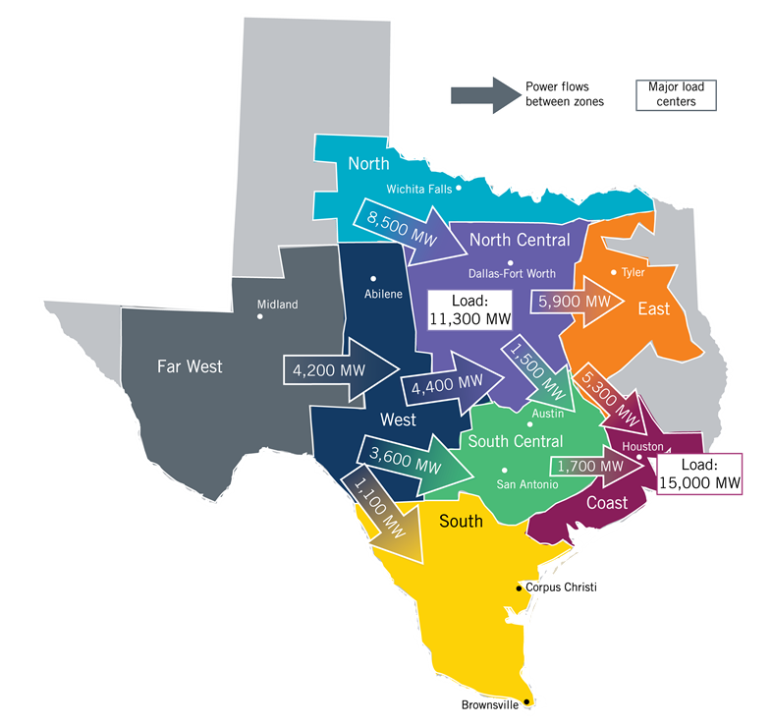
Recap
The results of this analysis are intended to be indicative of likely future challenges to be faced in the ERCOT grid and recommendations are provided to further evaluate and address those challenges.
Load: 42.2 GW (includes PUNs)
Solar output: 17 GW (90% dispatch)
Wind output: 11 GW (48% dispatch)
West Texas Exports: 15.5 GW
(major 345 kV circuits)
Losses (MW): 6%
Results:
8 Observations
9 Recommendations
Report is available at: http://www.ercot.com/content/wcm/lists/144927/Dynamic_Stability_Assessment_of_High_Penetration_of_Renewable_Generation_in_the_ERCOT_Grid.pdf

Slide 16
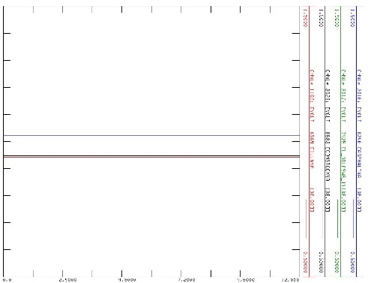
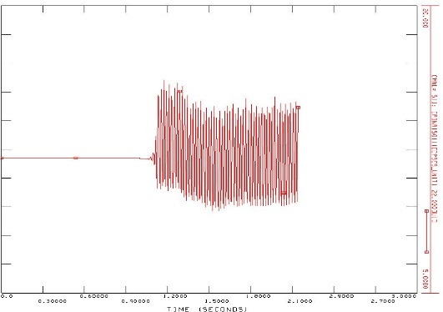
Summary
Observations:
  Significant active and reactive losses were found under high West Texas export conditions.
  Additional transfer paths between West Texas and Central Texas were beneficial.
  An acceptable modeled steady-state condition may not guarantee a stable response under low system strength conditions.
Recommendation:
  The Long Term System Assessment process should consider the impact of stability constraints.
Small disturbances

Slide 17
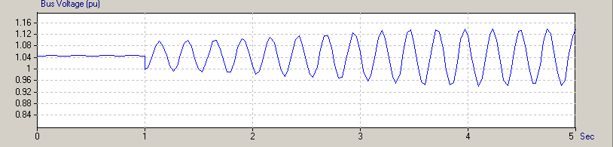
Summary (Continue)
Observations:
  Inverter-based generation controllers require sufficient system strength for reliable operation.
Recommendation:
  ERCOT, transmission service providers, and generation owners should regularly review controller settings in low system strength areas.
  Industry should investigate robust inverter control capability.
Recorded unstable response for a wind plant connected to a weak transmission grid

Slide 18
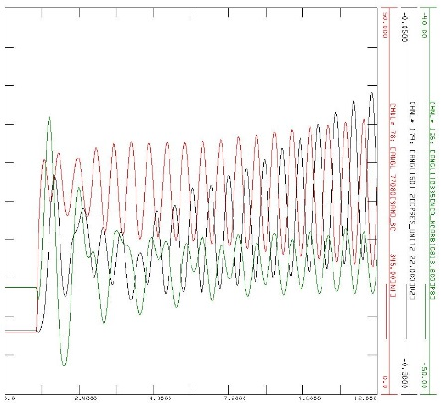
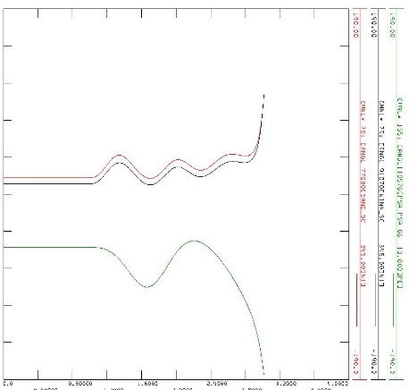
Summary (Continue)
Observations:
  Synchronous condensers are subject to synchronous machine stability limitations.
Recommendation:
  Planners should consider synchronous machine stability when recommending synchronous condensers.
  ERCOT should explore requirements for system damping support from renewable generation resources and transmission dynamic reactive devices.

Slide 19
Summary (Continue)
Observations:
  Typical phasor-based dynamic stability models and tools may not be adequate for future high renewable penetration scenarios.
  Large generation trips may cause voltage deviations before large frequency deviations are observed.
  Higher voltage transmission circuits were beneficial from a stability perspective.
Recommendations:
  ERCOT should consider dynamic model performance validation for all dynamic components.
  ERCOT should develop a standardized wide-area PSCAD model process and the ability to perform regular wide-area PSCAD studies.
  Dynamic load models should be regularly reviewed and validated.
  ERCOT and stakeholders should evaluate the full range of benefits of higher voltage level transmission circuits.

Slide 20
Discussion

Slide 21
Impacts Of Parameter Changes On Critical Inertia
Nitika Mago
Operations Planning
ERCOT
Synchronous Inertial Response (SIR) Workshop
May 18, 2018

Slide 22
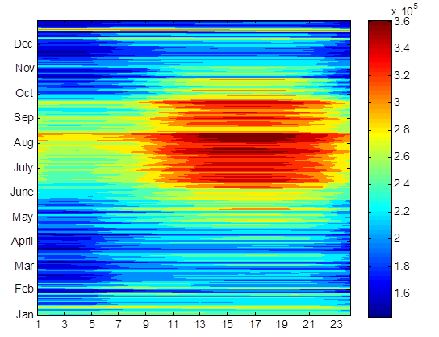
Responsive Reserve Service (RRS)
System Inertia 2016
RRS is procured to ensure sufficient capacity is available to respond to frequency excursions during unit trips.
To consistently meet BAL-003 Interconnection Frequency Response Obligation, ERCOT must plan not to activate UFLS for loss of 2750 MW of generation.
  UFLS relays will shed firm load if frequency drops to 59.3 Hz (5% of total ERCOT load).
  ERCOT plans to maintain frequency nadir at or above 59.4 Hz for loss of 2750 MW (0.1 Hz margin).
Responsive Reserve Requirements 2017

Slide 23
RRS Study Methodology
A set of recent cases at varying inertia levels are selected to to represent a wide range of expected future inertia conditions. Following assumptions are applied to each case/study,
    Model 1150 MW of PFR from Generation Resources.
      Generation mix when,
        Inertia < 250 GW·s: 30% Coal + 70% Gas
        Inertia ≥ 250 GW·s: 15% Coal + 85% Gas
    Load Resources providing RRS will trip at 59.7 Hz, with a delay of 0.416 s (relay delay = 0.333 s; breaker action = 0.083 s).
    Load damping factor was assumed to be 2% at the system level.
Trip 2750 MW of generation simultaneously and identify the amount of LR needed to maintain frequency at 59.4 Hz.

Slide 24
Current RRS Table
 | Scenario 1 | Scenario 2 | Scenario 3 | Scenario 4 | Scenario 5 | Scenario 6 | Scenario 7 | Scenario 8 | Scenario 9 | Scenario 10 | Scenario 11 | Scenario 12
LR/PFR | 2.25:1 | 2.11:1 | 1.99:1 | 1.87:1 | 1.77:1 | 1.69:1 | 1.61:1 | 1.54:1 | 1.47:1 | 1.41:1 | 1.36:1 | 1.3:1
Inertia (GW∙s) | 130 | 140 | 150 | 160 | 170 | 180 | 190 | 200 | 210 | 220 | 230 | 240
PFR Req. (no LR) (MW) | 5246 | 4916 | 4620 | 4361 | 4132 | 3927 | 3743 | 3576 | 3424 | 3285 | 3157 | 3040
RRS 50% Lim (MW) | 3229 | 3162 | 3090 | 3039 | 2984 | 2920 | 2868 | 2815 | 2772 | 2726 | 2676 | 2643
RRS 60% Lim (MW) | 2998 | 2951 | 2898 | 2867 | 2835 | 2793 | 2760 | 2725 | 2697 | 2664 | 2626 | 2604
 | Scenario 13 | Scenario 14 | Scenario 15 | Scenario 16 | Scenario 17 | Scenario 18 | Scenario 19 | Scenario 20 | Scenario 21 | Scenario 22 | Scenario 23 | Scenario 24 | Scenario 25
LR/PFR | 1.26:1 | 1.22:1 | 1.17:1 | 1.14:1 | 1.1:1 | 1.07:1 | 1.04:1 | 1.01:1 | 1.00:1 | 1.00:1 | 1.00:1 | 1.00:1 | 1.00:1
Inertia (GW∙s) | 250 | 260 | 270 | 280 | 290 | 300 | 310 | 320 | 330 | 340 | 350 | 360 | 370
PFR Req. (no LR) (MW) | 2932 | 2831 | 2737 | 2650 | 2569 | 2492 | 2421 | 2353 | 2290 | 2230 | 2173 | 2119 | 2068
RRS 50% (MW) | 2594 | 2550 | 2523 | 2477 | 2446 | 2408 | 2373 | 2342 | 2290 | 2230 | 2173 | 2119 | 2068
RRS 60% (MW) | 2564 | 2528 | 2507 | 2466 | 2440 | 2405 | 2372 | 2341 | 2290 | 2230 | 2173 | 2119 | 2068
RRS 50% Lim (MW) - quantity is calculated with limit of 50% limit on LRs.
RRS 60% Lim (MW) - quantity is calculated using language approved in NPRR 815.
Red font in table above identifies study scenario where RRS needed < 2300 MW. 2300 MW floor will be used in RRS requirement determination.
Generation mix (CCs, Gas, SC, Coal, Steam) providing 1150 MW of PFR has been aligned with actual historic system operations.
Inertia < 250 GW·s: 30% Coal + 70% Rest. Inertia ≥ 250 GW·s: 15% Coal + 85% Rest

Slide 25
Critical Inertia Definition
Minimum level of system inertia that will ensure LRs will have sufficient time to respond before Frequency hits 59.3 Hz (UFLS threshold)
Tf = LRs Response time

Slide 26

Current Critical Inertia for ERCOT
$$T=f \left(Inertia\right) =3×{10}^{−5}×{Inertia}^{2}+0.0016×Inertia+0.0048$$
Critical Inertia: 94 GW*s
LR Response Time
0.42s

Slide 27
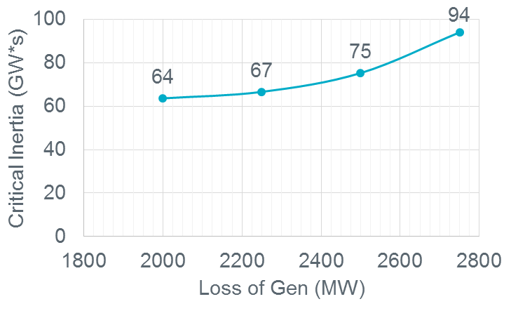
Potential Parameters Changes
Faster Response
Changing UFLS Settings
Critical Contingency
 | UFLS @59.3Hz | UFLS @59.1Hz
0.42s LR Response Time
0.25s LR Response Time
94 GW*s
71 GW*s
68 GW*s
52 GW*s

Slide 28
Fast Frequency Response (FFR) – NPRR 863
NPRR 863 introduces a framework for Fast Frequency Response.
  Fast Frequency Response (FFR) From NPRR 863
  The automatic self-deployment and provision by a Resource of their obligated response within 30 cycles after frequency meets or drops below a preset threshold (59.85 Hz) or via an ERCOT Verbal Dispatch Instruction (VDI). Resources capable of automatically self-deploying and providing their full Ancillary Service Resource Responsibility within 30 cycles after frequency meets or drops below a preset threshold and sustaining a full response for at least 15 minutes may provide Frequency Response Service (FRS).
  A Resource providing PFRS as FFR that is deployed may not recall their capacity until system frequency is greater than 59.98 Hz.
  Once recalled, a Resource providing FRS as FFR must restore their full PFRS Ancillary Service Resource Responsibility within 15 minutes after cessation of deployment or as otherwise directed by ERCOT.

Slide 29
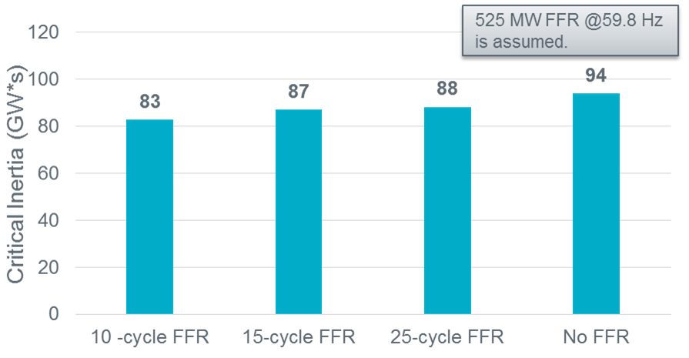
FFR Impact
With appropriately selected trip settings, FFR will help with Critical Inertia.
 | No FFR | 525 MW FFR (59.8 Hz,15 cycles)
0.42s LR Response Time
0.25s (15 cycles) LR Response Time
94 GW*s
87 GW*s
68 GW*s
66 GW*s

Slide 30
Frequency Response Times
Type of Detection | Measure & Identify | Signal
Direct Detection | ≤ 40-60 ms (2.4-3.6 cycles) | ∼ 20 ms (1.2 cycles)
Detection with PMU | ∼ 40-60 ms (2.4-3.6 cycles) | ∼ 20 ms (1.2 cycles)
Local Frequency detection | ≥ 100 ms (6 cycles) | nil
Technology | Activate | Activate Fully
Wind Turbine with IBFR | 40 ms (2.4 cycles) | ∼ 500 ms (30 cycles)
Lithium Batteries, Flow Batteries, Super Capacitor | 10-20 ms (0.6-1.2 cycles)
Lead-Acid Batteries | 40 ms (2.4 cycles)
Flywheels (inverter) | ≤ 4 ms (0.24 cycles)
Solar PV | 100-200 ms ( 6-12 cycles)
HVDC | 50-500 ms (3-30 cycles)
Load |  | Depends on Load
Source: GE Energy Consulting, Technology Capabilities for Fast Frequency Response, prepared for AEMO, March 2017

Slide 31
Coming Up Next
Faster Response
  RRS from Load Resources and the feasibility of faster response.
  Inertia based Frequency Response from Wind Resources – Industry Experience and ERCOT wind fleet’s capabilities.
Critical Contingency
  NERC BAL-003 SDT Update
Changing UFLS Settings
  Discuss pros and cons

Slide 32
RRS from Load Resources and The Feasibility of Faster Response
Mark Patterson
Demand Integration
ERCOT
Synchronous Inertial Response (SIR) Workshop
May 18, 2018

Slide 33
Load Resource UFR Requirement
From 2.3.1.2 Additional Operating Details for Responsive Reserve Providers in the ERCOT Nodal Operating Guide
  The under-frequency relay must have a delay of no more than 20 cycles (or 0.33 seconds for relays that do not count cycles). Total time from the time frequency first decays to a value low enough to initiate action of the under frequency relay(s) to the time Load is interrupted should be no more than 30 cycles, including all relay and breaker operating times;
  The initiation setting of the under-frequency relay shall not be any lower than 59.7 Hz; and
Note: 1) ERCOT validates the UFR relay delay and trip setting by review of the relay test sheet provided as part of the qualification process.
2) Breaker operating times are currently not validated and are assumed to be 10 cycles or less to meet this requirement

Slide 34
Reduce Critical Inertia
Faster response from the Load Resources on high-set under-frequency relays will aid in reducing Critical Inertia
  Add option for LRs to respond within 15 cycles
  Discussed viability of this option with various DR providers
  Option dependent on the types of Load Resources
  Probably not viable for all Load Resources
  ERCOT may be willing to allow LRs that meet the 15 cycle response requirement to move their trip setting from 59.7 Hz to something less.

Slide 35
Under-Frequency Events Impacting Load Resources
Since 2011, 14 UFR Events that tripped Load Resources
  12 events for frequency near 59.7 Hz
  2 events below 59.7 Hz

Slide 36
To-Be-Determined
Faster response setting for Load Resources interrupting within 15 cycles to be explored
Validation requirements for faster response may be required
  Relay
  Breaker
New parameters for Non-Controllable Load Resources may be needed

Slide 37
Discussion

Slide 38
Appendix

Slide 39
Under-Frequency Events Impacting Load Resources
2011
Date | Time | Duration (min) | Amount of Response (MW) | Type of Deployment
3/23/2011 | 14:46 | 31 | 393 | UF Event for frequency near 59.7 Hz that caused some Load Resources to trip offline
4/5/2011 | 22:02 | 6 | 75 | UF Event for frequency near 59.7 Hz that caused some Load Resources to trip offline
5/19/2011 | 14:08 | 9 | 114 | UF Event for frequency near 59.7 Hz that caused some Load Resources to trip offline
11/29/2011 | 3:29 | 15 | 739 | UF Event for frequency < 59.7 Hz but of uncertain duration
2012
Date | Time | Duration (min) | Amount of Response (MW) | Type of Deployment
7/10/2012 | 20:46 | 14 | 198 | UF Event for frequency near 59.7 Hz that caused some Load Resources to trip offline
7/30/2012 | 16:03 | 13 | 324 | UF Event for frequency near 59.7 Hz that caused some Load Resources to trip offline
11/2/2012 | 1:41 | 11 | 882 | UF Event for frequency < 59.7 Hz but of uncertain duration
2013
Date | Time | Duration (min) | Amount of Response (MW) | Type of Deployment
1/4/2013 | 9:41 | 20 | 572 | UF Event for frequency near 59.7 Hz that caused some Load Resources to trip offline
1/8/2013 | 16:40 | 10 | 974 | UF Event for frequency near 59.7 Hz that caused some Load Resources to trip offline
11/1/2013 | 21:47 | 10 | 463 | UF Event for frequency near 59.7 Hz that caused some Load Resources to trip offline

Slide 40
Under-Frequency Events Impacting Load Resources
2014
Date | Time | Duration (min) | Amount of Response (MW) | Type of Deployment
1/18/2014 | 8:41 | 59 | 850 | UF Event for frequency near 59.7 Hz that caused some Load Resources to trip offline; resulted in EEA Level 1 event.
2015
Date | Time | Duration (min) | Amount of Response (MW) | Type of Deployment
7/29/2015 | 18:16 | 10 | 22 | UF Event for frequency near 59.7 Hz that caused some Load Resources to trip offline
2016
Date | Time | Duration (min) | Amount of Response (MW) | Type of Deployment
5/1/2016 | 20:20 | 4 | 927 | UF Event for frequency near 59.7 Hz that caused some Load Resources to trip offline
2018
Date | Time | Duration (min) | Amount of Response (MW) | Type of Deployment
4/21/2018 | 17:11 | 19 | 546 | UF Event for frequency near 59.7 Hz that caused some Load Resources to trip offline

Slide 41
Inertia based Frequency Response from Wind Resources
Industry Experience
Julia Matevosjana
Resource Adequacy
ERCOT
Synchronous Inertial Response (SIR) Workshop
May 18, 2018

Slide 42
Background
Most of modern wind turbines are Type 3 and 4
  Type 3 - Doubly Fed Induction Generator
  Type 4 - Full Converter Generator
These designs allow variable generator speed to achieve greater efficiency
Variable speed operation requires for generator speed and system frequency to be decoupled from each other – via use of power electronic converters
Variable speed wind turbines do not naturally provide inertial response to grid disturbances
The delivery of active power is controlled by power electronics, which allow almost instantaneous (few cycles) adjustment of electrical torque
Controlled inertial response can be implemented but is not the same as inherent (uncontrollable) response of synchronous machines.

Slide 43
Terminology debate
Different terms are used to call this functionality: synthetic inertia, emulated inertia, wind inertia…
Available controls are enabled by accessing energy stored in the inertia of a wind turbine – so in that sense this is inertial energy
However, physical behavior is fundamentally different from inertial response from synchronous machines
The power is injected to the grid in response to grid frequency deviation – a variety of frequency response
However, energy available is limited and cannot be sustained until frequency returns back to 60 Hz, unlike response from storage or Load Resources.
GE proposed a term “Inertia-Based Frequency Response” (IBFR) which describes this functionality most comprehensively.

Slide 44
IBFR Basic Principals
As wind turbine extracts available power from wind, it is possible to generate a temporary active power overproduction. This temporary active power overproduction mainly depends on rotational speed variations, drive train inertia and wind speed conditions.
Source: G.C. Tarnowski, P. C. Kajaer, P.E. Sorensen, J. Ostergaard Variable Speed Wind Turbines Capability for Temporary Over-Production, IEEE PES GM 2009
Notes:
Variable speed wind turbines normally operate at an optimal rotational speed;
If under-frequency event is detected, IBFFR function increases the active power set point by $∆P_{OP}$ on top of the pre-event active power reference, $P_{e0}$.
The electrical power output is then given by $P_{e}=P_{e0}+∆P_{OP}$,
For wind speeds below rated $P_{e0}$ is equal to available mechanical power and has a maximum limit at higher wind speeds (rated power)
When $∆P_{OP}$>0, electric power output $P_{e}$ is higher than available wind power and there’s an imbalance between mechanical input and electrical output, extra power is drawn from kinetic energy stored in WT rotating masses (i.e. no pre-curtailment needed but available energy is limited!)
As a result wind turbine rotational speed is decreasing from optimal, mechanical shaft torque is also decreasing due to decrease in aerodynamic efficiency for a given wind speed, exacerbating speed decline.
This positive feedback may lead to aerodynamic stall which must be avoided
After initial increase, electrical power has to drop to below mechanical to allow energy to recover re-accelerating the rotor back to its optimal speed;
The amount of energy needed to re-cover includes the extra arresting energy delivered to the grid and energy not collected during turbine speed drop due to loss in aerodynamic efficiency.

Slide 45
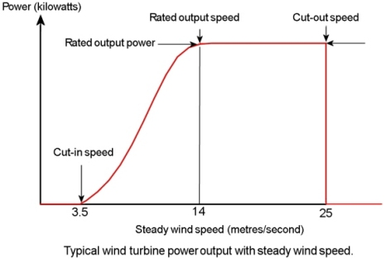
IBFR at different wind speeds
Performance close to nominal wind speed is most demanding for the recovery phase
Source: AESO, Recommendations on Synthetic Inertia, August 2016
Source: GE Energy Consulting, Technology Capabilities for Fast Frequency Response, prepared for AEMO, March 2017
Notes:
When the wind speed is above rated, the turbine controls in normal operation reduce mechanical torque by decreasing the angle of attack through pitch control.
Under these conditions, the available wind power is greater than turbine output
During frequency events, initial response it provided using wind turbine kinetic energy as described before, but then it is possible to increase the captured wind power (mechanical power), using pitch control.
Under these conditions, the decline in rotor speed is less and the energy recovery is minimal or non-existent
Under curtailment conditions, IBFFR can be combined with PFR and sustained until frequency recovers.

Slide 46
IBFR Impact on System Frequency
Source: EPRI, 40.020 Frequency Response Adequacy, Project Updates Dec. 2013

Slide 47
Additional Considerations
The value of IBFR is in energy delivery during the arresting period and “buying” time for PFR to act.
Delaying IBFR provision beyond nadir may result in too severe recovery.
Recovery should be coordinated with rate of rise of the PFR during post nadir period
Turbine speed and mechanical stress management controls take priority over IBFR
IBFR decreases drastically at 50% of rated power dropping to 0 at 20% of rated power
The ability to tune inertial response (including shutting it off) provides the planning engineer with an additional tool to manage system stability.
Source: GE Energy Consulting, Technology Capabilities for Fast Frequency Response, prepared for AEMO, March 2017
Notes:
(if recovery is too fast frequency will fall again if too slow then more energy will be needed to recover).

Slide 48
Hydro Quebec, Facts
Facts
Not synchronously interconnected with other systems
Peak Load 37.6 GW
3.5 GW of wind generation
Minimum inertia 60 GW·s
Hydro-dominated, inertia is low
RCC=1700 MW (multiple units in a hydro power plant)
Concerns
Inertia is low, RCC is high, PFR is slow, time to UFLS is a concern
Mitigation
Limits largest contingency in real time based on inertia conditions
System operator performs real-time generation re-dispatch or increases the level of synchronous generation online to ensure the limit is not exceeded
Synthetic inertia requirement for all WGRs > 10 MW

Slide 49
HQ “Inertial Response” requirement, 2009
Wind power plants >10 MW must be equipped with frequency control system activated during major frequency deviations
Must reduce frequency deviations at least as much as the inertial response of a synchronous generator with H=3.5 s.
This target performance is met with 5% increase of active power for 10 s when a large frequency deviation occurs on the power system.
Inertial Response (IR) requirement is based on studies with and w/o wind generation on the system
Criteria: “inertia part” of frequency trace after a disturbance should be the same with and w/o wind
Tested different dead-bands,% contribution, time duration of response, % and duration of recovery
Source: Transmission Provider Technical Requirements for The Connection of Power Plants to the Hydro Quebec Transmission System, February 2009

Slide 50
HQ event with and without IR
Source:

Slide 51
Updated HQ requirement 2016
Source: M. Asmine, C.E. Langlois, N. Aubut, Inertial Response from Wind Power Plants during a Frequency Disturbance at the Hydro-Quebec System – Event Analysis and Validation, International Wind Integration Workshop, 2016
Notes:
Full overproduction activated at a given frequency threshold or overproduction proportional to frequency deviation;
Dead band adjustable [-0.1 , -1] Hz with respect to 60 Hz;
Maximum momentary real power overproduction equal to at least 6% of rated power of each wind generator in service;
Maximum overproduction duration of at least 9 s (from the start of power ramp up to the start of power ramp down);
Rise time to reach maximum overproduction limited to 1.5 s or less;
Real power decrease during energy recovery (if needed) limited to ∼20% of rated power;
Operational for every wind generator in service when their generation level reaches ∼25% of the rated power;
Able to operate repeatedly with a 2 min delay after the end of the recovery period following the previous operation.
Wind generating station performance takes precedence over individual wind generator performance. The power producer must demonstrate the operation and performance of the inertial response system design based on tests performed on actual wind generators.

Slide 52
IR Contribution Verification by HQ
Source: M. Asmine, C.E. Langlois, N. Aubut, Inertial Response from Wind Power Plants during a Frequency Disturbance at the Hydro-Quebec System – Event Analysis and Validation, International Wind Integration Workshop, 2016

Slide 53
IR Measurements vs Simulation
Source: M. Asmine, C.E. Langlois, N. Aubut, Inertial Response from Wind Power Plants during a Frequency Disturbance at the Hydro-Quebec System – Event Analysis and Validation, International Wind Integration Workshop, 2016
Notes:
Modeling contribution as a fixed % of installed capacity may not accurately represent the performance at all wind conditions.

Slide 54
Simulation Results
Source: M. Asmine, C.E. Langlois, N. Aubut, Inertial Response from Wind Power Plants during a Frequency Disturbance at the Hydro-Quebec System – Event Analysis and Validation, International Wind Integration Workshop, 2016
Notes:
Acceptable performance nadir without IR is by 0.1 Hz lower than with IR

Slide 55
Stress test
Next test is low load, low inertia, 3300 MW of wind,
Without IR nadir is below UFLS trigger.
Second nadir interplays with additional UFLS protection and causes UFLS even in the case with IR.
Source: M. Asmine, C.E. Langlois, N. Aubut, Inertial Response from Wind Power Plants during a Frequency Disturbance at the Hydro-Quebec System – Event Analysis and Validation, International Wind Integration Workshop, 2016

Slide 56
Conclusions from HQ study
IR from WTGs during underfrequency events has an impact on the HQ frequency dynamics
Good fit between measurements and simulations was achieved
Both Enercon and Senvion WTGs meet the intent of the initial requirements
A trade-off is needed to take maximum benefits from the IR
– improved frequency nadir with more power contribution
– delayed frequency recovery due to the recovery phase
A moderate and slow recovery phase is more suitable than a deep and fast power reduction
Enercon is in the process of improving its Inertia Emulation control
HQ also have developed validation and testing for IBFR
Additionally, HQ considers taking advantage of smart loads and storage
Notes:
–Expected contribution during the first nadir
–Second frequency nadir caused by the recovery phase

Slide 57
IESO, Facts
Facts
HVDC connection with Hydro Quebec, AC tie lines with Eastern Interconnection
Peak Load of 21,786 MW in 2017
20% of installed capacity is transmission connected wind, 2.2% is embedded wind,
1.7% transmission connected solar and 8.5% embedded solar
23% of installed capacity is nuclear which makes up almost all of the baseload supply. Units all have good inertia constants
System inertia currently not monitored, no requirements for minimum inertia
RCC = 4500 MW for the Eastern Interconnection
Concerns
No inertia or frequency related concerns at this time
Mitigation
Inertia emulation required for all transmission connected WTGs

Slide 58
IESO requirement
Wind turbines are required to provide a temporary boost in active power (from stored rotating energy) during severe frequency decline.
No capability for a sustained increase in active power is required, i.e. no need to continually “spill” wind.
Functional requirements for this feature are as follows:
The active power boost shall be triggered at < 59.7 Hz.
The boost activation time <1 second.
The boost must be >10% of pre-trigger active power.
The boost shall last ≥ 10 seconds for f< 59.964 Hz.
The boost shall be cancelled if f > 59.964 Hz.
The rate of energy withdrawn during recovery must be less than the rate of energy injected during the active power boost.
Following an activation, the capability shall be available again within 30 min
Source: IESO Requirements, Market Manual 2: Market Administration. Part 2.20: Performance Validation, Dec. 2016
Notes:
The IESO will notify generators that have wind turbines with this capability when this feature must be placed in-service.

Slide 59
IESO requirement, Representative Responses
GE: Limiting recovery power increases the time and energy needed to recover!
Source:
Notes:
Representative responses of a wind turbine with this feature placed in-service, consistent with the functional requirements above, are shown in Figure 5 below for two illustrative cases (corresponding to two different triggering events).

Slide 60
AESO, Facts
Facts
Two AC tie lines with WECC (AC, 1500 MW) and Saskatchewan (DC, 150 MW)
Peak Demand 11.6 GW
1.5 GW of wind generation
Loss of Alberta – BC and Montana tie line trip due to generator trip in AESO
Concerns
Expects 5000 MW of additional renewables by 2030
Expects 6300 MW of coal retirements, concern with increased size of Most Severe Single Largest Contingency (MSSC)
Mitigation
Limits MSSC in real time to avoid overloading (and tripping interconnectors),
Conducted a future-looking study investigating need for IBFR requirement for wind generation

Slide 61
AESO Evaluation
IBFR may improve frequency performance depending on settings and system conditions
In the recovery stage of IBFR second nadir lower than initial nadir is observed in the simulations in certain operating states
Only few WTG manufacturers offer this capability, a requirement for IBFR may obstruct otherwise economic projects.
Coordination of IBFR is advantageous but increases complexity at interconnection stage and performance testing
Settings cannot be uniform because IBFR implementation is differs by manufacturer. Performance evaluation is an issue.
Other remediation will still be required, e.g. fast frequency response. With other remediation in place IBFR is not necessary in AESO system.
Source: AESO, Recommendations on Synthetic Inertia, August 2016

Slide 62
GE: Important Considerations for IBFR Specifications
Specification of minimum turbine power below which inertial response is not required
Specification of preferred interactions/priority with other plant controls
Not specified to be identical with synchronous machine
Not specified to be identical in all operating conditions
Not specified to be exactly reproducible with individual turbine tests
Not specified to be energy neutral for all events
Not overly prescriptive or putting impossible recovery constraints
Not require energy delivery beyond that necessary to improve the frequency nadir.
Source: GE Energy Consulting, Technology Capabilities for Fast Frequency Response, prepared for AEMO, March 2017

Slide 63
UCD Research
At the end of 2014-2015 University College Dublin analyzed IBFR potential of ERCOT system, using 2013 generation data, 11 GW of installed capacity, assuming all of it is IBFR capable
With IBFR active power boost of 5% of installed capacity, maximum power injection achievable from all WGRs was 550 MW
At wind generation levels ≥ 35% of installed capacity between 50-100% of IBFR potential is available (225-550MW)
Recovery energy is never 0 and is highest at WGRs output 50-80% of installed capacity.
Parameter tuning is important and optimal parameters depend on system conditions
Tuning process is a trade off between raising initial frequency nadir and avoiding/reducing second frequency dip
Notes:
Ideally, either IBFR parameters should be dynamically set or only a subset of WGRs experiencing high power output (above rated wind speed) should be responding.

Slide 64
Discussion

Slide 65
ERCOT Wind Fleet’s Capability To Provide Emulated Inertia Response
Pengwei Du
Operations Planning
ERCOT
Synchronous Inertial Response (SIR) Workshop
May 18, 2018

Slide 66
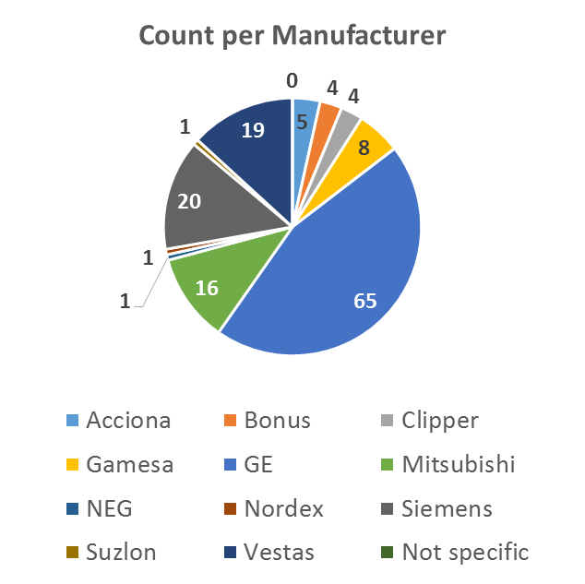
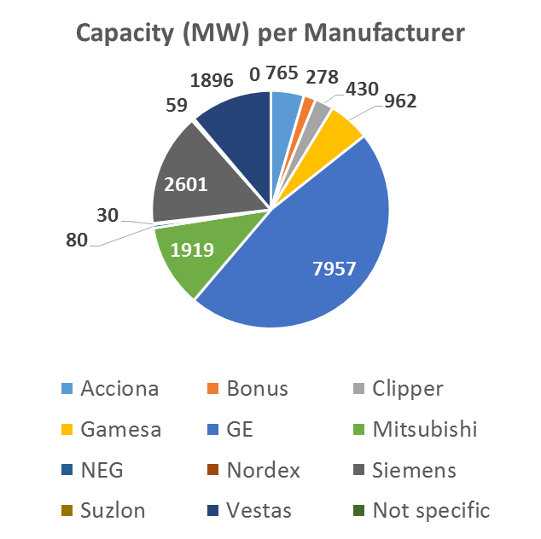
Introduction
Wind Emulated Inertia RFI was issued in 2015
  146 Wind Generators with a total wind capacity of 17,194 MW responded to Wind Emulated Inertia RFI

Slide 67
Survey Response Summary
Are there currently any Wind Generators (WGRs) that currently provide Emulated Inertia Response (EIR) in ERCOT?
  None of the 146 WGRs have this capability.
How many WGRs have the capability installed and are able to activate it?
  27 (all GE type turbines) have the capability to provide EIR.
    Will require a software upgrade and a testing period.
    Downtime of the WGR is estimated to be less than 4 hours.
    Is an OEM/commercial offering at a cost to the wind farm.
  88 do not yet have the capability to provide EIR.
    Either the WGR cannot physically provide EIR, or
    Would require hardware/software upgrades, down-time, and money.
  31 do not know whether they have such a capability to provide EIR.

Slide 68
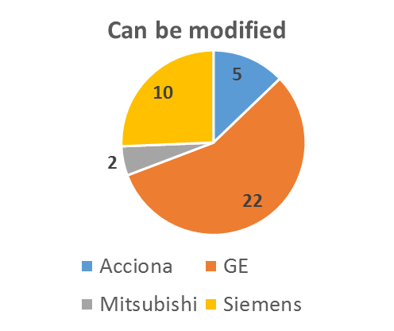
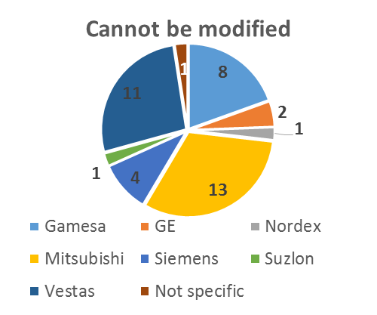
Survey Response Summary
Can the WGR be modified to provide Emulated Inertia Response?
  Of the 119 WGRs that do not currently have the capability to provide EIR
    39 WGRs can be modified to provide EIR.
      Development/update of software/hardware
      Load checks/testing
    39 WGRs need more analysis to determine whether their turbines can be modified based on WGR manufacturer/type.
    Remaining 41 WGRs
      Are unable to provide EIR.
      This feature would have to be developed by the OEM.
      Need further time to assess the possibility of an upgrade.
        Likely will determine that software upgrade and testing would be required.

Slide 69
Survey Response Summary
Please describe the inertia response characteristics for the WGR
  59 WGRs responded to this question.
  Following is a collection characteristics received.
    Response Trigger: 200 mHz (47 WGRs)
    Response Time: 1s (44 WGRs)
    Response Type: Fixed (56 WGRs)
    Maximum Response Magnitude: 10% (51 WGRs)
    Maximum Response Duration: 10s (57 WGRs)
    Maximum Energy Recover Magnitude: 5% (47 WGRs)
    Maximum Energy Recover Duration: < 20s (48 WGRs)
    Response Limit: > 900rpm (33 WGRs)
  47 WGRs with GE type turbines confirmed that the dynamic models can be configured or updated to simulate synthetic inertia response capability.

Slide 70
Discussion

Slide 71
Appendix

Slide 72
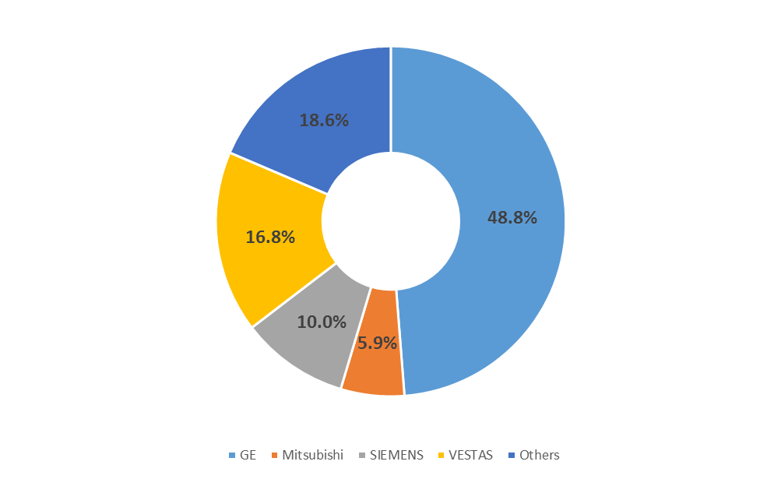
WGRs by Turbine Type as of Q2 2018

Slide 73
Critical Contingency And NERC BAL-003 SDT Update
Sandip Sharma
Operations Planning
ERCOT
Synchronous Inertial Response (SIR) Workshop
May 18, 2018

Slide 74
Project 2017-01 BAL3 SAR Drafting Team
PHASE-I
  Revise the IFRO calculation in BAL‐003‐1 due to issues identified in the 2016 Frequency Response Annual Analysis (FRAA) Report, such as the IFRO values with respect to Point C and varying Value B;
  Reevaluate the interconnections’ Resource Contingency Protection Criteria;
  Reevaluate the frequency nadir point limitations (currently limited to t0 to t+12);
  Review and modify as necessary Attachment A of the Reliability Standard to remove administrative tasks and provide additional clarity, e.g., related to Frequency Response Reserve Sharing Groups (FRSG) and the timeline for Frequency Response and Frequency Bias Setting activities; and
  Make enhancements to the BAL-003-1.1 FRS Forms that include, but may not be limited to, the ability to collect and submit FRSG performance data.

Slide 75
Discussion

Slide 76
Discussion on Changing UFLS Settings
Sandip Sharma
Operations Planning
ERCOT
Synchronous Inertial Response (SIR) Workshop
May 18, 2018

Slide 77
UFLS Setting Current vs. Study
5.8%
59.3 Hz
11%
59.1 Hz
58.9 Hz
10%
58.8 Hz
10 %
10%
58.5 Hz
58.5 Hz
4.7%
Current
Study

Slide 78
UFLS Change Impact
 | UFLS @59.3Hz | UFLS @59.1Hz
0.42s LR Response Time | 94 GW*s
71 GW*s

Slide 79
Pros and Cons of Changing UFLS Settings
Pros
  Only changes the triggering frequency threshold of under frequency relay
  TSPs have experience with making such changes to UFLS settings
  Consistent protection against Critical Inertia
  Framework for gauging effectiveness of UFLS Program already exists (and is required by NERC)
Cons
  Coordinated implementation plan that spans potentially many years may be needed to make the UFLS settings changes.
  ERCOT grid may be subject to more events with frequency between 59.3 Hz and 59.1 Hz.

Slide 80
Discussion

Slide 81
Lunch Break
Synchronous Inertial Response (SIR) Workshop
May 18, 2018

Slide 82
Synchronous Inertial Response As an Ancillary Service
Sai Moorty
Market Design & Development
ERCOT
Synchronous Inertial Response (SIR) Workshop
May 18, 2018

Slide 83
Synchronous Inertial Response Service (SIRS)
ERCOT’s 2015 Proposal for a
Synchronous Inertial Response Service (SIR Service) Market
http://www.ercot.com/content/wcm/key_documents_lists/55752/Proposal_for_Synchronous_Inertial_Response_Service_Market_March112015.docx

Slide 84
Synchronous Inertial Response Service (SIRS)
Physics:
The stored kinetic energy (synchronous inertia) of a synchronous generator that is On-Line inherently responds to grid disturbances by resisting changes to the grid frequency
The more synchronous inertia on grid, the lower the Rate of Change of Frequency (RoCoF)
Inertia (MW-sec) provided in Real-Time by a synchronous generator is determined by:
  Whether the generator is On-Line (determined by telemetry)
  Inertia constant (H) – provided to ERCOT via Resource Asset Registration Form (RARF)
  MVA rating - provided to ERCOT via RARF
Inertia provided by a synchronous generator is independent of its power output
Stored Kinetic Energy (synchronous inertia) = H.MVA (if On-Line)

Slide 85
Synchronous Inertial Response Service (SIRS)
Potential SIRS Market construct for the Day-Ahead Market (DAM):
Market-based solution to ensure sufficient synchronous inertia is available on the grid for all hours
Create new Ancillary Service (AS): Synchronous Inertial Response Service (SIRS)
New input to DAM from ERCOT studies:
  Hourly requirements for SIRS (MW-sec)
  Posted as part of DAM AS Plan
As with all Ancillary Services:
  LSE QSEs are assigned their SIRS obligation on a Load Ratio Share (LRS) basis
  LSE QSEs may self-arrange all or part of their assigned SIRS obligations

Slide 86
Synchronous Inertial Response Service (SIRS)
Potential SIRS Market construct for the Day-Ahead Market (DAM):
DAM to procure SIRS based on available Resource-specific SIRS offers from synchronous generators
Resource-specific SIRS Offers:
  Only from synchronous Generation Resources
  Offer submission is voluntary (like any other AS offer)
  Quantity of synchronous inertia is measured in MW-sec, capped at H.MVA (max capability of Resource)
  SIRS awards may be partial
  Offer Cap: TBD
    Current energy offer cap is $9,000/MWh
    AS offer cap is $9,000/MW/h
    SIRS offer cap could be $9,000 $/MW-sec(?)
A QSE may submit a SIRS Offer for a Resource in its portfolio even if there is no corresponding Resource-specific Three Part Offer (or EOC) for energy and/or Resource-specific AS Offer

Slide 87
Synchronous Inertial Response Service (SIRS)
Potential SIRS Market construct for the Day-Ahead Market (DAM):
A DAM award for SIRS:
  Places responsibility on the QSE (just like any other AS)
  QSE updates Resource-specific COP with SIRS responsibility (new field in COP) before DRUC
  Is NOT a capacity (MW) reservation
    HASL calculation is not impacted by SIR Offer awards
In Real-Time, Resources carrying SIRS responsibility must provide quantity of SIRS responsibility via new telemetry point
SIRS Procurement Constraint:
Sum(SIRS_{Award}) >= ERCOT_SIR_{Requirement} – Total_SIRS_{Self-Arrangement}
MCPC for SIRS = Shadow Price of SIRS Procurement Constraint = SP_{sir}
:

Slide 88
Discussion

Slide 89
Open Discussion On Potential Solutions
Synchronous Inertial Response (SIR) Workshop
May 18, 2018

Slide 90
Short Term Options
Short Term = Approaches that can be undertaken without System changes.
  Maintain enough inertia through Command & Control
  Increase the minimum generation that provides RRS beyond 1150 MW (feasible post NPRR 815 implementation)

Slide 91
Mid Term Options
Mid Term = Approaches that involve System Changes
  Lower Critical Inertia by getting faster response from Load Resources
  Consider frequency response product that is faster than 30 cycles and earlier than 59.70 Hz.
    NPRR 863 currently includes this FFR but with 30 cycles response requirement
  Make synthetic inertia an interconnection requirement for new WGRs.

Slide 92
Long Term Options
Long Term = Approaches that involve significant system changes at ERCOT and MPs (such as new AS product)
  Synchronous Inertial Response as an A/S
  Change UFLS settings?

Slide 93
Action Items
& Next Steps

