Slide 1

Overview of GMD Activities at Texas A&M
Thomas J. Overbye, Komal S. Shetye
Texas A&M University
overbye@tamu.edu
shetye@tamu.edu
May 10, 2018

Slide 2

A Little Bit About Me
Originally from Wisconsin, al degrees from Univ. of Wisconsin-Madison: BSEE 1983, MSEE 1988, PhD 1991
Utility engineer with Madison Gas and Electric, 1981-1991
University of Illinois ECE Faculty, 1991-2016
Founded PowerWorld Corporation, 1996
Joined TAMU in January 2017

Slide 3
GMD Background
We got involved in GMD research starting in 2010 through a DOE funded PSERC project focusing on the modeling of high impact, low frequency (HILF) events
After JASON presentation in June 2011 got the idea to embed GMD analysis into PowerWorld Simulator
  Initial version was done by August 2011
Began involvement with the NERC effort in Nov. 2011
Did a number of utility and EPRI studies starting in 2012
Have continued doing research in GMD, and in summer of 2016 also added EMP analysis

Slide 4
Current Research Projects
NSF Hazards SEES: GIC Hazard Prediction – From the Solar Wind to Power System Impacts
  Multi-university and company (CPI Inc.), inter-disciplinary project: UIUC, TAMU, VTech, CSM, Utexas
  $2.6 million, running from 8/15 to 8/19
  Geophysics, Remote Sensing, Power Engineering, K-12 Education
  http://gmd.mste.illinois.edu/research
Bonneville Power Administration Technology Innovation Project (TIP) 359: Improved System Modeling for GMD and EMP Assessments
  UIUC + TAMU + CPI Inc.
  Key CPI Personnel: Dr. Jennifer Gannon
  Ending May 2018

Slide 5
Goals of Our Research
Overall, broad goal of research is to help in the continued development of a sustainable and resilient electric grid
  Goal is to leverage a wide range of technologies for the smarter electric grid of the future
Passion for transferring research results to industry!
  That certainly involves high quality undergraduate and graduate education
With GMD the goal is to do the R&D to help industry have the tools to make appropriate decisions
Challenge with GMD to students is “assume a large GMD will occur in one year; how is your research helping the electric utility industry to minimize its impact?”

Slide 6
Impact of a Large GMD from an Operations Perspective
Would be maybe a day warning but without specifics
  Satellite at Lagrange point one million miles from earth would give
  more details, but with less than 30 minutes lead time
  Could strike quickly; rise time of minutes, rapidly covering a good
  chunk of the continent
Reactive power loadings on hundreds of high voltage transformers could rapidly rise
Increased transformer reactive loading causes heating issues and potential large-scale voltage collapses
Power system software like state estimation could fail
Control room personnel would be overwhelmed
The storm could last for days with varying intensity
Waiting until it occurs to prepare is not be a good idea!

Slide 7
Major Areas of TAMU GMD Work
Developing synthetic but realistic large scale test systems, which include GMD parameters
  Research results based on actual, large system models often cannot be freely shared due to CEII concerns
  Cases developed are not CEII; mimic complexity of real grids
Analyzing the effect of electric field hot-spots
Validating GICs calculated using electric fields derived from 1D and 3D models, with measurement GICs
Real-time GIC Monitoring and Control Environment
  GIC “State Estimation”
  Impact Analysis: Heating, var losses, loss of var support
  Interactive Control and Mitigation

Slide 8
Major Areas of Work
Model validation using GIC measurements to estimate
  Electric fields
  Substation grounding resistances
Algorithms for GIC mitigation (minimizing var losses)
  Corrective line switching
  Blocking devices
Performing GMD assessments for utilities
Modeling advancements in GIC analysis, tech transfer to industry/software
  Automated hotspot analysis with varying grid location and size
  Time-series simulations
  Transient Stability

Slide 9
Synthetic Networks
Being developed for an ARPA-E project
First case with GMD parameters had 150 buses, based geographically in Tennessee
More cases now developed with added network complexities
  IL-500, SC-500, Texas 2000, 10k bus system based in Western US,
  70k bus system based
  in Eastern US

Slide 10
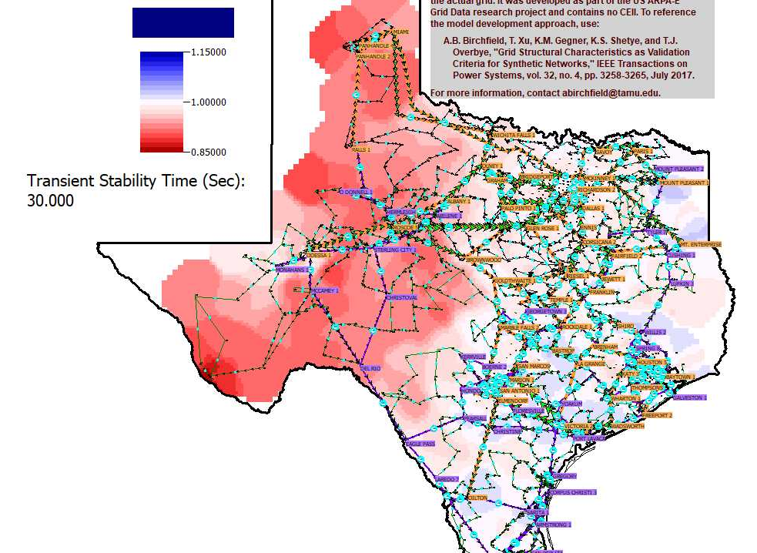
Synthetic Texas GMD Example
Associated
movie shows
the impact
of a gradually
increasing
electric field
on the bus
voltages

Slide 11
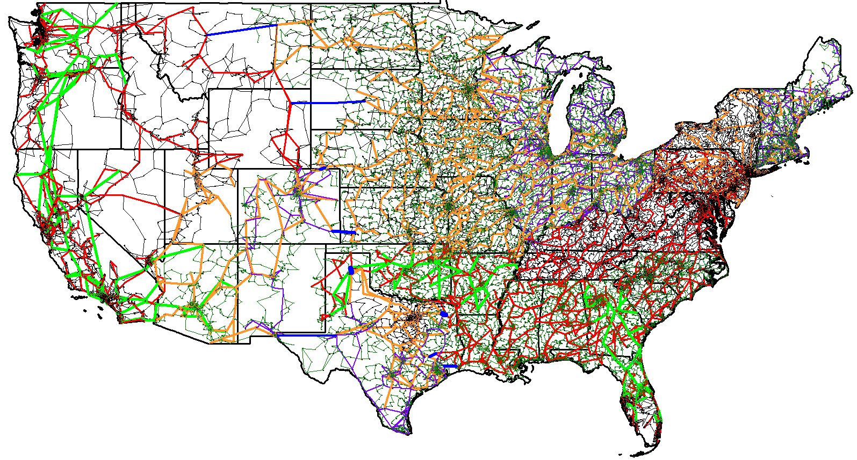
Synthetic Electric Networks: Current Status is 82,000 Buses Covering Continental US
All models have parameters needed for GIC and transient stability analysis. They contain no CEII and hence are fully public.

Slide 12
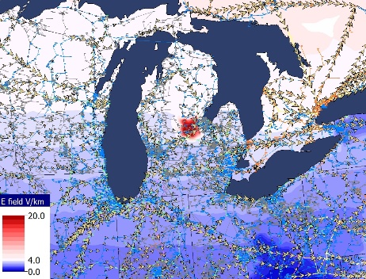
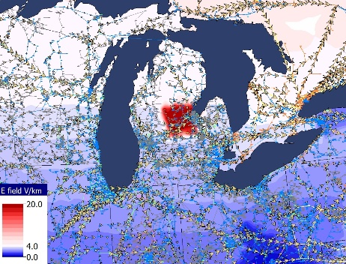
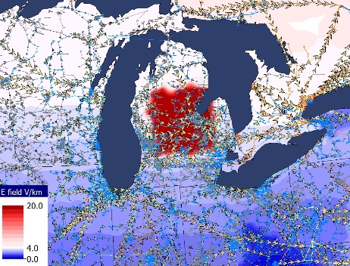
Electric Field Hotspot Modeling
A “box” of a specified width, and centered at a geographic point, with localized intensification of electric field
  20 V/km hotspot shown below (purely illustrative)
  50 km, 100 km, and 200 km wide

Slide 13
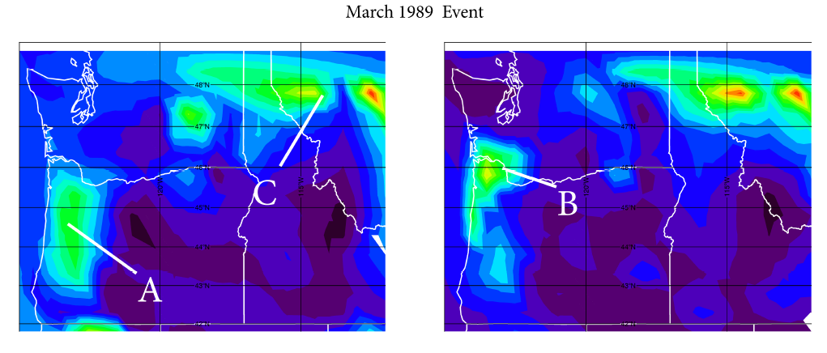
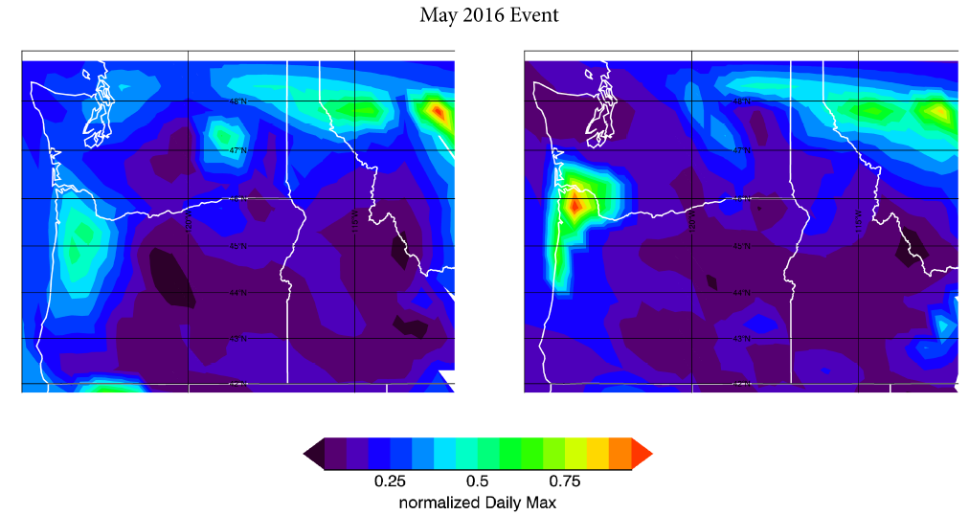
3D Electric Field Maps
Three locations “A, B and C” where electric field peaks occur for multiple events
Two of those events are shown here
Electric field values shown are normalized for each event such that max = 1 (red) and the rest are scaled accordingly
Gannon, J. L., Birchfield, A. B., Shetye, K. S., & Overbye, T. J. (2017). A comparison of peak electric fields and GICs in the Pacific Northwest using 1-D and 3-D conductivity. Space Weather, 15, 1535–1547

Slide 14
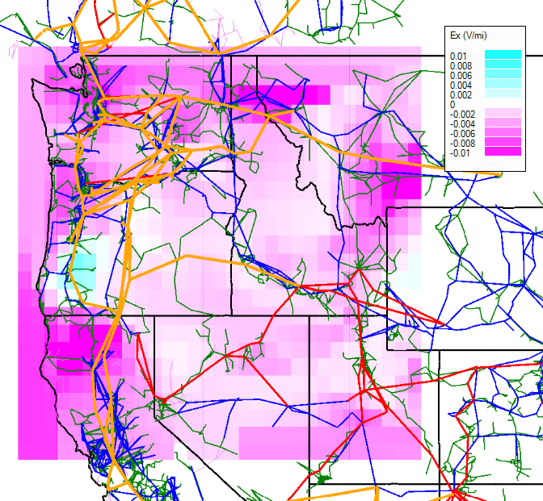
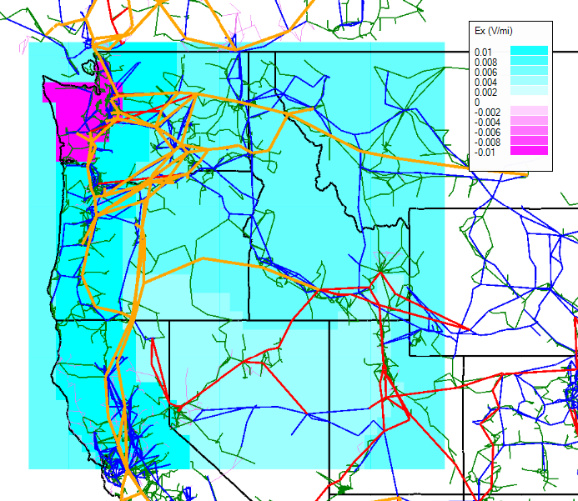
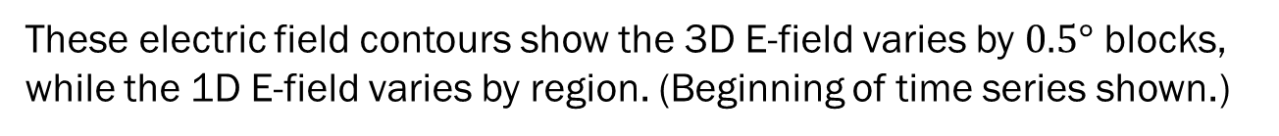
Electric fields for May 9, 2016 Storm
These electric field contours show the 3D E-field varies by $0.5°$ blocks, while the 1D E-field varies by region. (Beginning of time series shown.)
Ex component
3D conductivity model
Ex component
1D conductivity model

Slide 15
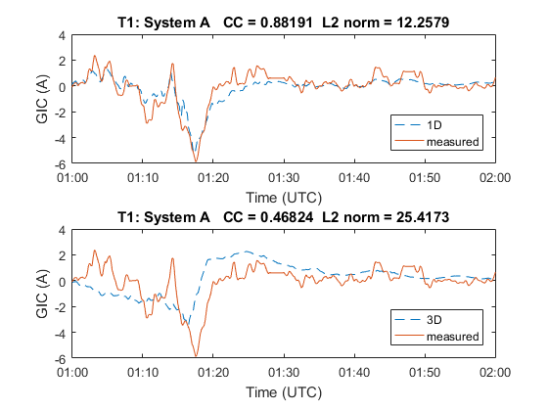
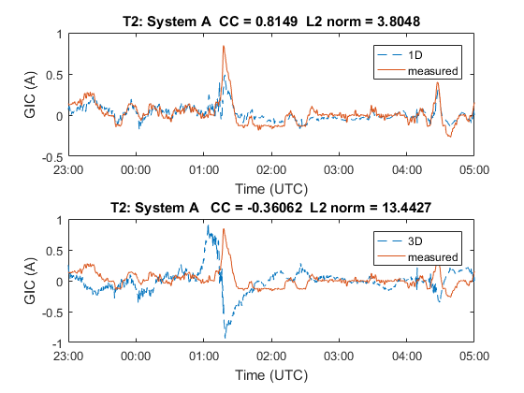
GIC Validation Results
Compared 1D and 3D simulated GICs with actual measurements
  May 2016 storm in Western US
  Two transformers T1 and T2 shown here
Metrics
  Correlation coefficient
  Euclidean distance (L2 norm)
Result: For this system and storm, 1D shows better results
  More storms and data will be useful to confirm this

Slide 16
GIC Validation Results
Compared 1D and 3D simulated GICs with measurements
  June 2015 storm data, from the East
Metrics
  Correlation coefficient
  Euclidean distance (L2 norm)
Result: For this storm, 1D shows marginally better results
  More storms and data will be useful to confirm this

Slide 17
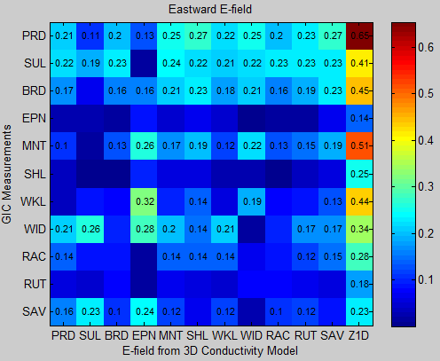
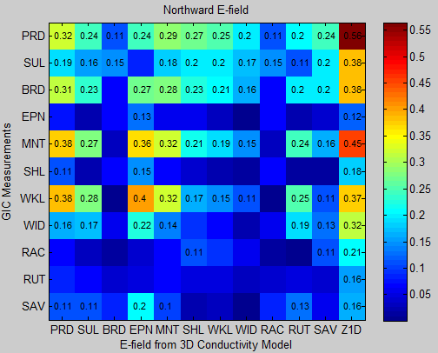
June 22, 2015 Storm
GIC Validation using Correlation
Same storm and system as previous page
The Pearson correlation coefficient between the GIC measurements (rows) and the E-field obtained from the 3D conductivity model (columns).
The last column correspond to the E-field obtained from 1D conductivity model (the intermagnet 1 minute data at BSL observatory and the CP2 conductivity model).
Notes:
The value of the coefficients is written down in the plots when they are larger than 0.1. For coefficients smaller than 0.1, the color map indicates the value.
The absolute value of the correlation coefficients are shown in all plots.

Slide 18
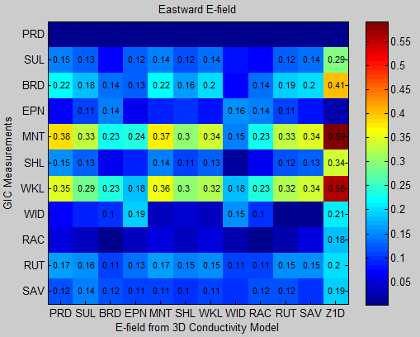
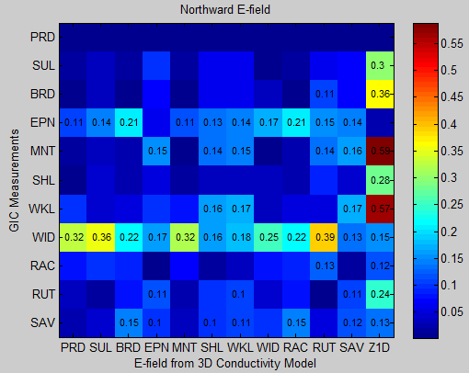
June 22, 2015 Storm
GIC Validation using Correlation
October 2015 storm
The Pearson correlation coefficient between the GIC measurements (rows) and the E-field obtained from the 3D conductivity model (columns).
The last column correspond to the E-field obtained from 1D conductivity model (the intermagnet 1 minute data at BSL observatory and the CP2 conductivity model).
Notes:
The value of the coefficients is written down in the plots when they are larger than 0.1. For coefficients smaller than 0.1, the color map indicates the value.
The absolute value of the correlation coefficients are shown in all plots.

Slide 19
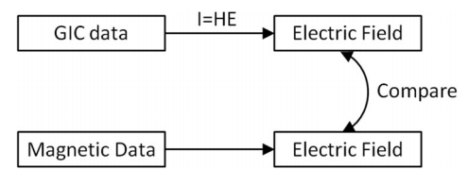
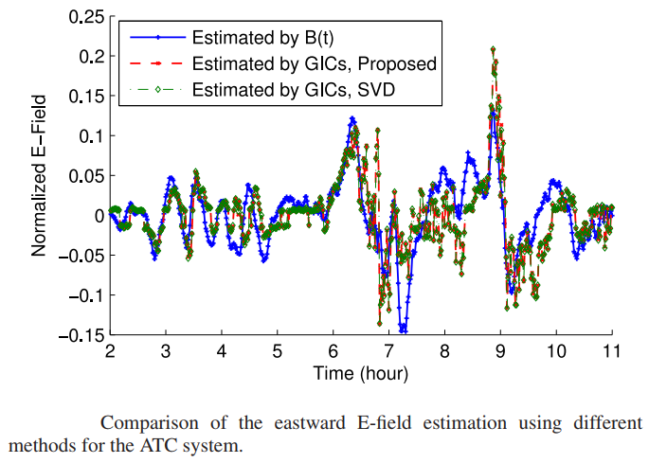
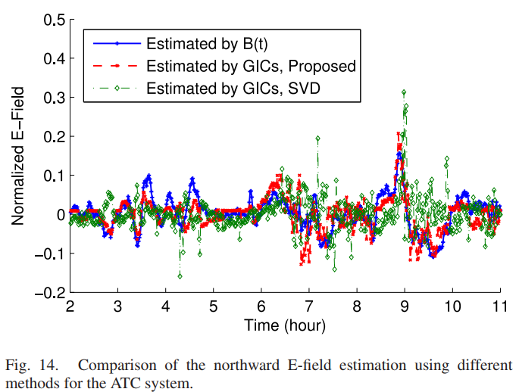
Other Validation Methods
M. Kazerooni, H. Zhu, T. J. Overbye and D. A. Wojtczak, "Transmission System Geomagnetically Induced Current Model Validation," in IEEE Transactions on Power Systems, vol. 32, no. 3, pp. 2183-2192, May 2017.

Slide 20
GIC Data Sharing
Actual, measured data is crucial for GMD research
  Validation, to ensure models and data collected for studies are producing realistic results
  Need more comparisons of simulated GICs with observed, to eliminate uncertainties in conductivity, latitude scaling, etc.
GICs measured at transformer neutrals during moderate-strong events are important
  Though the underlying system model is useful, just the GICs and location or name of transformer can provide valuable information
Several researchers requesting this data have a good precedent set with utilities on sharing data through NDA’s (e.g. system model)
  Confidentiality is not compromised. E.g. data anonymized in publications, not shared with other entities outside of NDA etc.

Slide 21
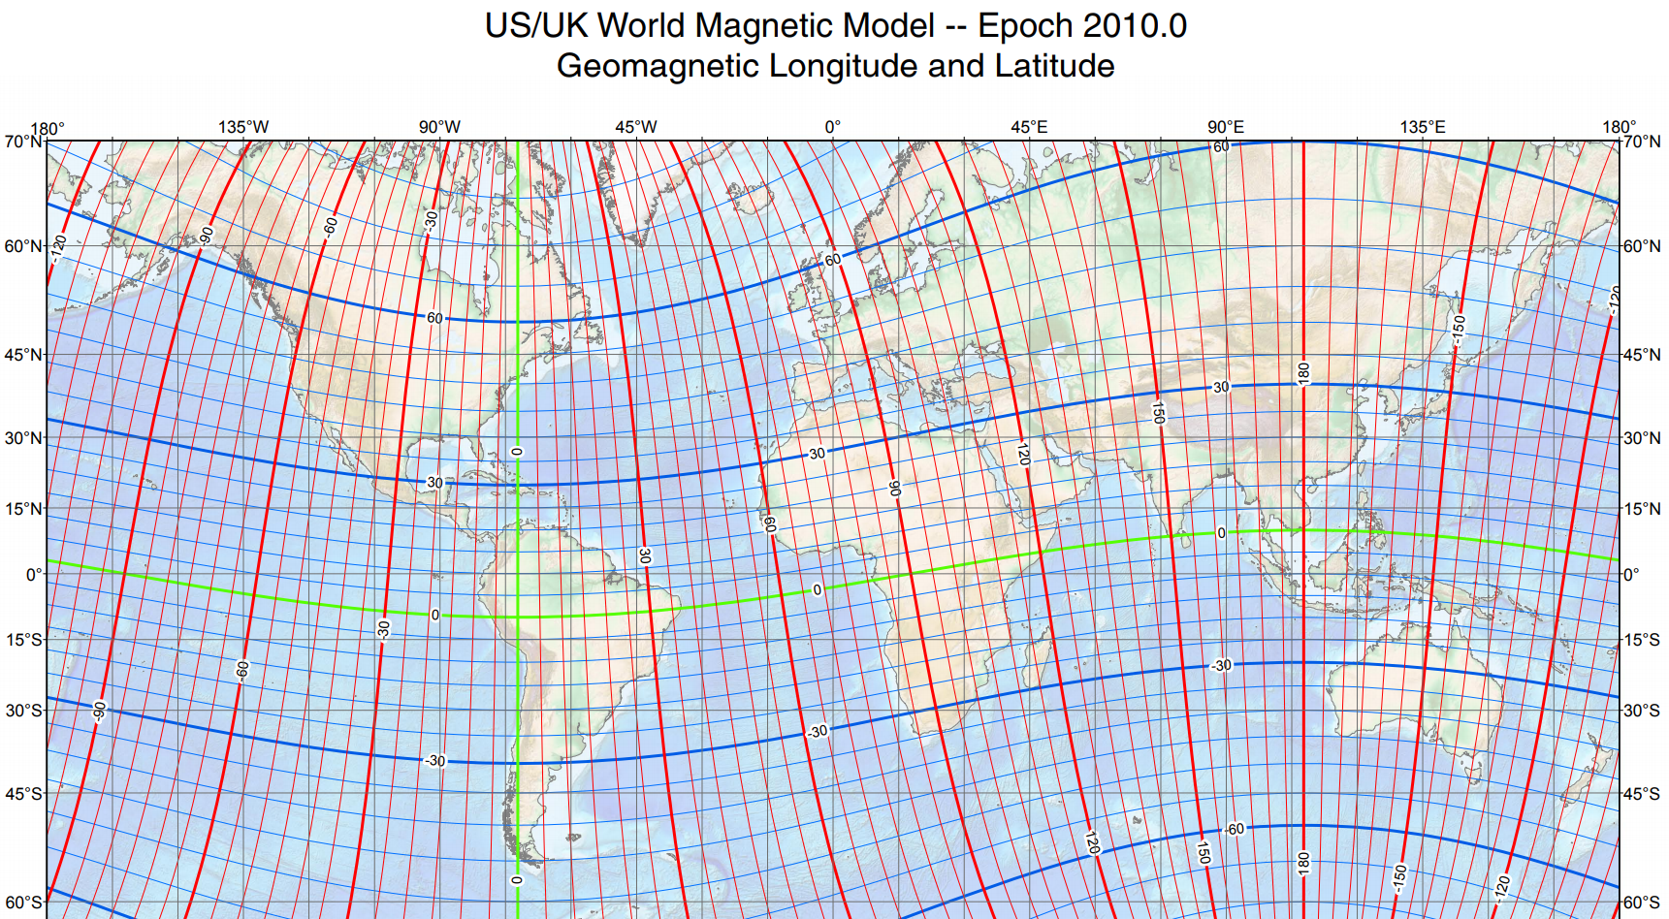
Geomagnetic Latitude

Slide 22
Do GMDs matter in Texas?
The largest magnetic field variations occur right under the auroral electrojet
  Usually at higher latitudes
For larger GMDs the auroral boundary extends further south
  How far the largest storms could push the aurora is not known
  E.g. auroras have been spotted in Colorado during major GMDs; also reported in Texas during the Carrington event
GMD concern even further south of Texas
  The Mexican government is sponsoring a project to measure GICs and place magnetometers along the northern border
GMD provides a natural laboratory for other types of hazards, such as EMP
  GMD monitoring equipment is useful for EMP as well

Slide 23
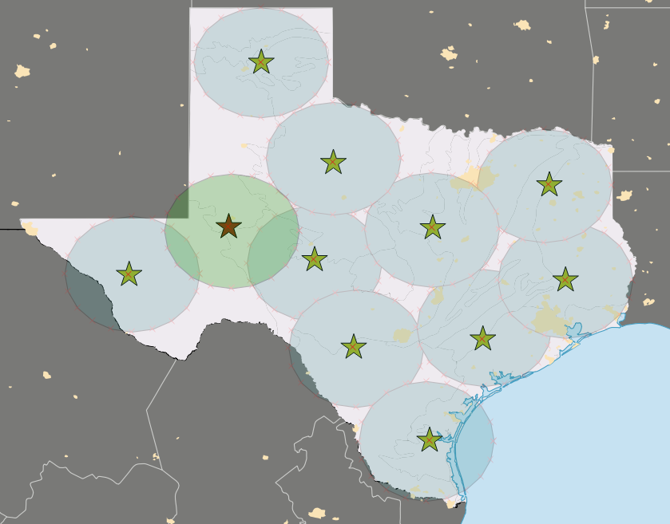
Potential Texas GIC Network
Installation of ten magnetometers will provide coverage for the majority of Texas power infrastructure
  Built off of NSF project design
  Run autonomously (low power, solar panels)
  Connect through wireless access points for secure communication
  Installed co-located with GIC monitors
Odessa, TX
Already installed through the NSF project
Image: Jenn Gannon, CPI
100-150 miles radius

Slide 24
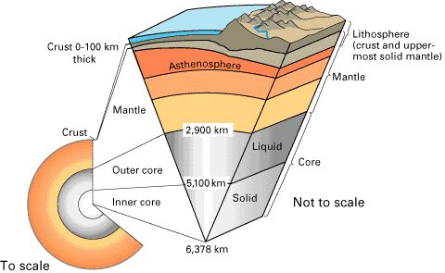
GIC Network Goals: Conductivity
Improve understanding of Texas geophysics for GIC and EMP hazard analysis
  There is a high degree of uncertainty in the available conductivity models for Texas.
  There are no models built specifically for Texas - this limits our understanding of how GIC and EMP hazard varies between locations.
  Measurements and model improvements could realized immediate gains in GIC and EMP hazard analysis.
  Multiple ways to achieve this goal.

Slide 25
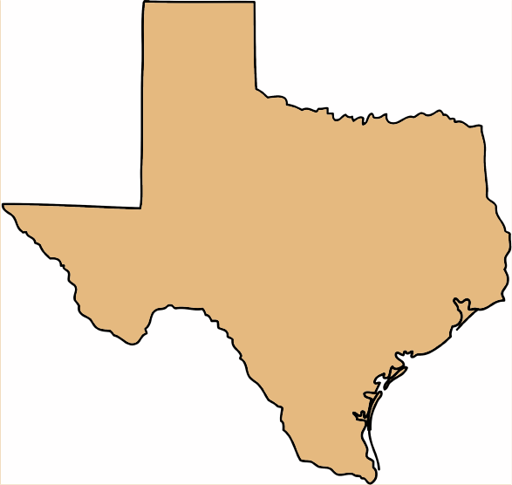
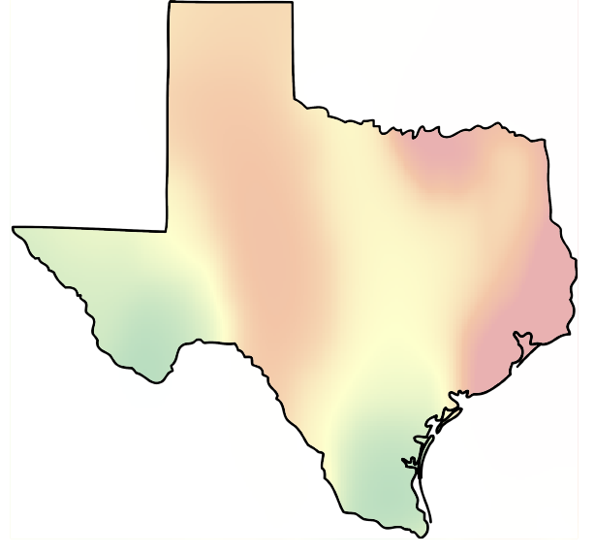
GIC Network Goals: Electric Fields
With improved information in B and conductivity, realistic electric field scenarios can be built specifically for Texas

Slide 26
GIC Network Goals: Monitoring and State Estimation
GIC Monitor Installations
  Leverage existing GIC monitors, if available
  Ideally, at least one within 100 miles of each magnetometer
  Can be used for validation
  Using GIC and electric field measurements, a “GIC State Estimator” can be set up, in a real-time environment
    Estimate GICs at unmonitored locations
    Wide-area GIC situational awareness for operators to help in decision-making

Slide 27
Thanks!
Questions?
overbye@tamu.edu
shetye@tamu.edu

