Slide 1
Regulation Bias Analysis Post SCR-773
February 2018
ERCOT
Operations Planning
PDCWG | March 7th, 2018

Slide 2
Discussion Points
Current GTBD Parameters & References
Metric to measure Regulation bias and performance
Regulation Deployed comparison for last three months.
Total Regulation (net) Deployed Comparison
Regulation Deployed 15-minute interval comparison by each hour for 2016, 2017, and 2018 months
Regulation Exhaustion Rate
Regulation bias for consecutive 5-min SCED intervals
Time Error & Contributing Factors
Summary

Slide 3
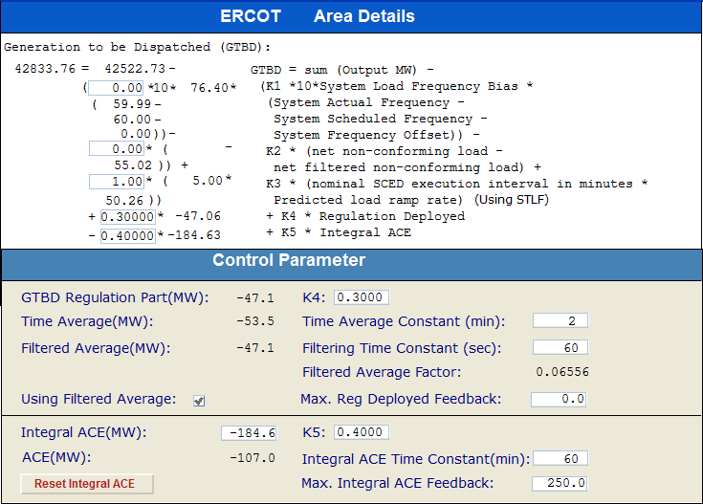
Current GTBD Parameters

Slide 4
References

Slide 5
Metrics to Measure SCR-773 Performance
Trend and monitor the regulation deployed by hour.
Set target of 50 MW for total regulation deployed by hour for peak hours.
Set target of 85% for the number of intervals where regulation deployment was both up and down for peak hours.
Track the Regulation exhaustion rate for all hours (not to exceed <1.2%).
Using a 50MW filter, target 15 occurrences or less per month for regulation bias of six or more consecutive 5 minute intervals for peak hours.

Slide 6
Total Regulation Deployed Comparison
Total regulation deployed for the last three months.

Slide 7
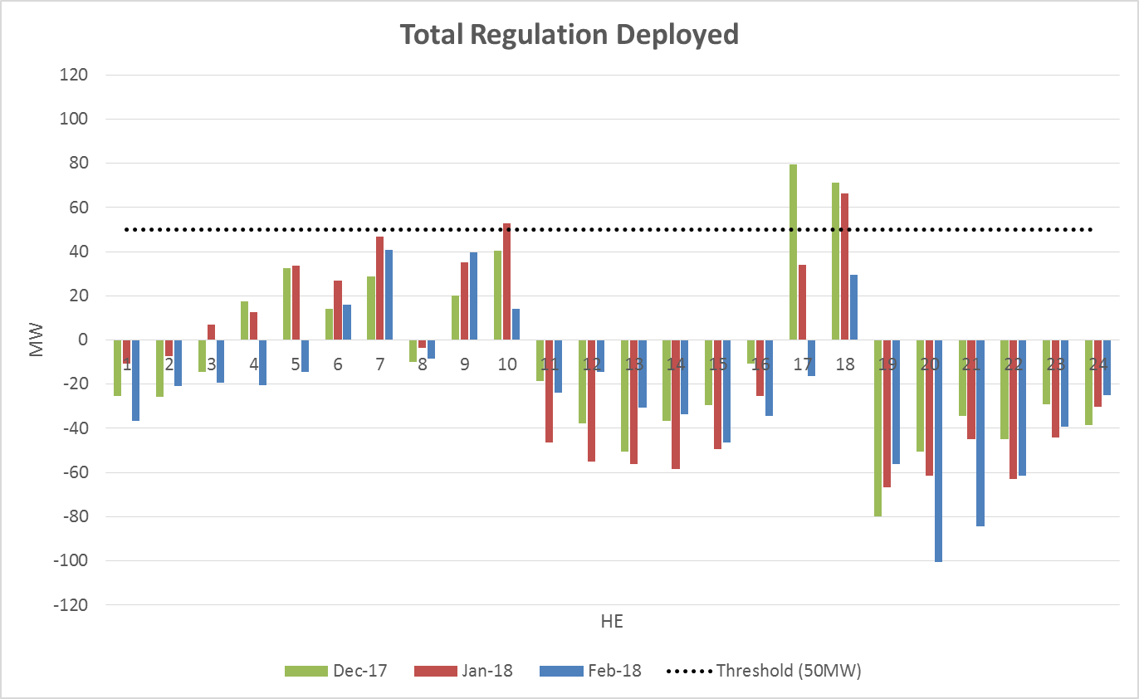
Total Regulation Deployed Comparison - Monthly

Slide 8
Metric 1: Regulation Deployed Comparisons
Trend and monitor the regulation deployed by hour.

Slide 9
Regulation Deployed Comparison

Slide 10
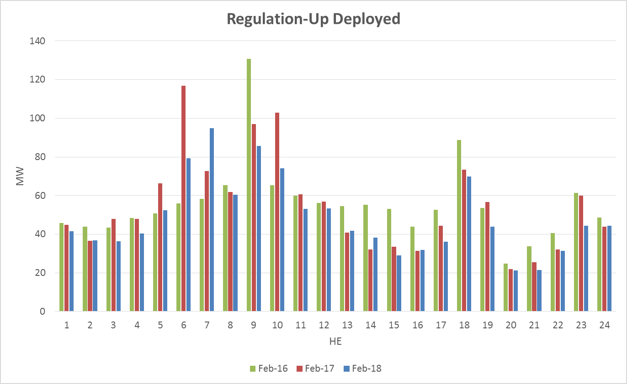
Regulation Deployed Comparison

Slide 11
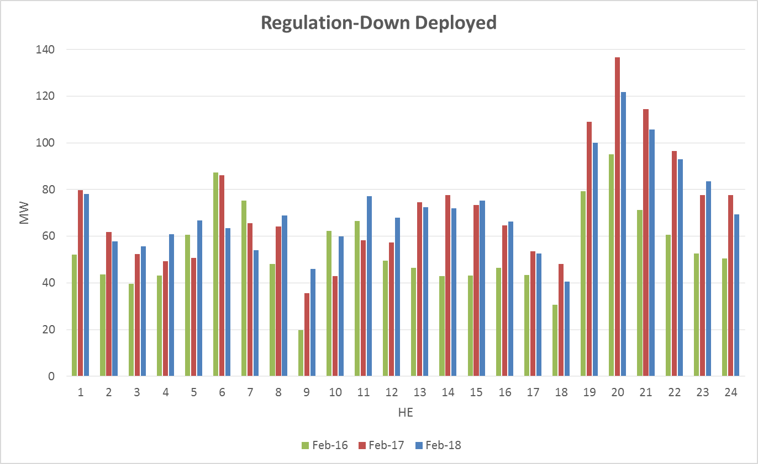
Regulation Deployed Comparison

Slide 12
Metric 2: Total Regulation Deployed Comparisons
Set target of 50MW for total regulation deployed by hour for peak hours.

Slide 13
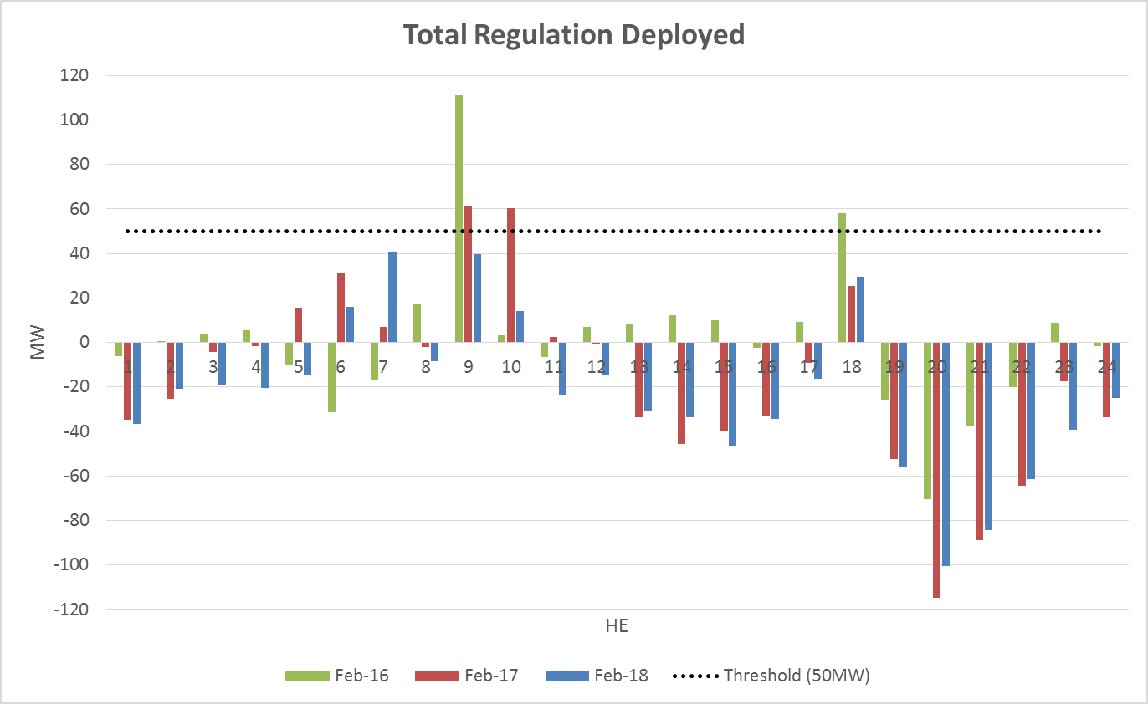
Total Regulation Deployed Comparison

Slide 14
Metric 3: 15-min Intervals Where Both REGUP/REGDN Were Deployed
Set target of 85% for the number of intervals where regulation deployment was both up and down for peak hours.

Slide 15
“Zero” Crossing Regulation

Slide 16
“Zero” Crossing Regulation

Slide 17
Metric 4: Regulation Exhaustion Rate
Track the regulation exhaustion rate for all hours (not to exceed 1.2%.)

Slide 18
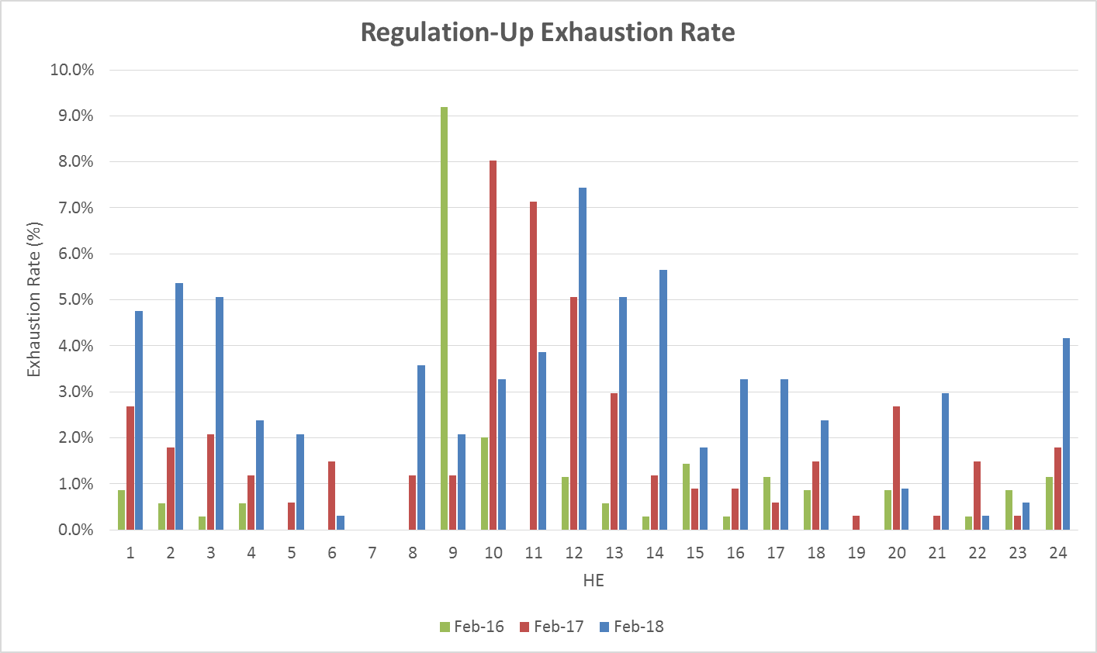
Regulation Exhaustion Rate

Slide 19
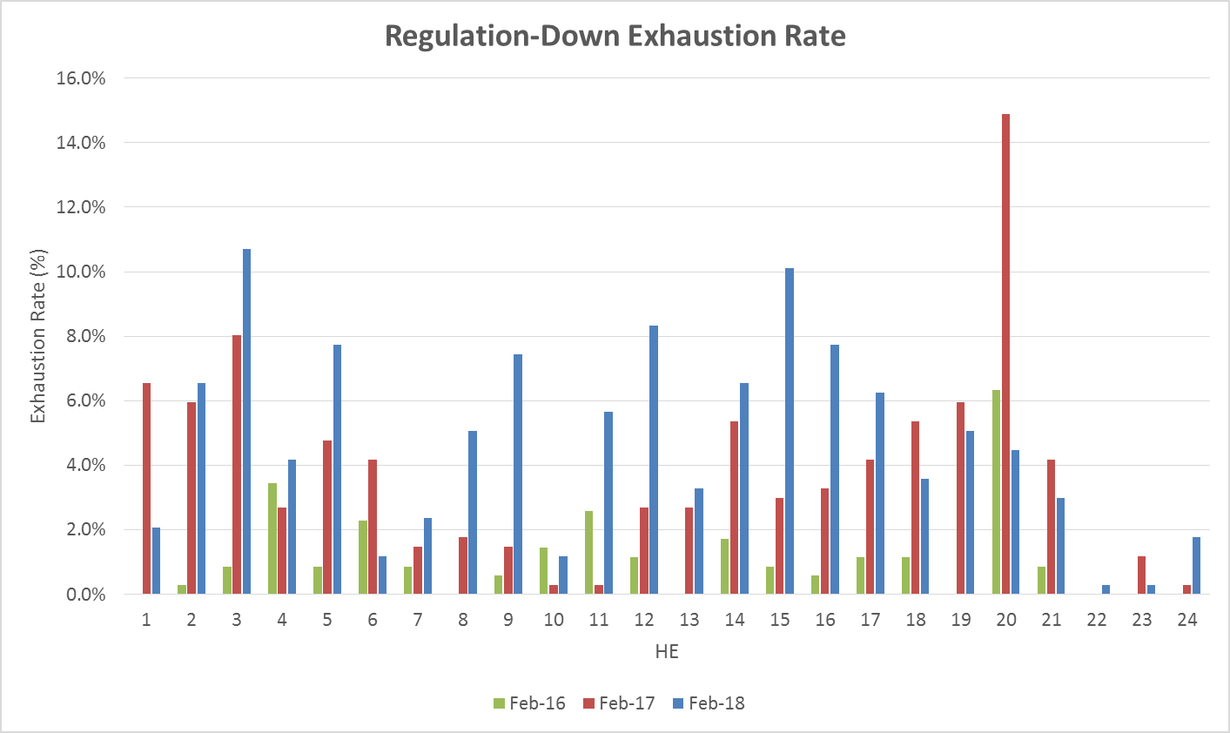
Regulation Exhaustion Rate

Slide 20
Metric 5: Stats on REGUP Bias for Consecutive 5-min Intervals
Using a 50MW filter, target 15 occurrences or less per month for regulation bias of six or more consecutive 5-minute intervals for peak hours.

Slide 21
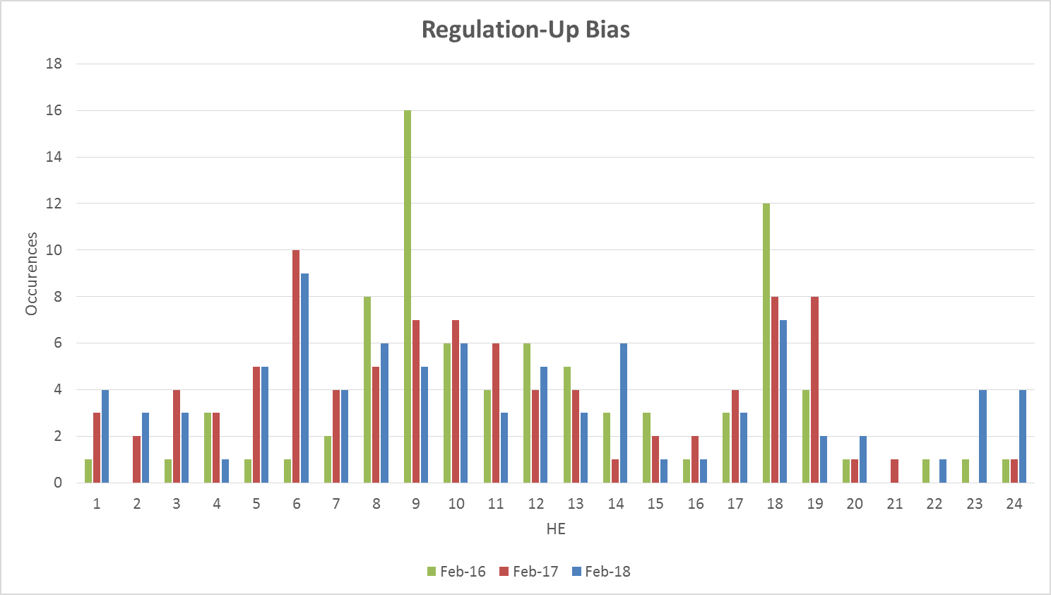
Regulation Bias for Consecutive SCED Intervals

Slide 22
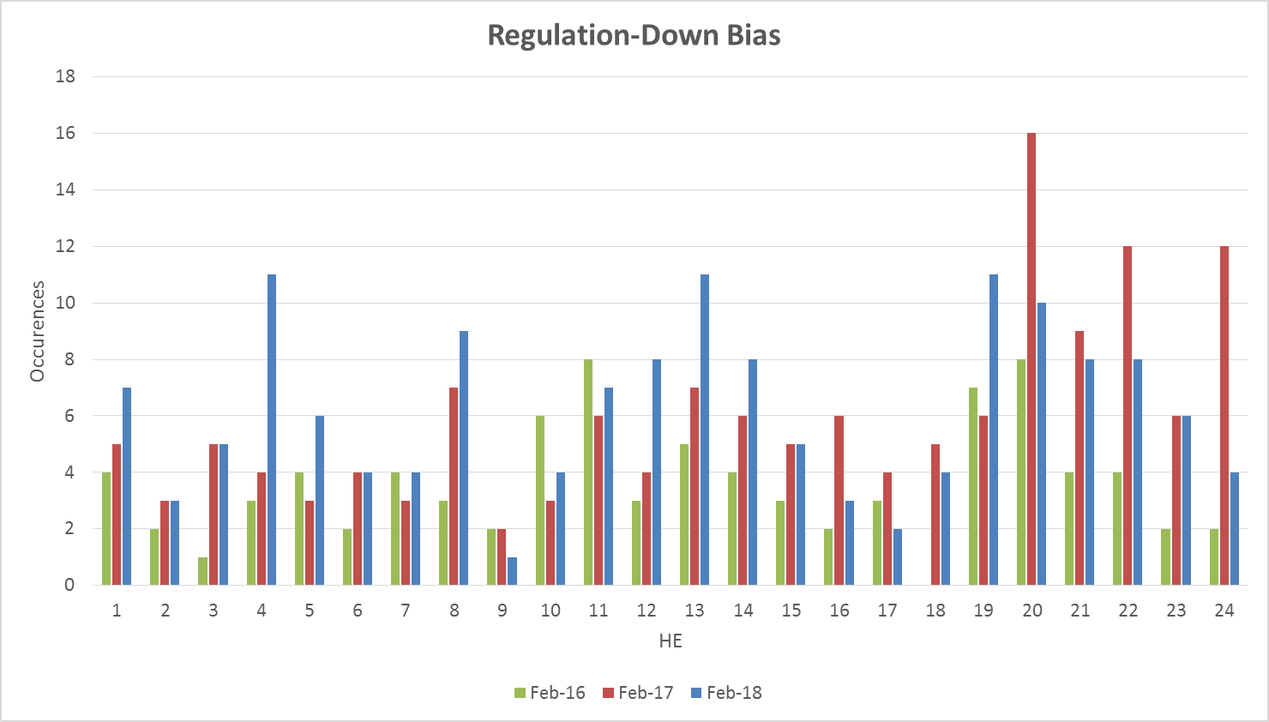
Regulation Bias for Consecutive SCED Intervals

Slide 23
Time Error and Contributing Factors
Accumulated Time Error, Load Ramp, Start-Up/Shut-Down Hours, STLF Error, and Expected Generation Deviation.

Slide 24
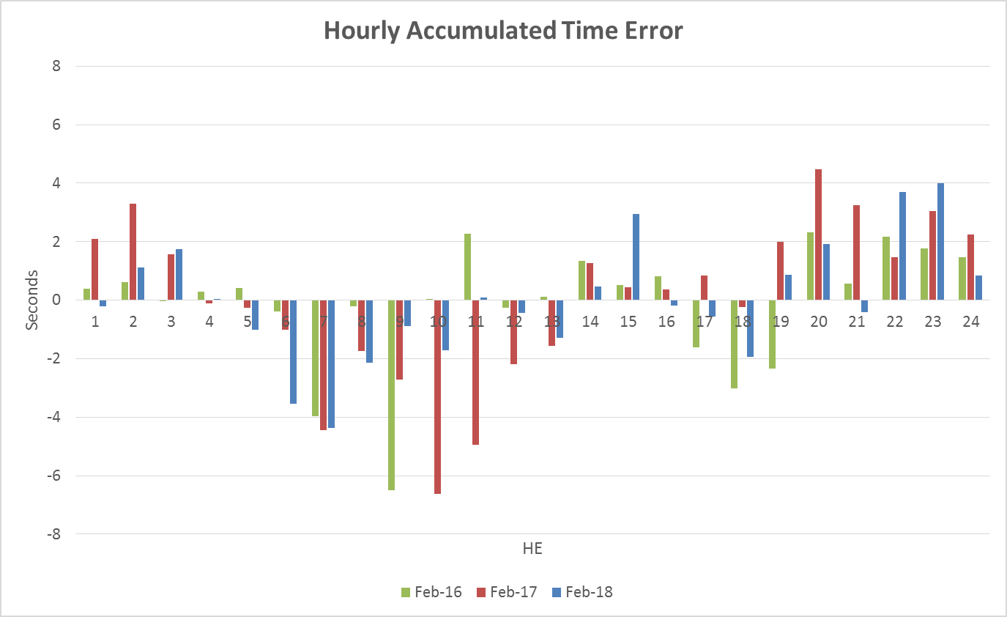
Time Error Accumulation

Slide 25
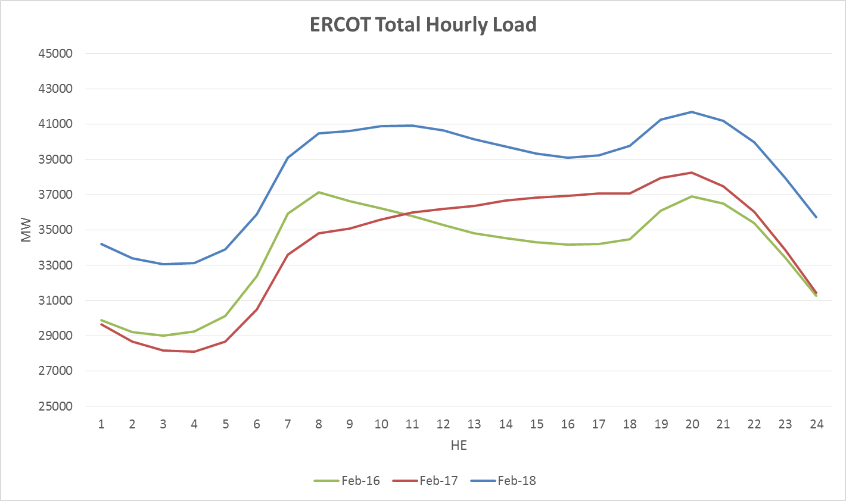
Load Profile

Slide 26
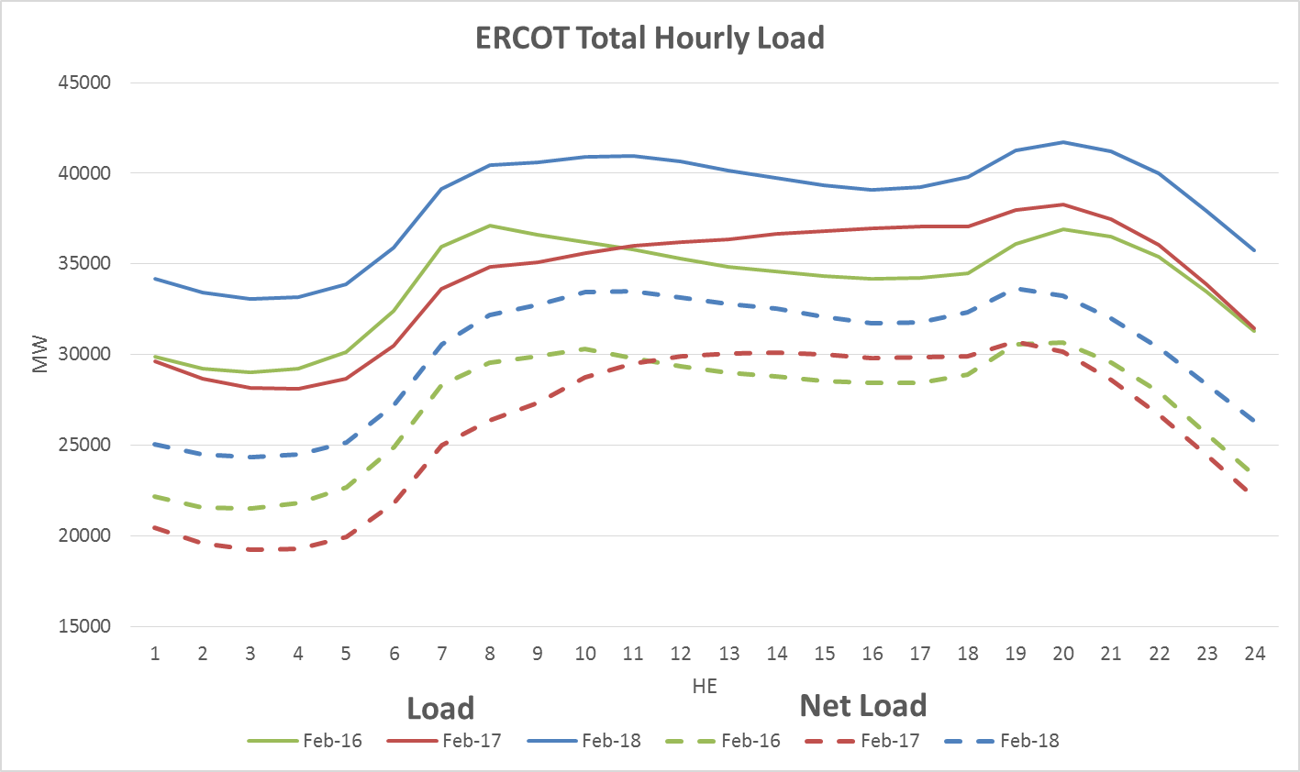
Net Load Profile

Slide 27
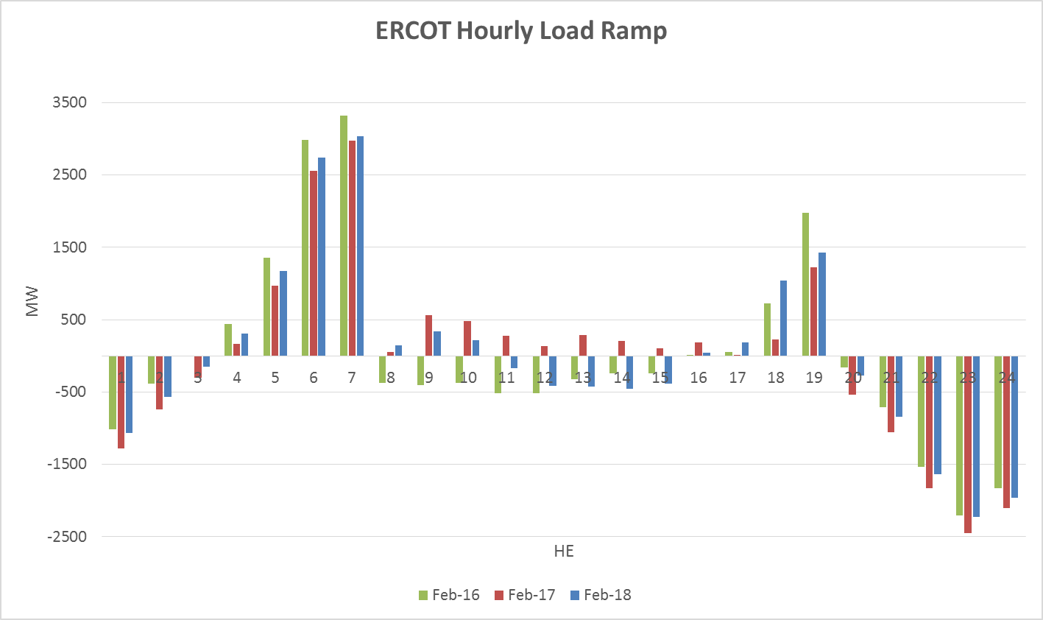
Load Ramp

Slide 28
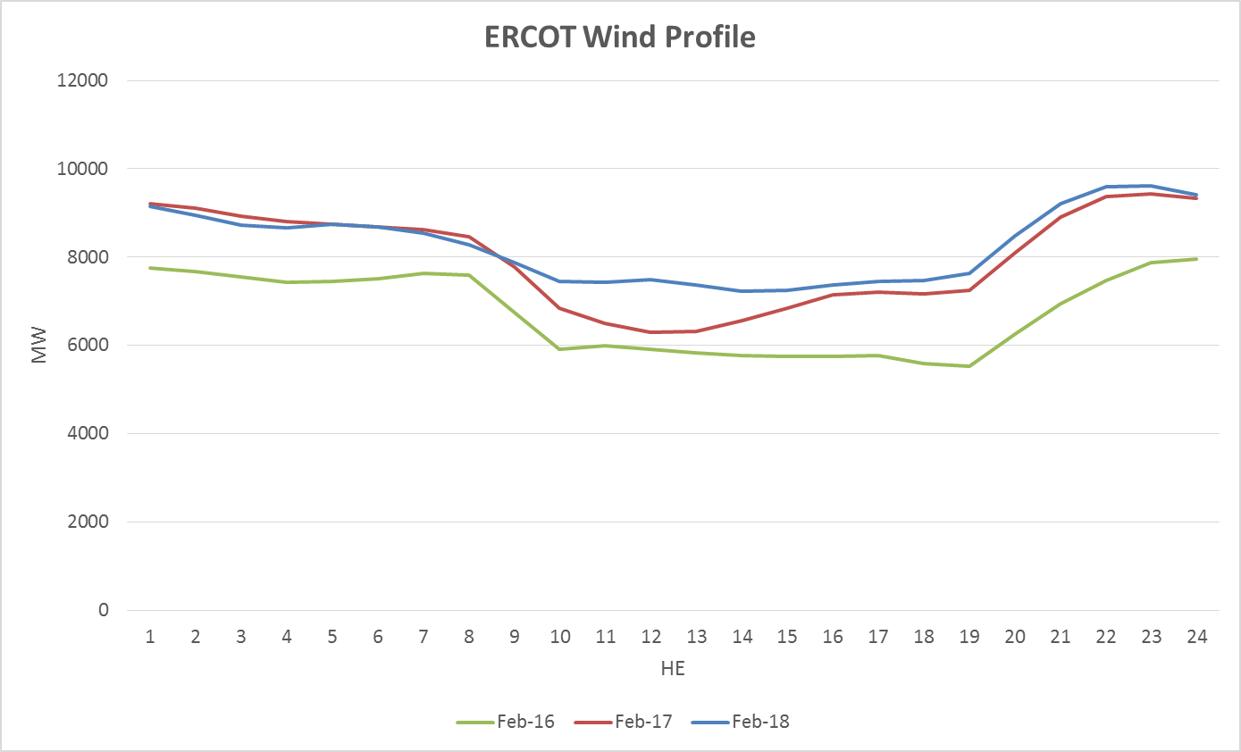
Wind Profile

Slide 29
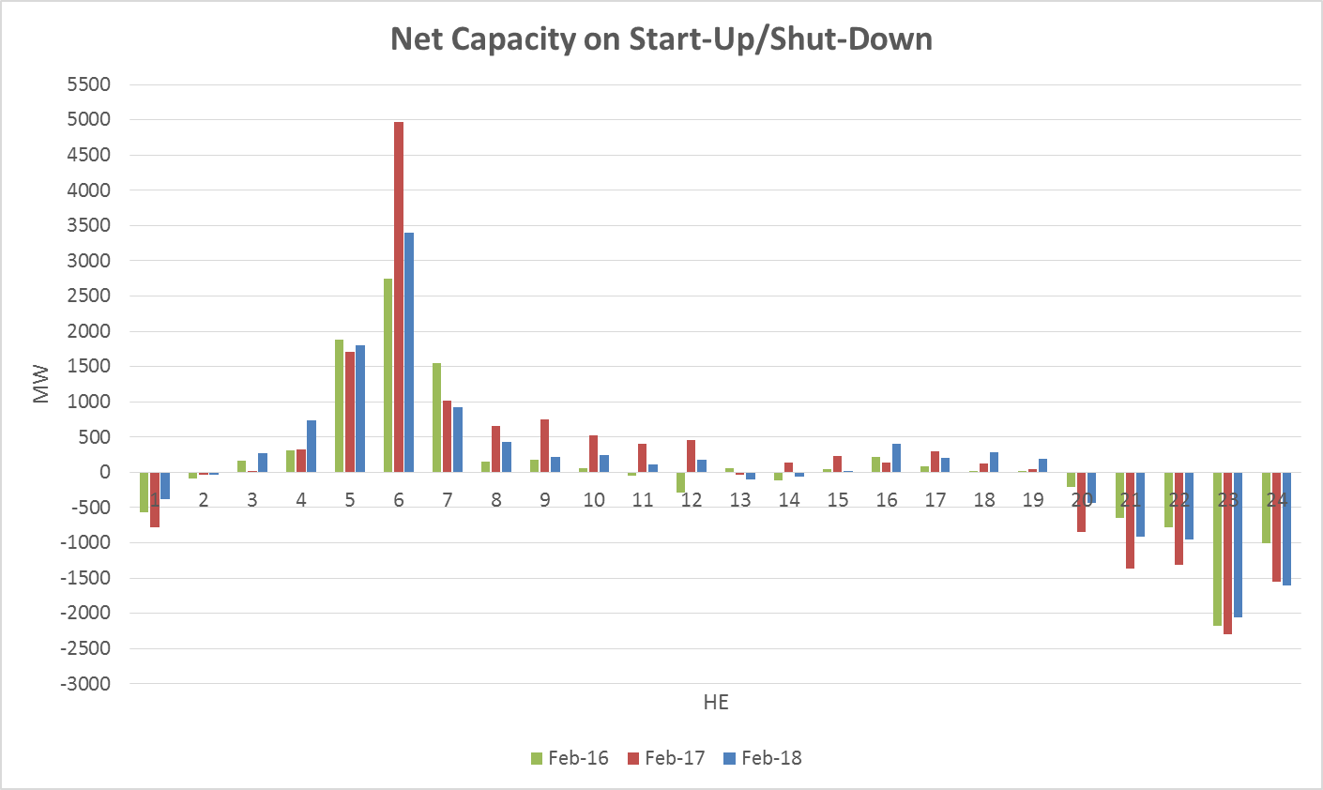
Start-Up & Shut-Down Hours

Slide 30
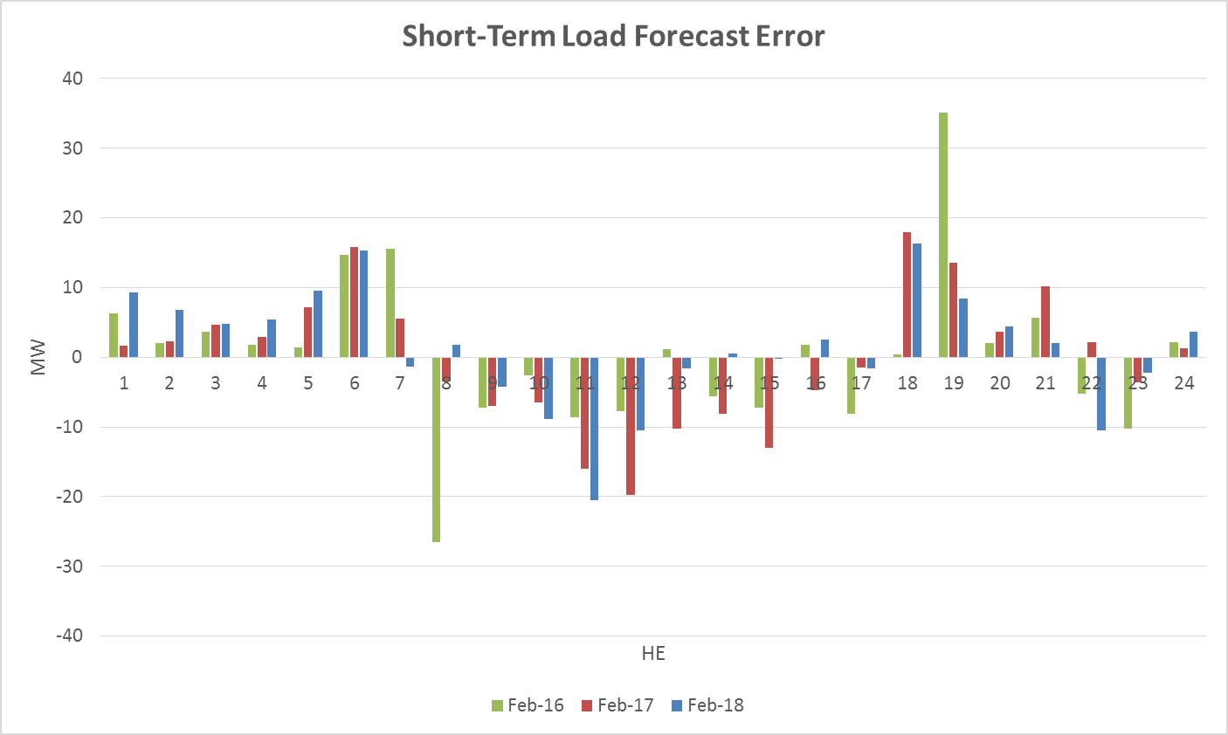
Short-Term Load Forecast Error

Slide 31
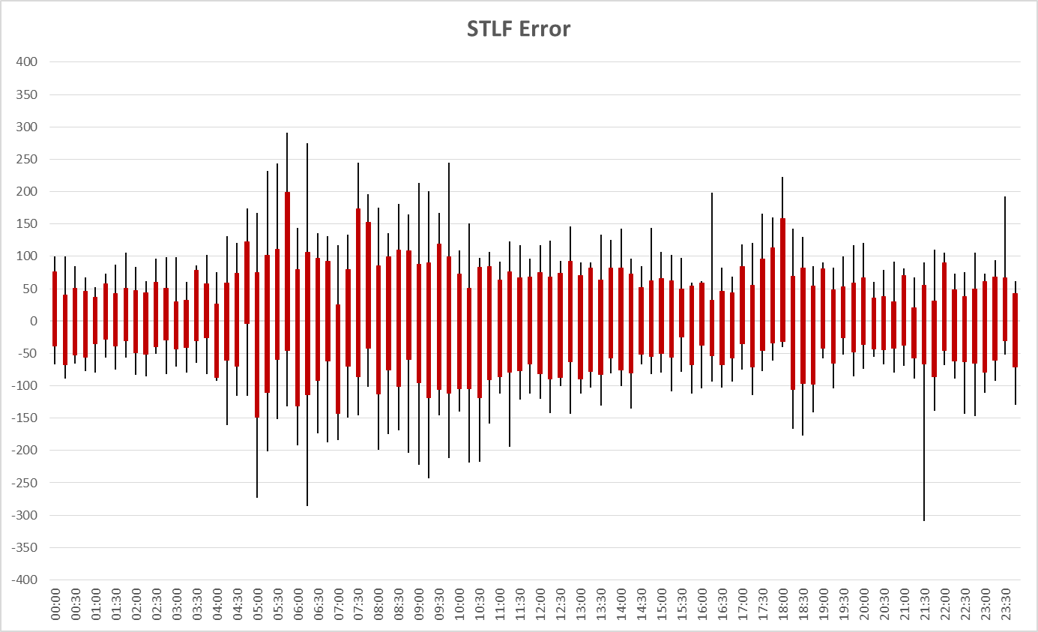
STLF Error Chart
Notes:
Min,Max, 10th, 90th percentile

Slide 32
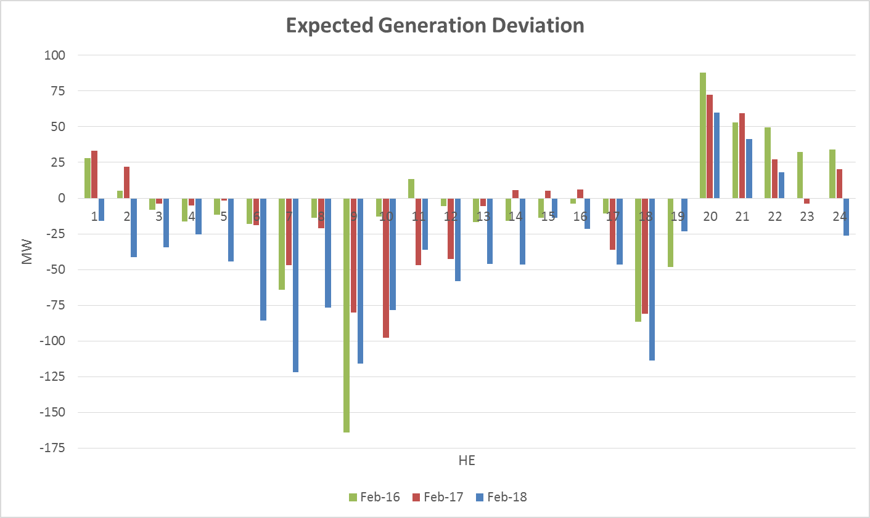
Expected Generation Deviation

Slide 33
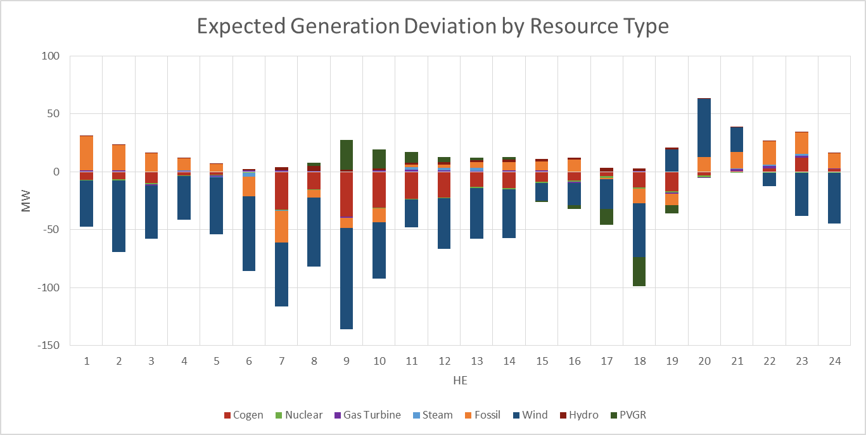
Expected Generation Deviation

Slide 34
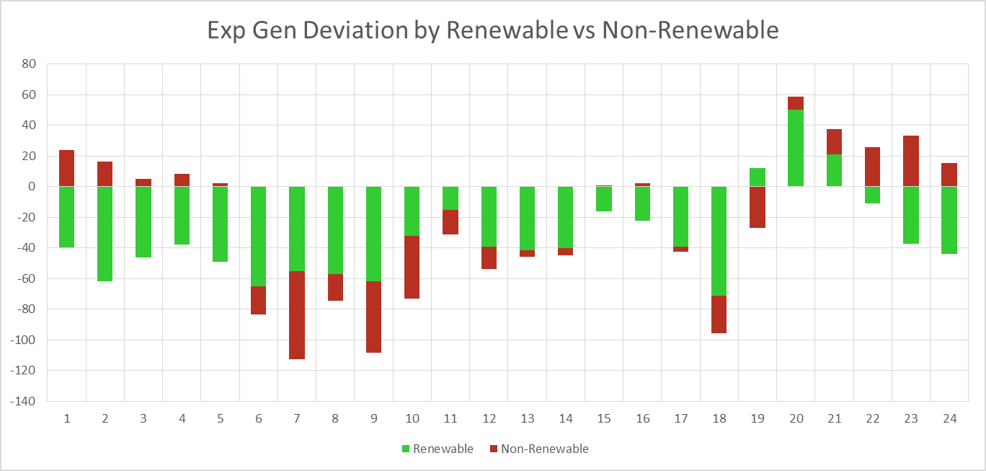
Expected Generation Deviation

Slide 35
Questions?
Thank you!

