Slide 1
ERCOT Frequency Control Report
January 2018
ERCOT
Operations Planning
PDCWG | February 14th, 2018

Slide 2
Frequency Control
CPS1, BAAL, & RMS1

Slide 3
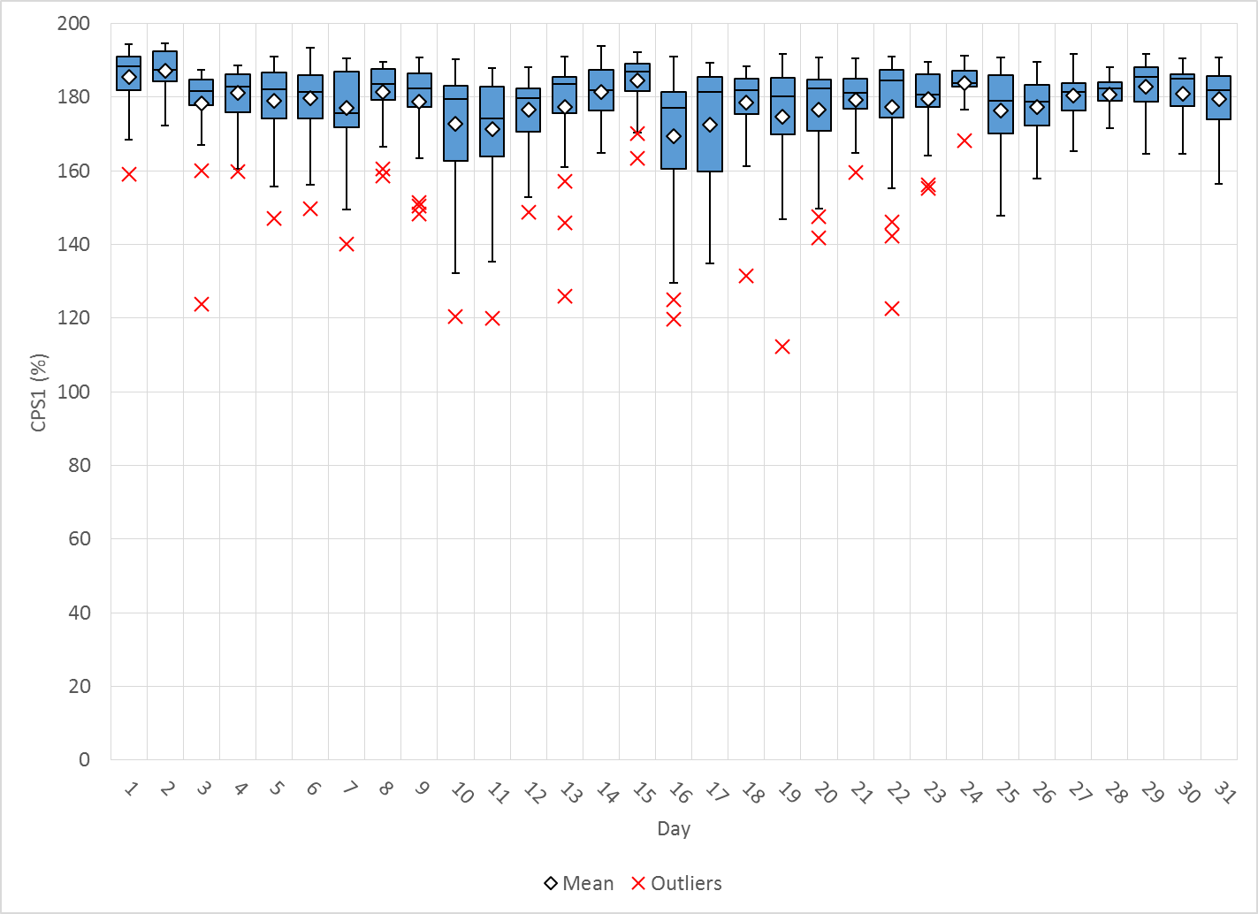
Hourly CPS1 by Day
Jan-18 CPS1 (%): 178.79
Notes:
No Outliers for December

Slide 4
BAAL Exceedances & Violations
There were no BAAL exceedances

Slide 5
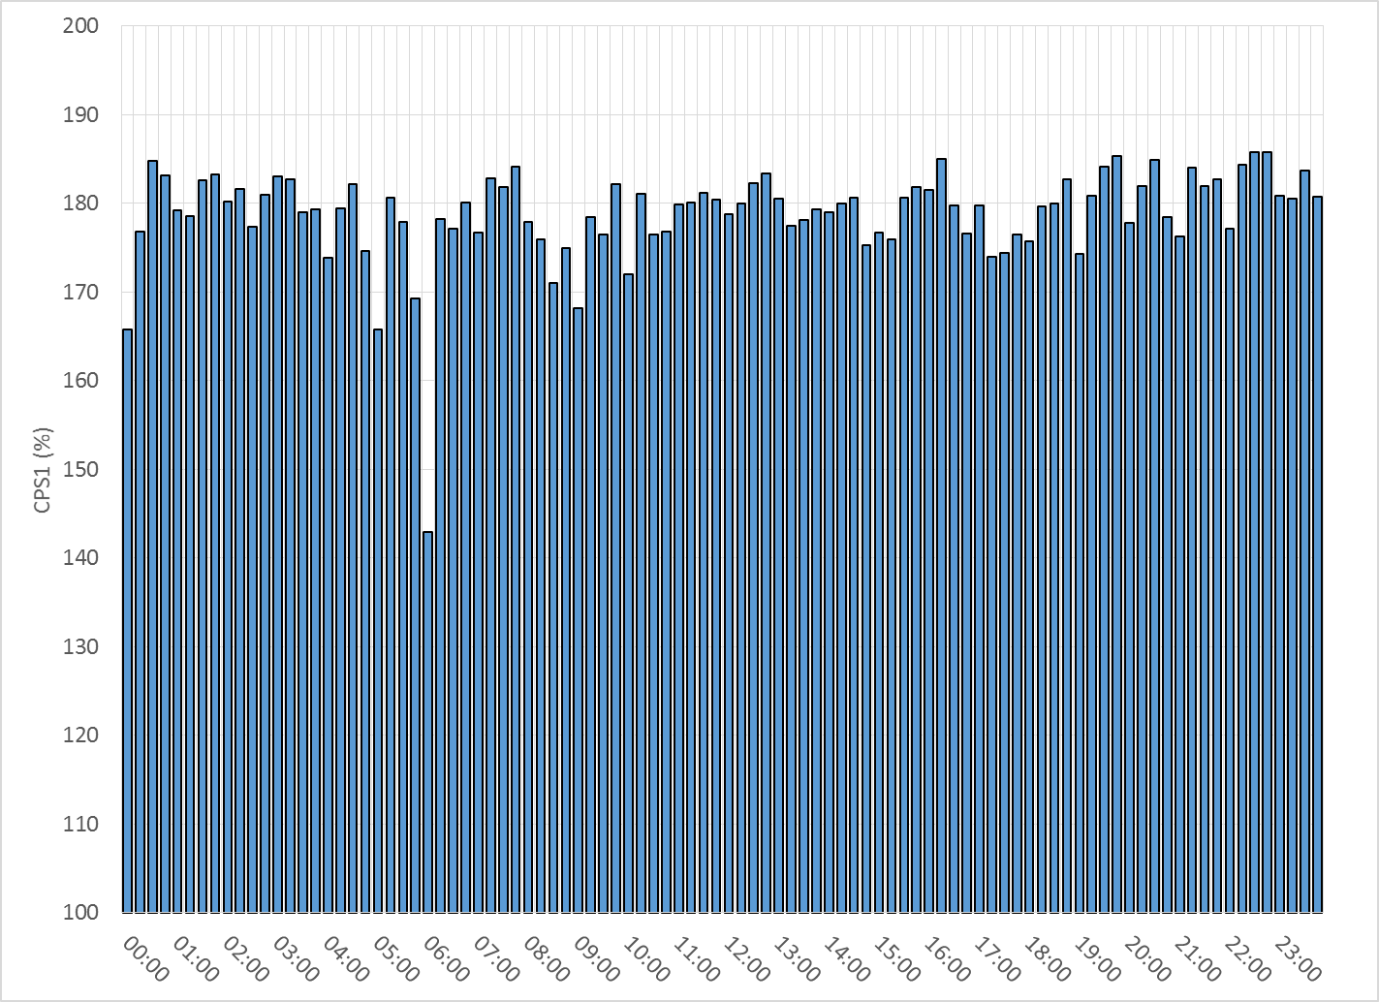
15-Minute Average CPS1%
Jan-18 CPS1 (%): 178.79
Notes:
Hour 6 is lowest CPS by 15 minute at 151%

Slide 6
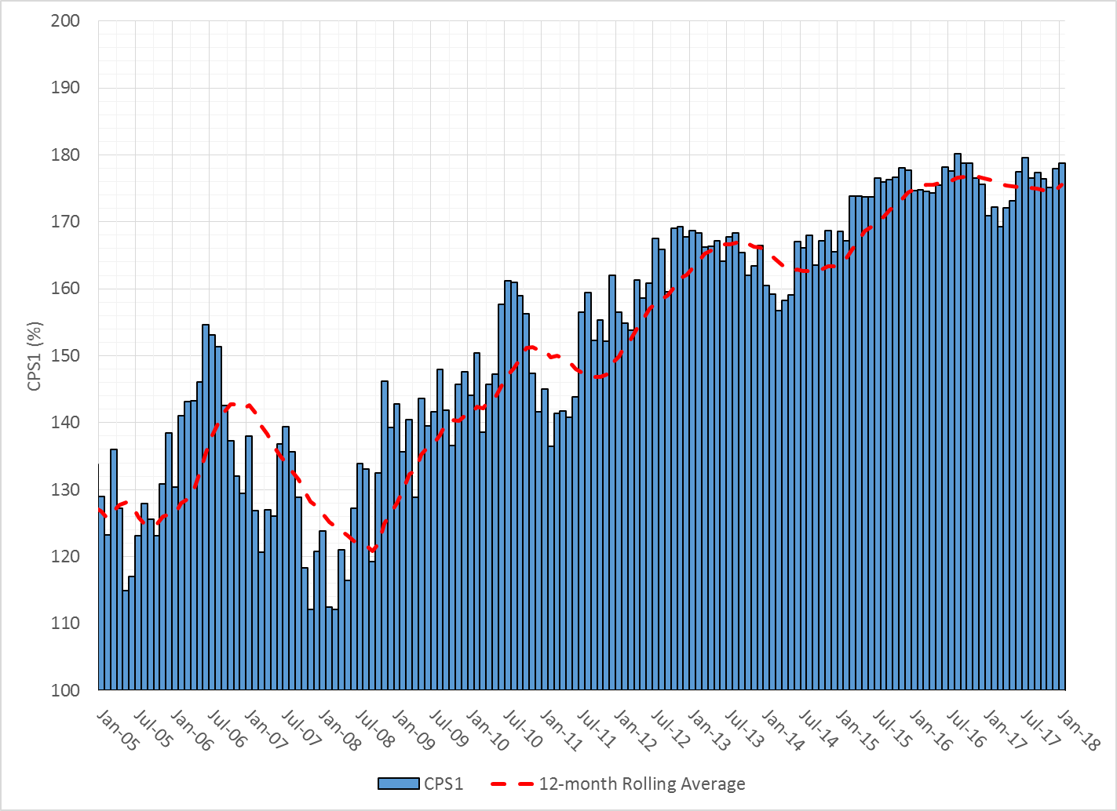
12-Month Rolling Average CPS1
Current 12-Month Rolling Average: 175.51%

Slide 7
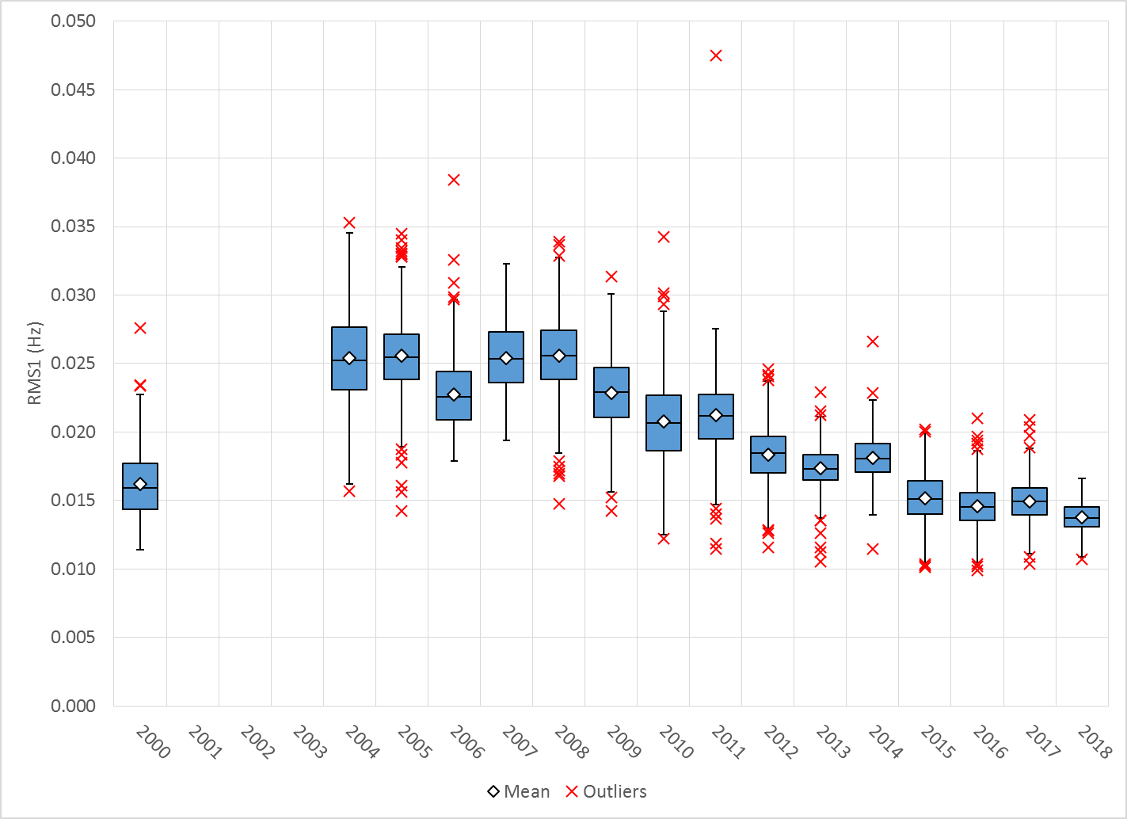
Daily RMS1 of ERCOT Frequency by Year
Notes:
Outlier was 10.7 mHz on Jan 2nd
Mean is 13.75 mHz

Slide 8
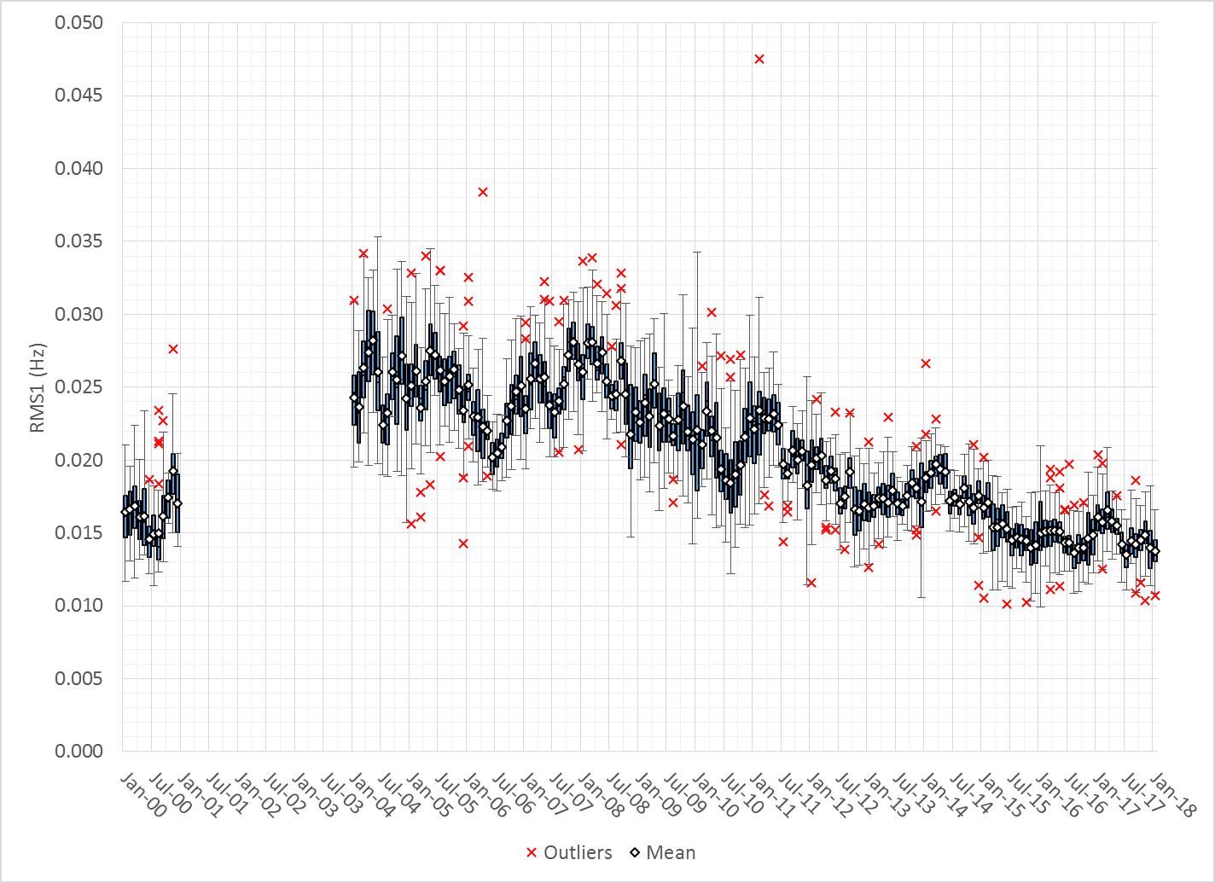
Daily RMS1 of ERCOT Frequency by Month

Slide 9
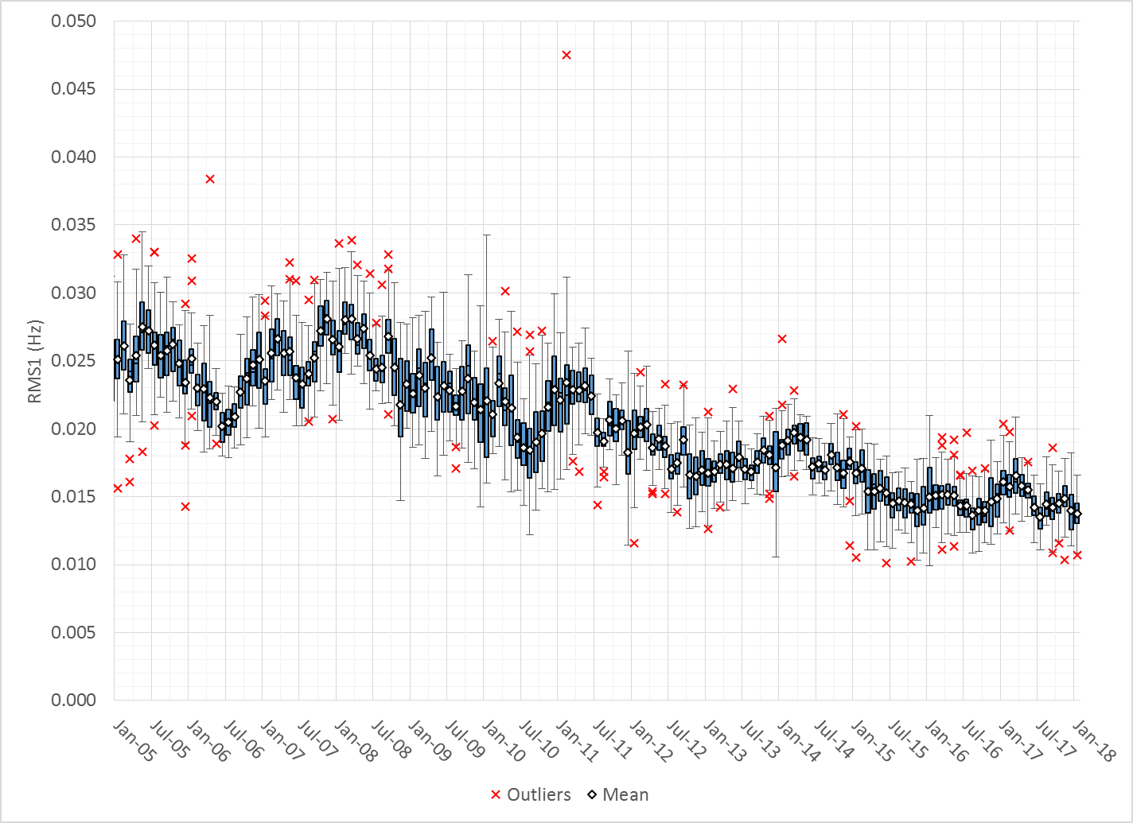
Daily RMS1 of ERCOT Frequency by Month

Slide 10
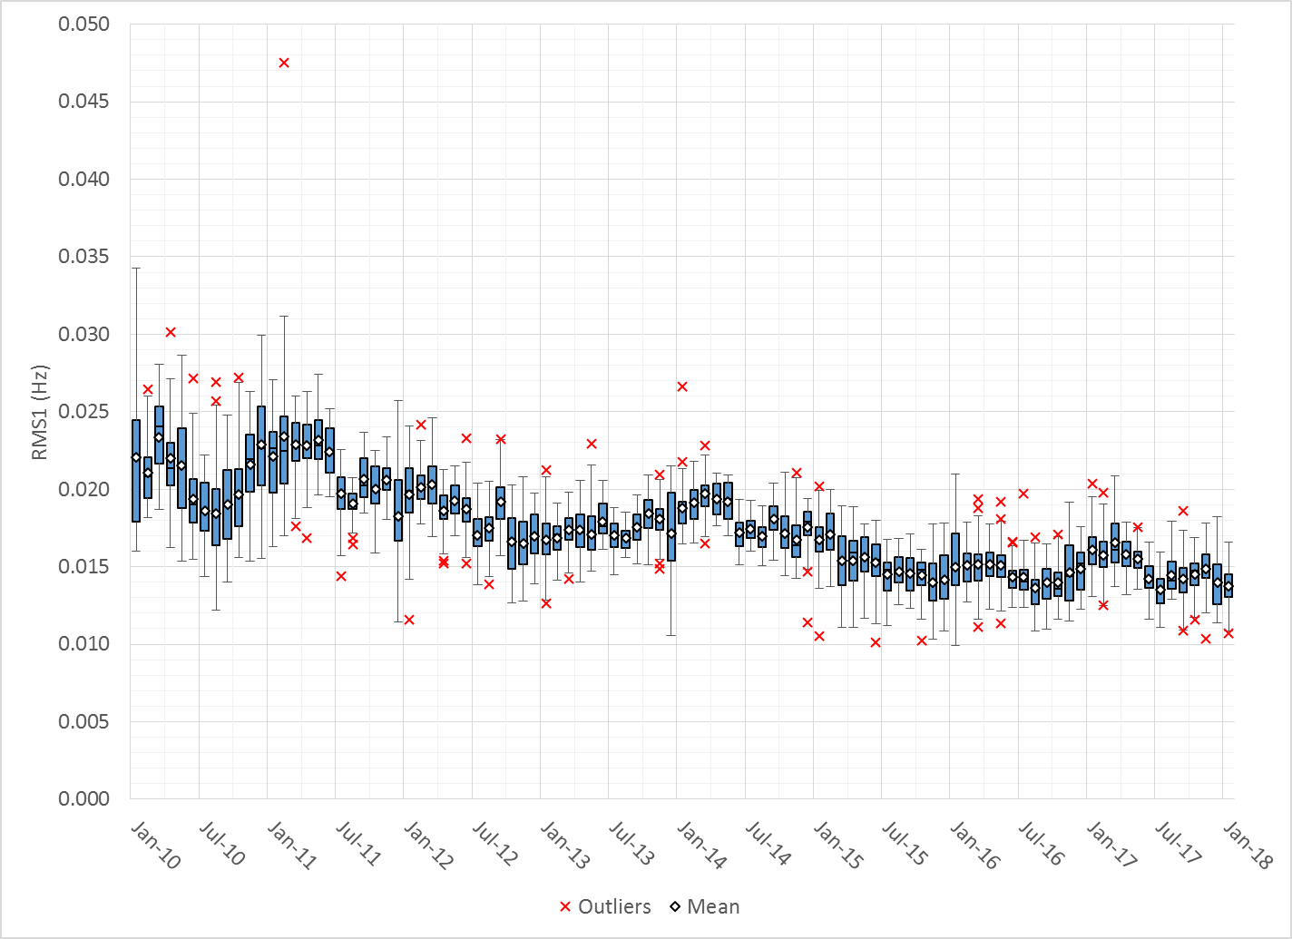
Daily RMS1 of ERCOT Frequency by Month
Notes:
Mean: 13.75 mHz
Min: 10.71 mHz
Max: 16.59 mHz

Slide 11
Frequency Profile Comparison

Slide 12
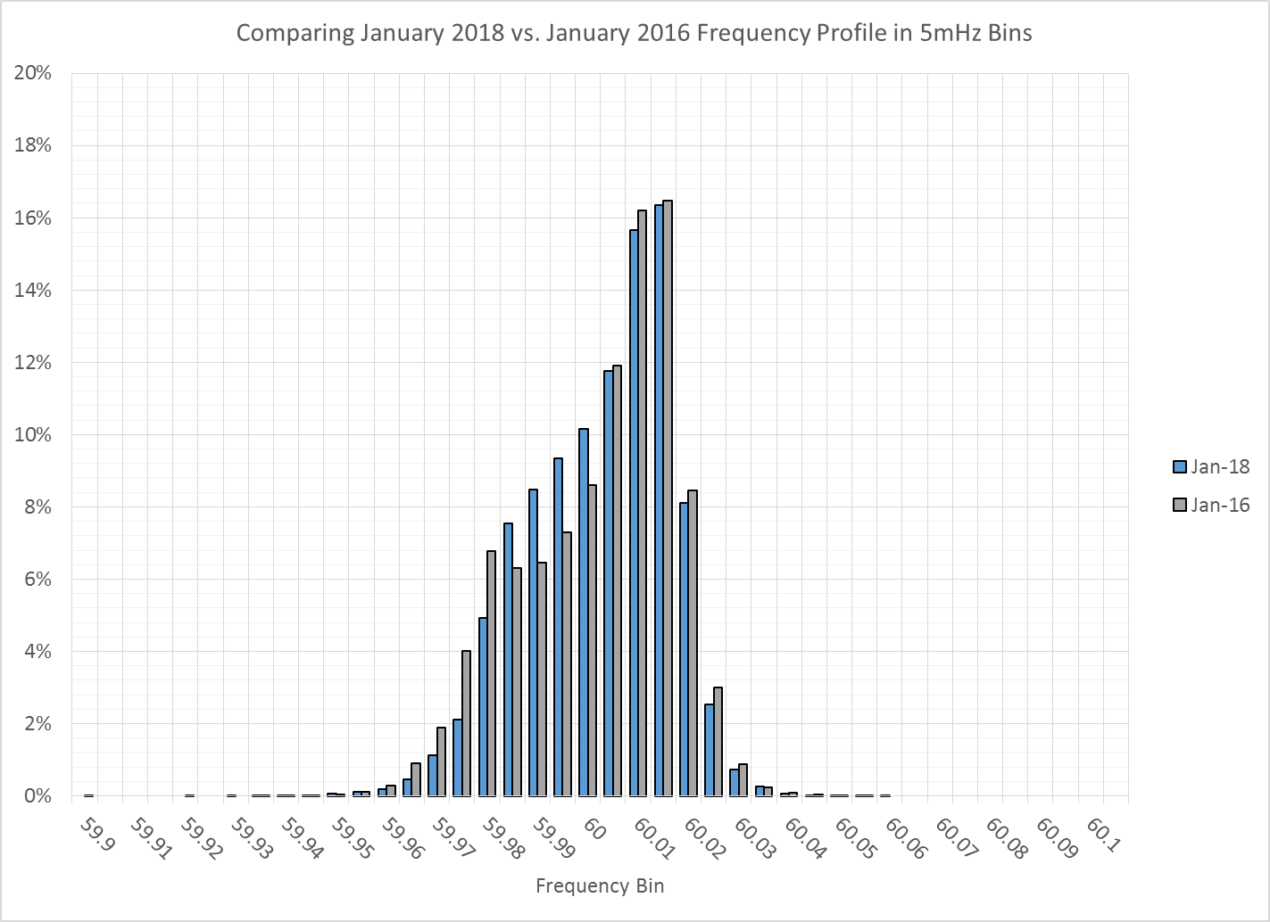
Frequency Profile Comparison

Slide 13
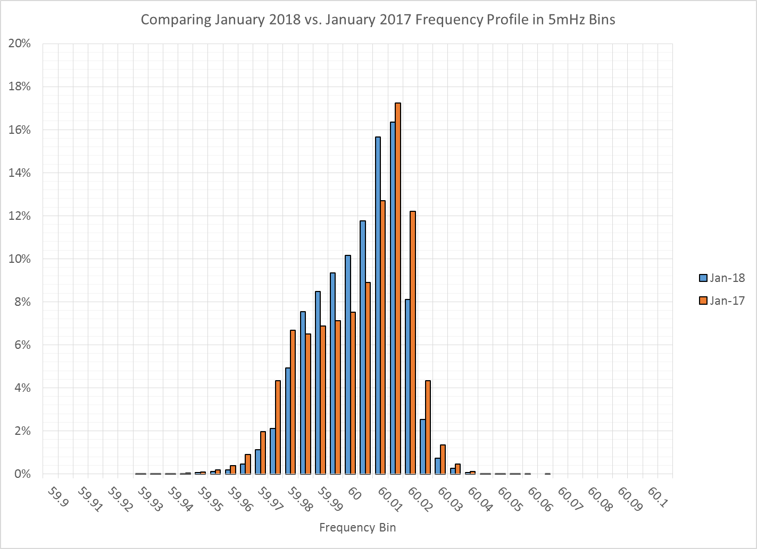
Frequency Profile Comparison

Slide 14
Time Error Correction

Slide 15
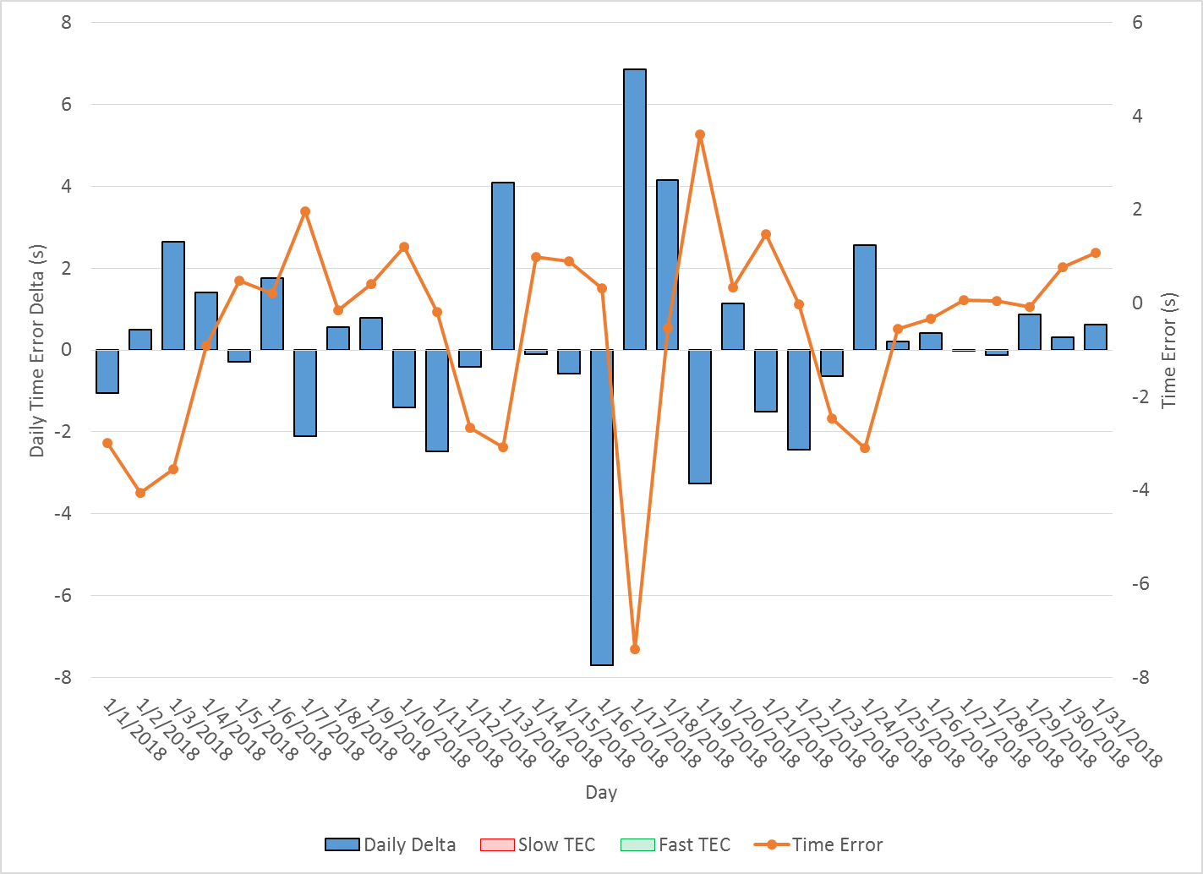
ERCOT Daily Time Error

Slide 16
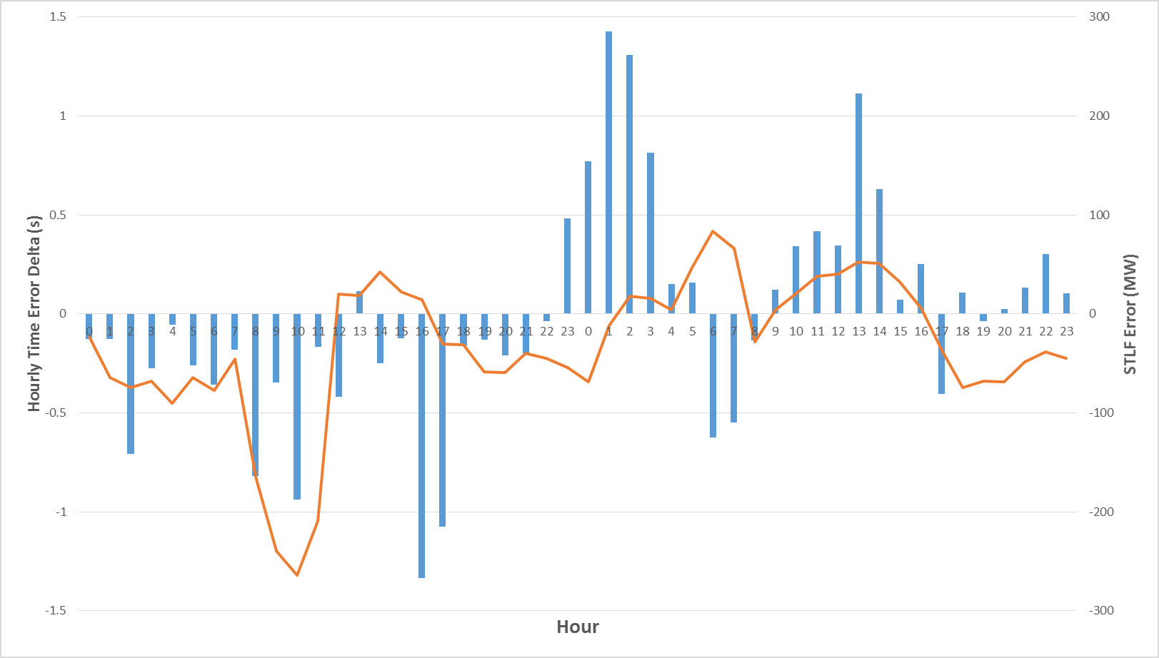
Hourly Time Error with STLF Error
Notes:
Shows hourly data for the 16th and 17th of January
Ice day was the 16th
Large STLF Error ~300
Accumulating Negative Time Error on 16th
Accumulating Positive Time Error on 17th

Slide 17
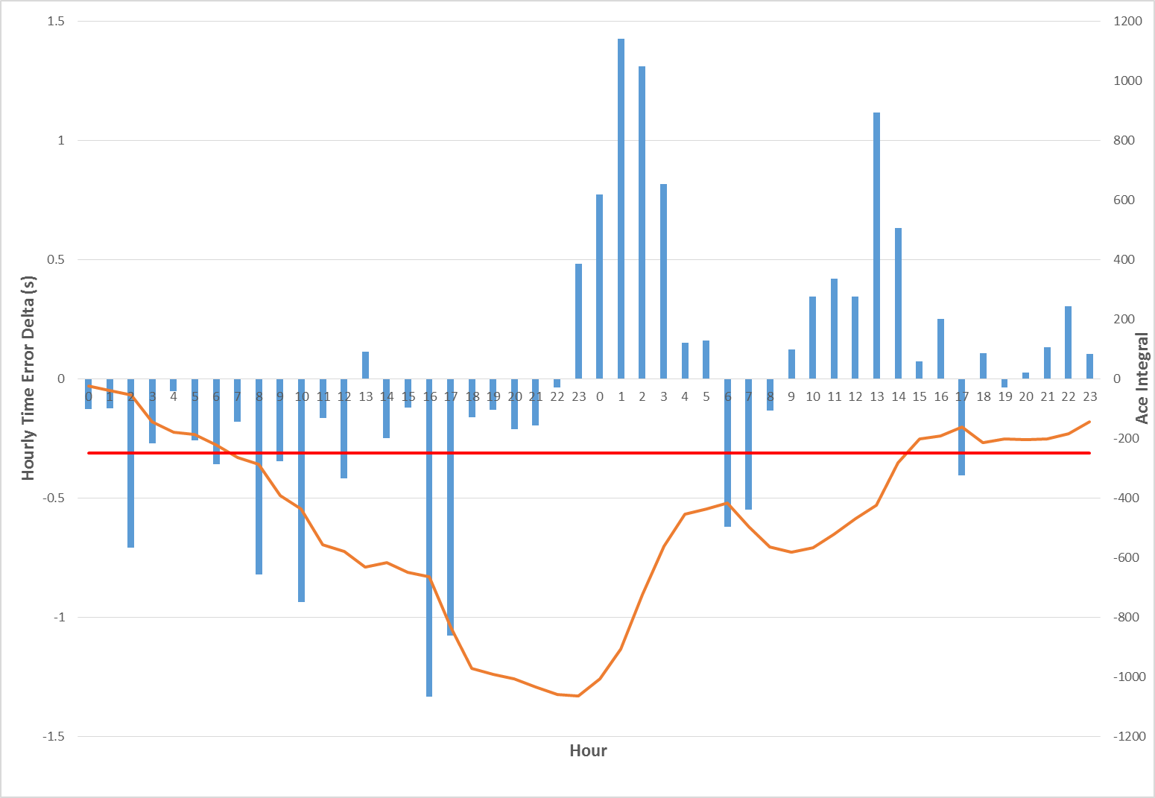
Hourly Time Error with Ace Intgeral
Notes:
16th and 17th data again
Now showing Ace Integral being largely negative and capped
Unable to adjust to STLF error so continue to gain negative errror

Slide 18
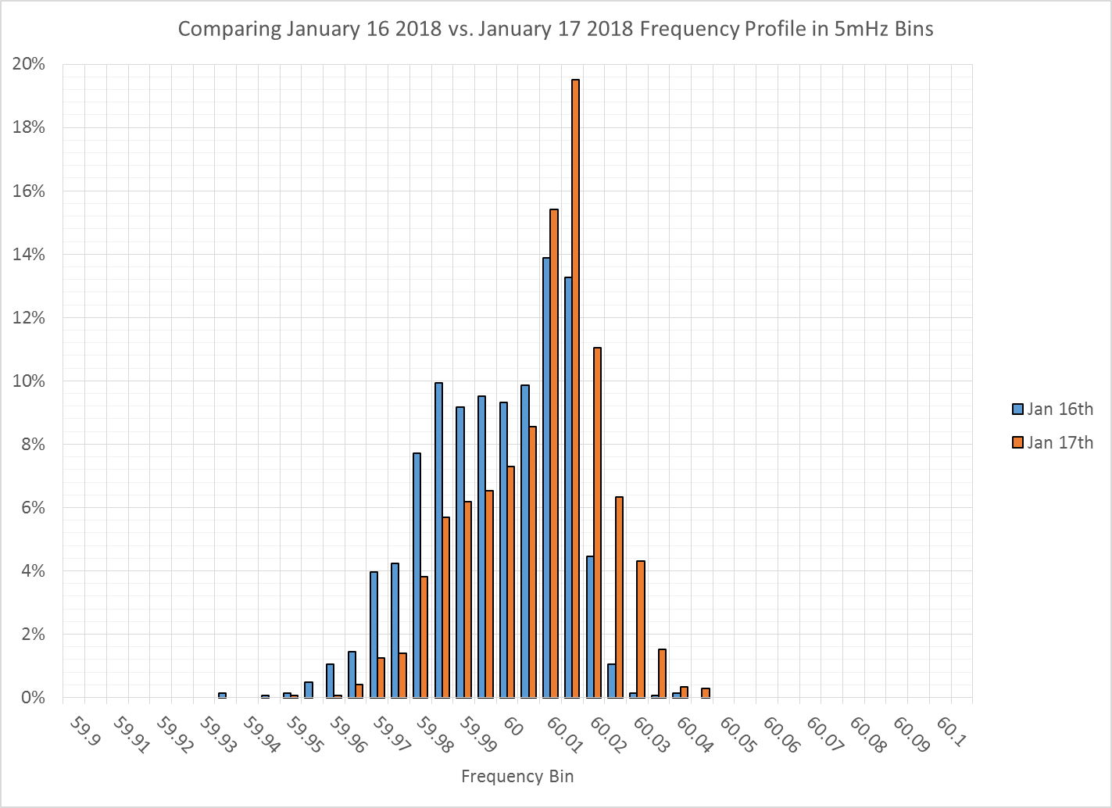
Frequency Profile
Notes:
We spent a lot of time on the lower end of 60 Hz on the 16th
Recovered time error on 17th by spending more time on the upper end of 60 Hz

Slide 19
Time Error Corrections Log Summary

Slide 20
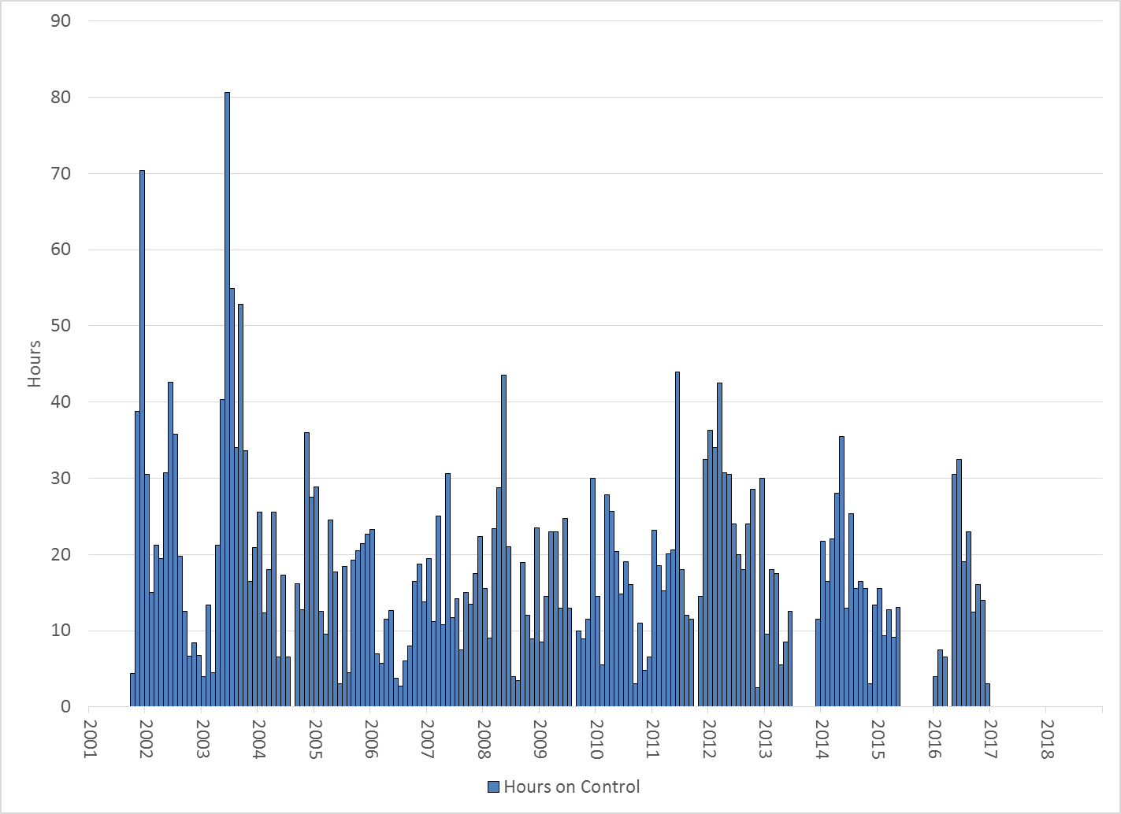
Hours on Time Error Control

Slide 21
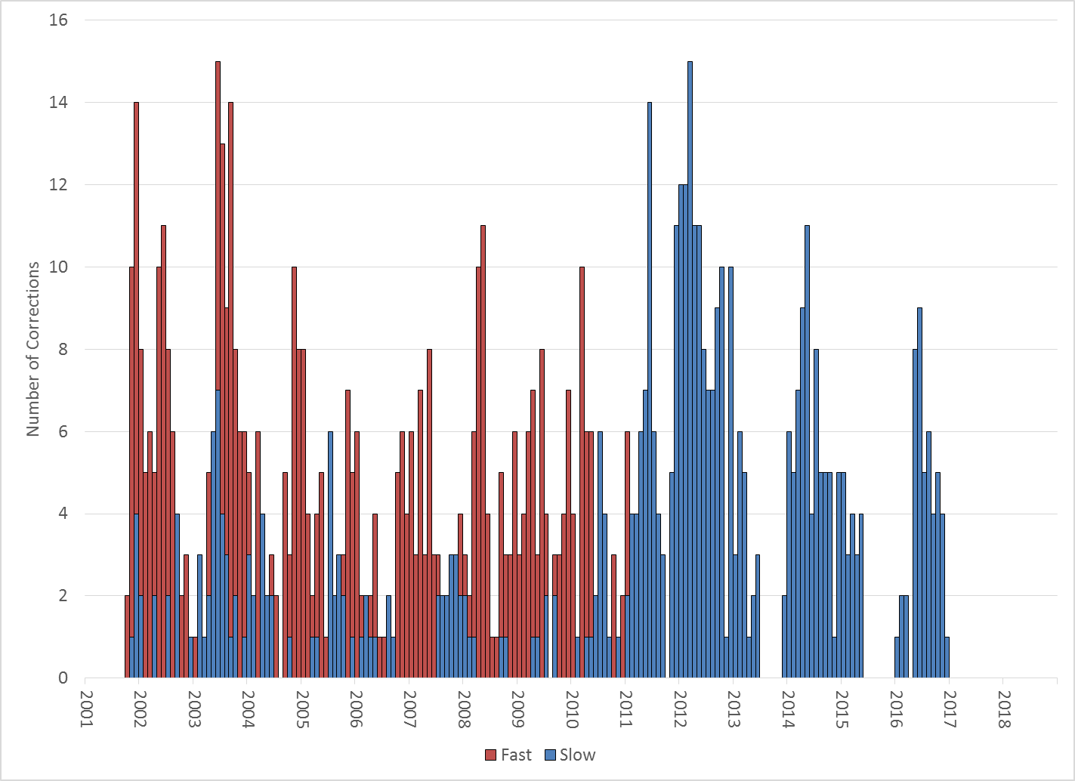
Number of Time Error Corrections

Slide 22
BAL-003 Performance

Slide 23
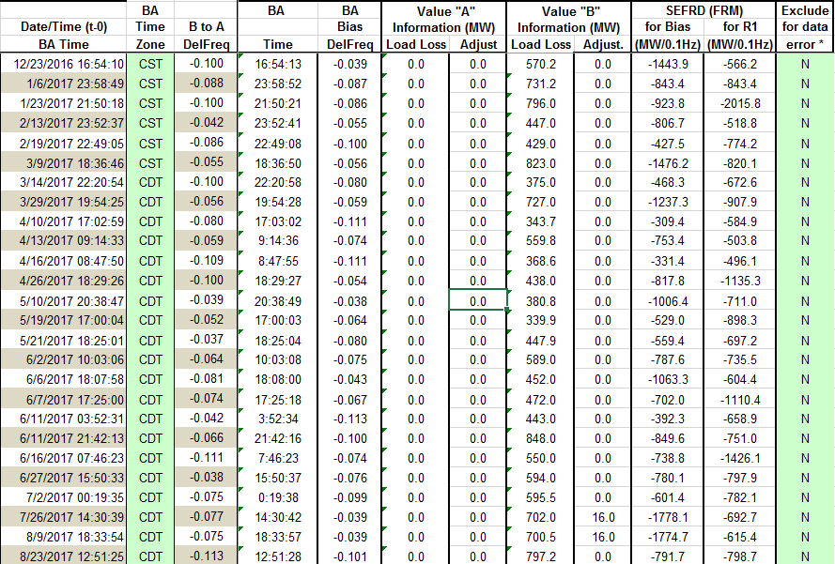
BAL-003 Selected Events

Slide 24
Current BAL-003 FRM Performance
FRM Performance Results for 2017
2017 | Current data year (December thru November)
-381.0 | Operating Year 2018 BA Frequency Response Obligation (FRO) for next year's FRM
-381.0 | Operating Year 2017 BA Frequency Response Obligation (FRO)
-743.27 | 2017 FRM - Median Estimated Frequency Response MW/0.1Hz for BA Compliance to R1, minimum Frequency Response
-812.3 | 2017 FRM - Average Estimated Frequency Response MW/0.1 Hz using SEFRD for R1
0.0 | 2017 FRM - Regression Estimated Frequency Response MW/0.1Hz using SEFRD for R1
Notes:
Put in some history of what these values were
Updated quarterly

Slide 25
ERCOT Energy Statistics

Slide 26
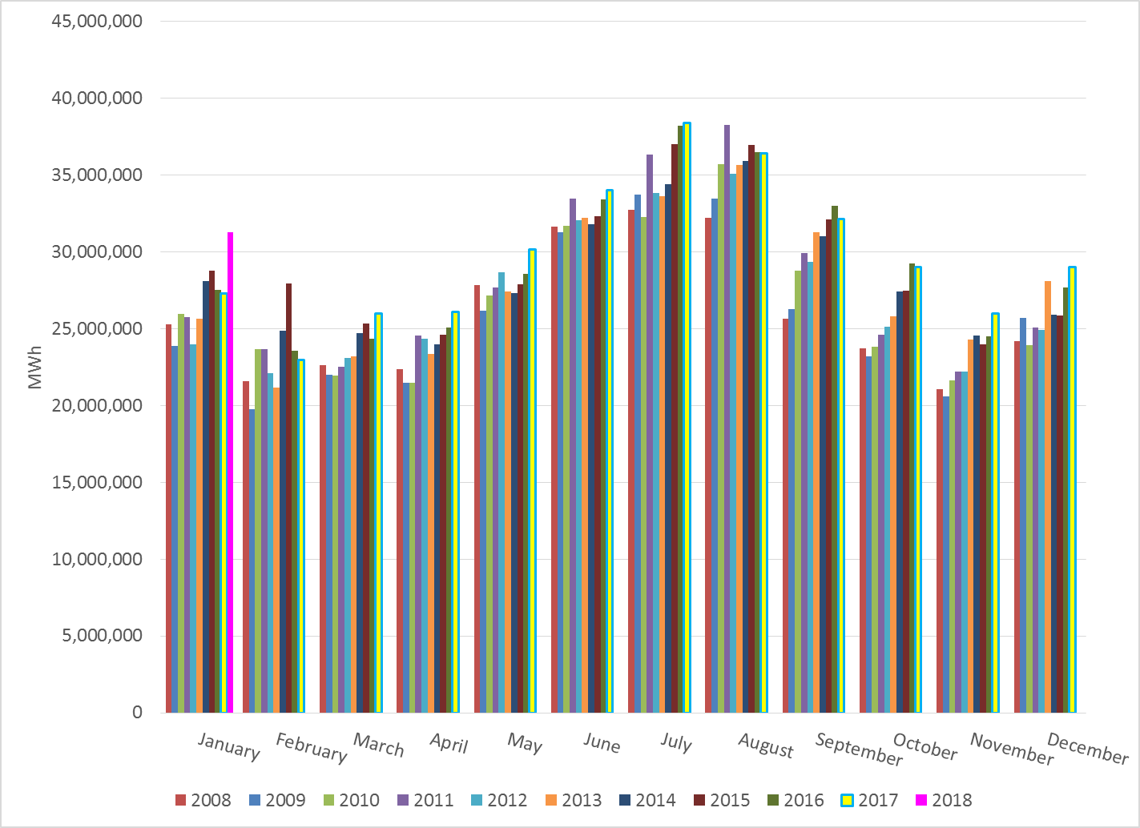
Total Energy
Notes:
31,278,046

Slide 27
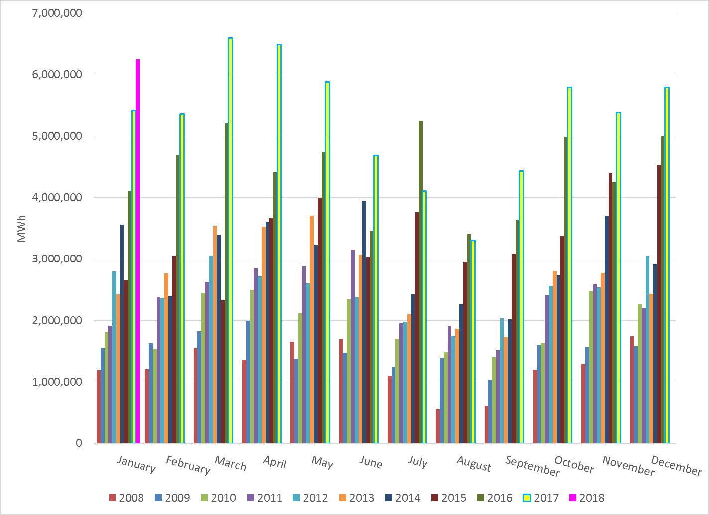
Total Energy from Wind Generation
Notes:
6,250,264

Slide 28
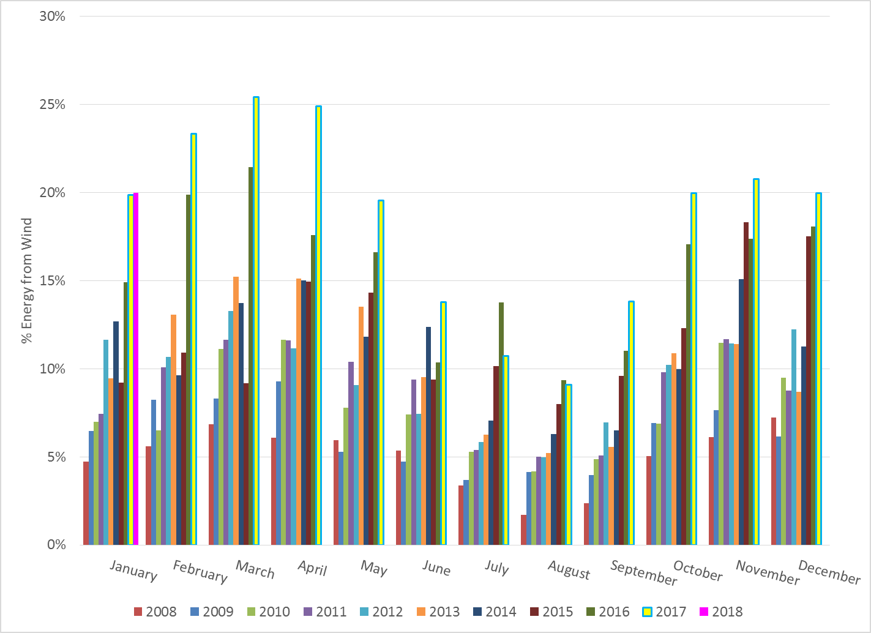
% Energy from Wind Generation
Notes:
19.98%

Slide 29
ERCOT System Inertia

Slide 30
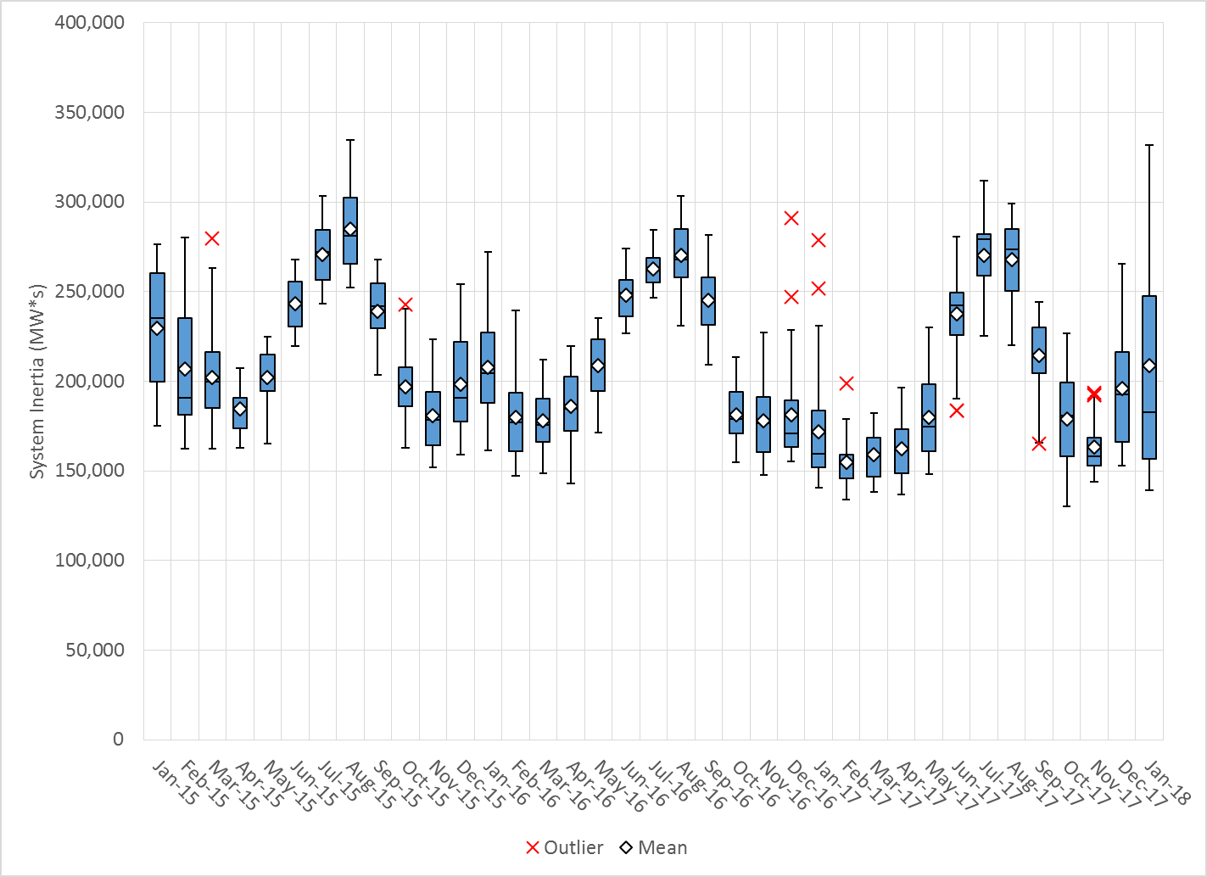
Daily Minimum System Inertia
Notes:
Minimum Inertia = 130,014 MW*s on 10/27/2017. This was also our record wind day.
Jan:
Mean: 208,502
Max: 331,839 on Jan 2nd
Min: 138,977 on Jan 21st

Slide 31
Questions?
Thank you!

