Slide 1
ERCOT Frequency Control Report
February 2018
ERCOT
Operations Planning
PDCWG | March 7th, 2018

Slide 2
Frequency Control
CPS1, BAAL, & RMS1

Slide 3
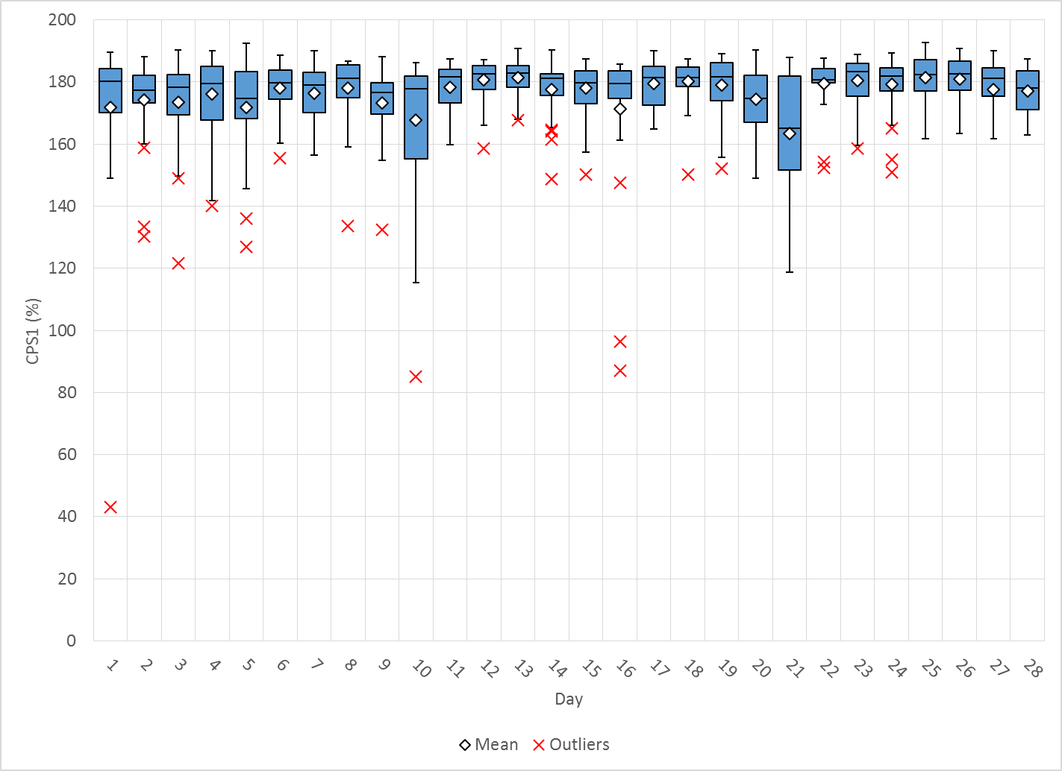
Hourly CPS1 by Day
Feb-18 CPS1 (%): 176.49
Notes:
Outliers
2/1/18 at 04:00 - 42.9% - Large Down Wind Ramp Loss of 1500 MW over the hour and reg up exhausted. (~30 mins under 60Hz) and load on up ramp
2/10/18 at 10:00 – 84.7% - Large Down Wind Ramp Loss of 1700 MW over the hour and reg up exhausted. (~30 mins under 60Hz) and load on up ramp
2/16/18 at 12:00 – 96.5% - Large Down Wind Ramp Loss of 2400 MW over the hour and reg up exhausted. (~30 mins under 60Hz) and load on up ramp
2/16/18 at 13:00 – 87.1% - Large Down Wind Ramp Loss of 1096 MW over the hour and reg up exhausted. (~30 mins under 60Hz) and load on up ramp

Slide 4
BAAL Exceedances & Violations
There were 2 BAAL exceedances
  February 5th 2018
    FME at 14:04:45
    Loss of 816 MW
    Less than 59.91 for 2 minutes

Slide 5
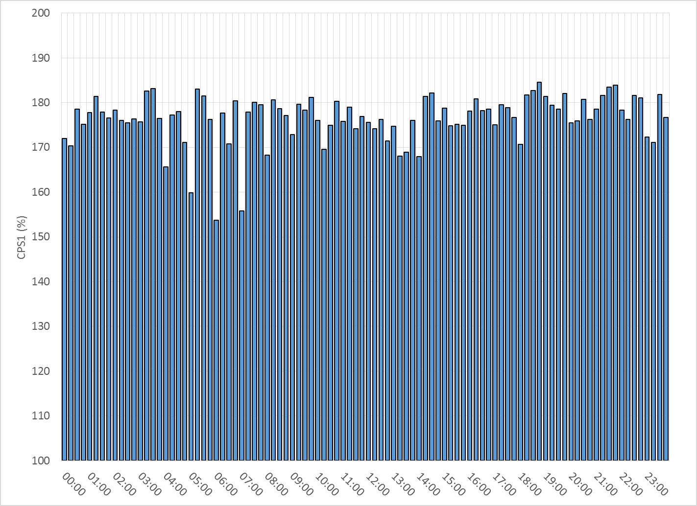
15-Minute Average CPS1%
Feb-18 CPS1 (%): 176.49

Slide 6
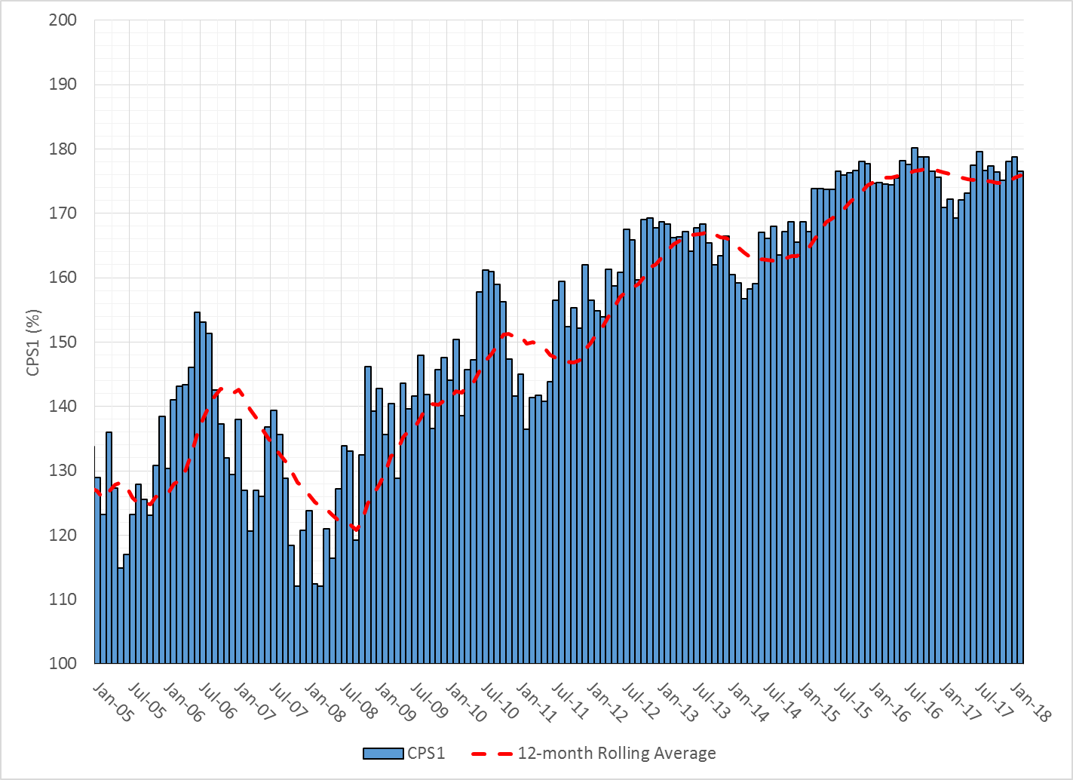
12-Month Rolling Average CPS1
Current 12-Month Rolling Average: 175.86%

Slide 7
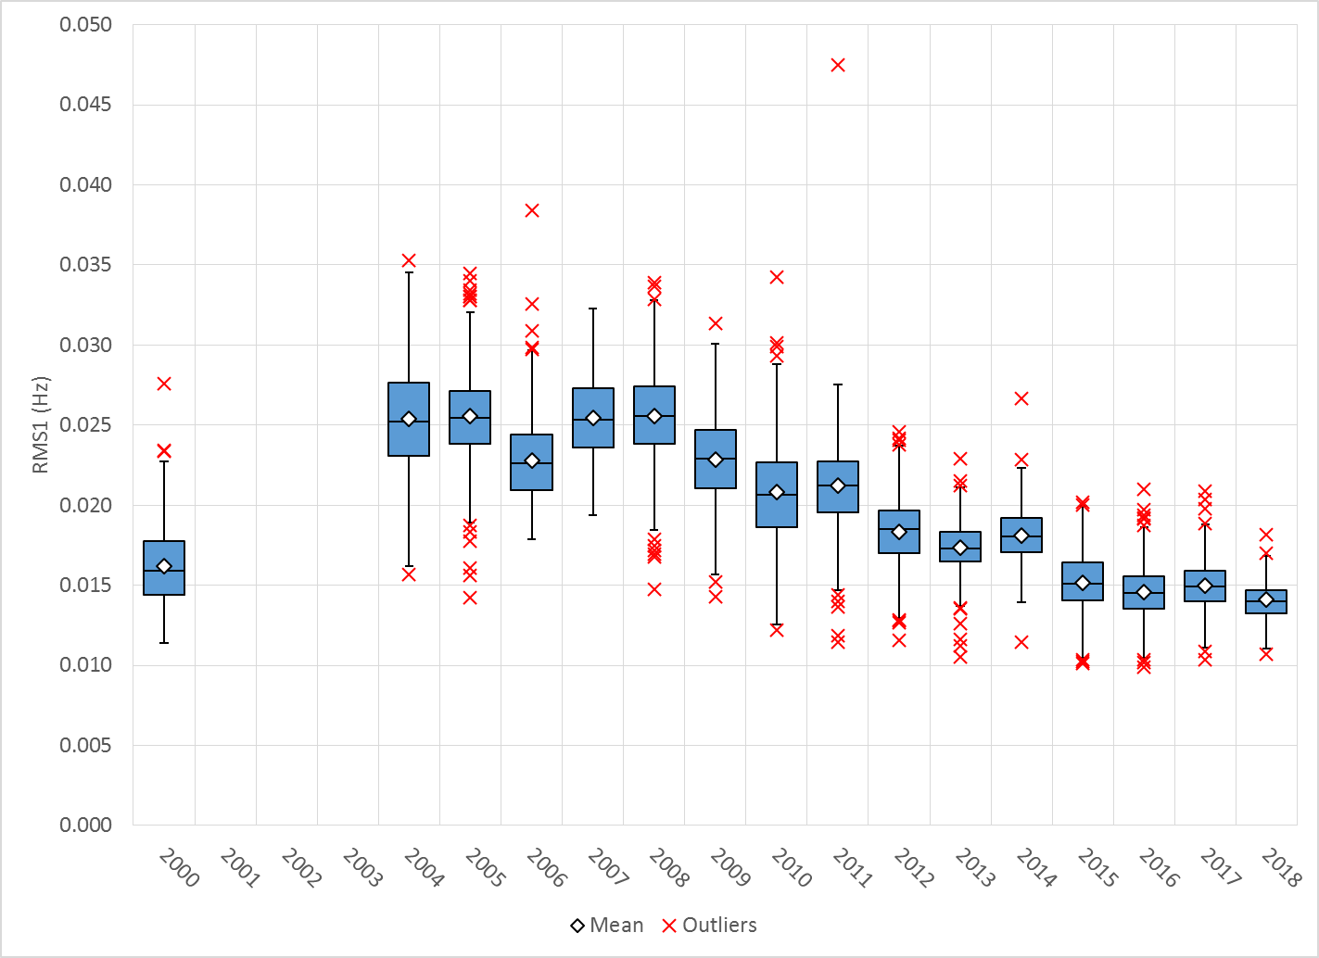
Daily RMS1 of ERCOT Frequency by Year
Notes:
Mean is 14.50 mHz

Slide 8
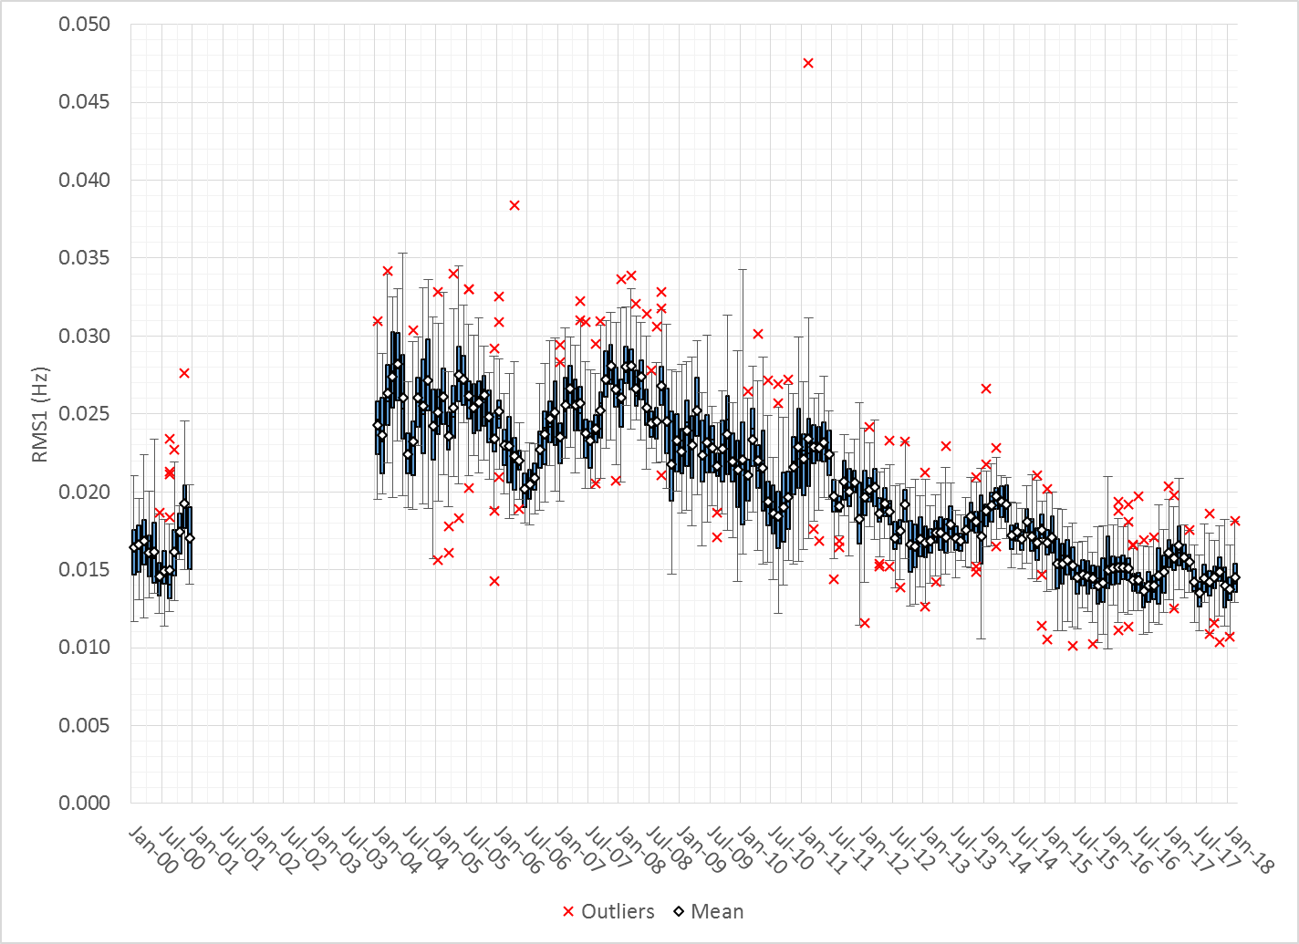
Daily RMS1 of ERCOT Frequency by Month

Slide 9
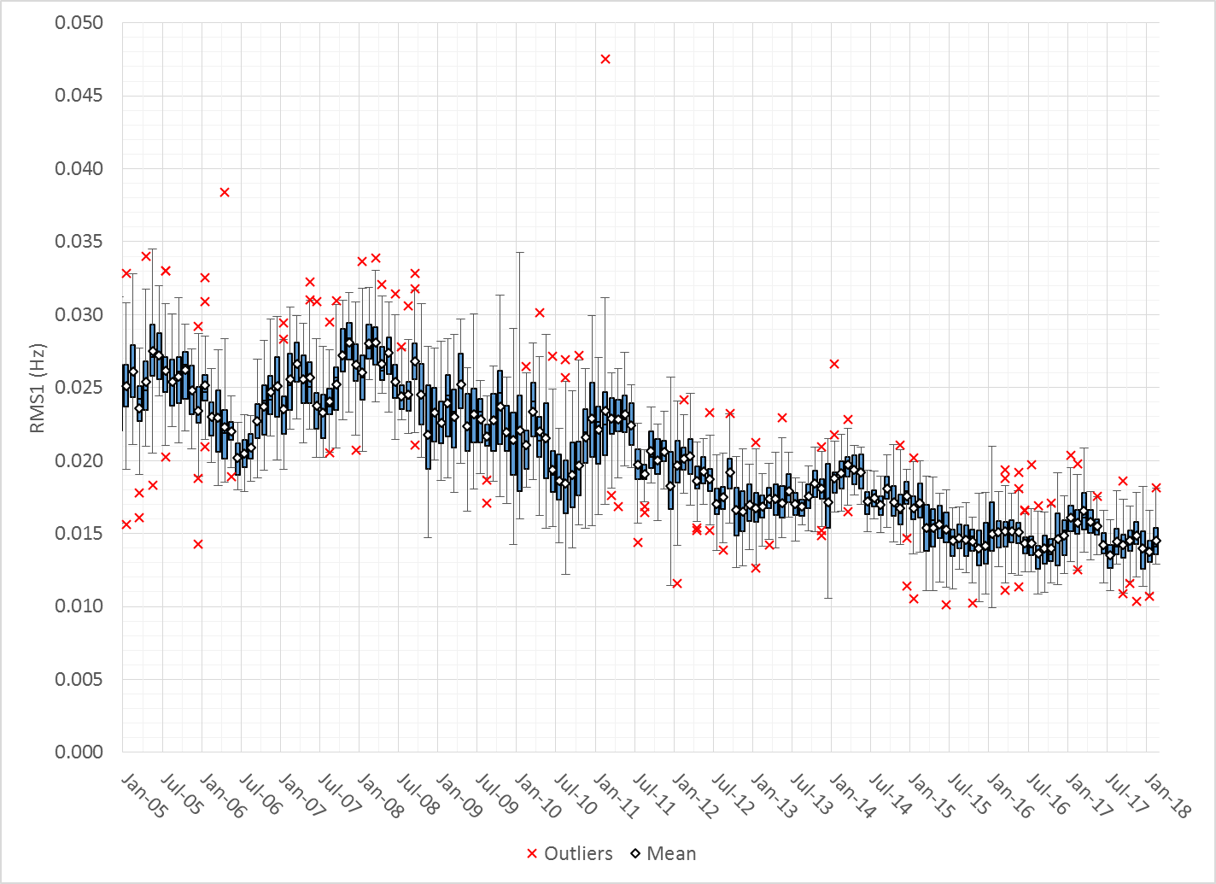
Daily RMS1 of ERCOT Frequency by Month

Slide 10
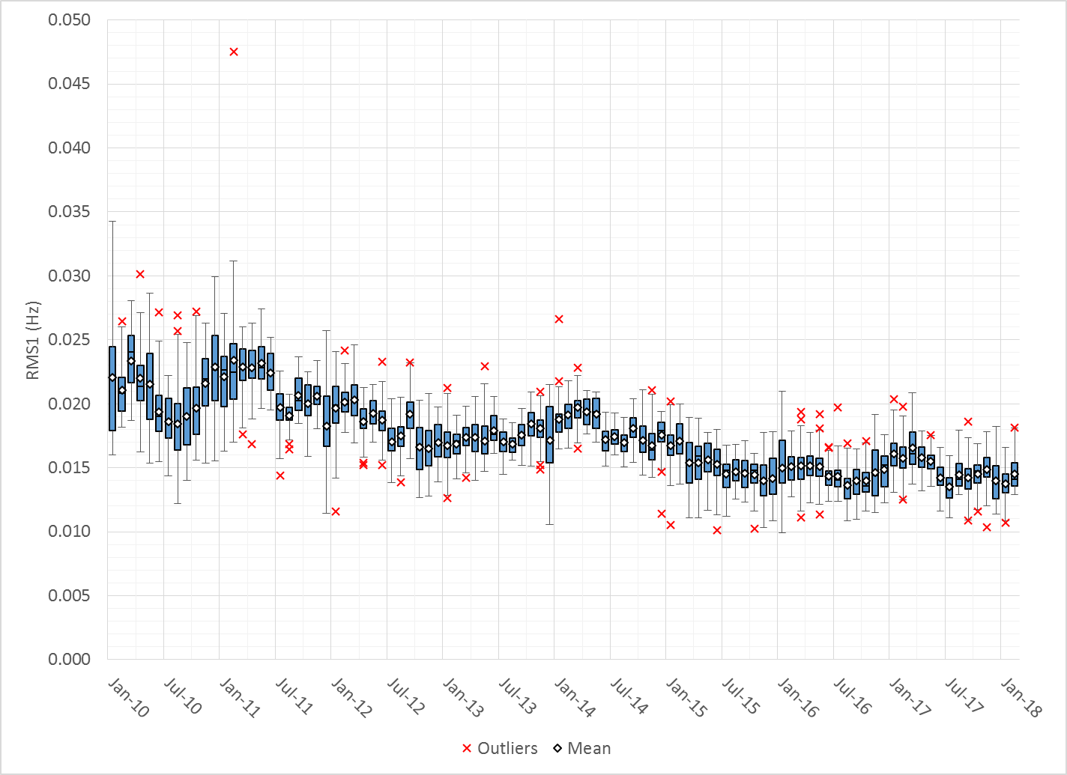
Daily RMS1 of ERCOT Frequency by Month
Notes:
Mean: 14.50 mHz
Min: 12.92 mHz
Max: 18.15 mHz

Slide 11
Frequency Profile Comparison

Slide 12
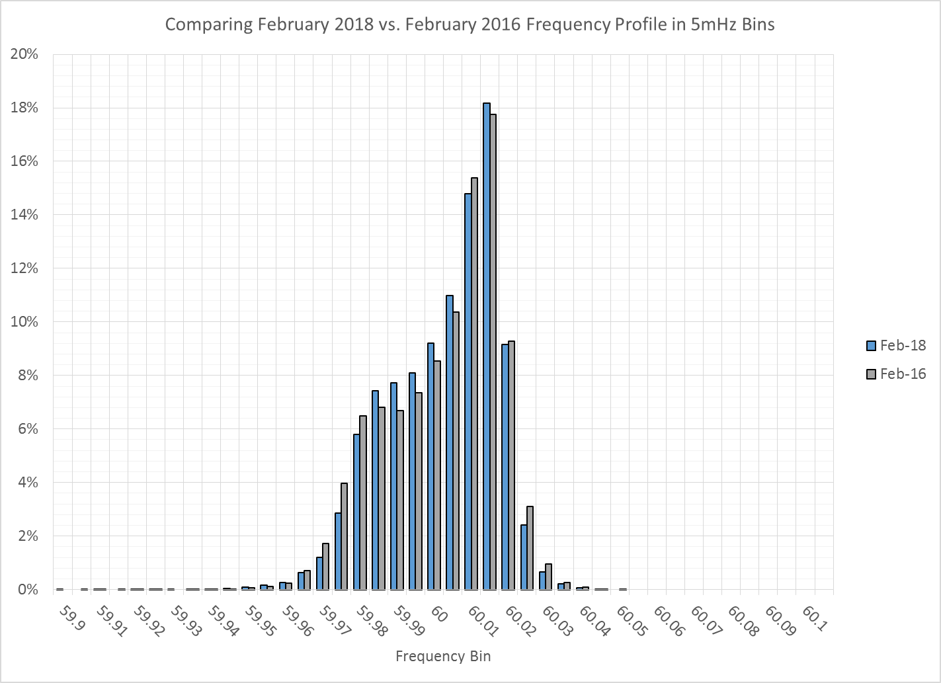
Frequency Profile Comparison

Slide 13
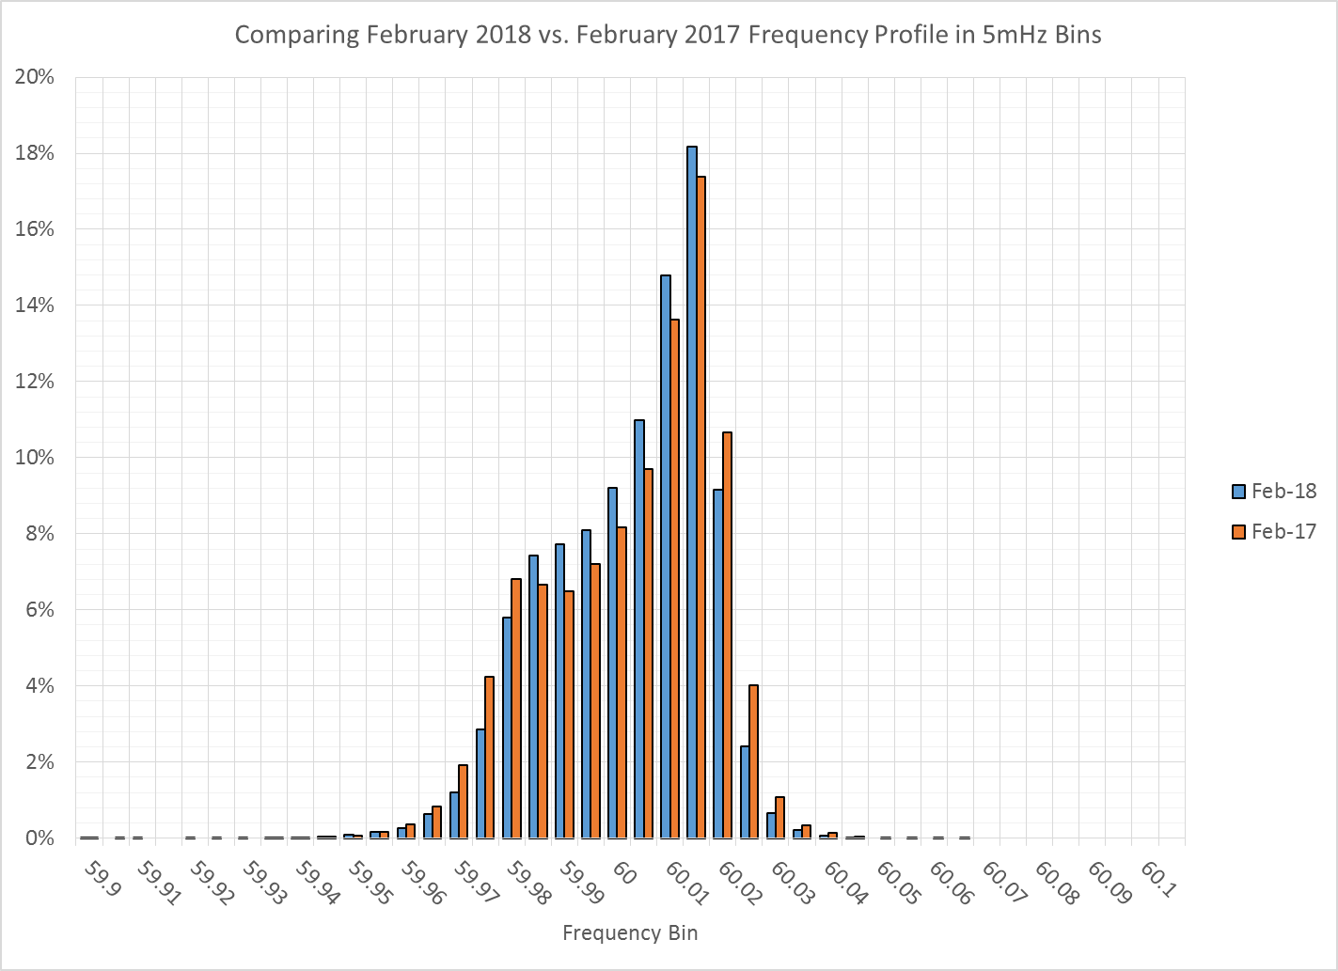
Frequency Profile Comparison

Slide 14
Time Error Correction

Slide 15
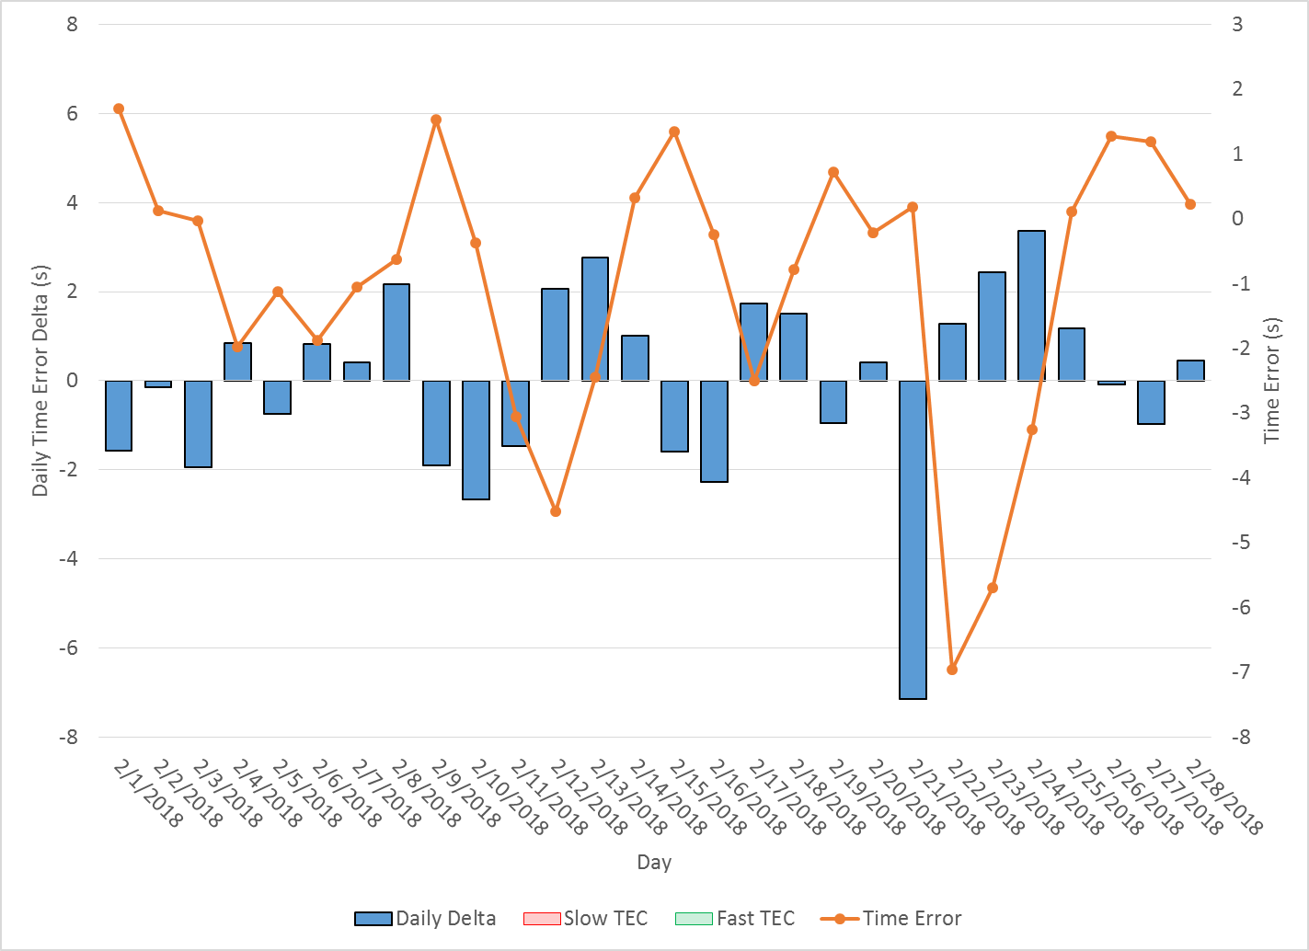
ERCOT Daily Time Error

Slide 16
Time Error Corrections Log Summary

Slide 17
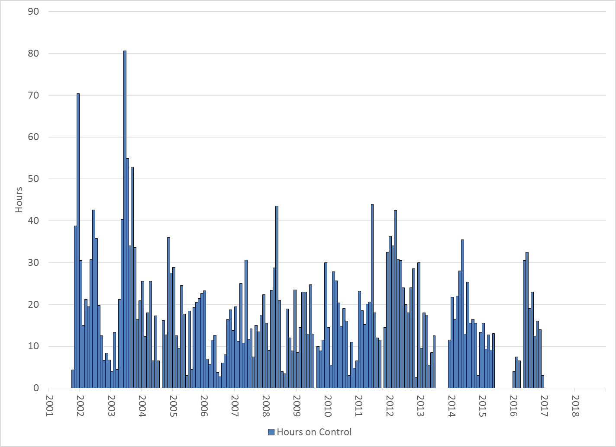
Hours on Time Error Control

Slide 18
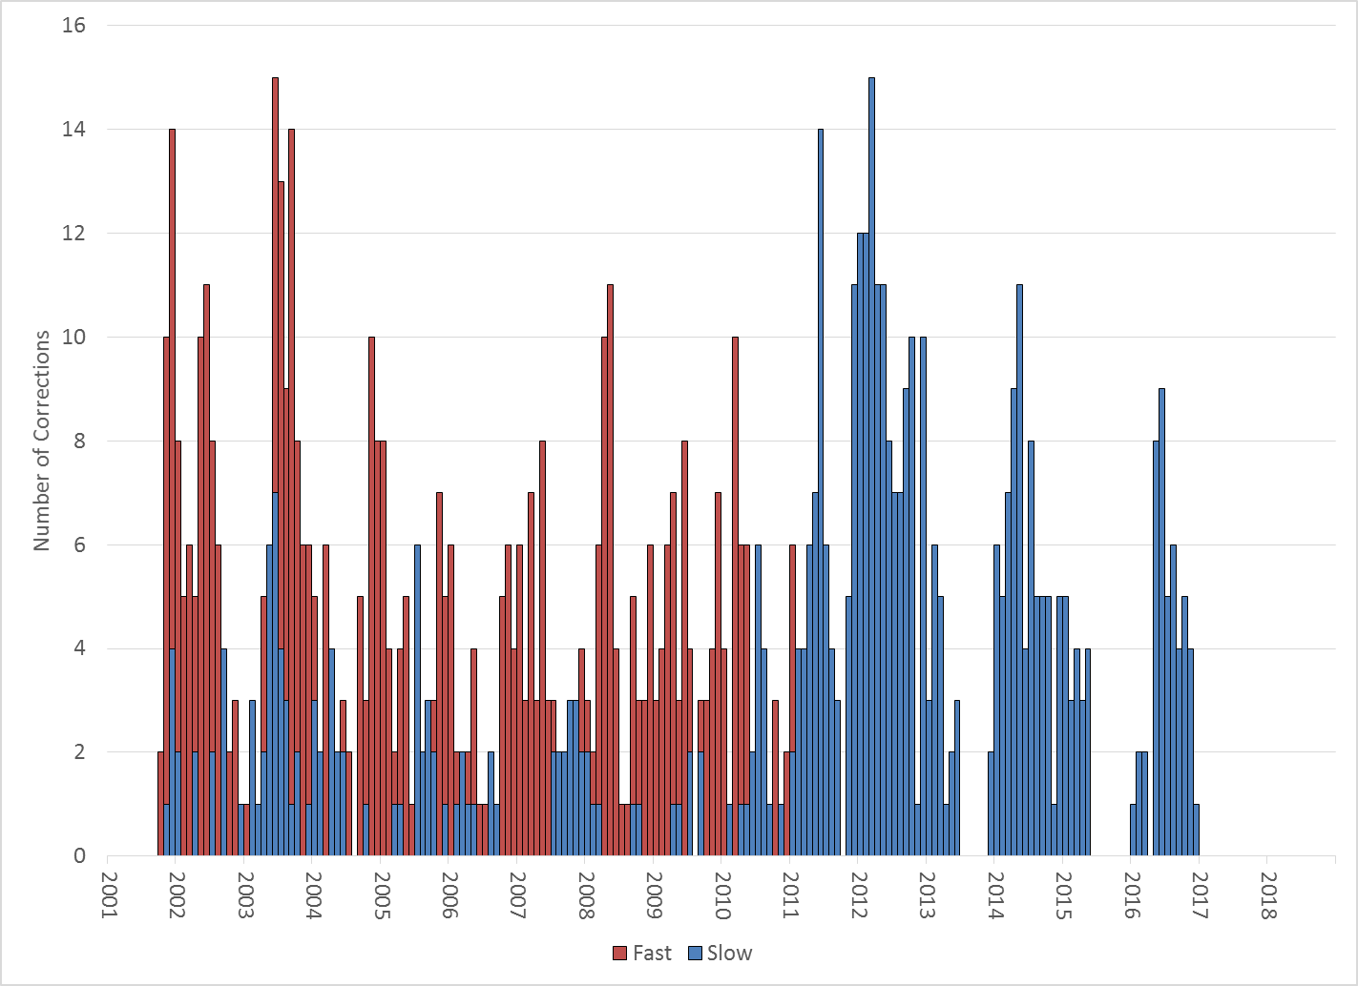
Number of Time Error Corrections

Slide 19
BAL-003 Performance

Slide 20
BAL-003 Selected Events

Slide 21
Current BAL-003 FRM Performance
Notes:
Put in some history of what these values were
Updated quarterly

Slide 22
ERCOT Energy Statistics

Slide 23
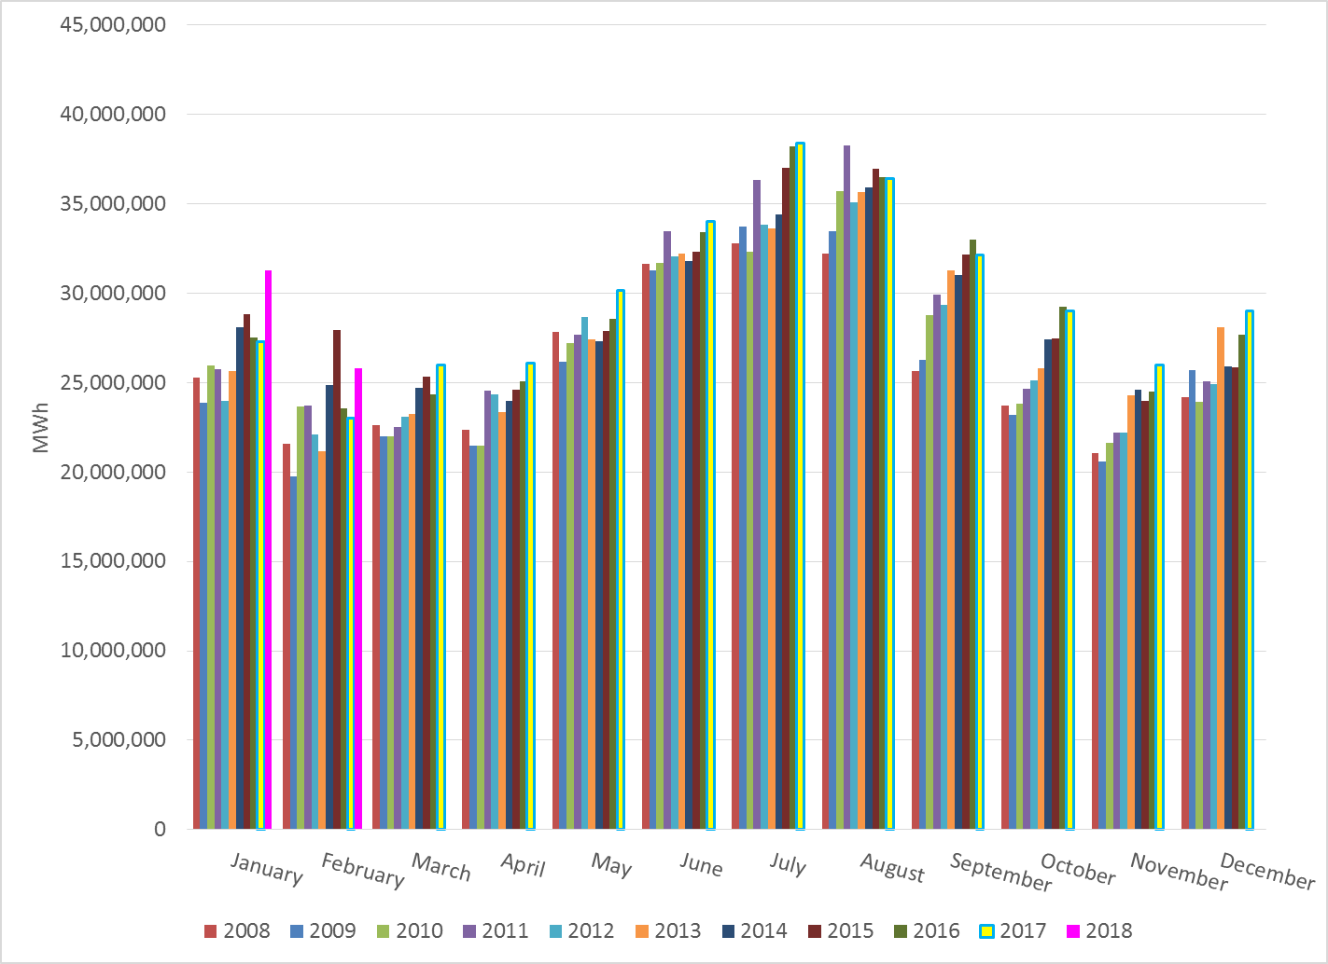
Total Energy
Notes:
31,278,046

Slide 24
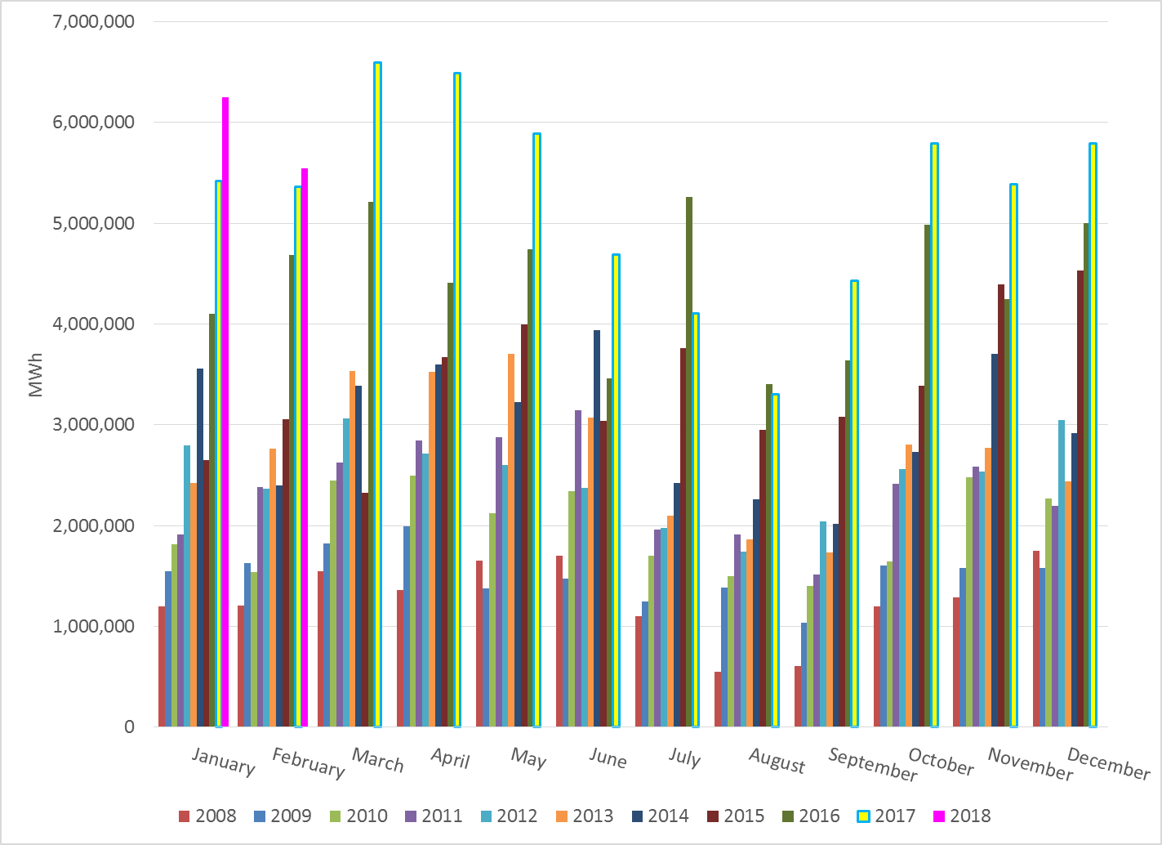
Total Energy from Wind Generation
Notes:
6,250,264

Slide 25
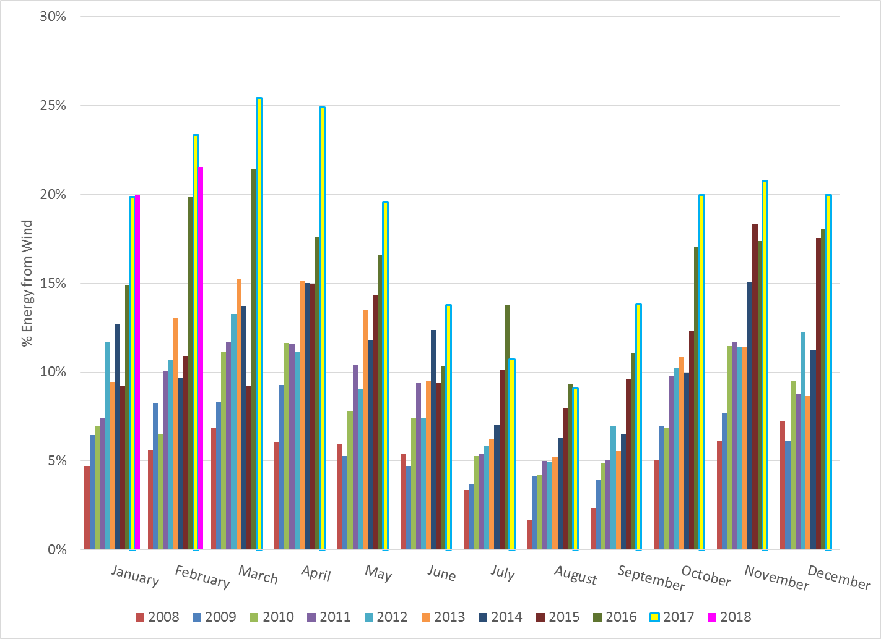
% Energy from Wind Generation
Notes:
19.98%

Slide 26
ERCOT System Inertia

Slide 27
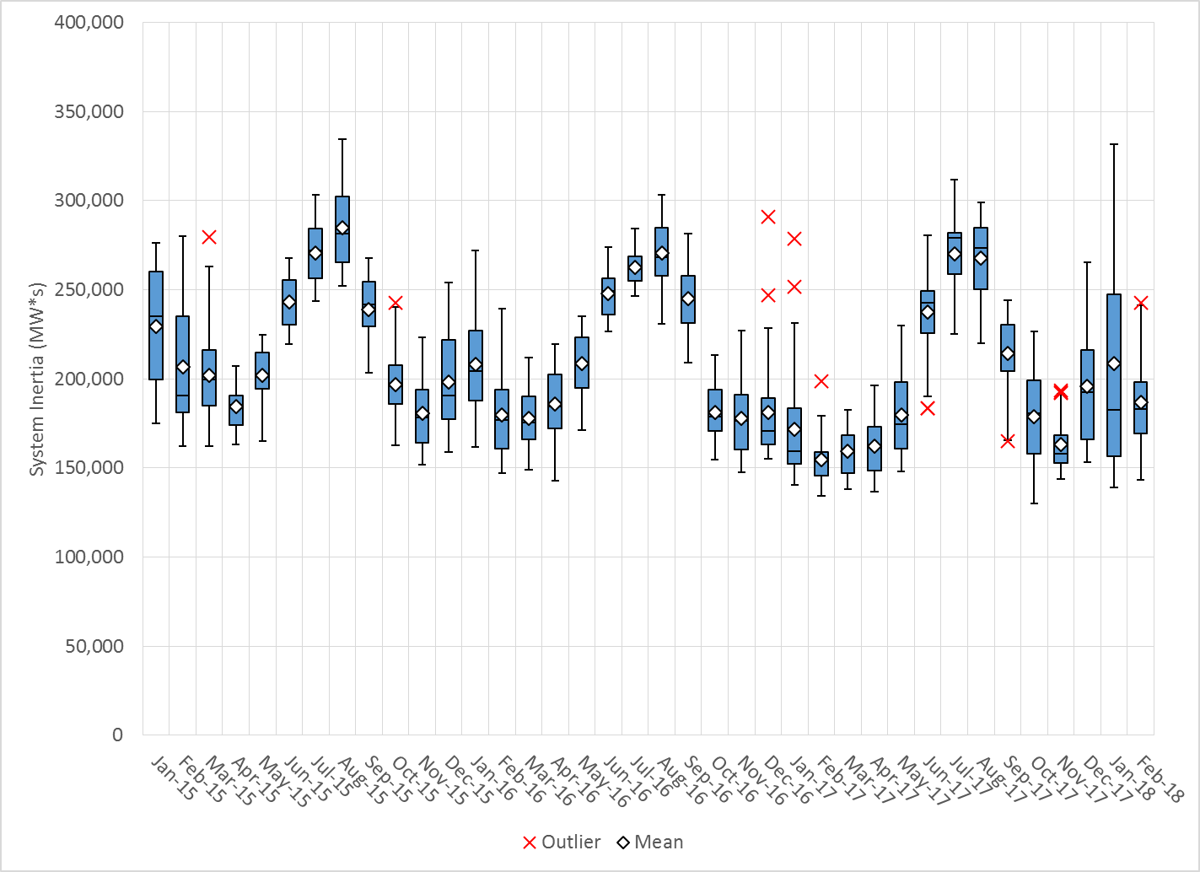
Daily Minimum System Inertia
Notes:
Minimum Inertia = 130,014 MW*s on 10/27/2017. This was also our record wind day.
Feb:
Mean: 186,900
Max: 242,865 on Feb 22nd
Min: 143,362 on Feb 1st

Slide 28
Questions?
Thank you!

