Slide 1
ERCOT Frequency Control Report
April 2018
ERCOT
Operations Planning
PDCWG | May 9th, 2018

Slide 2
Frequency Control
CPS1, BAAL, & RMS1

Slide 3
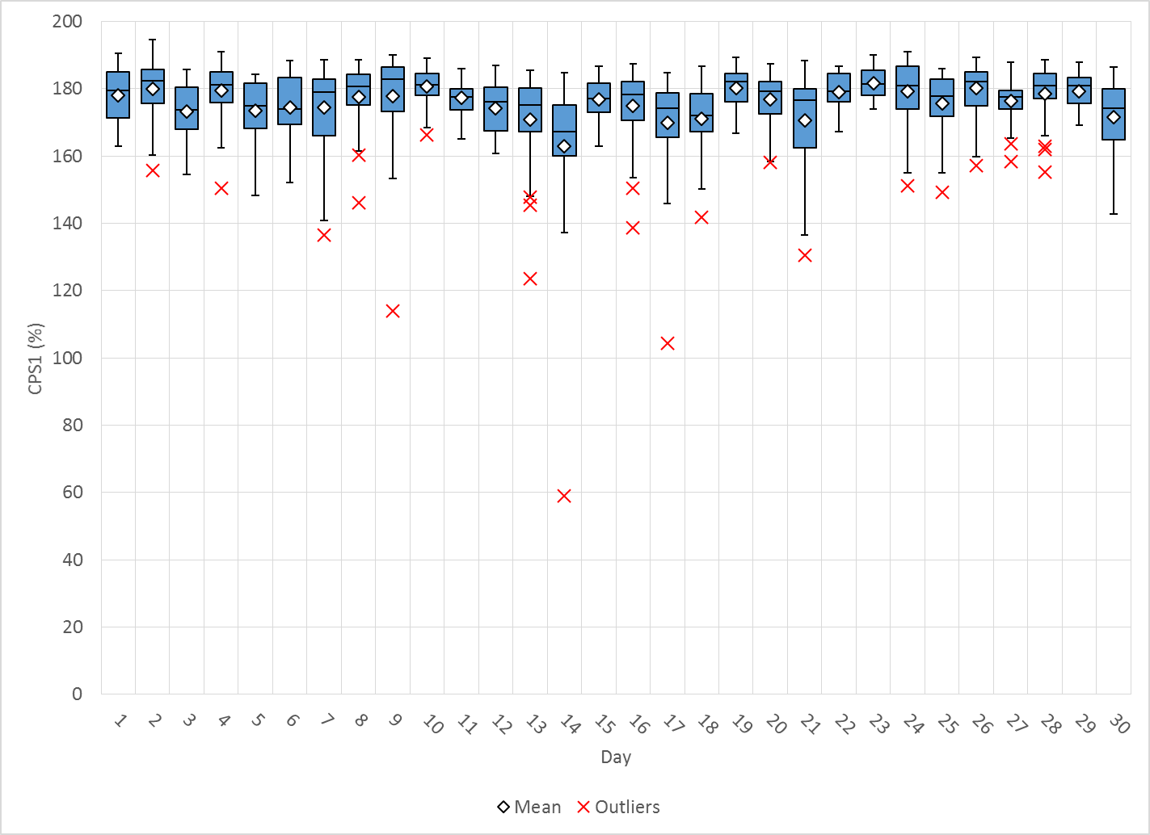
Hourly CPS1 by Day
Apr-18 CPS1 (%): 175.93
Notes:
Outliers
4/14/18 at 19:00 – 59.11% - Large expected generation deviation over the hour (down ~1900 MW) and ACEI and reg up exhausted. Wind and Solar ramping down. (~30 mins under 60Hz) and load on up ramp

Slide 4
BAAL Exceedances & Violations
There were no BAAL exceedances

Slide 5
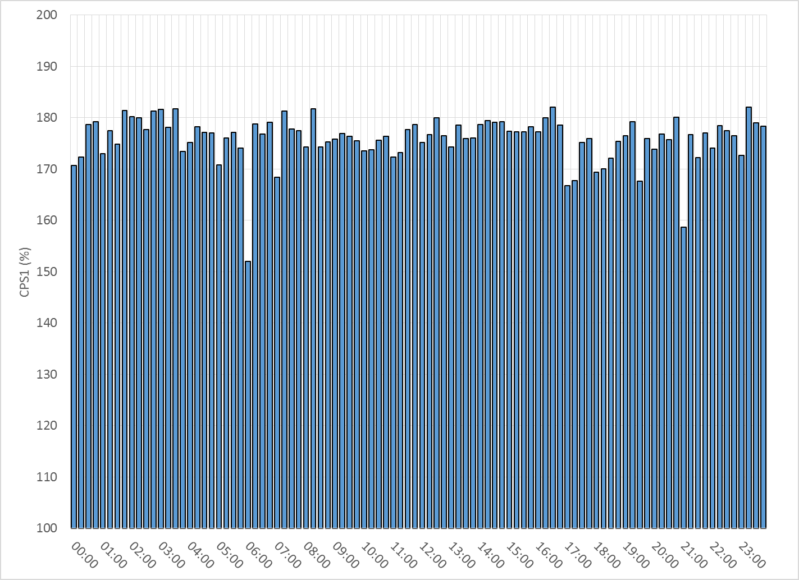
15-Minute Average CPS1%
Apr-18 CPS1 (%): 175.93

Slide 6
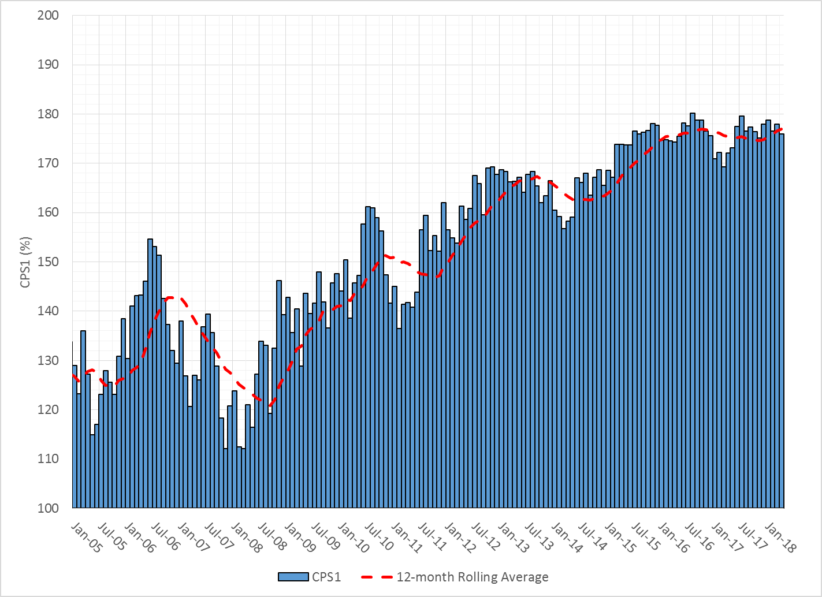
12-Month Rolling Average CPS1
Current 12-Month Rolling Average: 176.90%

Slide 7
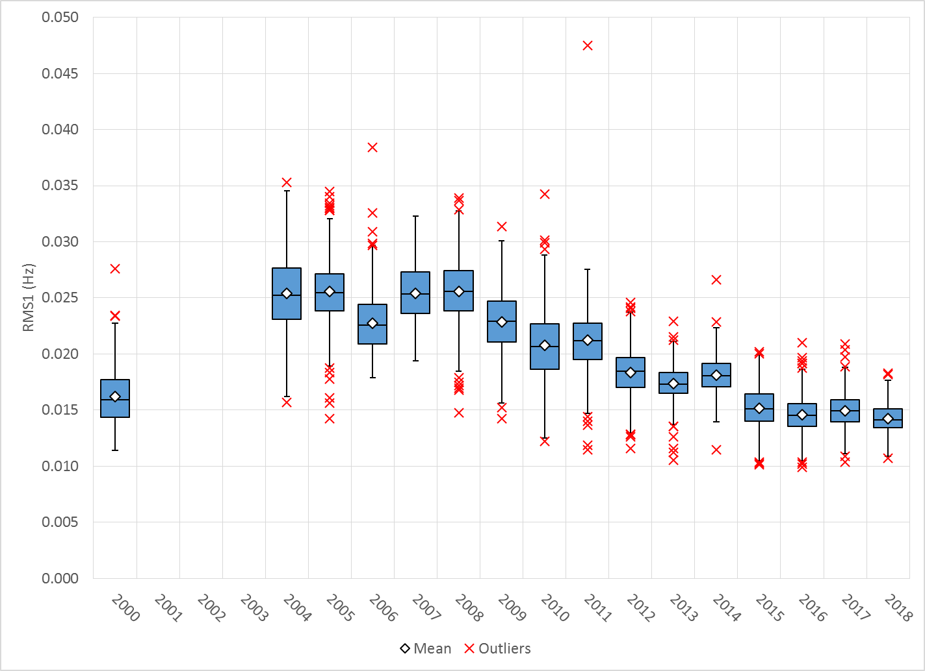
Daily RMS1 of ERCOT Frequency by Year
Notes:
Mean is 14.2 mHz

Slide 8
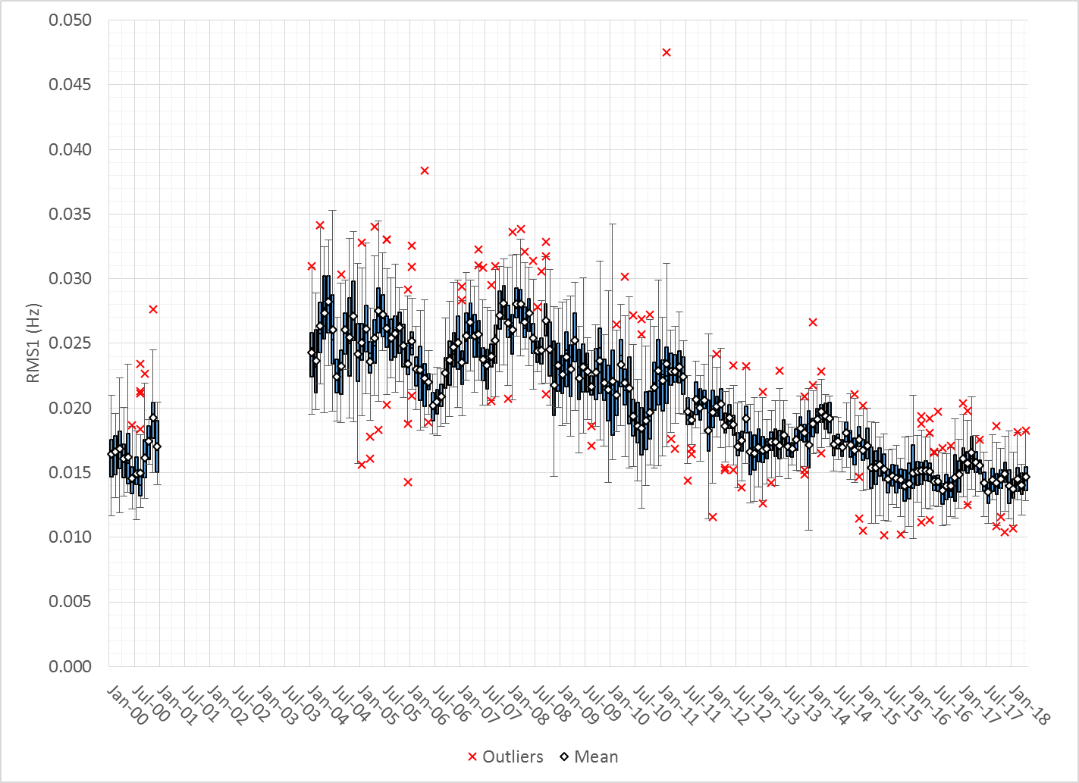
Daily RMS1 of ERCOT Frequency by Month

Slide 9
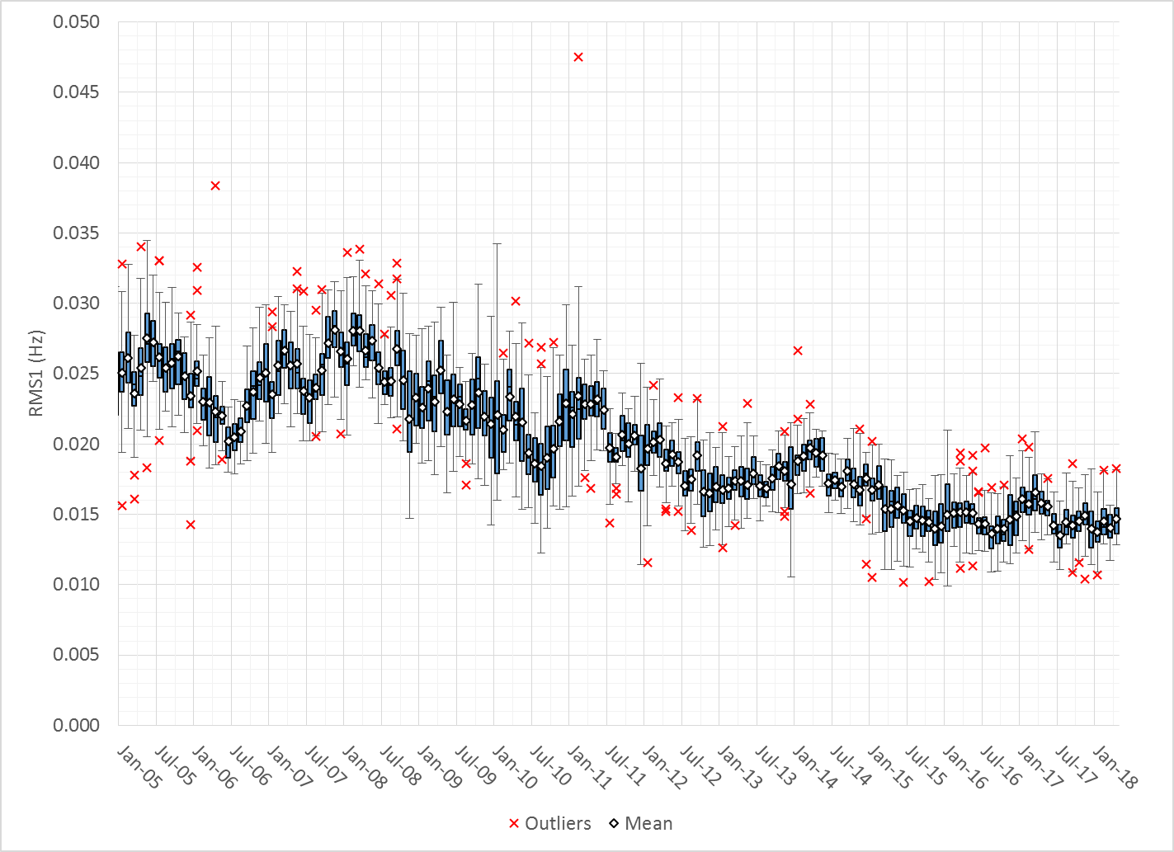
Daily RMS1 of ERCOT Frequency by Month

Slide 10
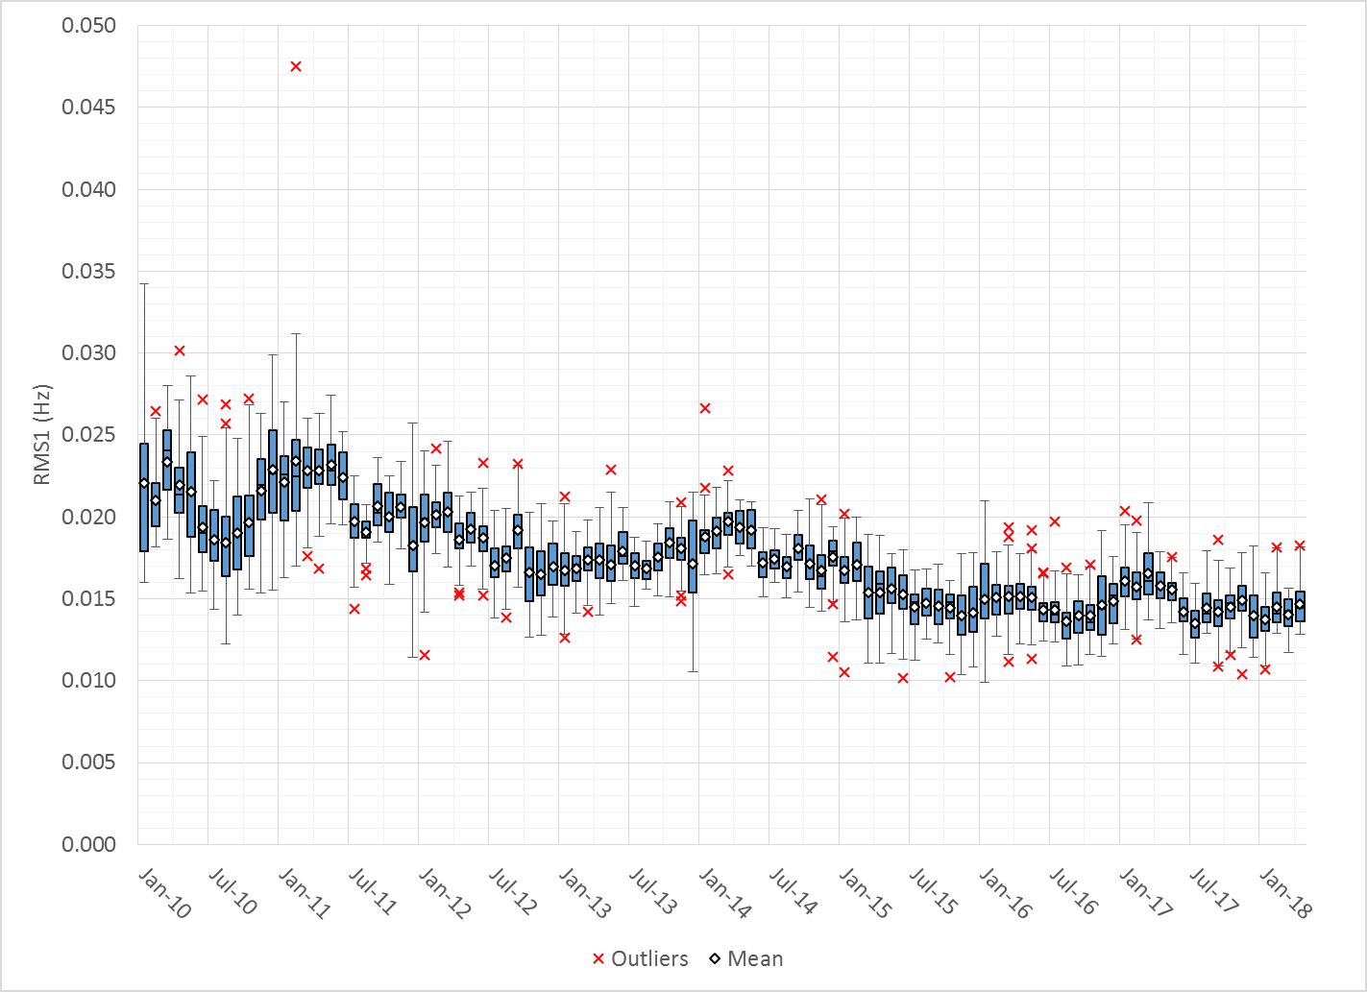
Daily RMS1 of ERCOT Frequency by Month
Notes:
Mean: 14.68 mHz
Min: 12.82 mHz
Max: 18.26 mHz

Slide 11
Frequency Profile Comparison

Slide 12
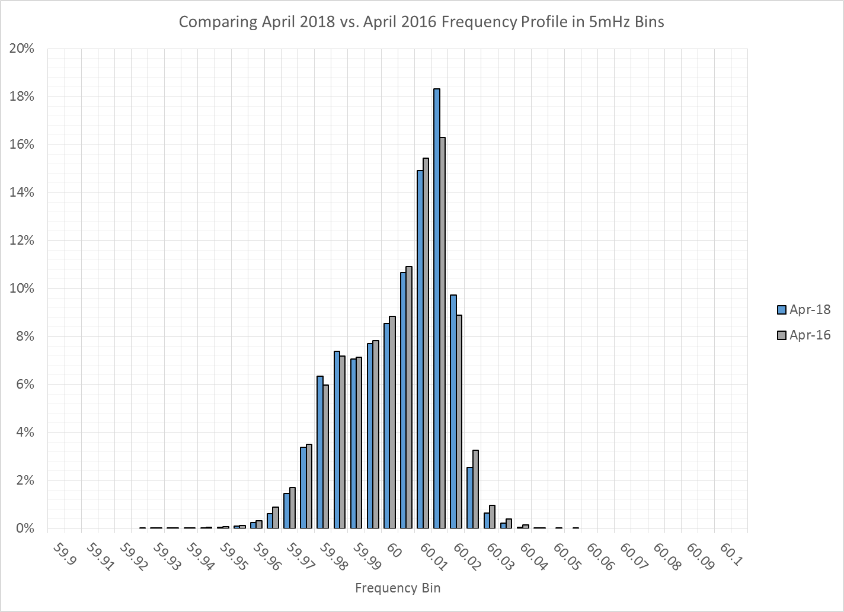
Frequency Profile Comparison

Slide 13
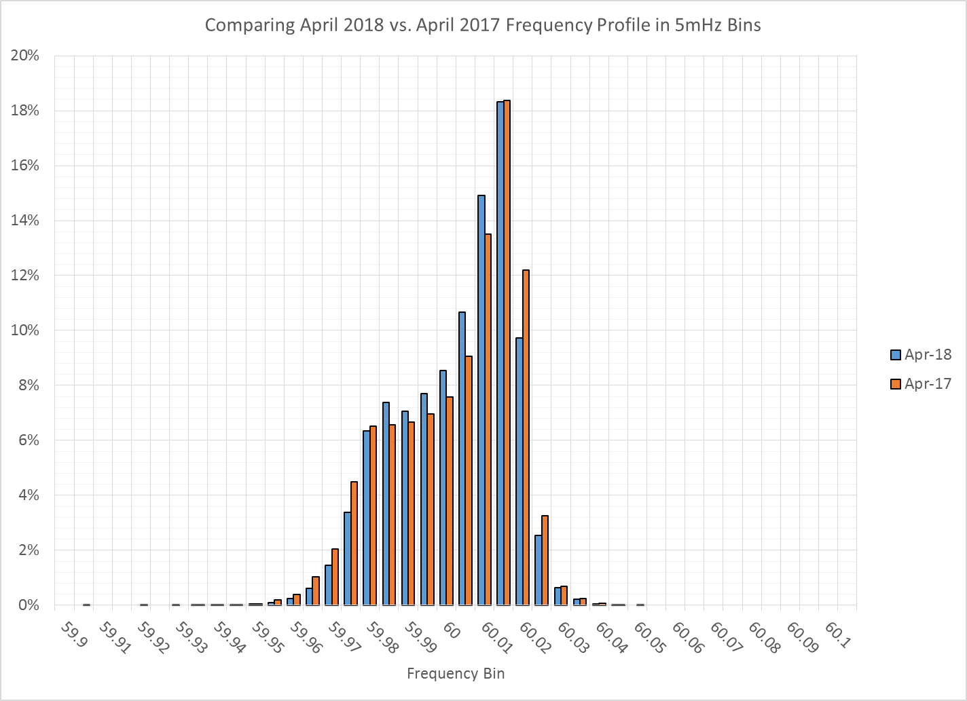
Frequency Profile Comparison

Slide 14
Time Error Correction

Slide 15
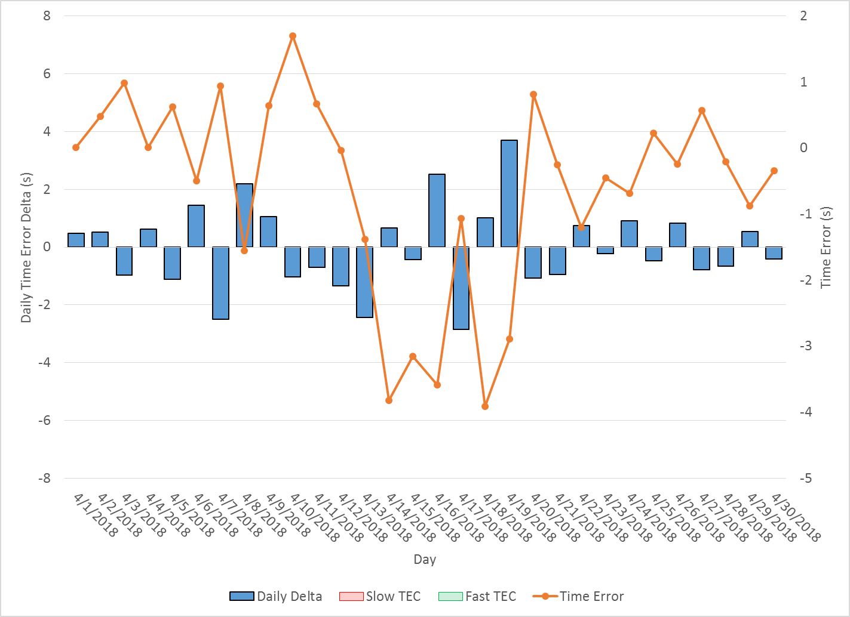
ERCOT Daily Time Error

Slide 16
Time Error Corrections Log Summary
There have been no time error corrections since December 2016

Slide 17
BAL-003 Performance

Slide 18
BAL-003 Selected Events
Notes:
Frequency Bias updated from 764 to 759 in April

Slide 19
Current BAL-003 FRM Performance
Notes:
Put in some history of what these values were
Updated quarterly

Slide 20
ERCOT Energy Statistics

Slide 21
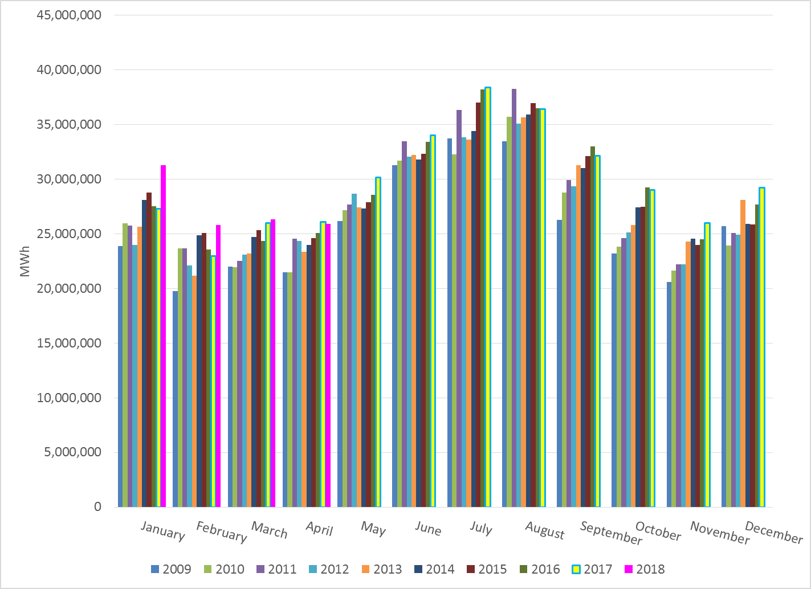
Total Energy
Notes:
25,900,024 Mwh

Slide 22
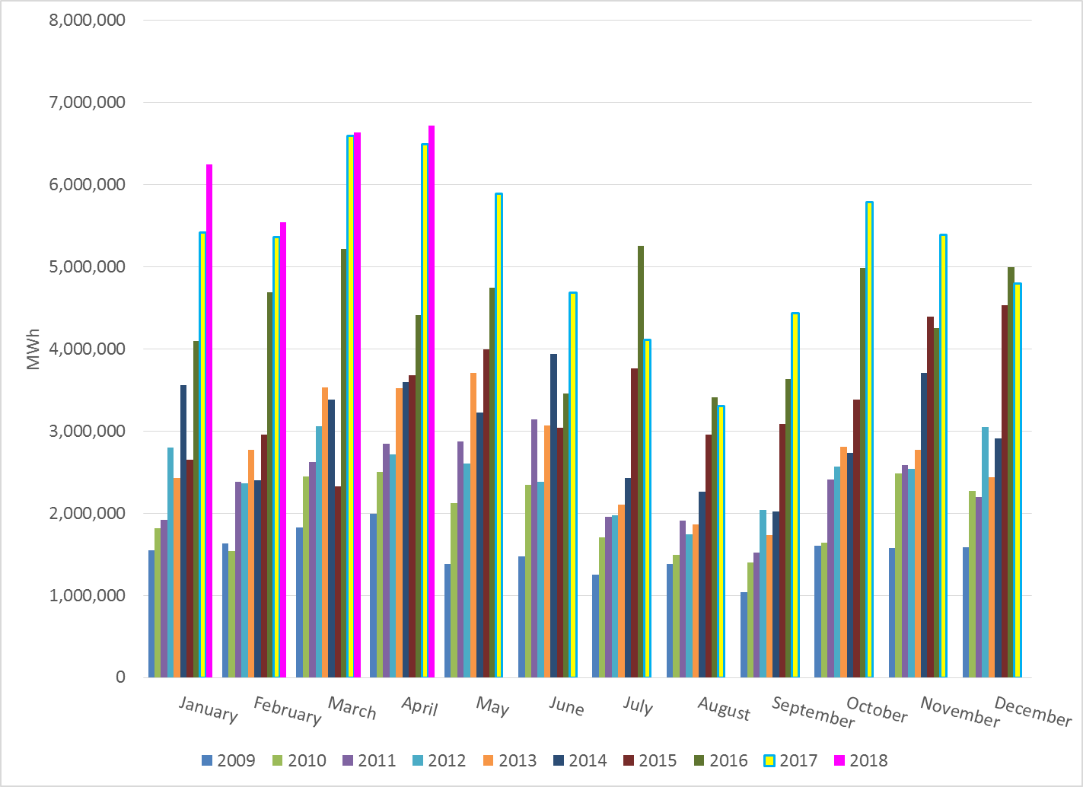
Total Energy from Wind Generation
Notes:
6,721,813

Slide 23
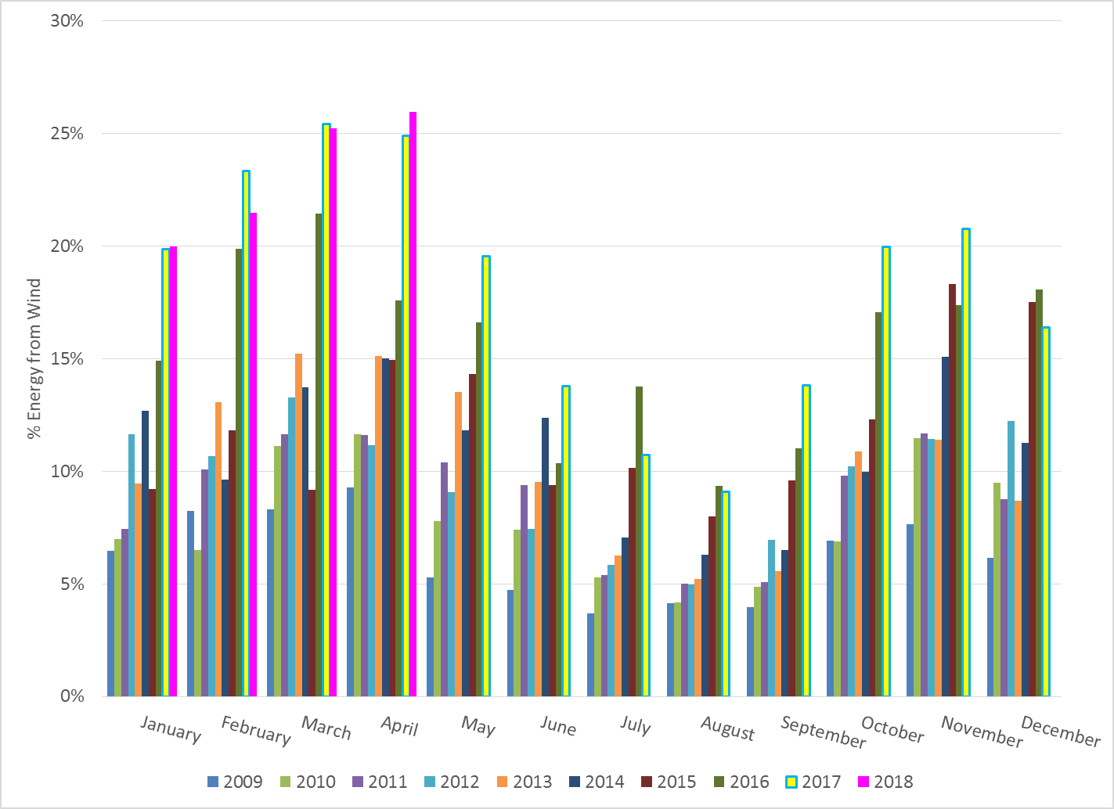
% Energy from Wind Generation
Notes:
25.95%

Slide 24
ERCOT System Inertia

Slide 25
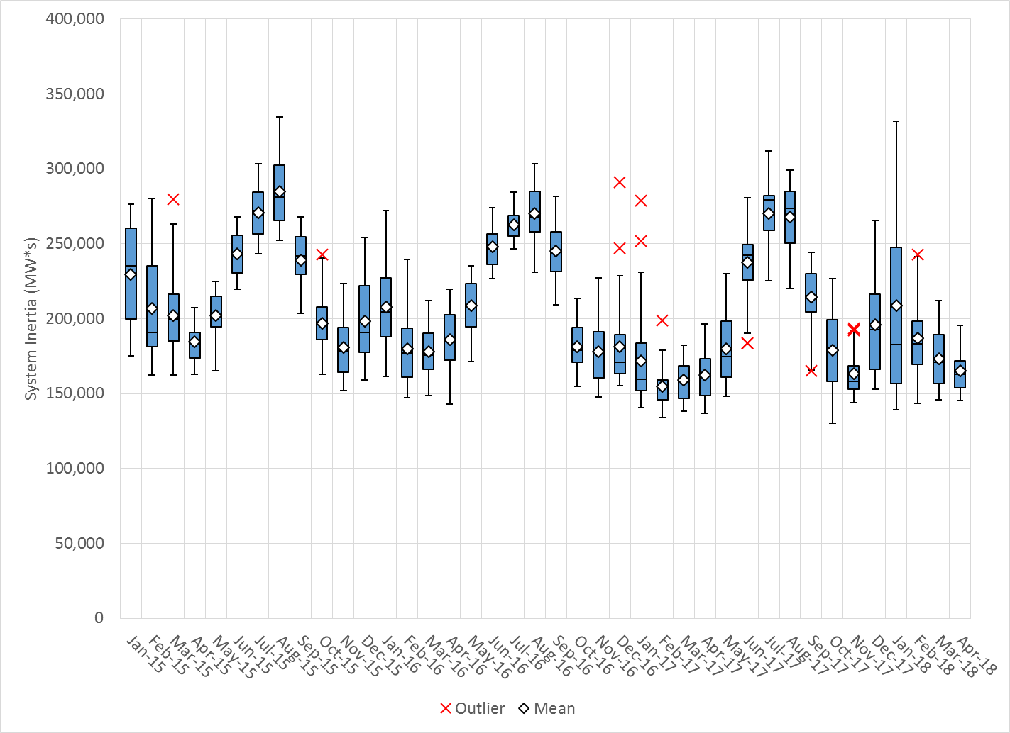
Daily Minimum System Inertia
Notes:
Minimum Inertia = 130,014 MW*s on 10/27/2017. This was also our record wind day.
Apr:
Mean: 165,290
Max: 195,435 on Apr 23rd
Min: 145,361 on Apr 3rd

Slide 26
Questions?
Thank you!

