Slide 1
New Approach for Identifying Regulation Requirements & a Proposal for Running SCED More Often
ERCOT
Operations Planning
QMWG | May 14th, 2018

Slide 2
Agenda
Proposed Concept for Purchasing Regulation
  What causes Regulation deployments?
  Current methodology
  Possible deficiencies
  Proposed concept
  Regulation purchasing comparison
Running SCED More Often Proposal
  Proposed methodology
  Statistics (May-17 to Apr-18)

Slide 3
Proposed Concept for Purchasing Regulation

Slide 4
Causes of Regulation Deployment
Real Question: What causes frequency deviations?
  General generation and load imbalance
    Non-conforming load
    Faster, more granular deviations that are difficult to account for and regulate.
  Unit trips
  Expected generation deviation
  STLF error
  IRR ramping
  DC Tie ramping
    Better way of accounting for this would be to include DC Tie Schedule changes in GTBD.

Slide 5
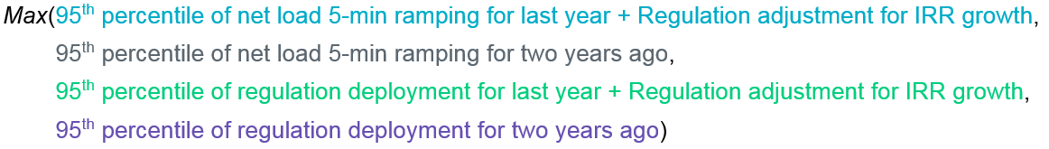
Current Methodology
Equation:
Positive net load used for Regulation-Up purchasing and vice-versa.

Slide 6
Current Methodology (Potential Problems)
Potential problems…
  Load ramping could undercut IRR ramping in net load calculation
    SCED sees load ramp through STLF and PLDRR and shouldn’t be included in regulation purchasing

Slide 7
Proposed Concept
Calculation and procedure…
  Xth percentile of Net IRR Ramping & STLF Error…
    IRR (wind + solar) 5-min ramping + STLF 5-min error
  Floor amount set to Bias * .03Hz
    .03Hz * (759MW/0.1Hz) = 228MW
  Calculation performed for each Month and Hour for data from the last two years.
    720+ data samples for each hour (2years * 30days * 12intervals/hour)
  Negative Net IRR Ramping & STLF Error intervals used to calculate Regulation-Up and vice versa.
    Wind ramping down, SCED needs Regulation-Up to cover lost generation
    Negative STLF error, SCED undershooting actual 5-min load ramp and needs Regulation-Up to cover higher load
98.8th percentile used for this analysis.

Slide 8
Proposed Concept (Reasoning)
Example (using Load Ramp and IRR Ramp):
Counts as a single interval in the greater percentile analysis.
Scenario | Description | Load Ramp | IRR Ramp | Net Load Ramp | Current Methdology |  | Proposed Concept |  | Determination | % of 5-min Intervals Scenario Occurs (May 2015 thru April 2017)
 |  |  |  |  | MW | Type | MW | Type
1 | Load Ramping Up, IRR Ramping Up More | 100 | 160 | -60 | 60 | Reg-Dn | 160 | Reg-Dn | Purchasing too little Regulation Down. | 7%
2 | Load Ramping Up, IRR Ramping Up Less | 100 | 20 | 80 | 80 | Reg-Up | 20 | Reg-Dn | Purchasing Regulation Up when you need Regulation-Down. | 17%
3 | Load Ramping Up, IRR Ramping Down | 130 | -40 | 170 | 170 | Reg-Up | 40 | Reg-Up | Purchasing too much Regulation Up. | 26%
4 | Load Ramping Down, IRR Ramping Down Less | -130 | -40 | -90 | 90 | Reg-Dn | 40 | Reg-Up | Purchasing Regulation-Down when you need Regulation-Up. | 18%
5 | Load Ramping Down, IRR Ramping Down More | -60 | -130 | 70 | 70 | Reg-Up | 130 | Reg-Up | Purchasing too little Regulation Up. | 7%
6 | Load Ramping Down, IRR Ramping Up | -310 | 70 | -380 | 380 | Reg-Dn | 70 | Reg-Dn | Purchasing too much Regulation Down. | 25%
Notes:
Based on data from timestamps…
Timestamp Load Ramp IRR Ramp
02-May-15 11:35:00 106 166
01-May-15 11:55:00 104 19
04-Apr-17 06:50:00 130 -39
02-May-15 00:50:00 -132 -41
23-Apr-17 00:35:00 -63 -129
30-Apr-17 23:20:00 -316 69

Slide 9
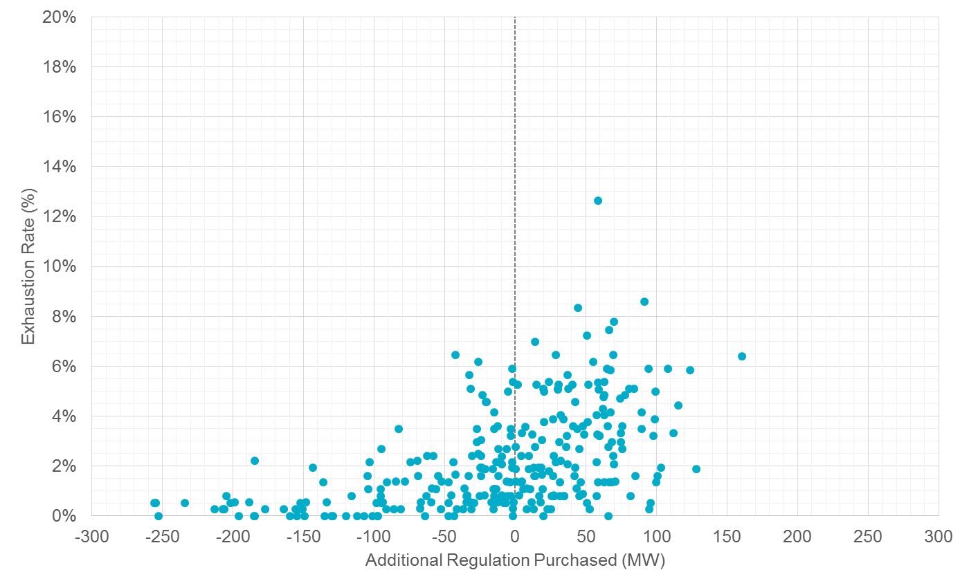
Regulation-Up Purchasing
Purchasing more Regulation-Up in intervals that were more frequently exhausted, and vice versa.

Slide 10
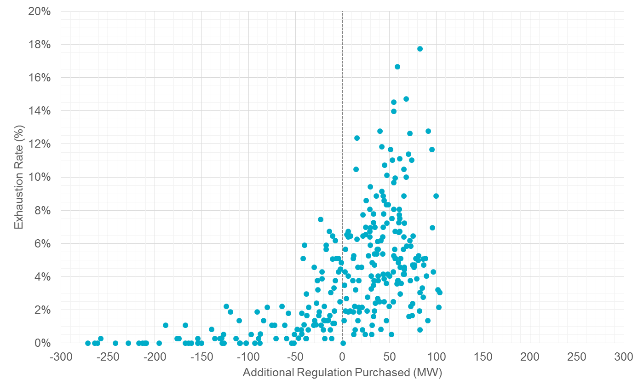
Regulation-Down Purchasing
Purchasing more Regulation-Down in intervals that were more frequently exhausted, and vice versa.C

Slide 11
Regulation-Up Purchasing
 |  | Month
 |  | Jan | Feb | Mar | Apr | May | Jun | Jul | Aug | Sep | Oct | Nov | Dec
Hour Ending | 1 | 308 | 301 | 331 | 319 | 369 | 360 | 245 | 228 | 262 | 291 | 272 | 273
 | 2 | 289 | 261 | 330 | 343 | 370 | 368 | 229 | 265 | 247 | 248 | 259 | 268
 | 3 | 266 | 280 | 288 | 342 | 324 | 329 | 251 | 291 | 255 | 244 | 265 | 272
 | 4 | 289 | 318 | 308 | 339 | 335 | 331 | 249 | 241 | 228 | 239 | 240 | 242
 | 5 | 336 | 292 | 366 | 340 | 340 | 278 | 271 | 269 | 275 | 271 | 267 | 294
 | 6 | 424 | 456 | 447 | 424 | 447 | 330 | 319 | 334 | 375 | 356 | 460 | 406
 | 7 | 485 | 444 | 443 | 446 | 383 | 366 | 364 | 352 | 436 | 410 | 456 | 430
 | 8 | 282 | 330 | 326 | 287 | 308 | 307 | 316 | 278 | 278 | 331 | 263 | 311
 | 9 | 363 | 410 | 379 | 337 | 331 | 333 | 338 | 307 | 324 | 334 | 313 | 348
 | 10 | 392 | 377 | 367 | 319 | 330 | 310 | 255 | 276 | 293 | 323 | 269 | 318
 | 11 | 262 | 343 | 349 | 332 | 303 | 339 | 274 | 284 | 270 | 261 | 298 | 297
 | 12 | 280 | 351 | 338 | 287 | 384 | 265 | 344 | 311 | 288 | 267 | 296 | 289
 | 13 | 360 | 269 | 296 | 295 | 324 | 260 | 373 | 326 | 273 | 233 | 248 | 286
 | 14 | 288 | 259 | 299 | 267 | 271 | 246 | 253 | 291 | 276 | 228 | 280 | 270
 | 15 | 294 | 256 | 290 | 240 | 303 | 314 | 228 | 277 | 278 | 228 | 247 | 314
 | 16 | 270 | 264 | 289 | 361 | 261 | 266 | 228 | 244 | 271 | 228 | 271 | 270
 | 17 | 314 | 269 | 317 | 343 | 257 | 228 | 274 | 236 | 236 | 228 | 320 | 351
 | 18 | 390 | 337 | 326 | 255 | 376 | 258 | 243 | 228 | 228 | 233 | 312 | 330
 | 19 | 337 | 323 | 286 | 389 | 323 | 282 | 246 | 251 | 254 | 324 | 282 | 305
 | 20 | 284 | 327 | 420 | 427 | 362 | 305 | 287 | 280 | 284 | 246 | 228 | 228
 | 21 | 332 | 250 | 292 | 366 | 350 | 261 | 309 | 228 | 253 | 228 | 237 | 228
 | 22 | 264 | 415 | 317 | 318 | 288 | 263 | 281 | 237 | 324 | 234 | 248 | 304
 | 23 | 268 | 427 | 299 | 335 | 385 | 300 | 265 | 275 | 355 | 235 | 316 | 299
 | 24 | 339 | 333 | 344 | 332 | 399 | 337 | 256 | 269 | 287 | 233 | 282 | 315

Slide 12
Regulation-Down Purchasing
 |  | Month
 |  | Jan | Feb | Mar | Apr | May | Jun | Jul | Aug | Sep | Oct | Nov | Dec
Hour Ending | 1 | 290 | 268 | 299 | 383 | 393 | 328 | 290 | 261 | 228 | 258 | 282 | 299
 | 2 | 228 | 228 | 249 | 228 | 307 | 291 | 231 | 258 | 228 | 228 | 228 | 228
 | 3 | 228 | 232 | 253 | 270 | 276 | 353 | 259 | 254 | 228 | 228 | 228 | 243
 | 4 | 228 | 296 | 228 | 244 | 236 | 315 | 228 | 228 | 228 | 250 | 259 | 242
 | 5 | 299 | 268 | 294 | 256 | 248 | 271 | 228 | 228 | 228 | 233 | 249 | 299
 | 6 | 397 | 380 | 330 | 387 | 356 | 280 | 286 | 234 | 314 | 276 | 323 | 386
 | 7 | 350 | 387 | 353 | 364 | 386 | 368 | 228 | 238 | 299 | 298 | 337 | 314
 | 8 | 292 | 275 | 352 | 274 | 286 | 228 | 228 | 262 | 238 | 228 | 345 | 262
 | 9 | 344 | 229 | 306 | 298 | 315 | 292 | 285 | 335 | 315 | 273 | 228 | 256
 | 10 | 345 | 319 | 343 | 268 | 301 | 326 | 292 | 311 | 401 | 334 | 294 | 299
 | 11 | 306 | 284 | 307 | 282 | 271 | 319 | 257 | 314 | 333 | 258 | 307 | 293
 | 12 | 281 | 306 | 296 | 241 | 275 | 276 | 257 | 263 | 299 | 266 | 278 | 321
 | 13 | 318 | 301 | 274 | 260 | 272 | 267 | 228 | 283 | 252 | 253 | 271 | 316
 | 14 | 268 | 273 | 296 | 288 | 296 | 274 | 232 | 332 | 300 | 285 | 289 | 256
 | 15 | 247 | 339 | 257 | 305 | 335 | 297 | 286 | 309 | 247 | 252 | 286 | 268
 | 16 | 229 | 274 | 280 | 263 | 324 | 293 | 263 | 267 | 274 | 252 | 256 | 228
 | 17 | 232 | 228 | 277 | 333 | 320 | 298 | 310 | 290 | 244 | 270 | 232 | 228
 | 18 | 362 | 263 | 291 | 327 | 353 | 337 | 374 | 340 | 297 | 255 | 330 | 346
 | 19 | 357 | 427 | 335 | 360 | 376 | 345 | 421 | 371 | 379 | 316 | 348 | 360
 | 20 | 317 | 352 | 391 | 410 | 350 | 285 | 296 | 322 | 316 | 370 | 338 | 282
 | 21 | 296 | 343 | 374 | 368 | 353 | 327 | 317 | 353 | 324 | 310 | 296 | 309
 | 22 | 308 | 355 | 405 | 406 | 379 | 374 | 348 | 335 | 342 | 284 | 298 | 295
 | 23 | 339 | 317 | 360 | 380 | 396 | 376 | 369 | 365 | 358 | 272 | 276 | 308
 | 24 | 263 | 303 | 303 | 359 | 300 | 280 | 286 | 278 | 255 | 228 | 236 | 241

Slide 13
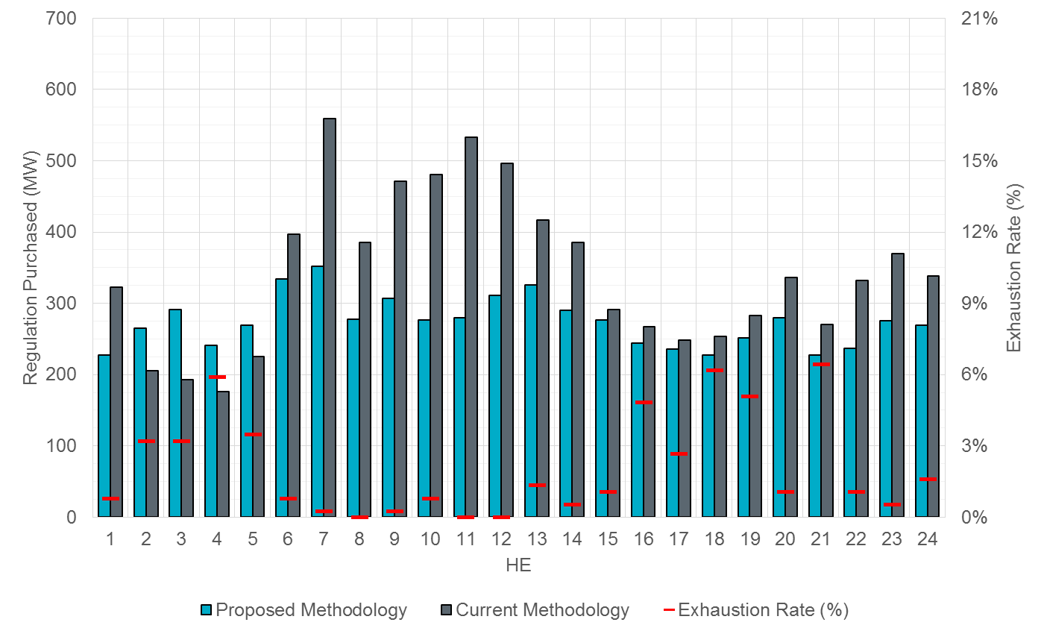
Regulation-Up Purchasing Example (Aug-17)
Purchasing less Regulation-Up in region where Regulation-Up was exhausted less.

Slide 14
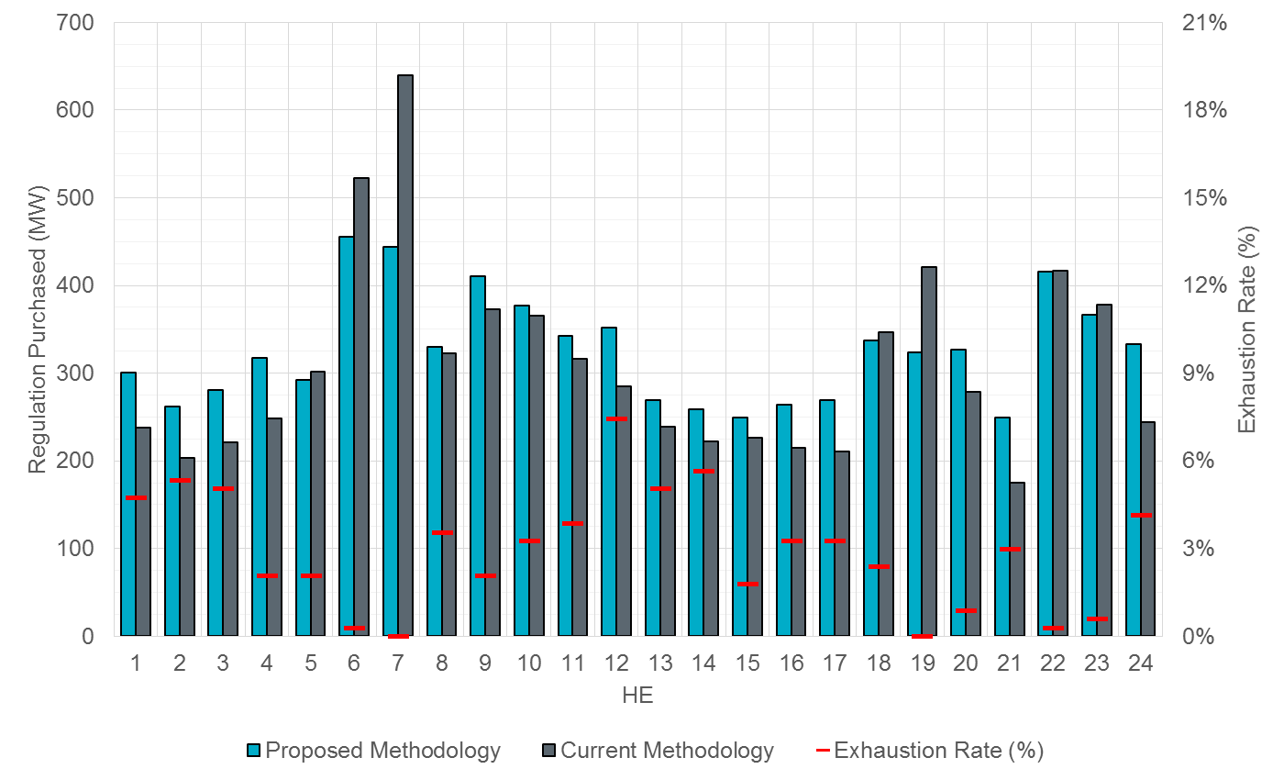
Regulation-Up Purchasing Example (Feb-18)
Fewer spikes in purchasing amounts.

Slide 15
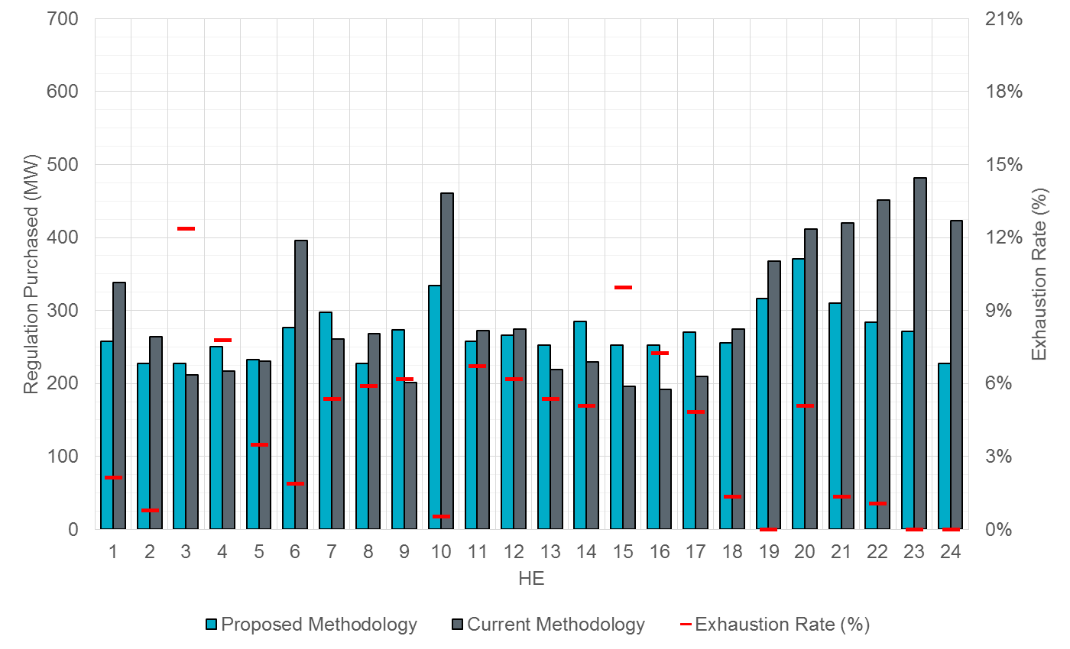
Regulation-Down Purchasing Example (Oct-17)
More Regulation-Down is purchased and it is spread throughout the day.

Slide 16
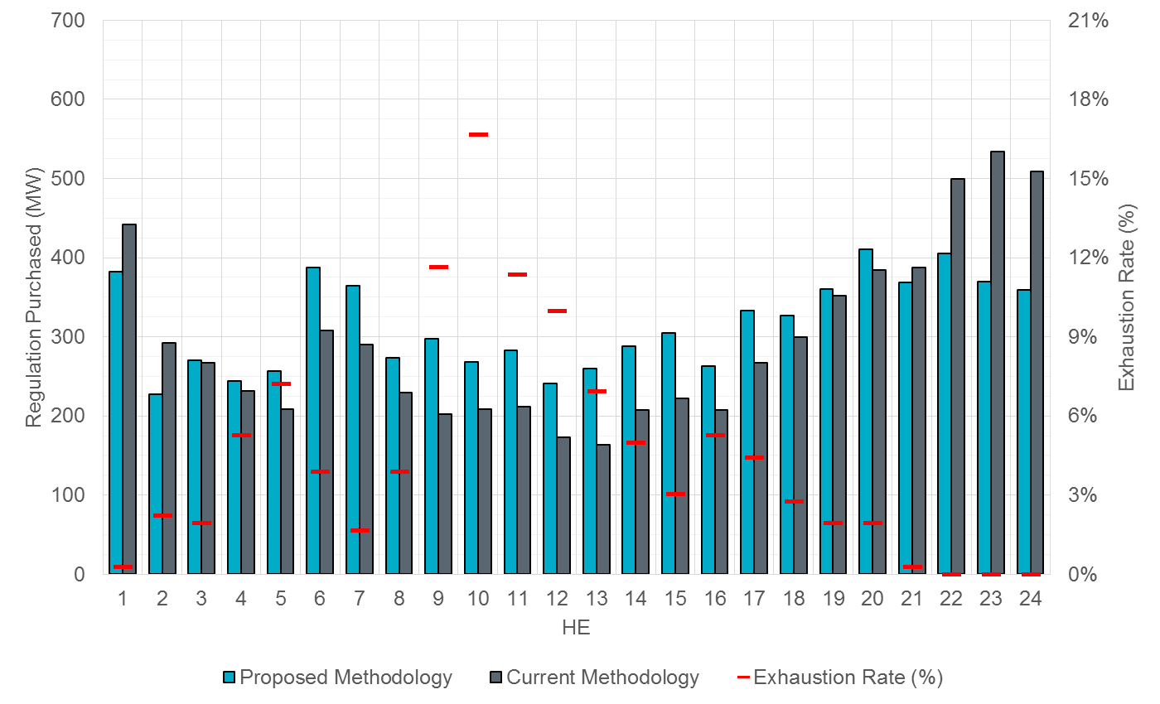
Regulation-Up Purchasing Example (Apr-18)
More purchased and fewer spikes.

Slide 17
More Regulation-Up Purchased
 | Month
 | Jan | Feb | Mar | Apr | May | Jun | Jul | Aug | Sep | Oct | Nov | Dec
1 | 58 | 63 | 81 | 48 | -16 | 3 | -47 | -95 | -53 | -6 | 0 | -14
2 | 94 | 58 | 108 | 124 | 95 | 66 | -34 | 60 | 43 | 46 | 51 | 63
3 | 55 | 59 | 67 | 112 | 69 | 103 | 63 | 98 | 75 | 32 | 70 | 84
4 | 42 | 70 | 78 | 76 | 82 | 134 | 59 | 65 | 51 | 43 | 31 | 45
5 | 0 | -10 | 67 | 5 | 46 | 52 | 35 | 44 | 32 | 20 | -5 | 10
6 | -104 | -67 | -30 | -32 | 13 | -60 | -2 | -63 | -34 | -44 | 20 | -81
7 | -202 | -196 | -135 | -129 | -213 | -120 | -97 | -207 | -184 | -152 | -112 | -155
8 | -24 | 7 | -31 | 0 | -31 | -149 | -159 | -107 | -14 | -6 | -34 | 13
9 | 37 | 37 | 17 | -22 | -27 | -130 | -155 | -164 | -133 | -47 | -26 | 4
10 | 69 | 12 | 51 | -2 | -15 | -153 | -234 | -205 | -148 | -95 | -15 | -2
11 | -15 | 27 | 26 | -41 | -55 | -170 | -256 | -249 | -199 | -105 | 13 | -35
12 | 58 | 66 | -27 | -45 | 23 | -188 | -159 | -185 | -185 | -116 | 41 | 31
13 | 128 | 30 | -3 | -52 | -15 | -94 | -32 | -91 | -143 | -136 | -13 | 37
14 | 32 | 37 | 4 | -69 | -44 | -59 | -91 | -94 | -78 | -98 | 36 | 14
15 | 89 | 30 | 27 | -42 | 8 | 68 | -58 | -14 | 14 | -62 | 19 | 69
16 | 63 | 49 | 11 | 71 | -4 | 15 | -24 | -23 | 19 | -2 | 75 | 29
17 | 20 | 58 | 35 | 25 | -16 | 2 | 6 | -12 | -6 | 29 | 42 | 59
18 | -74 | -10 | 91 | 40 | 101 | 35 | -12 | -26 | 5 | -20 | -85 | -83
19 | -64 | -98 | -21 | 160 | 32 | 36 | -29 | -32 | -24 | 14 | 65 | 58
20 | 62 | 48 | 85 | 66 | 10 | 27 | -3 | -56 | -13 | -14 | 17 | 24
21 | 63 | 75 | 58 | -36 | 30 | -2 | 27 | -42 | 18 | 28 | 20 | -3
22 | 68 | -2 | 96 | 99 | -37 | -17 | -16 | -95 | -12 | -33 | -10 | 76
23 | -8 | 49 | -6 | 99 | -25 | -101 | -103 | -95 | -67 | -255 | 34 | 20
24 | 100 | 89 | 53 | -1 | -47 | -25 | -32 | -69 | -96 | -151 | 8 | 51

Slide 18
More Regulation-Down Purchased
 |  | Month
 |  | Jan | Feb | Mar | Apr | May | Jun | Jul | Aug | Sep | Oct | Nov | Dec
Hour Ending | 1 | 6 | -58 | -31 | -59 | -20 | -128 | -166 | -155 | -139 | -80 | -15 | -30
 | 2 | 9 | 5 | -27 | -64 | -30 | -41 | -103 | -72 | -48 | -36 | -1 | -4
 | 3 | 32 | 45 | 28 | 3 | -17 | 72 | -25 | 11 | -12 | 16 | -13 | -27
 | 4 | 22 | 43 | 35 | 12 | -10 | 99 | 12 | 25 | 40 | 33 | 65 | 32
 | 5 | 33 | 22 | 33 | 47 | 31 | 75 | 66 | 72 | 47 | 2 | 34 | 12
 | 6 | 62 | -10 | -75 | 79 | -131 | -28 | 100 | 42 | -11 | -120 | -9 | 14
 | 7 | 24 | 75 | 35 | 74 | 62 | 104 | 30 | 12 | 77 | 37 | 85 | 33
 | 8 | 17 | -11 | 59 | 45 | 56 | 38 | 21 | 20 | 29 | -40 | 86 | -8
 | 9 | 66 | -23 | 72 | 96 | 29 | 29 | -4 | 76 | 34 | 72 | 61 | 43
 | 10 | 83 | -8 | 96 | 59 | 44 | -3 | 4 | 38 | 73 | -127 | 81 | 91
 | 11 | -22 | -17 | 43 | 70 | 38 | 41 | 2 | 29 | 50 | -14 | 68 | 53
 | 12 | -26 | 47 | 76 | 68 | 61 | 82 | -25 | 37 | 54 | -8 | 43 | 74
 | 13 | 17 | 30 | 57 | 96 | 68 | 54 | 30 | 65 | -9 | 34 | 57 | 56
 | 14 | 14 | 25 | 88 | 81 | 90 | 63 | 3 | 43 | 73 | 56 | 83 | 29
 | 15 | 6 | 106 | 49 | 83 | 97 | 54 | 55 | 78 | 40 | 56 | 66 | 44
 | 16 | 25 | 61 | 59 | 55 | 71 | 61 | 33 | 55 | 66 | 60 | 60 | 55
 | 17 | 38 | 16 | 37 | 66 | 18 | 61 | 6 | 41 | 6 | 60 | 51 | 62
 | 18 | 102 | 58 | 47 | 27 | 31 | 30 | 52 | 14 | -38 | -19 | 92 | 103
 | 19 | 42 | 86 | 17 | 8 | -44 | -25 | 4 | -36 | -44 | -52 | 68 | 65
 | 20 | 36 | -2 | 50 | 26 | -13 | -87 | -109 | -90 | -20 | -42 | 53 | 3
 | 21 | -23 | -39 | -16 | -19 | -7 | -19 | -54 | -38 | -124 | -110 | -22 | 22
 | 22 | -51 | -47 | -88 | -93 | -91 | -154 | -174 | -217 | -176 | -167 | -103 | -61
 | 23 | -71 | -125 | -167 | -154 | -161 | -209 | -213 | -261 | -214 | -210 | -110 | -84
 | 24 | -97 | -44 | -114 | -150 | -188 | -264 | -271 | -258 | -242 | -195 | -126 | -136

Slide 19
Summary
Regulation Up
 | Current | Proposed | Change
Jan | 7169 | 7718 | 549 | 8%
Feb | 7411 | 7826 | 415 | 6%
Mar | 7345 | 8038 | 693 | 9%
Apr | 7589 | 8042 | 453 | 6%
May | 8159 | 8116 | -43 | -1%
Jun | 7963 | 7165 | -798 | -10%
Jul | 8051 | 6624 | -1427 | -18%
Aug | 8235 | 6573 | -1662 | -20%
Sep | 7982 | 6847 | -1135 | -14%
Oct | 7583 | 6452 | -1131 | -15%
Nov | 6687 | 6895 | 208 | 3%
Dec | 6934 | 7248 | 314 | 5%
Total | 91108 | 87546 | -3562 | -4%
Regulation Down
 | Current | Proposed | Change
Jan | 6780 | 7125 | 345 | 5%
Feb | 7012 | 7185 | 173 | 2%
Mar | 7090 | 7442 | 352 | 5%
Apr | 7098 | 7542 | 444 | 6%
May | 7720 | 7689 | -31 | 0%
Jun | 7495 | 7343 | -152 | -2%
Jul | 7525 | 6769 | -756 | -10%
Aug | 7500 | 7020 | -480 | -6%
Sep | 7415 | 6913 | -502 | -7%
Oct | 7271 | 6478 | -793 | -11%
Nov | 6160 | 6789 | 629 | 10%
Dec | 6438 | 6877 | 439 | 7%
Total | 85504 | 85171 | -333 | 0%
This proposal allows ERCOT to more optimally identify regulation requirement.

Slide 20
Running SCED More Often Proposal

Slide 21
Proposed Concept
Running SCED more often in times when Regulation is being excessively used allows the system to be re-dispatched to account for real-time imbalance.
  Expected generation deviation
  IRR ramping
  STLF error
  DC Tie ramping
PROPOSAL: Initiate an off-schedule SCED run ~2min after each schedule SCED run IF Regulation (Up or Down) is deployed beyond 50% of the systems total Obligation.

Slide 22
Current Criteria
Criteria ERCOT operators use when deciding whether to initiate an off-schedule SCED run:
  Frequency deviation is >= +/- 0.10Hz, OR sudden loss of generation/load is > 450MW.
  Frequency is greater than 60.05Hz for > 5mins and Regulation-Down is still deploying.
    Another SCED run after manual offset is entered if Regulation-Down is exhausted.
  Frequency drops below 59.95Hz for 5min and Regulation-Up is still deploying.
    Another SCED run after manual offset is entered if Regulation-Up is exhausted.
  10 consecutive minutes of ACE above BAALHigh (60.09Hz).
    Another SCED run after inputing and re-adjusting manual offsets for incremental BAALHigh violations every 5min.
  10 consecutive minutes of ACE above BAALLow (59.91Hz).
    Another SCED run after inputing and re-adjusting manual offsets for incremental BAALLow violations every 5min.

Slide 23
Questions?
Thank you!!

