Slide 1
Letter of Credit Issuer Limits
Spoorthy Papudesi
Credit Work Group
ERCOT Public
May 16, 2018

Slide 2
Letter of Credit Issuer Limits
Protocol Section 16.11.2, Requirements for Setting a Counter-Party’s Unsecured Credit Limit, incorporates letter of credit (LC) issuer limits determined by the long-term issuer rating and the Tangible Net Worth of the Issuer.
Protocol Section 16.11.2 requires ERCOT Board approval (upon TAC recommendation) when limits are being revised.
CWG/MCWG has requested a review of the letter of credit issuer concentration.

Slide 3
Letter of Credit Issuer Limits
LC issuer limits are determined as follows:
Issuer Rating ⁽¹⁾ |  | Maximum Letter of Credit Issuer Limit as a % of Tangible Net Worth
Moody’s | Fitch/S&P
Aaa | AAA | 1.00%
Aa1 | AA+ | .95%
Aa2 | AA | .90%
Aa3 | AA- | .85%
A1 | A+ | .80%
A2 | A | .75%
A3 | A- | .70%
⁽¹⁾ Determined in accordance with ERCOT Protocol Section 16.11.2, based on most recent audited financial statements.
In addition, each issuer is subject to an overall limit of $750 million.

Slide 4
Letter of Credit Issuer Limits
ERCOT computed the issuer limits and reviewed outstanding LCs as of 5/10/2018
Summary Statistics
Number of issuers: 26
Minimum computed limit: $17.47 million
Issuers with limit at $750 million cap: 3
Minimum excess capacity: $12.15 million
Maximum excess capacity: $722 million
LC issuances in violation of limits: 0

Slide 5
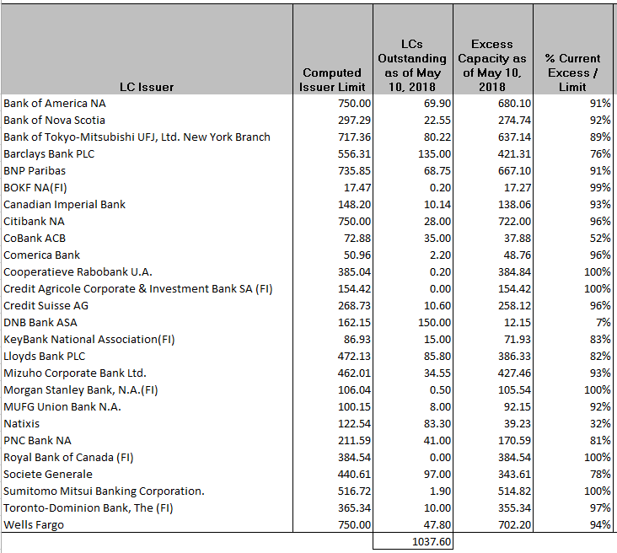
Letter of Credit Issuer Limits
Letter of Credit Concentration Limits ($ millions)

Slide 6
Letter of Credit Issuer Limits
Questions

