Slide 1
DC Tie Flows 8/2/11 – 8/5/11

Slide 2
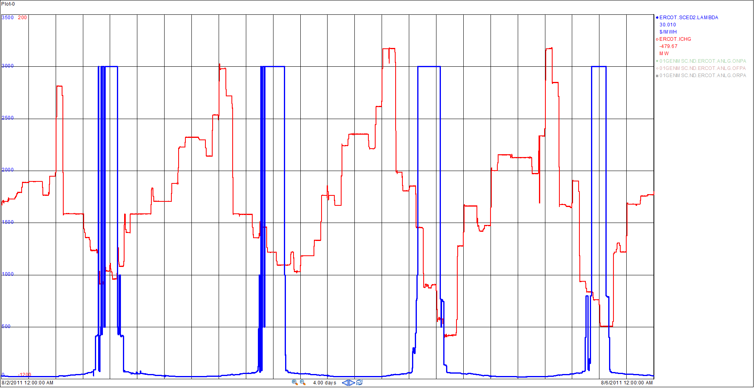
DC Tie Flows and Prices 8/2/11 – 8/6/11

