Slide 1
Project Update and Summary of
Project Priority List (PPL) Activity
May 10, 2018

Slide 2
Project Update Agenda
Project Portfolio Update p. 3-8
Recent / Upcoming Project Implementations
2018 Release Targets
Planned Project Starts
2018 Project Spending Forecast
Revision Request Funding Placeholder Status
Priority/Rank Options for Revision Requests with Impacts
Appendix
Project Portfolio Gantt Chart p. 9-16
Location of Project Priority List (PPL): http://www.ercot.com/services/projects/index

Slide 3
Recent / Upcoming Project Implementations
2018 May Release – 5/29/2018 – 5/31/2018 In Flight
NPRR768 – Revisions to Real-Time On-Line Reliability Deployment Price Adder Categories
OBDRR002 – ORDC OBD Revisions for PUCT Project 47199
NPRR815 – Revise the Limitation of Load Resources Providing RRS
Includes OBD – Methodologies for Determining Minimum AS Requirements
June 1 Release In Flight
NPRR776 – Voltage Set Point Communication
NOGRR167 – Alignment with NPRR776, Voltage Set Point Communication
Release TBD In Flight
NPRR864 – RUC Modifications to Consider Market-Based Solutions
Project initiated on April 18th
Note: Projected Go-Live dates are subject to change. Please watch for market notices as the effective dates approach.

Slide 4
2018 Release Targets – Board Approved NPRRs / SCRs / xGRRs
February 2/6 – 2/8 | April 4/5 – 4/9 | May 5/29 – 5/31 | August 8/7 – 8/9 | October 10/23 – 10/25 | December 12/11 – 12/13
NPRR659 NPRR683 NPRR743 NPRR760 NPRR800 NPRR810 PGRR042 NPRR846 | NPRR562(b) SCR792 | NPRR768 NPRR809(b) NPRR815 OBDRR002 NPRR776 NOGRR167 | NPRR819 NPRR825(a) NPRR844 SCR791 GINR Go-Live | NPRR843 NPRR854 SCR793 SCR794 | NPRR519 NPRR620 NPRR741 NPRR755 PGRR057 NPRR809(b) NPRR842
8 | 2 | 5 | 4 | 4 | 7
ü
ü
ü
ü
ü
ü
ü
ü
ü
ü
E
E
E
P
E
P
I
NS
NS
NS
E
E
E
E
E
E
NS
CMM Release 1a
CMM Release 1b
1/1 & 2/1
4/7 – 4/8
(Retail)
6/1
8/30
10/27 – 10/28
(Retail)
12/15 – 12/16
(Retail)
1/1
E
E
2/1
TBD Items (and point at which they became “TBD”)
2014 | 2015 | 2016 | 2017
NPRR664 | None | SCR781 P | NPRR702 P, SCR777, NPRR831(b), NPRR749 E, NPRR833 E, NPRR864 I, RRGRR015, RRGRR016, NPRR858, NPRR865
Go-live dates can differ from Protocol effective dates – Please refer to market notices for more details
APPENDIX
Red Text: New additions and target release changes
Strike-Through Text: Previous target release changes
(a), (b), etc. indicates multiple phases
Project Status Codes
NS = Not Started
I = Initiation
P = Planning
E = Execution
H = On Hold
Release targets are subject to change
NPRR825(a) – NoticeBuilder changes
NPRR562(b) – Reporting/posting system changes
NPRR809(b) – Reporting/posting system changes
NPRR831(b) – CRR system changes

Slide 5
Approved Revision Requests “Not Started” – Planned to Start in Future Months
Revision Request | Target Start Date | Release Target | Cost Estimate | Author
NPRR843 – Short-Term System Adequacy and AS Offer Disclosure Reports Additions | May 2018 | 2018-R5 | $70k-$90k | ERCOT
NPRR854 – NOIE TDSP Submittal of Meters with Bidirectional Flow Caused by Generation Interconnected at Distribution Voltage | May 2018 | 2018-R5 | $20k-$30k | STEC
SCR793 – SSR Related Telemetry for Transmission Service Provider (TSP) Operators | June 2018 | 2018-R5 | $40k-$50k | Cross Texas Transmission
SCR794 – Update SCED Limit Calculation | June 2018 | 2018-R5 | $25k-$35k | ERCOT
SCR795 – Addition of Intra-Hour Wind Forecast to GTBD Calculation | June 2018 | 2018-R5 | $30k-$40k | ERCOT
NPRR842 – Study Area Load Information | July 2018 | 2018-R6 | $60k-$80k | ERCOT
NPRR817 – Create a Panhandle Hub | Sept 2018 | 2019-R2 | $150k-$200k | DC Energy
April Board approval
April Board approval
April Board approval
Moved start date due to higher priorities
Green Shading: Upcoming project initiations
Aging Items Report | Last Action | Status
NPRR664 – Fuel Index Price for Resource Definition and Real-Time Make-Whole Payments for Exceptional Fuel Cost Events | Board approved on 12/9/2014 | Pending submission / approval of alternate approach

Slide 6
2018 Project Spending
2018 PPL Budget = $20.0M
“Potential Demand” represents internal ERCOT projects that have not been fully approved

Slide 7
Revision Request Funding Placeholder Status
In 2018 and 2019, ERCOT forecasted $4.0M for Revision Request work
Yearly Revision Request Spending Forecast Summary
Project Status | 2018 | 2019
YTD Actuals | $0.38M
Approved – In-Flight / Complete | $1.66M | $0.20M
Approved – On Hold | $0.19M | $0.00M
Approved – Not Started | $0.41M | $0.27M
Remaining Funding | $1.74M | $3.53M
Total Allocation | $4.00M | $4.00M
As of 3/31/2018
NPRR833

Slide 8
Priority / Rank Options for Revision Requests with Impacts
Options for…
Revision Request | Description | Priority | Rank | Comments
NPRR867 | Revisions to CRR Auction Credit Lock Amount to Reduce Excess Collateral | 2018 | 2230 | Work into upcoming CMM Upgrade project release
PPL Rank Information
Next available Rank in Business Strategy = 2230
Next available Rank in Regulatory = 210

Slide 9
Appendix
5/1/2018 Project Gantt
In-flight items sorted by Project End Date
“On Hold” projects listed separately
“Not Started” items sorted by Project Start Date

Slide 10
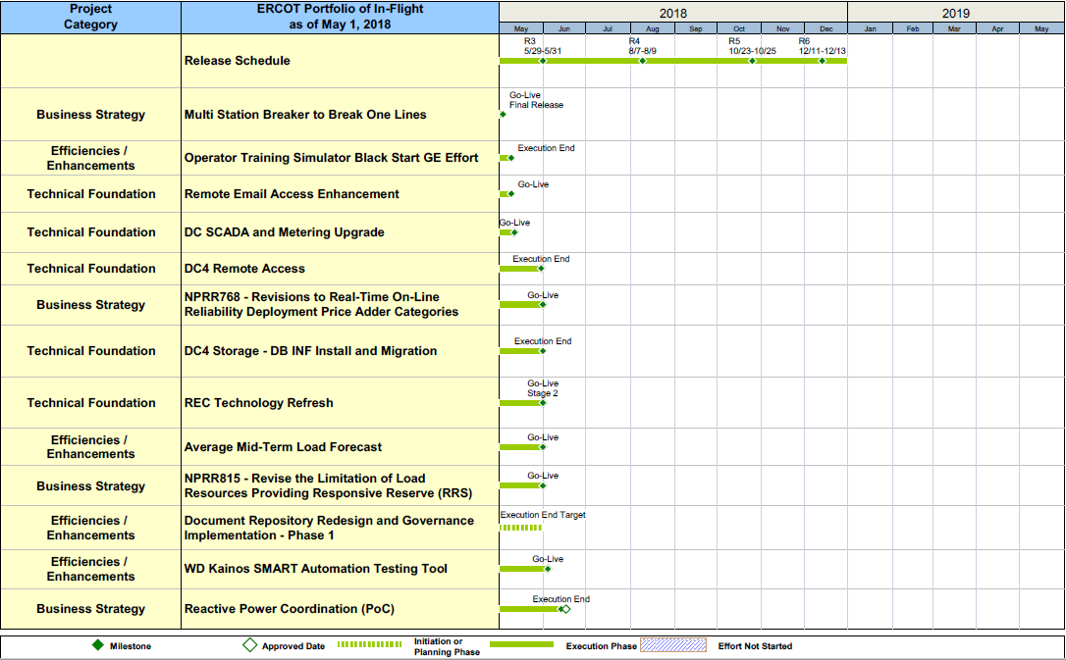
Project Portfolio Status – as of 5/1/2018

Slide 11
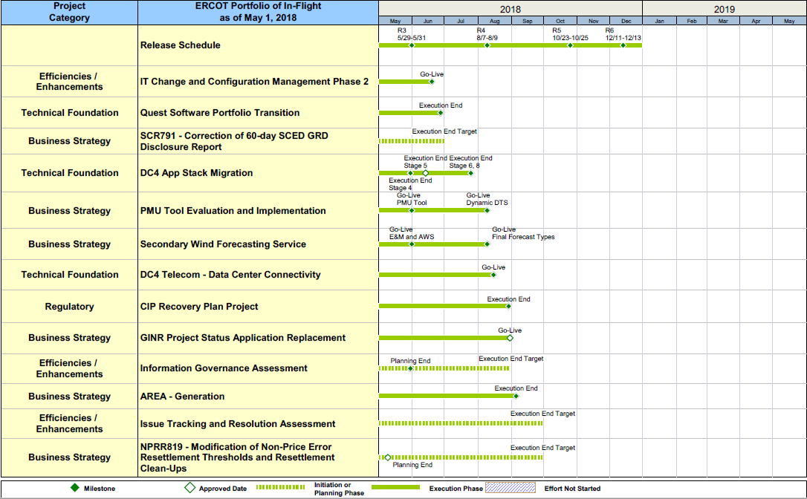
Project Portfolio Status – as of 5/1/2018

Slide 12
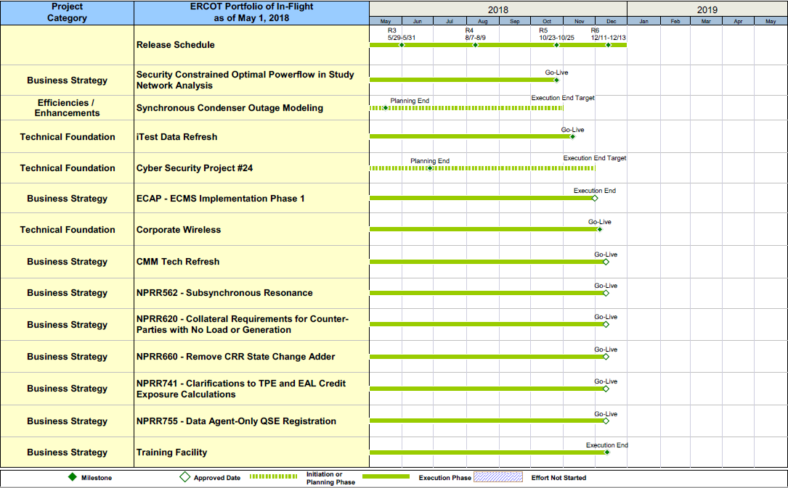
Project Portfolio Status – as of 5/1/2018

Slide 13
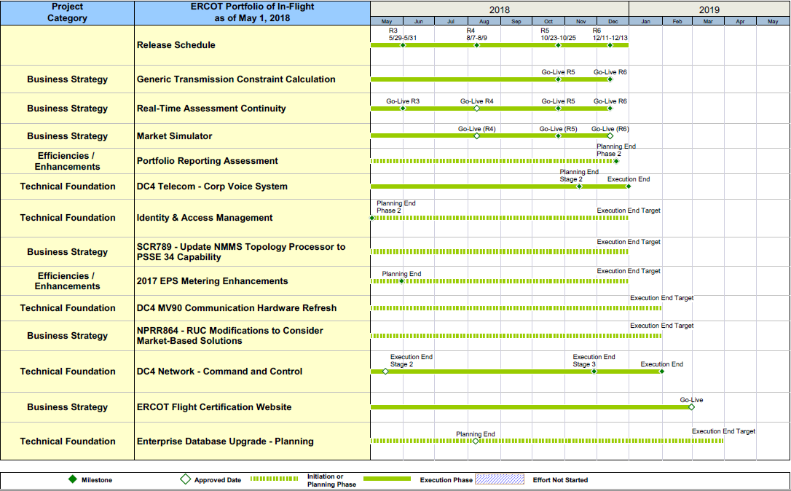
Project Portfolio Status – as of 5/1/2018

Slide 14
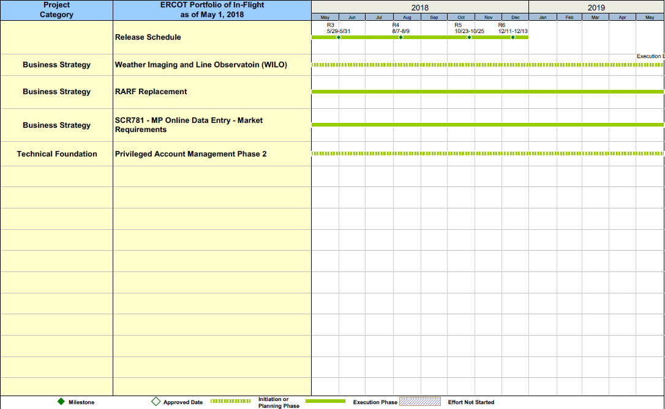
Project Portfolio Status – as of 5/1/2018

Slide 15
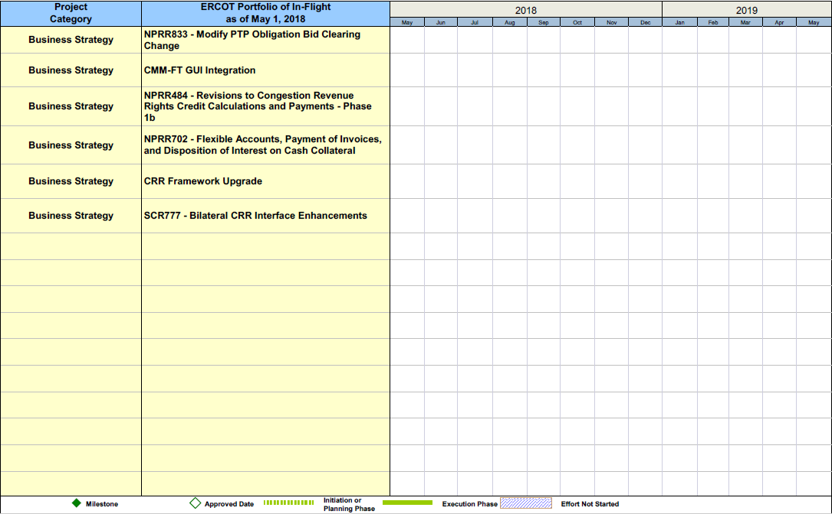
Project Portfolio Status – as of 5/1/2018 – On Hold

Slide 16
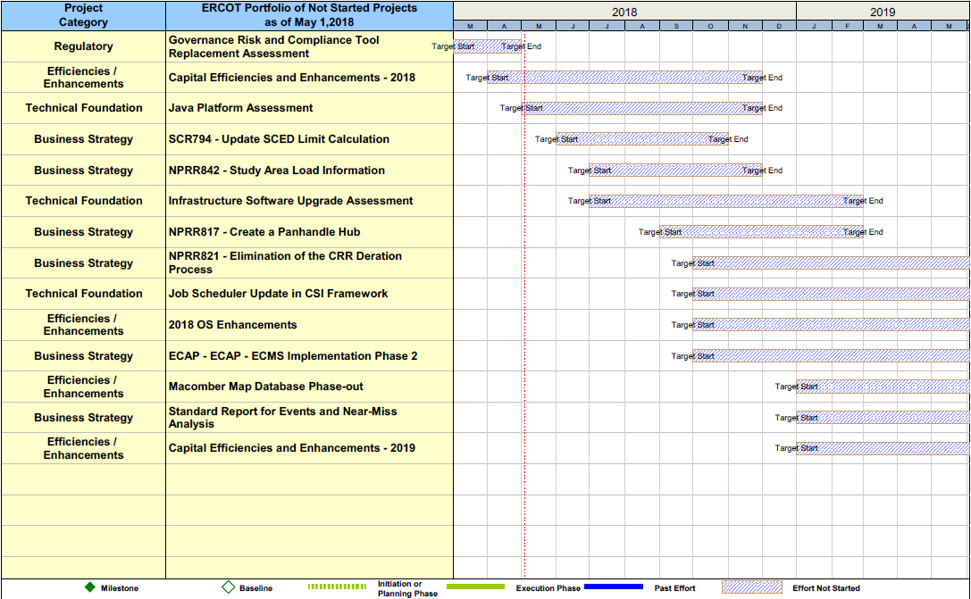
Project Portfolio Status – as of 5/1/2018

