Slide 1
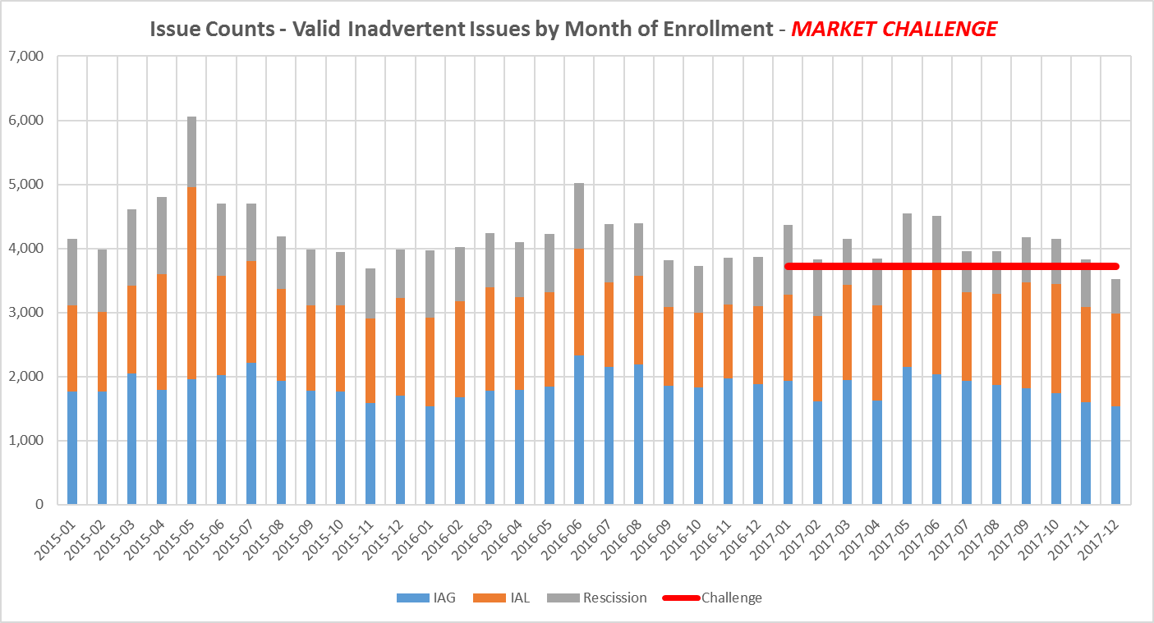
Market Challenge
Overall % Reduction in IAS volumes ->
2015 to 2016 = 6.62%
2016 to 2017 = 7.80%
CHALLENGE:
Reduce the total volume by another 10%!!
Drive % volume to below 1.5% !!

Slide 2
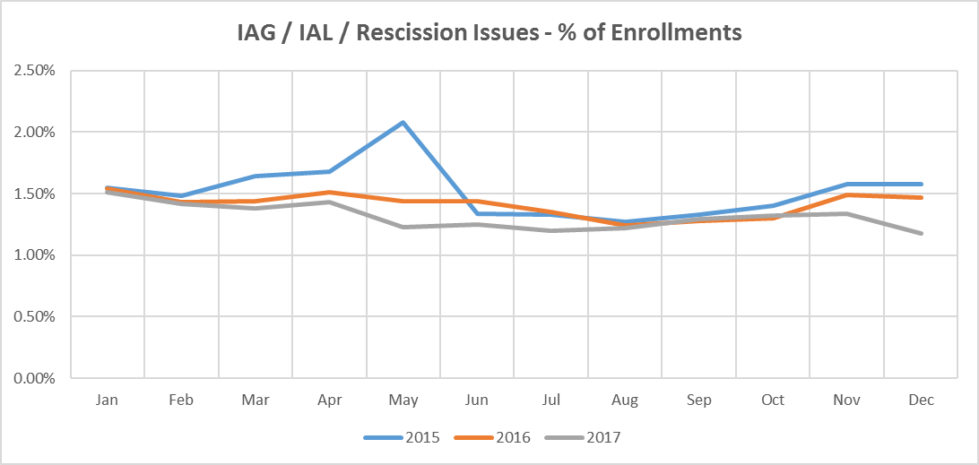
Market Challenge

