Slide 1
Texas Data Transport & MarkeTrak Systems
(TDTMS)
Update to RMS
May 8, 2018
Monica Jones (NRG) – Chair Sam Pak (ONCOR) – Vice Chair

Slide 2
April Meeting Summary
NPRR778 Stabilization
Review of the RMTE User Guide for possible enhancements to the current environment
Reviewed Analysis for MarkeTrak Subtype ‘Cancel with Approval’
What are the impacts to the ‘Cancel with Approval’ volumes since the December 2017 implementation of NPRR778?
Could there be potential impacts to Inadvertent Gains/Loses & Customer Rescissions with the decrease in CWA volumes?

Slide 3
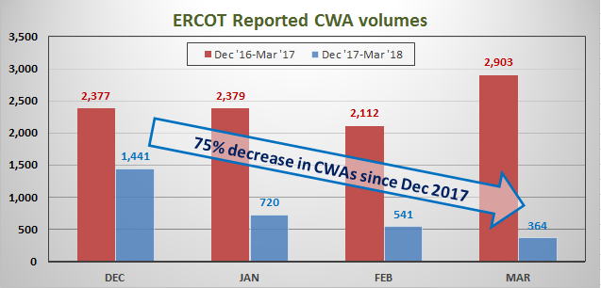
Impacts of NPRR 778
75% decrease in CWAs since Dec 2017

Slide 4
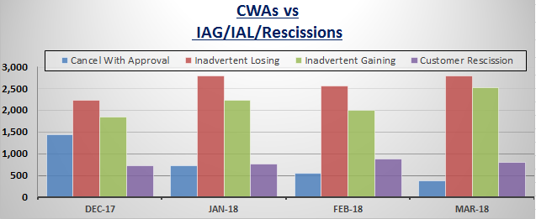
CWAs & IAG/IAL/Rescissions
No discernible relationship in the decrease of CWAs to IAG/IAL/Rescissions

Slide 5
Next Meeting
Next meeting information:
Joint TDTMS/TX SET Meeting
Tuesday, May 15, 2018
9:30am-11:30am
@ ERCOT MET Center
Room 201A
TDTMS meeting website:
http://ercot.com/committees/board/tac/rms/tdtms/index.html

