Slide 1
Commercial Operations Subcommittee (COPS)
Update to RMS
5/8/2018

Slide 2
COPS Meeting 5/8/2018
TAC Subcommittee Restructuring Discussion
  Review of Approval Timeliness
  Attendance Policy
    Three Strikes
      Consecutively
      Term
    Proxy/Alternate
    Segment Representative
      Notification
      ? On Proxy/Representative being from Segment.
  .

Slide 3
COPS Meeting 5/8/2018
IDR Meter Read Discussion
  Discussion was moved to RMS
ERCOT Updates
Service Availability – March 2018
  Market Data Transparency IT systems met all SLA targets
Incidents & Maintenance – March 2018
  03/09/18 – ERCOT's Market Participant Identity Management (MPIM) application was unavailable from 2:26 PM – 6:36 PM
  03/19/18 – The Supplemental IDR Interval Data Extract (COMS-457, Report ID 1041) posted with incomplete data, was removed from the Market Information System (MIS) Certified for 03/19/2018, and reposted
  03/20/18 – 03/21/18 – ercot.com experienced delays in rendering some pages

Slide 4
COPS Meeting 5/8/2018
Profiling Working Group
  LPGRR064 –recommend approval as submitted
  COPMGRR047 – Recommend approval as submitted
Q1 Settlement Stability Report
  Appendix A

Slide 5
Questions?
The next COPS meeting is scheduled for
May 9th, 2018

Slide 6
Appendix A
Settlement Stability Report Q1 2018
Settlement Stability
2018 Q1 Update to COPS
Austin Covington
ERCOT
04/11/18

Slide 7
8.2(2)(c)(i) Track number of price changes
Reporting Period: 2018 Q1
Operating Day | # of Corrected Settlement Point Prices |  |  |  | # of Intervals Affected
 | DASPP | RTSPP | RTRMPR | ORDC Adders | DASPP | RTSPP | RTRMPR | ORDC Adders
- | - | - | - | - | - | - | - | -
Notes:
There were no price changes in Q1 2018.
The price changes reported on this slide display the price corrections that have been done after the Settlement Statement has posted for the Operating Day.

Slide 8
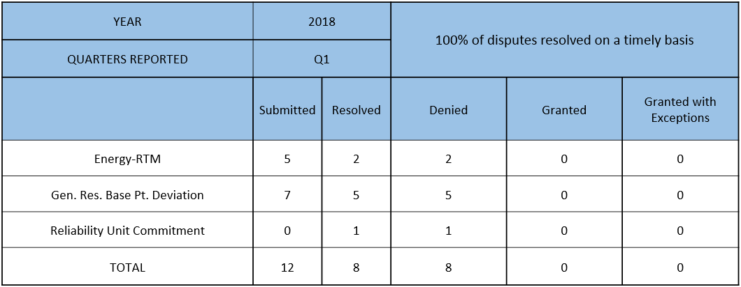
8.2(2)(c)(ii) Track number and types of disputes submitted
8.2(2)(c)(iii) Compliance with timeliness of response to disputes
Submitted but not resolved disputes may be:
Not started
Open
Rejected
Withdrawn

Slide 9
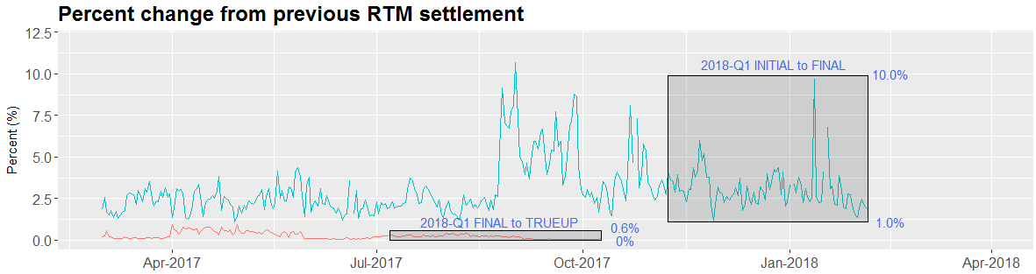
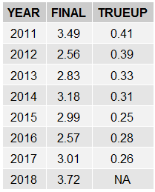
8.2(2)(c)(iv) Other Settlement metrics
NOTE: ERS Final settlement OD data is not represented in graph.
Average percent change

Slide 10
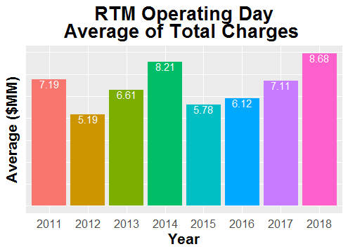
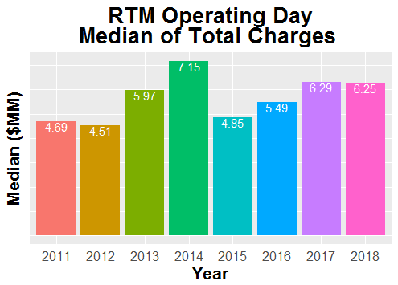
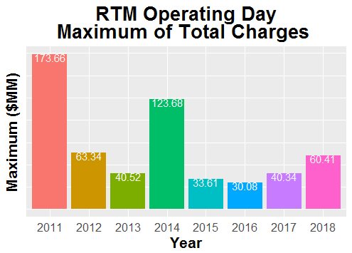
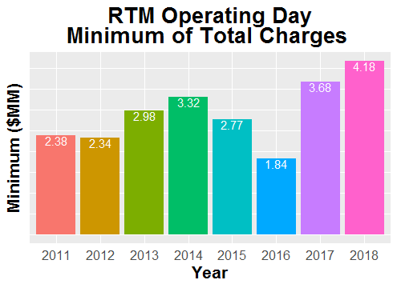
8.2(2)(c)(iv) Other Settlement metrics

Slide 11
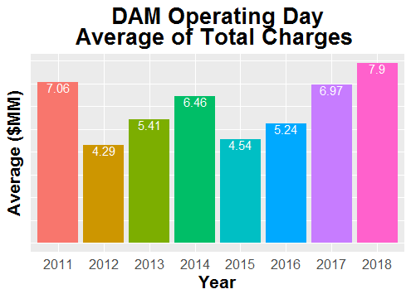
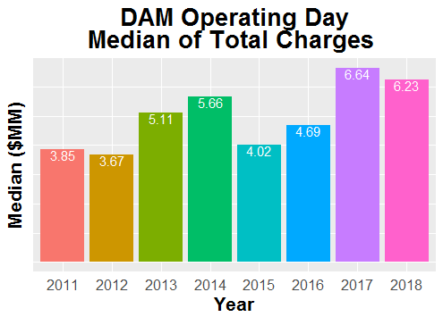
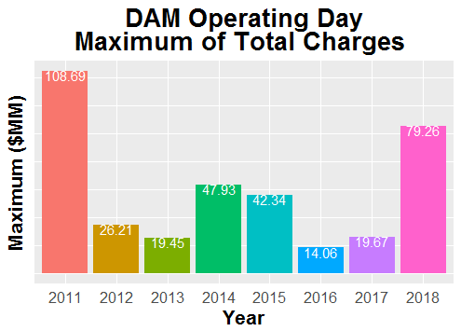
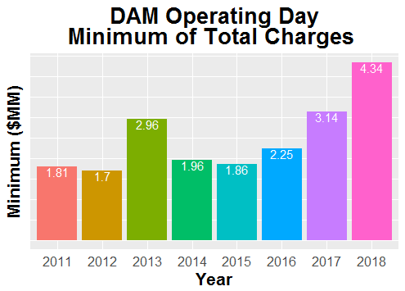
8.2(2)(c)(iv) Other Settlement metrics

Slide 12
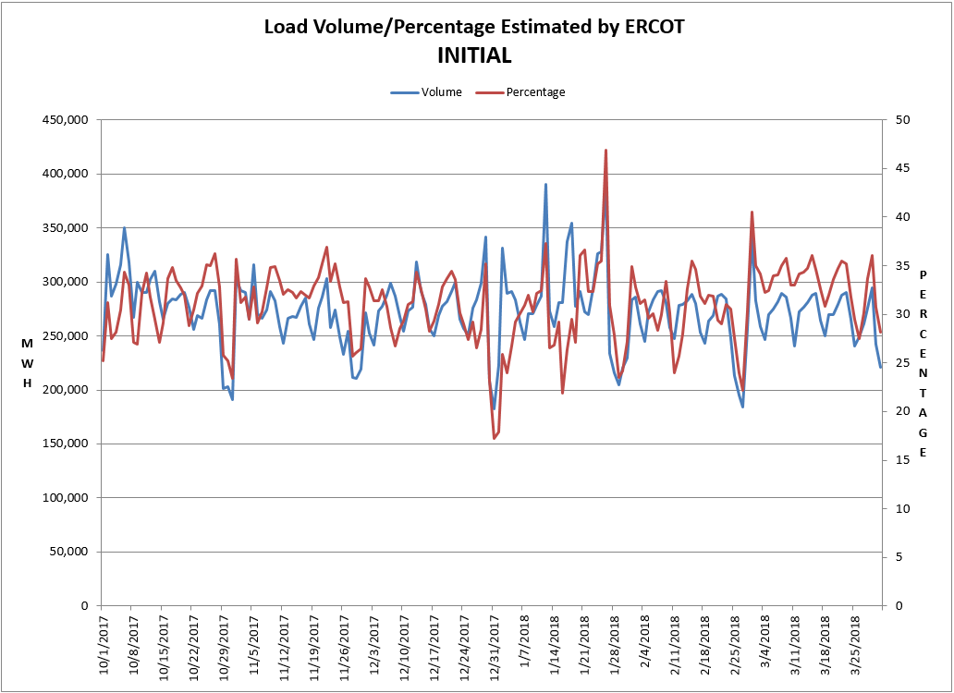
8.2(2)(c)(v) Availability of ESIID consumption data

Slide 13
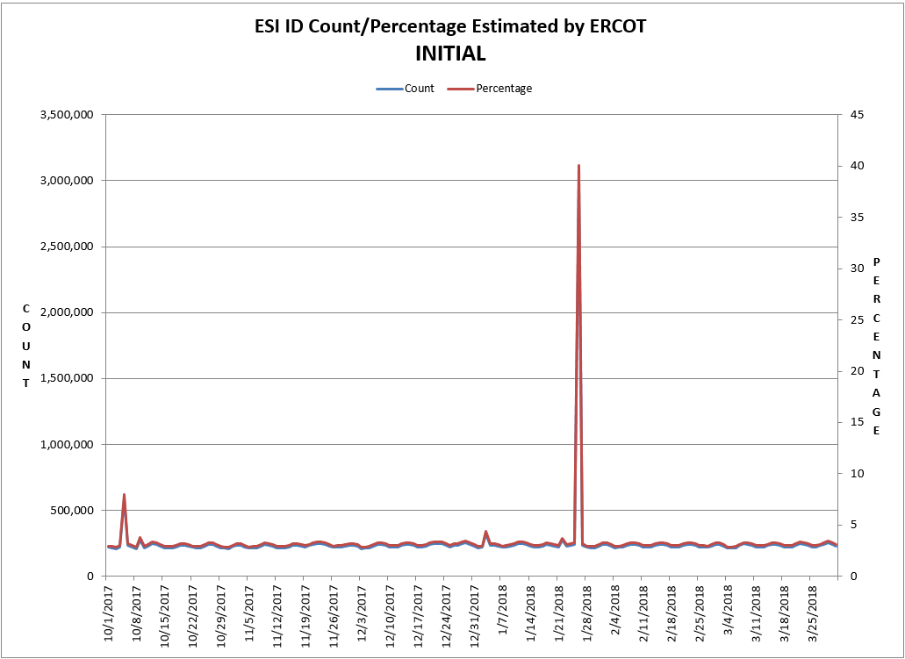
8.2(2)(c)(v) Availability of ESIID consumption data

Slide 14
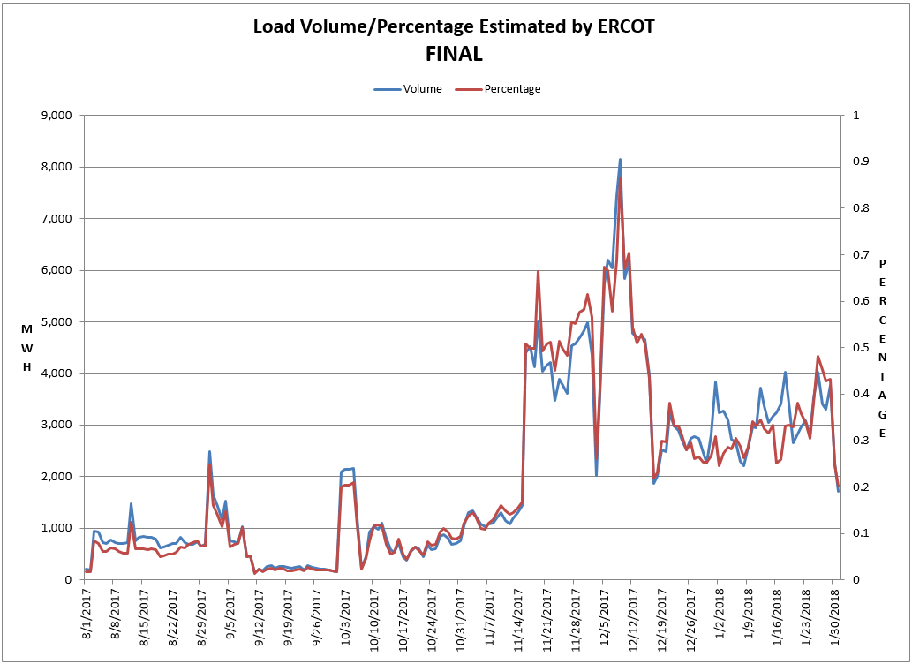
8.2(2)(c)(v) Availability of ESIID consumption data

Slide 15
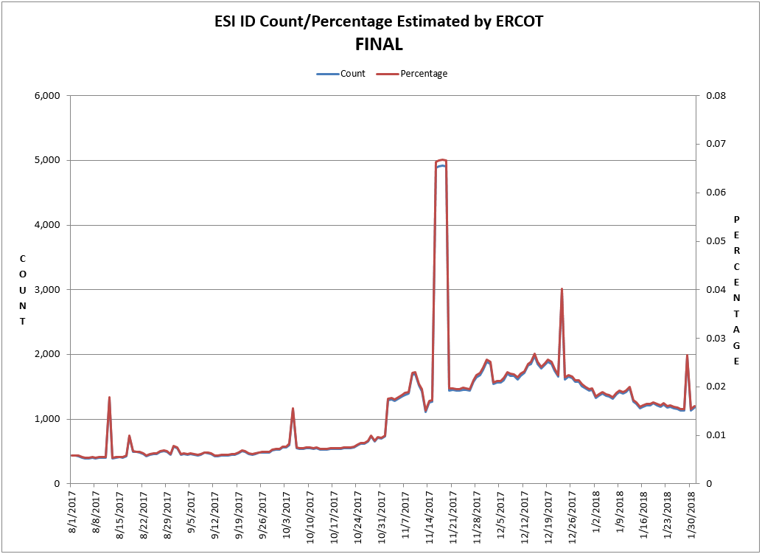
8.2(2)(c)(v) Availability of ESIID consumption data

Slide 16
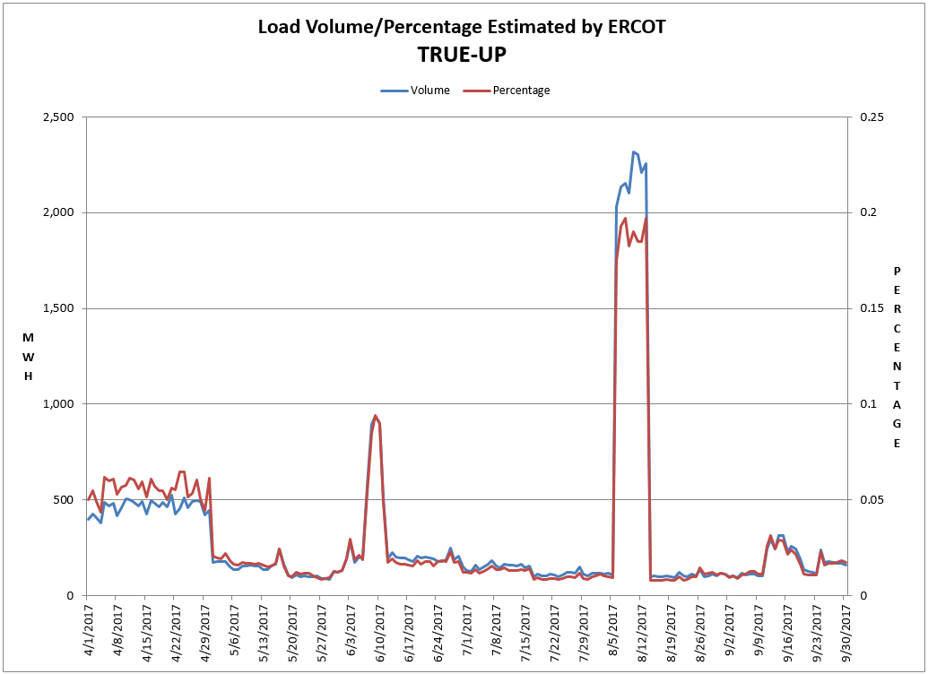
8.2(2)(c)(v) Availability of ESIID consumption data

Slide 17
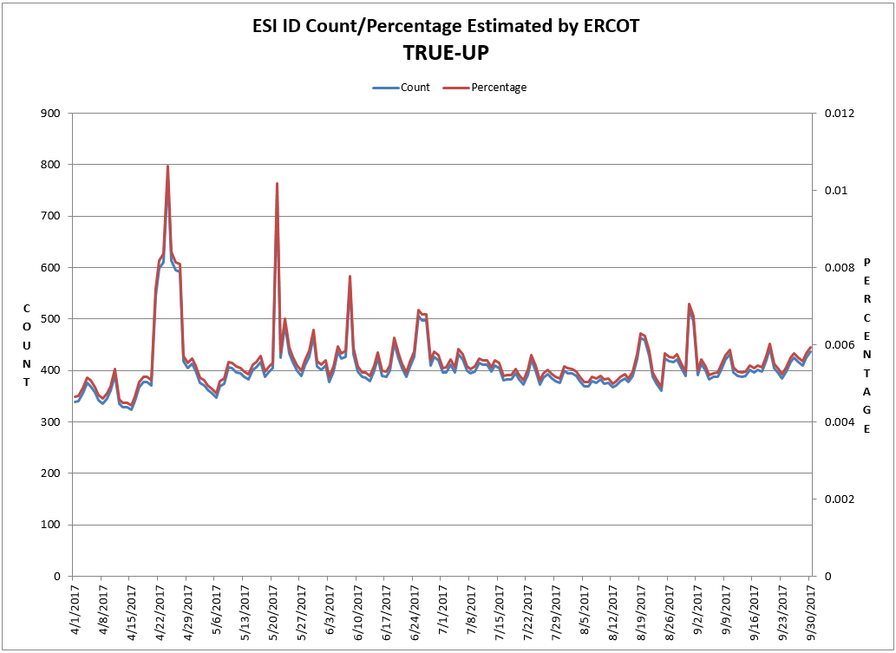
8.2(2)(c)(v) Availability of ESIID consumption data

Slide 18
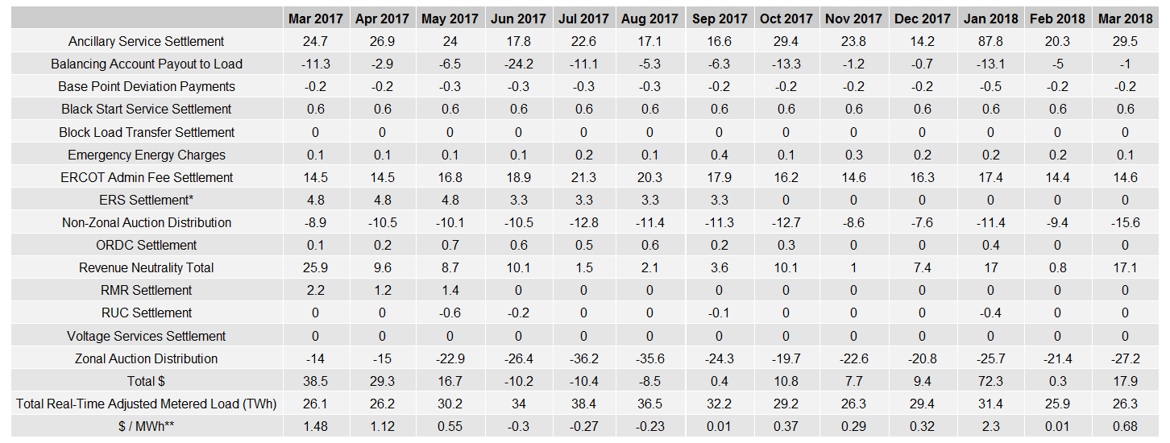
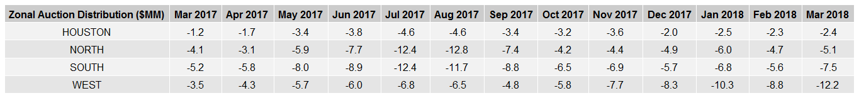
8.2(2)(g) Net Allocation to Load - Totals and $/MWh
NET ALLOCATION TO LOAD ($MM)
AUCTION REVENUE PER CONGESTION MANAGEMENT ZONE ($MM)
* The total ERS charges have been evenly allocated across the contract period.
** The $/MWh value as calculated per PR 8.2 (2) g

