Slide 1
Texas REC Program Update
Release scheduled for late May 2018
Don Tucker
RMS 5-8-2018 & COPS 5-9-2018

Slide 2
Topics
Adding informative information to the REC website that was in the COPS Market Guide
New optional selection when voluntary retirements are initiated to indicate green-e or export
New ability to generate and email a summary report for selected retirement transactions

Slide 3
Renewable Energy Credit Program – (link from Home Page)

Slide 4
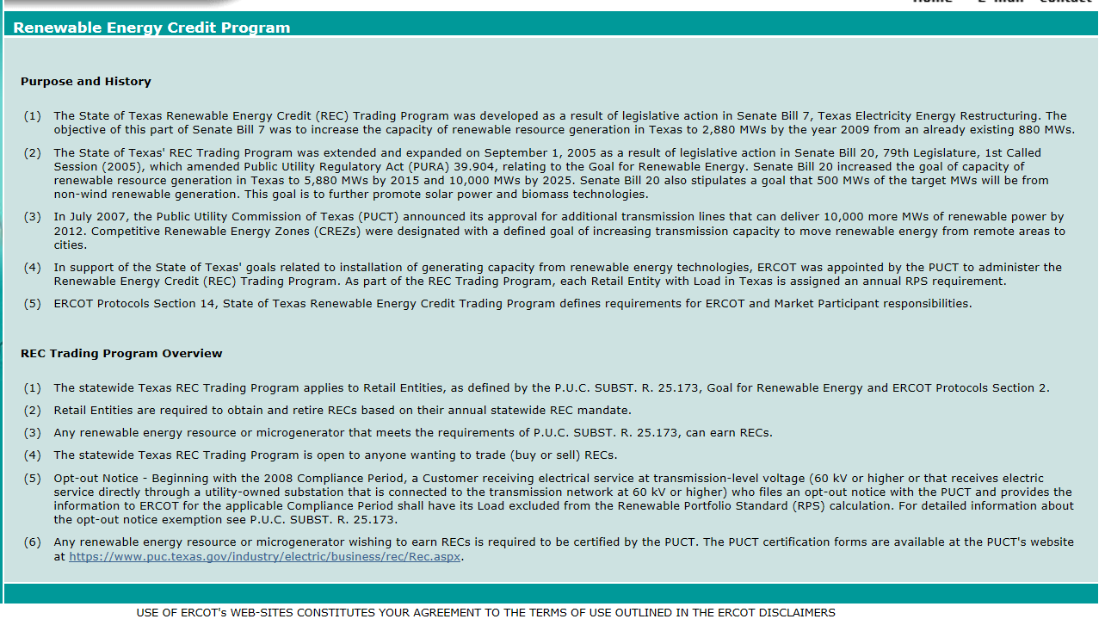
Renewable Energy Credit Program – (link from Home Page)

Slide 5
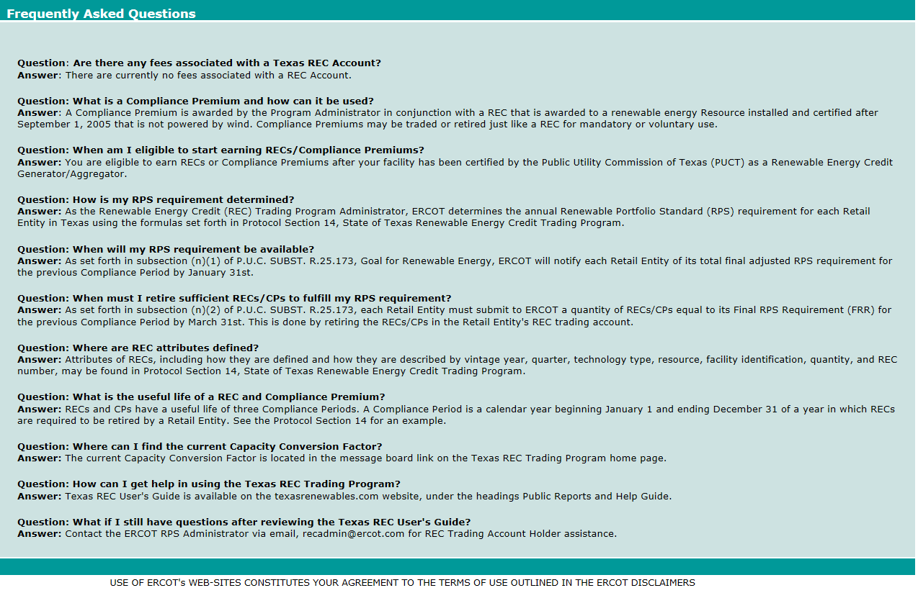
Frequently Asked Questions – (link from Home Page)

Slide 6
Retirement Selections

Slide 7
Voluntary Retirement Optional Selections

Slide 8
Generating and Emailing a Summary Report

Slide 9
Generating and Emailing a Summary Report

Slide 10
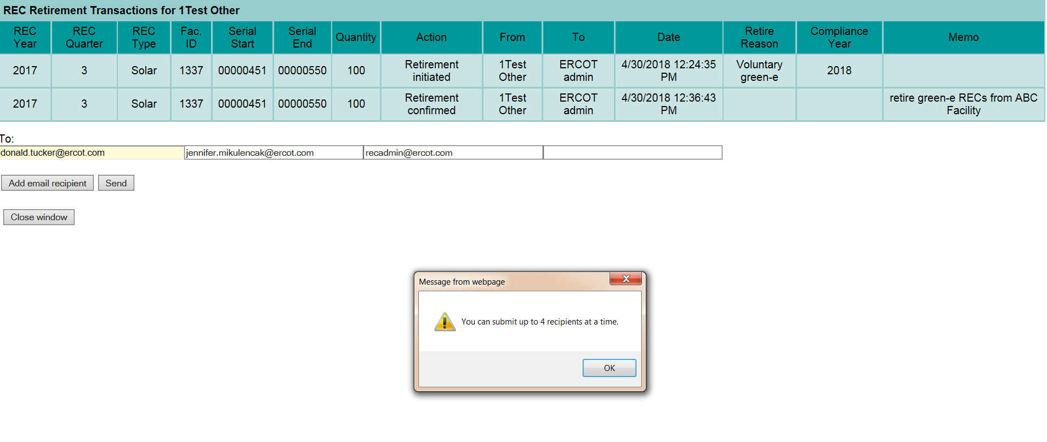
Generating and Emailing a Summary Report

Slide 11
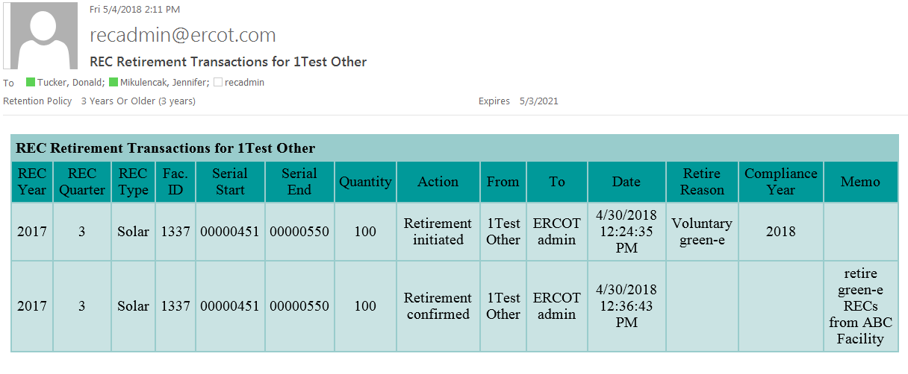
Email for REC Summary Report

Slide 12
Email for CP Summary Report

Slide 13
Questions and discussion

