Slide 1
LBNL’s Frequency Response Study for FERC
Prepared for
ERCOT Reliability and Operations Subcommittee
Presenters
Joe Eto – Background/Overview
John Undrill – Frequency Response Issues
Sydney Niemeyer - Independent Observations
May 3, 2018

Slide 2
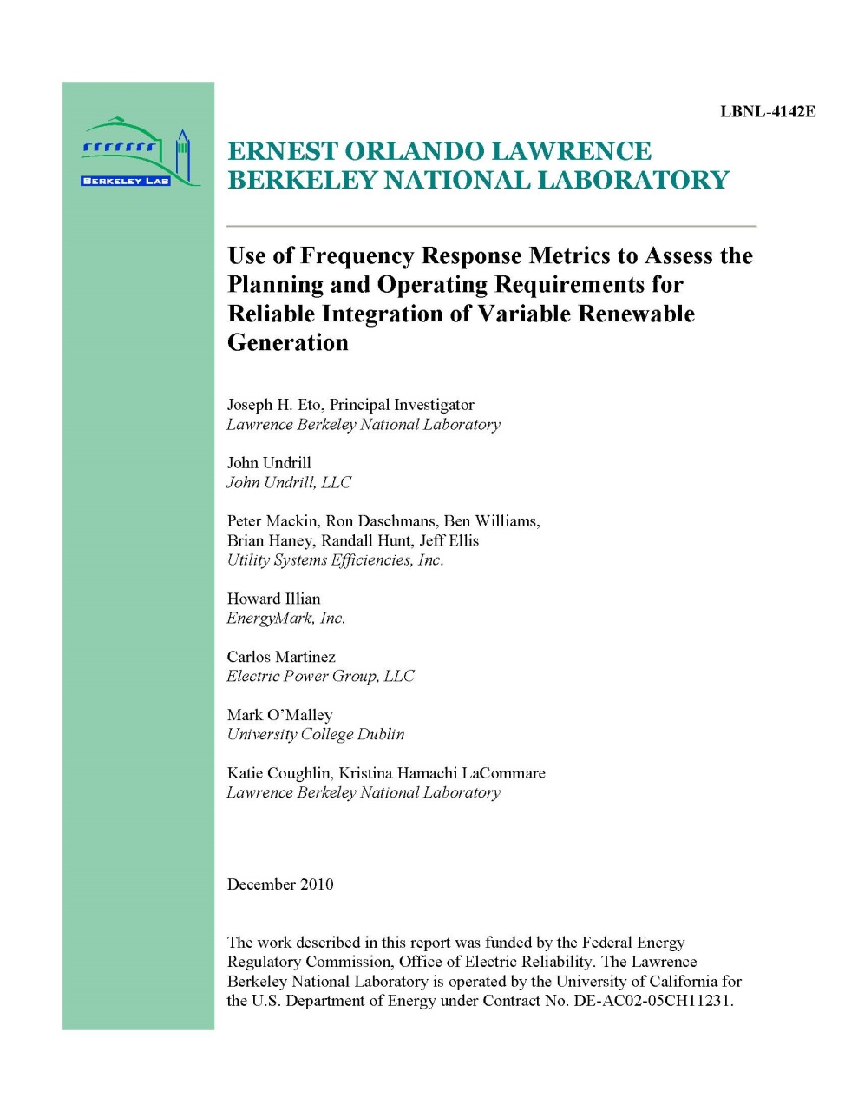
Project Objectives and Motivation
To build upon a previous FERC report prepared by LBNL to address frequency response issues holistically considering how all aspects of the US generation fleet (and loads) might change in the future on an interconnection-specific basis
The LBNL 2010 study developed new metrics, but used them to study only the impacts of one new form of generation (i.e., electronically coupled, variable renewable generation) on frequency response

Slide 3
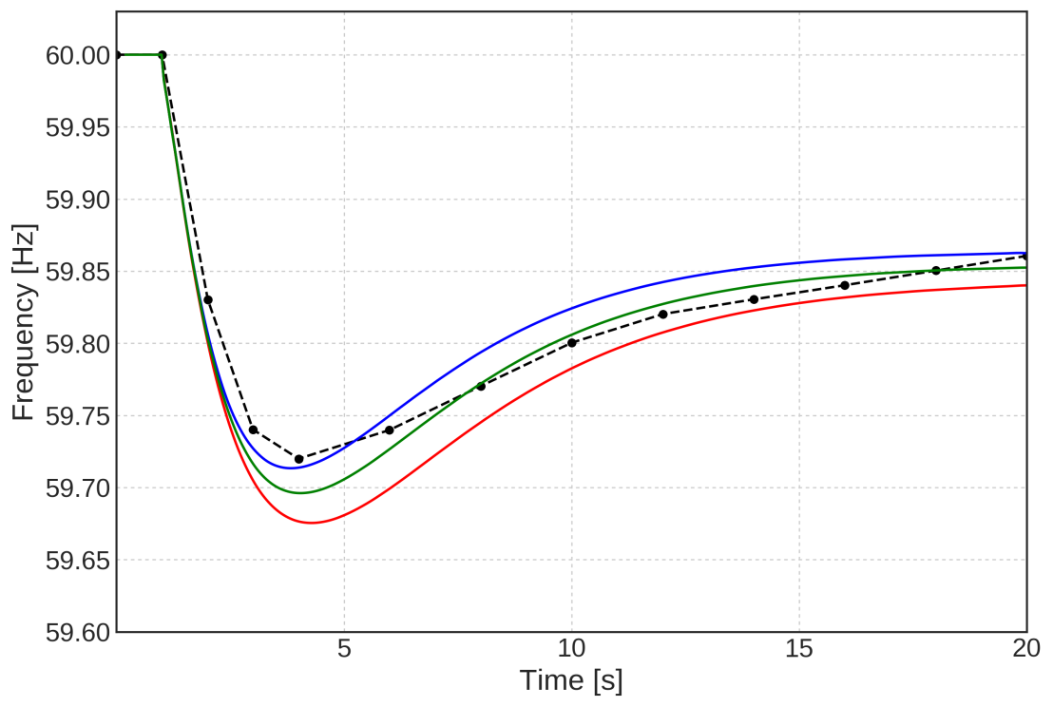
Project Study Methods
Started from, but expanded previous FERC-sponsored, LBNL modeling and simulation framework
  Used industry standard simulation tool (GE PSLF)  facilitates reproducibility of results
  Examined broader range of frequency response topics  sustained frequency response
  Did not model transmission system or protection
Developed a simplified and highly flexible approach to system modeling
  Conducted several 1000 parametric simulations
  Usefulness confirmed by comparison with more detailed, industry-developed interconnection planning models
Texas Interconnection
Red: 25% Steam
Green: 30% Steam
Blue: 35% Steam
Black: PSS/E Simulation

Slide 4
Key Study Findings
Rapidly deployed and then sustained primary control action in response to the sudden loss of generation is a fundamental reliability requirement.
This requirement is met by the action of turbine governors and, in some cases, by fast demand response.
Generation interconnection policies determine:
The extent to which the fleet is equipped to provide primary frequency response
Generation dispatch policies determine:
The amount of primary frequency response that can be delivered
  …which depends on the size of the generation loss event the interconnection is designed to withstand
The speed with which primary frequency response will deploy
  …which depends on the types of units dispatched and the headroom assigned to individual units
Notes:
NEW SLIDE

Slide 5
Study Recommendations
Focused attention needed on the collection, maintenance, and validation of operating data and study models
International practices should be reviewed as options for U.S. grid operators to consider for adaptation/adoption
All generators should have the capability to provide sustained primary frequency response
Barriers to adding a frequency bias to plant load controllers should be evaluated and addressed
The contributions of non-traditional resources for primary frequency control should be studied and incorporated, as appropriate, into future operations
The changing composition of loads should be studied and addressed

Slide 6
List of Reports
Eto, J. H., J. Undrill, C. Roberts, P. Mackin, and J. Ellis (2018). Frequency Control Requirements for Reliable Interconnection Frequency Response. Berkeley: Lawrence Berkeley National Laboratory.
Undrill, J.M. (2018). Primary Frequency Response and Control of Power System Frequency. Berkeley: Lawrence Berkeley National Laboratory.
Undrill, J.M., P. Mackin, and J. Ellis. (2018). Relating the Microcosm Simulations to Full Scale Grid Simulations. Berkeley: Lawrence Berkeley National Laboratory.
Roberts, C. (2018). Review of International Grid Codes. Berkeley: Lawrence Berkeley National Laboratory.
https://certs.lbl.gov/project/interconnection-frequency-response

Slide 7
FREQUENCY RESPONSE ISSUES
J. Undrill
Austin, TX
May 2018

Slide 8
MAIN POINTS
The collective amount of sustainable reserve for Frequency Response
must be sufficient to meet, and slightly exceed, the chosen loss of
production event
The Frequency Response must be produced on a sufficiently quick
time scale and must be sustained
The responsibility to produce Frequency Response must be
allocated to, and accepted by, a number of turbines such that
individual turbines need to change output by only a small fraction
of their full capacities

Slide 9
PRACTICAL POINTS
Timing with which Frequency Response must be produced depends
on basic physics of rotating inertia.
In practical terms, frequency response, must be produced in 2-4
times the system effective inertia constant, H
Timing with which Frequency Response can be produced depends on
- the thermal and structural physics of steam and gas turbine plants
- the water inertia physics of hydro plants

Slide 10
CONCEPTUAL POINTS
Inertia constant, alone, is not (not yet) the most important
parameter of the system in determining the required amount of
frequency response reserve
Inertia may, or may not, become the determining parameter,
depending on the evolution of electronic controls
The timing with which Frequency Response is produced is as
important as system inertia constant (and will continue to be)
The amount and timing of load response to frequency variation is
an important aspect of system frequency response

Slide 11
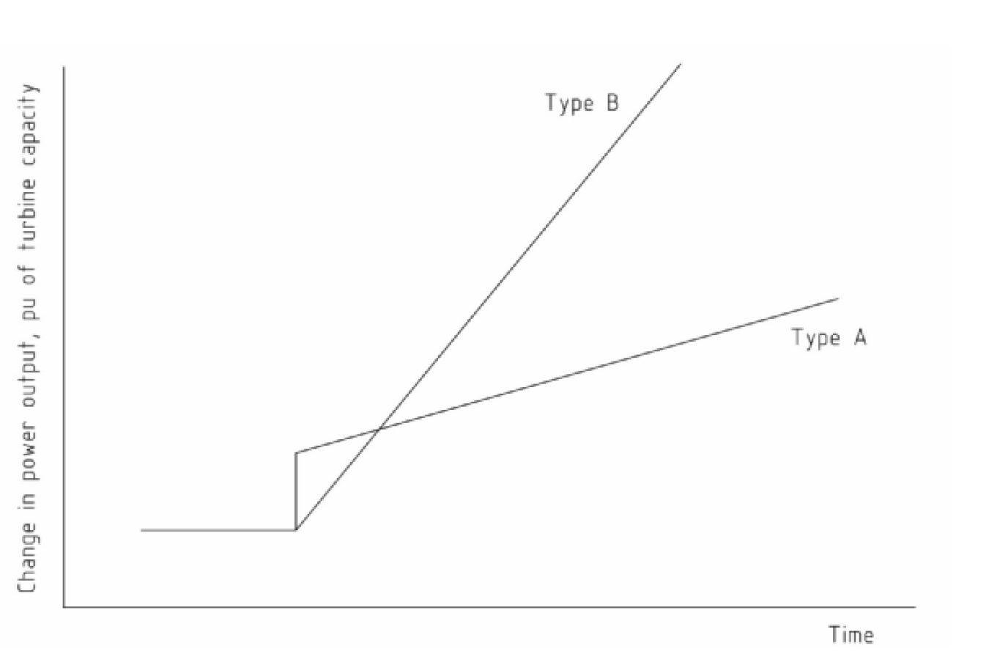
OPERATIONAL POINTS
Steam turbine and gas turbine plants can respond quickly over a
small range, but may not move so quickly outside of that small
range
The initial response of (most) hydro plants is significantly slower
than initial thermal plant response but (most) hydro plants can
carry on at their characteristic rate over their full range

Slide 12
INSTRUMENTATION AND CONTROL
To be achieved with the required timing
Frequency response must be implemented by Primary Control
Primary control is - Governing Control
Reserve (headroom) for Frequency Response can be
managed by Secondary Controls - such as
- plant Distributed Control Systems (DCS)
- Balancing Area Automatic Generation Control
systems (AGC/LFC)

Slide 13
INSTRUMENTATION AND CONTROL
Governing action is
        local and autonomous
        not subject to communication latency
        not dependent on reliability of communication
Grid level secondary control (balancing controls / AGC)
              - is dependent on communication channels
              - is dependent on reliability of communication

Slide 14
MODELING
Modeling of turbine-governor controls has been shown by
testing (in WECC, Europe, Asia)to give trustworthy indications
of dynamic behavior -
to the extent that the physical effects are represented
in the models
Models in general use do not represent effects such as:
- fuel gas pressure variations and supply adequacy
- quenching effects of water injection (for emissions compliance)
- boiler control dynamics
- actions of power plant and grid operators
Dynamic simulation data bases do not aid in recognition of:
- ambient temperature effects
- variation of load characteristic with time of day
- plant operational practices

Slide 15
MICROCOSM MODEL FOR SIMULATIONS
OF FREQUENCY RESPONSE

Slide 16
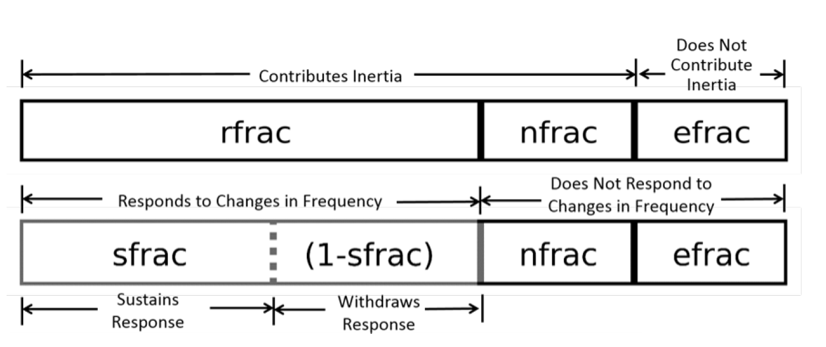
CLASSES OF GENERATING CAPACITY

Slide 17
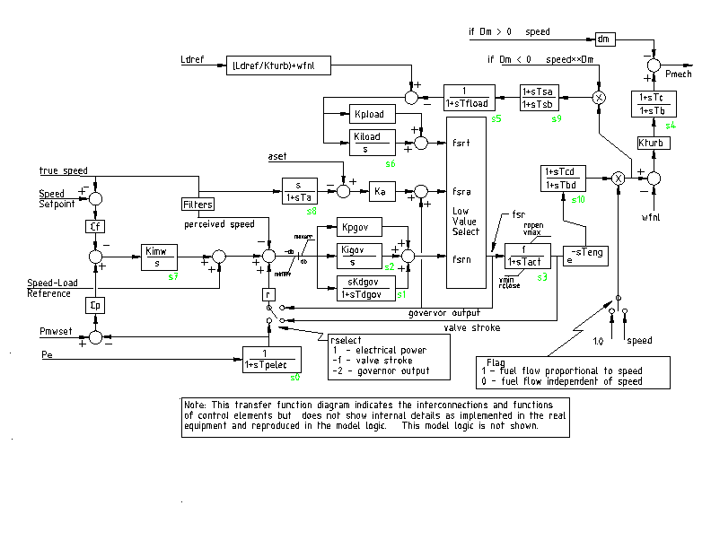
Governor
ggov1 turbine-controller model
Temperature limit
Load controller
Turbine

Slide 18
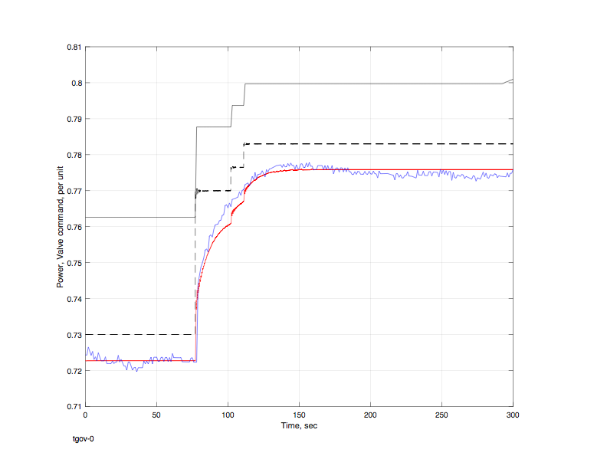
Prime mover models are well correlated with test responses of operating turbines
(Large steam turbine)
Blue test
Red - model

Slide 19
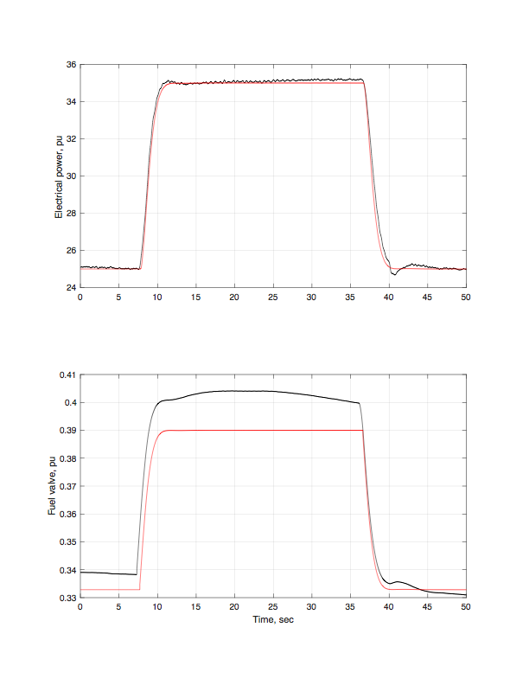
Prime mover models are well correlated with test responses of operating turbines
(Aeroderivative gas turbine)
Black - test
Red - model

Slide 20
QUESTIONS ADDRESSED BY SIMULATIONS
How much frequency responsive reserve is needed
immediately (Rfrac)
How much frequency response must be sustained
after initial response (Sfrac)
What is sensitivity of FR reserve requirement to:
- system inertia constant
- timing of turbine responses
- withdrawal of initial response
- governor dead bands
- gas turbine temperature/speed dependence
How should plant (DCS) and turbine (governor) controls be
coordinated

Slide 21
DEAD BAND
Deadband was
zeroed-out for simulations intended to show sensitivity
to other factors
modeled explicitly in simulations intended to show
its effect

Slide 22
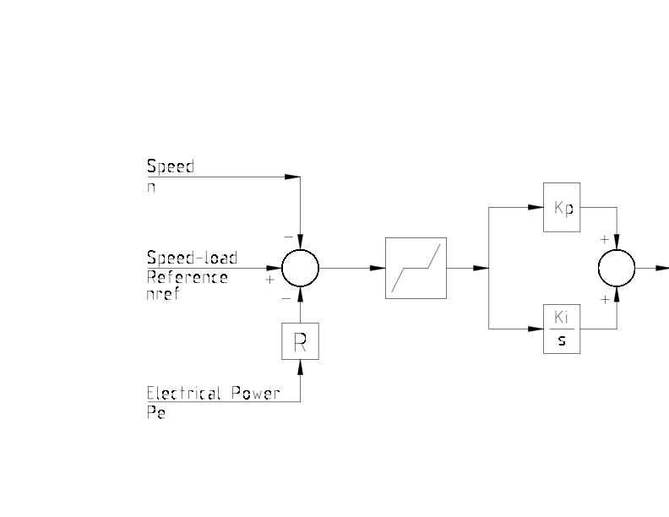
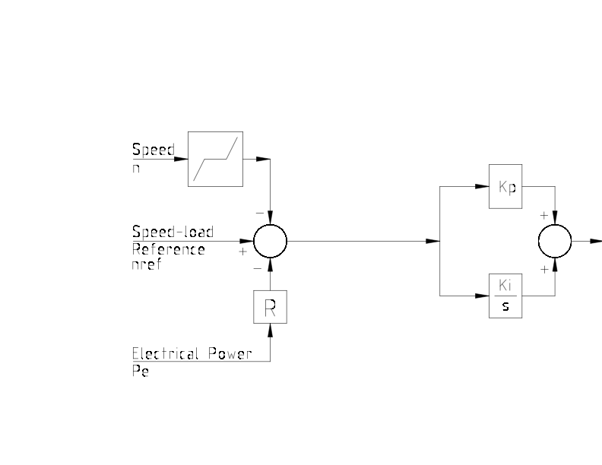
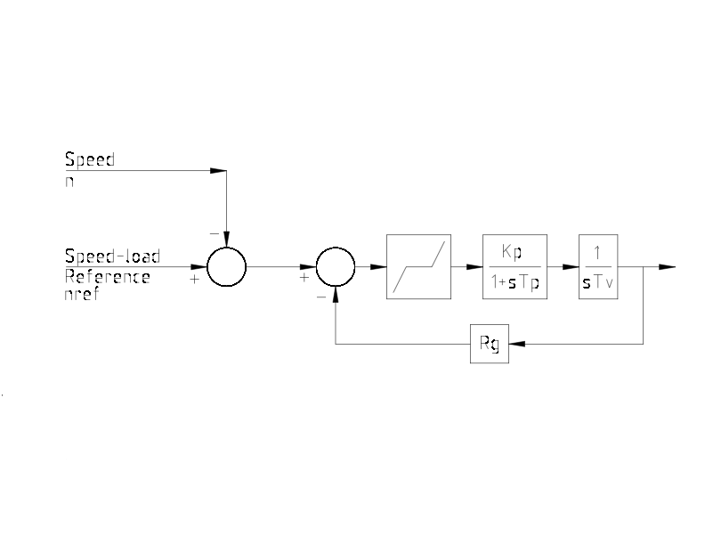
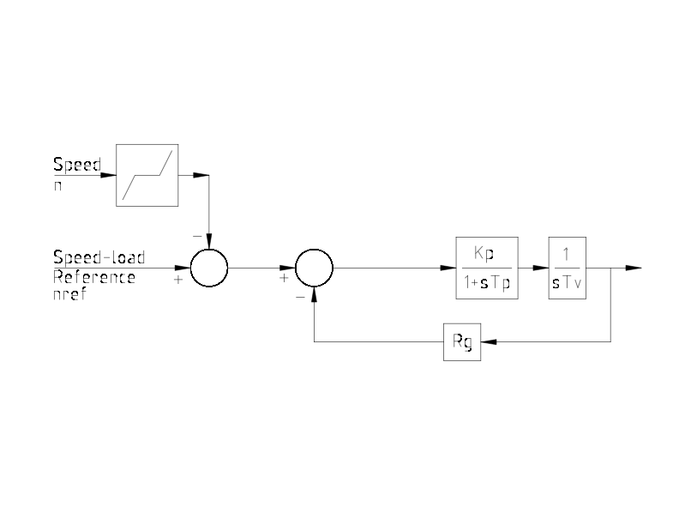
FORM and LOCATION of DEAD BAND ARE SIGNIFICANT

Slide 23
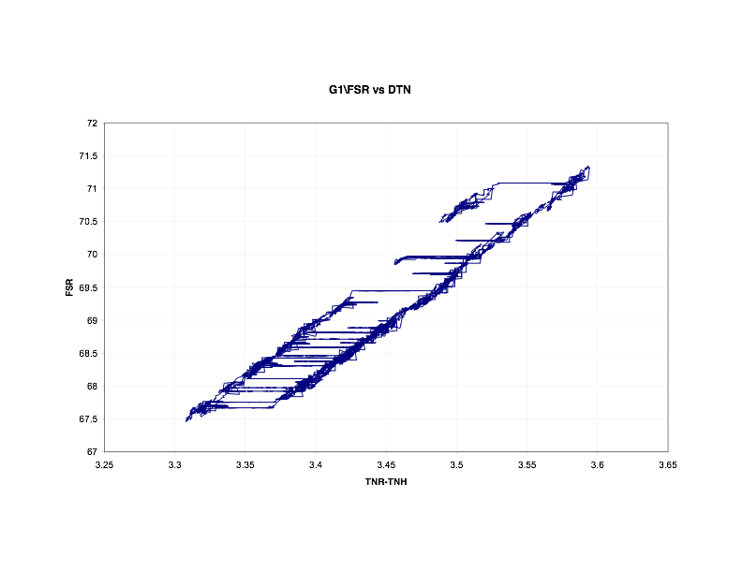
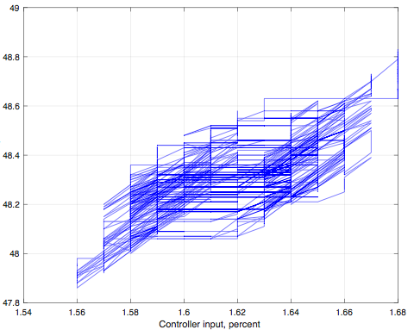
DEAD BAND IS MEASURABLE
and is settable in most modern turbine controls
GE 7FA +/-0.025 Percent
15 mHz in 60Hz system
GE 9FA +/-0.025 Percent
12.5 mHz in 50Hz system

Slide 24
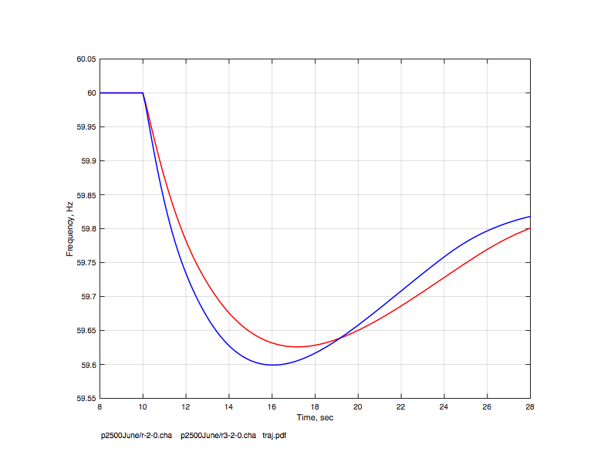
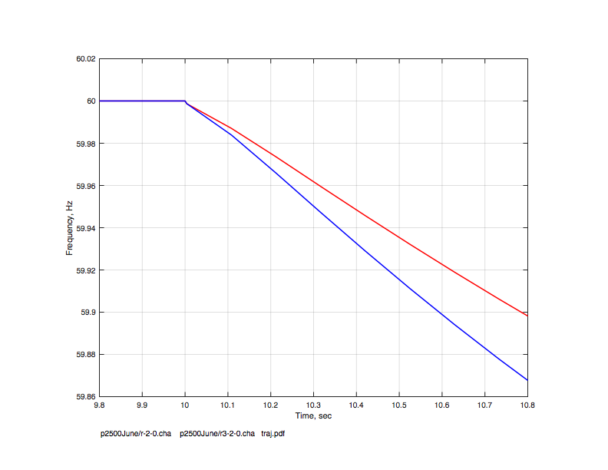
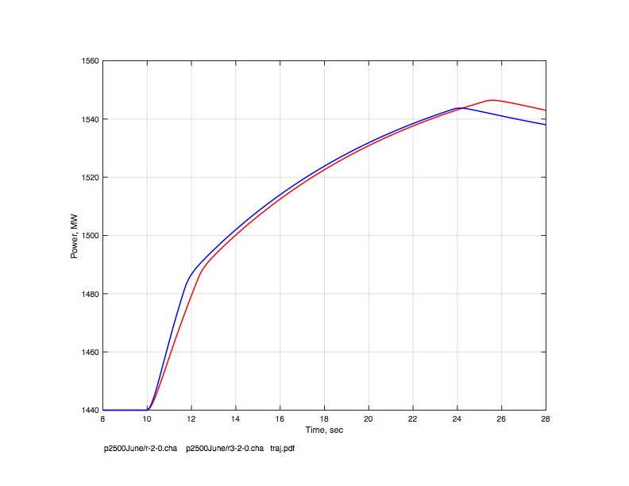
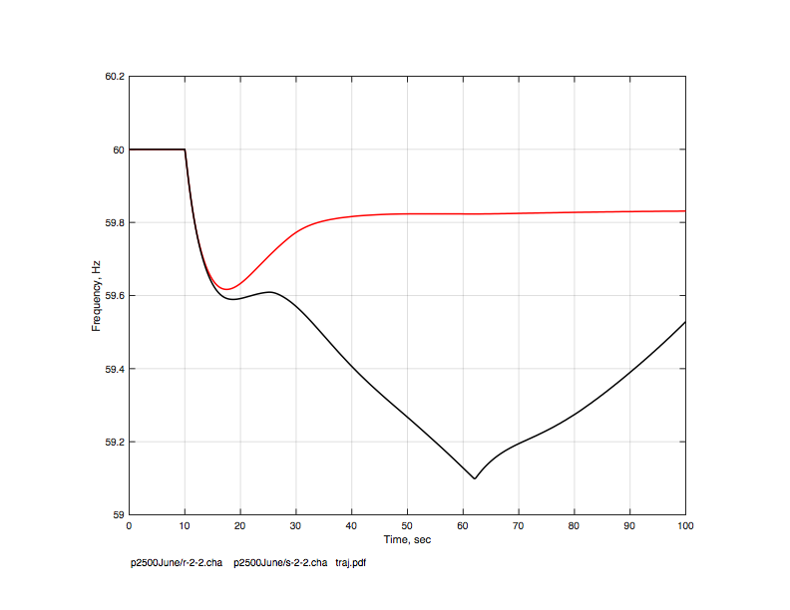
BASIC SIMULATION
Red H=4
Blue H=3
Frequency
Frequency
0 20 sec
0 1 sec
Red Adequate sustaining fraction
Black Inadequate
Turbine
Power
Frequency
0 20 sec
0 100 sec

Slide 25
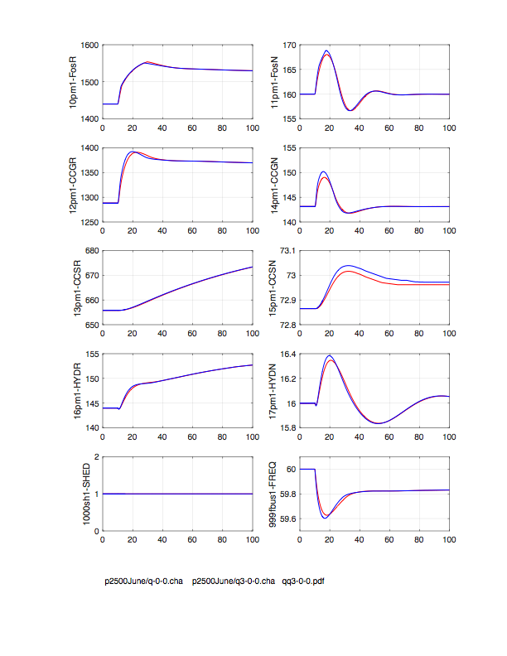
Sensitivity to inertia constant
Electronic fraction 0.0
Responsive fraction 0.4
Sustaining fraction 0.9*0.4
H of rotating generation = 4.0
Stored energy 48000 MW-sec
H of system = 4.0
Nadir frequency 59.63
H of rotating generation = 3.0
Stored energy 36000 MW-sec
H of system = 3.0
Nadir frequency 59.60

Slide 26
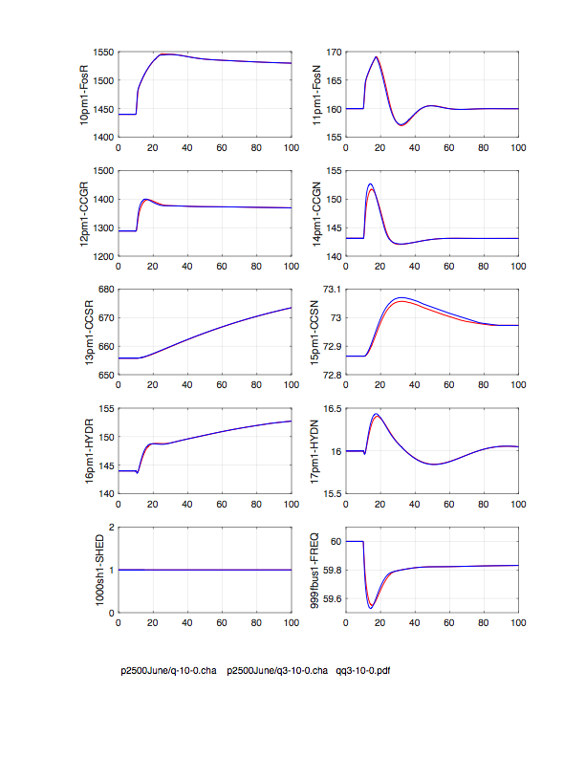
Sensitivity to inertia constant
Electronic fraction 0.5
Responsive fraction 0.4
Sustaining fraction 0.9*0.4
H of rotating generation = 4.0
Stored energy 24000 MW-sec
H of system = 2.0
Nadir frequency 59.55
H of rotating generation = 3.0
Stored energy 18000 MW-sec
H of system = 1.5
Nadir frequency 59.53

Slide 27
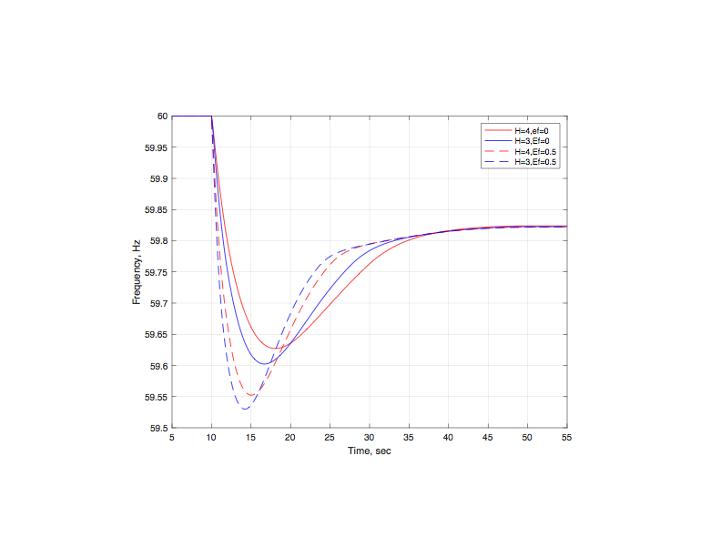
Sensitivity to inertia constant
                H Inertia Nadir
                of rotating of freq
                machines fleet Hz
                sec MW-sec
4 48000 59.63 Zero electr
3 36000 59.60
4 24000 59.55 Half electr
3 18000 59.53

Slide 28
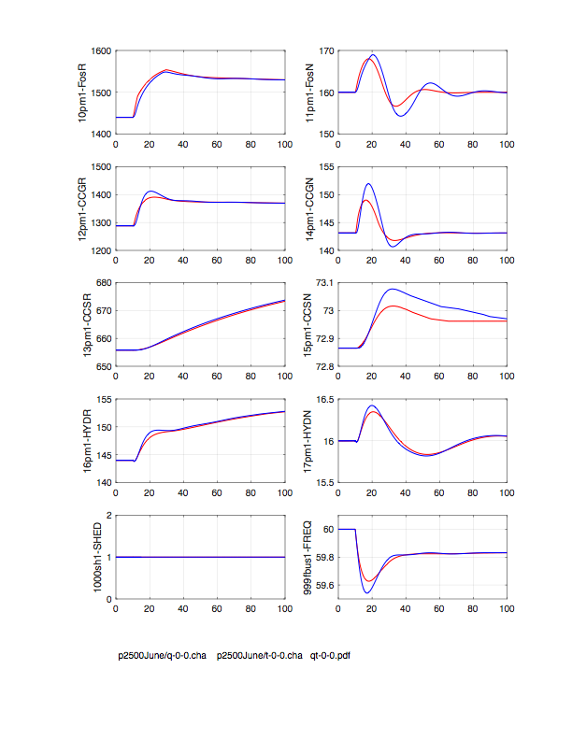
Sensitivity to speed of primary response
Electronic fraction 0.0
Responsive fraction 0.4
Sustaining fraction 0.9*0.4
Quick primary response
H of rotating generation = 4.0
Stored energy 48000 MW-sec
H of system = 4.0
Nadir frequency 59.63
Slow primary response
H of rotating generation = 4.0
Stored energy 48000 MW-sec
H of system = 4.0
Nadir frequency 59.54

Slide 29
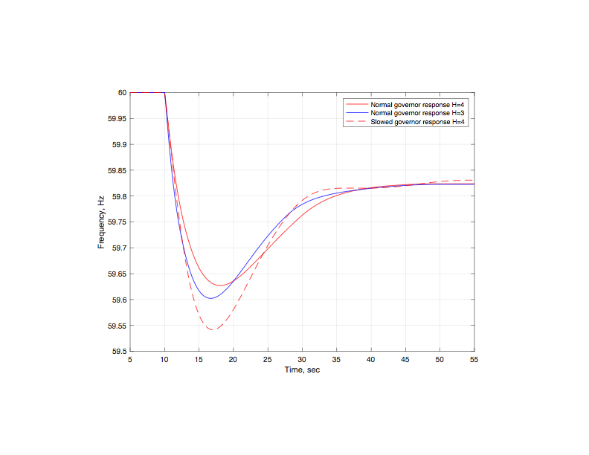
Sensitivity to speed of primary response

Slide 30
WITHDRAWAL OF INITIAL PRIMARY RESPONSE
There are two main influences that result in withdrawal of frequency response after it has been produced by governor action
load control action of plant DCS systems
fall-off of single-shaft gas turbine power with falling
grid frequency

Slide 31
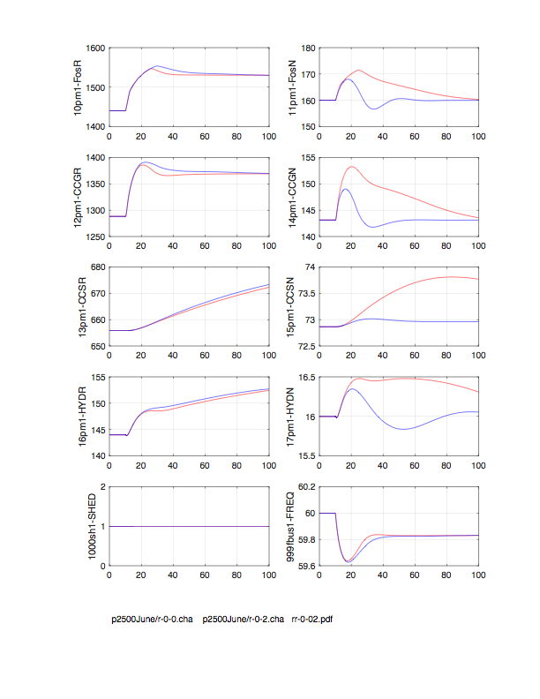
Sensitivity to speed of secondary control action
Electronic fraction 0.0
Responsive fraction 0.4
Sustaining fraction 0.9*0.4
Slow secondary response
H of rotating generation = 4.0
Nadir frequency 59.63
Quick secondary response
H of rotating generation = 4.0
Nadir frequency 59.62

Slide 32
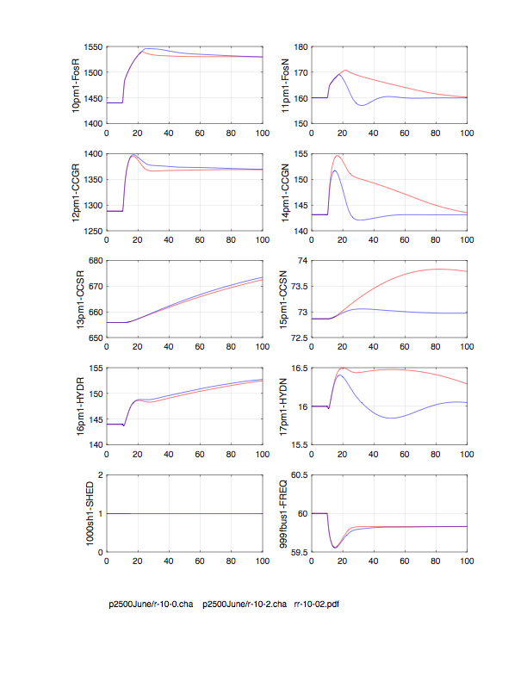
0 percent electronic 50 percent electronic
Nadir at 59.63Hz
after 8 sec
Nadir at 59.55Hz
after 7 sec

Slide 33
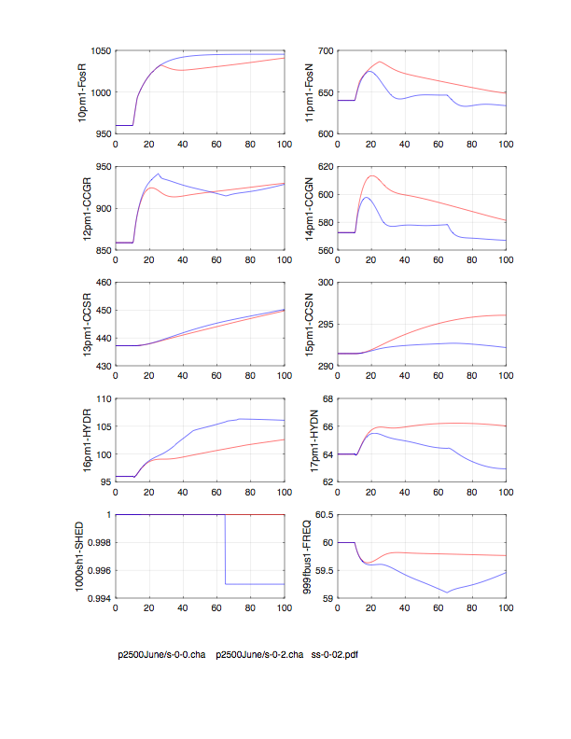
Rf = 0.4 Sf = 0.9 Rf = 0.4 Sf = 0.6
Red - cautious DCS action
Blue - aggressive DCS action

Slide 34
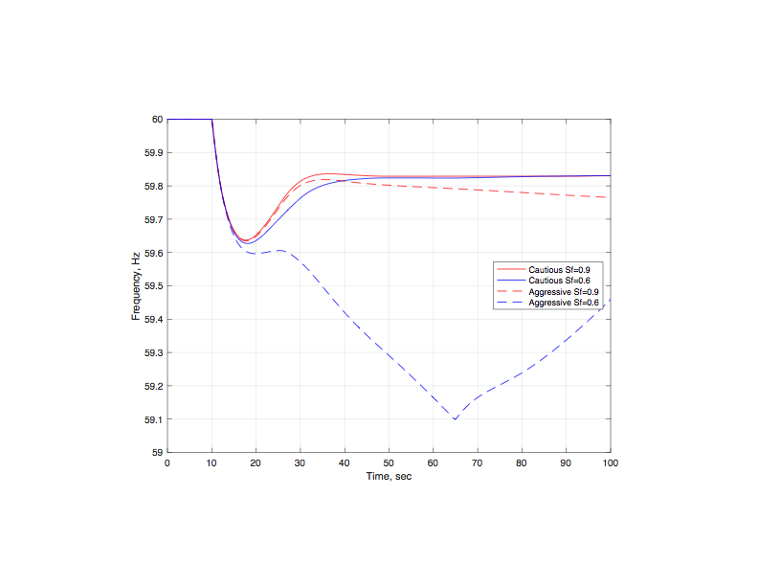
Effect of aggressive withdrawal of initial response

Slide 35
BEHAVIOR OF LARGE GAS TURBINES
When operating at "base load" a gas turbine is at its temperature limit - the governor is NOT in command
When at temperature limit the output of a gas turbine decreases as speed decreases
This behavior is counter to what the power system needs to stabilize frequency

Slide 36
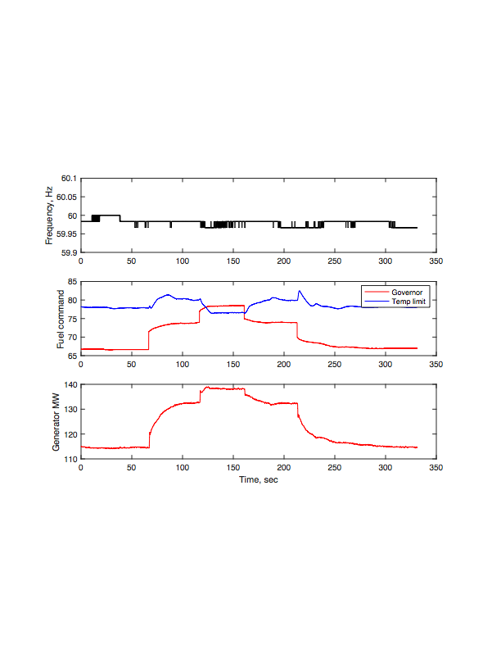
Exhaust temperature limit overrides governor
Test conditions

Slide 37
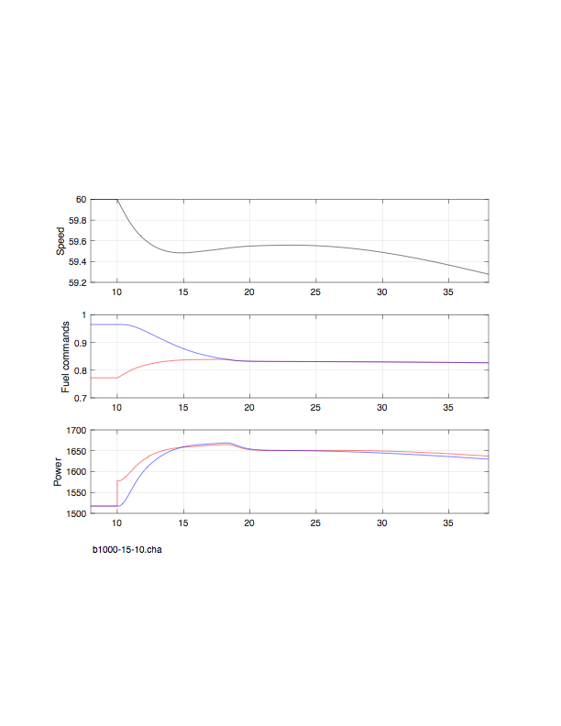
Exhaust temperature limit overrides governor
Simulation of low frequency conditions
Gas turbine speed
Fuel command - temperature
Fuel command - governor
Generator electrical power
Turbine mechanical power

Slide 38
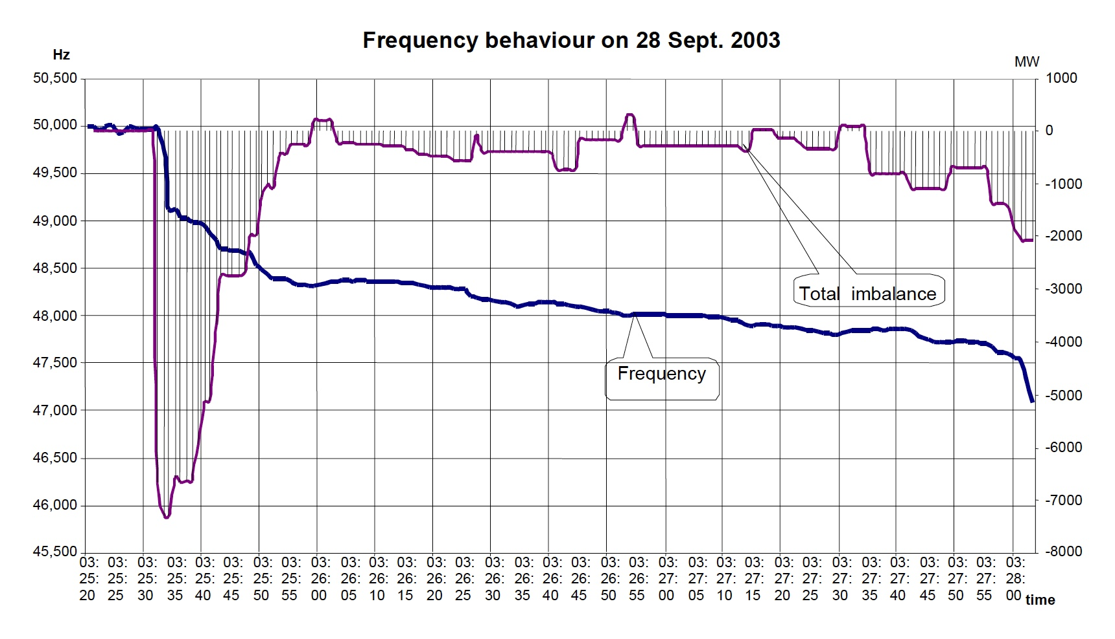
Frequency collapse largely due to adverse speed-sensitivity
of gas turbine maximum power
160 seconds

Slide 39
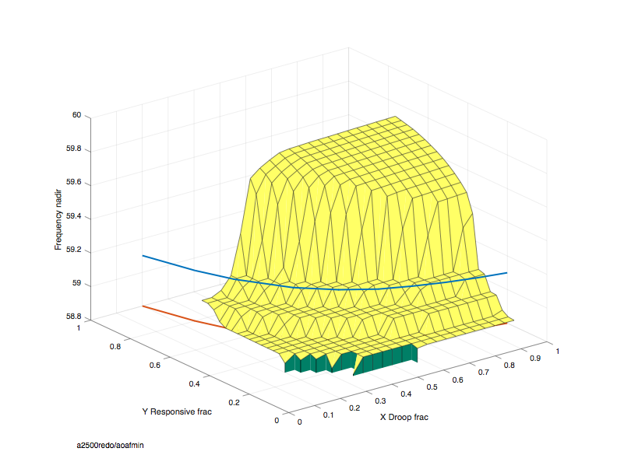
Importance of sustained primary response
Responsive turbines have 9 percent headroom
2 percent loss of production
Minimum requirement for sustained frequency
response is 2/0.09 = 22 percent of total generating
capacity
Responsive fraction, Sf
Sustaining fraction, Sf

Slide 40
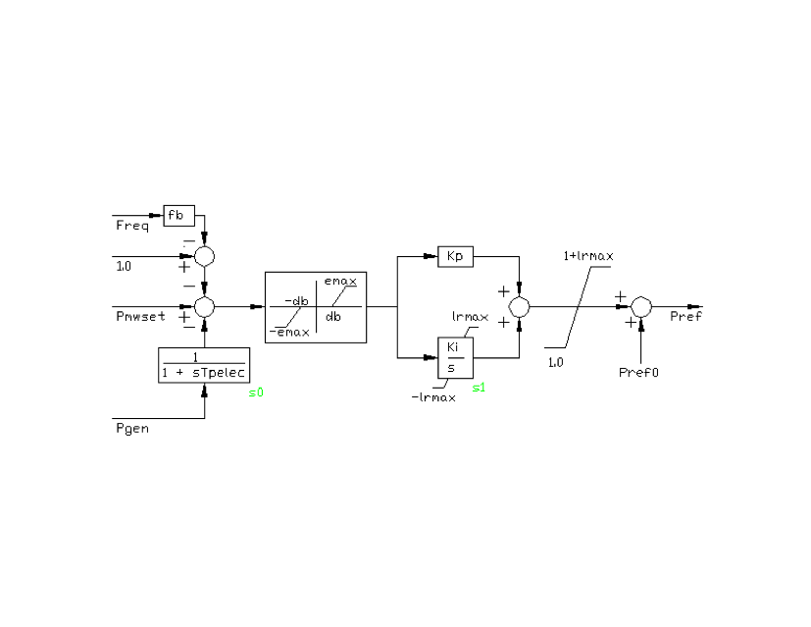
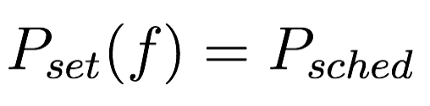

Use of frequency bias in plant (DCS) load controllers

Slide 41
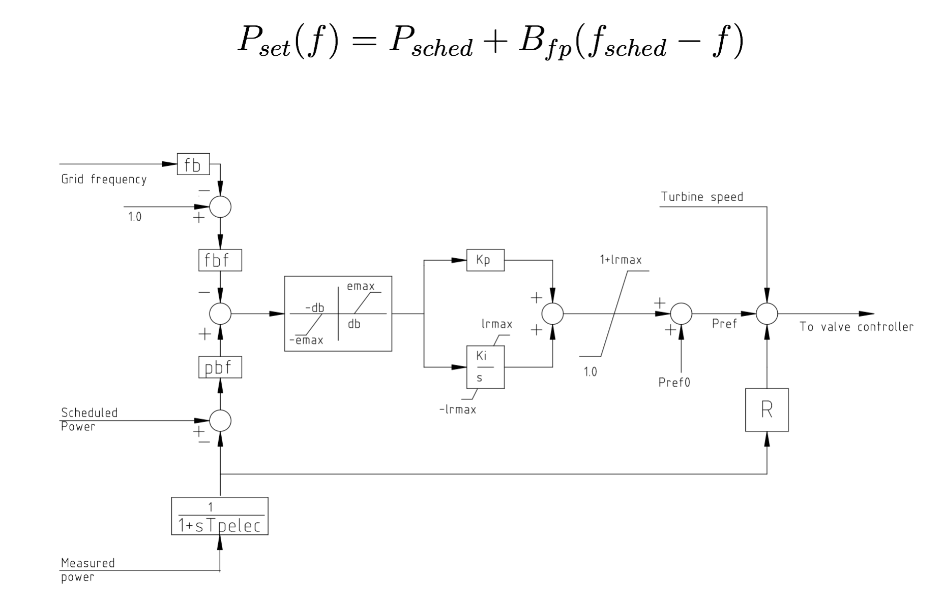
Use of frequency bias in plant (DCS) load controllers

Slide 42
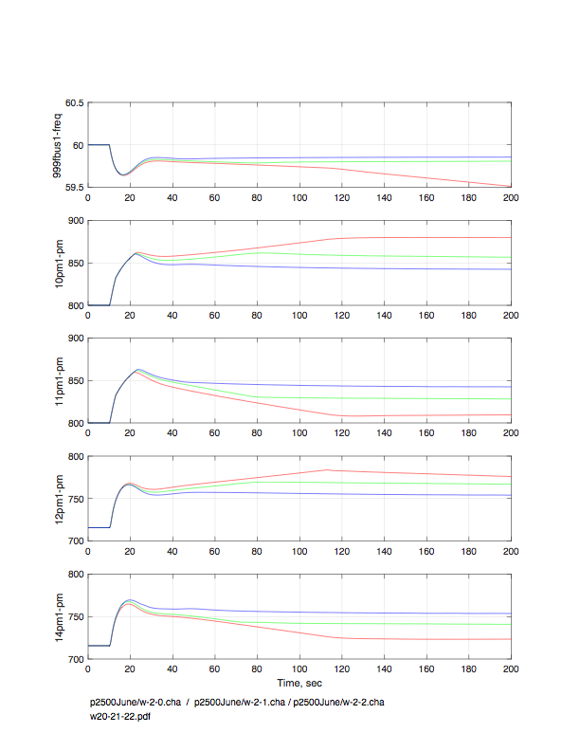
Use of frequency bias in plant (DCS) load controllers
Frequency
Steam in droop mode
No frequency bias
Bias corresponds to half of governor droop
Steam in load control mode
Bias corresponds to governor droop
CCGT in droop mode
CCGT in load control mode

Slide 43
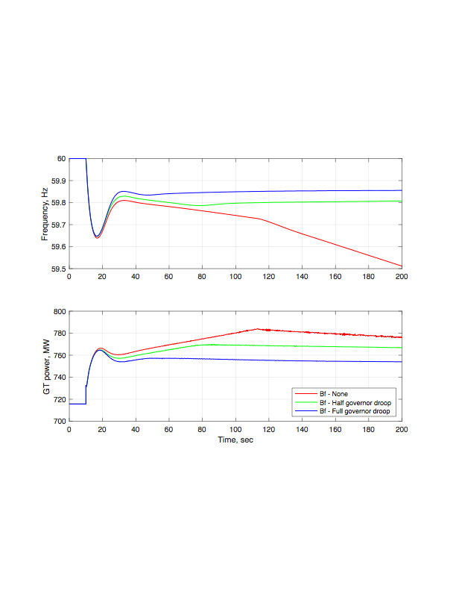
Use of frequency bias in plant (DCS) load controllers

Slide 44
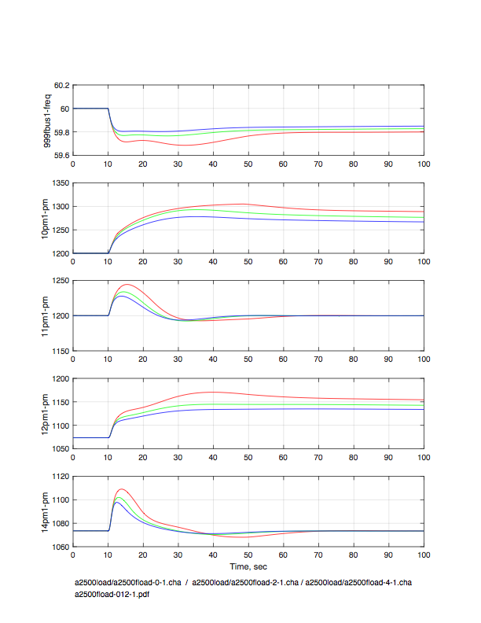
Effect of load frequency sensitivity
Frequency
D = 0
D = 1
D = 2
Steam in droop mode
Steam in load control mode
CCGT in droop mode
CCGT in load control mode

Slide 45
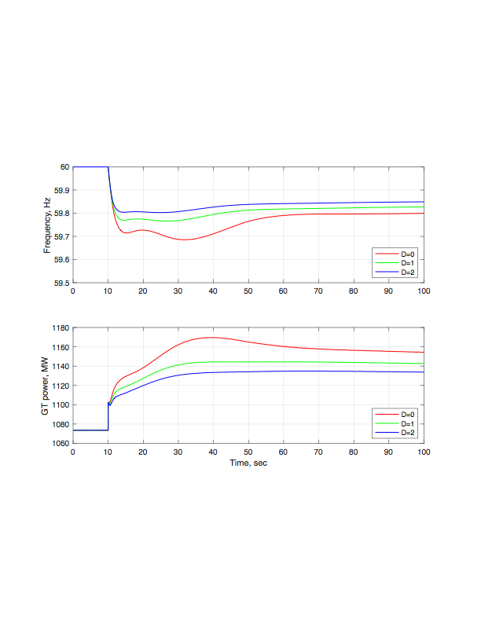
Effect of load frequency sensitivity

Slide 46
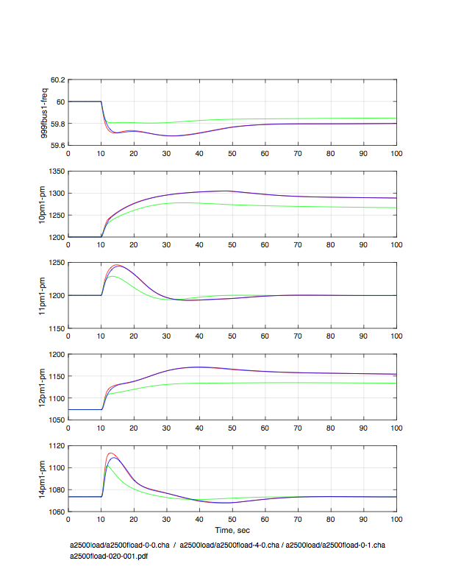
Relative sensitivity to inertia and load damping
Frequency
D = 0 H = 3
D = 2 H = 3
D = 0 H = 4
Steam in droop mode
Steam in load control mode
CCGT in droop mode
CCGT in load control mode

Slide 47
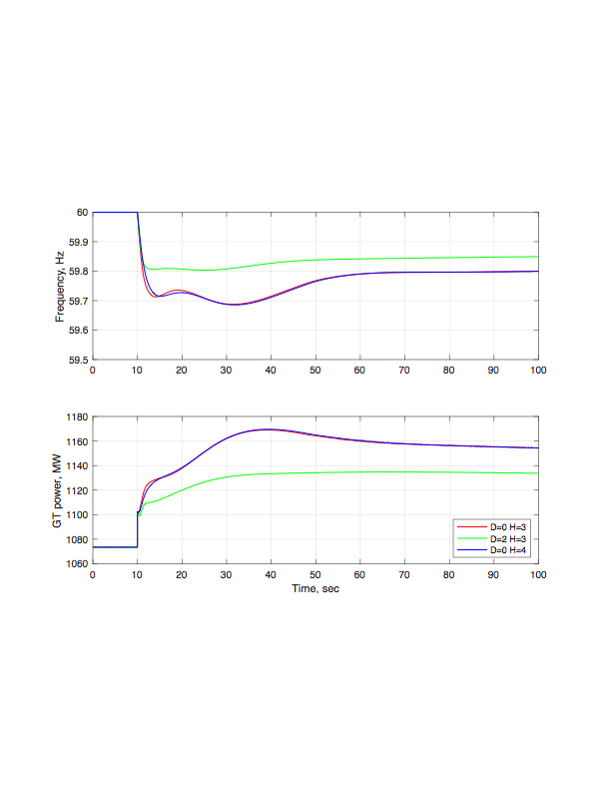
Relative sensitivity to inertia and load damping
D = 0 H = 3
D = 2 H = 3
D = 0 H = 4

Slide 48
COMMENTARY AND CONCLUSION
Responsibility for Frequency Response must be carried by
allocating Frequency Response duty as
- a small fraction of the operational range
- of a sufficiently large number of turbines
Primary response must be delivered on a time scale of 5-10
seconds - with present fleet make up
As system effective inertia constant decreases, the time scale for
delivery of primary response will be correspondingly shortened
Thermal/hydro turbines will, eventually, not be able to provide
primary control response with the required promptness
Electronically coupled generation and load can, and will have to,
provide and sustain primary control response

Slide 49
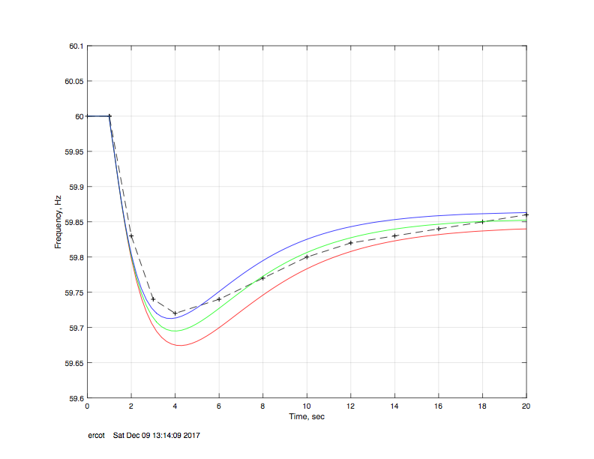
FULL SCALE versus MICROCOSM SIMULATION
ERCOT
Black PSLF full scale
Red Decreased steam
Green Nominal steam
Blue Increased steam

Slide 50
Independent Observations of the Study
Sydney Niemeyer

Slide 51
Aggregate Frequency Control Performance Required
Provided by the fleet of resources that must be kept on-line at all times to respond to generation-loss events?
All generators, to the extent feasible, must be capable of providing sustained primary frequency response?
All non-traditional resources for primary frequency control such as demand response, energy storage, and other forms of electronically coupled loads and generation should be utilized.
The sensitivity of loads to frequency is changing.
Other countries ensure adequate Primary Frequency Control by requiring specific generator governor settings and by spreading the frequency responsive reserves over many generators.

Slide 52
Frequency Control Performance Required – The Design Event
The simultaneous loss of the largest, single substation facility.
  STP 1 & 2 1375 MW net each, 1430 MW gross each.
    Following a trip of a nuclear generator the auxiliary power demand will increase not decrease.
    Traditional fossil fueled facilities auxiliary power demand decreases significantly following a trip of the plant.
    Net loss to the grid for a nuclear generator would be closer to 1433 MW each or 2866 MW total compared to the present design of 2750 MW.

Slide 53
Combined Cycle Facilities Operating at Combustion Turbine Exhaust Temperature Limit.
  Any combustion turbine operating at its temperature limit will decrease MW output at lower frequencies. The rate of decrease is about 2.76 MW/1000 MW of capacity/ 0.1 Hz.
  Given a 30,000 MW interconnection with 35% of generation (10,500 MW) from combustion turbines/combined cycle plants. If 80% (8,400 MW) were operating at the temperature limit. This would result in a decrease in generator output of:
    23 MW at 59.9 Hz.
    69 MW at 59.7 Hz.
    162 MW at 59.3 Hz.
    This occurs anytime frequency is below 60 Hz.

Slide 54
Total Primary Control Required From Generators
2866 MW loss to the grid.
162 MW loss from combustion turbines.
Less Load Resources tripping at 59.7 Hz.
  1400 MW normal purchase used in this example.
Load Dampening:
  25,000 MW Load ~ 61.25 MW/0.1 Hz or 429 MW @ 59.3 Hz.
  35,000 MW Load ~ 85.75 MW/0.1 Hz or 600 MW @ 59.3 Hz.
  45,000 MW Load ~ 110.25 MW/0.1 Hz or 772 MW @ 59.3 Hz.
MW needed from Generators by the frequency nadir, in 3 to 5 seconds:
  2866 + 162 MW = 3028 MW loss
  Less 1400 MW Load Resources = 3028 – 1400 = 1628 MW
  Less Load Dampening: 1628 – 429 = 1199 MW @ 25,000 MW load.
  Less Load Dampening : 1628 – 600 = 1028 MW @ 35,000 MW load.
  Less Load Dampening: 1628 – 772 = 856 MW @ 45,000 MW load.

Slide 55
Limits of Generator Performance
Frequency events in the ERCOT Interconnection vary from typical values of:
  ERCOT 59.700 to 59.950 Hz. Frequency rarely goes below 59.700 Hz due to Load Resources tripping.
These typical events limit the generator’s exposure and experience of operating at very low frequencies near UFLS.
During the May 15, 2003 ERCOT event where frequency dropped to 59.28 Hz, generators experienced governor demands that they had never seen before. For 5% droop, a 23% increase. For steam generators a sudden drop in throttle steam pressure reduced governor performance and they were only able to deliver 12 to 13% instead of 23%. Combustion turbines delivered around 18%. These limits in delivery must be accounted for and understood.

Slide 56
Governor Dead-bands
A Large Dead-band of 0.036 Hz as compared to a 0.017 Hz Dead-band will result in less Primary Frequency Response.
  19% less Primary Frequency Response for a 59.90 Hz Deviation
  9.5% less Primary Frequency Response for a 59.80 Hz Deviation
  6.3% less Primary Frequency Response for a 59.70 Hz Deviation
  2.7% less Primary Frequency Response for a 59.30 Hz Deviation
Large Dead-bands on governors reduce Primary Frequency Response and delay the delivery of the response.

Slide 57
Standards and Requirements on Primary Frequency Control
NERC BAL-003-1 Does not have requirements on governor settings or the speed of delivery of response.
NERC Regional Standard BAL-001-TRE-1 does have requirements on governor settings but not on the speed of delivery of response at the frequency nadir.
MOD-27 does not require any response, only that the models reflect the actual generator performance.

Slide 58
Summary
The speed of delivery of Primary Frequency Response is critical.
  Steam turbines are fast for a portion of their response but have limited response due to the decay in throttle steam pressure during extreme events.
  Combustion turbines are good responders but are slower than steam turbines.
  Hydro turbines are much slower but can deliver large quantities of response.
Frequency Responsive Reserves must be spread over many generators to successfully deliver the needed response in the time required to prevent UFLS action.

Slide 59
Thank You
Joe Eto – jheto@lbl.gov
John Undrill - jundrill1@gmail.com
Sydney Niemeyer - sydney.niemeyer@att.net
Eddy Lim - Eddy.Lim@ferc.gov

