Slide 1
PDCWG Report to ROS
Chair: Percy Galliguez, Brazos Electric Power Cooperative, Inc.
Vice Chair: Chad Mulholland, NRG
ROS
May 3rd, 2018

Slide 2
Report Overview & Notes
Report Overview
  Meeting Minutes
  BAL-001-TRE-1 FMEs & IMFR
    2 FMEs in the month of March
  Frequency Control Report

Slide 3
Meeting Minutes
PDCWG Meeting 04/11/18
  NPRR863 – Separation of PFR and RRS Ancillary Service. No Updates to NPRR863 provided by STEC Cliff Lange but discussed reliability concerns to 0.036Hz frequency deadband change.
  NOGRR-174 Status and Update. Reviewed ERCOT language changes to be reviewed next by OWG.
  Regulation & Frequency Control Reports
  BAL-001-TRE-001
    Operating Condition Guidelines for PFR Performance
    LCRA-Combined Cycle Steam Droop setting clarification or possible SAR
    Performance Evaluation to check for pass/fail before scoring(Reschedule for next meeting.
    No Evaluation of Resources below LSL(Reschedule for next meeting)

Slide 4
Frequency Measurable Events Performance

Slide 5
Frequency Measurable Events
There were 2 FMEs in March
  3/5/2018 06:51:19
    Loss of 513 MW
    Interconnection Frequency Response:
    7 of 53 (1 of 22 RRS Providers) Evaluated Generation Resources had less than 75% of their expected Initial Primary Frequency Response.
    7 of 53( 2 of 22 RRS Providers) Evaluated Generation Resources had less than 75% of their expected Sustained Primary Frequency Response.
  3/24/2018 20:47:14
    Loss of 797 MW
    Interconnection Frequency Response:
    5 of 56(1 of 30 RRS Providers) Evaluated Generation Resources had less than 75% of their expected Initial Primary Frequency Response.
    5 of 56(1 of 30 RRS Providers) Evaluated Generation Resources had less than 75% of their expected Sustained Primary Frequency Response.

Slide 6
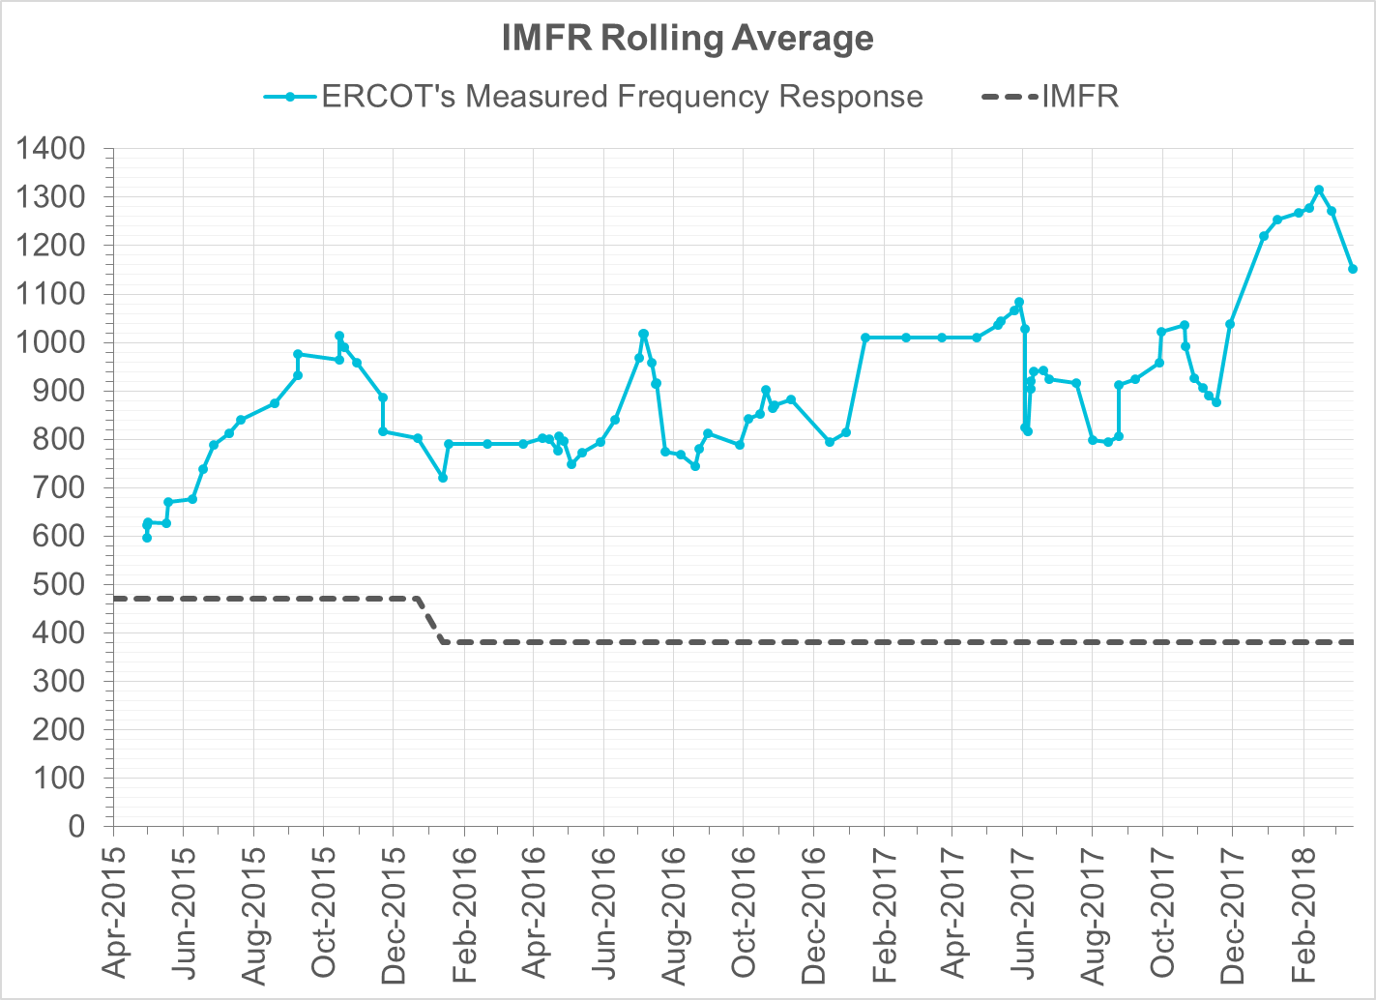
Interconnection Minimum Frequency Response (IMFR) Performance
IMFR Performance currently 1151.05 MW/0.1Hz

Slide 7
Frequency Control Report
March 2018

Slide 8
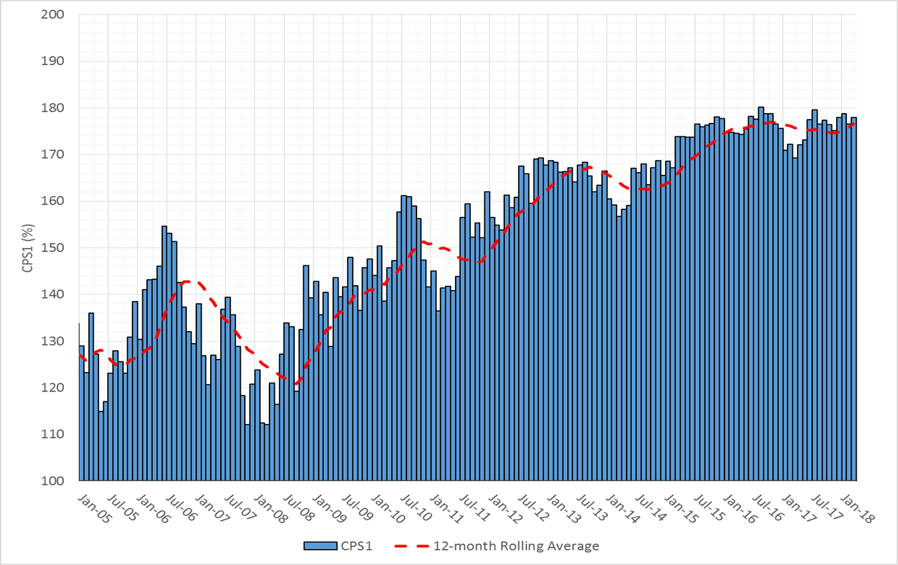

CPS1 Performance

Slide 9
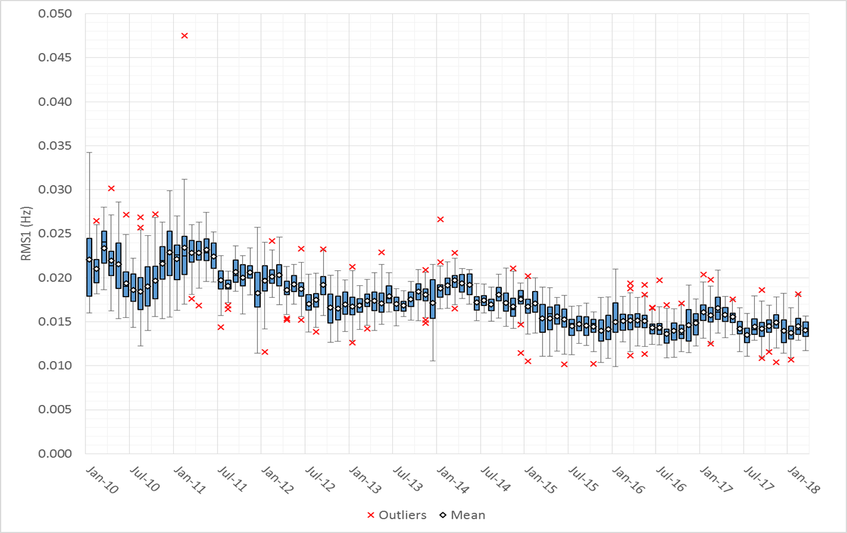
RMS1 Performance of ERCOT Frequency

Slide 10
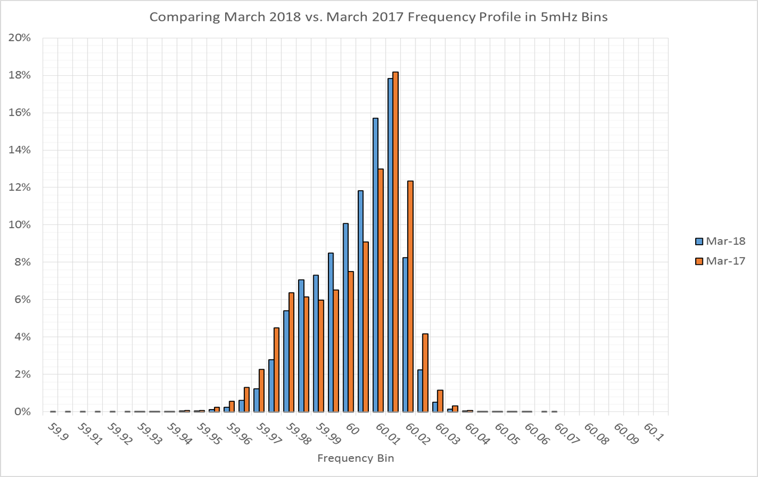
Frequency Profile Analysis

Slide 11
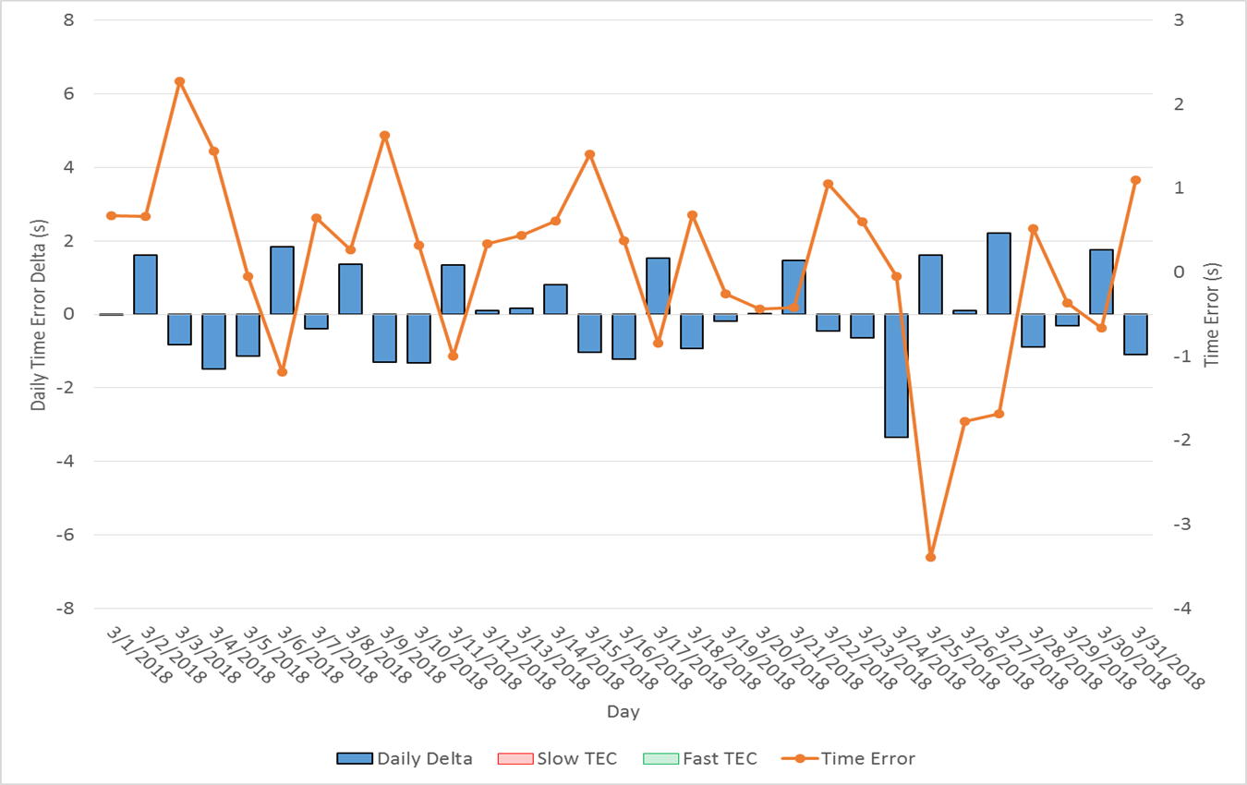
Time Error Corrections
There were no Time Error Corrections (TEC) in March

Slide 12
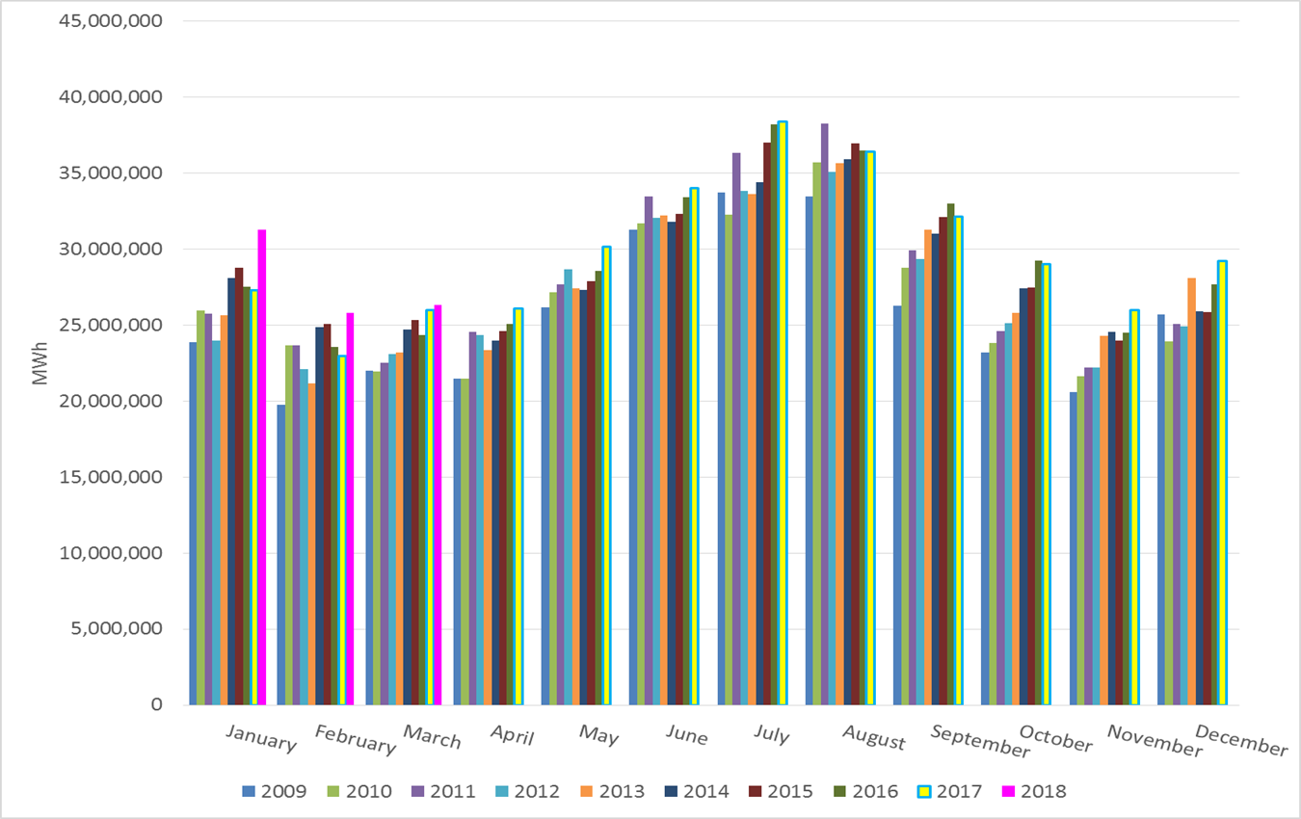
ERCOT Total Energy

Slide 13
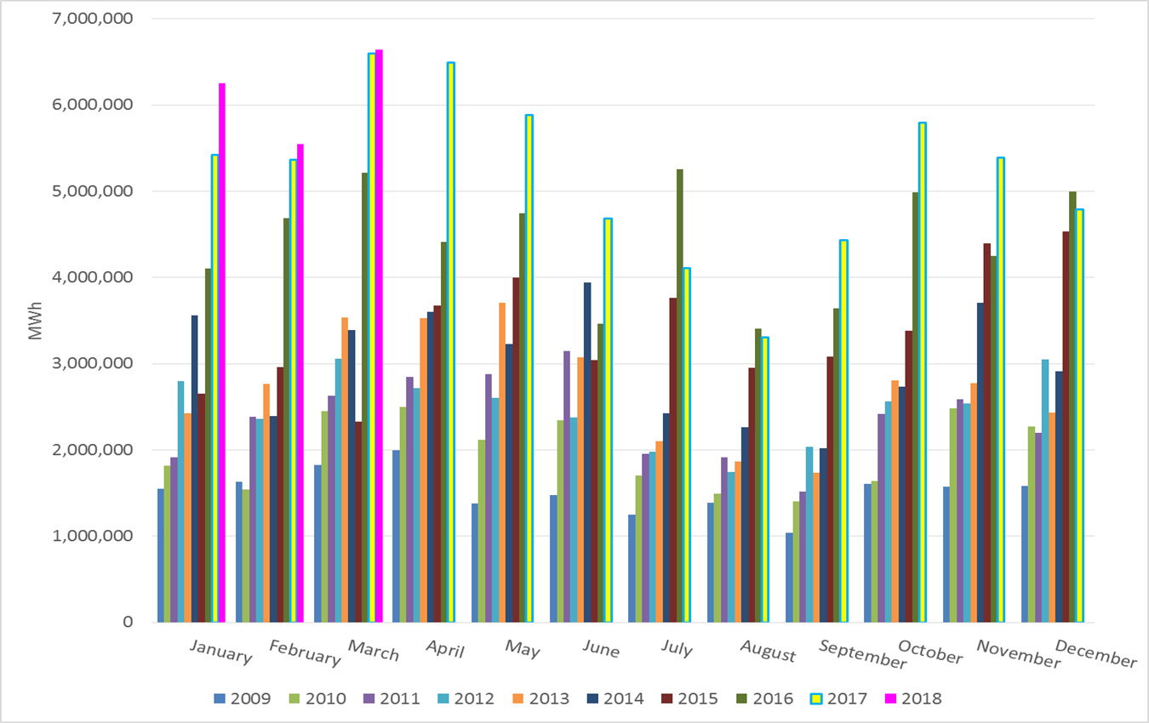
ERCOT Total Energy from Wind Generation

Slide 14
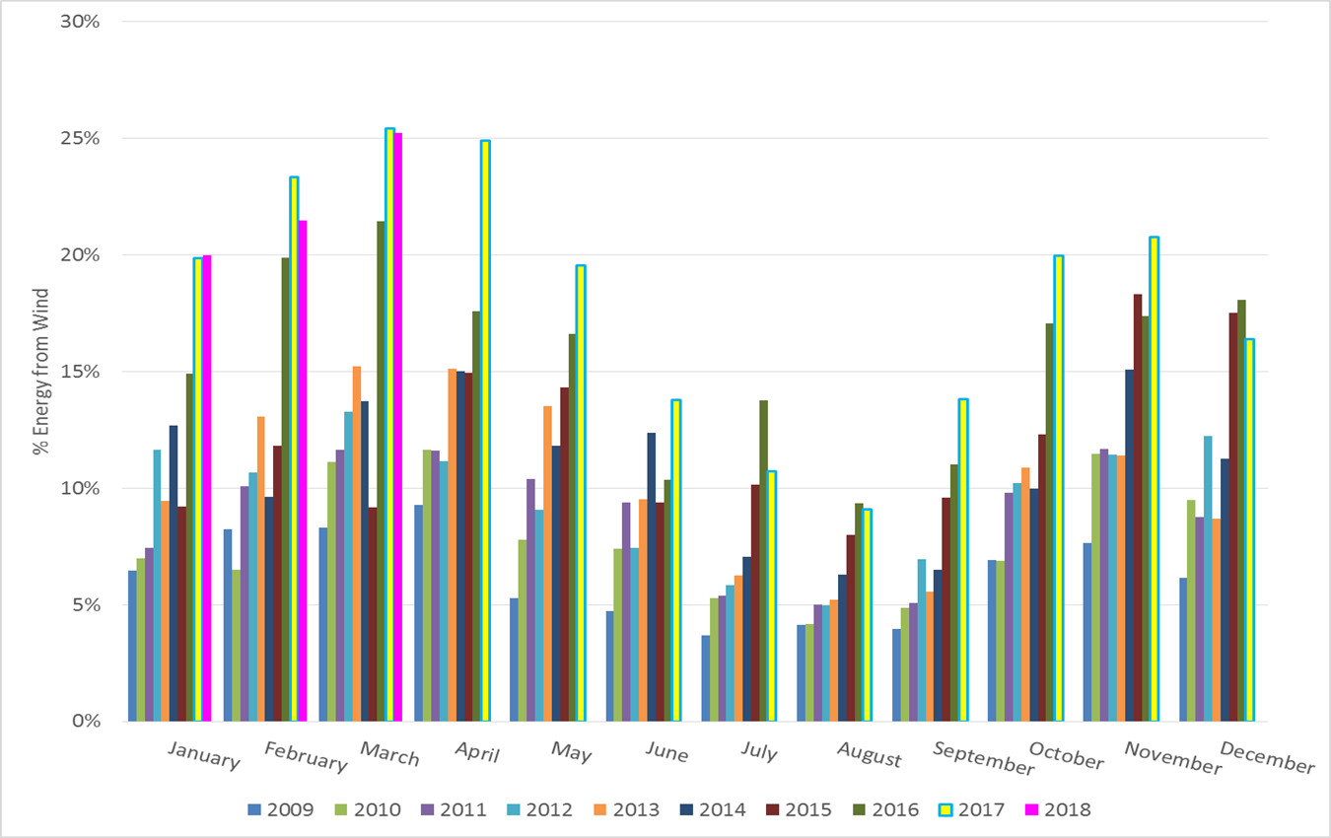
ERCOT % Energy from Wind Generation

Slide 15
Questions?

