Slide 1
Market Credit Working Group update to the Wholesale Market Subcommittee
5/2/2018

Slide 2
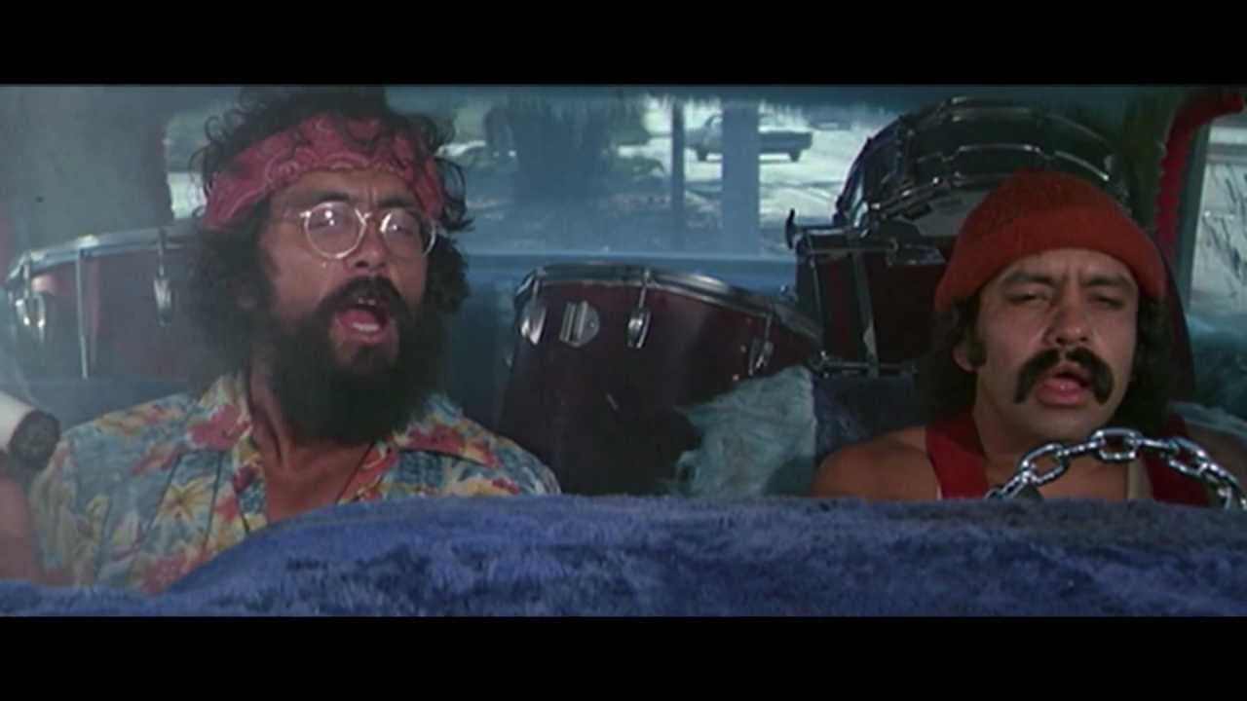
MCWG update to WMS
Joint meeting of MCWG and CWG held on Friday, April 20th at 1:00pm.
3 NPRRs reviewed for credit impacts
Comments filed on 2 by CWG in support (both sponsored or endorsed by CWG action)
1 no impact
Let’s head to the Met Center, man. The Credit Working Group is starting soon.

Slide 3
MCWG update to WMS
NPRR850 Market Suspension and Restart
General framework for the non-black start related activities of the ERCOT market related to the operation of real-time / day-ahead / CRR markets, Credit, Settlements, and Retail transaction processing.
Assumption that the event is ‘lengthy’ in nature (likely a week or longer) and market activities are disrupted.
Could be caused by any number of events (natural or man-made disasters, ERCOT computer failure(s), grid collapse and restart, sabotage/terrorism, etc.)
Proactive effort to minimize long term market disruption, credit defaults, mass transitions, etc.
http://www.ercot.com/content/wcm/key_documents_lists/139412/Item_4_Update_to_CWG_on_NPRR_850_Credit_Related_Framework_-_April_2018.pptx

Slide 4
CWG/MCWG Discussion on REP Default process
CWG/MCWG discussion has focused on maximizing the opportunity for other REPs to step in and acquire the defaulting REP before a mass transition is triggered.
Ideas discussed include:
Secondary auction administered by ERCOT
Voluntary list of acquiring REPs
ERCOT-administered REP default auction is challenged due to customer protection rules, notice requirements.
Recommendation: ERCOT could host a voluntary list of REP Contacts to facilitate a bilateral purchase of REP Book.

Slide 5
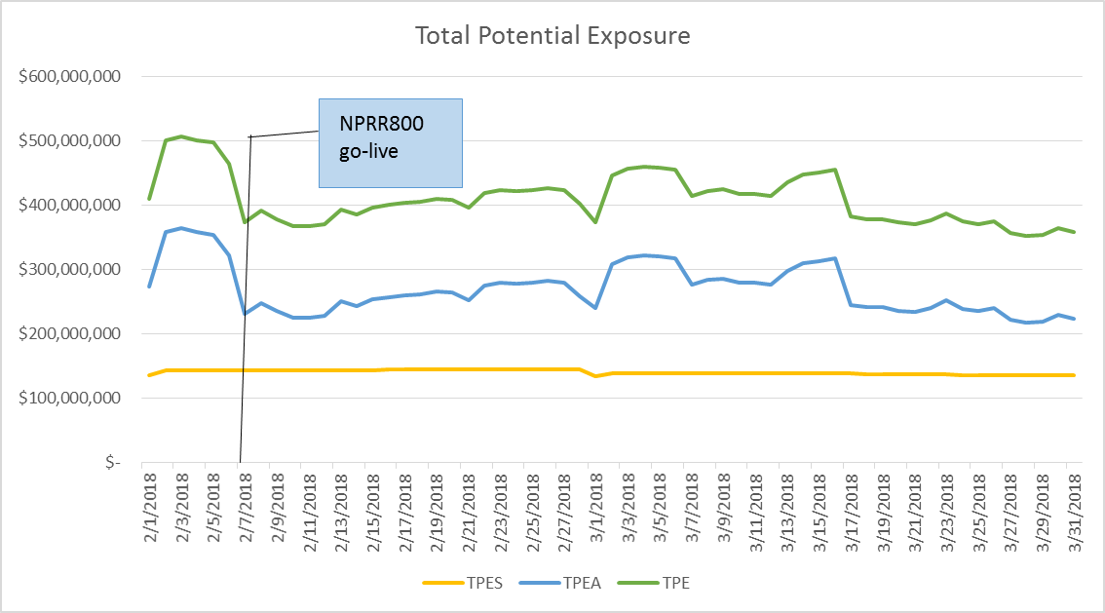
Credit Exposure Update

Slide 6
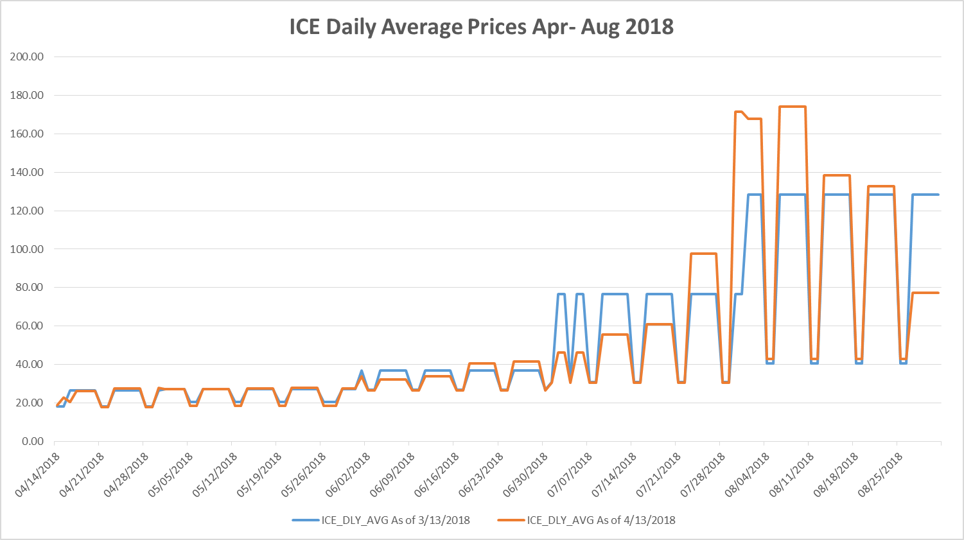
Credit Exposure Update
We are here

Slide 7
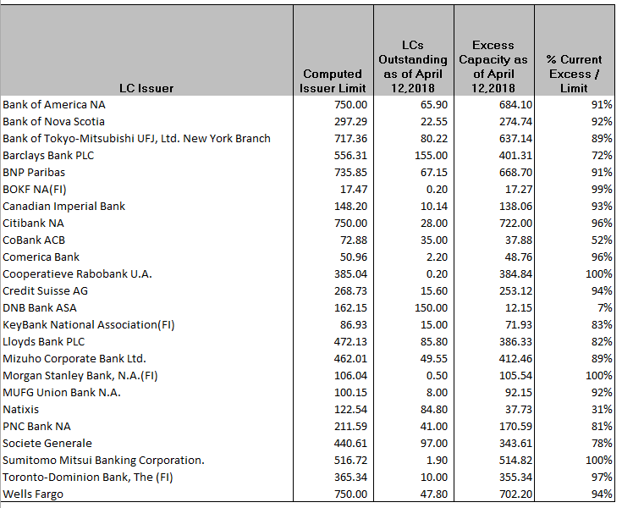
Letter of Credit Issuer Limit Update

