Slide 1
Proposal for Improving Efficiency of Fuel Index Price (FIP)
Kevin Hanson
Lead Market Operations Analyst,
Wholesale Market Operations and Analysis
QMWG
April 30, 2018

Slide 2
There is a deficiency in the current FIP
Historically, there have been some days in which a Houston Ship Channel (HSC) index is not available.
While not typically the case, using the last available HSC index can result in an increased lag in capturing market dynamics.
Either a much higher price from the prior day is lower in all markets the following day (or visa versa)
Such a case occurred on a day during the cold weather event between January 15th and 18th, 2018.
Utilizing a nearby pricing point, such as Katy, could help.

Slide 3
Katy and HSC prices are similar on average
Average Annual Day Ahead Prices ($/MMBtu) | Houston Ship Channel | Katy Texas
2014 | 4.30 | 4.31
2015 | 2.57 | 2.56
2016 | 2.45 | 2.45
YTD 2017 | 3.00 | 2.98
Source: https://www.ferc.gov/market-oversight/mkt-gas/gulf/ngas-sc-yr-pr.pdf

Slide 4
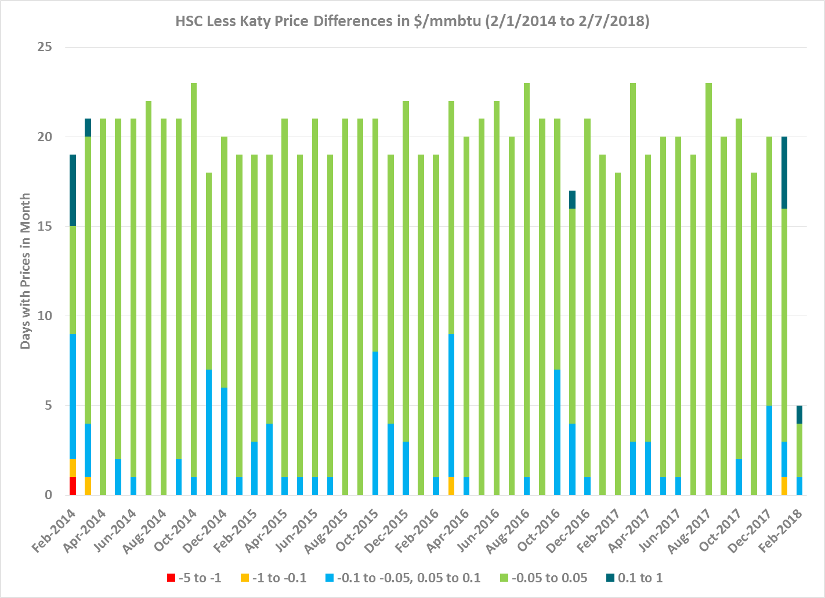
Absolute HSC Less Katy Price Differences
Source: Argus
Source: Argus

Slide 5
Katy was pricing on all days in which the HSC index was unavailable
Number of Business Days Houston Ship Channel Not Published by Year
2018 YTD | 1
2017 | 9
2016 | 5
2015 | 10
Source: Argus
* For all indexes, weekends and holidays do not have published prices

Slide 6
Katy has a larger volume of trades than HSC
Average Daily Volume (MMBtu) | Houston Ship Channel | Katy Texas | Katy vs HSC
2014 | 71,753 | 295,628 | 4.1
2015 | 48,406 | 329,658 | 6.8
2016 | 69,017 | 487,626 | 7.1
2017 | 42,238 | 356,487 | 8.4
Source: Argus

Slide 7
Possible Solutions
With the indexes already being provided to ERCOT by Argus, there may be some cost effective ways to address missing HSC data.
Option 1 – No change (Keep doing what we are doing)
Option 2 – Fill in the missing days with prices from Katy
Option 3 – Replace HSC with Katy
Option 4 – Fill in the missing days with prices from Katy for X years and than replace with Katy

Slide 8
Questions?
Notes:
https://castaylor.ercot.com/owa/redir.aspx?C=oPhl4_Wz9UCI7oVqJkGdaM-P4-MvhtMIRAMJFZ7-K5eOg6lo6esBMUiebAbXd4c8z8FTPzV8g8A.&URL=https%3a%2f%2ftheconversation.com%2fwhen-will-rooftop-solar-be-cheaper-than-the-grid-heres-a-map-54789%3futm_source%3dtwitter%26utm_medium%3dreferral%26utm_campaign%3dUTAustinNews
http://www.vox.com/2015/6/19/8808545/wind-solar-grid-integration
http://greeningthegrid.org/quick-reads
https://ec.europa.eu/energy/intelligent/projects/en/projects/pv-grid
http://energy.gov/eere/sunshot/systems-integration

Slide 9
APPENDIX

Slide 10
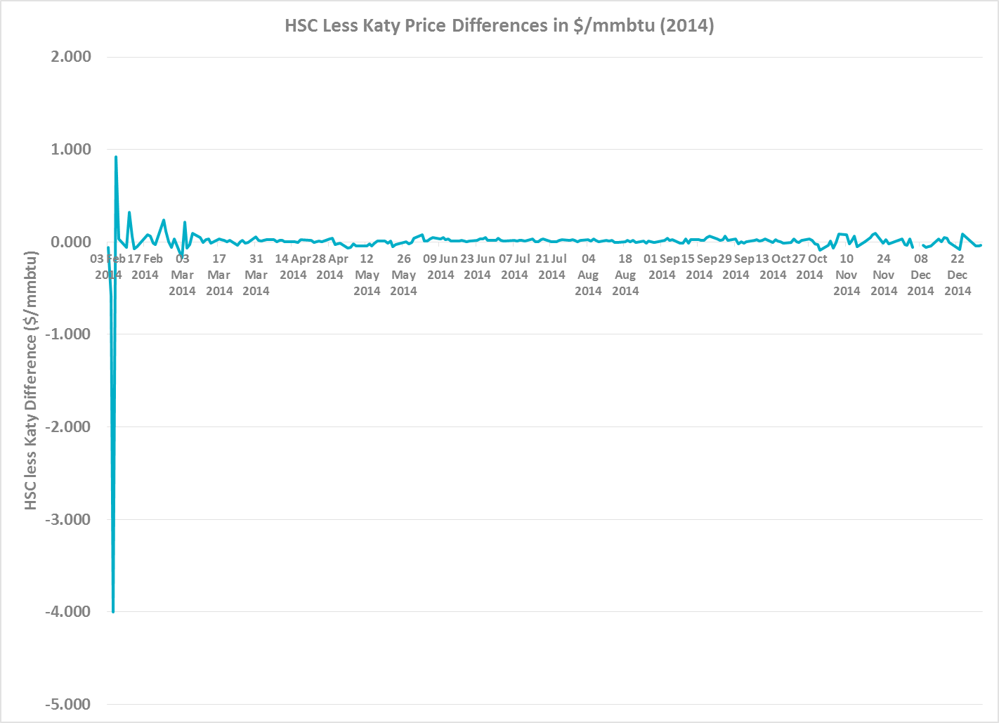
HSC Less Katy Price Differences in $/mmbtu (2014)
Source: Argus

Slide 11
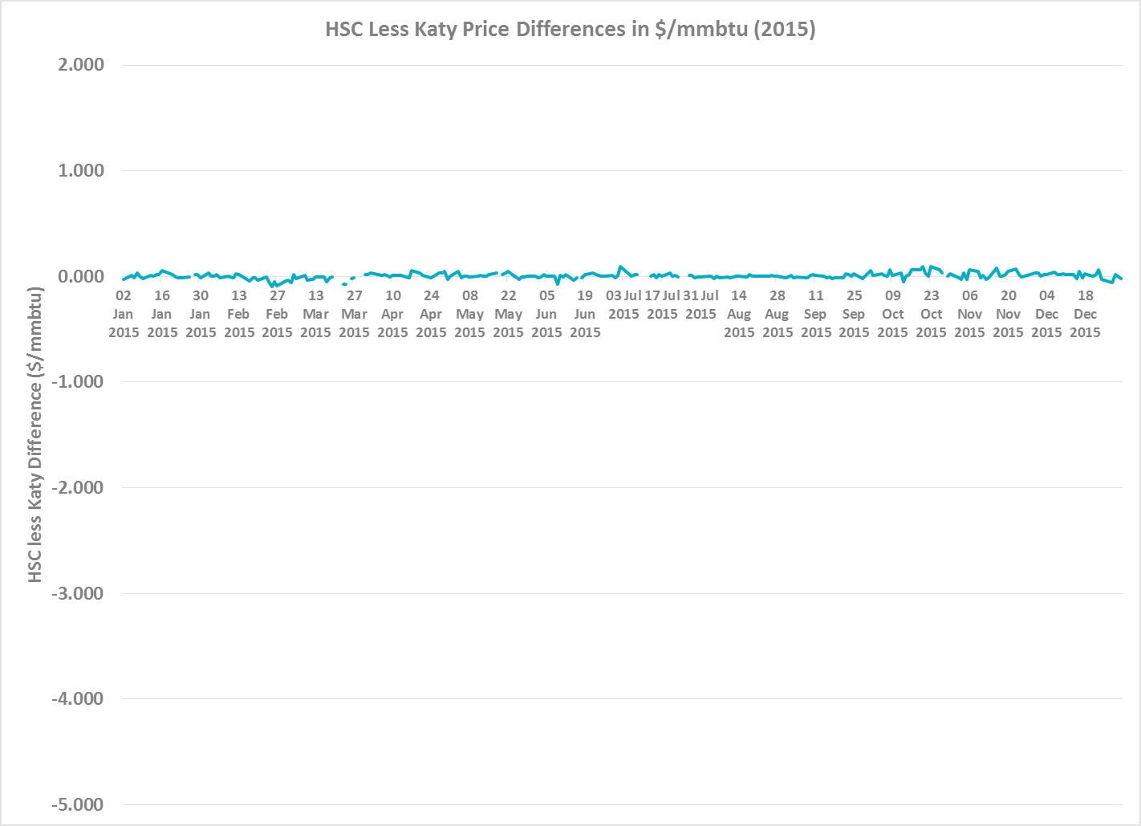
HSC Less Katy Price Differences in $/mmbtu (2015)
Source: Argus

Slide 12
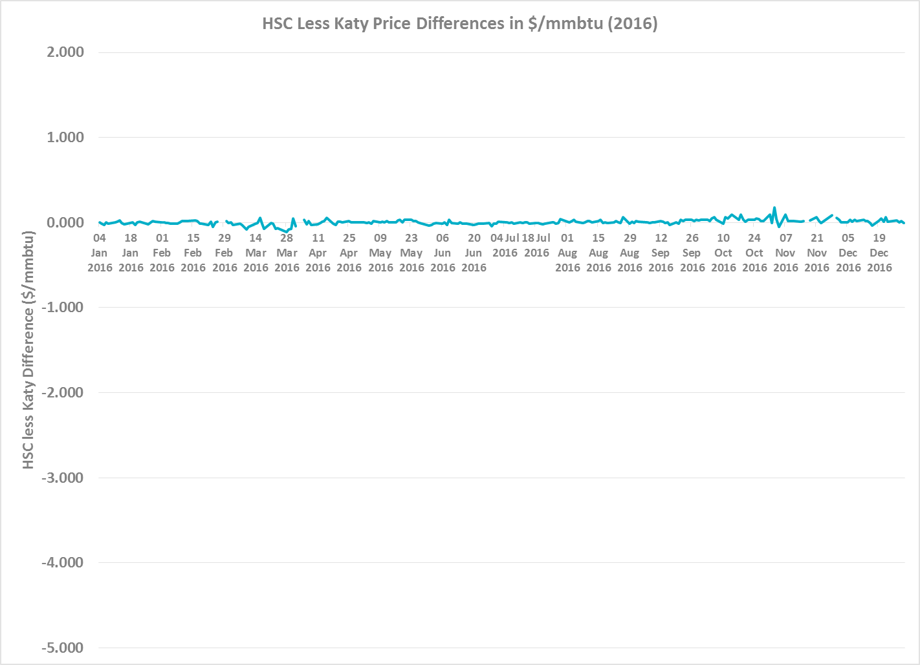
HSC Less Katy Price Differences in $/mmbtu (2016)
Source: Argus

Slide 13
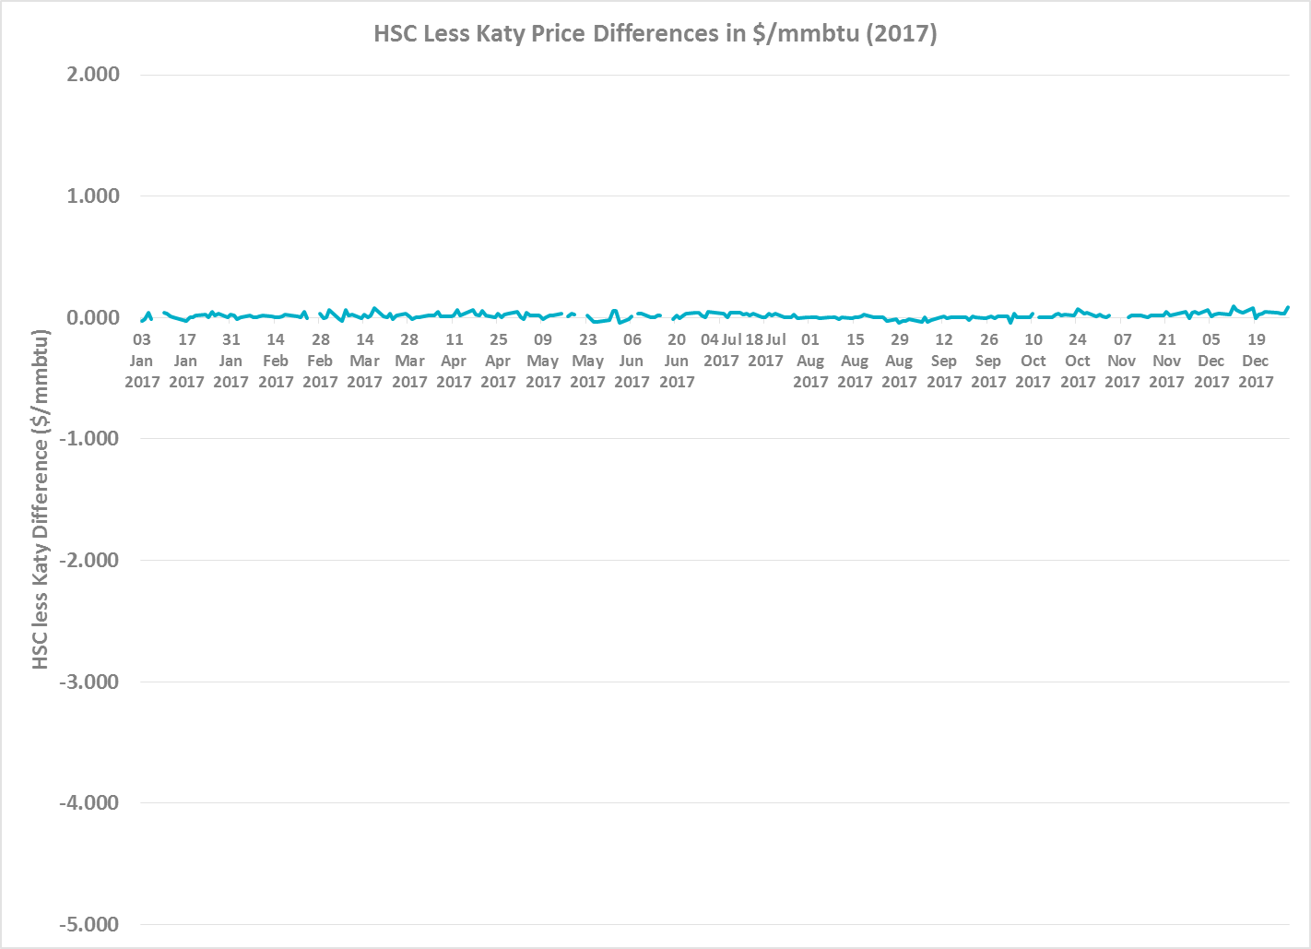
HSC Less Katy Price Differences in $/mmbtu (2017)
Source: Argus

Slide 14
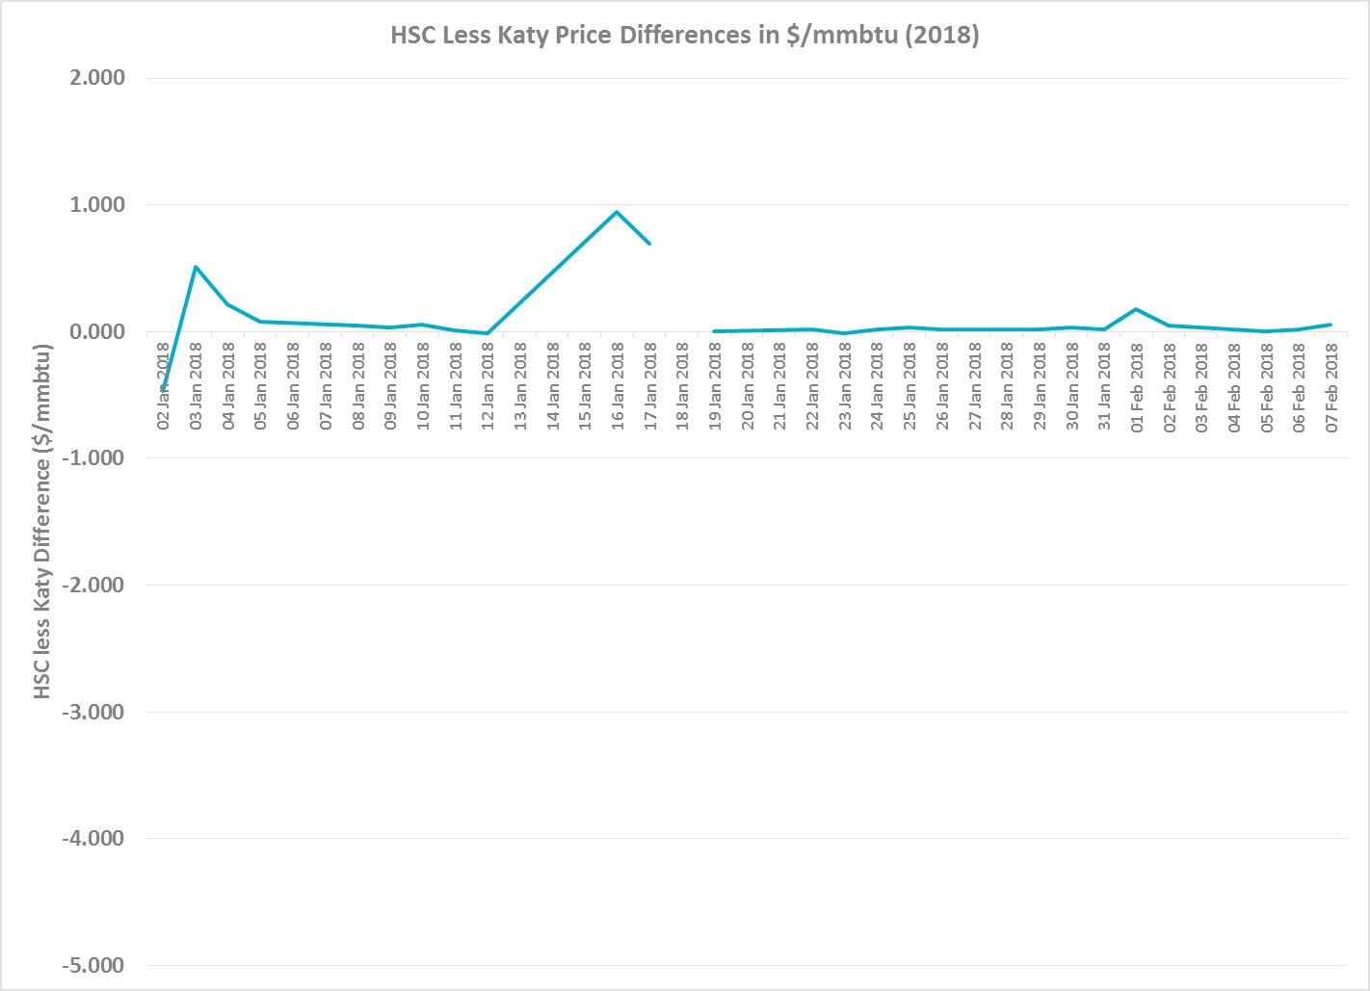
HSC Less Katy Price Differences in $/mmbtu (2018)
Source: Argus

