Slide 1
NPRR864 – Study of Scaling Factor for Costs of Shorter Start Time Resources
Aaron Townsend
April 30, 2018

Slide 2
Study
Re-ran selected HRUCs
Re-ran two cases for each HRUC:
Base Case: with as-submitted (pre-NPRR864) costs
20% Scaling Case: with start-up and minimum generation costs of fast-start (CST <= 1 hour) resources scaled per NPRR864 (verifiable or generic costs scaled by a factor of 20%)
Generally the results are as would be expected: recommendations shift to prefer fast-start resources
Two examples are shown in the following slides

Slide 3
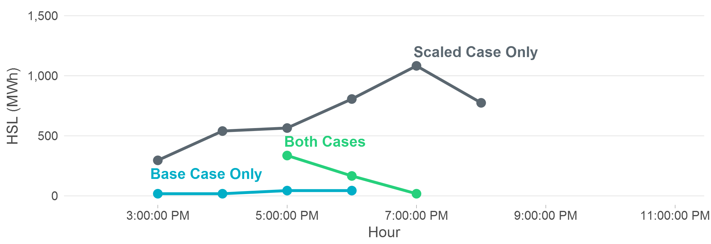
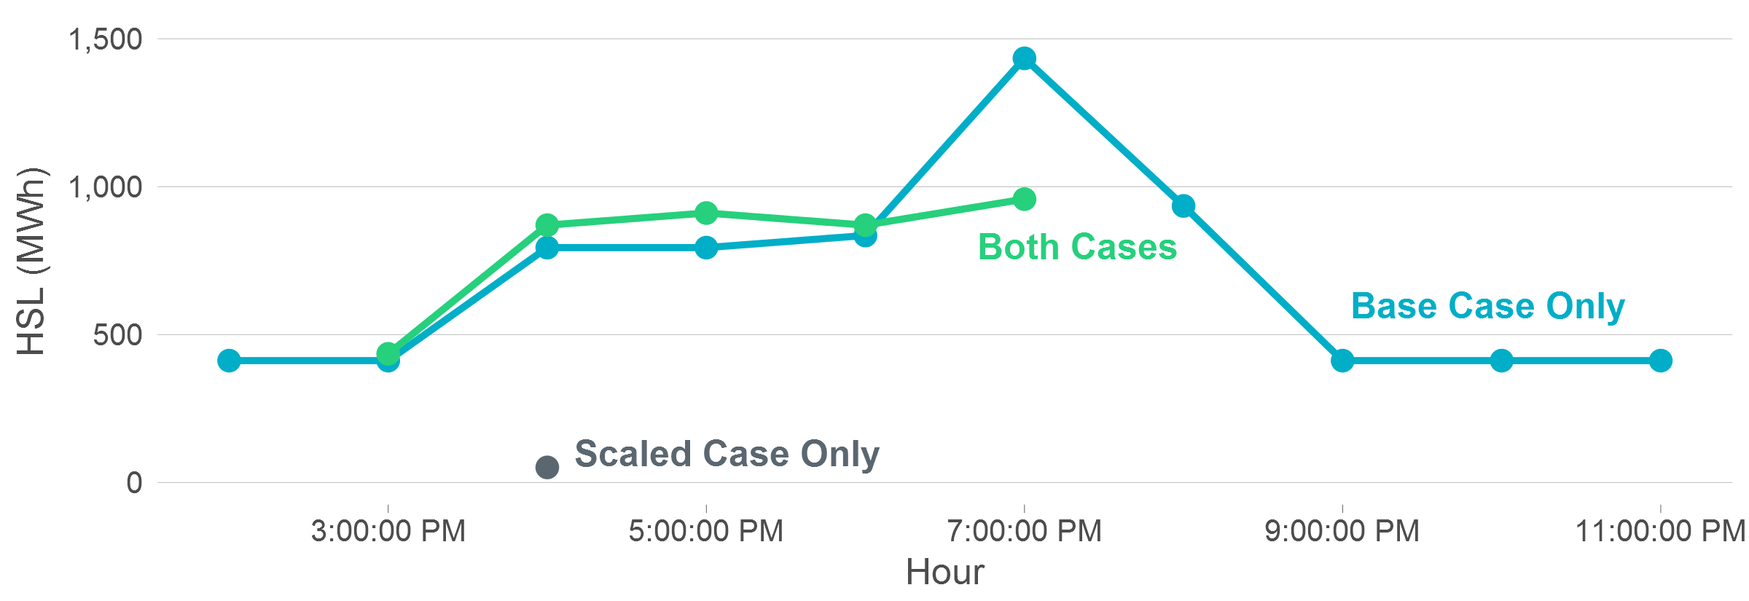
8/6/2017 7am HRUC Recommendations
Fast-Start Resources
Slow-Start Resources

Slide 4
8/6/2017 7am HRUC Metrics
Recommendation Metrics | Without Commitments | Base Case | 20% Scaling
Unique Hours | - | 10 | 6
Unique Resources | - | 18 | 31
Unique Fast Starts | - | 11 | 27
Unique Slow Starts | - | 7 | 4
Total HSL | - | 11,540 MWh | 8,670 MWh
Peak HSL | - | 2,410 MW | 2,058 MW
Total LSL | - | 2,329 MWh | 3,265 MWh
Peak LSL | - | 503 MW | 774 MW
Constraints Binding | 8 | 5 | 5
Constraint Binding Hours | 12 | 13 | 13
Constraint Violation | 58 MWh | 0 MWh | 0 MWh
Max Constraint Shadow Price | $100,000 MWh | $26/MWh | $26/MWh
Capacity Shortage | 8,431 MWh | - | -
Capacity Shortage Peak | 1,855 MW | - | -

Slide 5
8/6/2017 7am HRUC Conclusions
Capacity committed in the base case from slow-start units was replaced by fast-start units in the scaled case
HSL energy and peak MW decreased
LSL energy and peak MW increased
The capacity shortage was resolved in both cases

Slide 6
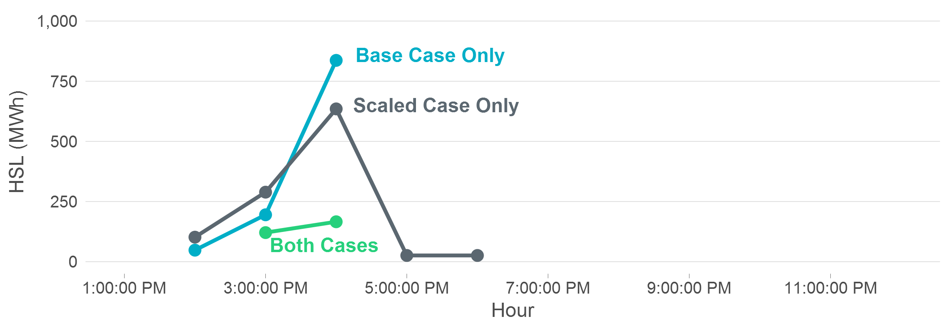
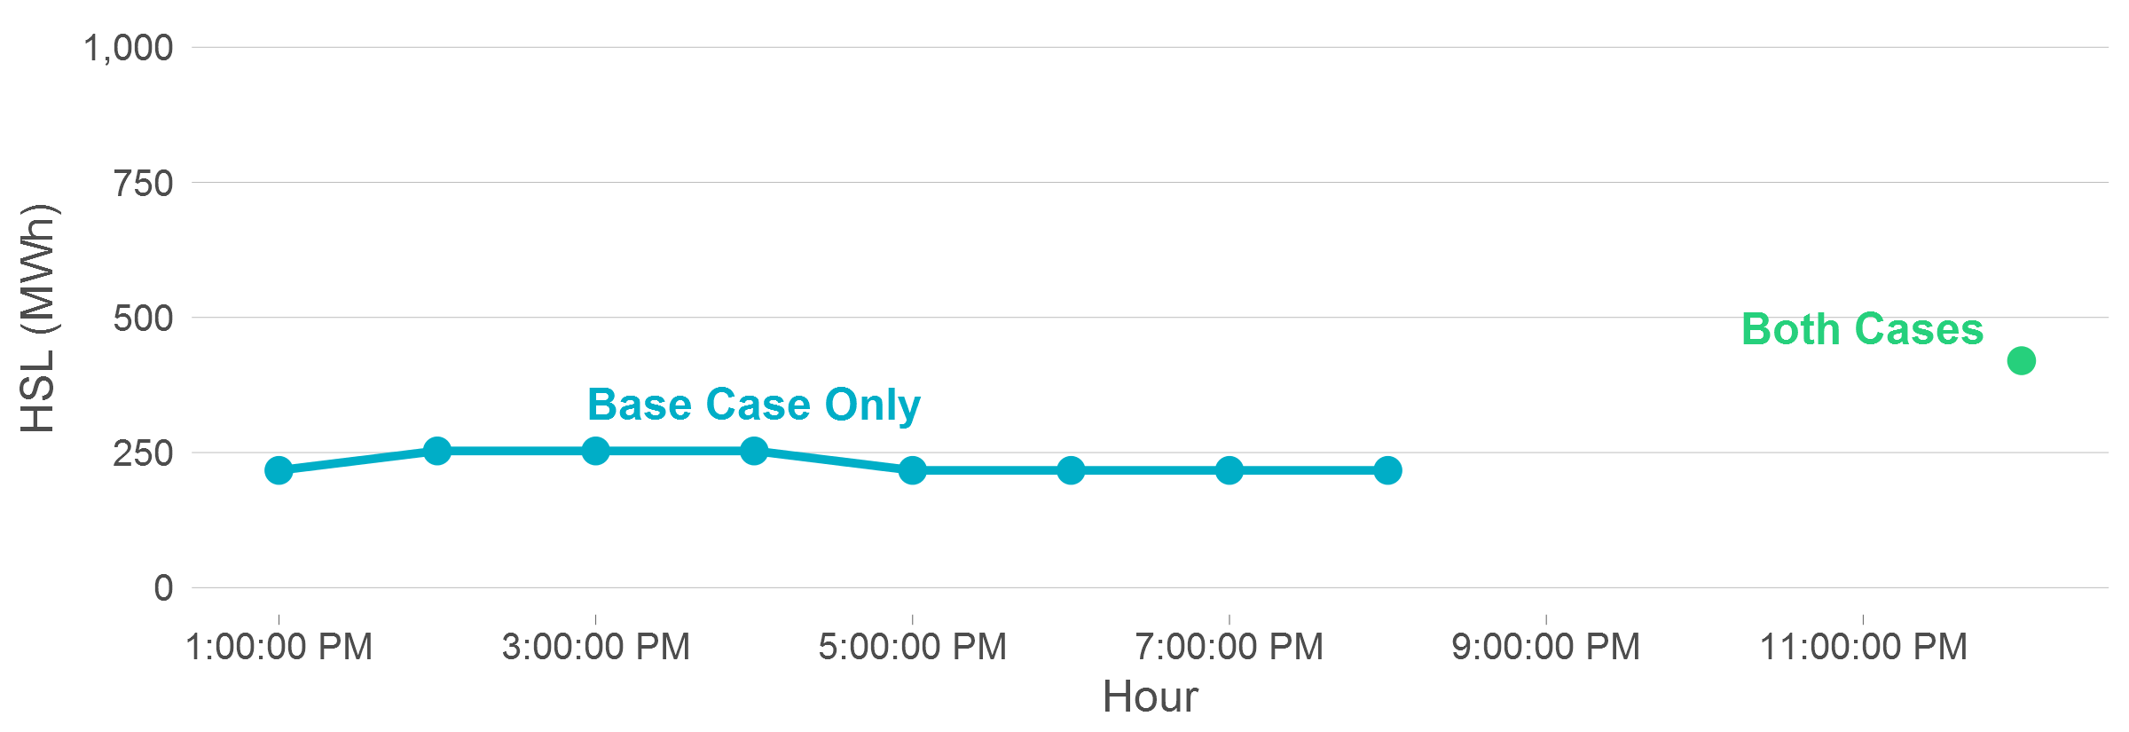
6/12/2017 5am HRUC Recommendations
Fast-Start Resources
Slow-Start Resources

Slide 7
6/12/2017 5am HRUC Metrics
Recommendation Metrics | Without Commitments | Base Case | 20% Scaling
Unique Hours | - | 5 | 6
Unique Resources | - | 25 | 18
Unique Fast Starts | - | 22 | 17
Unique Slow Starts | - | 3 | 1
Total HSL | - | 3,630 MWh | 1,785 MWh
Peak HSL | - | 1,256 MW | 801 MW
Total LSL | - | 1,262 MWh | 876 MWh
Peak LSL | - | 551 MW | 510 MW
Constraints Binding | 11 | 14 | 13
Constraint Binding Hours | 16 | 16 | 16
Constraint Violation | 628 MWh | 84 MWh | 84 MWh
Max Constraint Shadow Price | $100,000/MWh | $100,000/MWh | $100,000/MWh
Energy/AS Shortage | - | - | -
Energy/AS Shortage Peak | - | - | -

Slide 8
6/12/2017 5am HRUC Conclusions
More expensive fast-start resources with better shift factors were recommended in the scaled case
Fewer recommendations overall
Both HSL and LSL energy and peak MW decreased
Constraint violations remained at the same level
No slow-start resources were recommended in the scaled case

Slide 9
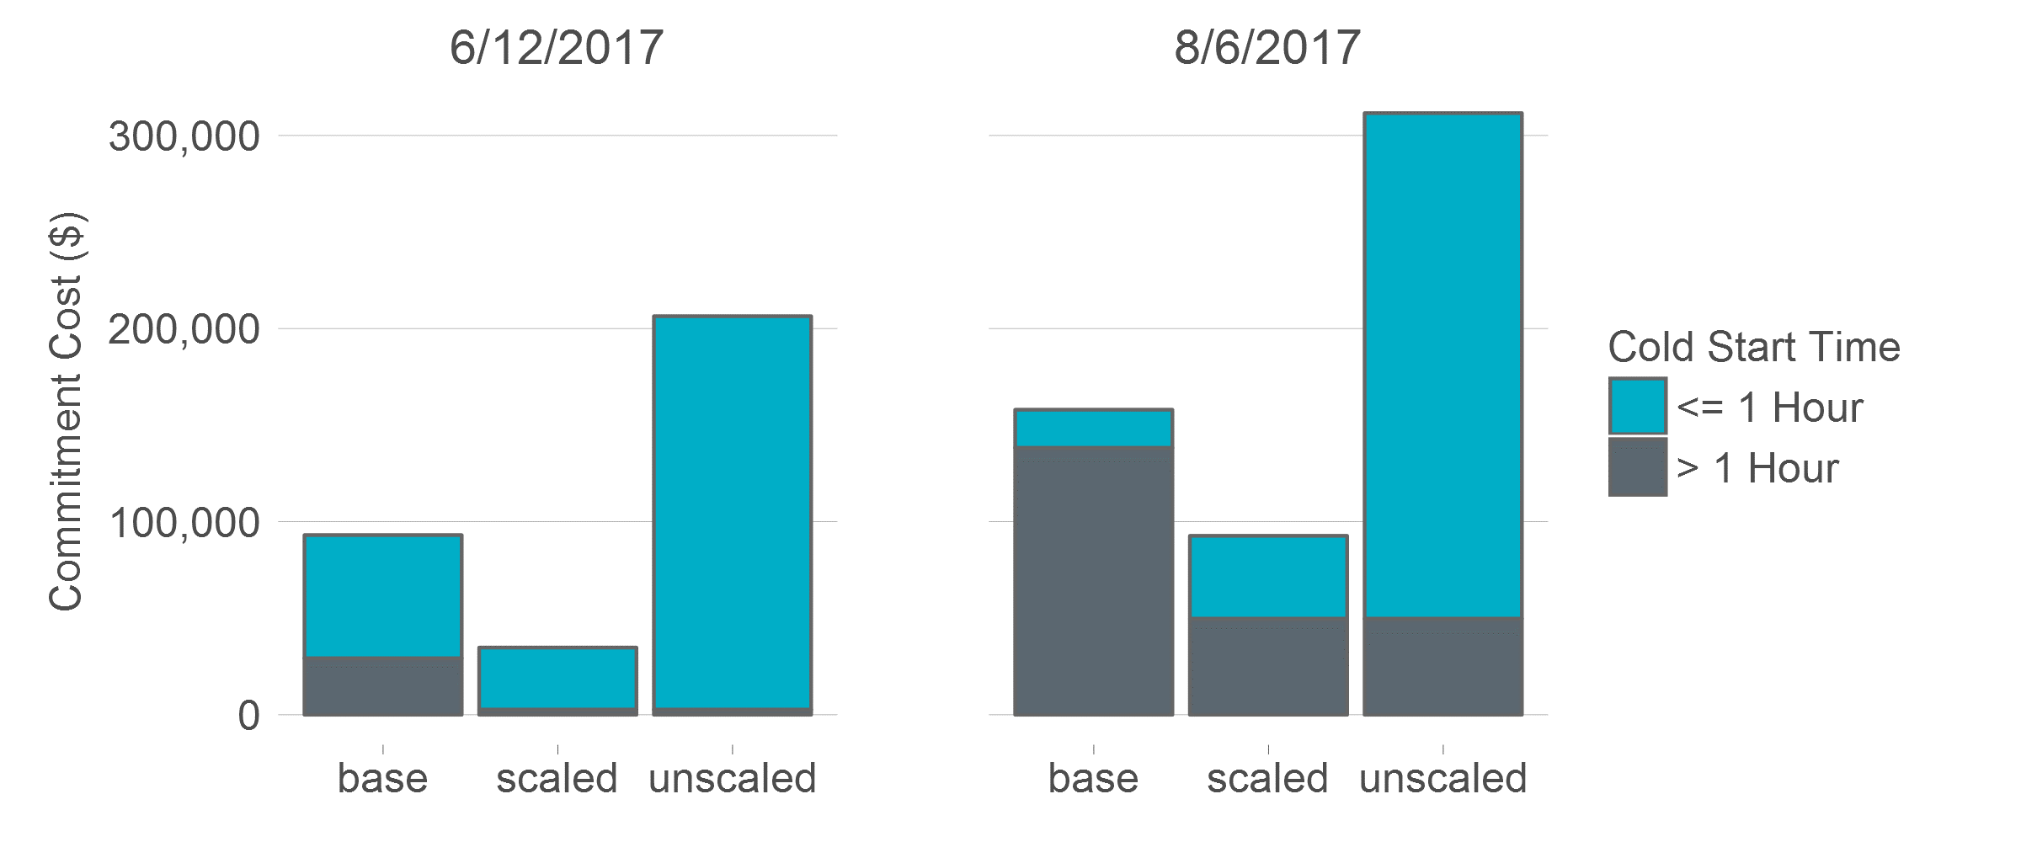
Commitment Cost Comparisons
Scaling fast-start resource costs causes RUC to prefer solutions that do not have the lowest real-world commitment costs
Recommendations would have higher real-world costs if all were actually committed
Delaying a commitment decision may remove the need for the RUC through self-commitment or other changes in system conditions

Slide 10
Scaled Case Solutions Are Not Simple Substitutions
Results are not always intuitive
Fast-starts are not simply substituted for slow-starts
Scaled case recommendations are often very different than base case
In many cases it requires in-depth analysis to determine why one solution is selected over another
Fast-Start
Resources
Base Case Recommendations
Scaled Case Recommendations

Slide 11
Other General Observations
Recommendations usually have a larger number of smaller resources
Often recommends marginally lower total HSL energy and peak MW
Recommendations often contain higher-LSL resources
LSL energy is heavily discounted so less incentive to choose low-LSL resources
Recommendations may be for different hours due to choosing different resources with different minimum runtime constraints (usually different slow start resources)

