Slide 1
2018 LTSA Update
Regional Planning Group Meeting
April 24, 2018

Slide 2
Agenda
Results of completed scenarios
  Current Trends redo
  High Economic Growth
  High Renewable Penetration
DC tie Review from Current Trends Scenario
Next Step

Slide 3
Starting Capacity Mix Updated
Included planned resources which meet Planning Guide 6.9

Slide 4
Current Trends Results Updated
Reserve margin in final year:4.6%
Built 7,500 MW gas generation
Built 14,400 MW solar
Built 3,000 MW wind
Total retirement was 7,780 MW
Unserved energy in 2028 thru 2033. Shortages occur hours 19 thru 21. Maximum magnitude is over 6,000 MW

Slide 5
High Economic Growth Assumptions
2.2% average annual load growth rate;
2.5 GW rooftop PV by 2033;
Gas price – 2018 AEO Reference Case.

Slide 6
High Economic Growth Results
Reserve margin in final year: 8.8%
Built 3,075 MW gas generation
Built 21,700 MW solar
Built 14,200 MW wind
Total retirement was 1,112 MW
Unserved energy in all years. 2019 shortages occur hours ending 14 thru 17.
2033 shortages occur hours ending 20 and 21, with maximum magnitude over 7,800 MW

Slide 7
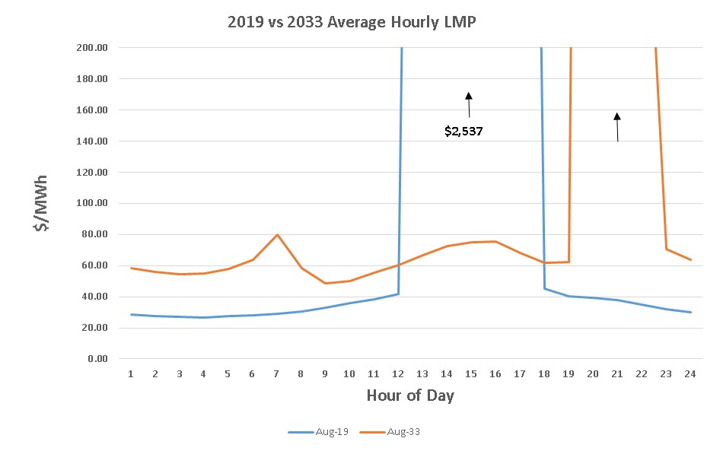
August Average LMP 2019 vs 2033 in High Economic Growth
Results illustrated same evening peak issue in 2033 as seen in 2016 LTSA with solar generation ramping off.
$1,791

Slide 8
High Renewable Penetration Assumptions
Added 20,000 MW of distributed PV by 2033;
Reduced annual amount of wind and solar that could be built to 2,000 MW and 1,000 MW respectively;
CO₂ cost of $25/ton.

Slide 9
High Renewable Penetration Results
Reserve margin in final year: 9.9%
Built 10,000 MW gas generation
Built 3,000 MW wind
Built 8,600 MW solar
Total retirement was 10,253 MW
Unserved energy in 2023 thru 2033. In 2033 unserved hours were 19 thru 21, similar to other scenarios, with a maximum unserved of 6,750 MW.

Slide 10
New DC Tie in Current Trends
Created an area outside of ERCOT
  2000 MW load
  4,000 MW Combined Cycle with same NG price as ERCOT and a 7,000 Btu/kWh heat rate
  2,000 MW tie line with 2.00 $/MWh wheeling rate for exporting and 45.00 $/MWh rate for importing
Results showed large amounts of exports mostly during high renewable operation and small amount of imports during ERCOT peak periods

Slide 11
Next Step
Generation Expansion
  High Renewable Cost Scenario
  Emerging Technology Scenario

Slide 12
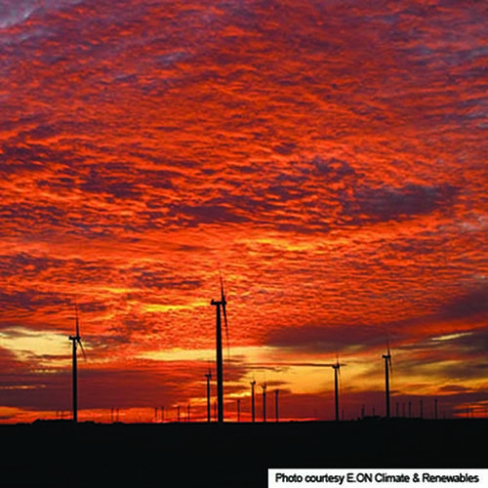
Questions
Contact info:
Julie Jin Doug Murray
julie.jin@ercot.com douglas.murray@ercot.com
512.248.3982 512.248.6908
Sandeep Borkar
sandeep.borkar@ercot.com
512.248.6642

