Slide 1
Example Contingency Definitions
April 30, 2018

Slide 2
Agenda
Purpose of contingency analysis
Contingency definition
Discuss example contingencies and processing
#1 Outages branches only
#2 Outages branches and load
#3 Outages branches, load, generation, and resource node
#4 Outages unit

Slide 3
Purpose of contingency analysis
ERCOT is required to maintain N-1 security in Real-Time where possible
Contingency Analysis tool is used to identify transmission branch overloads under various “what-if” scenarios
If RAS/RAP cannot resolve transmission branch overloads then transmission constraints are provided to optimization engine to resolve. Note that in Real-Time, the Operator reviews transmission constraints before activating
ERCOT approach to meeting reliability is “Preventative” dispatch

Slide 4
Contingency definition
Contingencies are defined “breaker-to-breaker,” meaning multiple line sections may be outaged as part of a given contingency definition
Single circuit contingencies are programmatically generated by ERCOT modeling tools and updated with each Network Operations Model database load
Double circuit contingency details are submitted through the NOMCR process by TSPs; ERCOT modeling tools use this information to generate the double circuit contingency definitions
Share common tower for more than ½ contiguous mile
IS considered an N-1 event in the Operations Horizon

Slide 5
Contingency definition
Nuances
Motor-operated switches that behave like a breaker – Can use these devices to stop a contingency definition trace
Normally Open devices – Contingency definition traces stop at Normally Open equipment
Breakers without relaying – Can set the model so a contingency trace goes past a breaker without relaying capability
ERCOT does not consider sectionalizing in its contingencies, but does consider load rollover if the rollover schemes are in the Network Operations Model (TSP-defined)
Manual Contingencies
Used for interim configurations during topology upgrades/changes or when relaying is temporarily disabled

Slide 6
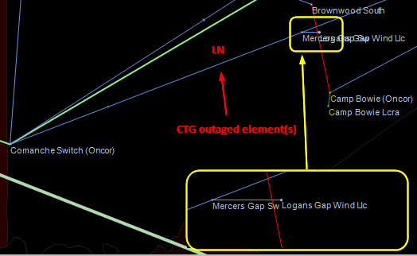
#1 SZEPCMN8: Mercers Gap Switch to Comanche Switch

Slide 7
#1 SZEPCMN8: Mercers Gap Switch to Comanche Switch - Processing
Outaged equipment
Line Comanche Switch to Mercers Gap 138 KV

Slide 8
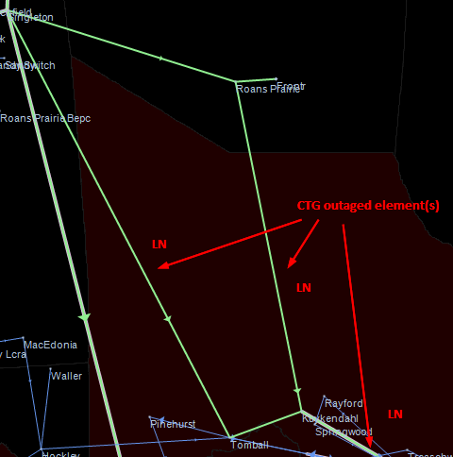
#2 DRNS_TB5: TWR (345) SNG-TB74 & RNS-RTW75

Slide 9
#2 DRNS_TB5
Outaged equipment
Line Tomball to Singleton 345 kV Kuykendahl to Rothwood 345 kV Kuykendahl to Roans Prairie 345 kV (Kuykendahl is a tap station w/o breakers on the RNS – RTW line) Load Kuykendahl 345 kV KDL_TR2 ~45 MW Series Device KDLTAP74_1

Slide 10
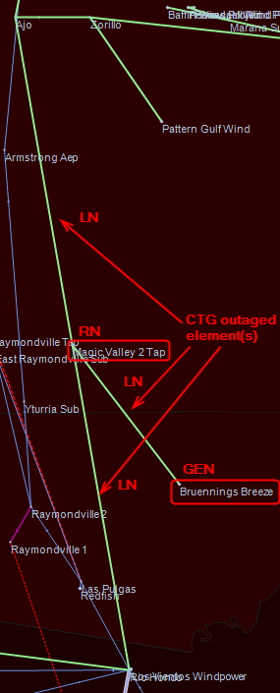
#3 SAJORI25: Ajo to Rio Hondo

Slide 11
#3 SAJORI25: Ajo to Rio Hondo
Outaged equipment
Line Ajo to Magic Valley 2 Tap 345 KV (Magic Valley 2 Tap is a tap station w/o breakers on the Ajo to Rio Hondo Line) Magic Valley 2 Tap to Rio Hondo 345 KV Magic Valley 2 Tap to Bruennings Breeze 345 KV Resource Node BBREEZE_1_2 (in station Magic Valley 2 Tap) Generator BBREEZE_UNIT1 BBREEZE_UNIT2 Load BRU_LD1 BRU_LD2

Slide 12
#4 UST2STP1
Outaged equipment
Generator STP G2 The Resource Node remains energized

