Slide 1
Analysis of Load Reductions Associated with 4-CP Transmission Charges and Price Responsive Load/Retail DR
Carl L Raish
Principal Load Profiling and Modeling
Demand Side Working Group – April 20, 2017

Slide 2
Overview
  4CP Analysis
    Competitive and NOIE Areas
  Price Response and Retail DR
    Block and Index Pricing (BI)
    Other Load Control (OLC)
    Other Voluntary DR (OTH)
    Peak Rebate (PR)
    Real Time Pricing (RTP)
    Time-of-Use Pricing (TOU)
      Analysis not available
  NOIE Price Response
  Interaction of 4CP and price response

Slide 3
Hurricane Impact Days - 2017
August 25
September 20

Slide 4
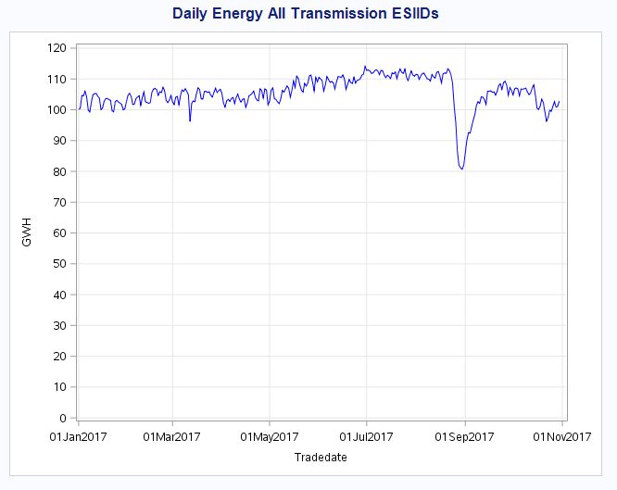
Hurricane Impact Days - 2017
Determine hurricane affected weather/load zones
Identify ESIIDs/NOIEs in those areas with at least 10% daily energy reductions for at least 5 consecutive days
Identify next day which begins at least 5 days of near normal use
Assume no 4CP or price response for those days
Do not use days for baseline calculations

Slide 5
Competitive 4 CP Days - 2017
CP Reduce = 859
CP Reduce = 759
CP Reduce = 382
CP Reduce = 684

Slide 6
NOIE 4 CP Days - 2017
CP Reduce = 153
CP Reduce = 782
CP Reduce = 175
CP Reduce = 267

Slide 7
Competitive + NOIE 4 CP Days - 2017
CP Reduce = 1,011
CP Reduce = 1,541
CP Reduce = 557
CP Reduce = 952

Slide 8
Competitive 15-Minute Response 2009 - 2017

Slide 9
NOIE 15-Minute Response 2009 - 2017

Slide 10
Competitive Hour Ending 17:00 Response

Slide 11
NOIE Hour Ending 17:00 Response

Slide 12
2012 – 2017 Pricing Events
For this analysis a High Price Event has been defined as a day with a Load zone price > $200 for 4 consecutive 15-minute intervals
For the 2012 – 2017 years,194 days with high price events were identified in one or more load zones
  AEN – 66 days
  CPS – 58 days
  Houston – 73 days
  LCRA – 67 days
  North – 46 days
  Raybn – 49 days
  South – 89 days
  West – 116 days
119 days had high price events in only 1 load zone
40 days had high price events in all 8 load zones
Of the 92 4CP/NearCP days, only 5 had high price events
  3 were actual 4CP days and 2 NearCP days
  Each of those 5 days had high price events in all 8 load zones
  13 of the 40 days with high price events in all 8 load zones occurred during a summer month (June – September)

Slide 13
2017 Block & Index Analysis
21 Reps; 18,886 Bus customers; 193.9 MW; 19 event days
Houston
May 19, 2017
36.2 MW Reduce
North
Oct 4, 2017
88.6 MW Reduce
West
Dec 7, 2017
33.3 MW Reduce
South
April 3, 2017
35.8 MW Reduce

Slide 14
2017 OLC Analysis
2 Reps reported 15 deployments in 2017 affecting 2,345 Res customers
One composite graph shown combining day with each REP’s largest reduction
2.2 MW Reduce

Slide 15
2017 Other Voluntary DR Analysis
3 Reps reported 23 deployments in 2017 affecting 56,276 customers
Program same description as 2016
Reductions ranged from 0 – 26.7 MW
Aug 1, 2017
10.9 MW Reduce
Aug 2, 2017
26.7 MW Reduce
Aug 17, 2017
9.4 MW Reduce
Aug 21, 2017
13.5 MW Reduce

Slide 16
2017 Peak Rebate Analysis
2 Reps reported 3 deployments in 2017 affecting 39,942 customers
No days with deployments by both REPs
Composite Deployment 2017
13.4 MW Reduce

Slide 17
2017 Real Time Pricing Analysis
14 Reps; 14,769 customers; 24.5 MW; 19 event days
Houston
May 19, 2017
8.4 MW Reduce
North
Oct 4, 2017
12.9 MW Reduce
West
May 30, 2017
2.1 MW Reduce
South
May 19, 2017
1.2 MW Reduce

Slide 18
2017 NOIE Price Response Analysis
10 NOIEs identified as responding to high prices; 257.1 MW; 17 event days
Composite Deployment 2017
257.1 MW Reduce

Slide 19
Interaction of 4CP and Price Response
4CP days for ESIIDs and NOIEs that respond both to 4CP events and high price events
CP Reduce = 483
CP Reduce = 566
CP Reduce = 304
CP Reduce = 488

Slide 20
Interaction of 4CP and Price Response
ESIIDs (BI and RTP) that respond to 4CP/NearCP plus NOIEs identified as price responsive and as responding to 4CP/NearCP account for a significant share of the total 4CP/NearCP response.
These same ESIIDs and NOIEs provide about 221.1 MW of the response to high prices, which is 46.5% of the total response from all BI and RTP ESIIDs and all NOIEs identified as price responsive.
  Note: as indicated in the table above, these ESIIDs 4CP response ranged from 160.5 MW to 509.2 MW and averaged 350.2 MW.

Slide 21
Questions?
ON
OFF
craish@ercot.com 512/248-3876

