Slide 1
Credit Exposure Update
Spoorthy Papudesi
Credit Work Group
ERCOT Public
April 20, 2018

Slide 2
Credit Exposure Update
Inputs and Assumptions:
Only Active Counter-Parties are included
Counter-Parties are classified by rating and market activity
TPE and collateral balances used are averages for February(7th-28th) and March 2018
Counter-Parties that are subsidiaries of, or guaranteed by, rated entities are given the parent/guarantor’s rating, adjusted down one notch

Slide 3
Credit Exposure Update
March 2018 compared to post-NPRR800 February
Market-wide average TPE slightly increased from $398.5 million to $398.7 million.
TPE decreased by $0.78 million for “Trader” category.
TPE increased by $0.78 million for “Gen Only” category.
TPE increased by $0.21 million across all other categories.
Excess collateral slightly increased from $1,828 million to $1,833 million.
increased by $3.28 million for “Trader” category
increased by $1.56 million for “Gen Only” category.
decreased by $0.04 million across all other categories.
Number of active Counter-Parties increased from 213 to 219.

Slide 4
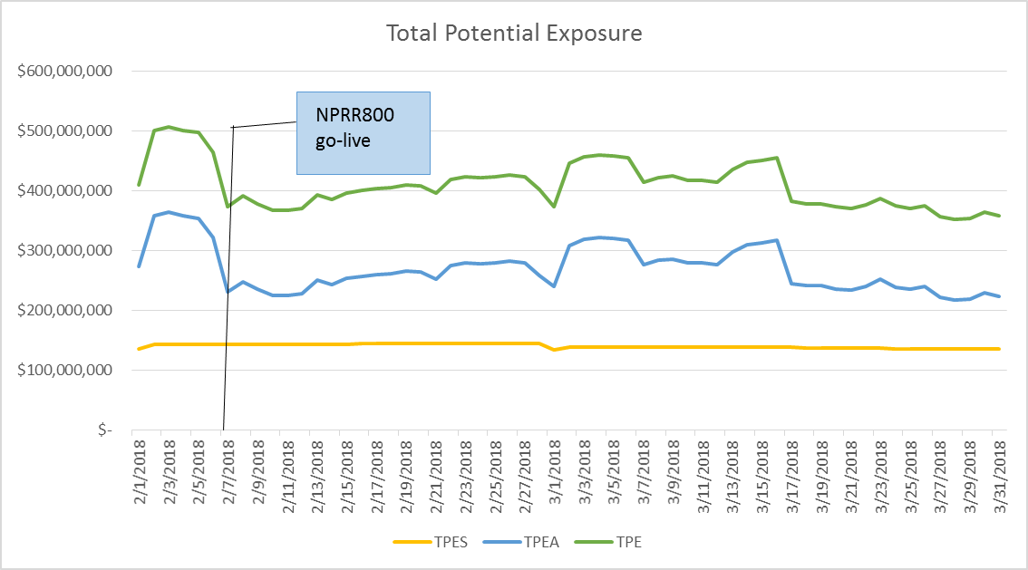
Credit Exposure Update

Slide 5
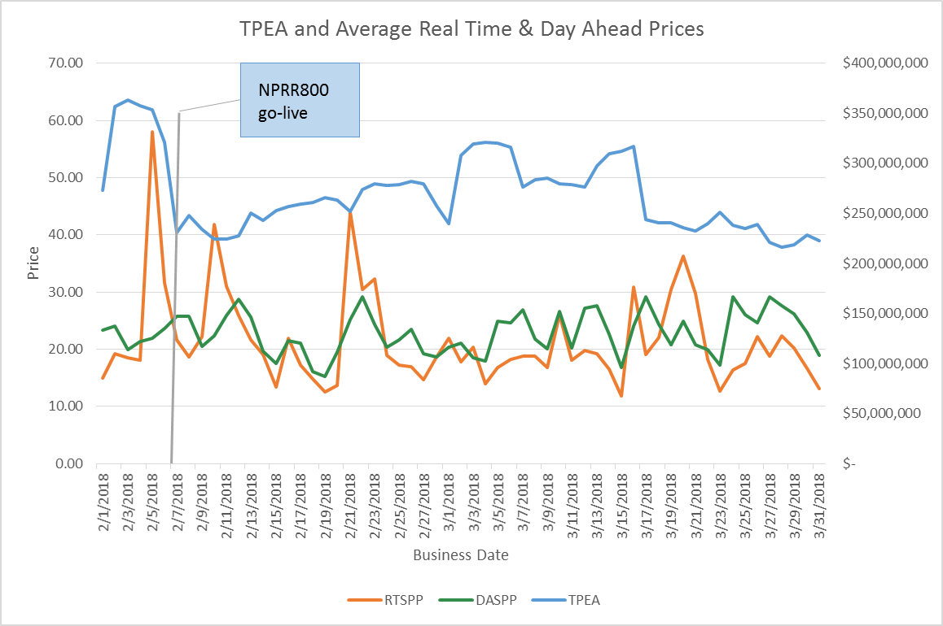
Credit Exposure Update

Slide 6
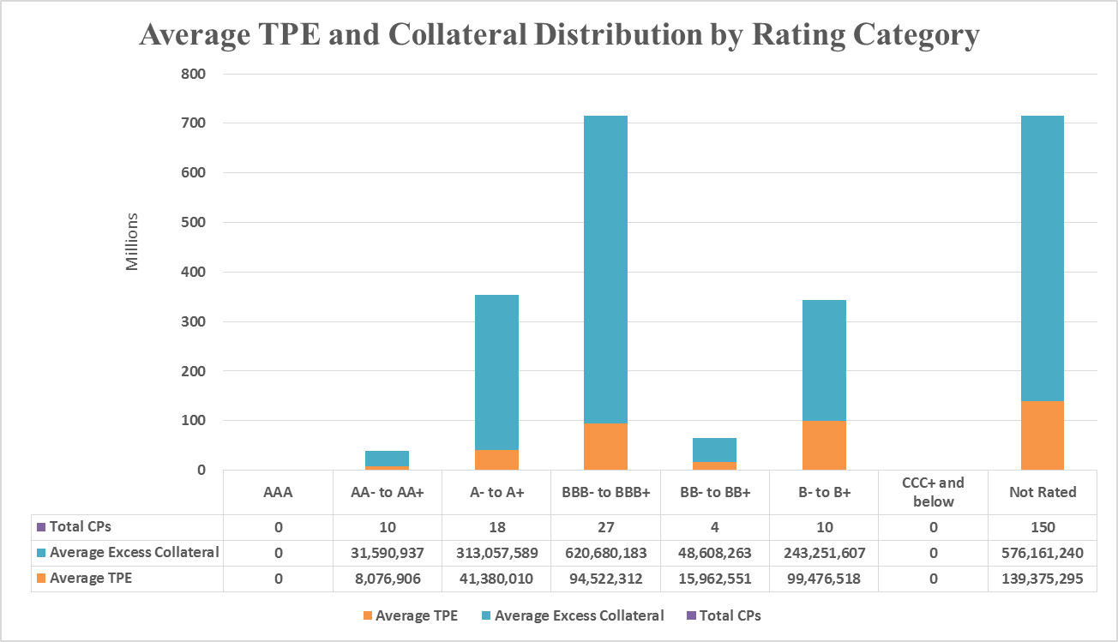
Credit Exposure Update

Slide 7
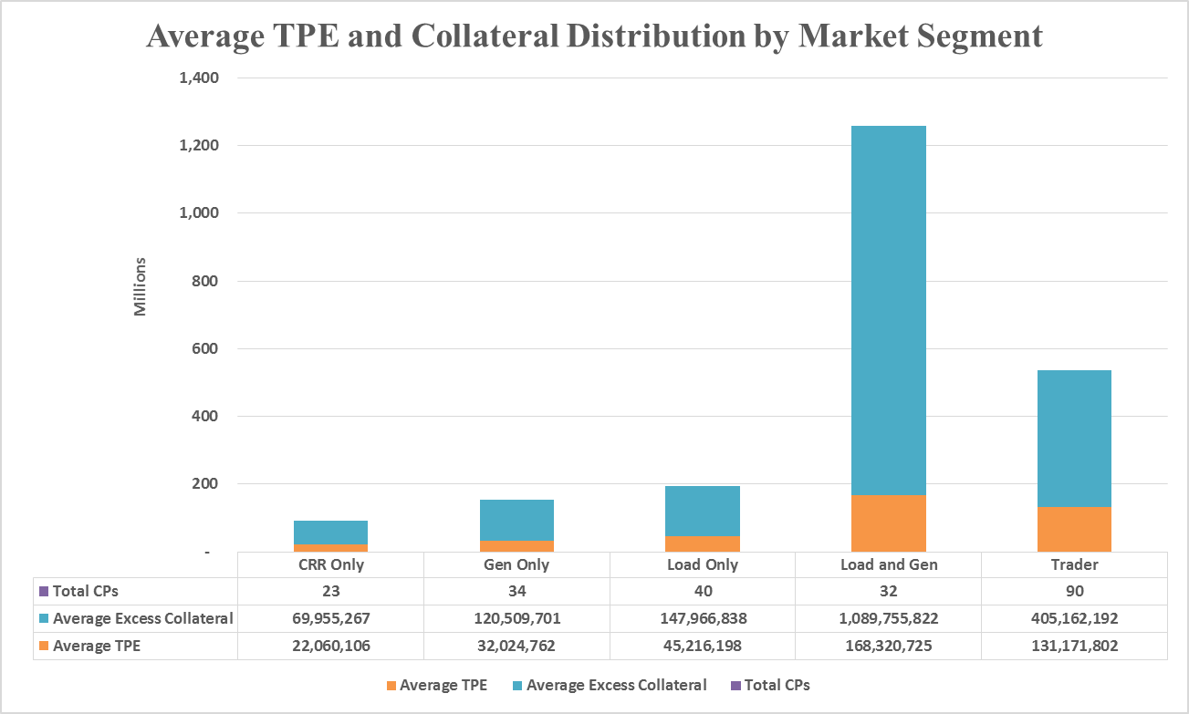
Credit Exposure Update

Slide 8
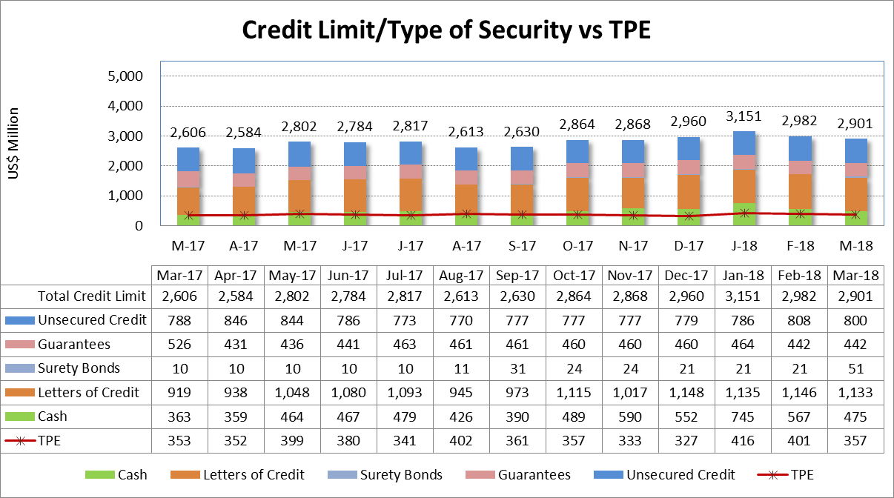
Credit Exposure Update

Slide 9
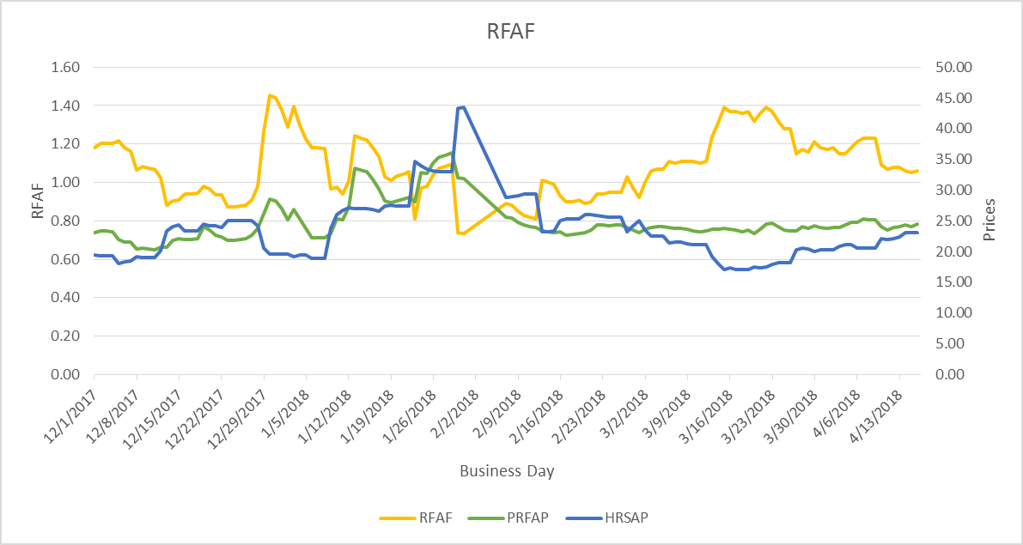
Credit Exposure Update
Real-Time Forward Adjustment Factor (RFAF)
RFAF is calculated using 21 days of ICE future prices and 14 days of ERCOT Real Time Settled Prices for HB_NORTH settlement point

Slide 10
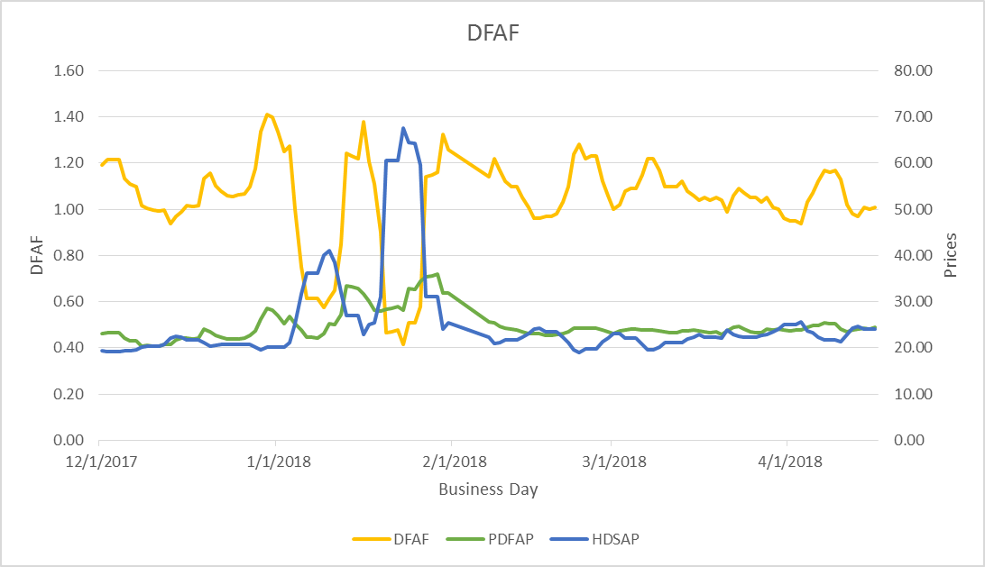
Credit Exposure Update
Day-Ahead Forward Adjustment Factor (DFAF)
DFAF is calculated using 21 days of ICE future prices and 7 days of ERCOT Day Ahead Settled Prices for HB_NORTH settlement point

Slide 11
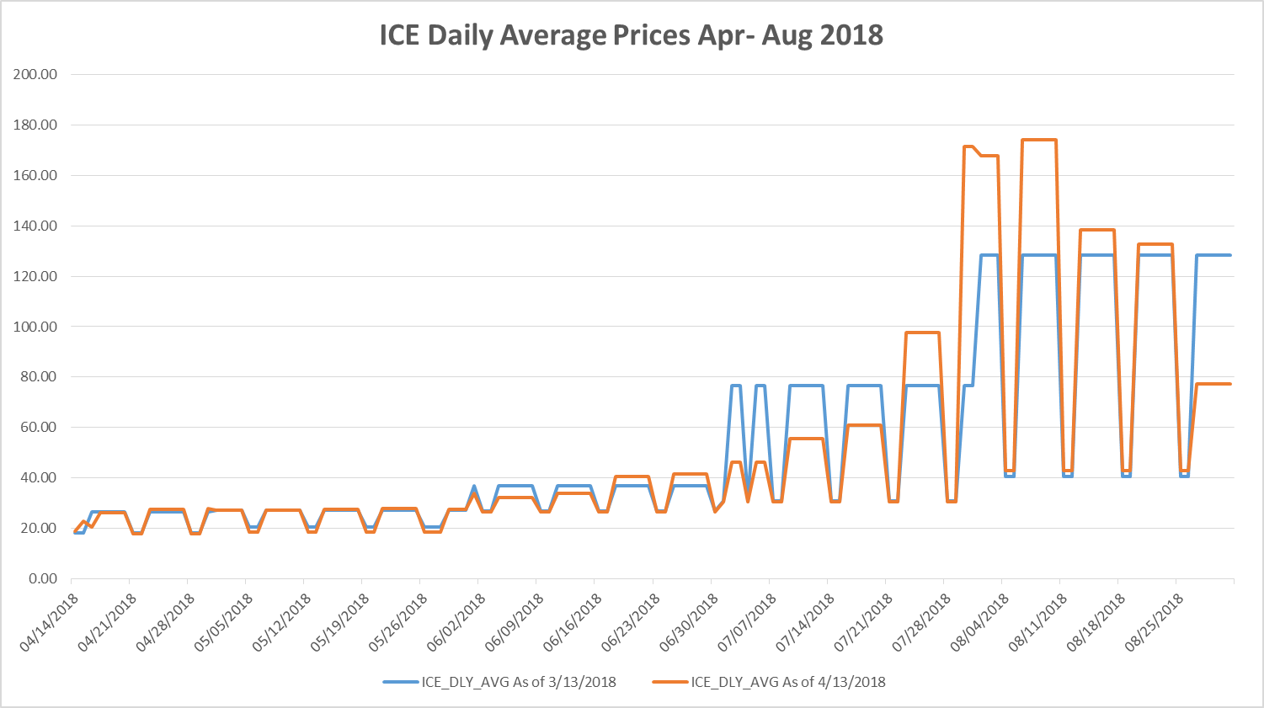
ICE Forward Curves April – August 2018

Slide 12
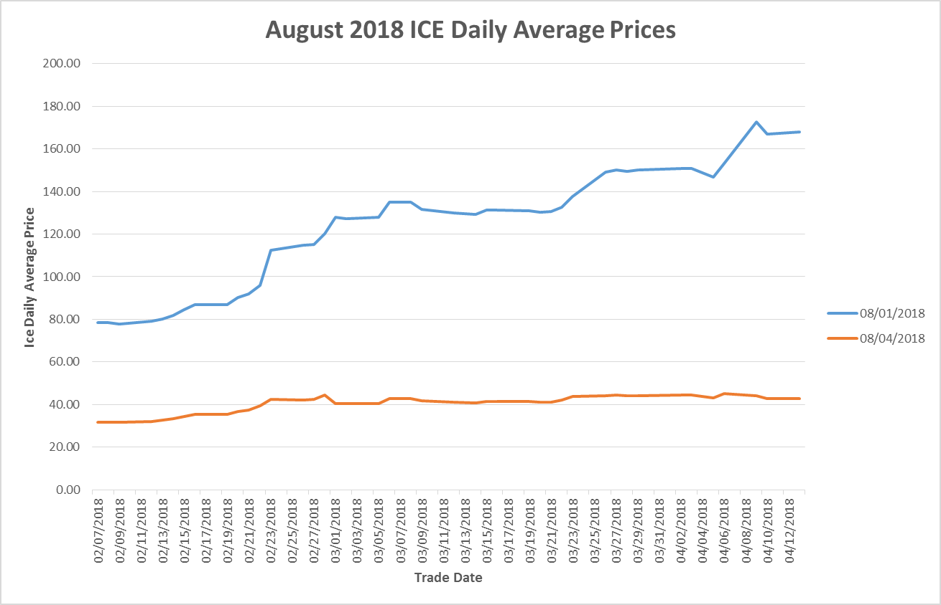
ICE Forward Curves April – August 2018
August ICE forward price evolution for weekdays and weekends.

Slide 13
Credit Exposure Update
Appendix

Slide 14
Credit Exposure Update
Summary statistics by Market Segment

Slide 15
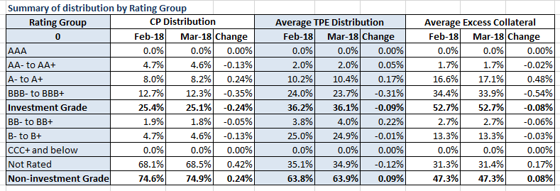
Credit Exposure Update
Summary statistics by Rating Group

Slide 16
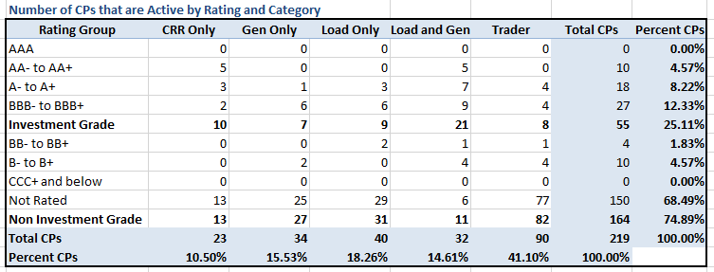
Credit Exposure Update
Active Counter-Parties distribution by rating and category- Mar 2018

Slide 17
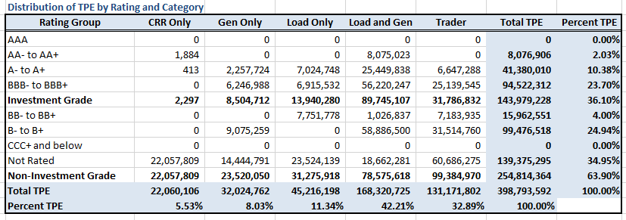
Credit Exposure Update
Average Total Potential Exposure distribution-Mar 2018

Slide 18
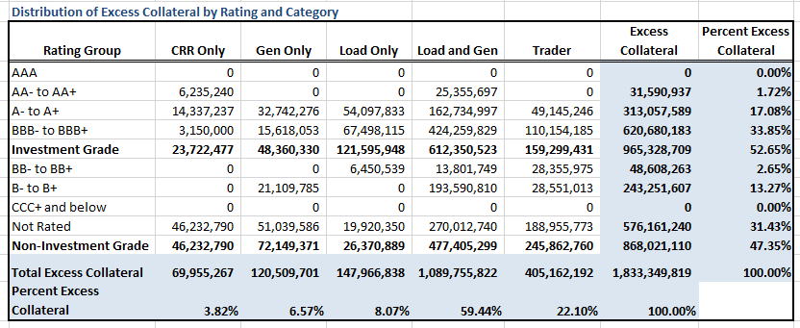
Credit Exposure Update
Average Excess Collateral distribution^{*-}Mar 2018
*Excess Collateral is a voluntary disposition by Counterparty

Slide 19
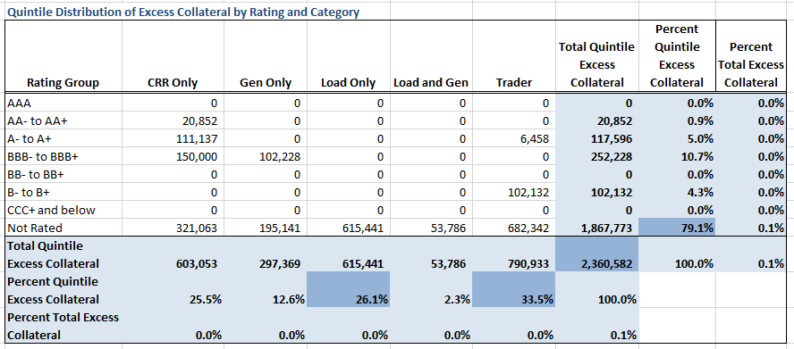
Credit Exposure Update
Distribution in the Bottom Quintile of Excess Collateral^{*-}Mar 2018
*Excess Collateral is a voluntary disposition by Counterparty

Slide 20
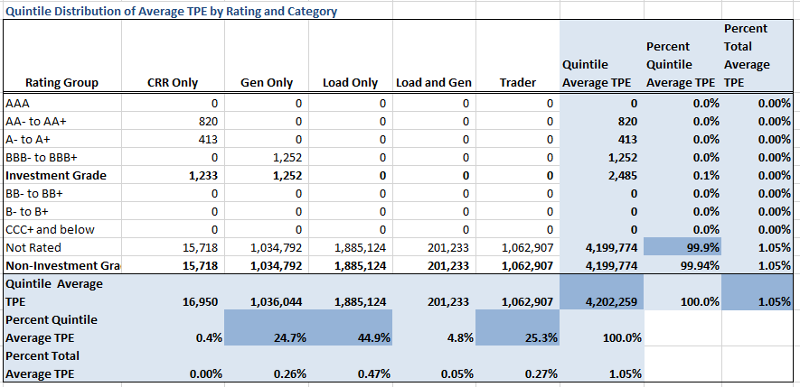
Credit Exposure Update
Distribution in the Bottom Quintile of Excess Collateral⁻Mar 2018

Slide 21
Credit Exposure Update
Questions

