Slide 1
NDSWG – April 17, 2018
Joe Weatherly
Network Modeling Manager
ERCOT Public
April 17, 2018

Slide 2
MGRR
Zero Impedance requirement:
When less than 1x10-5 per unit: use 0

Slide 3
DCTO – NPRR 857
Implementation to start mid-2019 completion in 2020
TSPs will undergo a registration process
ERCOT processes affected: Siebel, MIS, NMMS/SGEM, EMMS, Outage Scheduler, etc.

Slide 4
NPRR 776 (KV_POI)
Modeled points met requirements on 4/4/2018…However, need TSP ICCP values for QSE-side setup
June 1 deadline for QSEs to handle TSP targets
Market Notice 3/19/2018:
TOs/TSPs
(1) Submit any necessary Network Operations Model Change Requests (NOMCRs) for a model ready date of April 4, 2018.
(2) Begin updating the Voltage Set Point target to match the seasonal Voltage Profile Voltage Set Point or any updated Voltage Set Point instructions given to the Generation Resource beginning April 6, 2018.
(3) ERCOT recommends that TOs/TSPs coordinate with Resource Entities to discuss procedural steps, verbal communication protocols, etc., prior to April 6, 2018.
QSEs
(1) Begin receiving the Voltage Set Point target and associated POI kV measurement from ERCOT via ICCP beginning April 6, 2018.
(2) Begin providing the Voltage Set Point target and associated POI kV measurement provided by ERCOT (via the TO/TSP) to its Generation Resources before June 1, 2018.

Slide 5
SGEM Training
Success ! Thank You
Slides ZIP located on CITRIX (Gateway) under NMMSProd\NMMS_Postings\Training
Results & material from April’s 5-6 Intermediate class pending
Next (and last) 2018 Training class on May 10-11

Slide 6
SGEM Training
Comments from March 1-2 Beginner’s Training
Interim Update Report
Mobile loads should not be included in the report
Planning model updates should not be included in the report
Template Updates
Add EB to the bus bar template
Add local name to the line template
End cap template (error of base-voltage)
SGEM/MAGE Enhancements
Have option of saving just model change and not saving the diagram in MAGE
Want option to View In ME an archived model on the ‘Model Auditing’ tab in SGEM
Clean up ‘Model Auditing’ tab in SGEM by not having all the archived models list first, the user has to page through archived models to get to current and future models
The View In ME button is active on the ‘Modeling Auditing’ tab in SGEM for an archived model, however when selected there are no CRs to see. The View In ME button should be grayed out.

Slide 7
SGEM Training
Comments from March 1-2 Beginner’s Training
Outage Scheduler
Switches still appear in the OS even after the end date, they still look active. There is no distinction that the switch is no longer avail. Causes confusion.
Contingencies
There was a concern of the new responsibilities in regards to contingencies. The modelers do not know what should be a contingency, which means them having to find someone to provide that additional data. They want to discuss contingency process at next NDSWG.
Should models be validated with contingencies even though the Protection Scheme Group verify contingencies in model annually?
NDSWG
It was suggested that the NDSWG has a designated person to take notes at the meetings.
Suggested to have an Operations Modeling Symposium outside of training and NDSWG meetings.
Topic: Handling topology transitions in real-time that affect Modeled Contingencies. Group discussion with Ops & Modeling

Slide 8
SGEM Training
Comments from March 1-2 Beginner’s Training
TSP Asking for Guidance
If TSP wants to rename their substations to create consistency, how do they start this effort? Any suggestions from ERCOT?
Citrix Posting
Can the current NMMS postings on Citrix, all be moved to MIS?
Agenda desired prior to start of class to be posted for MPs

Slide 9
Bay modeling
Benefit: describing substation layout with attribute “Breaker Configuration” and/or “Busbar Configuration”
Possible future benefit: software upgrades incorporate feature
Provides method to improve Displays by minimize spaghetti layout
Provides method to improve Outage Scheduler by minimizing entries

Slide 10
Processing Contingencies / Real-time Transitions
DOUBLE Contingencies
Annual update of Double Contingencies almost complete
Use ICR to declare “No Change to Double Contingencies for 2018”
If needed, Double Contingencies can be changed as needed in future.
Existing / Future Contingencies
New process through CAMR will enable MPs to verify the Manual contingency created by ERCOT is appropriate.
Real-Time Transitions
TDSPs are responsible to notify ERCOT Operations when the Manual Contingencies need to be enabled and which Contingencies should be disabled. ERCOT will initiate the DPC process to enable and disable contingencies on the TDSP’s behalf.

Slide 11
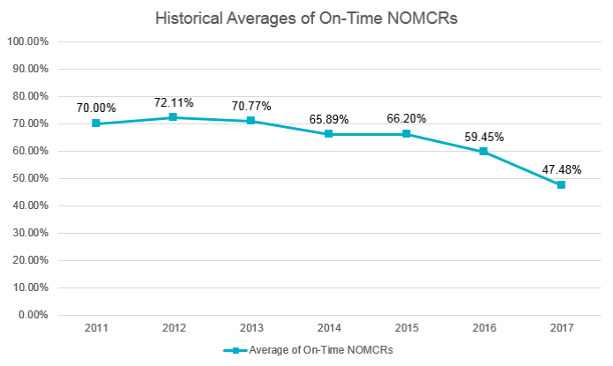
Interim restrictions
Reason for change:
Submittals meeting Protocol timelines have decreased to levels that negatively impact several key ERCOT functions.
Model validation
Outage Coordination
CRR auction accuracy
When: Oct 1, 2018

Slide 12
Interim restrictions
5 items removed from interim updates***:
New substations with Line-Breakers (or substation Breaker/Line reconfiguration) and Contingencies
New physical Lines and Contingencies
New Transformers and Contingencies
New Generation & Synchronous Condenser (already enforced)
Items requiring ResourceNode additions/modifications
3 Interim items considered for processing if meeting 65 Calendar Days prior to Database Load:
New Tap Station (No Line controlling Breakers)
New Shunt Compensator
New SVCs
2 Interim items considered for processing if meeting 20 Calendar Days prior to Database Load
Field vs Model Cleanup (Only Deletes)
New Loads (with controlling Breaker if applicable)

Slide 13
Interim restrictions
***Exceptions:
If needed for reliability of the ERCOT grid, the MP shall provide the ERCOT form for ERCOT’s consideration along with powerflow study(ies) that demonstrate the change relieves a reliability concern.
In an ERCOT declared Emergency, Interim Update restrictions may be temporarily waived.

Slide 14
Phases Angle data population
Since the initial 2016 population by ERCOT from an RFI of Phase Angles to be applied to the model, there has been a growth of newly modeled breakers with default 90deg. Phase Angle. Please review your modeled devices and update as needed. Assistance from ERCOT to help with a bulk update is available.

Slide 15
Protocol Improvement?
Noticed situations where MPs not providing MVA ratings (on modeled Lines) though they own terminal equipment in that circuit.
As per Protocol Definition of Rating: “…including substation terminal equipment in series with a conductor or transformer…” indicates all physical equipment (breakers and even Wavetraps/CT/etc. that not modeled) shall have its representation of Rating limits under the modeled-Line and modeled-transformer in the ERCOT model (per Protocol 3.10.7.1.1(2)(e) and 3.10.7.1.4(3)(e)).
In both Protocols “Each TSP” is specified indicating input expected from all owners of equipment.
ERCOT’s systems will select the most conservative MVA rating of all company submittals to ensure the MLSE of the circuit is monitored & maintained.

