Slide 1
Settlement Improvements for Price Sensitive Loads
Demand Side Working Group
Floyd J. Trefny
April 20, 2018

Slide 2
Background
Interval Data Recorders (IDR) meters measure retail load on 15-minute intervals
Load Zone Settlement Point Prices from ERCOT that retail consumers pay are based on 15-minute intervals.
Calculated for each bus’s load weighted average of 5-minute bus LMPs from each SCED executed during the 15-minute period
These 5-minute averages are further weighted by the change in system load over the 15 minute period
Retail Loads pay metered kWh multiplied by the 15-minute settlement point price
There is a disconnect between what retail load pays and the 5-minute SCED prices that load may respond to
Loads may not receive the proper price benefit of their demand response actions
Discourages optimal demand response behavior

Slide 3
Loads and Interruption Scenarios
Most Industrial and Commercial Loads look to the ERCOT postings
of the Load Zone LMP from each SCED execution as the primary
indicator of the eventual settlement point price
For example, a flat 152 MW load, consumes approximately
38,000 kWh every 15 minutes; 12,667 kWh for 5 minutes
 |  | SCED Intervals
Scenario | load | 5 | 10 | 15 |  | 15- Minute kWh | Price* | Cost
Base |  | Low price ($45) | Low price ($45) | Low price ($45)
 |  | 12,667 | 12,667 | 12,667 |  | 38,000 | $45 | $1,710
*- 15-minute price assumes there is no effect from price weighting based on total load changes

Slide 4
Loads and Interruption Scenarios
High Prices without an interruption costs significantly
An interruption of consumption in the first interval yields no cost assuming, if it can be done quickly
 |  | SCED Intervals
Scenario | load | 5 | 10 | 15 |  | 15- Minute kWh | Price* | Cost
Base |  | Low price ($45) | Low price ($45) | Low price ($45)
 |  | 12,667 | 12,667 | 12,667 |  | 38,000 | $45 | $1,710
 |  | High price ($3,000) | High price ($3,000) | High price ($3,000)
No Interruption |  | 12,667 | 12,667 | 12,667 |  | 38,000 | $3,000 | $114,000
*- 15-minute price assumes there is no effect from price weighting based on total load changes

Slide 5
Loads and Interruption Scenarios
 |  | SCED Intervals
Scenario | load | 5 | 10 | 15 |  | 15- Minute kWh | Price* | Cost
Base |  | Low price ($45) | Low price ($45) | Low price ($45)
 |  | 12,667 | 12,667 | 12,667 |  | 38,000 | $45 | $1,710
 |  | High price ($3,000) | High price ($3,000) | High price ($3,000)
No Interruption |  | 12,667 | 12,667 | 12,667 |  | 38,000 | $3,000 | $114,000
 |  | Low price ($45) | High price ($3,000) | High price ($3,000)
Interrupt second interval |  | 12,667 | 0 | 0 |  | 12,667 | $2,015 | $ 25,523
High Prices in second and third interval costs even if the consumer interrupts as soon as 5- minute SCED prices are posted
Consumer should only be paying $570
*- 15-minute price assumes there is no effect from price weighting based on total load changes

Slide 6
Loads and Interruption Scenarios
 |  | SCED Intervals
Scenario | load | 5 | 10 | 15 |  | 15- Minute kWh | Price* | Cost
Base |  | Low price ($45) | Low price ($45) | Low price ($45)
 |  | 12,667 | 12,667 | 12,667 |  | 38,000 | $45 | $1,710
 |  | High price ($3,000) | High price ($3,000) | High price ($3,000)
No Interruption |  | 12,667 | 12,667 | 12,667 |  | 38,000 | $3,000 | $114,000
 |  | Low price ($45) | High price ($3,000) | High price ($3,000)
Interrupt second interval |  | 12,667 | 0 | 0 |  | 12,667 | $2,015 | $ 25,523
 |  | Low price ($45) | Low price ($45) | High price ($3,000)
Interrupt third interval |  | 12,667 | 12,667 | 0 |  | 25,333 | $1,030 | $ 26,093
Consumer should only be paying $1,140
*- 15-minute price assumes there is no effect from price weighting based on total load changes

Slide 7
Fixes
Generators do not have the same problem as loads
Protocol section 6.6.3.1, Real-Time Energy Imbalance Payment or Charge at a Resource Node, addressed a similar problem with generation settlements
ERCOT uses Generation Base Points to adjust 15-minute energy data into 5 minute data for settlement purposes
Structure of Load settlement equations make it difficult to easily change calculations for individual loads
Loads are summed up individually for each QSE by LZ and then pricing is applied to result in a charge to a QSE
Use AMI metering or Load Telemetry to ERCOT to make adjustments to QSE settlement equations
Settle Loads that desire 5-minute settlement who install appropriate metering

Slide 8
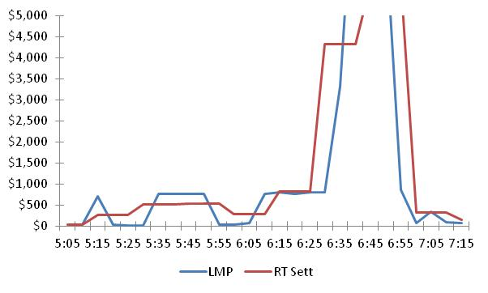
LMP and 15-Minute Settlement Pricing
January 23, 2018 was particularly volatile

Slide 9
ERCOT Action
What is the best way to provide accurate settlements for loads that are able to respond to 5 minute pricing?
Implement similar approach used for wholesale storage loads?
Change kWh meters to latest technology meters and use 5 minute kWh data?
Is SCADA telemetry adequate?

