Slide 1
Discussion Document for the Credit Working Group Related to NPRR 850 Credit Related Framework Issues
4/20/2018

Slide 2
ERCOT Market Restart Credit Framework
NPRR850 Market Suspension and Restart
General framework for the non-black start related activities of the ERCOT market related to the operation of real-time / day-ahead / CRR markets, Credit, Settlements, and Retail transaction processing.
Assumption that the event is ‘lengthy’ in nature (likely a week or longer) and market activities are disrupted.
Could be caused by any number of events (natural or man-made disasters, ERCOT computer failure(s), grid collapse and restart, sabotage/terrorism, etc.)
Proactive effort to minimize long term market disruption, credit defaults, mass transitions, etc.

Slide 3
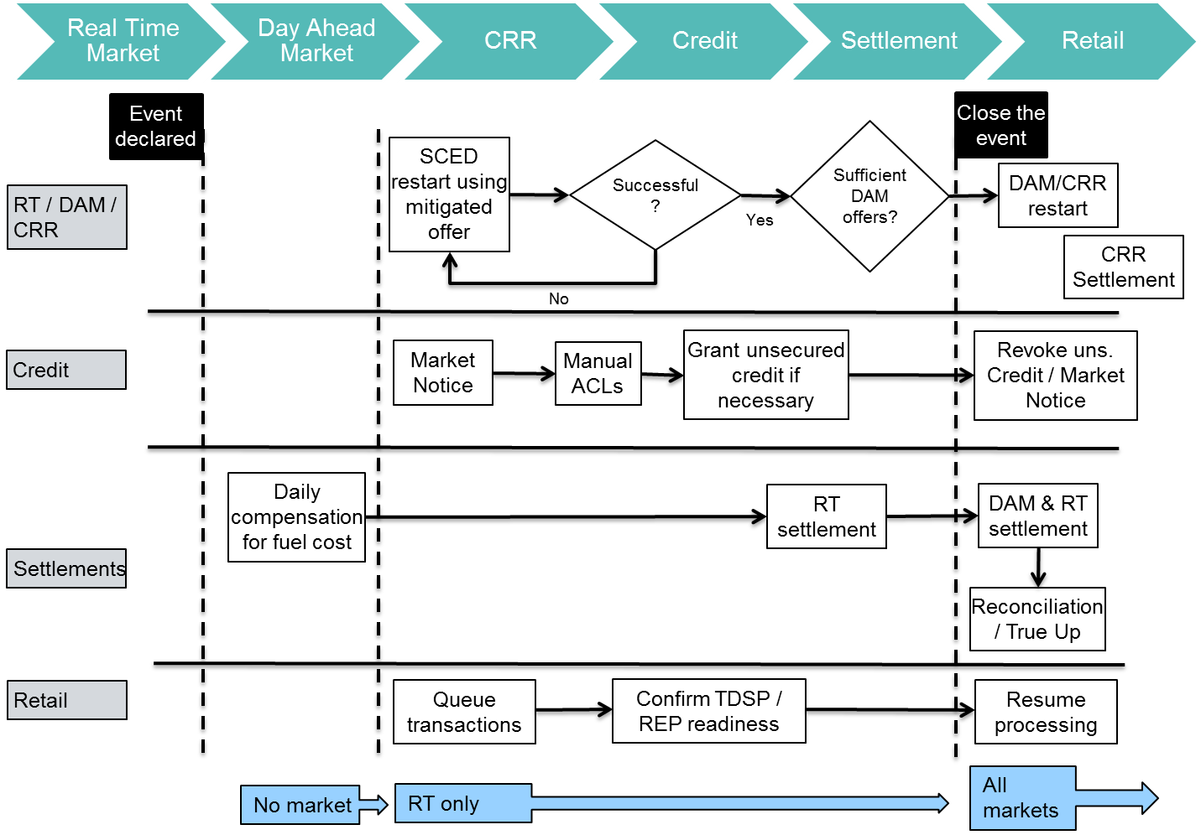
NPRR 850 - ERCOT Market Suspension and Restart Conceptual Framework “Swim Lanes”

Slide 4
ERCOT Market Credit Language in NPRR 850
25.4.1 Market Suspension Credit Assumptions
During a Market Suspension, the estimation of market credit is contingent upon the following conditions:
(a) ERCOT systems critical to credit processes have been restored, with the understanding that some data normally used in credit calculations might not be available;
(b) Adequate means of communication with Counter-Parties are available; and
(c) Systems are available for transfer of funds to and from Market Participants.
25.4.2 Determination of Counter-Party Available Credit Limits
During a Market Suspension, a Counter-Party’s Available Credit Limit for the CRR Auction (ACLC) and Available Credit Limit for the DAM (ACLD) will be determined pursuant to Section 16.11.4.6, Determination of Counter-Party Available Credit Limits.
During a Market Suspension, ERCOT may, at its sole discretion, set an Unsecured Credit Limit for Counter-Parties not otherwise eligible per the ERCOT Creditworthiness Standards and/or increase Unsecured Credit Limits for Counter-Parties currently eligible for Unsecured Credit.

Slide 5
ERCOT Market Credit Language in NPRR 850
25.4.2 Determination of Counter-Party Available Credit Limits
In accordance with Section 25.4.3, Collateral Management, ERCOT may, at its sole discretion, waive, in part or in full, the requirements in paragraph (2) of Section 16.11.5, Monitoring of a Counter-Party’s Creditworthiness Credit Exposure by ERCOT, for Counter-Parties to maintain designated amounts of Secured and/or Remainder Collateral.
The exercise of any measures described in paragraphs (2) and (3) above shall be reflected in the estimated ACLC and/or ACLD values provided to Counter-Parties pursuant to Section 16.11.4.6.
25.4.3 Collateral Management
During a Market Suspension, ERCOT may, at its sole discretion, forego the requirement in paragraph (3) of Section 16.11.5, Monitoring of a Counter-Party’s Creditworthiness Credit Exposure by ERCOT, to provide prompt notice to Counter-Parties of the need to increase Financial Security.
During a Market Suspension, ERCOT may, at its sole discretion, extend the timelines in paragraph (6) of Section 16.11.5 to allow Counter-Parties to make arrangements to provide collateral, without unmet requests for collateral being designated as Late Payments.

Slide 6
Credit Issues Related to NPRR 850
With a desire to avoid credit defaults and resulting market participant disqualification and potential mass transitions, ERCOT may need to use extensive discretion – especially during events of a longer duration and/or involving high market prices prior to or while exiting the suspension.
Some market participants subject to the events leading to a market suspension may ultimately face invoices beyond their capacity to make payment and additional discretionary credit may still ultimately lead to default with potentially greater market uplift – in essence ‘throwing good money after bad’.
Possible scenario of a dry, hot summer with multiple $9,000/MWh intervals over several days prior to a black start event where an undercapitalized REP already facing liquidation is granted additional unsecured credit and incurs additional exposure during market restart.

Slide 7
Credit Questions to Ask About NPRR 850
Should ERCOT always be able to use ‘its sole discretion’?
How much additional unsecured credit should be made available to counterparties?
Should a market participant with $3 million in posted collateral and a normal TPE of $1 million and audited financial statements showing $20 million in total capital be allowed $20 million, $30 million, or $40 million of unsecured credit?
How rapidly should unsecured credit be revoked after restoration – all at once or slowly over days/weeks?
What happens if certain market participants are unable to fully pay large invoices accrued prior to and during the suspension once restoration is underway/complete?

Slide 8
NPRR 850 Possible Credit Scenario Approach
There can be several possible causes to a market suspension – many perhaps which may not be identified prior to an actual event.
However what is possible is to categorize the nature of the events leading up to the market suspension as ‘prolonged’ (significant market notice as in the case of extremely high energy prices and multiple EEA notices for hours or days before an eventual black-start) or ‘sudden’ (such as a computer failure or terrorist attack).
The main credit difference is in a ‘prolonged’ start many market participants may already be financially stressed – some perhaps beyond recovery – while in a ‘sudden’ event there is little to no additional market financial stress.
Similarly during the event either power is continuing to flow (as may be the case in an ERCOT market system failure) or not (as in the case of a black start or possible disaster).
Generation and Load are much more vulnerable without flowing power where they will not receive operational revenue than a market systems failure event where verifiable or make-whole costs at least avoid loss.

Slide 9
NPRR 850 Possible Credit Scenario Approach
Timeframe to Event and Functionality of Grid | ‘Sudden’ Entry into Market Suspension | ‘Prolonged’ Entry into Market Suspension
Power Remains Flowing | Likely little financial stress prior to event, market participants will also most likely be ‘made whole’ as generators receive revenue for power produced and REPs invoice customers for power consumed. | Perhaps significant financial stress for certain market participants pre-existing before event, continued generation at ‘make whole’ prices and REP sales to customers may somewhat moderate risk, however there may be elevated risk for previous outstanding invoices.
Power Flows are Disrupted | Likely little financial stress prior to event, generators and load will have lost operational revenue and there may be high prices for a time during restart, but ERCOT is not exposed to continuing direct credit losses if power is not flowing, only outstanding pre-event invoices and perhaps short-term high prices as the market is reestablished. | Certain market participants may already face significant financial stress prior to the event compounded by ongoing lost operational revenue. ERCOT may have to extend substantial credit to entities without the financial capacity for repayment to restart, especially if restart prices are high.

