Slide 1
Resource Definition Task Force Progress Update
April 2018

Slide 2
Background
Previous attempts at addressing non-modeled generation or distributed generation have struggled to resolve the various issues.
This task force is intended to resolve issues with the protocols regarding resources and definitions in ERCOT.
  Attempting to resolve with a single over-arching NPRR to address everything is expected to stretch out the timeline significantly to get overall agreement.
The recommended approach is to selectively identify and resolve issues
  It is anticipated that several NPRRs will be developed to address existing issues.
  Topics or definitions the group is unable to resolve but require further review will be included in a whitepaper that is shared with PRS.

Slide 3
Stages of Activities
Stage 1 - Align definitions to identify differences
  Initial Framework by Jay identifies resource types. (see slide 6)
  Initial table comparing NERC/PURA/PUCT/ERCOT generated
  Develop consensus on new Terms and/or definitions
  Align with Jay’s Resource analysis
    Revise and streamline to capture key issues and gaps
  Publish new Terms/Definitions
    Terms or definitions without agreement will be included in the whitepaper.
  Should suggested changes be sent to PRS for approval?
Estimated duration 6-8 months

Slide 4
Stages of Activities (cont)
Stage 2 – Clarify Definitions for Transmission connected resources
  Revise/replace “Non-modeled” term per new definitions
  Recommend/Submit first NPRR.
Estimated Duration 6 months

Slide 5
Stages of Activities (cont)
Stage 3 – Clarify definitions for Distribution connected resources
  Generate new categories addressing multiple configurations
  Utilize definitions established in step 1 where possible.
  Include current and proposed future DG categories together, or address in separate NPRRs?
  Submit NPRR(s).
Estimated duration 6-8 months

Slide 6
The RTF Journey through the wilderness….
The information on the following slides represents the discussions that took place over the months as we discussed and debated what was in the protocols and what would require further clarification.
The priority was to separate and refine by topics those that were simply definition items from those that could include additional requirements.
  Additional Items resolved among the group as needing further work with NPRR are captured on slide #20
  Additional Items identified as requiring significant further work in other committees are captured on slide #21
Extensive notes have been added to the following slides to help clarify the thought processes along the way.

Slide 7
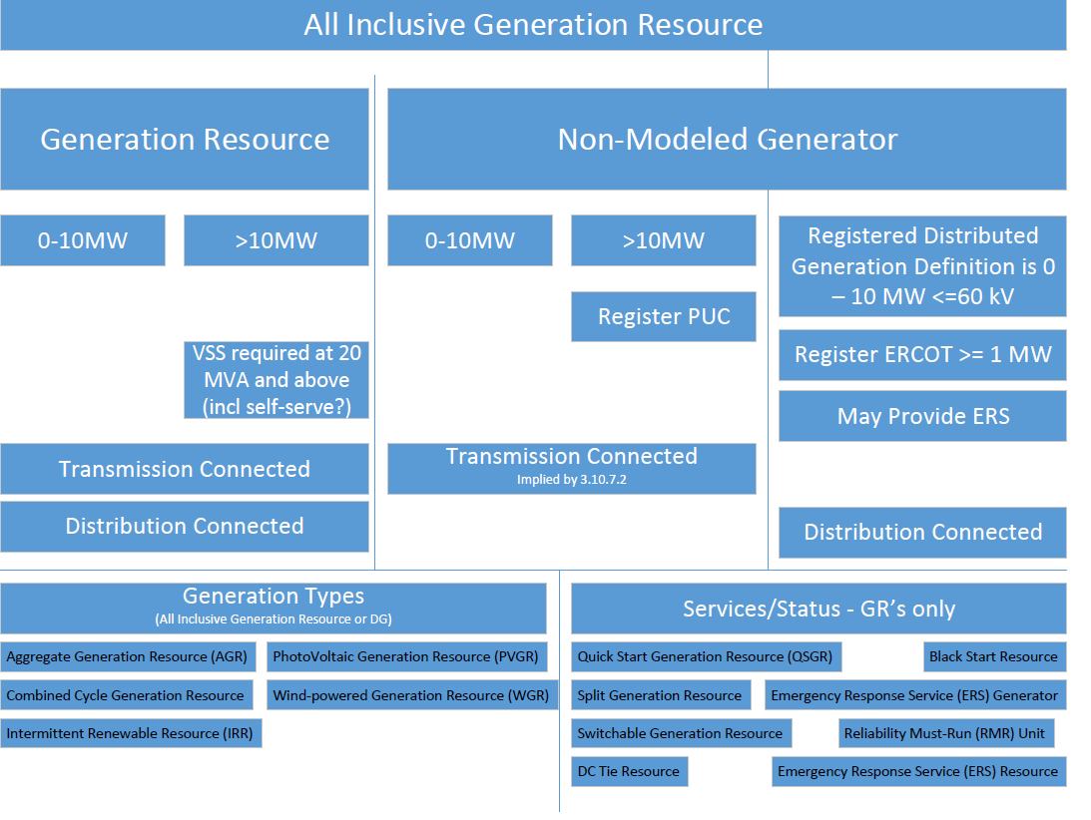
Jay’s First Proposal for a Framework
(see RTF Aug 11, 2017)
Notes:
This key diagram represents the first proposal of how the protocols define resources from a 10,000 foot level, and are (primarily)based on size and how they are connected to the ERCOT system.
(note-the top half of the diagram was modified slightly from the original presentation in August to reflect the existing protocol requirements.)
The Generation types listed in the bottom left of the diagram, although listed in the definitions section as types of Generation Resources, are not really helpful to the user in terms of what they are. The terms are more reflective of the various technologies used by the Generation Resources, and adds to some of the confusion.
The Service/statuses listed in the bottom right of the diagram, also listed in the definitions section as types of Generation Resources are again, not helpful since they are more reflective of either services they are qualified to provide (blackstart, etc) or the status of the resource itself (mothballed, etc)
Bottom line– the top half of the diagram provides a good 10,000 foot view of how the resources are differentiated, but the bottom half identifies a number of terms that confuse new users.

Slide 8
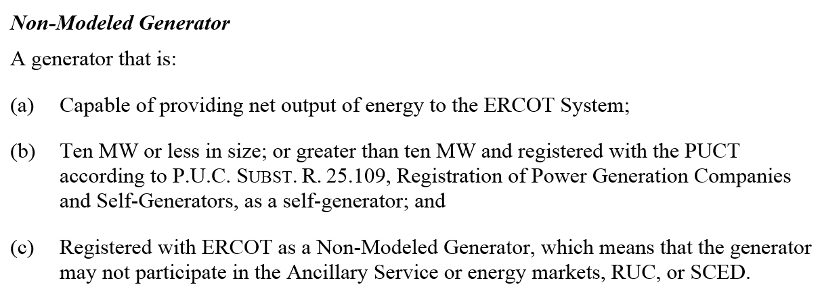
Current definition (Protocol Section 2.1)
Notes:
Back to the Protocols for the Straight-up definition to help with resolving the term “non-modeled generation”.
Note that two factors are used for identification – size and market participation. (more on that later)

Slide 9
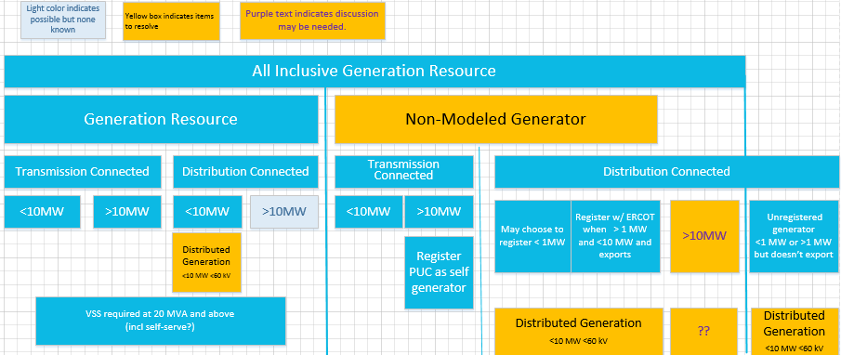
Framework proposal, revision 2 –
Includes all distributed generation types.
Notes:
This follow-up narrowed down framework included all of the resources in ERCOT, including those on the distribution system, and identified some of the sources of confusion.

Slide 10
Framework Proposal (continued)
  All-Inclusive Generation Resources (comprised of Generation Resources and Non-Modeled Resources) must meet existing designated technical and data provision requirements (“Technical Requirements”) as well as the Market Requirements.
  Generation Resources must also meet additional qualification requirements depending on the “Services” they are providing:
    Example – Additional requirements to be qualified for providing Black Start Services

Slide 11
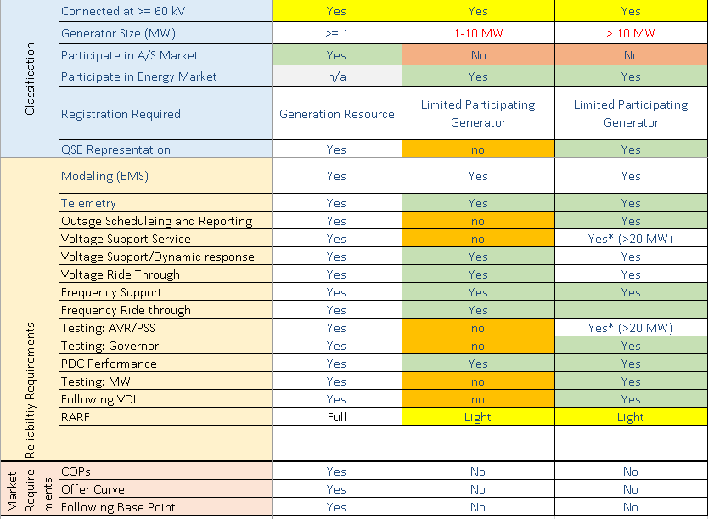
Example Technical Requirements
*
*
Draft—not meant to be either comprehensive or reviewed for accuracy
* Term used as part of the original NPRR190-for example only

Slide 12
Example Market Requirements
  COPs
  Offer curves
  Following Base Points
  Dispatch Instructions outside of Emergency conditions
  Etc.
This is not a comprehensive list of the Market Requirements for Generation Resources.
The rules should not change any requirements for Generation Resources, so sections of the Protocols related to requirements exclusively for Generation Resources should not change for this effort.

Slide 13
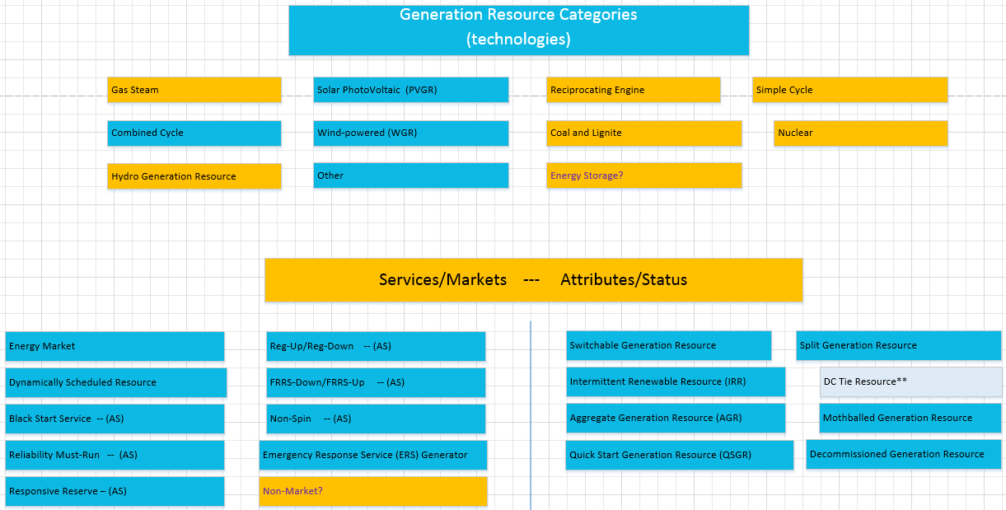
Generation Resource Breakdown
Note—Items in yellow are not in the definitions section 2.5 of the protocols, even though they are used in the other sections.

Slide 14
Revise terminology for resources in the ERCOT systems
Old Nomenclature
Generation Resource
Non-modeled Generator
Unregistered generator
(Distribution connected Generation > 10MW)
Revised nomenclature
Generation Resource (no change)
New term(s)
  Transmission connected
  Distribution connected
Microgenerator (see PUCT defs)
Generation Resource

Slide 15
Some Examples
  The following pages illustrate a few simplistic examples of Generators.
  In each example, Generators that are owned by different companies are shown in different colors.
  Transmission voltage elements are shown in green and blue; distribution voltage elements and/or PUN-owned transmission are shown in gray.

Slide 16
Examples
Examples of Transmission Connected Resources
100 MW
Traditional Generation Resource
with POI to transmission
9.9 MW
< 10 MW Generator with POI to transmission

Slide 17
Examples of PUN Resources
100MW
100 MW
150 MW
PUN with gens >10MW
9.9 MW
4 MW
9.9 MW
5 MW
20 MW
1 MW
PUN with Aggregation of gens >10MW
PUN with no single generator or aggregation >10MW

Slide 18
Examples of Distribution Connected Resources
9.9MW
9.9MW
1MW
20MW
Generator < 10MW on Distribution System
not in SCED or AS Market
Generator < 10MW on Distribution System
not in SCED or AS Market
9.9 MW
1
MW
9.9 MW
8
MW
1-20 MW
1-20 MW
Multiple gens < 10MW on Distribution System
with different Service Delivery Points
Aggregation of gens at common
Service Delivery Point < 10MW
Note: Unregistered Generator < 1 MW on Distribution System not shown

Slide 19
Examples of Distribution Connected Resources
>10 MW
1-20 MW
Generator > 10 MW
on Distribution System

Slide 20
Proposed Category Nomenclature – using existing requirements
Transmission Generation Resource (TGR) Transmission-connected Registered with ERCOT as GR Participates in the market SCED A/S Modeled in ERCOT systems Telemetry, etc. Settled Nodally |  | Settlement Only Transmission Generator (SOTG) Transmission-connected less than 10 MW Registered with ERCOT as SOG Settled for exported energy only Intermittent sources will typically export based on fuel availability. Self-dispatched may choose to export based on prices Modeled in ERCOT systems Reliability systems only Not scheduled/dispatchable Settled - Load Zone | Transmission Self-Generator (TSG) Transmission-connected Registered with PUC as a Self-Generator and registered with ERCOT as SOG May occasionally export, but does not generate with the intent to sell at wholesale If it exports, then settled for exported energy only Continuous exports will be re-evaluated for TGR Modeled in ERCOT systems Reliability systems only Not scheduled/dispatchable Settled - Load Zone
Distribution Generation Resource (DGR) Distribution connected Registered with ERCOT as GR >10 MW require to register as GR Participates in the market SCED A/S Pseudo-Modeled in ERCOT systems Future--Modeling light? Telemetry, etc. Settled Nodally |  | Settlement Only Distribution Generator (SODG) Distribution connected but less than 10 MW Registered with ERCOT as SOG Settled for exported energy only Intermittent sources will typically export based on fuel availability. Self-dispatched may choose to export based on prices Mapped in ERCOT systems Not scheduled/dispatchable Telemetry not required Settled - Load Zone | Unregistered Distribution Self-Generator (UDSG) Distributed generation greater than 1 MW co-located with larger load, but smaller than minimum facility load. Registered with PUC as a Self-Generator but not registered with ERCOT May not export—otherwise must register with ERCOT as SODG. Neither Mapped nor modeled in ERCOT systems (future mapping?) No ERCOT settlement policy since no exports. | Unregistered Distributed Microgenerator* (UDMG) Distribution connected less than 1 MW No requirement for registration Reported by DSP per PUCT 25.211(n) (competitive choice) Reported by NOIEs per ERCOT protocol 10.2.2.1.b(ii) for 50kW -1 MW Not reported by NOIEs for <50kW Neither Mapped nor modeled in ERCOT systems (future mapping of accumulations?) ERCOT settles as negative load in competitive choice areas once meter configuration updated to DG No ERCOT settlement policy for NOIE areas.
 | **Settlement Only means that the generator may not participate in Ancillary Services Market, RUC, SCED, or make Energy OffersNote: Transmission connected resources are required to be modeled in ERCOT NMMS systems. Studies are determined based on requirements for size and resource category type. *Microgenerator definition may need resolution with PUC

Slide 21
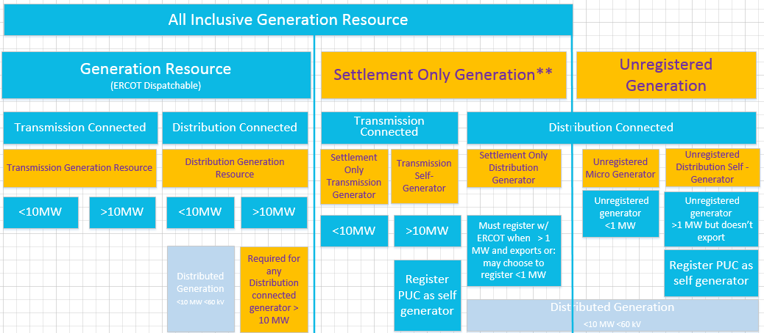
Final Proposed Resource Definition Framework
**Settlement Only generator means that they may not participate in Ancillary Services Market, RUC, SCED, or make Energy Offers.

Slide 22
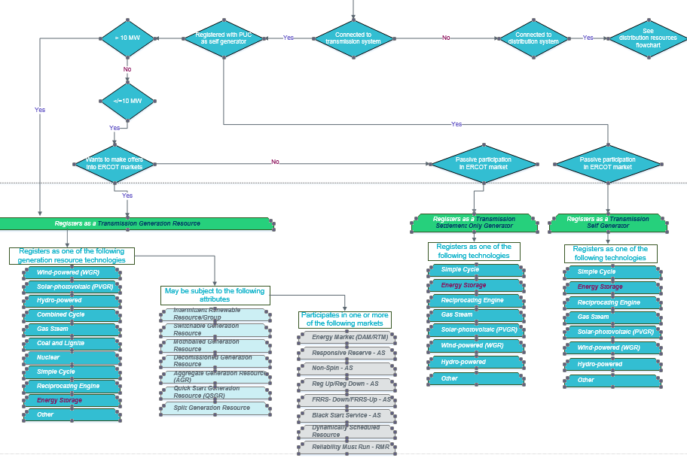
Example Registration Flowchart page 1

Slide 23
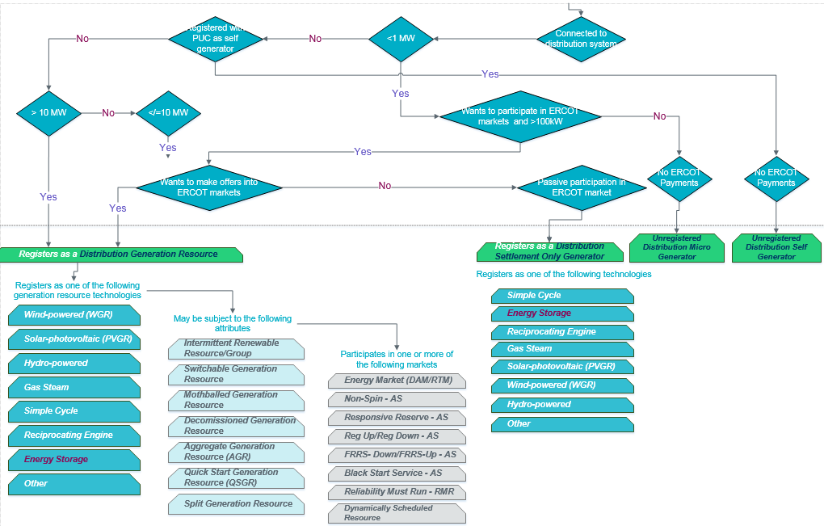
Example Registration Flowchart page 2

Slide 24
Points brought up during discussions for consideration in future NPRRs (Stage 2+)
Clarify Implicit Definitions in Protocols for Distribution connected resources 10 MW and greater
All transmission connected resources would be required to be registered and modeled, regardless of size.
A Transmission connected self-generator may be registered as an Non-modeled even though it might occasionally produce more than 10 MW net output for payment during an ERCOT-declared Emergency.
  ERCOT would review output and determine if a generator is exceeding the threshold and should subject to registering as a Generation Resource.
Any resource that wants to participate in Ancillary service market or SCED is required to register as a Generation Resource.
Existing resources that are not currently registered, but might be required to register under any proposed requirements and choose to register as Non-modeled generators, may be grandfathered if they cannot meet specific “Technical Requirements” (reactive, governor).

Slide 25
Topics for Additional Discussion
  How to handle Aggregations of distribution connected generators that want to register as Generation Resources ?
  Energy Storage registration/modeling issues.
    This will not be a significant area of focus as part of this task force and will instead be included in the whitepaper for further discussion.
  To what extent do we construct definitions-- and do definitions correlate to obligations? This may be a whitepaper issue.

