Slide 1
Supply Analysis Working Group Meeting
Pete Warnken
Manager, Resource Adequacy
April 13, 2018

Slide 2
Preliminary Summer SARA Review

Slide 3
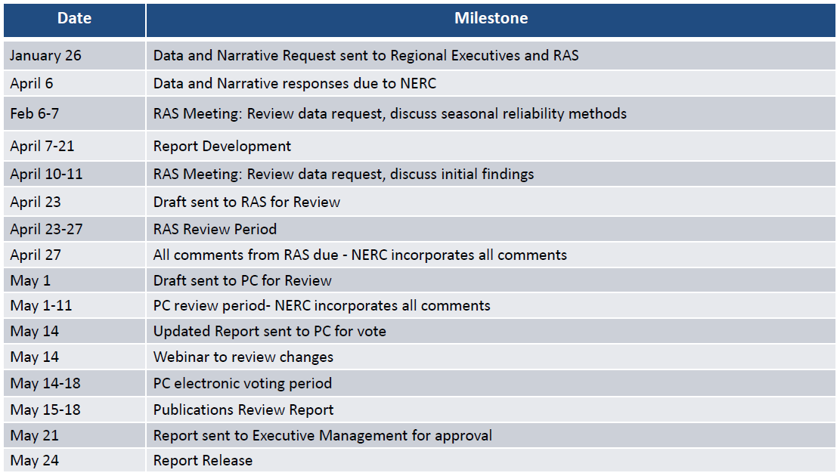
NERC Summer Reliability Assessment (SRA)
2018 Schedule

Slide 4
NERC Summer Reliability Assessment (SRA)
Draft Data, submitted 4/6/2018:

Slide 5
EORM-MERM Study Update
Contractor Schedule (High-level)
Will use LTSA “Current Trends” Natural Gas Price assumptions (EIA 2018 AEO High Oil and Gas Resource and Technology Case)

