Slide 1
ERCOT’s Dispatchable Demand Response Services
Mark Patterson
Manager, ERCOT Demand Integration

Slide 2
Summer Communication
ERCOT annually conducts a communications meeting prior to entering into the summer months
2018 meeting scheduled for May 17th
Contact Leslie Sopko to get on invite list

Slide 3
DR available for ERCOT dispatch
Service | MWs | Notes
Load Resources providing Responsive Reserve Service (RRS) | ≤1400 | Non-Controllable Load Resources -- procured on an hourly basis in the Day-Ahead Market for next Operating Day Deployed via XML instruction followed by All QSE Hotline call or instantaneously based on grid frequency < 4400 MWs registered and qualified to provide RRS
Emergency Response Service (ERS) | ~900* | DR and DG assets with 10- or 30-minute ramp periods Deployed via XML Instruction followed by All QSE Hotline call Procured three times per year (4-month strips), with 6 Time Periods within each contract term
TDSP Load Management Programs | ~223* | C&I and Residential Loads procured for summer peak hours only Dispatched concurrently with ERS through agreements between ERCOT and TDSPs Deployed via TO Hotline Call
* Summer 2017 contracted capacities

Slide 4
Load Resources Providing RRS
Responsive Reserve Service Deployment Requirements
Manually by Operators during an Emergency using XML followed by VDI
System Capacity Issues (declared Energy Emergency Alert)
Capacity split into two groups (group 1 & 2)
Deployment could be for single group or all
Interconnection Reliability Operating Limit (IROL) Violations
Resource Specific Instruction
As a last resort before firm Load Shedding
Required to deploy within 10 minutes of instruction being issued
Required to remain deployed until recalled
Automatic Response to Underfrequency Event
UFR set to trip at no less than 59.7 hz with 20 cycle delay
Required to remain deployed until recalled
Once recalled must return to pre-deployment level within 3 hours

Slide 5
Load Resource Deployment Instructions
XML Instruction
AS_TYPE: RRS
RES_NAME: XXXXXXXX_LD2
DEPLOY_MW: 2.9
BEGIN_TIME: 2017-06-09 10:15:57
END_TIME: 2017-06-09 11:00:00
DURATION: 0 Hrs 44 Mins
All QSE Hotline Call
Scripts for all verbal deployments available on ERCOT MIS. The ramp period starts at the conclusion of the VDI

Slide 6
Load Resource deployment Events
Since 2012 there have been 10 LR deployment events
9 of the 10 were UFR deployments
1 event due to system wide capacity insufficiency (Jan 6, 2014)
UFR events typically last less than 15 minutes
Manual deployment are typically much longer (1+ hours)

Slide 7
Emergency Response Service (ERS)
ERS may be provided by:
Loads or Back-up-Generation capable of being deployed within specified ramp rates
Distributed Generation capable of injecting energy within specified ramp rates
ERS Product Types
Non-Weather Sensitive ERS-10
Weather Sensitive ERS-10
Non-Weather Sensitive ERS-30
Weather Sensitive ERS-3030-Minute Ramp ERS
Interval Metering Required
No Real-Time telemetry Required

Slide 8
ERS-Deployment
ERCOT must be in EEA Level 1, 2 or 3 to deploy ERS-30
ERCOT must be in EEA Level 2 or 3 to deploy ERS-10
Deploys available contracted Emergency Response Service via an Extensible Markup Language (XML) message followed by a Verbal Dispatch Instruction (VDI) to the all-QSE Hotline
ERS Resources must be fully deployed by the end of their contracted ramp period (either 30 or 10 minutes)
ERCOT shall notify QSEs of the release of ERS via an XML message followed by VDI to the all-QSE Hotline.
Upon release by ERCOT ERS Resources must return to a condition capable of meeting its ERS performance requirements as soon as practical, but no later than 10 hours following release.

Slide 9
ERS Deployment Instructions
XML Instruction
AS_TYPE: ERS,
QSE_NAME: QWXYZ,
RAMP_TYPE: 10 or 30
GROUP_NUMBER: 1, 2, 3, 4 (number represents ERS service type)
GROUP_TYPE: d (represents event deployment)
WS_TYPE: NON-WS or WS
DEPLOY_MW: 0.0, (obligation)
BUSINESS_HOUR: TP1 – TP6
BEGIN_TIME: 2018-09-03 11:46:01
All QSE Hotline Call
Scripts for all verbal deployments available on ERCOT MIS. The ramp period starts at the conclusion of the VDI

Slide 10
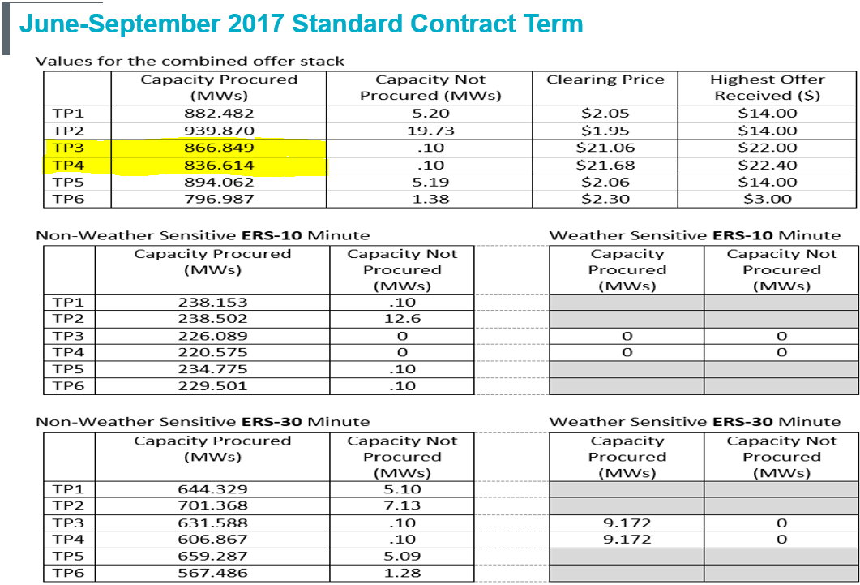

Slide 11
TDSP Load Management Programs
Programs designed to help TDSPs meet their Annual Energy Efficiency Goals set by the PUCT.
Available
From 1-7 pm weekdays (except holidays)
June – Sept months only
Dispatched by ERCOT instruction as early as EEA Level 2
Deployed via the Transmission Operator Hotline call
Programs vary slightly across TDSPs
Available to Commercial, Small Industrial and Residential Loads
Program Capacities
2015 183.9 MWs
2016 188.6 MWs
2017 223.1 MWs
2018 ------- MWs Information becomes available mid-May

