Slide 1
Market Credit Working Group update to the Wholesale Market Subcommittee
4/4/2018

Slide 2
MCWG update to WMS
NPRR867 – Revisions to CRR Auction Credit Lock Amount to Reduce Excess Collateral (Vote)
  NPRR867 changes the lock amount of each Counter Party’s ACL for CRR Auctions during the duration of the auction process so that it is capped at the pre-auction screening credit exposure amount.
  NPRR867 will reduce the amount of ACL that is locked while the CRR Auction process is occurring. Currently the total amount of credit that is locked for auctions by all Counter-parties exceeds the total pre-auction screening credit exposure amount.
  ERCOT’s analysis indicates that approximately $10.4B of excess credit has been locked since October 2013.

Slide 3
MCWG update to WMS
Joint meeting of MCWG and CWG on Wednesday, March 21st
4 NPRRs reviewed for credit impacts
  No credit impact

Slide 4
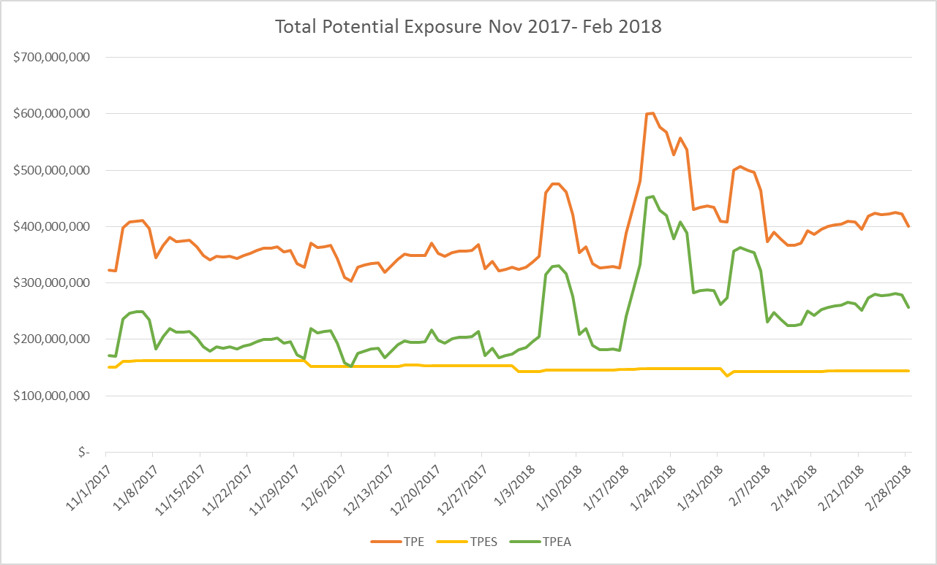
NPRR800 Update
NPRR800 go-live

Slide 5
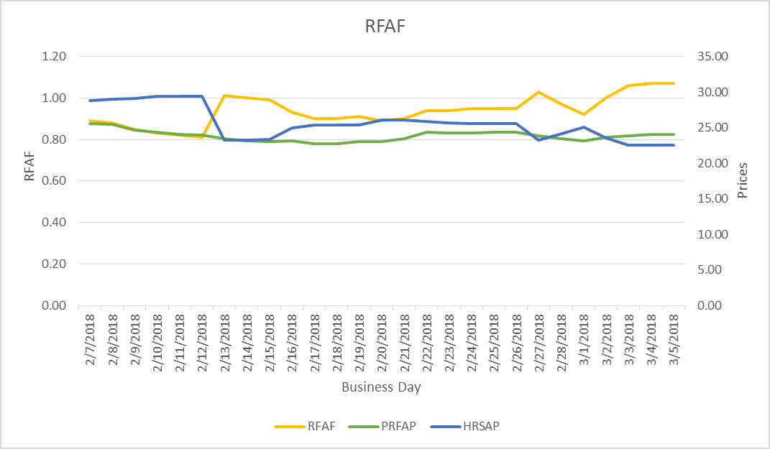

NPRR800 Update
Real-Time Forward Adjustment Factor (RFAF)
RFAF is calculated using 21 days of ICE future prices and 14 days of ERCOT Real Time Settled Prices for HB_NORTH settlement point

Slide 6
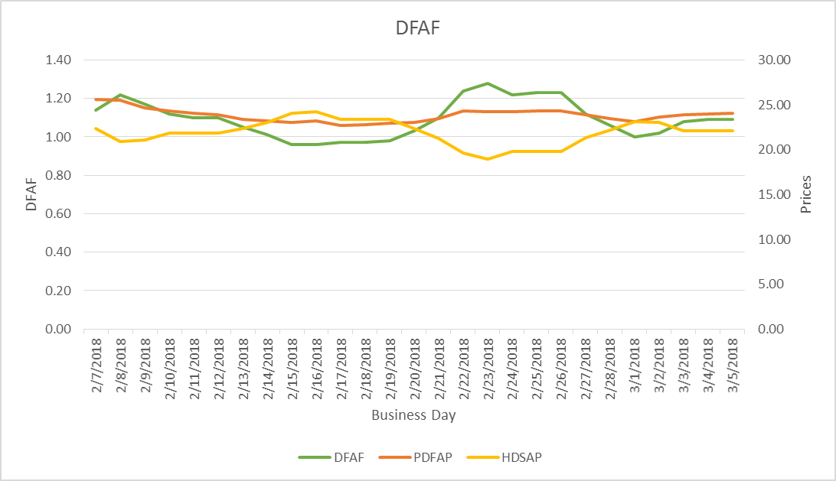
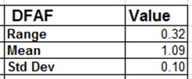
NPRR800 Update
Day-Ahead Forward Adjustment Factor (DFAF)
DFAF is calculated using 21 days of ICE future prices and 7 days of ERCOT Day Ahead Settled Prices for HB_NORTH settlement point

Slide 7
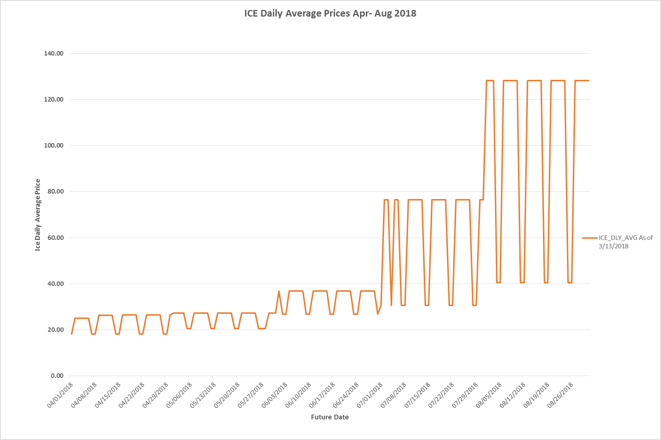
NPRR800 Update
Be aware of what is coming

Slide 8
REP Defaults & Mass Transition
Objective: Review the process for REP defaults & mass transitions and discuss whether there are improvements to the process to avoid/limit uplifting default costs to the market.

Slide 9
Process Review: Defaults & Mass Transition
If an invoice is not paid, ERCOT will look first to available cash collateral and withhold payments to the QSE before short-paying the market (§9.19).
Payment Breach is a default under the Standard Form Agreement unless cured within one Bank Business Day after notification from ERCOT (§16.11.6). Note that liquidation of non-cash collateral may require more than one Bank Business Day.
Collateral calls are due by:
  15:00 on the second Bank Business Day from Notice if ERCOT delivered Notice before 1500
  17:00 on the second Bank Business Day from Notice if ERCOT delivered Notice between 15:00 and 17:00 (§16.11.5(6).
Upon Breach, ERCOT issues a Breach Notice allowing one Bank Business Day to cure (SFA §8.A(1))
If applicable, a Mass Transition begins at this point.

Slide 10
Process Review: Defaults & Mass Transition
Notification Day (pre-Launch stage) has historically followed immediately upon termination of the REP’s SFA. This is a collaboration between PUCT Staff and ERCOT.
Mass Transition processes are addressed in Retail Market Guide §7.11.1, Retail Market Guide Section 9 Appendices F1-F3, Protocol Section 15.1.3.1, and PUCT Rules.
Note that Protocol Section 1.3.1.1, Items Considered Protected Information, includes
  (h) Raw and Adjusted Metered Load (AML) data (demand and energy) identifiable to:
    (i) A specific QSE or Load Serving Entity (LSE). The Protected Information status of this information shall expire 180 days after the applicable Operating Day; or
    (ii) A specific Customer or Electric Service Identifier (ESI ID);
  (k) Number of ESI IDs identifiable to a specific LSE. The Protected Information status of this information shall expire 365 days after the applicable Operating Day;

Slide 11
CWG/MCWG Discussion on REP Default process
CWG/MCWG discussion has focused on maximizing the opportunity for other REPs to step in and acquire the defaulting REP before a mass transition is triggered.
Ideas discussed include:
  Secondary auction administered by ERCOT
  Voluntary list of acquiring REPs
Discussion will continue at upcoming CWG/MCWG meetings

