Slide 1
Summer Preparedness
RMS
April 3, 2018
ERCOT Public

Slide 2
Summer Preparedness
Impact of NPRR 800, Revisions to Credit Exposure Calculations to Use Electricity Futures Market Prices
Potential impact of Letter of Credit issuer limits
Recap of default / Mass Transition processes
Note that ERCOT anticipates holding a Summer preparedness communications workshop on Thursday, May 17, 2018. ERCOT expects to issue additional communications informational material for Market Participants prior to that time.

Slide 3
Summer Preparedness
Impact of NPRR 800, Revisions to Credit Exposure Calculations to Use Electricity Futures Market Prices
Potential impact of Letter of Credit issuer limits
Recap of default / Mass Transition processes

Slide 4
Impact of NPRR 800
NPRR 800, Revisions to Credit Exposure Calculations to Use Electricity Futures Market Prices, was implemented along with three other NPRRs on February 7, 2018. NPRR 800 represents a fundamental revision in ERCOT credit exposure calculations.
Real-Time and Day-Ahead components of the credit exposure calculation are adjusted by the ratio of ICE forward ERCOT North Hub prices to lagging actual settled prices.
Therefore, a large increase in ICE prices will be reflected in increased credit requirements.
Forward prices are incorporated on a rolling forward 21-day horizon.
Market Participants should be aware that credit requirements may increase rapidly in high forward price environments and maintain appropriate collateral accordingly.

Slide 5
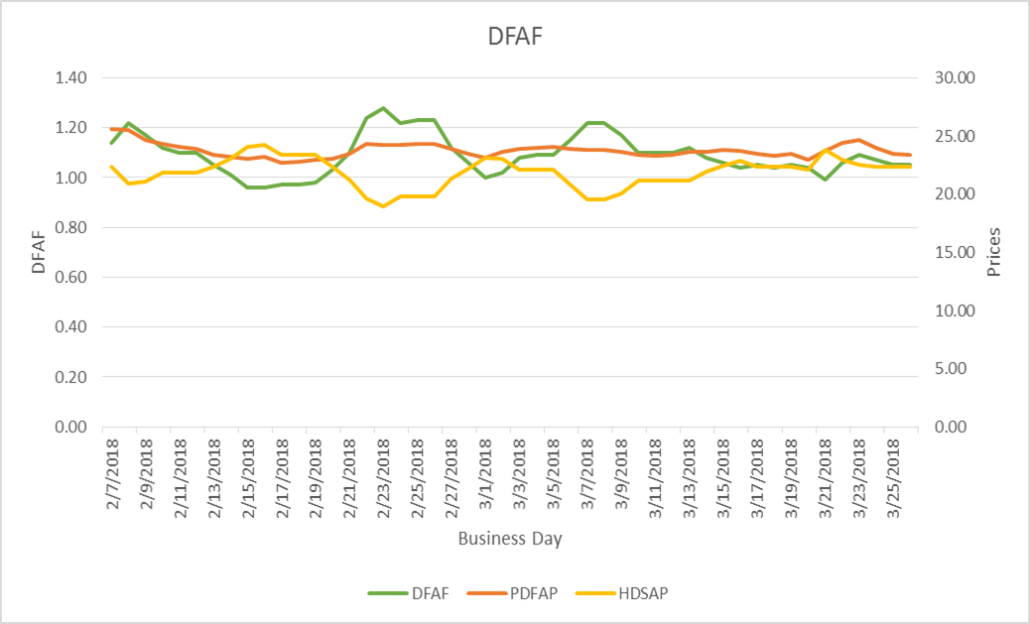
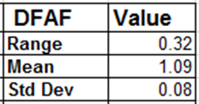
Impact of NPRR 800
Day-Ahead Forward Adjustment Factor (DFAF)
DFAF is calculated using 21 days of ICE future prices and 7 days of ERCOT Day Ahead Settled Prices for HB_NORTH settlement point

Slide 6
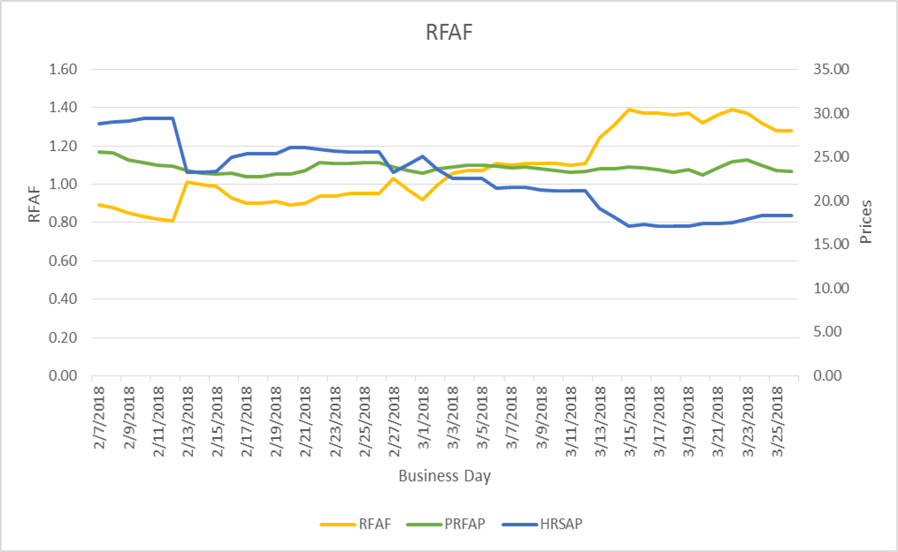
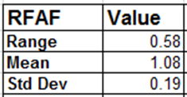
Impact of NPRR 800
Real-Time Forward Adjustment Factor (RFAF)
RFAF is calculated using 21 days of ICE future prices and 14 days of ERCOT Real Time Settled Prices for HB_NORTH settlement point

Slide 7
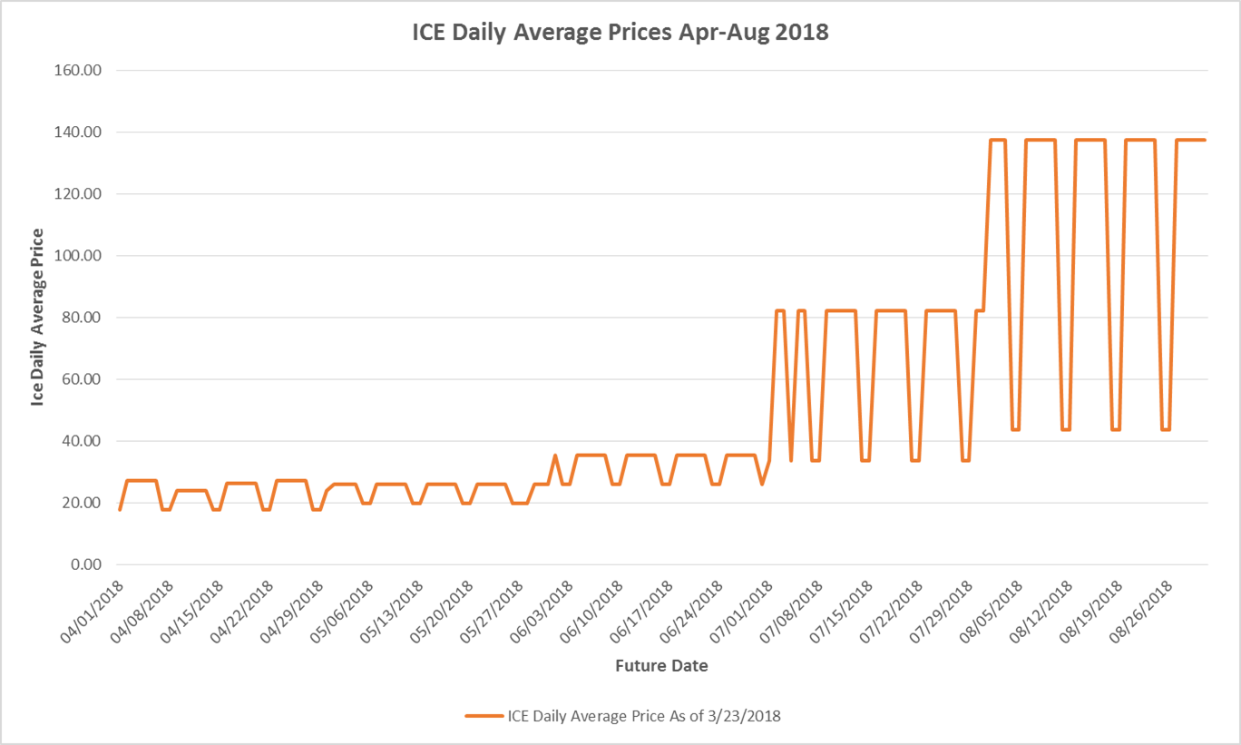
ICE Forward Curves April – August 2018

Slide 8
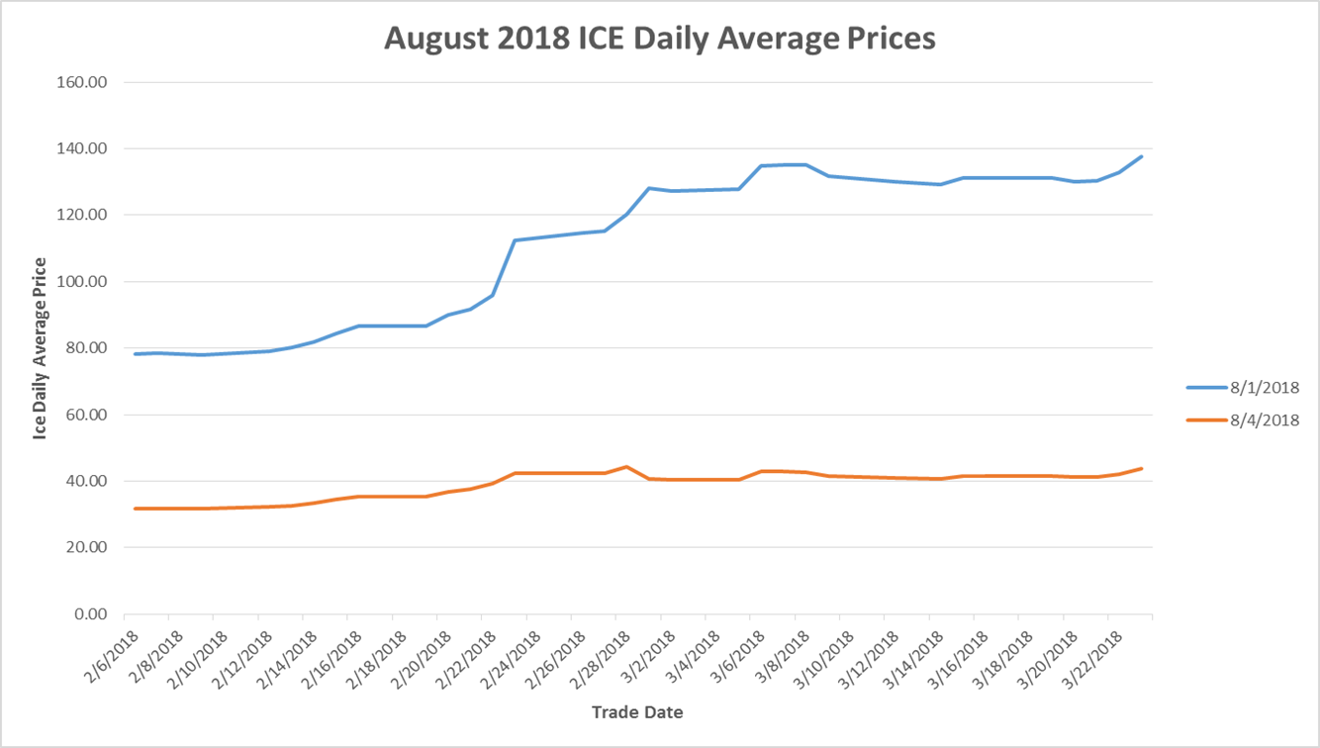
ICE Forward Curves April – August 2018
August ICE forward price evolution for weekdays and weekends.

Slide 9
Summer Preparedness
Impact of NPRR 800, Revisions to Credit Exposure Calculations to Use Electricity Futures Market Prices
Potential impact of Letter of Credit issuer limits
Recap of default / Mass Transition processes

Slide 10
Letter of Credit Issuer Limits
Protocol Section 16.11.2, Requirements for Setting a Counter-Party’s Unsecured Credit Limit, incorporates letter of credit (LC) issuer limits determined by the long-term issuer rating and the Tangible Net Worth of the issuer.
LC issuer limits are determined based on the issuing bank’s credit rating and tangible net worth, with an overall cap of $750m.
Per Protocol Section 16.11.3(1)(b)(iii), if an issuer limit is breached ERCOT will notify affected Counter-Parties and no new letters of credit from the issuer will be accepted. After four months of the limit in breach, ERCOT will no longer accept either new letters of credit or amendments to existing letters of credit from the issuer.
ERCOT encourages Counter-Parties to ensure that they have sufficient collateral funding in the event of materially higher credit exposures during the summer.

Slide 11
Letter of Credit Issuer Limits
Outstanding Letter of Credit Issuer Limits as of March 26, 2018
Report available at: http://mis.ercot.com/misapp/GetReports.do?reportTypeId=13218&reportTitle=The%20Letter%20of%20Credit%20Concentration%20Limits%20Report&showHTMLView=&mimicKey

Slide 12
Summer Preparedness
Impact of NPRR 800, Revisions to Credit Exposure Calculations to Use Electricity Futures Market Prices
Potential impact of Letter of Credit issuer limits
Recap of default / Mass Transition processes

Slide 13
Default and Mass Transition
Default timeline
If an invoice is not paid ERCOT will look first to available cash collateral and withhold payments to the QSE before short-paying the market (§9.19).
Payment Breach is a default under the Standard Form Agreement unless cured within one Bank Business Day after notification from ERCOT (§16.11.6). Note that liquidation of non-cash collateral may require more than one Bank Business Day.
Collateral calls are due by:
  15:00 on the second Bank Business Day from Notice if ERCOT delivered Notice before 1500
  17:00 on the second Bank Business Day from Notice if ERCOT delivered Notice between 15:00 and 17:00 (§16.11.5(6)).
Upon Breach ERCOT issues a Breach Notice allowing one Bank Business Day to cure (SFA §8.A(1))
If applicable, a Mass Transition begins at this point.

Slide 14
Default and Mass Transition
Default timeline
Notification Day (pre-Launch stage) has historically followed immediately upon termination of the REP’s SFA. This is a collaboration between PUCT Staff and ERCOT.
Mass Transition processes are addressed in Retail Market Guide §7.11.1, Retail Market Guide Section 9 Appendices F1-F3, Protocol Section 15.1.3.1, and PUCT Rules.
Note that Protocol Section 1.3.1.1, Items Considered Protected Information, includes
  (h) Raw and Adjusted Metered Load (AML) data (demand and energy) identifiable to:
    (i) A specific QSE or Load Serving Entity (LSE). The Protected Information status of this information shall expire 180 days after the applicable Operating Day; or
    (ii) A specific Customer or Electric Service Identifier (ESI ID);
  (k) Number of ESI IDs identifiable to a specific LSE. The Protected Information status of this information shall expire 365 days after the applicable Operating Day;

Slide 15
Default and Mass Transition
Sample Mass Transition timeline
CR = Competitive Retailer
TDSP = Transmission and/or Distribution Service Provider
POLR = Provider of Last Resort
ESI ID = Electric Service Identifier
Initial Notification E-mail Sent Before 1500
Default confirmed by ERCOT legal
Initial Notification e-mail sent before 1500
Initial Market Call will be scheduled no later than 1800 on Day 0
Mass Transition process:
ESI ID allocation
814_03s flow requesting second calendar day.
ESI ID lists for POLRs and/or Designated CRs and affected TDSPs are generated.
ERCOT requests Customer billing Contact Information.
Market Status Call
867_02s from TDSP to ERCOT.
814_04s from TDSP to ERCOT.
814_11s from ERCOT to Losing CR.
814_14s from ERCOT to POLR and/or Designated CRs.
Customer billing information sent by ERCOT to POLR and/or Designated CRs and affected TDSP(s).
Market Status Call
TDSP sends to ERCOT – Final 867_03s (for calendar day 2) and ERCOT forwards to Losing CR.
TDSP sends 867_04s (for calendar day 2) to ERCOT and ERCOT forwards to POLR and/or Designated CRs.
ESI ID(s) - Mass Transition completes at ERCOT.
Transition Date
Market Status Call
TDSP performs meter reads (actuals or estimates) for Self-Selected Switch requested date.
Day 0
1
2
3
4
5
Customer transition should be completed in no more than five calendar days.

Slide 16
Default and Mass Transition
As part of summer preparations, ERCOT is planning to conduct a default / Mass Transition drill prior to the summer. As feasible ERCOT staff may be reaching out to selected Market Participants to participate. The date and scope for a potential drill have not yet been finalized.

Slide 17

Summer Preparedness
Questions

