Slide 1
NPRR830 4CP Adjustment
WMS
April 4, 2018

Slide 2
Background Info
During PUC Docket No. 47777, Commission Staff’s Application to Set 2018 Wholesale Transmission Service Charges for the Electric Reliability Council of Texas, issues were raised concerning the methodology used by ERCOT in developing the ERCOT 4CP report. This was the first time ERCOT used the new calculation methodology as required per NPRR830.
ERCOT filed a supplement to the report explaining the new methodology and parties agreed that following the close of PUC Docket No. 47777, stakeholder concerns would be addressed.
Today’s discussion is the first step of addressing those concerns.

Slide 3
ERCOT Generation = Settlement Load
Unaccounted for Energy (UFE)
ERCOT Generation
Internal Generation + DC Tie Import Schedules + Block Load Transfer (BLT) Imports
GAP - - - - - - >
Losses:
Transmission & Distribution
Interval Data
Energy Usage
Generation
Compared to
Load Buildup
Profiled Energy Usage
Non-Metered Accounts

Slide 4
Load Aggregation – Lowest Level Segments (LLS)
LLS Data Stored with Twelve Identifying Attributes
  REP, QSE, PROFILE TYPE, WEATHER ZONE, METER TYPE, WEATHER SENSITIVITY, TOU CLASS, LOSS CODE, UFE ZONE, LOAD ZONE, TDSP, METHOD
    Example: LSEGUNADJ_108_7_BUSIDRRQ_SCENT_IDR_NWS_NOTOU_T_U1_LZ_CPS_122_NLA
Data Computed at Four Distinct Levels
  Unadjusted (LSEGUNADJ)
  Unadjusted + Distribution Losses (LSEGDL)
  Unadjusted + Distribution Losses + Transmission Losses (LSEGTL)
  Unadjusted + Distribution Losses + Transmission Losses + UFE (LSEGUFE)
LSEGUFE data is the source for all load aggregations required for the ERCOT wholesale settlement process (RTAML, LRS, HLRS…)
  Sum of all LSEGUFE = ERCOT Generation

Slide 5
4CP Calculation (Prior to NPRR830)
ERCOT 4CP Load
  Sum of LSEGUFE minus
    DC Tie Exports
    Wholesale Storage Load
    BLT Exports
TDSP 4CP Load
  Sum of LSEGUFE grouped by TDSP minus
    DC Tie Exports
    Wholesale Storage Load
    BLT Exports
ERCOT 4CP Load = Sum of TDSP 4CP Load

Slide 6
4CP Calculation (Post NPRR830)
ERCOT 4CP Load (ERCOT Native Load)
  Internal Generation + BLT Imports + Actual DC Tie Imports – BLT Exports – Actual DC Tie Exports - WSL
New ERCOT 4CP load not equivalent to Old ERCOT 4CP load (more on this later)
Adjustment must be applied to the Old TDSP 4CP load so that the sum equals New ERCOT 4CP load (P.U.C. SUBST. R. 25.192)
Adjustment Amount = New ERCOT 4CP Load – Old ERCOT 4CP Load
New TDSP 4CP Load =
(Old TDSP 4CP Load / Old ERCOT 4CP Load) * Adjustment Amount + Old TDSP 4CP Load
2017 Adjustment Amounts (MW)
  June: 1.079857
  July: -3.173785
  August: 6.259944
  September: 3.304351

Slide 7
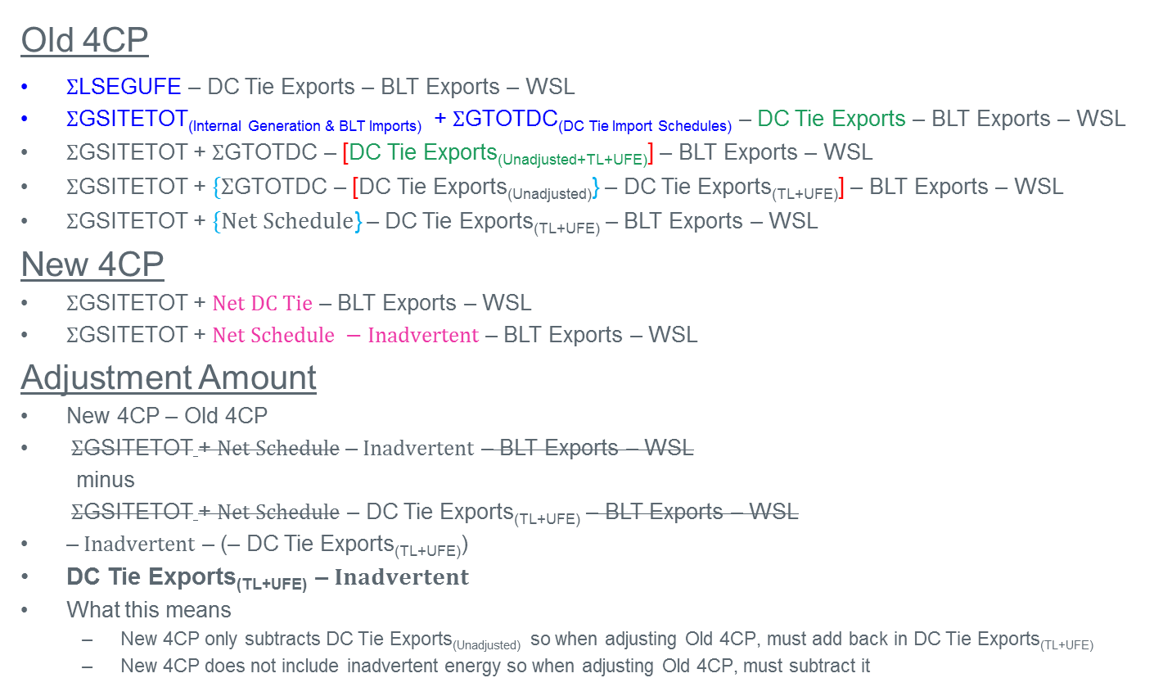
Old 4CP vs. New 4CP – What is the Difference
Old 4CP
$Σ$LSEGUFE – DC Tie Exports – BLT Exports – WSL
$Σ$GSITETOT(Internal Generation & BLT Imports) + $Σ$GTOTDC_{(DC Tie Import Schedules)} – DC Tie Exports – BLT Exports – WSL
$Σ$GSITETOT + $Σ$GTOTDC – [DC Tie Exports_{(Unadjusted+TL+UFE)}] – BLT Exports – WSL
$Σ$GSITETOT + $\{Σ$GTOTDC – [DC Tie Exports_{(Unadjusted)}} – DC Tie Exports_{(TL+UFE)}] – BLT Exports – WSL
$Σ$GSITETOT + $\{Net Schedule$} – DC Tie Exports_{(TL+UFE)} – BLT Exports – WSL
New 4CP
$Σ$GSITETOT + $Net DC Tie$ – BLT Exports – WSL
$Σ$GSITETOT + $Net Schedule −Inadvertent$ – BLT Exports – WSL
Adjustment Amount
New 4CP – Old 4CP
$Σ$GSITETOT + $Net Schedule \text{–} Inadvertent$ – BLT Exports – WSL
minus
$Σ$GSITETOT + $Net Schedule$ – DC Tie Exports_{(TL+UFE)} – BLT Exports – WSL
$\text{–} Inadvertent$ – (– DC Tie Exports_{(TL+UFE)})
DC Tie Exports_{(TL+UFE)} $\text{–} Inadvertent$
What this means
  New 4CP only subtracts DC Tie Exports_{(Unadjusted)} so when adjusting Old 4CP, must add back in DC Tie Exports_{(TL+UFE)}
  New 4CP does not include inadvertent energy so when adjusting Old 4CP, must subtract it

Slide 8
Adjustment Options
Leave As-Is
  No-Cost Option
Apply Adjustment Amount to Competitive TDSPs Only via Competitive Load Ratio Share
  Less expensive option
Use LSEGTL Settlement Load Volumes (No Adjustment Applied – Requires NPRR since Total Load no Longer Equal to NPRR830 Methodology)
  No-Cost Option
Apply Adjustment Amount as per Contributing Factors
(add DC Tie Exports_{(TL+UFE)} and subtract inadvertent energy)
  Most expensive option

Slide 9

DC Tie Supporting Formulas
Net Schedule = $Σ$Imports - $Σ$Exports
Net Meter = $Σ$Imports - $Σ$Exports
Inadvertent = Net Schedule – Net Meter

Slide 10
Questions?

