Slide 1
2018 RTP Update
March 27, 2018

Slide 2
Agenda
PG 3.1.7 Load review update
Noteworthy updates to the 2018 RTP scope

Slide 3
Load forecast (MW) with TSPs Feedback Incorporated
SSWG Load– Based on 17 SSWG cases dated 10/21/2017 with TSPs Feedback incorporated (highlighted in blue) less self-served load
90th percentile Load Forecast– less losses

Slide 4
Load forecast: 2018 RTP final load level –less self-served and losses (MW)
The Far West weather zone load is still under review..

Slide 5
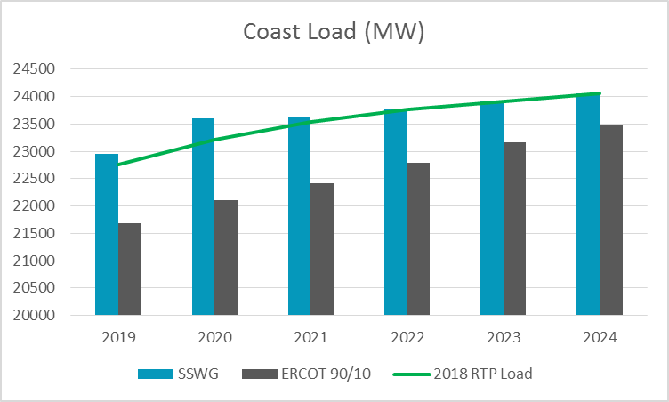
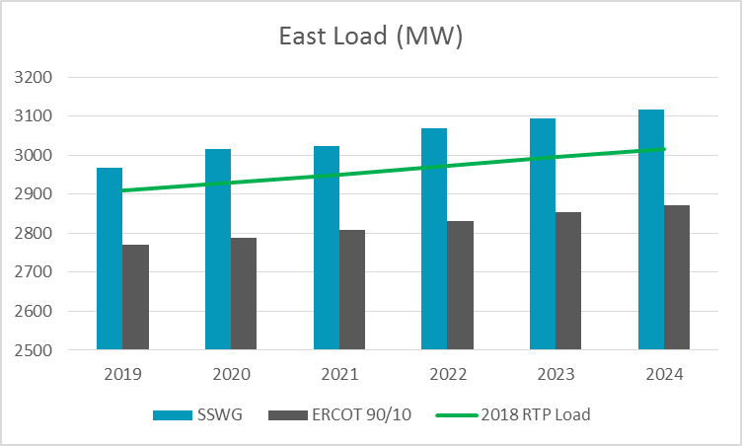
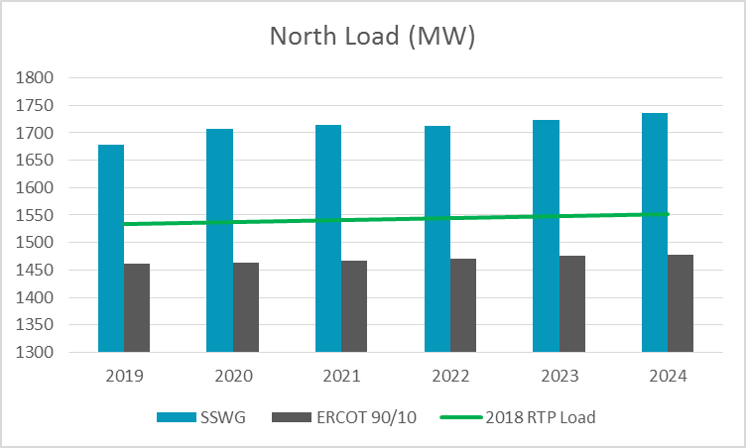
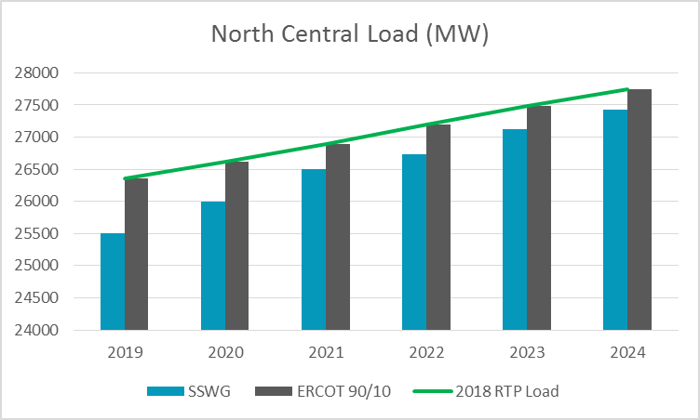
SSWG load v/s ERCOT 90/10 (less losses and self served)

Slide 6
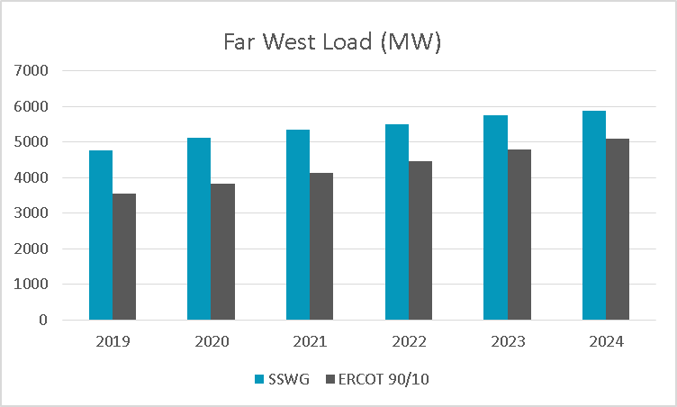
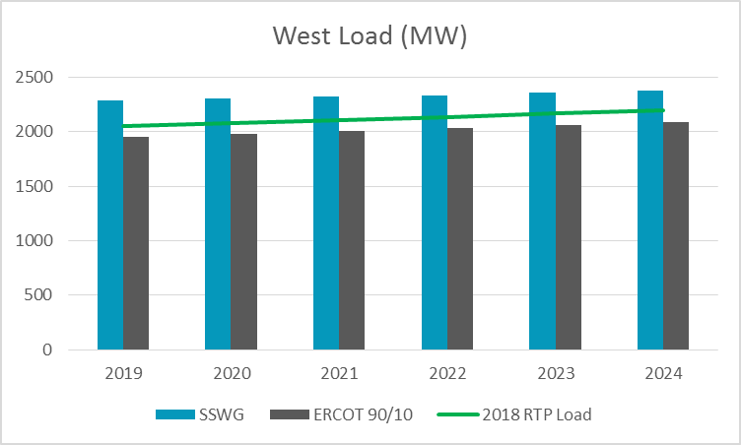
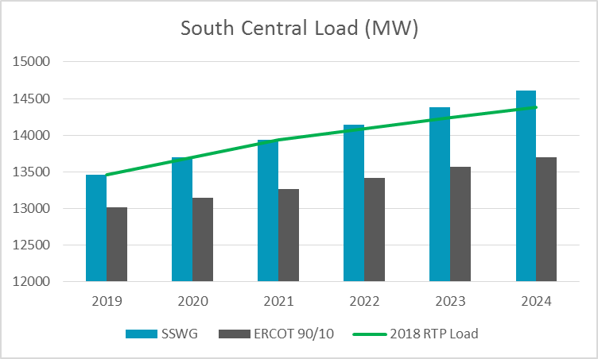
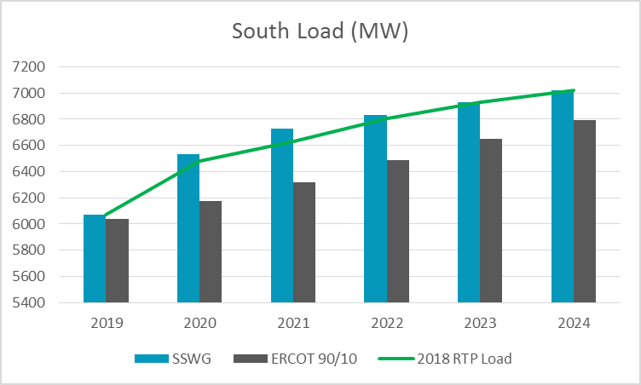
SSWG load v/s ERCOT 90/10 (less losses and self served)

Slide 7
2018 Load review
ERCOT has performed load review after receiving TSP feedback
The load level to be used in the 2018 RTP has been finalized for all weather zones except for the Far West

Slide 8
Far West Load Forecast Comparison

Slide 9
Load review: Schedule
Key dates:
February 28, 2018: TSPs either approve or provide necessary documentation supporting additional loads. No response from TSP inferred as “No Comments”.
April 1, 2018: RTP loads freeze

Slide 10
Load forecast: 2018 RTP final load level (with self-served) (MW)
The Far West weather zone load is still under review..

Slide 11
Noteworthy updates to 2018 RTP Scope & Process
2018 RTP economic analysis
  Start earlier (April) in the year
  Start cases: Final 2017 RTP reliability cases
  Study years: 2020 and 2023
All loads identified as DG (Distributed Generation) in the SSWG start cases will be modeled as offline in the reliability analysis

Slide 12
References
PG 317 TAC presentation
  (http://www.ercot.com/content/wcm/key_documents_lists/107880/PG_317_LoadThreshold_rev.pptx)
PG 317 RPG presentation (Aug 2017)
  (http://www.ercot.com/content/wcm/key_documents_lists/108880/Load_Forecast_Review.pptx)

Slide 13
Bounded higher-of methodology (x=5%)

Slide 14
Load review process
Rationale:
Historic load growth
Committed load additions
Forecast methodology
Past forecast performance
Special circumstances
Other?
Preliminary RTP start cases will be shared to allow TDSPs to review the impact of load distribution on pockets within the weather zones.

