Slide 1
Existing Resource Definition Framework

Slide 2
Proposed Category Nomenclature – using existing requirements
Transmission Generation Resource (TGR) Transmission-connected Registered with ERCOT as GR Participates in the market SCED A/S Modeled in ERCOT systems Telemetry, etc. Settled Nodally |  | Settlement Only Transmission Generator (SOTG) Transmission-connected less than 10 MW Registered with ERCOT as SOG Settled for exported energy only Intermittent sources will typically export based on fuel availability. Self-dispatched may choose to export based on prices Modeled in ERCOT systems Reliability systems only Not scheduled/dispatchable Settled - Load Zone | Transmission Self-Generator (TSG) Transmission-connected Registered with PUC as a Self-Generator and registered with ERCOT as SOG May occasionally export, but does not generate with the intent to sell at wholesale If it exports, then settled for exported energy only Continuous exports will be re-evaluated for TGR Modeled in ERCOT systems Reliability systems only Not scheduled/dispatchable Settled - Load Zone
Distribution Generation Resource (DGR) Distribution connected Registered with ERCOT as GR >10 MW require to register as GR Participates in the market SCED A/S Pseudo-Modeled in ERCOT systems Future--Modeling light? Telemetry, etc. Settled Nodally |  | Settlement Only Distribution Generator (SODG) Distribution connected but less than 10 MW Registered with ERCOT as SOG Settled for exported energy only Intermittent sources will typically export based on fuel availability. Self-dispatched may choose to export based on prices Mapped in ERCOT systems Not scheduled/dispatchable Telemetry not required Settled - Load Zone | Unregistered Distribution Self-Generator (UDSG) Distributed generation greater than 1 MW co-located with larger load, but smaller than minimum facility load. Registered with PUC as a Self-Generator but not registered with ERCOT May not export—otherwise must register with ERCOT as SODG. Neither Mapped nor modeled in ERCOT systems (future mapping?) No ERCOT settlement policy since no exports. | Unregistered Distributed Microgenerator* (UDMG) Distribution connected less than 1 MW No requirement for registration Reported by DSP per PUCT 25.211(n) (competitive choice) Reported by NOIEs per ERCOT protocol 10.2.2.1.b(ii) for 50kW -1 MW Not reported by NOIEs for <50kW Neither Mapped nor modeled in ERCOT systems (future mapping of accumulations?) ERCOT settles as negative load in competitive choice areas once meter configuration updated to DG No ERCOT settlement policy for NOIE areas.
 | **Settlement Only means that the generator may not participate in Ancillary Services Market, RUC, SCED, or make Energy OffersNote: Transmission connected resources are required to be modeled in ERCOT NMMS systems. Studies are determined based on requirements for size and resource category type. *Microgenerator definition may need resolution with PUC

Slide 3
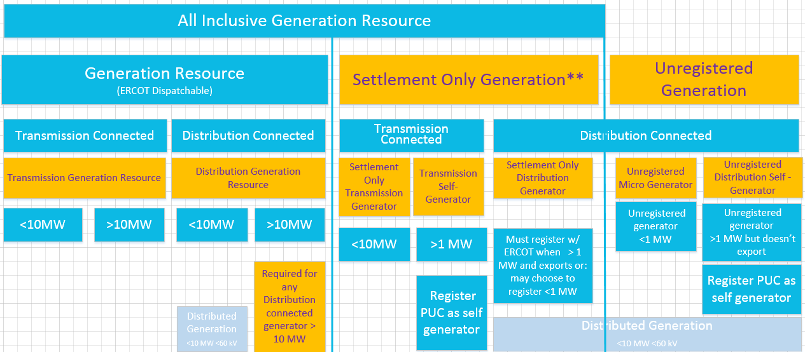
Proposed Resource Definition Framework
**Settlement Only generator means that they may not participate in Ancillary Services Market, RUC, SCED, or make Energy Offers.

Slide 4
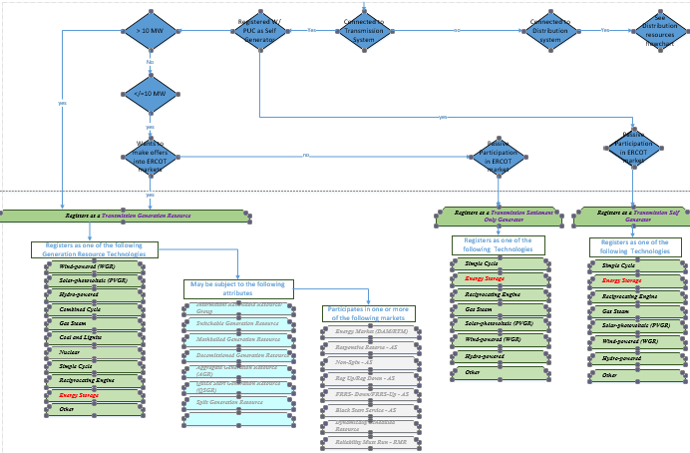
Example Registration Flowchart page 1

Slide 5
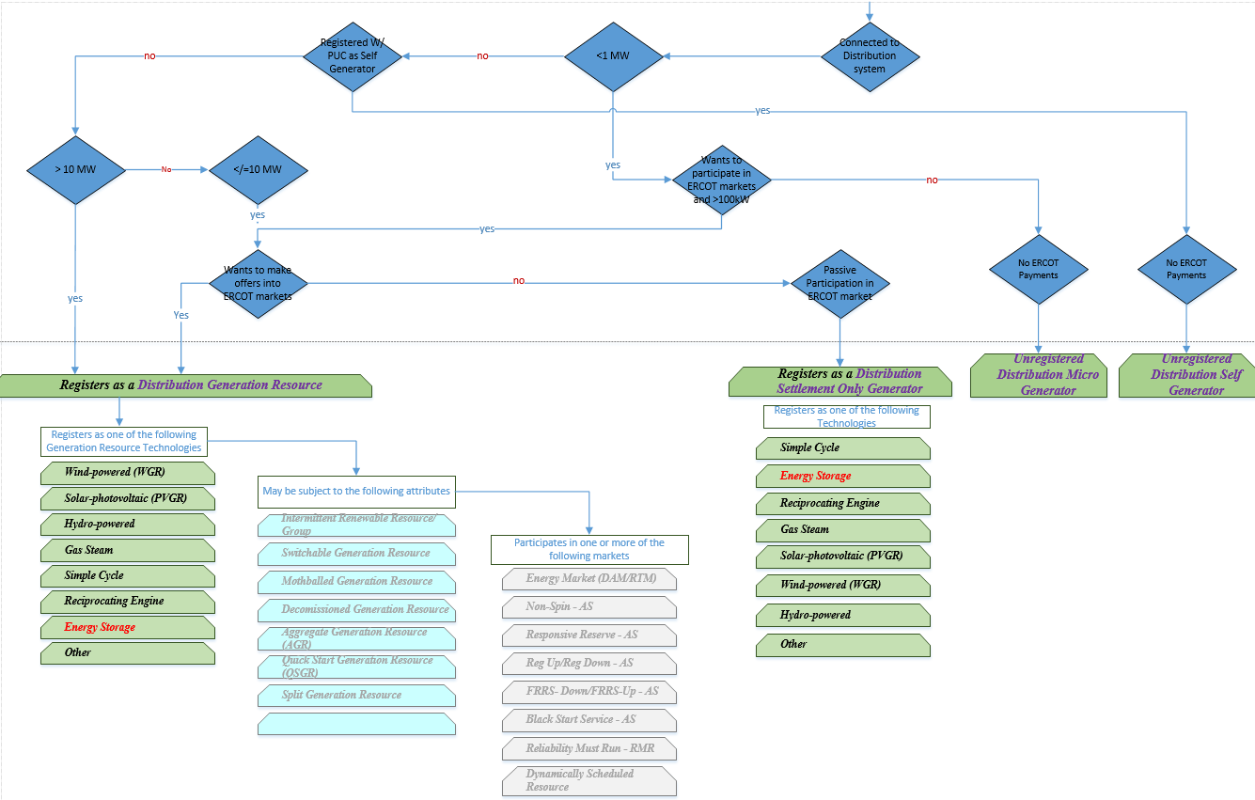
Example Registration Flowchart page 2

