Slide 1
January 2018 Revenue Neutrality Allocation
Jian Chen
Market Analysis and Validation
CMWG/QMWG
March 19th, 2018

Slide 2
High RENA on Jan.16~18
High Real-Time Revenue Neutrality Amount (RENA) was observed during Jan.16,17 and 18, when winter weather went through the ERCOT region.

Slide 3
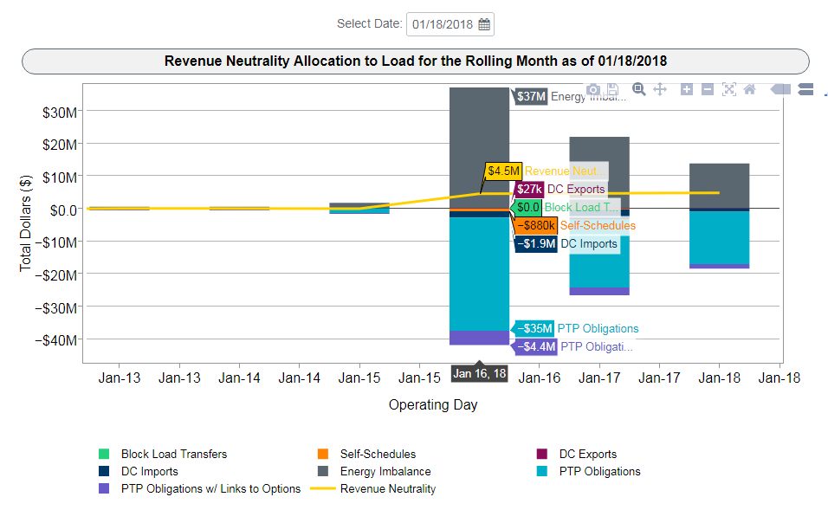
Breakdown of RENA

Slide 4
Understanding the RENA
Using RT congestion rent to pay the RT values of transfer scheduled in DAM
RT congestion rent: The difference between RT load charges and RT generation payment, caused by RT congestions.
Transfers scheduled in DAM: The power flow transfers scheduled among different settlement points, when Three-Part Offer, Energy Only Bid/Offer, Point-to-Points cleared in DAM.

Slide 5
Possible causes of RENA
“Over-selling” of DAM transfers
As DAM clears with all DAM awards (3PO, Energy, PTP), there should be no violation on any transmission element in the DAM network model. However, due to the following reasons, the flow scheduled by the DAM awards could overload the transmission element in the Real-Time network model:
Topology changes (e.g. missing outages in DAM)
Inaccurate load distribution factors

Slide 6
Possible causes of RENA
Impact of Settlement Point Price floor
As 15-minute interval Settlement Point Prices (RTSPP) are calculated from SCED LMP, a price floor of $-251 is applied to RTSPP. Depending on the RT and DAM positions at the settlement points, the RENA could be impacted in the following way:
Increase RENA when RT output larger than DAM position
Reduce RENA when RT output less than DAM position

Slide 7
Possible causes of RENA
DAM Point-to Point Obligation with links to Options
When DAM clears the PTP Obligations with links to Options, they are treated as other normal PTP Obligations in the DAM optimization engine. However, during the settlement, they are treated as options, which could cause missing revenue as there is no charge to options in the settlement:
Increase RENA when those PTP obligations shows up with negative values based on RT prices

Slide 8
All Impacts to RENA
 | Jan.16 | Jan.17 | Jan.18
“Over-selling” of RT congestion | -5.2 | 0.9 | 1.2
Impact from SPP price floor | -0.1 | -1.7 | 0.03
Impact from PTP w links to options | 10.2 | 5.1 | 3.3
Others* | -0.4 | 0.4 | 0.2
Settlement RENA of the operating day | 4.5 | 4.7 | 4.7

Slide 9
PTP w/ links to Options during Jan.16~18
DAM Point-to Point Obligation with links to Options combined with high RT congestion costs was the major cause of high RENA during the period of Jan.16~18.
PTP w links to Options | Jan.16 | Jan.17 | Jan.18
Values when settled as options | 4.4 | 2.4 | 1.4
Values if settled as obligation | -5.8 | -2.8 | -1.9
Impact to RENA | 10.2 | 5.1 | 3.3
Settlement RENA of the operating day | 4.5 | 4.7 | 4.7

Slide 10
RT Congestions during Jan.16~18
Most of the congestion that happened on Jan.16~18 was inside or around the Valley area, which caused the RT price of Resource Nodes in the Valley to be significantly higher than the Load Zone.
Date | Constraint Name | Contingency | RT Congestion Rent
1/16/2018 | VALIMP | BASE CASE | 14.0
1/16/2018 | NEDIN_138H | XNED258 | 11.3
1/17/2018 | NEDIN_138H | XNED258 | 10.2
1/17/2018 | HAINE__LA_PAL1_1 | SE_HLA_9 | 3.9
1/17/2018 | VALIMP | BASE CASE | 3.2
1/18/2018 | NEDIN_138H | XNED258 | 7.4
1/18/2018 | JK_TOKSW_1 | DJEWSNG5 | 2.8
Major congestions (with the rent over $2.5 million)

Slide 11
Price separation between Valley and LZs
Due to the congestion, the Resources Nodes in the Valley had much higher prices than other settlement points. This led to PTPs sourced from those Resource Nodes to have negative value in the RT market.

Slide 12
Extra DAM Congestion Revenue vs. Missing RT Revenue
When PTP Obligations with links to Options are awarded in DAM, unlike other PTP Obligations, no payment is made in DAM to the buyers of those PTPs even when the source DAM SPP is higher than the sink DAM SPP
As the result, it lets more DAM congestion revenue go to CRR balancing account.
 | Impact to DAM Funds ($ million) | Impact to RT Funds ($ million)
1/1/2018~1/31/2018 | 1.8 | -20.5
1/1/2017~2/28/2018 | 24.5 | -62.1

Slide 13
Update on Recent Notable RENA
Negative -$1.5 million RENA on OD 2/21
Related to unexpected outage extension
DAM flow was significantly undersold as it was in the opposite direction of the RT congestion
High RENA in early March
RENA was mostly caused by DAM flow oversold
Part of the oversold was related to RT net load increase at one PUN site, but not modeled in DAM
Among the total $3.2 million RENA on 3/1~3/3, about $0.9 million was caused by the PUN load distribution factor errors.

