Slide 1
SCR-795
Addition of Intra-Hour Wind Forecast to GTBD Calculation
Operations Planning
ERCOT
QMWG
March 19th, 2018

Slide 2
Description
Include intra-hour wind forecast (5-min) in GTBD to give SCED a better indication of how wind may ramp.
Currently: uncurtailed wind dispatched to their HSL.
  Assumes wind will stay the same at their HSL for next 5-min.
  What if wind ramps?
    Regulation used to make up for gain/loss of wind MW
    Regulation exhausted more frequently due to wind ramps.
Equation:
GTBD = Total Gen + K1*10*System Load Frequency Bias + K2*[(net non-conforming Load) – (net filtered non-conforming Load)] + K3*5*PLDRR + K4*Regulation Deployed + K5*ACE Integral – K6*5*PWRR
|PWRR| ≤ Max PWRR Feedback
NEW ADDITIONS

Slide 3
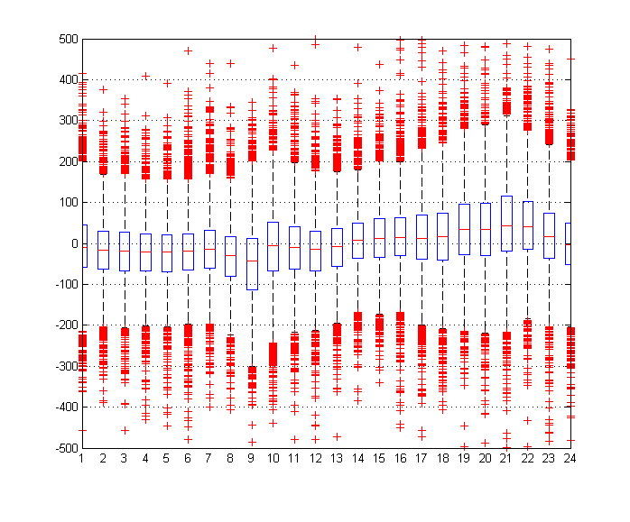
Wind Ramping
Wind ramping up more often in evening hours, down in morning hours.

Slide 4
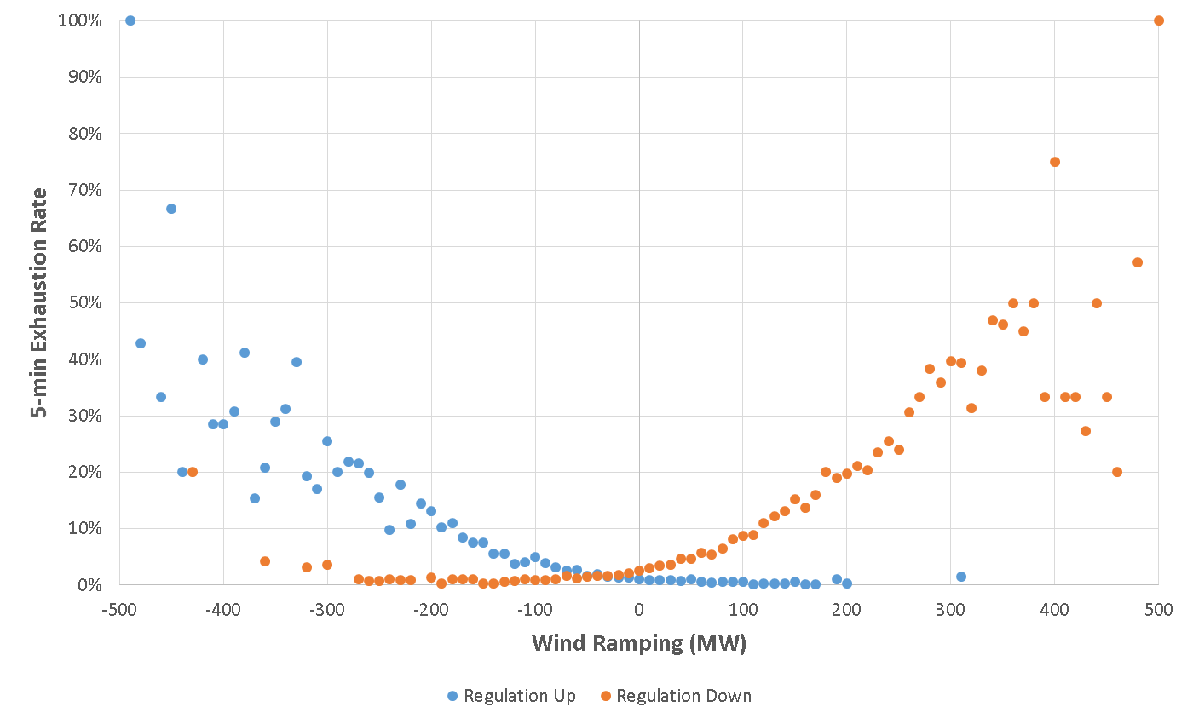
5-min Exhaustion Rates vs. Wind Ramp
As wind ramps up more, likelihood of Regulation-Down being exhausted goes up, and vice versa
Grouped into 10MW Wind Ramping boxes

Slide 5
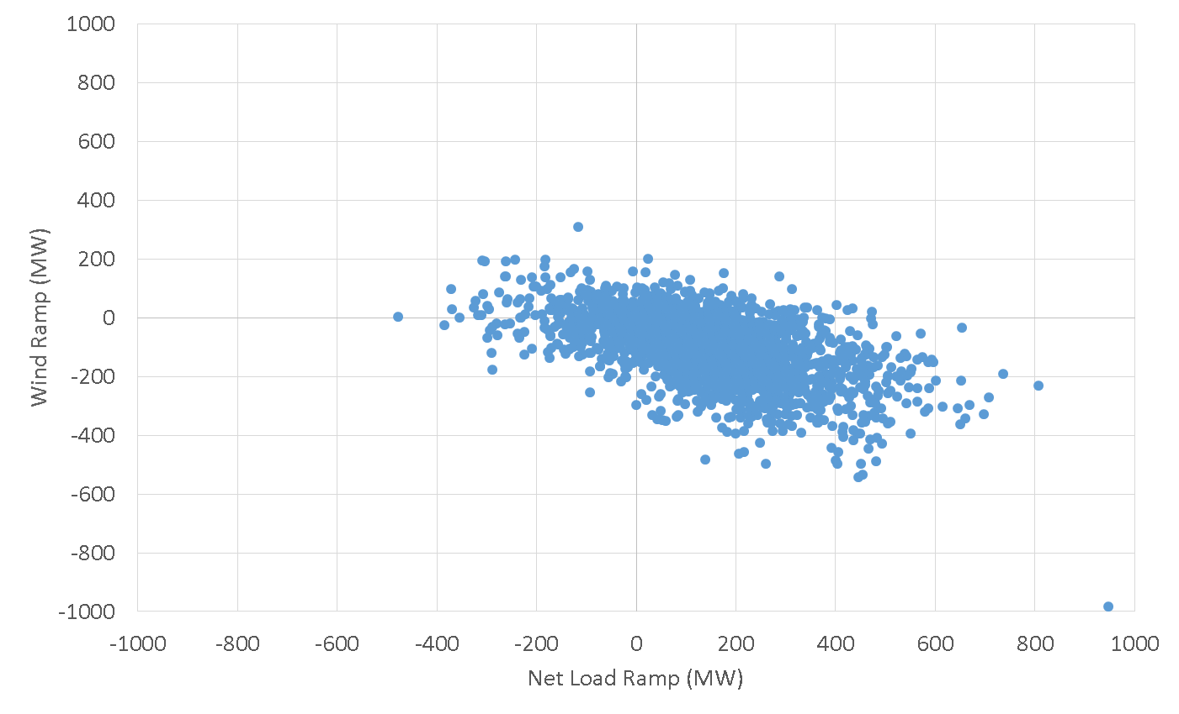
Regulation-Up Exhausted Intervals (5-min)
Regulation-Up exhausted intervals more likely fall into intervals where Net Load is positive and Wind is ramping down.

Slide 6
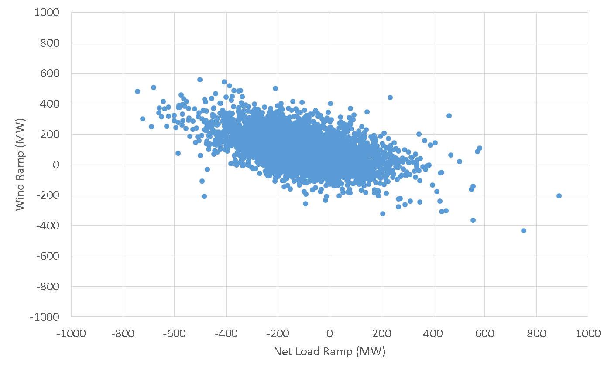
Regulation-Down Exhausted Intervals (5-min)
Regulation-Down exhausted intervals more likely fall into intervals where Net Load is negative and Wind is ramping up.

Slide 7
Intra Hour Forecast Performance

Slide 8
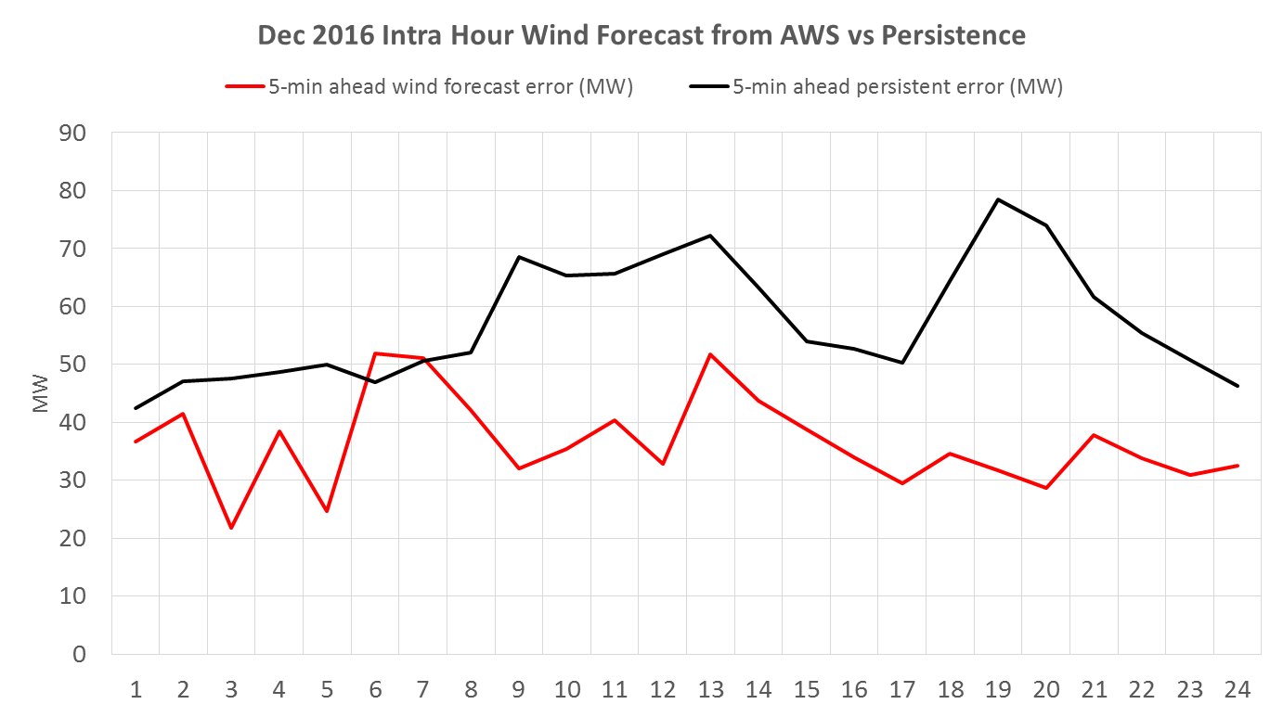
Intra Hour Forecast Performance AWS @ERCOT

Slide 9
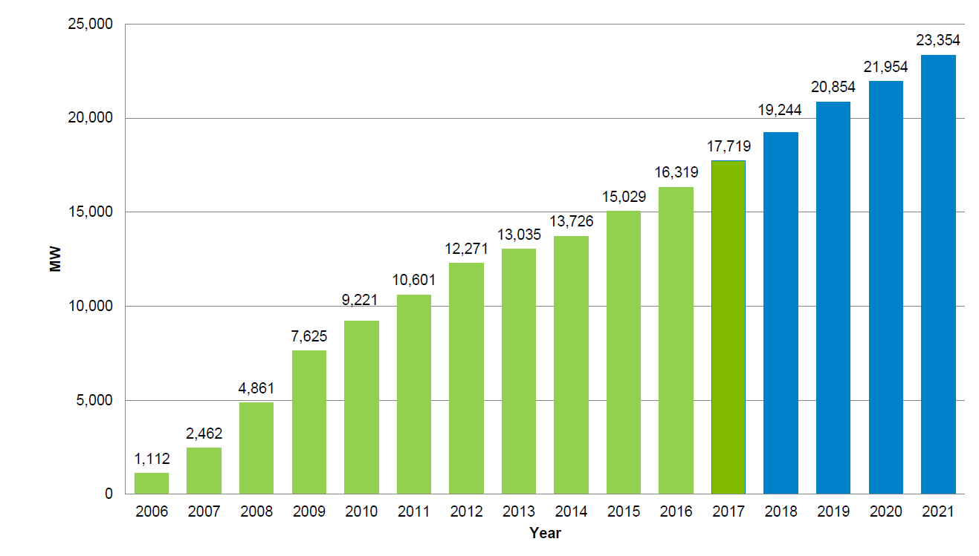
MISO Wind Installed Capacity

Slide 10
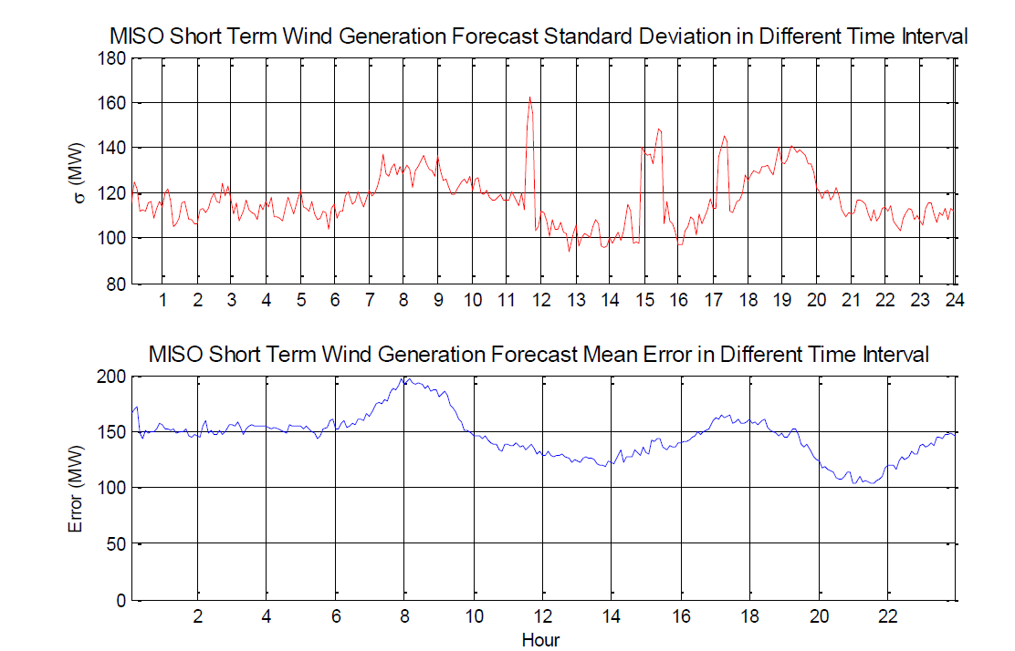
Intra Hour Forecast Performance E&M @MISO
10 min Ahead Wind Forecast Error (Standard Deviation)
10 min Ahead Wind Forecast Error (Mean)

Slide 11
Questions?
Thank you!

