Slide 1
Credit Exposure Update
Mark Ruane
Credit Work Group
ERCOT Public
March 21, 2018

Slide 2
Credit Exposure Update
Inputs and Assumptions:
Only Active Counter-Parties are included
Counter-Parties are classified by rating and market activity
TPE and collateral balances used are averages for January and February(7th-28th)
Counter-Parties that are subsidiaries of, or guaranteed by, rated entities are given the parent/guarantor’s rating, adjusted down one notch

Slide 3
Credit Exposure Update
January 2018 compared to post-NPRR800 February
Market-wide average TPE decreased from $430.6 million to $398.5 million.
TPE decreased by $39.9 million for “Load and Generation” category.
TPE decreased by $4.1 million for “CRR Only” category.
TPE increased by $12.1 million across all other categories.
Excess collateral increased from $1,822 million to $1,828 million.
increased by $26.4 million for “Load and Generation” category
decreased by $25.0 million for “Trader” category.
increased by $4.1 million across all other categories.
High volatility in Real-Time prices during both months
Number of active Counter-Parties decreased from 215 to 213

Slide 4
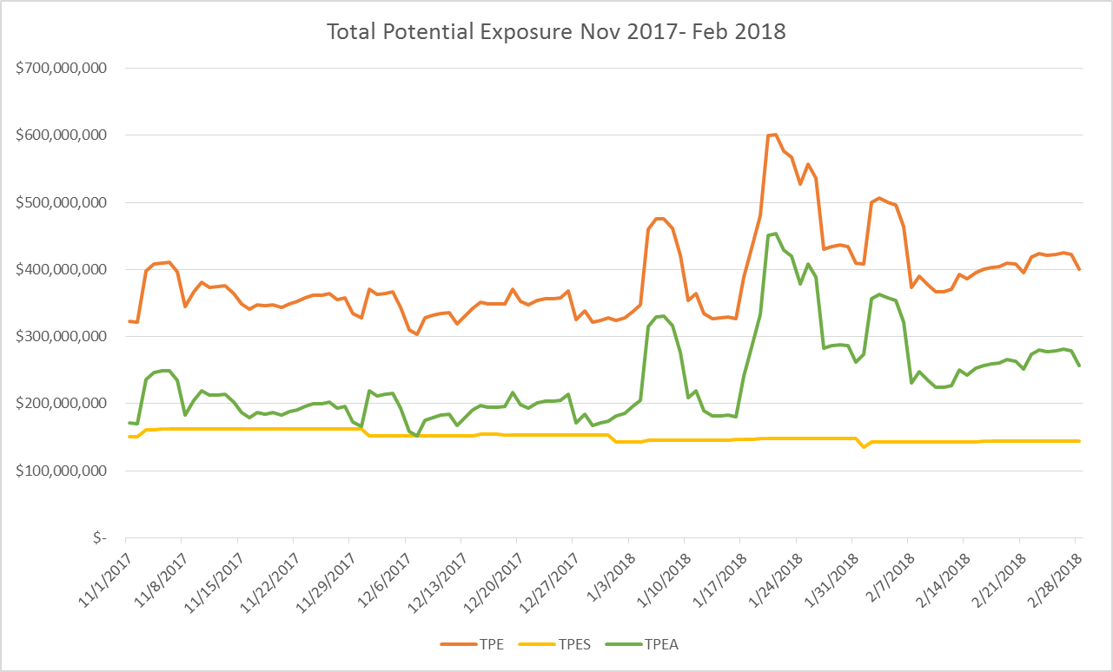
Credit Exposure Update
NPRR800 go-live

Slide 5
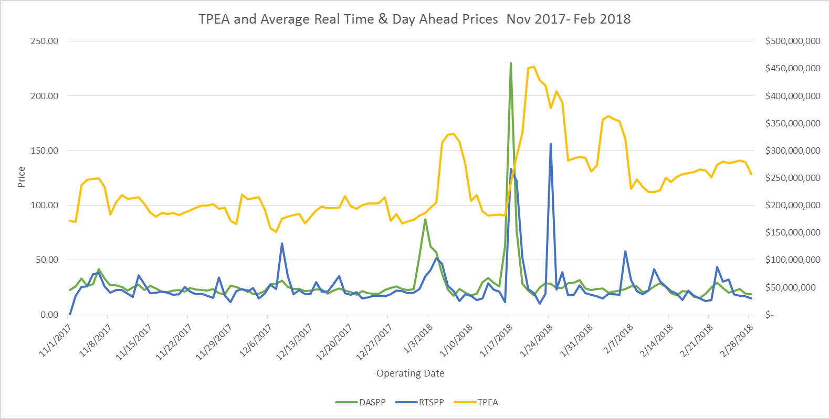
Credit Exposure Update
NPRR800 go-live

Slide 6
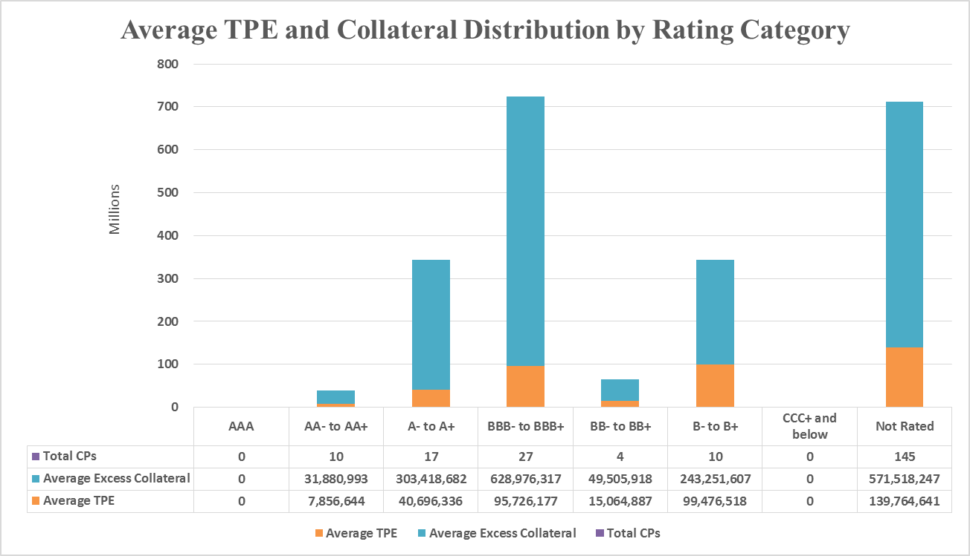
Credit Exposure Update

Slide 7
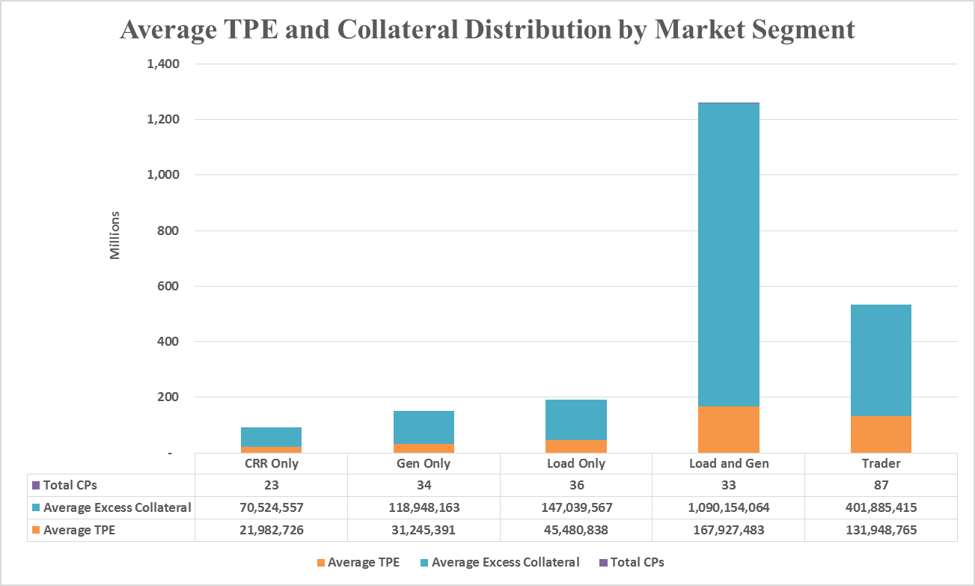
Credit Exposure Update

Slide 8
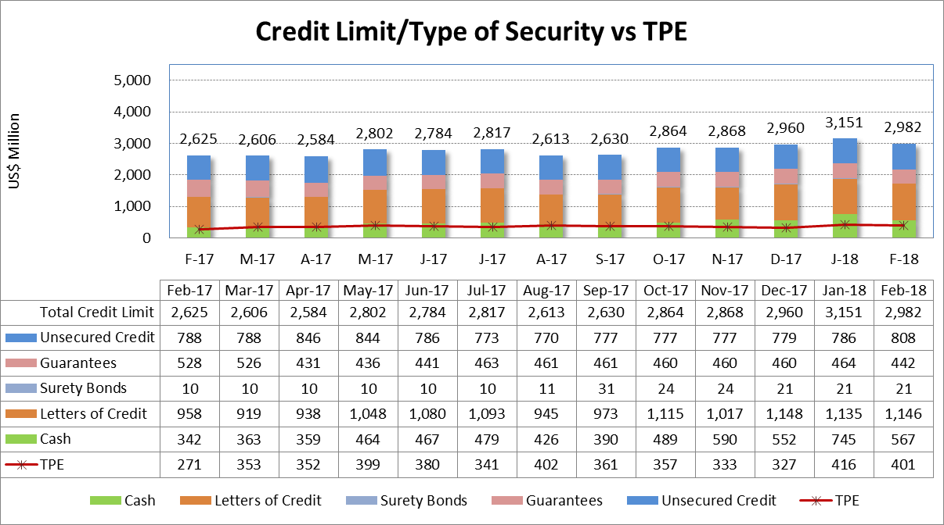
Credit Exposure Update

Slide 9
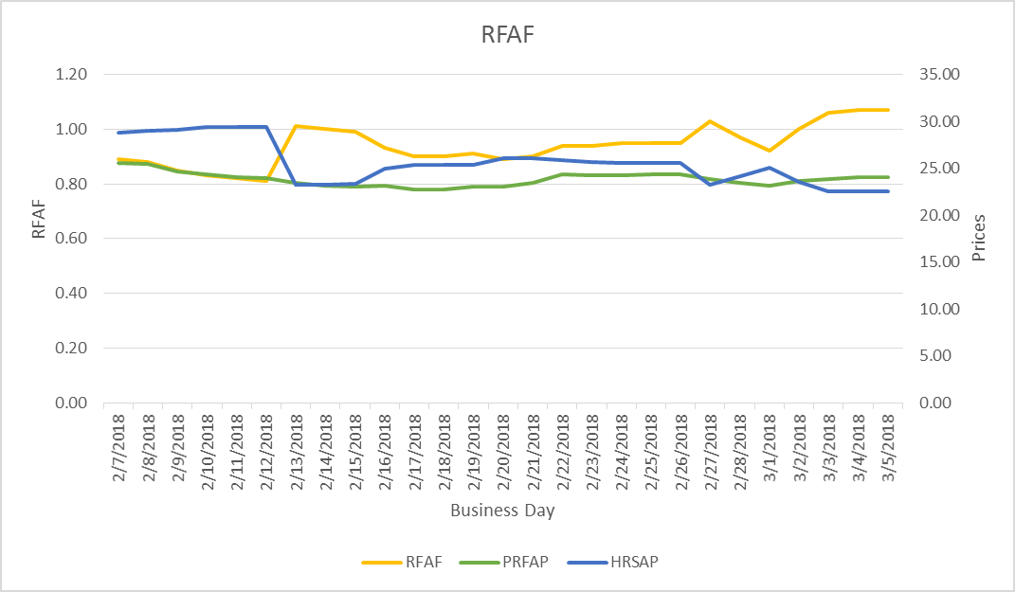
Credit Exposure Update
Real-Time Forward Adjustment Factor (RFAF)
RFAF is calculated using 21 days of ICE future prices and 14 days of ERCOT Real Time Settled Prices for HB_NORTH settlement point

Slide 10
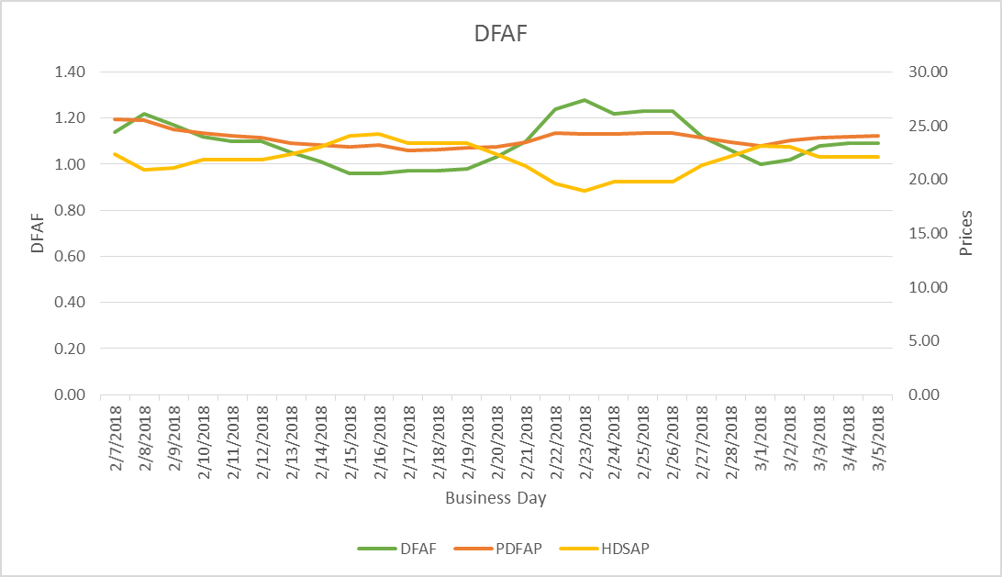
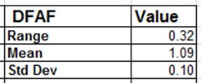
Credit Exposure Update
Day-Ahead Forward Adjustment Factor (DFAF)
DFAF is calculated using 21 days of ICE future prices and 7 days of ERCOT Day Ahead Settled Prices for HB_NORTH settlement point

Slide 11
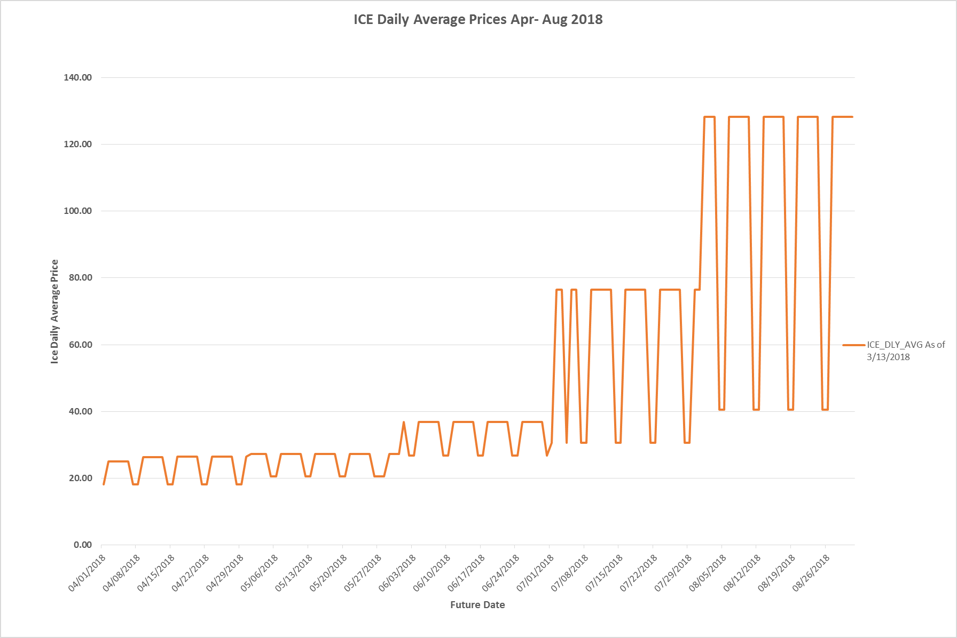
ICE Forward Curves April – August 2018

Slide 12
ICE Forward Curves April – August 2018
August ICE forward price evolution for weekdays and weekends.

Slide 13
Credit Exposure Update
Appendix

Slide 14
Credit Exposure Update
Summary statistics by Market Segment

Slide 15
Credit Exposure Update
Summary statistics by Rating Group

Slide 16
Credit Exposure Update
Active Counter-Parties distribution by rating and category- Feb 2018

Slide 17
Credit Exposure Update
Average Total Potential Exposure distribution-Feb 2018

Slide 18
Credit Exposure Update
Average Excess Collateral distribution^{*-}Feb 2018
*Excess Collateral is a voluntary disposition by Counterparty

Slide 19
Credit Exposure Update
Distribution in the Bottom Quintile of Excess Collateral^{*-}Feb 2018
*Excess Collateral is a voluntary disposition by Counterparty

Slide 20
Credit Exposure Update
Distribution in the Bottom Quintile of Excess Collateral⁻Feb 2018

Slide 21
Credit Exposure Update
Questions

