Slide 1
Power Balance Penalty Curve Proposal
QMWG March 19, 2018

Slide 2
From Business Practice Manual
The factors considered by ERCOT in its qualitative analysis, include the following:
The amount of regulation that can be sacrificed without affecting reliability,
The PUCT defined System Wide Offer Cap (SWCAP),
The expected percentage of intervals with SCED Up Ramp scarcity,
The expected extent of Ancillary Service deployment by operators during intervals with capacity scarcity, and
The transmission constraint penalty values.

Slide 3
2018 Regulation Up Procurement
HE | Jan | Feb | Mar | Apr | May | Jun | Jul | Aug | Sep | Oct | Nov | Dec
1 | 250 | 238 | 250 | 271 | 359 | 353 | 288 | 309 | 297 | 235 | 212 | 211
2 | 195 | 203 | 222 | 219 | 254 | 293 | 260 | 200 | 199 | 174 | 179 | 176
3 | 211 | 221 | 221 | 230 | 238 | 220 | 216 | 182 | 161 | 193 | 205 | 203
4 | 247 | 248 | 230 | 263 | 233 | 272 | 186 | 202 | 167 | 193 | 205 | 215
5 | 336 | 302 | 299 | 335 | 289 | 229 | 229 | 237 | 236 | 251 | 283 | 292
6 | 528 | 523 | 477 | 456 | 453 | 383 | 333 | 387 | 397 | 435 | 438 | 460
7 | 687 | 640 | 578 | 575 | 605 | 467 | 453 | 544 | 557 | 553 | 556 | 605
8 | 306 | 323 | 357 | 287 | 384 | 444 | 449 | 372 | 292 | 358 | 306 | 297
9 | 326 | 373 | 362 | 359 | 440 | 467 | 484 | 449 | 472 | 372 | 343 | 316
10 | 323 | 365 | 316 | 321 | 393 | 459 | 499 | 449 | 455 | 423 | 315 | 305
11 | 277 | 316 | 323 | 373 | 409 | 523 | 525 | 524 | 498 | 401 | 326 | 312
12 | 222 | 285 | 365 | 332 | 403 | 470 | 503 | 487 | 488 | 423 | 319 | 275
13 | 232 | 239 | 299 | 347 | 360 | 391 | 424 | 415 | 445 | 396 | 299 | 269
14 | 256 | 222 | 295 | 336 | 314 | 321 | 350 | 358 | 382 | 342 | 237 | 248
15 | 205 | 226 | 263 | 282 | 294 | 267 | 295 | 285 | 298 | 315 | 213 | 214
16 | 207 | 215 | 278 | 290 | 315 | 247 | 252 | 263 | 257 | 269 | 237 | 212
17 | 294 | 211 | 282 | 318 | 259 | 222 | 265 | 248 | 239 | 206 | 258 | 322
18 | 464 | 347 | 235 | 215 | 254 | 215 | 250 | 256 | 222 | 224 | 365 | 489
19 | 401 | 421 | 307 | 229 | 260 | 239 | 270 | 278 | 259 | 352 | 214 | 196
20 | 222 | 279 | 335 | 361 | 332 | 258 | 255 | 334 | 300 | 237 | 178 | 177
21 | 269 | 175 | 234 | 402 | 305 | 238 | 247 | 266 | 257 | 157 | 173 | 182
22 | 196 | 417 | 221 | 219 | 282 | 250 | 302 | 332 | 336 | 267 | 194 | 223
23 | 276 | 378 | 305 | 236 | 399 | 355 | 366 | 304 | 335 | 319 | 265 | 307
24 | 239 | 244 | 291 | 333 | 293 | 325 | 281 | 264 | 284 | 311 | 243 | 206
Total | 7169 | 7411 | 7345 | 7589 | 8127 | 7908 | 7982 | 7945 | 7833 | 7406 | 6563 | 6712
21 intervals BELOW the 200MWs needed for PBPC to work properly!
Many more intervals in the 200-300MW range.

Slide 4
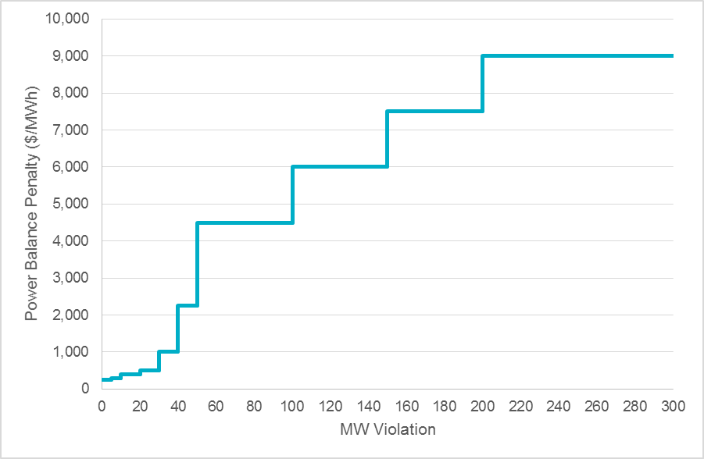
Current Power Balance Penalty Curve
MW Violation | Penalty Value ($/MWh)
≤ 5 | 250
5 < to ≤ 10 | 300
10 < to ≤ 20 | 400
20 < to ≤ 30 | 500
30 < to ≤ 40 | 1,000
40 < to ≤ 50 | 2,250
50 < to ≤ 100 | 4,500
100 < to ≤ 150 | 6,000
150 < to ≤ 200 | 7,500
200 or more | 9,001

Slide 5
Proposed Power Balance Penalty Curve
MW Violation | Penalty Value ($/MWh)
≤ 5 | 250
5 < to ≤ 10 | 300
10 < to ≤ 20 | 400
20 < to ≤ 30 | 500
30 < to ≤ 40 | 1,000
40 < to ≤ 50 | 2,250
50 < to ≤ 75 | 4,500
75 < to ≤ 100 | 7000
100 < or more | 9,001
Power Balance Penalty ($/MWh)
MW Violation

